Slide 1

Pathology ECR Teaching Programme
2023-2024
Katy Brown kab84@cam.ac.uk
Nick Greene npg22@cam.ac.uk
17/10/23 and 19/10/23
Notes:
Please display your full name in this Zoom meeting
We will share the slides, plus other information, after the meeting
Meeting will be recorded (for us or released?)

Slide 2
Meeting Info
Please display your full name in this Zoom meeting
We will share the slides, plus other information, after the second meeting on Thursday
Meeting will be recorded

Slide 3
ECR Programme Induction
The structure of the Part II pathology course
What is a supervision
What makes a good supervision
Planning a supervision
During the supervision
After the supervision
Questions
Notes:
Intro to us and the scheme (2nd year)
Broad nature of postdocs (Cambridge or not, taught before or not) so please bear with us
Lots of supervisions in Cambridge:
L250,000 supervisions each academic year, delivered by 4,800 supervisors.
• approximately 30% of all supervisions are provided by postgraduates/ECR
• ECR/postgraduates are approximately 50% of all supervisors a
1,150 new supervisors each year,

Slide 4

Cambridge terminology!
Tripos
Michaelmas
Part IB
Part IA
Easter
Part II
Lent
Moodle
CRSid
CAMCORS
DOS
Notes:
There are many strange terms if you haven't been involved with undergraduate education in Cambridge before!

Slide 5
Cambridge Undergraduate Courses
Tripos – undergraduate honours degree
Academic year is divided into three eight week terms
Michaelmas – October to December
Lent – January to March
Easter – April to June
Most teaching is in Michaelmas and Lent Terms: Lectures, practicals and supervisions
DOS – Director of Studies: the college officer responsible for the academic welfare of students
Notes:
Terms are shorter than many UK universities and correspondingly more intense. All the supervisions taught within term
DOS: the college officer who you could approach if you had concerns about any students (hopefully not needed!)
More on CAMCORS and Moodle later

Slide 6
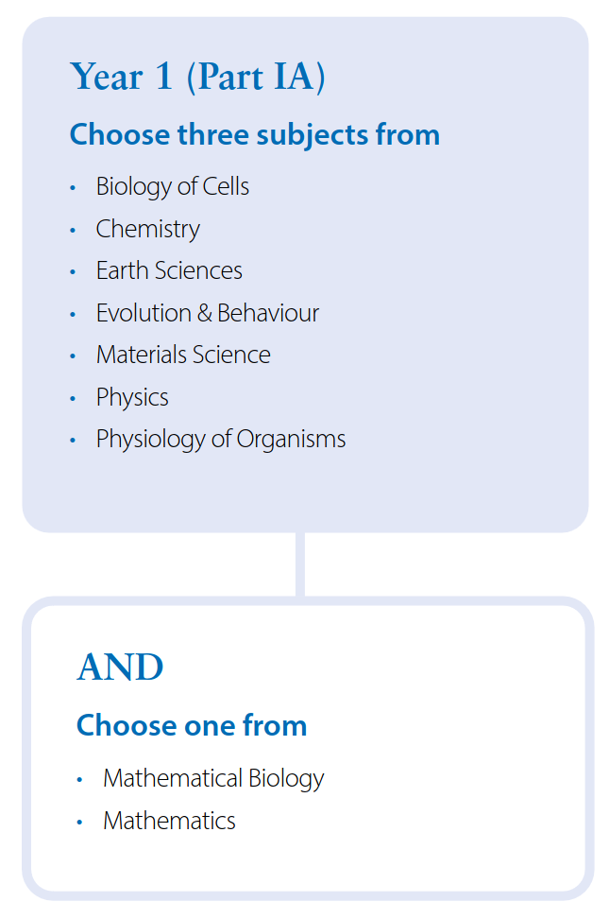
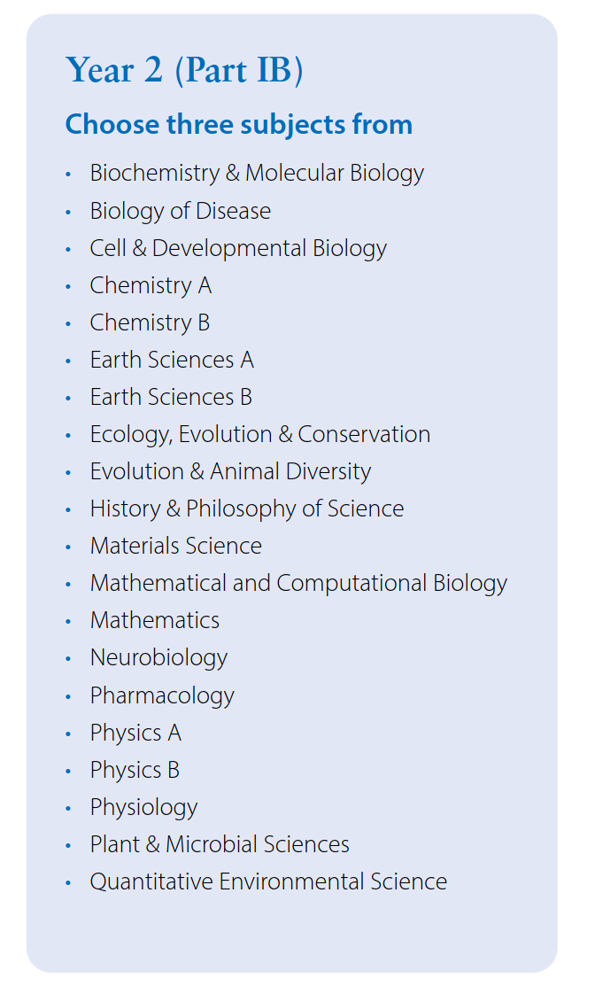
Natural Sciences Tripos (NST) Years 1-2
Supervisions provided by colleges (usually)
Generally one supervisor per subject, regularly through the year
https://www.natsci.tripos.cam.ac.uk/files/naturalsciencesbrochure.pdf
Notes:
Most undergraduate sciences in Cambridge are taught as part of the same degree – the Natural Sciences Tripos
Can specialise in many different sciences
Referred to as NST or NatSci
3 year course (some courses have an optional 4th year, Part III)
Part I – two years, core science
Part II – 1 year, specialised
No need to go through this – just say that they have lots of options for core science modules
Students should arrive at Part II with a broad grounding in science but may not have specialised knowledge

Slide 7
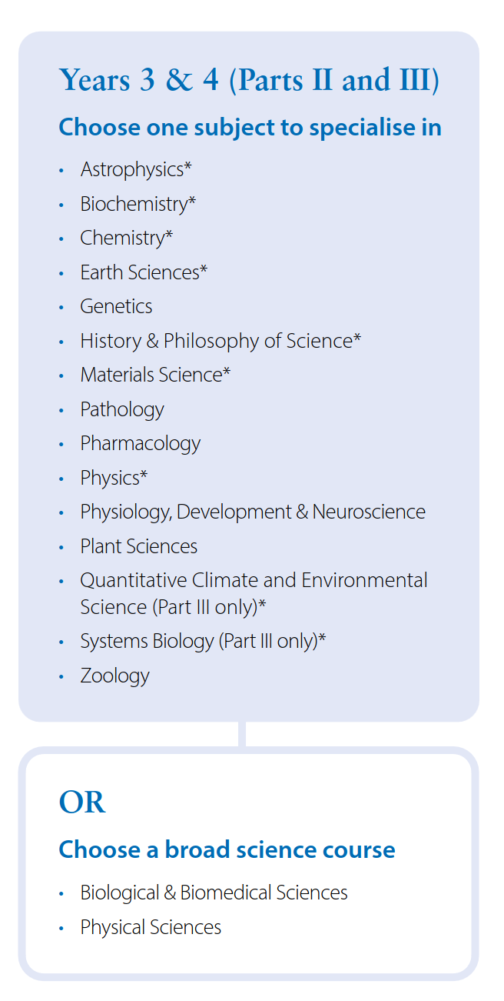
Course Structure - Part II – Year 3
NST students but can also be taken by Medics and Vets
(who have different more specialised Years 1 and 2)
Specialise in either one subject or choose a major and a minor subject as part of the Biological and Biomedical Sciences (BBS) course
We teach students who choose:
Pathology as a single subject
Pathology as a major subject as part of the BBS course
Notes:
Medics and Vets can choose to study Pathology in their 3rd year (years 1 and 2 are more specialised than NST course)
Pathology is not offered as a minor subject.
In 3rd year, greater independence and level of critical thinking is expected

Slide 8
Part II Pathology course
(Most) students take two modules in each term
Notes:
Module structure (new this year): mention old options because that is what the past exam papers will refer to.
Highlight the modules happening next term (especially cancer biology!)
How the students are examined: four papers: 2 with 90 minute questions, 2 with 2 x 45 minute questions (also a practical/data handling paper)
Four exams, each covering two modules in the same term. One with 4 x 45 minute essay questions – two per module and one with 2 x 90 minute essay questions – one per module

Slide 9
What is a supervision
Small group teaching for 1 hour
Allows the students to revise the lecture material, deepen their understanding and ask questions.
Supervisions at Part II
Arranged by the Department rather than the college
Specialist supervisors for individual topics: lecturer or postdoc
Organised directly between the supervisor and the students
Not every student in the course will want to attend a supervision
Usually 2 to 8 students in a group, tend to be repeated 1 to 4 times to accommodate all the students on the option

Slide 10

What makes a good supervision?
No single model!
Been planned by a well-prepared supervisor
Takes account of what the students want and what they already know
Involves the students actively contributing (not always easy)
Help the students understand, retain and use information from the lecture
Notes:
No one model but good supervisions have these qualities:
Need to adapt on the fly depending on the group of students you have (have a plan if material takes more or less time than you expect!
Be prepared to say if you don’t know (but you can find out) (although ideally this will only happen rarely!

Slide 11

What makes a good supervision?
A supervision shouldn't be:
A lecture
An opportunity for you to only talk about your own research
A time to introduce large amounts of new information
Notes:
Some information on the fringes of lecture is fine particularly to stretch the students when required

Slide 12
Some supervision activities
Essay planning
Students make an essay plan based on a past exam question (or similar question) before the supervision
Supervisor and students go through the plans together
Problem set
Provide the student with a short set of problems prior to the supervision
Supervisor and students go through the answers together
Q&A
Students ask questions about the lecture topic.
Supervisor can ask for the questions from the students in advance.
Works better with larger groups of students
Presentation
Ask students to present a short (5 minute) presentation to the rest of the group

Slide 13
Logistics of supervisions

Slide 14
Before the supervision
Before you start
CCTL Introduction to supervision course
How we arrange supervisions
Preparing the supervision (Moodle and lectures)
Setting work (and asking for questions)
Marking work (link to faculty guidelines)
Scheduling supervisions
Room booking
Access

Slide 15
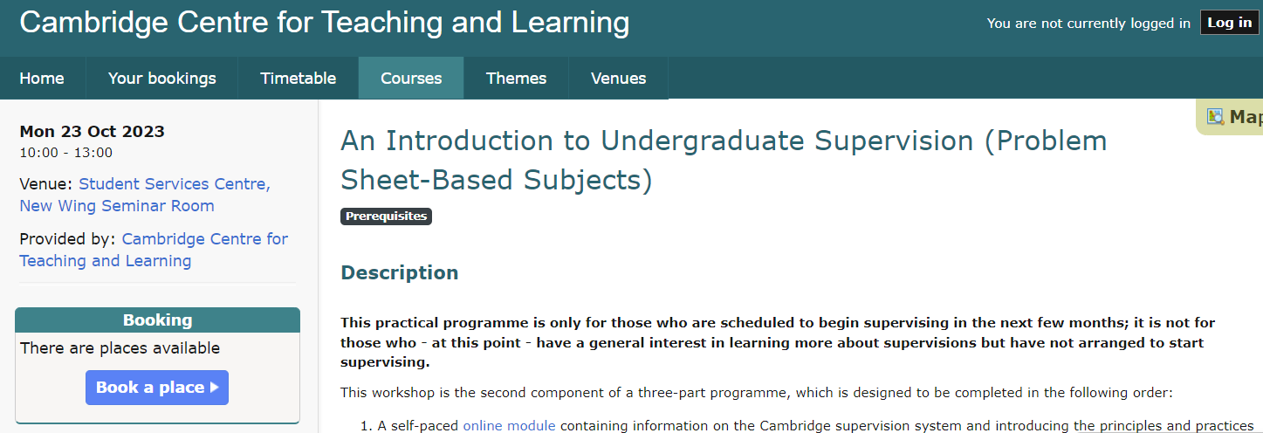
CCTL Introduction to Supervision Course
Required by the university for all supervisors (with specific exceptions)
Some colleges provide an equivalent course
If you can't get a place on the course prior to your supervisions please let us know (currently places on Mon 23rd October course) https://training.cam.ac.uk/event/4793280 https://training.cam.ac.uk/event/4793346
https://www.training.cam.ac.uk/cctl/event-timetable
Notes:
More courses are advertised as the organised ones fill up: so keep checking!
Links sometimes break, check timetable link
Courses are for problem based subjects or essay based subjects: for Pathology either is fine

Slide 16
How we arrange supervisions
We will give you contact details for the lecturers for the topics you are interested in
Some lecturers will already have planned supervisions and want you to be involved:
Make arrangements directly with them (but keep us informed)
Others (especially external lecturers) will not have planned supervisions
Make your own supervision plan and set up slots yourself, with their consent.
Supervisions will not be available for every topic
Lecturers sometimes decide not to have supervisions
Students don't want supervisions for every topic
Some lecturers teach all the supervisions themselves
If you know the lecturer please still keep us in the loop!
Notes:
Supervisions are not always immediately after the lecture – can be later in the year
We may not contact you for every topic – some topics are oversubscribed

Slide 17
Preparing for Supervisions
Every new supervisor should observe a supervision before they start teaching.
This can be with the lecturer (or other supervisor) for your topic or another topic.
If the lecturer you initially contact doesn't offer this, let us know and we'll help you arrange it.
Please watch or attend the lectures prior to the supervision
Ask the lecturer if you have any questions
Look at past exam questions to understand how the students are assessed
Notes:
Cambridge students have often read a lot, you need to be familiar with the lecture material

Slide 18
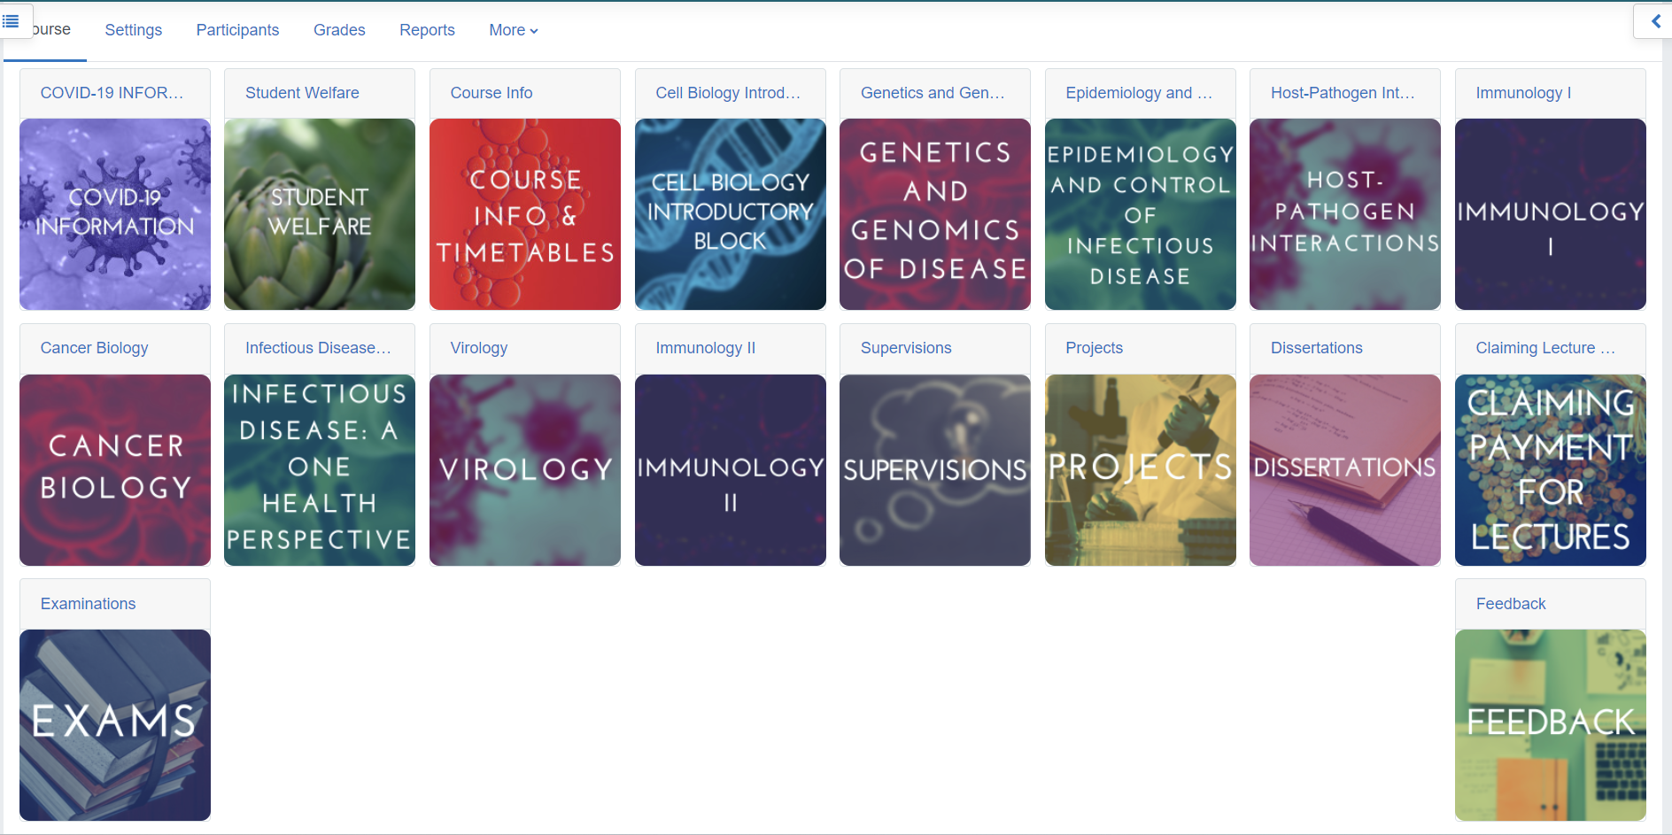
Preparing for Supervisions - Moodle
Notes:
Moodle is the University’s online teaching environment
Slides, lecture recordings, practicals and other materials will be here

Slide 19
Preparing for Supervisions - Moodle
Notes:
Exams (bear in mind syllabus change and there have been open book exam in the past

Slide 20
Setting and marking work
Prepare material which will help the students understand the lecture
Send the work to the lecturer to approve or edit before you send it to the students
Set work can be described in description of supervision
For problem sheets, you can work through the questions together during the supervision and provide model answers, or mark the work
For essays, provide feedback based on faculty guidelines
https://www.biology.cam.ac.uk/exams/AllExams/marking-tripos-essays
Provide positive and negative feedback!
Notes:
Past exam papers may serve as an inspiration
Comments in word is useful to make specific points and then a general comment at the end of the essay indicating what they have done well and what could be improved.

Slide 21
Scheduling Supervisions - Moodle
Notes:
See te

Slide 22
When should I schedule my supervisions
Most lectures are in the morning
Check on Moodle when other supervisions are scheduled
Don’t schedule more than two supervisions in a row
Supervisions should always be during term time
Let teaching office know and they can advertise your supervisions to relevant group
Notes:
In term time!
Timetabling supervisions: avoid lectures and other teaching (and other supervisions)
Sufficient slots for the number of people on the option
Avoid more than 2 supervisions in a row (you’ll get tired)

Slide 23
Holding supervisions
Rooms available in Pathology and Postdoc centre (and your college)
Never at your or student's home
Online only in specific circumstances and with prior discussion with the teaching office.
Make sure you can access the building before the supervision
May be useful to have a whiteboard and a projector
Make sure you take the names of the students who attended
Keep track of who is who for report writing later
Ask the students to wear name tags
Make brief notes immediately after supervision on students
Notes:
Already discussed what might make a good supervision but some logistics
Make sure students can access building

Slide 24
Accessibility
If a student needs accommodations to physically access the supervision, you should be told in advance – please contact us the Pathology teaching office in this case
Many students prefer to receive some information prior to the supervision about how it will be structured
Guidance here
https://www.cctl.cam.ac.uk/teaching-2020-21/guides/supervisions/disabled-students
Many of these tips are useful for all students

Slide 25
After the Supervision
CAMCORS
Report writing for colleges; see the Supervision guide
Interacting with students
Students might contact you after the supervision with questions
You can answer these if you like but if it is a significant workload please refer them back to the lecturer
If a student is unhappy with the supervision or your feedback, please let us and the lecturer know
Reporting to us
Please tell us after you've completed a supervision
We will provide a form for this in which you can also provide feedback on the scheme

Slide 26
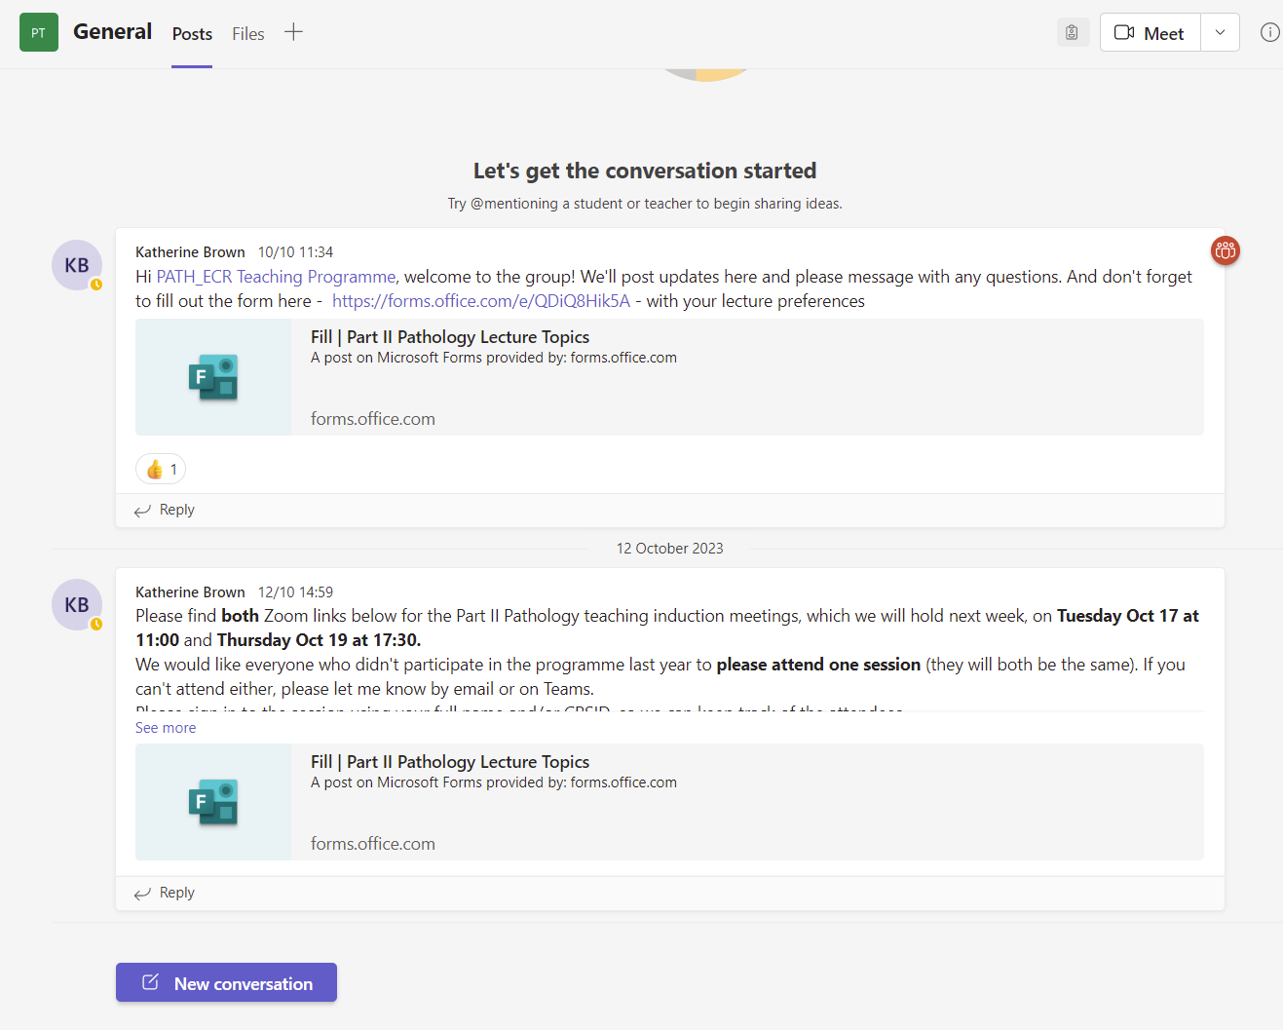
Any questions?
Notes:
Happy to answer any questions now.
Look in Files section for guides including overal supervision guides
Anything that occurs later, put in chat for the Team, may be useful for others

