Slide 1
XRootD and Object Store: A new paradigm
Katy Ellis, Chris Brew, George Patargias, Tim Adye, Rob Appleyard, Alastair Dewhurst, Ian Johnson
4th November 2019
katy.ellis@stfc.ac.uk
Notes:
HEP grid sites are interacting with XRootD in many different ways

Slide 2


Introduction to XRootD and Ceph at RAL
Rutherford Appleton Laboratory (RAL) is the UK Tier 1
Supports all LHC experiments and growing number of others in HEP, Astronomy and Space
RAL disk storage is known as Echo
Based on Erasure Coded Ceph Object Store
University of Glasgow is currently setting up a similar Ceph cluster
Access to Echo is primarily via XRootD
The challenge is to optimize access for the different use cases
Gridftp plugin, but intention is to phase out
Notes:
Glasgow will also be using gridftp and xrootd plugins for Ceph access
Gridftp plugin and S3 for the future, but the storage is basically an ‘XRootD’ system on Ceph object store
Unique among Tier 1s, but likely to become more common

Slide 3
Contents
Description of disk storage and XRootD at RAL
XRootD data access efficiency
CMS-AAA (remote data access system)
Job access
XRootD TPC
Object-store particulars
Delegation
XRootD authentication
ALICE configuration

Slide 4
XRootD interactions with Echo
data flow
Job container
Job container
External
Job container
User job
Worker Node
Job container
User job
GW container
User job
User job
GW container
XRootD client
GW container
XRootD client
XRootD client
XRootD cache
Job container
Gateway container
XRootD client
XRootD cache
Job container
XRootD server
Job container
XRootD cache
User job
Gateway
CMS-AAA-proxy
XRootD server
Job container
XRootD cache
User job
rados plugin
XRootD server
User job
XRootD server
rados plugin
XRootD server
User job
XRootD server
libradosstriper
XRootD client
rados plugin
libradosstriper
XRootD client
libXrdCeph
libXrdCeph
libXrdCeph
libradosstriper
XRootD client
libradosstriper
libradosstriper
XRootD client
libradosstriper
x800
x7
x2
Ceph storage node
Ceph storage node
Disk
Disk
Disk
Disk
Disk
Disk
Disk
Disk
Disk
Disk
Disk
Disk
Disk
Disk
Disk
Disk
Disk
Disk
Disk
Disk
Disk
Disk
Disk
Disk
Disk
Disk
Disk
Disk
Disk
Disk
Disk
Disk
Disk
Disk
Disk
Disk
Disk
Disk
Disk
Disk
Disk
Disk
Disk
Disk
Disk
Disk
Disk
Disk
Disk
Disk
Disk
Disk
Disk
Disk
Disk
Disk
Disk
Disk
Disk
Disk
Disk
Disk
Disk
Disk
Disk
Disk
Disk
Disk
Disk
Disk
Disk
Disk
Disk
Disk
Disk
Disk
Disk
Disk
Disk
Disk
Disk
Disk
Disk
Disk
Disk
Disk
Disk
Disk
Disk
Disk
Disk
Disk
Disk
Disk
Disk
Disk
Disk
Disk
Disk
Disk
Disk
Disk
Disk
Disk
Disk
Disk
Disk
Disk
Disk
Disk
Disk
Disk
Disk
Disk
Disk
Disk
Disk
Disk
Disk
Disk
Disk
Disk
Disk
Disk
Disk
Disk
Disk
Disk
x180

Slide 5
Erasure coding
Divide each file into 64 MB ‘stripes’
Then split into 8 x 8 MB objects called ‘shards’
An additional 3 shards are calculated for redundancy
The 11 shards are stored on 11 different servers
Any 3 out of 11 shards can be missing or corrupted without data-loss

Slide 6

Reconstruction of a stripe
Divide each file into 64 MB ‘stripes’
Then split into 8 x 8 MB objects called ‘shards’
An additional 3 shards are calculated for redundancy
The 11 shards are stored on 11 different servers
Any 3 out of 11 shards can be missing or corrupted without data-loss
1
2
3
4
5
6
7
8
9
10
11
2
3
4
6
7
8
9
10
Quickest shards
1
2
3
4
5
6
7
8
9
10
11
1
3
4
5
7
8
9
11
stripe
Gateway

Slide 7
XRootD interactions with Echo
data flow
Job container
Job container
External
Job container
User job
Worker Node
Job container
User job
GW container
User job
User job
GW container
XRootD client
GW container
XRootD client
XRootD client
XRootD cache
Job container
Gateway container
XRootD client
XRootD cache
Job container
XRootD server
Job container
XRootD cache
User job
Gateway
CMS-AAA-proxy
XRootD server
Job container
XRootD cache
User job
rados plugin
XRootD server
User job
XRootD server
rados plugin
XRootD server
User job
XRootD server
libradosstriper
XRootD client
rados plugin
libradosstriper
XRootD client
libXrdCeph
libXrdCeph
libXrdCeph
libradosstriper
XRootD client
libradosstriper
libradosstriper
XRootD client
libradosstriper
x800
x7
x2
Ceph storage node
Ceph storage node
Disk
Disk
Disk
Disk
Disk
Disk
Disk
Disk
Disk
Disk
Disk
Disk
Disk
Disk
Disk
Disk
Disk
Disk
Disk
Disk
Disk
Disk
Disk
Disk
Disk
Disk
Disk
Disk
Disk
Disk
Disk
Disk
Disk
Disk
Disk
Disk
Disk
Disk
Disk
Disk
Disk
Disk
Disk
Disk
Disk
Disk
Disk
Disk
Disk
Disk
Disk
Disk
Disk
Disk
Disk
Disk
Disk
Disk
Disk
Disk
Disk
Disk
Disk
Disk
Disk
Disk
Disk
Disk
Disk
Disk
Disk
Disk
Disk
Disk
Disk
Disk
Disk
Disk
Disk
Disk
Disk
Disk
Disk
Disk
Disk
Disk
Disk
Disk
Disk
Disk
Disk
Disk
Disk
Disk
Disk
Disk
Disk
Disk
Disk
Disk
Disk
Disk
Disk
Disk
Disk
Disk
Disk
Disk
Disk
Disk
Disk
Disk
Disk
Disk
Disk
Disk
Disk
Disk
Disk
Disk
Disk
Disk
Disk
Disk
Disk
Disk
Disk
Disk
x180

Slide 8
XRootD cache current setup
Disk caches on the Worker Nodes
Memory caches on the external Gateways
No cache on the CMS AAA
Notes:
Data in memory cache is accessed very fast – stored in RAM – but only exists while the application is running (non-persistent)
Data in disk cache is less fast, but persists, as it is stored on the disk.

Slide 9
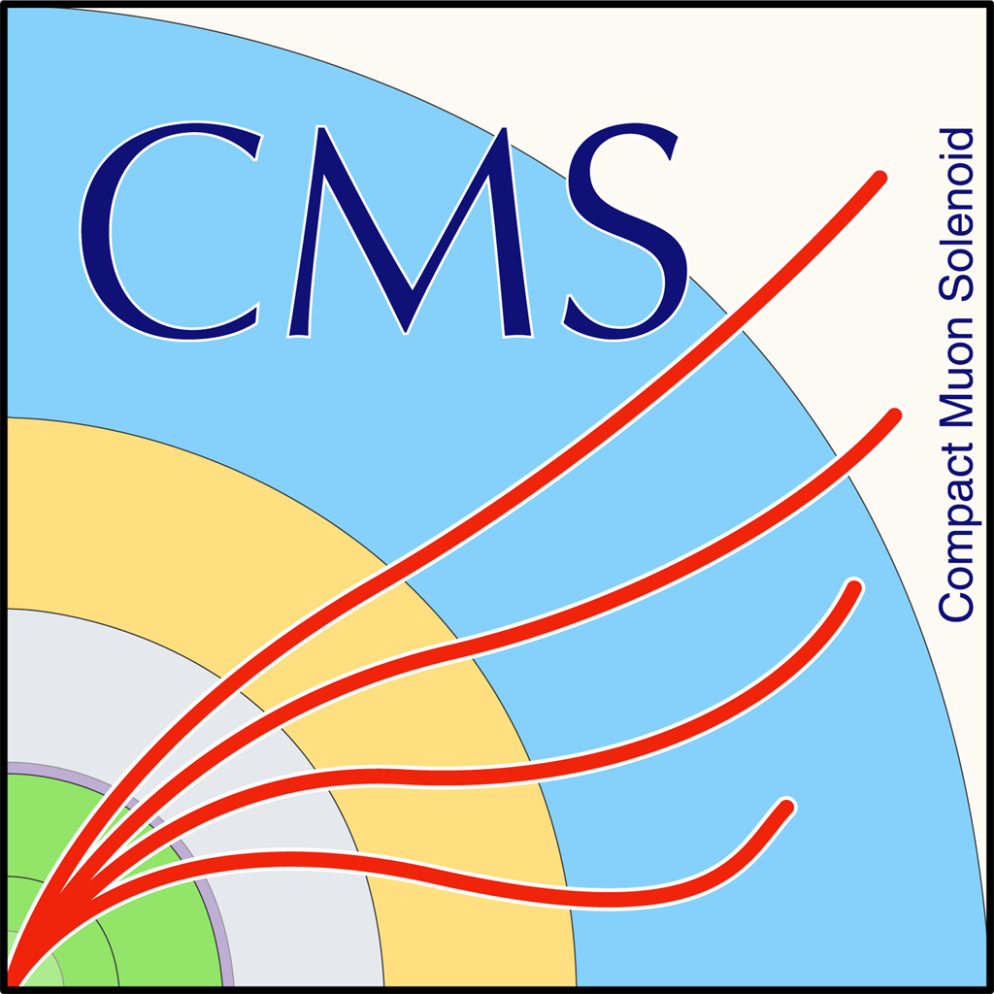
CMS jobs and Echo
Goal – learn about and improve the I/O for jobs run at RAL
Notes:
Containers in containers – with the proxy / gateway

Slide 10
CMS jobs and Echo – test setup
Goal – learn about and improve the I/O for jobs run at RAL
RAL worker node, drained and isolated from the farm
One job at a time
Using the full containerized setup
Submission via condor_submit
Various types of CMS jobs, previously run at RAL
Chose to use an analysis job written by RAL colleagues for the main test
Adapted site configuration file
(CMS jobs have an added option of “cache-hint”)
Notes:
Containers in containers – with the proxy / gateway

Slide 11
CMS jobs and Echo
Echo
XRootD gateway
XRootD proxy
Worker node (WN)
.root
Job
/pool/xcache/
Stripes are concatenated to form the ‘file’, depending on requirement
‘File’ is cached and served to the job container
File is mounted on the WN in case of repeat reads
Job received data through XRootD client
8 shards form stripes
Worker Node Docker Containers
/pool/xcache/
Tested different values of ‘cache—hint’
These affect the way data is transferred to and stored in the job container
<application-only>, <lazy-download>, <storage-only>, <auto-detect>
XRootD (manager)
XRootD Gateway
Job container
User job
XRootD Proxy
XRootD client

Slide 12
CMS jobs and cache-hint
Analysis job – making NTuple from 4 .root files with total size ~9 GB.
~10 tests for each cache-hint value.
Notes:
Highest minus lowest gives some indication of the spread – not really enough statistics for standard deviation.
Not sure how to tell what ‘auto-detect’ is doing, other than inference from the numbers

Slide 13
CMS jobs and cache-hint
Fairly tight distributions.
‘User’ time very similar for all tests except slightly greater for Storage-only.
Auto-detect appears to choose Application-only.
Lazy-download (used currently at RAL) is slowest.
However…this is one job (type).
What about when multiple jobs running simultaneously?
Reliability is a concern.
~10 tests for each cache-hint value.
Analysis job – making NTuple from 4 .root files with total size ~9 GB.
Cache-hint | Mean total (min:sec) | Highest - lowest | NetworkInputMb
Application-only | 32:11 | 1:45 | ~6900
Lazy-download | 36:04 | 1:25 | 9173
Storage-only | 35:15 | 1:46 | ~6680
Auto-detect | 32:13 | 1:47 | ~6900
Notes:
Highest minus lowest gives some indication of the spread – not really enough statistics for standard deviation.
Not sure how to tell what ‘auto-detect’ is doing, other than inference from the numbers
Hoping to spend a lot more time on this

Slide 14
XRootD Third Party Copy (TPC) and Echo
As Echo is an object store, the path name has to be specified exactly
For example, if this ‘path’ was used to write or read
root://xrootd.echo.stfc.ac.uk:1094/dteam:test1/testKaty1
XRootD can replace the slash with a double slash
root://xrootd.echo.stfc.ac.uk:1094//dteam:test1/testKaty1
To accept either path, and not rely on other sites to provide only pathnames with single slashes, a workaround was applied at RAL
Define additional paths with extra slashes in the authdb and then translate them back in the TFC (Trivial File Catalogue)
Two different object names in Echo
tim.adye@stfc.ac.uk
Notes:
TFC is normally only for CMS – but in this case it is being used by all experiments to get around this problem
Minor issues remain, Xrd, but related to RAL

Slide 15
XRootD Third Party Copy (TPC) and Echo
Concerning authentication, this setup requires the use of delegation of the command issuer’s credentials to the destination server, e.g.
xrdcp --tpc delegate only root://xrootd.echo.stfc.ac.uk:1094/dteam:test1/testSourceFile root://griddev03.slac.stanford.edu:2094//xrootd/atlas/tpctest/testDestFile [140B/140B][100%][==================================================][35B/s]
Notes:
Other changes specific for Echo in this slide. Tim believes everyone is now using ‘delegate only’ – but at the time not so much
Additional diagram of the xrootd proxy

Slide 16
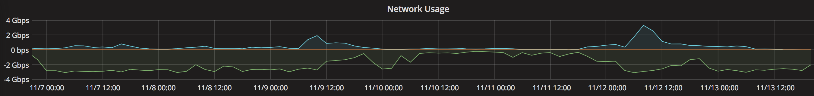
CMS AAA and Echo
CMS AAA is a service to deliver ”Any data, any time, anywhere” to jobs running at any CMS site.
Partial reads are common in CMS but not efficient for object store – Echo works best when serving whole stripes (64 MB section of a file).
Much more data into proxy than out!
Unclear whether (disk) caching is helpful – we believe the XRootD cache was demanding whole file, even if data from only a small number of stripes was requested.
As a result – overloaded service that required frequent intervention.

Slide 17
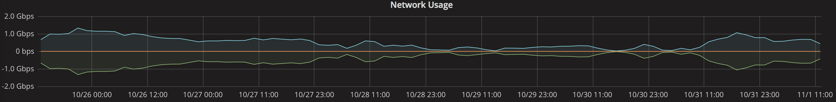
CMS AAA and Echo
External
AAA proxy cache was turned off.
More recent CMS files now store the metadata in one place near the start or end of files, instead of dispersed throughout.
Service is now much more stable and rarely requires intervention
CMS-AAA-proxy
XRootD server
libXrdCeph
libradosstriper
Ceph storage node
Disk
Disk
Disk
Disk
Disk
Disk
Disk
Disk
Disk
Disk
Disk
Disk
Disk
Disk
Disk
Disk
Disk
Disk
Disk
Disk
Disk
Disk
Disk
Disk
Disk
Disk
Disk
Disk
Disk
Disk
Disk
Disk
Disk
Disk
Disk
Disk
Disk
Disk
Disk
Disk
Disk
Disk
Disk
Disk
Disk
Disk
Disk
Disk
Disk
Disk
Disk
Disk
Disk
Disk
Disk
Disk
Disk
Disk
Disk
Disk
Disk
Disk
Disk
Disk

Slide 18

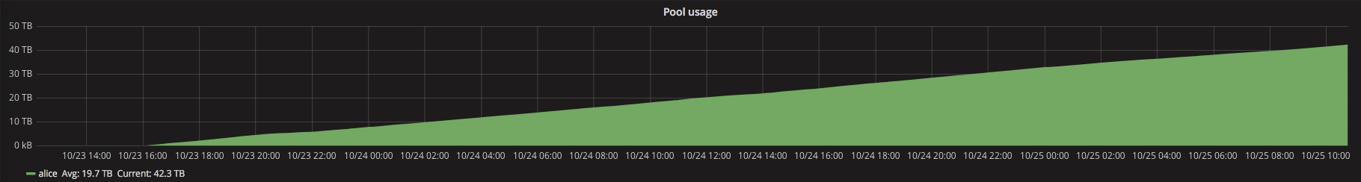
ALICE and Echo
ALICE require their own XRootD authentication plugin
Blocker for ALICE to move from CASTOR onto Echo
The source code was modified to accommodate the pool name alice:/
ALICE transfers are currently somewhat isolated from other VOs
Have their own Echo gateways
Have their own XRootD alias: alice.echo.stfc.ac.uk
george.patargias@stfc.ac.uk

Slide 19
Summary
Echo is working effectively with XRootD
Looking for continuous improvement
All four LHC experiments are up and running
Each saw their own individual issues
Non-LHC experiments are also, or will soon, use Echo for disk storage
Thanks to the XRootD developers for their collaboration!

Slide 20
Backup
Notes:
From Michel Simon’s talk: pfc.blocksize (large buffer for whole file streaming vs small for vector reads)
Pfc.ram – how much RAM to use for buffer
pfc.diskusage 0.89 0.90 purgecoldfiles 2d 5

Slide 21
CMS jobs and Echo – XRootD proxy config
Located on the WN : /etc/xrootd/xrootd-ceph.cfg
Matches the Echo stripe size:
xrootd.async segsize 67108864
xrd.buffers maxbsz 67108864
pfc = proxy file cache
pfc.ram 7g
pfc.blocksize 16m
Notes:
From Michel Simon’s talk: pfc.blocksize (large buffer for whole file streaming vs small for vector reads)
Pfc.ram – how much RAM to use for buffer
pfc.diskusage 0.89 0.90 purgecoldfiles 2d 5

Slide 22
Cache-hint options
application-only
This is the default and means ROOT will do the caching. If PoolSource.cacheSize is non-zero, a TTreeCache of that size will be created per open file. Asynchronous read-ahead will be turned off and the cache will be filled with normal reads.
storage-only
Means ROOT will drive the caching using a prefetch list, but will not allocate a cache of its own. If PoolSource.cacheSize is non-zero, a TTreeCache with a read-list of that size will be created, but no actual cache buffer -- the ROOT cache will be "virtual" and could in fact be very large. ROOT will hand over the prefetch list to the storage layer, which is expected to do its own caching. This method only makes sense if the underlying storage binding is capable of prefetching, which is currently true for local files (and anything downloading into a local file, such as srm, storm, gsiftp) and RFIO. Using this method with an incompatible storage system such as dCache will trigger an error.

Slide 23
Cache-hint options
lazy-download
Means remote files will be downloaded to a local shadow file on demand in 128MB segments. ROOT reads will be directed to this local file; ROOT will never read directly from the remote file. If PoolSource specifies a non-zero cache, it will behave as a "storage-only" virtual / prefetch cache. Note that the file will be downloaded lazily even if PoolSource.cacheSize is zero. The local shadow file will be created in the specified temporary directory and will be removed automatically when the corresponding remote file is closed. If no suitable local temporary directory with sufficient free space can be found, lazy download is automatically switched off.
auto-detect
This tells the I/O layer to pick the best strategy suited for the I/O technology in use. This will be "lazy-download" for RFIO, dCache and the "file" protocol, including any method which downloads remote files to local disk.

Slide 24
Changes required for TPC // problem
authdb:
# VO = Atlas
u atlasprod \atlas:datadisk/ a \atlas:scratchdisk/ a /atlas:datadisk/ a /atlas:scratchdisk/ a
u atlasuser \atlas:datadisk/ r \atlas:scratchdisk/ a /atlas:datadisk/ r /atlas:scratchdisk/ a
New xrootd storage.xml
<lfn-to-pfn protocol="direct" path-match="/*(.*)" result="$1"/>

Slide 25
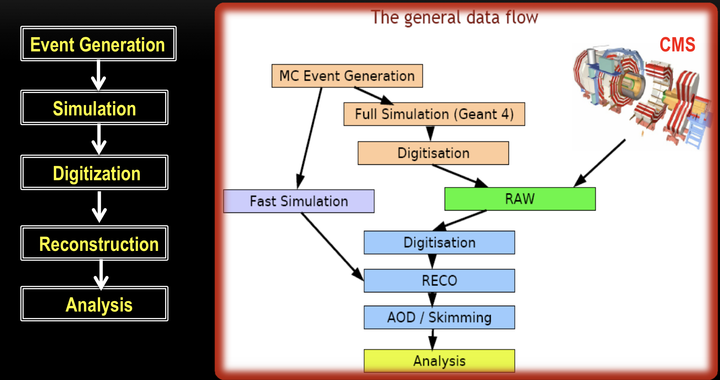
CMS jobs and Echo
MC production
CMS detector
(Full) SIM
DIGI
RAW
Digitization
RECO
AOD
Analysis
Notes:
https://indico.desy.de/indico/event/3246/session/2/material/1/3.pdf
What are the most important things to look at wrt echo data access

