Slide 1
Hospital Management System
Sri Vidya veggalapu EBEON0722630563
Katyayani Kommoju EBEON0722629133
K Asha Nandini EBEON0722628531
Vedita Mhatre EBEON0722627266
Triveni
Guided by
Varadharajan A

Slide 2
Hospital Management System
Admin
Doctor
Patient
Pharmacy Management System
Inventory
Laboratory
Appointment

Slide 3
Hospital Management System
Doctor module will manage the appointment of patients and view the list of patients.
Patient module will book an appointment while registering.

Slide 4
Patient
In this module of patient, there is a facility to register patients and view their reports and history. This module allows for getting detailed information about a patient’s details .

Slide 5
Doctor
This module allows registering the doctors working in a hospital. It updates them on complete appointment details with a patient’s health history.

Slide 6
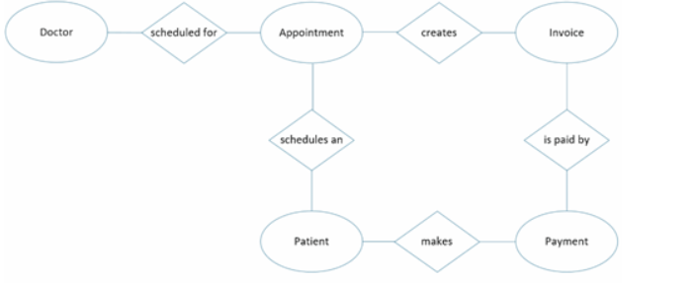
Project overview

Slide 7
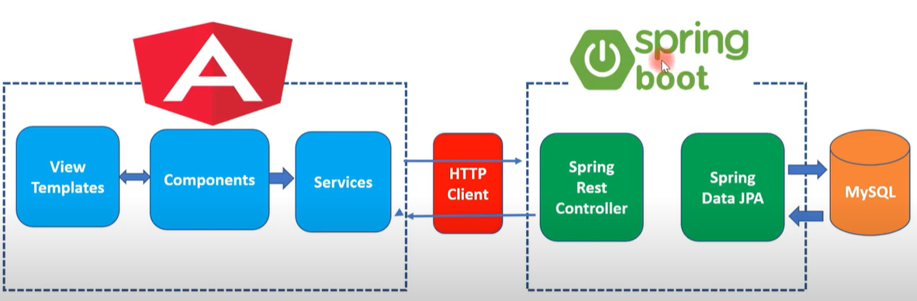
Technical architecture

Slide 8
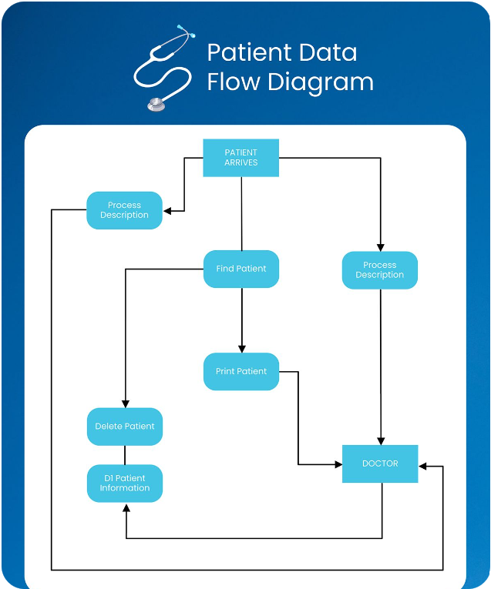
Dataflow diagram

Slide 9
Challenging issues
I have faced many errors during the development of my project. I resolved it by some sources in the Google and tried it in my project.
While working in the frontend part of my project, I couldn’t be able know how to start , for that I have taken the reference of some projects and implemented my project.

Slide 10
Testing
Testing Module | Expected Result | Pass/Fail
1.Add Doctor | Admin/Doctor can add doctors | Pass
2. View Doctor | Users can view the list of doctor’s list | Pass
3.Update Doctor | Admin/Doctor can update the doctors | Pass
4. Delete Doctor | Admin/Doctor can delete the doctors | Pass
4. Add Patient | Admin/Doctor can add patients | Pass
5.View Patient | Admin/Doctor can view the patient’s list | Pass
6. Update Patient | Admin/Doctor can update the patient | Pass
7. Delete Patient | Admin/Doctor can delete the patient | Pass

Slide 11
Features about the module
1.Doctor Module:
This enables the doctor’s to login, view the list of the doctors and add doctors in the database. It helps in managing all the data of the doctors.
2.Patient Module:
This enables the patient’s to login, view the list of the patients and add patients in the database. It helps in managing all the data of the patients. Patient can book appointment with the doctor about the disease.

Slide 12
Future enhancement
Hospitals generally have a series of information, from patient details to
recordings of the prescriptions, detailed treatment, and the hospital's
claim management. Hospitals can become overloaded with the
documentation process and lab inventory management. If this process could
have been automated, the hospital's workload could have reduced much
easier. The hospital management system helps in automating and
streamlining the hospital administration. It would help in integrating patient
care, every process right from the admission to discharge. HMS can create
electronic patient records for the hospital billing management and the claim
management of the hospital. This process would be easy for the hospital
department making tasks quickly and with inaccuracies.

Slide 13
Conclusion
The Hospital Management System is an inevitable part of hospitals. It helps
in automating numerous daily operations that help and enables smooth
interactions of the users. HMS helps store all kinds of records, provide
coordination and user communication, implement policies, improve day-to
day operations, and manage the financial source and hospital services. It
helps fulfill the needs of patients, staff, and the hospital staff that simplifies
their interactions. We can also say that HMS has become a usual approach
to manage hospitals.

