Slide 1


DG INTERNS HUB • CYBER SECURITY INTERNSHIP
Prepared by: Katyayni Negi | Submission Date: 14th Oct 2026
Web Security & Vulnerability Assessment (VAPT)
Hands-on security testing, OWASP Top 10 analysis, and exploitation using DVWA, Burp Suite, and OWASP ZAP.

Slide 2
1. Introduction to VAPT & Objectives
Vulnerability Assessment
Automated discovery of known security flaws and missing patches.
Core Objectives
Master OWASP Top 10 vulnerabilities
Configure Burp Suite, ZAP, and DVWA
Penetration Testing
Execute controlled manual exploits
Active exploitation to evaluate real-world impact and business risk.
Establish robust mitigation strategies

Slide 3


2. OWASP Top 10 Study Focus
SQL Injection
Cross-Site Scripting
Broken Auth
Misconfigurations
Unsanitised input manipulation allowing database compromise.
Client-side execution of injected malicious scripts in sessions.
Weak passwords, session flaws, and missing rate-limiting.
Default credentials and missing security headers.

Slide 4
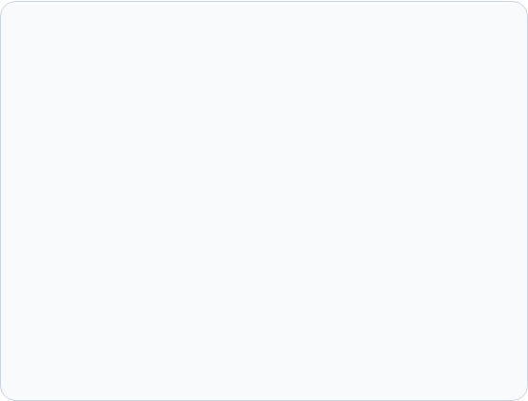
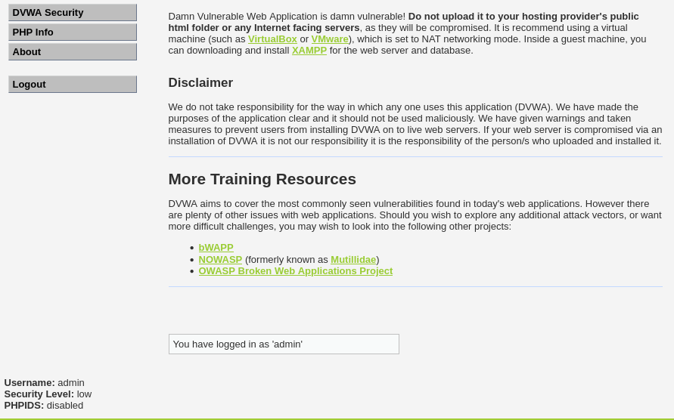
3. Tools & Lab Setup (DVWA)
Burp Suite Community
Man-in-the-middle proxy for traffic interception and repeater testing.
OWASP ZAP
Automated DAST scanner for rapid discovery and alert reporting.
DVWA on XAMPP
Deliberately vulnerable PHP/MySQL web app hosted locally.

Slide 5
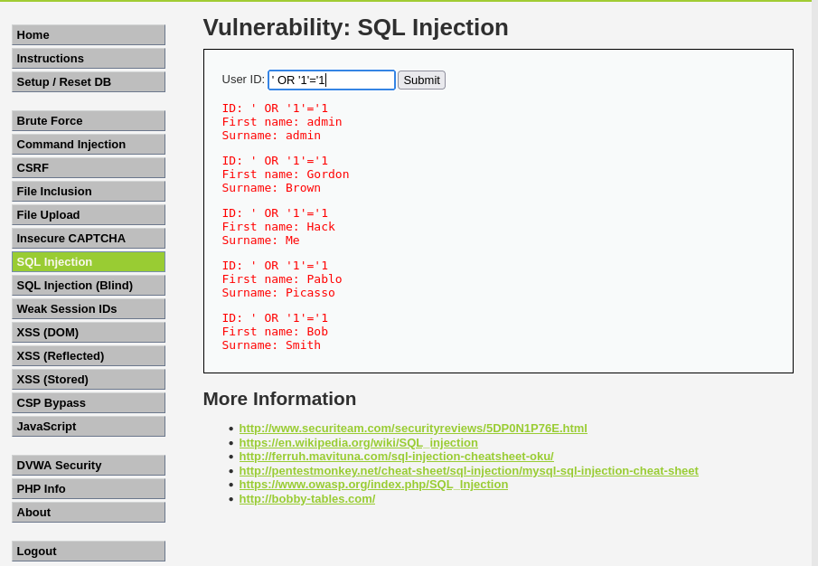
4. Vulnerability Testing: SQL Injection
Test Methodology
Tested User ID field in DVWA with payload .
' OR '1'='1
Observed Result
Application returned confidential details for all registered database users instantly.

Slide 6
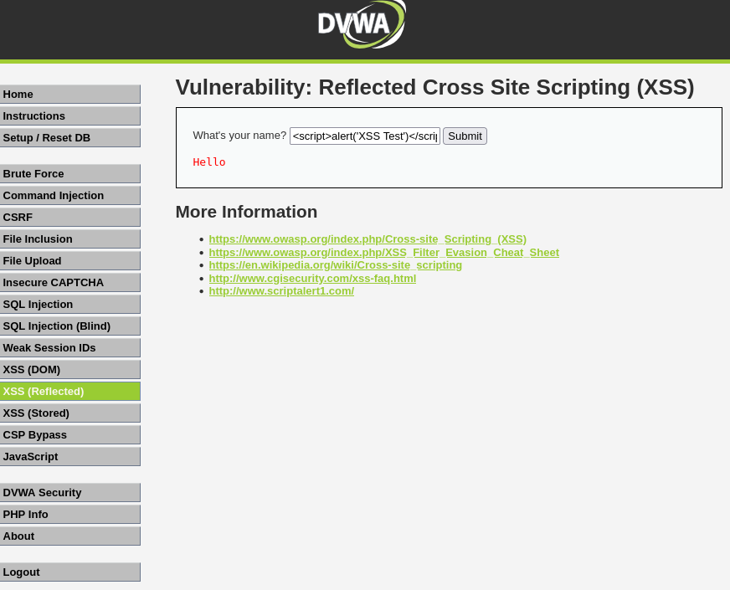
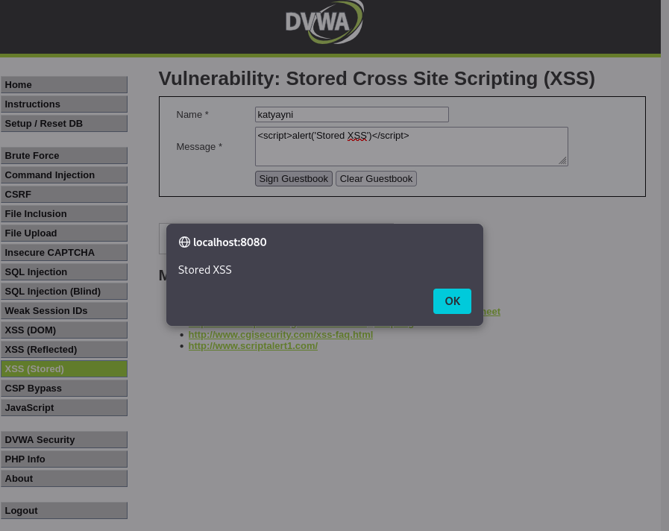
5. Vulnerability Testing: XSS (Reflected & Stored)
Reflected XSS
Injected script into name parameter, triggering immediate popup alert.
Stored XSS (Guestbook)
Persisted malicious script in DB, executing automatically for every visitor.

Slide 7
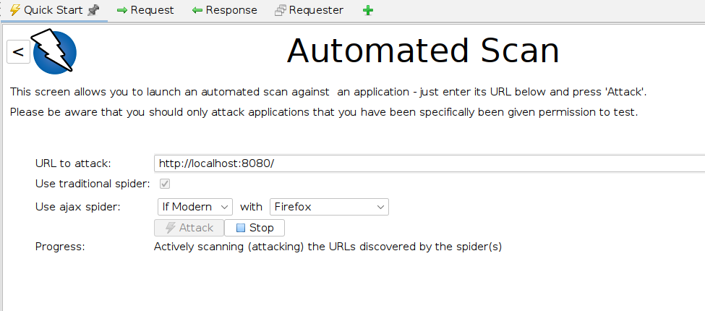
6. Automated Scanning: OWASP ZAP & Burp Suite
Spider & Active Scan
Crawled all endpoints and systematically probed parameters for flaws.
Key Alerts Generated
Identified missing CSP headers, missing Anti-CSRF tokens, and version leakage.

Slide 8
7. Summary of Findings & Risk Ratings
Vulnerability | Location | Risk Level | CVSS
SQL Injection (Low Sec) | DVWA SQL Module | Critical | 9.8
Stored XSS | DVWA Guestbook | High | 8.0
Reflected XSS | DVWA XSS Module | High | 7.2
Security Misconfiguration | Server Headers | Medium | 5.8

Slide 9
8. Mitigation & Security Controls
Parameterized Queries
Context-Aware Encoding
Security Headers & CSP
Prevent SQL injection by separating code from user-supplied data.
Neutralise XSS by escaping output before rendering in browser contexts.
Deploy strict CSP, HSTS, and X-Frame-Options to mitigate browser exploits.

Slide 10


Conclusion & GitHub Submission
Successfully completed VAPT lab exercise, documented findings, and prepared all artifacts for GitHub repository upload.
Report (PDF)
Presentation (PPT)
Screenshots & Notes

