Slide 1


Africa Crisis
Katayoon Mehr
Jan 2020

Slide 2
Project Introduction The data includes some demographic information about 13 major African countries since 1975 to 2014 and if they are in crisis. str (data) 'data.frame': 520 obs. of 18 variables colnames (data) "case" "cc3” "country" "year" "systemic_crisis" "exch_usd“ "domestic_debt_in_default" "sovereign_external_debt_default“ "gdp_weighted_default" "inflation_annual_cpi" "independence" "currency_crises" "inflation_crises" "banking_crisis" "population" "crime_rate" "GDP.bd." “edu”
Q1) What are the names of the countries and which countries have ever been in inflation crisis?
Query1<-sqldf("select distinct country from data") or levels(data$country)
Query2<-sqldf("select distinct country from data where inflation_crises=1") #using binary variable
Query3<-sqldf("select distinct country from data where inflation_annual_cpi>=35") #using inflation rate more than 35%
1 Algeria
2 Angola
3 Central African Republic
4 Egypt
5 Ivory Coast
6 Kenya
7 Mauritius
8 Morocco
9 Nigeria
10 South Africa
11 Tunisia
12 Zambia
13 Zimbabwe
1 Algeria
2 Angola
3 Central African Republic
4 Egypt
5 Ivory Coast
6 Kenya
7 Mauritius
8 Nigeria
9 Zambia
10 Zimbabwe
The CPI measures the average change in prices over time that consumers pay for a basket of goods and services, commonly known as inflation.
1 Angola
Kenya
Nigeria
Zambia
5 Zimbabwe

Slide 3
Q2) Is there any country in crisis in 2014. if not when was the last year when any of these African countries were in inflation crisis?
Query4<-sqldf("select distinct country from data where inflation_crises=1 AND year=2014")
# No country since 2008
Query5<-sqldf("select distinct country, inflation_annual_cpi from data where inflation_crises=1 AND year=2008")
Q3) What is the population and Literacy rate in 2014?
Query8<-sqldf("select country, population, edu from data where year=2014 order by population")
country inflation_annual_cpi
1 Zimbabwe 21989695
country | population | Edu
Mauritius | 1259456 | 72.85
Tunisia | 11179949 | 72.85
Zimbabwe | 13814629 | 71
Zambia | 15879361 | 68
Ivory Cost | 23226143 | 77.18
Angola | 27061724 | 66
Morocco | 34663603 | 66
Algeria | 39728025 | 72.85
Kenya | 47878336 | 76
South Africa | 55386367 | 66
Egypt | 101007882 | 80
Central Afcrican Republic | 154203219 | 75.38
Nigeria | 181137448 | 72.85
Mauritius with lowest population and Nigeria with highest population have the same education (litracy) rate.

Slide 4
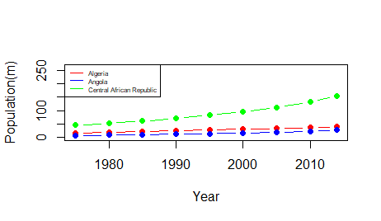
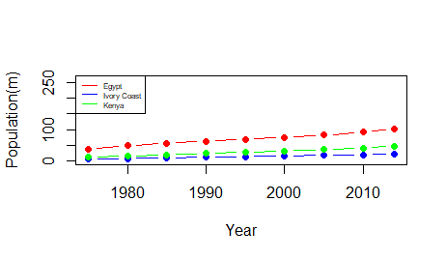
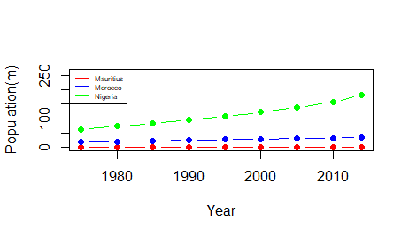
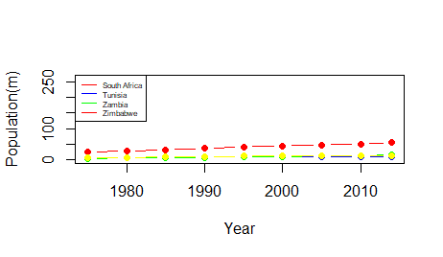
Q4) How is the trend of population growth over years?
data$pop_m=round(population/1000000,2)
subset1=subset(data, subset= year==1975 | year==1980 | year==1985 | year==1990 | year==1995 | year==2000 | year==2005 | year==2010 | year==2014, select=c("country", "year", "pop_m", "edu"))

Slide 5
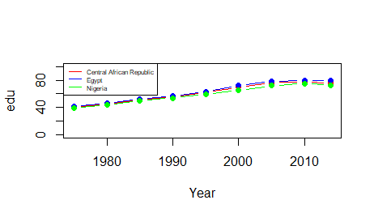
Q5) How is the trend of education for those countries with the highest population growth?
The countries are Nigeria, Central African Republic and Egypt
country | year | pop_m | pop_gr_rate | edu | edu_gr_rate
Central African Republic | 1975 | 45.95 |  | 40.1
Central African Republic | 2014 | 154.2 | 335.6 | 75.38 | 187.98
Egypt | 1975 | 38.55 |  | 41.1
Egypt | 2014 | 101.01 | 262 | 80 | 194.65
Nigeria | 1975 | 63.37 |  | 39.1
Nigeria | 2014 | 181.14 | 285.9 | 72.85 | 186.32

Slide 6
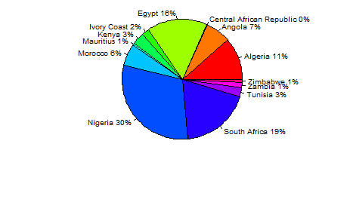
Q6) What is the share of GDP in 2014 for each country?
subset4=subset(data, subset=
year==2014, select=c("country", "GDP.bd."))
South Africa, Nigeria and Egypt consecutively have the highest GDP, comparing to the population, These are also the countries with highest population. Nigeria has the highest population and then Central African Republic is on the second place and Egypt and South Africa are the third and forth. So Although Central Africa has very high population, It doesn’t have a high GDP.
Country | GDP(b$) 2014
Algeria | 213.8
Angola | 126.7
Central African Republic | 1.7
Egypt | 305.5
Ivory Coast | 35.37
Kenya | 61.44
Mauritius | 12.8
Morocco | 109.9
Nigeria | 568.5
South Africa | 350.9
Tunisia | 47.59
Zambia | 27.15
Zimbabwe | 15.89

Slide 7
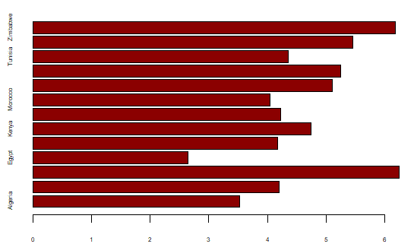
Q7) What is average rate of crime rate in each country? What countries have the worst history of crime?
r=range(crime_rate)
Query9<-sqldf("select Country, avg(crime_rate) as Average_Crime_Rate, max(crime_rate) as Max_Crime_Rate,
min(crime_rate) as Min_Crime_Rate, stdev(crime_rate) as sd_Crime_Rate from data group by country")
write.table(Query9, "Query9.csv", quote=FALSE, sep=",", row.names=FALSE)
barplot(Query9$Average_Crime_Rate, horiz=TRUE, cex.axis =0.5, cex.names=0.5, col="darkred")
country | Average_ Crime_Rate | Max_ Crime_Rate | Min_ Crime_Rate | sd_ Crime_Rate
Algeria | 6.175 | 10 | 2 | 2.384646
Angola | 5.45 | 9 | 2 | 2.57154
Central African Republic | 4.35 | 6 | 2 | 1.702939
Egypt | 5.25 | 10 | 1 | 2.853248
Ivory Coast | 5.1 | 10 | 3 | 1.661016
Kenya | 4.05 | 8 | 1 | 2.062485
Mauritius | 4.225 | 7 | 2 | 1.716996
Morocco | 4.75 | 8 | 1 | 2.250356
Nigeria | 4.175 | 7 | 3 | 1.278771
South Africa | 2.65 | 6 | 1 | 1.625912
Tunisia | 6.25 | 10 | 2 | 2.261722
Zambia | 4.2 | 9 | 1 | 2.377243

Slide 8
Q8) Is there any dependent Country?
r=range(independence) # NA
Query10<-sqldf("select distinct country from data where independence=1") # All the 13 countries are independent
Q9) What are the influential variables on Inflation?
model_1<- lm(inflation_annual_cpi ~ pop_m +edu + GDP.bd. + crime_rate + exch_usd , data = data) summary(model_1)
model_2<- lm(inflation_annual_cpi ~ pop_m +edu + GDP.bd. + exch_usd , data = data)
summary(model_2)
Coefficients:
Estimate Std. Error t value Pr(>|t|)
(Intercept) 213.45285 75.12139 2.841 0.00551 **
pop_m 0.23970 0.14983 1.600 0.11299
edu -2.79134 1.04979 -2.659 0.00921 **
GDP.bd. -0.09135 0.04477 -2.040 0.04411 *
crime_rate 0.88413 1.71792 0.515 0.60801
exch_usd -0.06404 0.03770 -1.699 0.09270
Coefficients:
Estimate Std. Error t value Pr(>|t|)
(Intercept) 221.85177 73.04302 3.037 0.00308 **
pop_m 0.24207 0.14918 1.623 0.10796
edu -2.86508 1.03594 -2.766 0.00683 **
GDP.bd. -0.09104 0.04459 -2.042 0.04396 *
exch_usd -0.05878 0.03615 -1.626 0.10725

Slide 9
Q10) What are the influential variables on banking crisis? Banking_crisis is a binary variable
data$BC <- 1
data$BC <- ifelse(data$banking_crisis=="crisis", 1, 0)
library (Rcpp); library (Amelia)
model_3<- glm(formula= BC ~ pop_m+edu+year, family = binomial(link = "logit"), data = data)
summary(model_3)
Estimate Std. Error z value Pr(>|z|)
(Intercept) 220.192508 78.287747 2.813 0.00491 **
pop_m 0.009330 0.003283 2.842 0.00448 **
edu 0.095029 0.038337 2.479 0.01318 *
year -0.114165 0.040333 -2.831 0.00465 **

Slide 10
Conclusion
Of 13 major African countries (Algeria, Angola, Central African Republic, Egypt, Ivory Coast, Kenya, Mauritius, Morocco, Nigeria, South Africa, Tunisia, Zambia, Zimbabwe) which they are independent just Morocco, South Africa and Tunisia has never suffered inflation crisis between 1975 and 2014. 5 countries Angola, Kenya, Nigeria, Zambia and Zimbabwe have the highest inflation rate of more than 35%.
Major inflation crisis belonged to 2008 and before that. From 2009 to 2014 we have not seen any evidence of inflation crisis in any of these 13 countries.
In 2008 Zimbabwe had a hyperinflation of 21989695.
The range of population for these countries is 1,259,456 for Mauritius and 181,137,448 for Nigeria in 2014. Although it seems the countries with higher population should have more problems with their education system. The rate of literacy is the same in these two countries by 72.85%

Slide 11
Conclusion
Nigeria with 286%, Central African Republic with 335% and Egypt with 262% have the highest rate of population growth since 1975. However the rate of education for these 3 countries is a bit less than 200%. In 1975 it was about 40% and at the end of 2014 has increased to almost 75%.
The highest GDG in 2014 belonged to Nigeria with the highest population. The second rank belongs to South Africa and the third to Egypt. All the 3 countries have high population. Just Central African Republic which has the second highest population doesn’t have high GDP respectively.
The highest average rate of crime for the years between 1975 and 2014 belongs to Tunisia (6.25) while the lowest belong to South Africa (2.65).

Slide 12
Conclusion
“Inflation rate” is a continuous variable and based on a linear regression model, it depends on “population”, “education”, “Country's GDP” and “currency exchange rate” compared to USD. Crime rate is not a influential variable on inflation rate. There is positive relation between “inflation” and “population”, but negative relation with “GDP”, “education” and exchange rate.
Being in “banking crisis” is a binary variable and based on a logistic regression model, it depends on the “year” crisis happened, “education” and “population”. In recent years there has be less banking crisis as the coefficient for year is negative. Higher population and higher education slightly increase the banking crisis.

Slide 13
Thank you
The End

