Slide 1
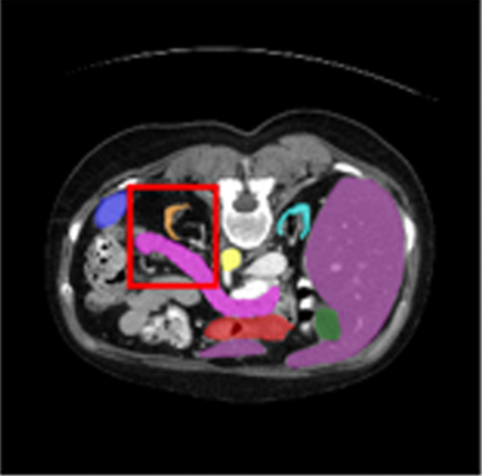
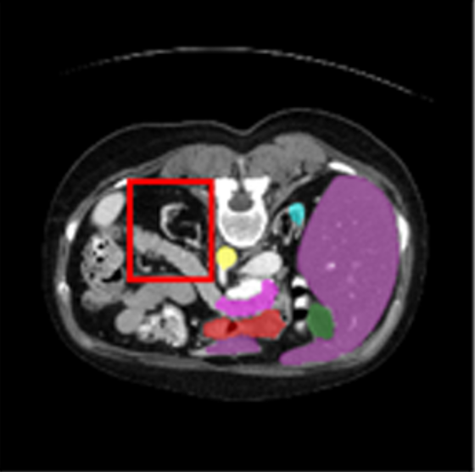
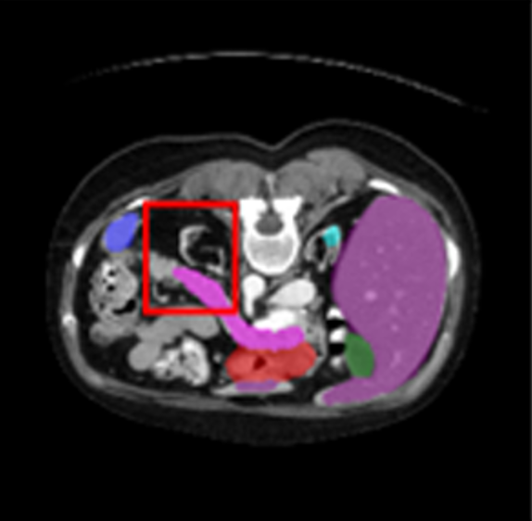
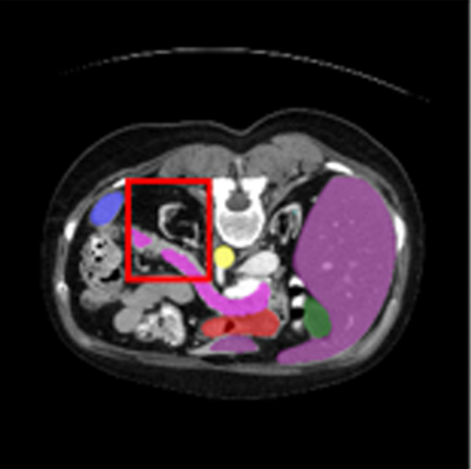
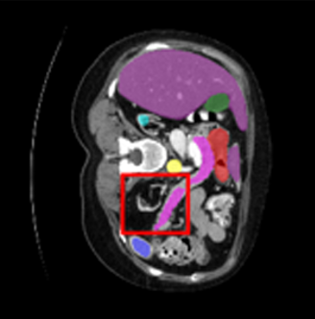
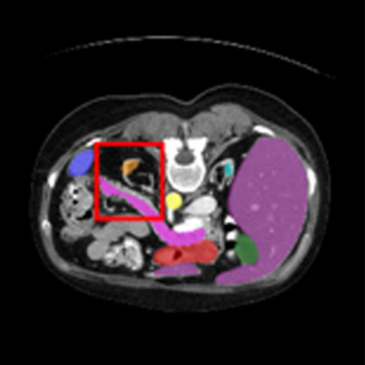
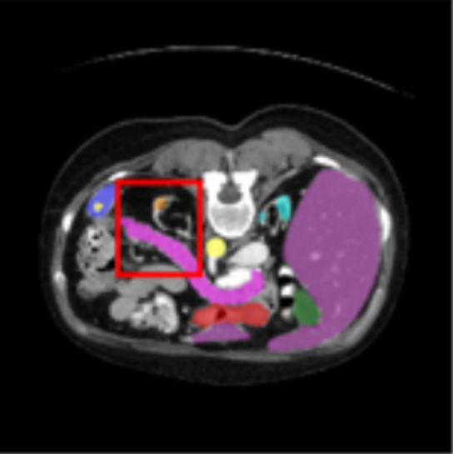
aorta
gallbladder
left kidney
right kidney
liver
pancreas
spleen
stomach
(a) Ground Truth
(b) TransUNet
(c) Swin-UNet
(d) TransDeepLab
(e) VM-UNet
(f) TransCASCADE
(g) SLMamba(ours)

