Slide 1
ISS 2022/23 intro
Honza Černocký, ÚPGM FIT VUT

Slide 2
Agenda
The very introduction …
Organization
Goals
A bit of motivation
Program of the course
Evaluation
Sources
Personal remarks on “being a student at FIT”

Slide 3
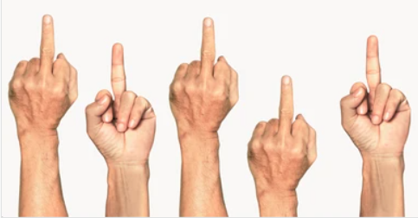
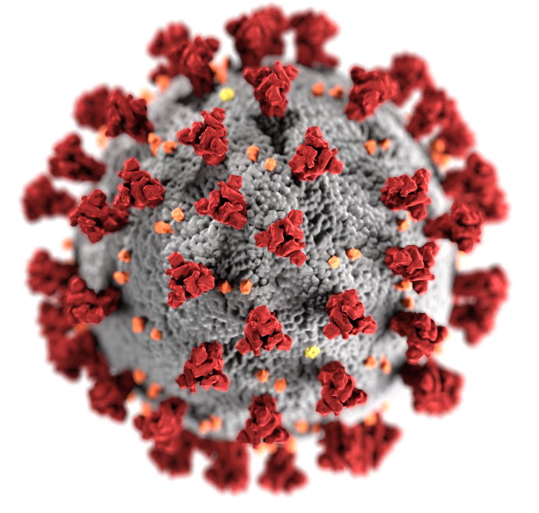
Hopefully done with COVID …

Slide 4
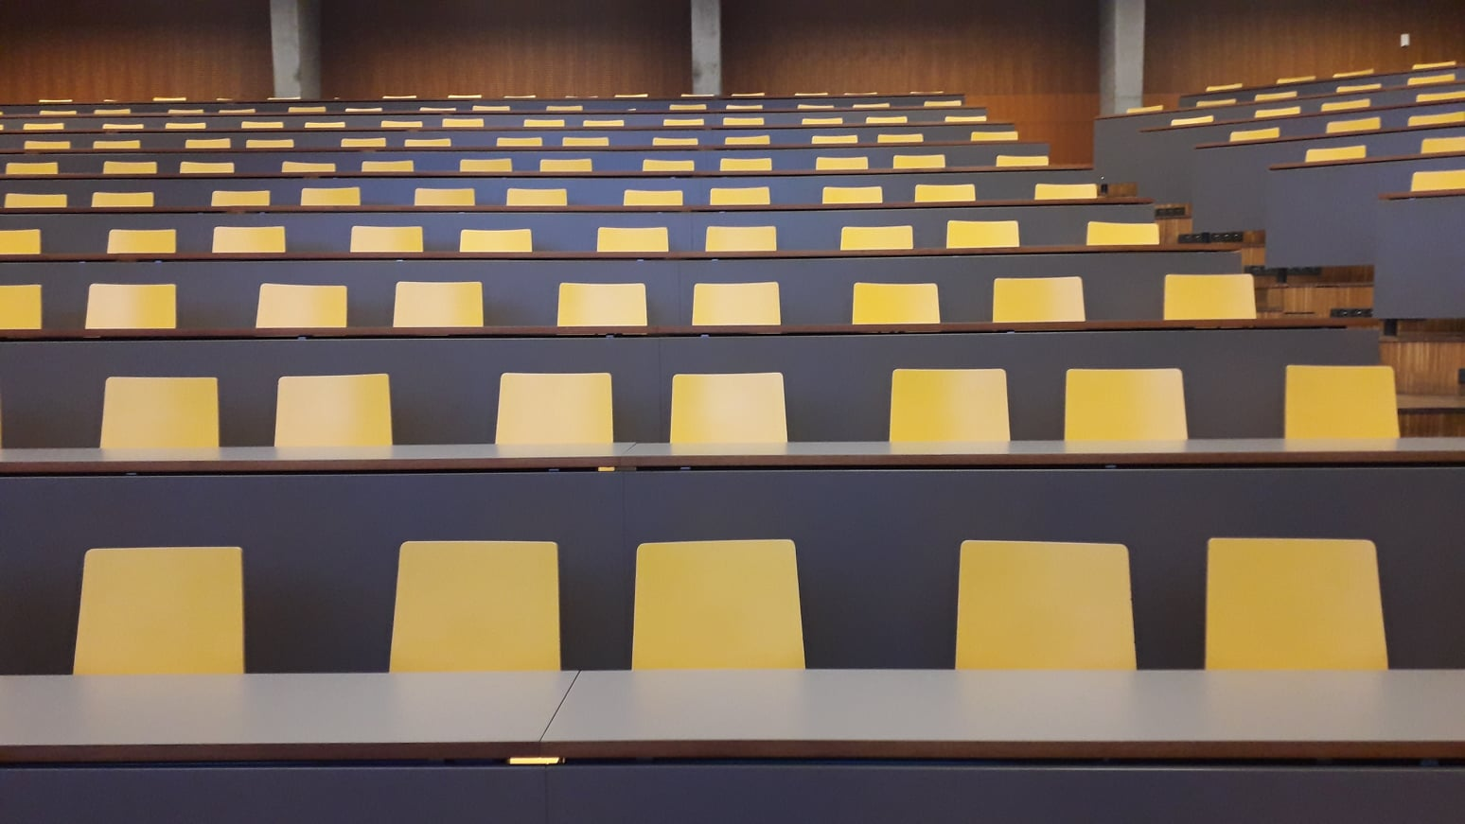
This was really terrible …

Slide 5
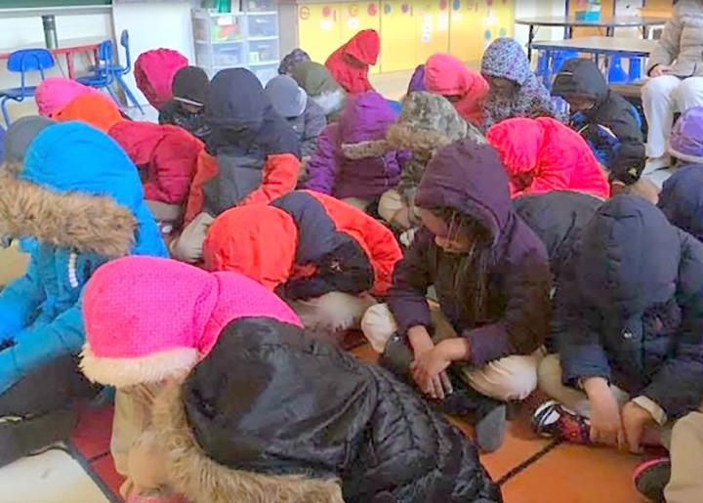
But the energy crisis can bring us another challenges …

Slide 6
Organization
Web
https://www.fit.vut.cz/study/course/ISS/
http://www.fit.vutbr.cz/study/courses/ISS/public
Organization
2 lecture groups 1 x week, 3h, 1 break.
Wednesday – Czech, Friday - ENGLISH.
Numerical exercise 1 x 14 days, 2h. 3 groups weekly are ENGLISH. Registration in IS VUT, hopefully OK. Tests.
Ex computer labs for self-study + loads of Python notebooks.
Project

Slide 7
Organization II.
Numericals on Wed 28.9. cancelled - please come to any other group within the 14-day block. Please inform the tutor of the target group.
Forum on Google groups – not much alive anymore … http://www.fit.vutbr.cz/study/courses/ISS/public/forum.html
Living Discord discussions with some ISS tutors (PhD students) in.
Recognition of points from exercise and project
Numerical exercises only 2020/21
Project 2020/21 and 2021/22, points converted to this year’s amount.

Slide 8
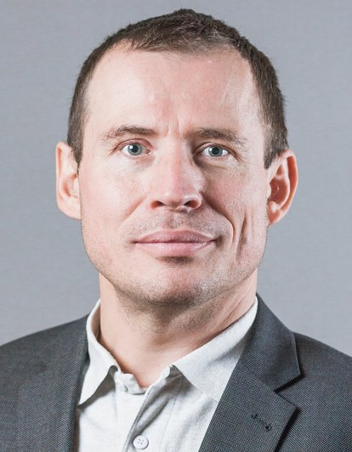
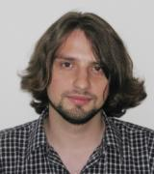
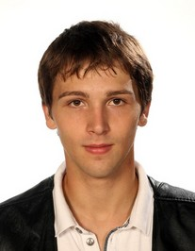
Who will teach the lectures ?
Lectures - Honza Černocký
Today Lukáš Burget (Honza Brukner as back-up)

Slide 9
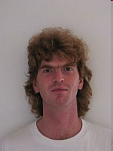
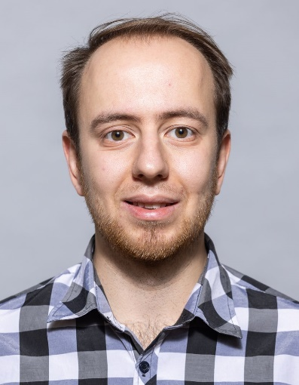
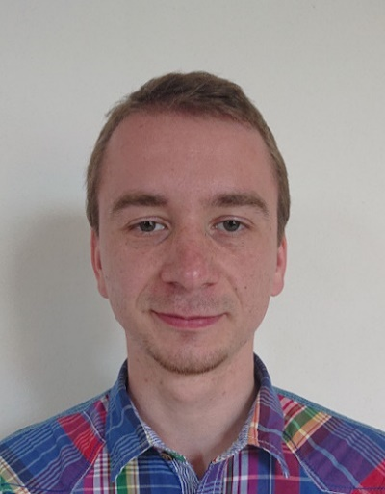
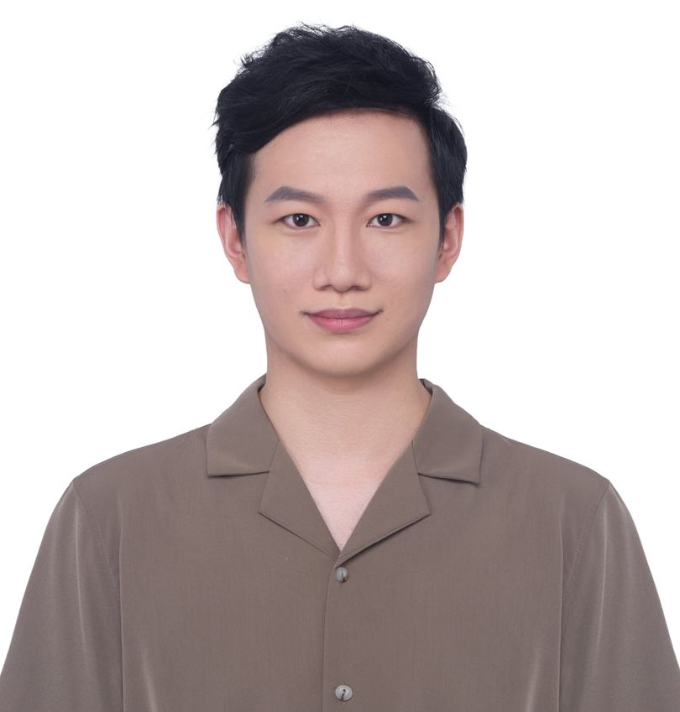
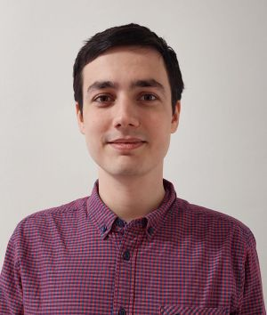
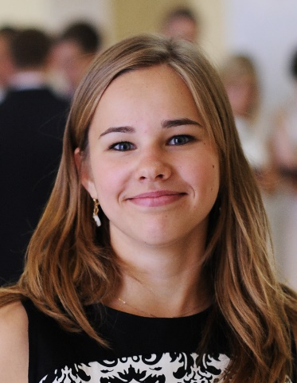
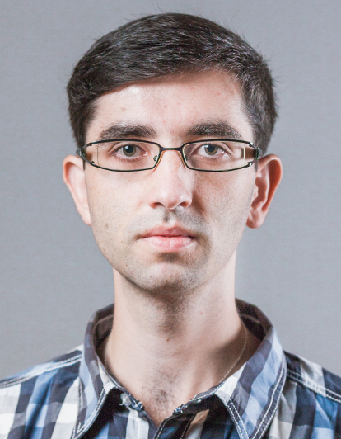
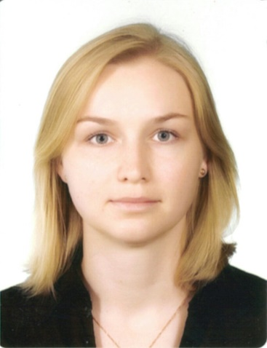
Who will teach the numerical exercises ?
assistants and PhD students of DCGM
Franta Grézl
Jiří Novák
Junyi Peng
Jiří Hanák
Jan Brukner
Ján Pavlus
Ania Silnova
Ladislav Mošner
Katia Egorova

Slide 10
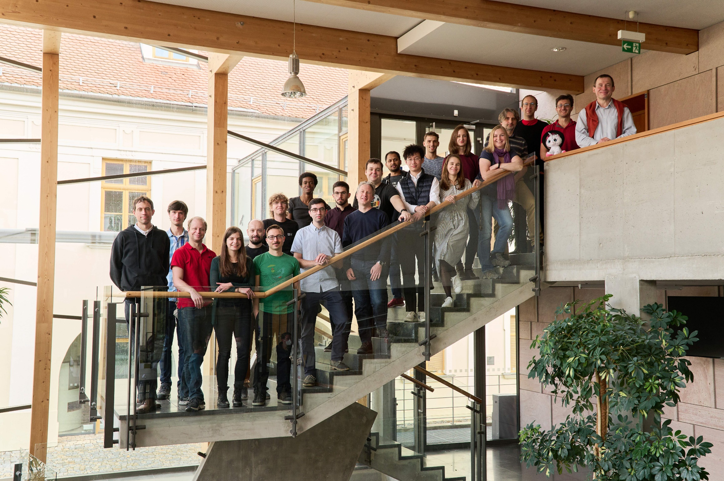











Why English ?

Slide 11
Contacting us
Personally
Anytime before/during/after lecture or exercise.
If other time, please make appointment by email.
Honza can be chased using DCGM secretaries – Sylva Otáhalová and Jana Slámová, next to the staircase in „L“ building
In case of generally interesting question, use Discord.
By email
Please use subject „ISS“
But mind Honza’s state of Inbox … currently 2650 messages that are not spam and should get some attention.

Slide 12
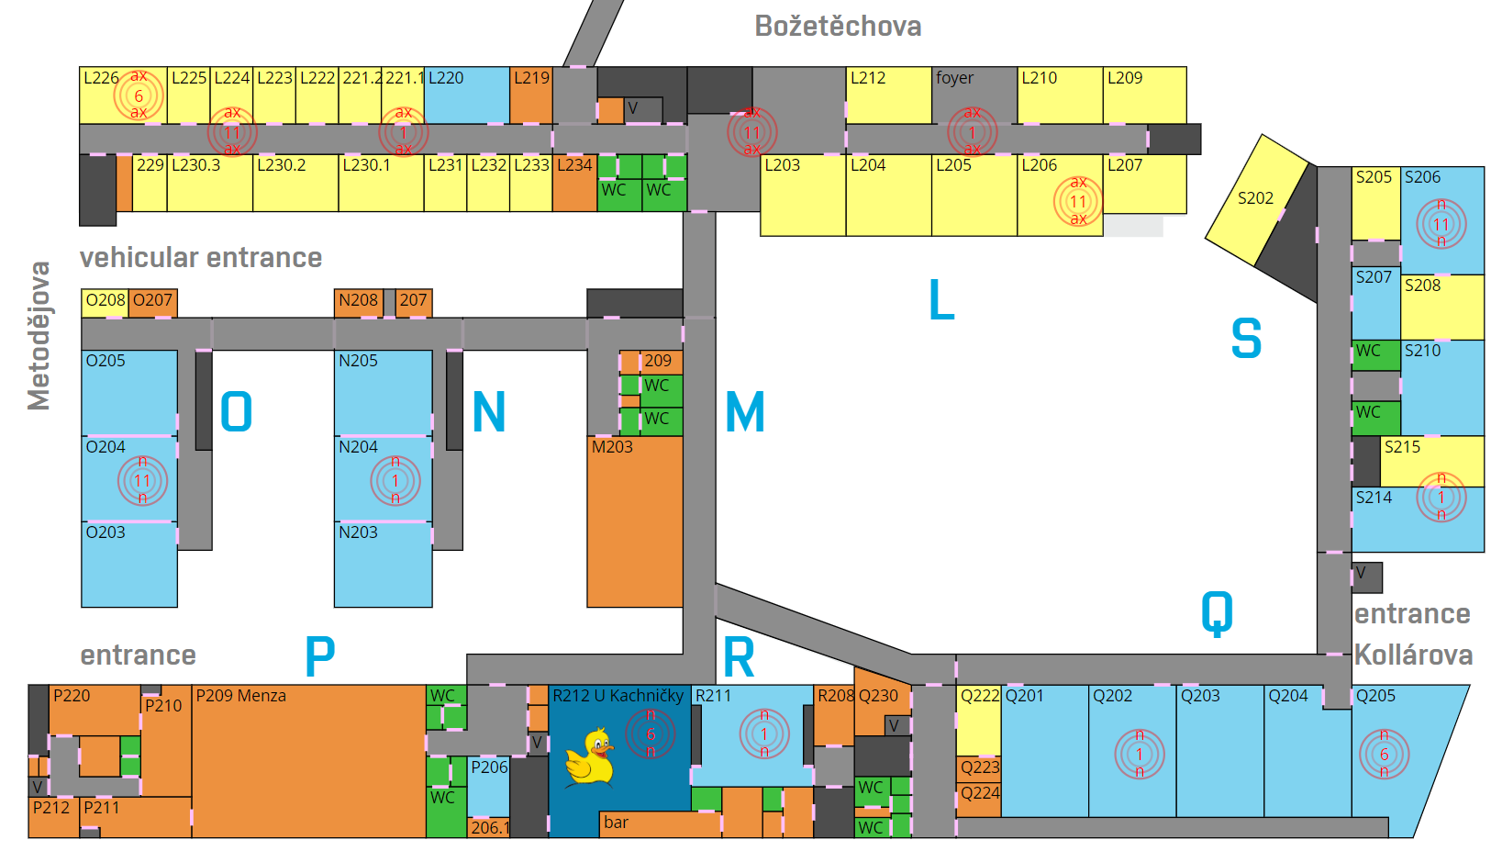
ISS
sekretariát
ISS
ISS
ISS
ISS
ISS

Slide 13
Goals of ISS
To learn and understand basic theory of signals and linear systems with continuous and discrete time. To introduce random signals. The emphasis of the course is on spectral analysis and linear filtering - two basic building blocks of modern communication systems.

Slide 14
Practically
Filtering – “how to change a signal”.
Spectral analysis - „how to look inside“
Random signals – „nothing around us is 100% sure“
Notes:
Tady se moc nezakecat !

Slide 15
Motivation I – Speech encoding for GSM / 3GPP in billions of cellphones worldwide

Slide 16
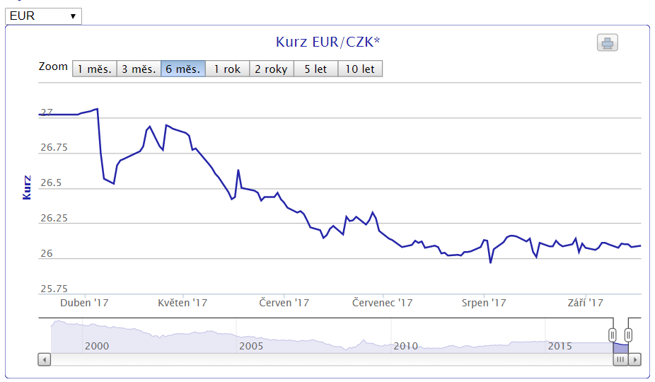
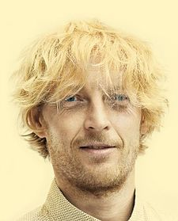
Motivation II –financial markets are also signals
Karel Janeček … is co-owner (23.6 %) and chairman of board of RSJ, net worth estimate in 2021: 3 bn CZK.

Slide 17
Demo - MP3
„Physical“ demonstration
Notes:
Play the sounds 0 no difference is audible.
Ask a student to say something and shout into it: demo of frequency masking Ask a student to say something and clap the door very loudly: demo of temporal masking.

Slide 18
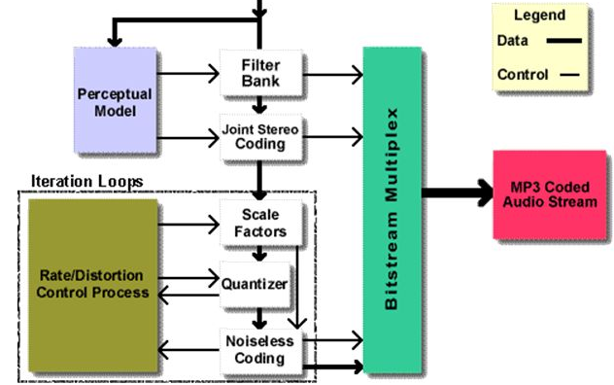
… and implementation
Source: Frauenhofer Institut, Germany.
Notes:
Both are used in the mp3 encoding that has billion uses worldwide.

Slide 19
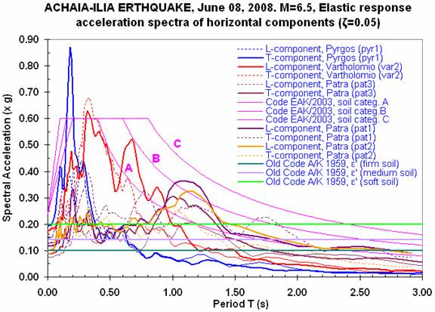
Not just audio and speech – geo-signals

Slide 20
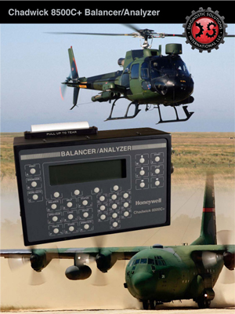
And it can save your life … vibration analysis

Slide 21
ISS -> features for machine learning
Models
Feature extraction
Evaluation of probabilities … likelihoods … scores … some values
“decoding”
input
output

Slide 22
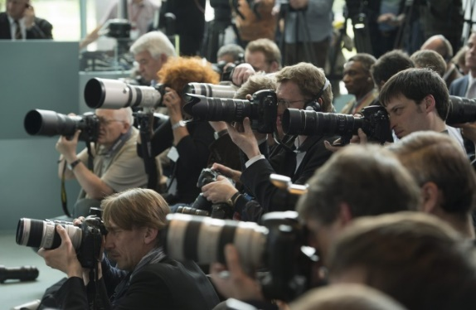

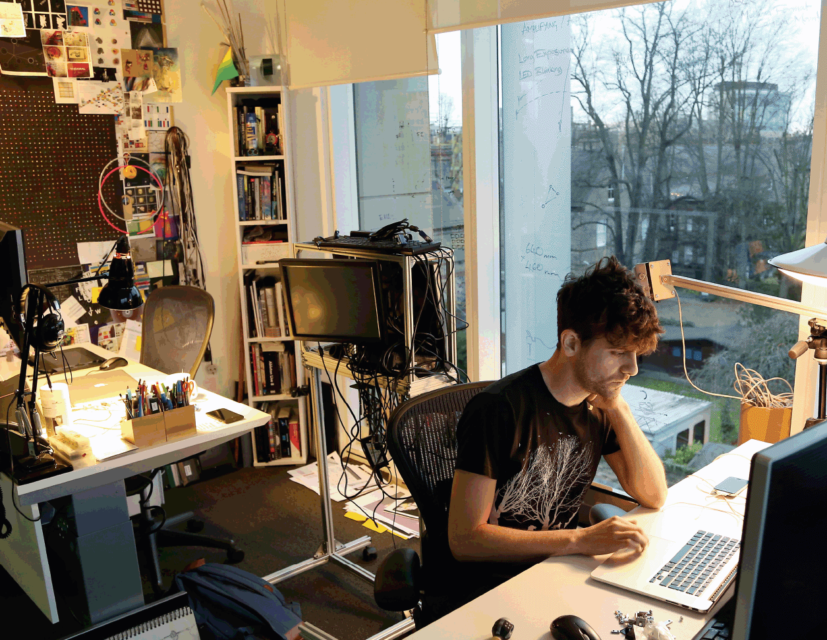
Today, everything is artificial intelligence (maybe time to rename FIT to FAI) !
Artificial intelligence !
Machine learning
Recognition, detection, classification, regression, Fourier transform, filtering…

Slide 23
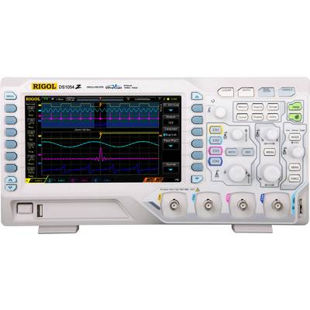
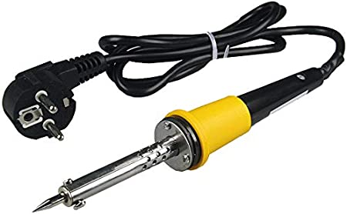
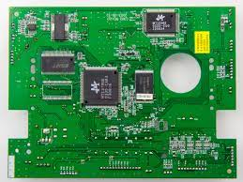

Classical program of signals and systems in electrical engineering programs
Analog world
Sampling
Digital world

Slide 24
ISS program at FIT from 2022 – “Digital first”
Introduction to projections and derivation of Discrete Fourier Transform (DFT)
Practical use and properties of DFT
Introduction to digital filtering, differential equation, implementation of filters, convolution
Frequency response and stability of digital filter. Applications of filtering.
Random signals - introduction.
Random signals II - correlation, spectra, white noise.
Processing of 2D signals - images.
Analog world - continuous time signal, Fourier transform, estimation using DFT. Sampling and quantization.
Periodicity of signals with discrete and continuous time - definition, Fourier series, Discrete Fourier series.
Fundamentals of systems - properties, impulse response.
Continuous-time systems - schematics, differential equation, frequency response, stability.
Conclusion - summary of frequency transformations and filtering.
Notes:
You can also mention the IFJ project that is destroying pretty much the 2nd part of semester …

Slide 25
Lecture slides and Python notebooks
New slides a bit more self-containing than the previous ones
Less writing on the “drawing pad” (too slow, not very readable, hard to read after the lecture is over, hard to see in recording / streaming).
Python notebook accompanying every lecture is an integral part of it to show you that the math is actually very easy to implement !

Slide 26

So …
Install Anaconda on your Linux or Windows
Run Python Notebook
Load the respective Py notebook and run it as I do it (Ctrl+Enter)
Change the parameters, tweak the code, modify it … it does not bite !
Use it wherever you want
BP, DP, other courses
Your professional life (price list: bottle of wine for your 1st million made with using these notebooks and, big black Mercedes for the 1st billion)
Use it in ISS project !
Please don’t expect a beautiful object-oriented code (I am an electrical engineer after all …)

Slide 27
Numerical exercises
Math: Complex numbers, cosines and complex exponentials and operations therewith – same as before
New (or re-structured)
Discrete time Fourier transform
Digital Filters
Digital Filters II
Random signals
Continuous signals including sampling

Slide 28
Numericals – organization
No PCs, paper and pencil !
Complete assignments and solutions on the Web.
Tests at the end of each exerciser – 2 points each.
Simple classification rules:
No idea, nothing: 0
At least something: 1
Most of it correct: 2

Slide 29
Project – study part (ex computer labs)
Projection to bases and Fourier series
Frequency analysis, filtering, working with sound.
Image processing
Random signals
Sampling and quantization
Previously in Matlab … Excellent remake (and more!) to Python by Petr Pálka BP: https://www.fit.vut.cz/study/thesis/24800/

Slide 30
Project
Based on lectures and computer exercises.
Submitted as a protocol (answers, graphs, …), code and maybe some audio results.
Use anything you like – Python Notebook preferred but we’ve seen also Matlab, Octave, C++, Java, C# … not yet brainfuck.
Chase Honza so that it is assigned it soon !

Slide 31

Project evaluation
Everything working and good doc – full number of points
Bonus exercise
Something harder for clever students.
No points, but bottle of French wine for the best/most innovative solution
Personal project possible
Can be linked to BP, work for company, project practice …
Must include work on signals (not web e-shop …)
Contact Honza ASAP.

Slide 32
ISS evaluation
Tests in numerical exercises each 2 pts, total max 12 pts.
Half-semestral exam, NOTHING allowed, full text, max 19 pts. 47th calendar week (10th semester week).
project – max 18 pts.
Final exam – max 51 pts, NOTHING allowed, list of equations will be available. Full text.
Lower limit for passing 17 pts.

Slide 33
Litterature and Internet sources
http://www.fit.vutbr.cz/study/courses/ISS/public/
Oppenheim A.V., Wilski A.S.: Signals and systems, Prentice Hall, 1997.
Jan, J., Kozumplík, J.: Systémy, procesy a signály. Skriptum VUT v Brně, VUTIUM, 2000.
Šebesta V.: Systémy, procesy a signály I., Skriptum VUT v Brně, VUTIUM, 1997
Text for ISS being created – cca 1/3 ready + lots of Python code, on ISS web.
Wikipedia
Youtube demos (see ISS web for some links)
Online lectures from elsewhere (MIT, Stanford)

Slide 34
Video - both CZ and EN lectures are streamed and recorded
Standard video servers https://video1.fit.vutbr.cz/index.php?categ_id=835
Youtube … Link TBD
Including speech recognition and indexing – thx ReplayWell http://www.superlectures.com/fit-iss/
attention to sequencing – changing in 2022/23 !

Slide 35
personal remarks on being a student at FIT
Advices rather for freshmen, but the start to the 2nd year is critical:
#1 Don’t let the liberty catch you by surprise – we have no supervisor. No guard. You’re far from parents. Good results at FIT mean at least 100% involvement. The responsibility is on you.
#2 Consider the teachers as partners and equals – just a bit more experienced. FIT is no primary school, we like discussion, comments, and criticism and students that challenge us !

Slide 36
personal remarks on being a student at FIT contd.
#3 In case you’re here because
You want to learn from people that are doing top research in IT and have started top business in IT,
Want to work on yourself and be the best
Are ready to become the elite of this nation and in future manage companies, cities, maybe the state.
Want to actively build your social networks among other students and teachers.
Want to see how our partners abroad are doing IT …
Welcome ☺

Slide 37
personal remarks on being a student at FIT contd.
#4 If you’re here because
You think that you know everything and need just “the degree”.
You programmed one web portal and think that this is the ultimate end of IT
Want to somehow survive till 26 years and have the health insurance paid by the state.
Want to survive without any math.
then are you sure you’re at the right place ? ☹

Slide 38
personal remarks on being a student at FIT contd.
#5 Be very careful about working while studying
Holiday work is good but the companies will like to have you working full time also during the academic year.
We can’t forbid this to you but the studies is then for nothing and you’re losing your value on the labor market.
You’ll stay “stupid” and those who studies harder will pass you.
They will be doing creative things and manage, you’ll obey and complain.
The star-graduates of FIT really DID study !

Slide 39
Don’t work while studying or does work on reasonable time-share in a company that is a partner of FIT.
Work 100% during studies
salary
study
Professional life
time

Slide 40
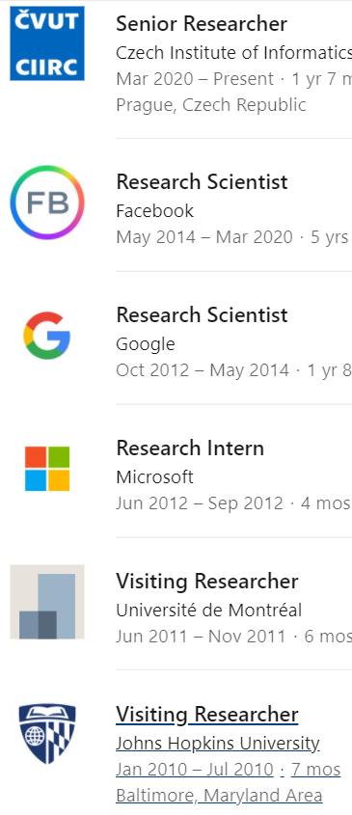
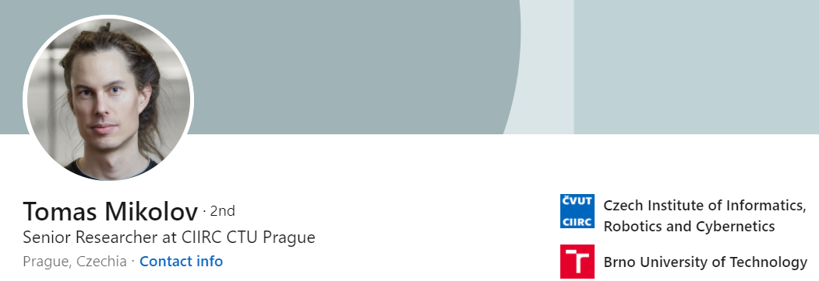
Bc. average 1,56
Mgr. average 1,78
Ph.D. thesis <4 years
Immediately hired by Google
After Marka Zuckerberg’s personal call, move to FB
Did not work in any company during the studies !
Tom managed to have a complete freedom anywhere he was !

Slide 41
personal remarks on being a student at FIT contd.
#6 Attend the lectures and don’t pay attention to Facebook and games, but to the subject taught
There’s an exam
You’ll use the knowledge in other courses and in your work
And even if not, it’s an excellent mental exercise !

Slide 42
personal remarks on being a student at FIT contd.
#8 Lecture recordings should serve as a tool when you miss lecture or study for exam, but not as a replacement of being in the lecture. Using the recordings as the only source for the course 2 days before the exam (Honza’s coefficient is around 1.5x), is pathological and I strongly warn you against it !

Slide 43
Being physically @FIT pays off !

Slide 44
End of the introduction

