Slide 1
ISS 2025/26 intro
Honza Černocký, ÚPGM FIT VUT

Slide 2
Agenda
Organization
Goals
A bit of motivation
Program of the course
Evaluation
Sources, technology and seeing each other

Slide 3
Organization
Web
https://www.fit.vut.cz/study/course/ISS/
http://www.fit.vutbr.cz/study/courses/ISS/public
Organization
2 lecture groups 1 x week, 2h
Wednesday – Czech, Friday - ENGLISH.
Numerical exercise 1 x 14 days, 2h. 5 groups weekly are ENGLISH. Registration in IS VUT, Wed 17th September, 20:07. Tests.
Ex computer labs for self-study + loads of Python notebooks.
Project

Slide 4
Organization II.
Numericals on 28.10. cancelled - please come to any other group within the 14-day block. Please inform the tutor of the target group.
Living Discord discussions with some ISS tutors.
No recognition of points from past years.
Only expceptional cases (Erasmus Socrates outgoing students).
Write me an email.

Slide 5
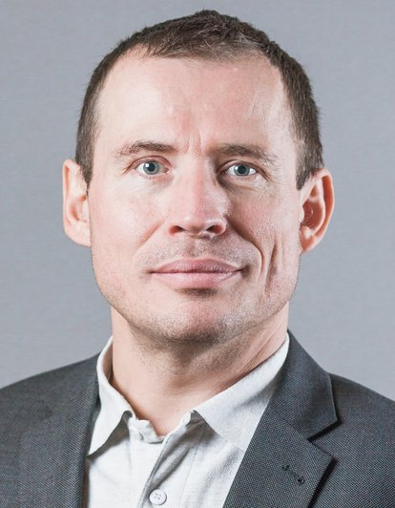
Who will teach the lectures ?
Lectures - Honza Černocký

Slide 6
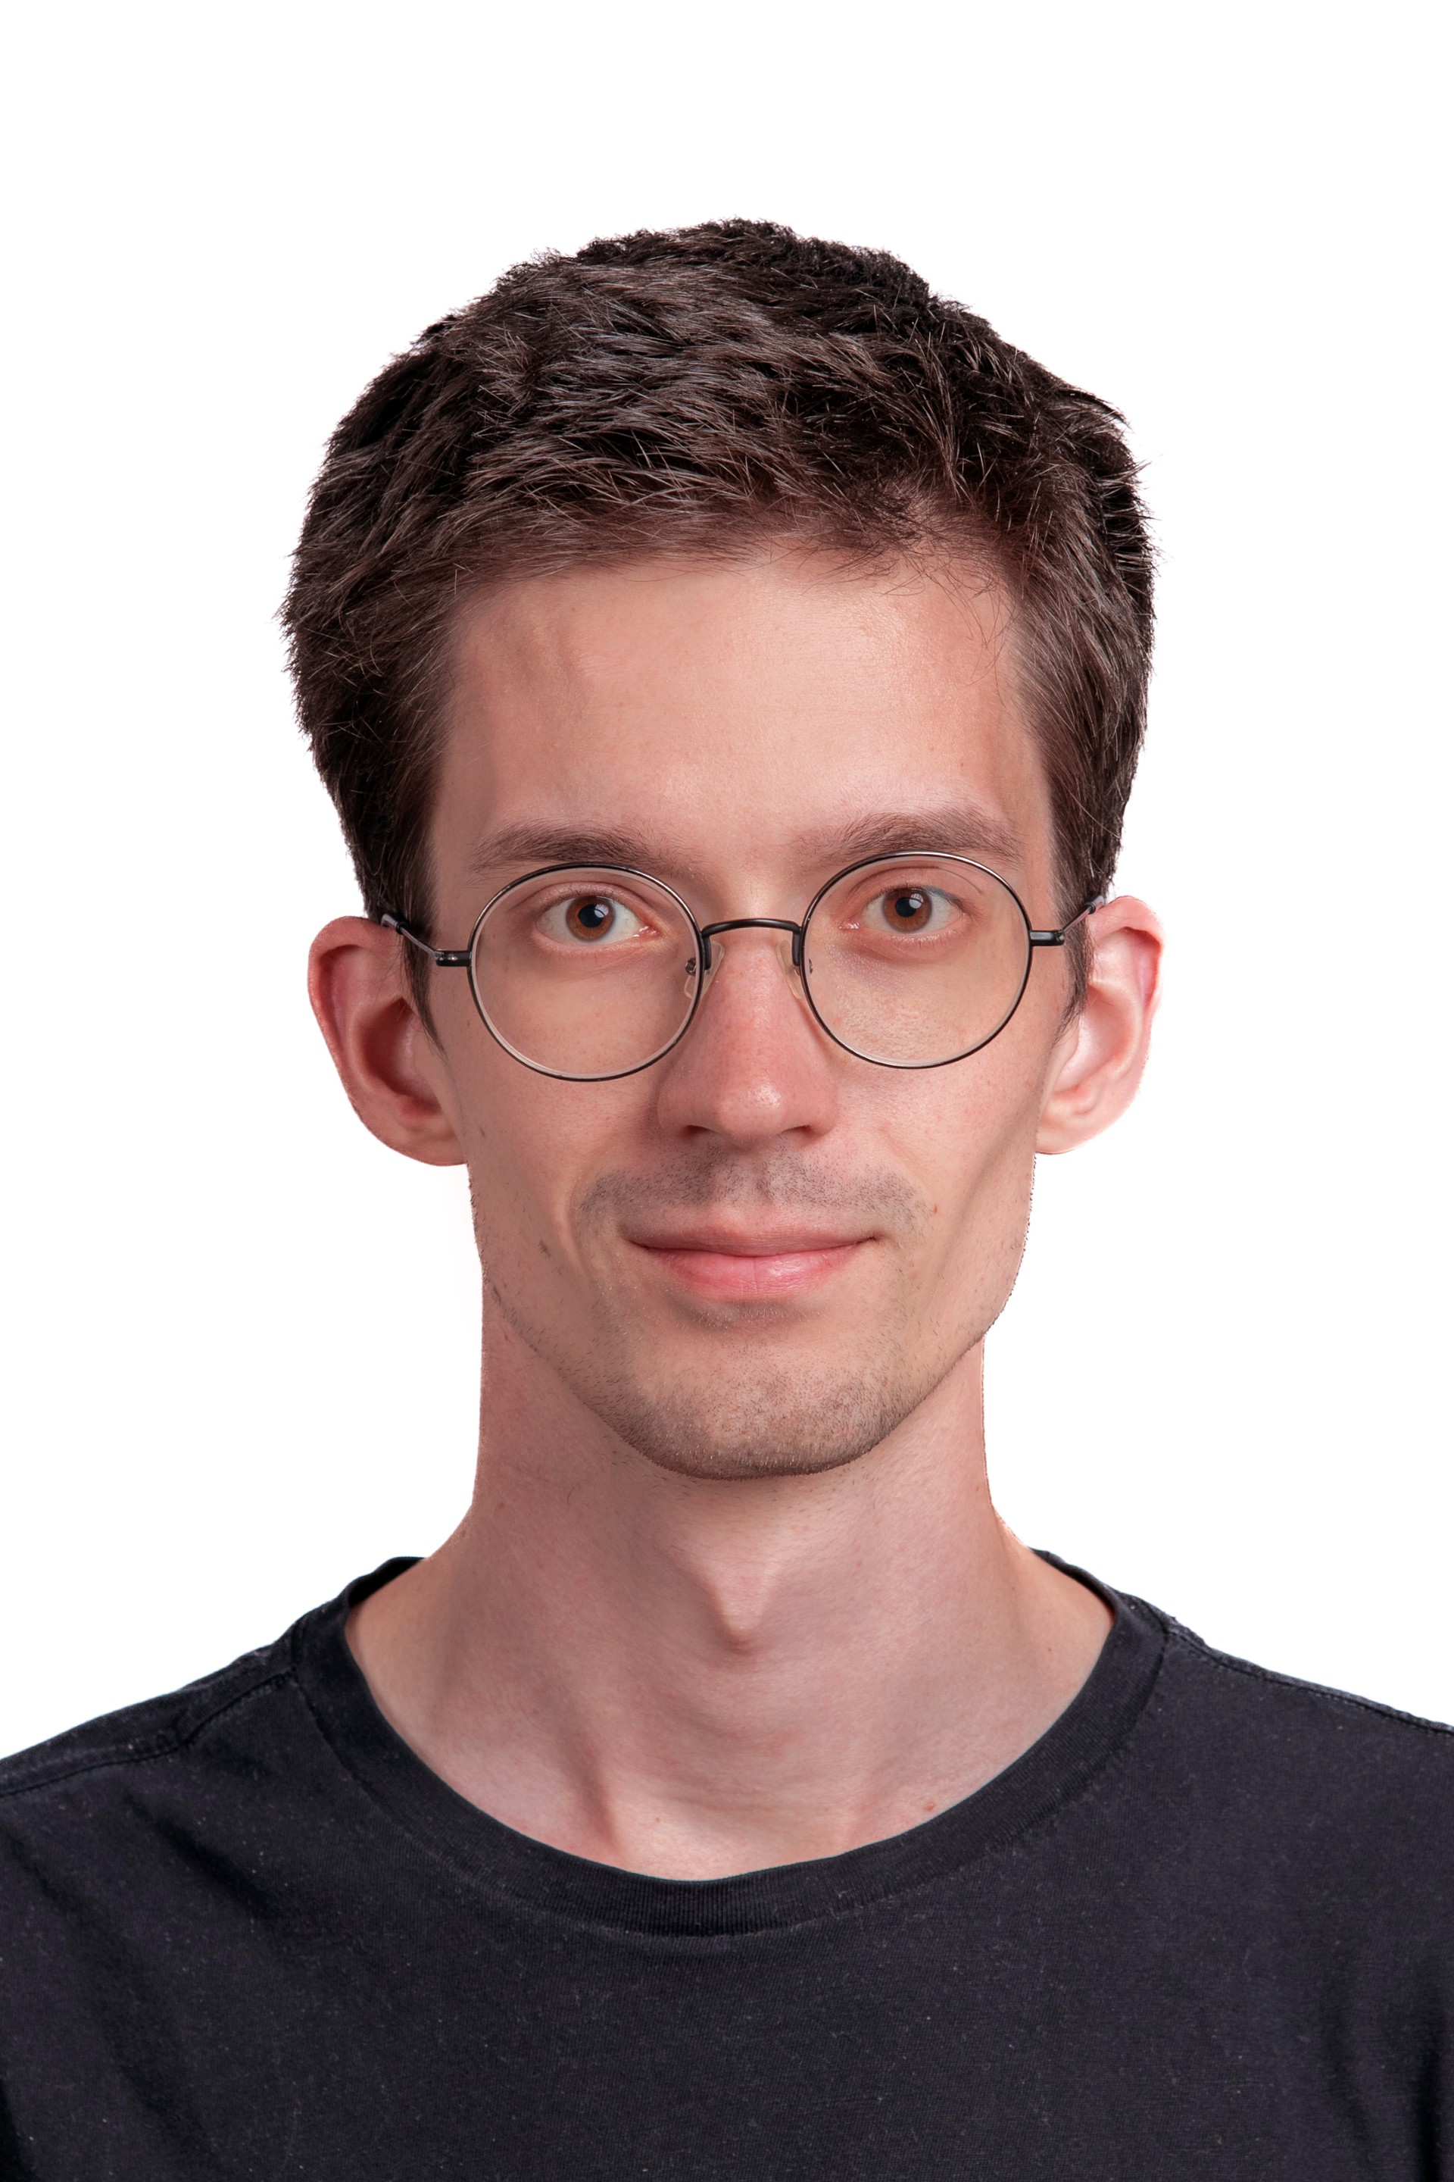
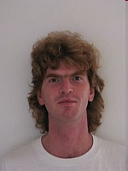
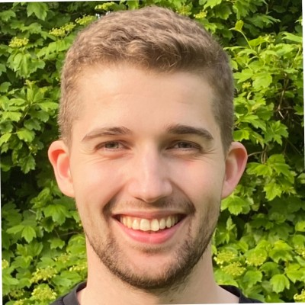
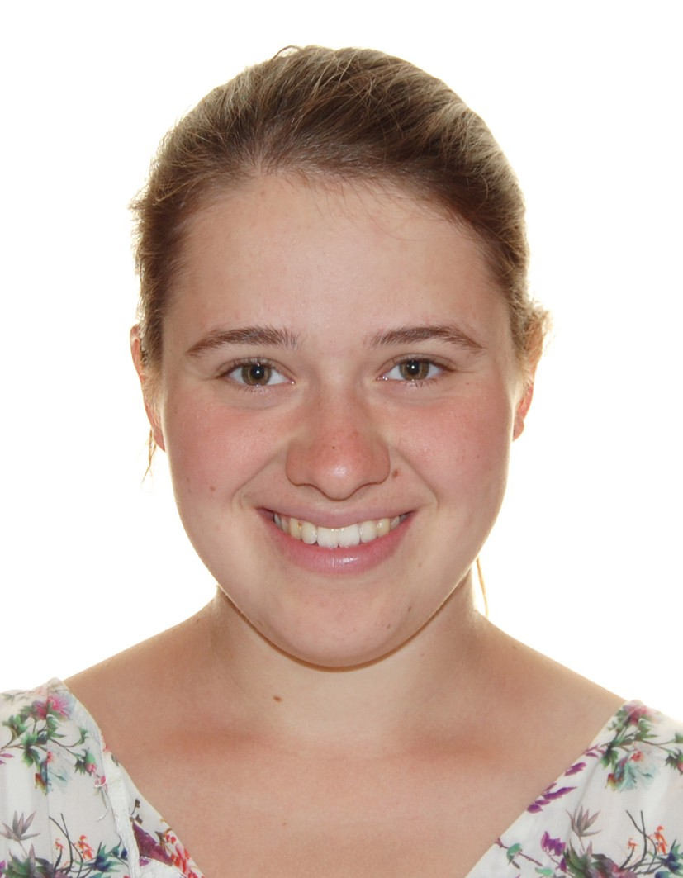
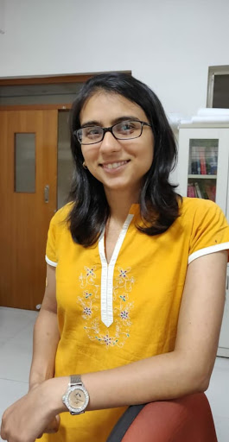
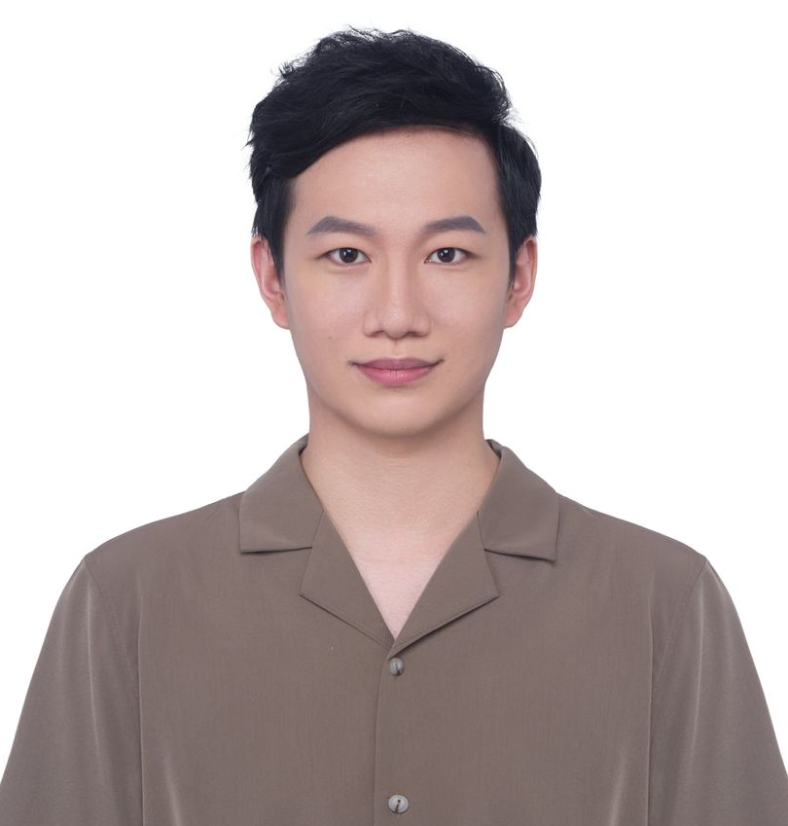
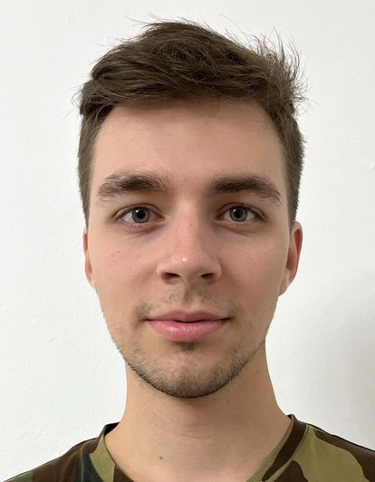
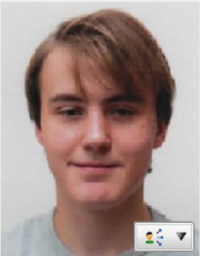
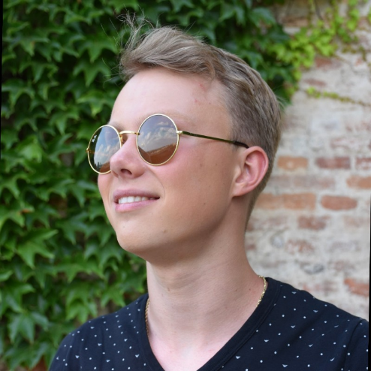
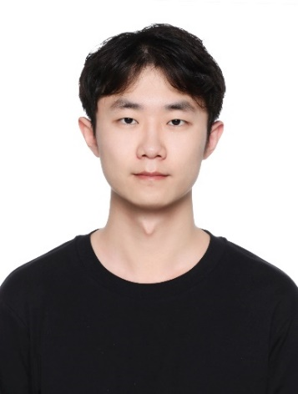
Who will teach the numerical exercises ?
assistants and PhD students of DCGM
Franta Grézl
Alex Polok
Katia Vendrame
Šimon Sedláček
Junyi Peng
Dominik Klement
Prachi Singh
Petr Pálka
Ondra Odehnal
Jiangyu Han

Slide 7
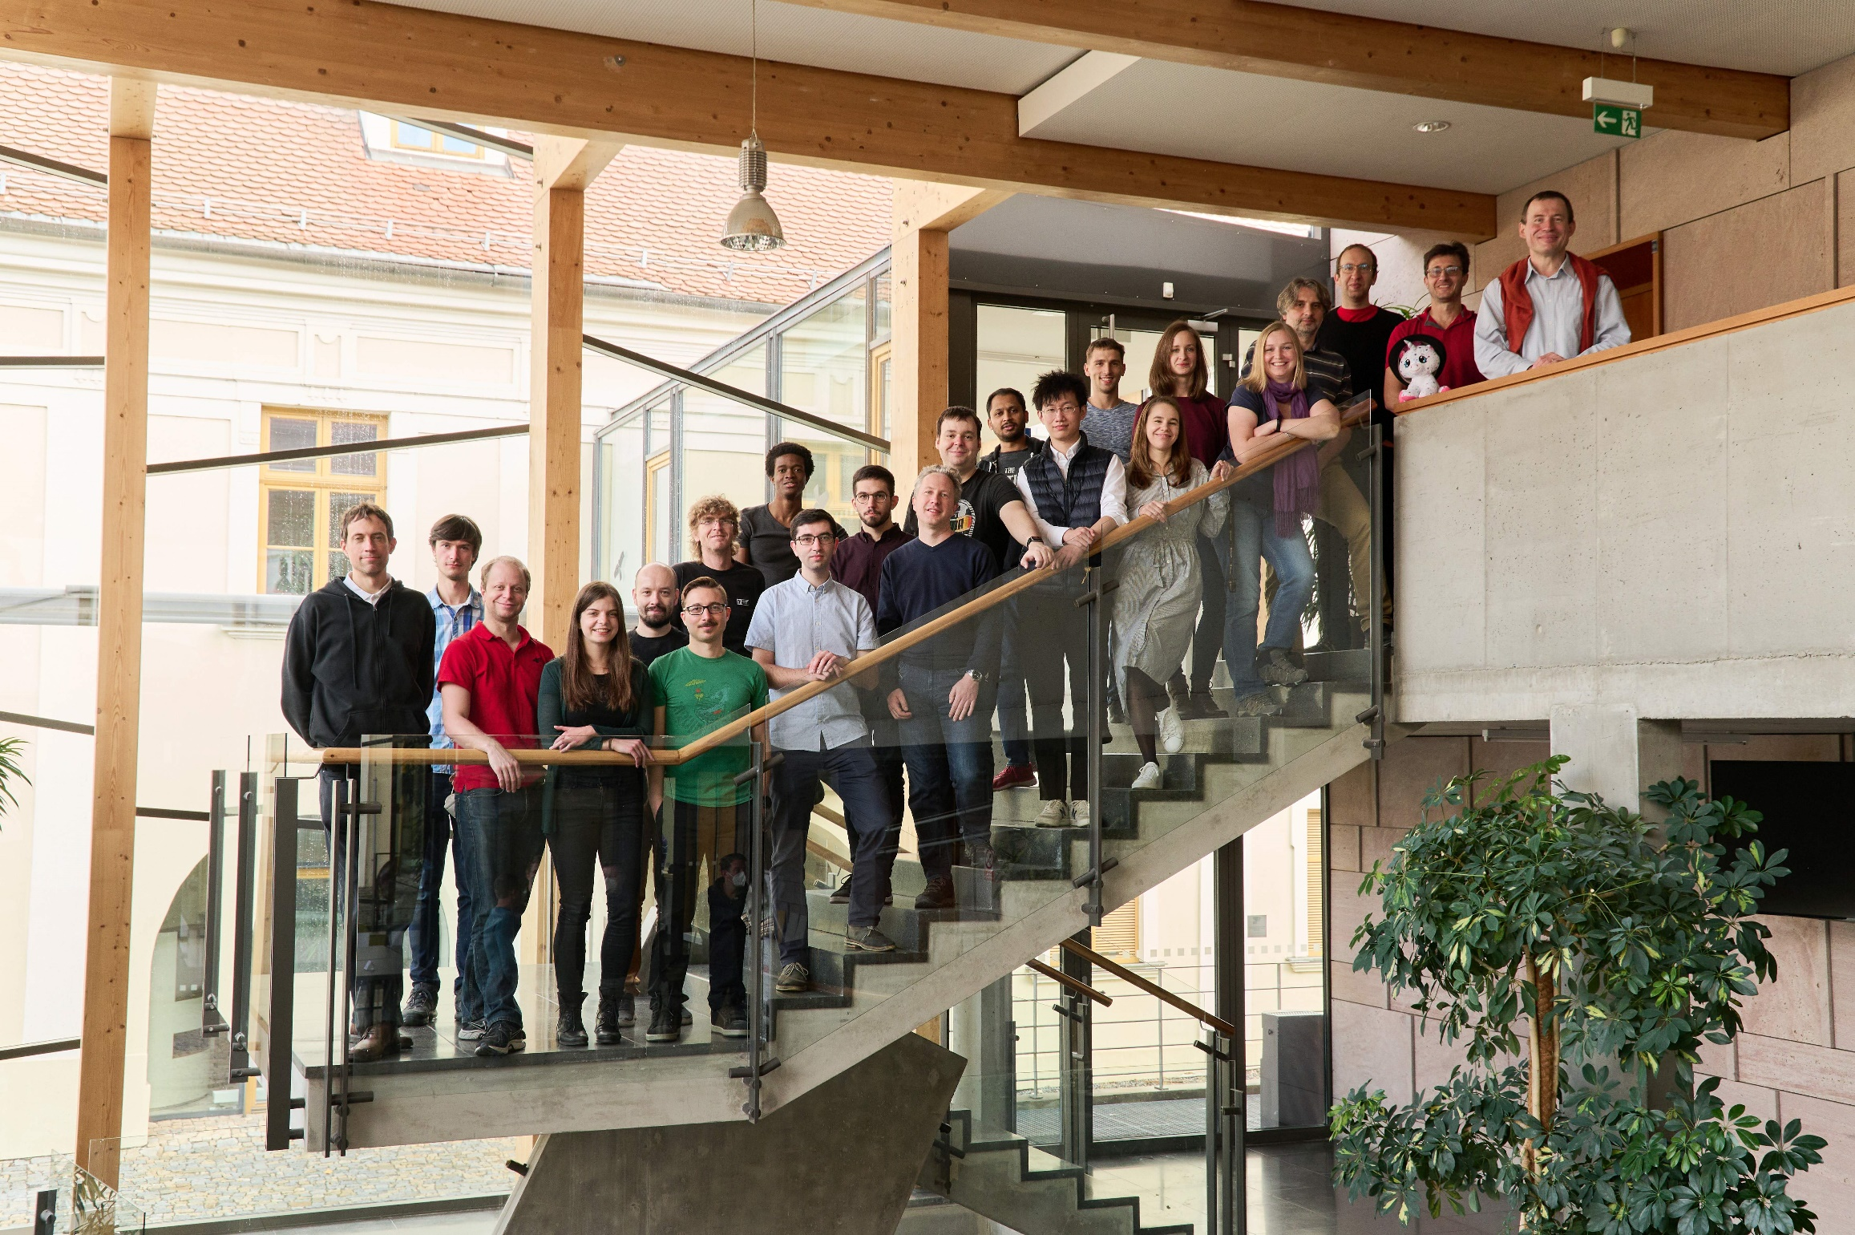









Why English ?

Slide 8
Contacting us
Personally
Anytime before/during/after lecture or exercise.
If other time, please make appointment by email.
Honza can be chased using DCGM secretaries – Sylva Otáhalová and Jana Slámová, next to the staircase in „L“ building
In case of generally interesting question, use Discord.
By email
Please use subject „ISS“
But mind my state of Inbox … currently 3306 messages that are not spam and should get some attention ☹

Slide 9
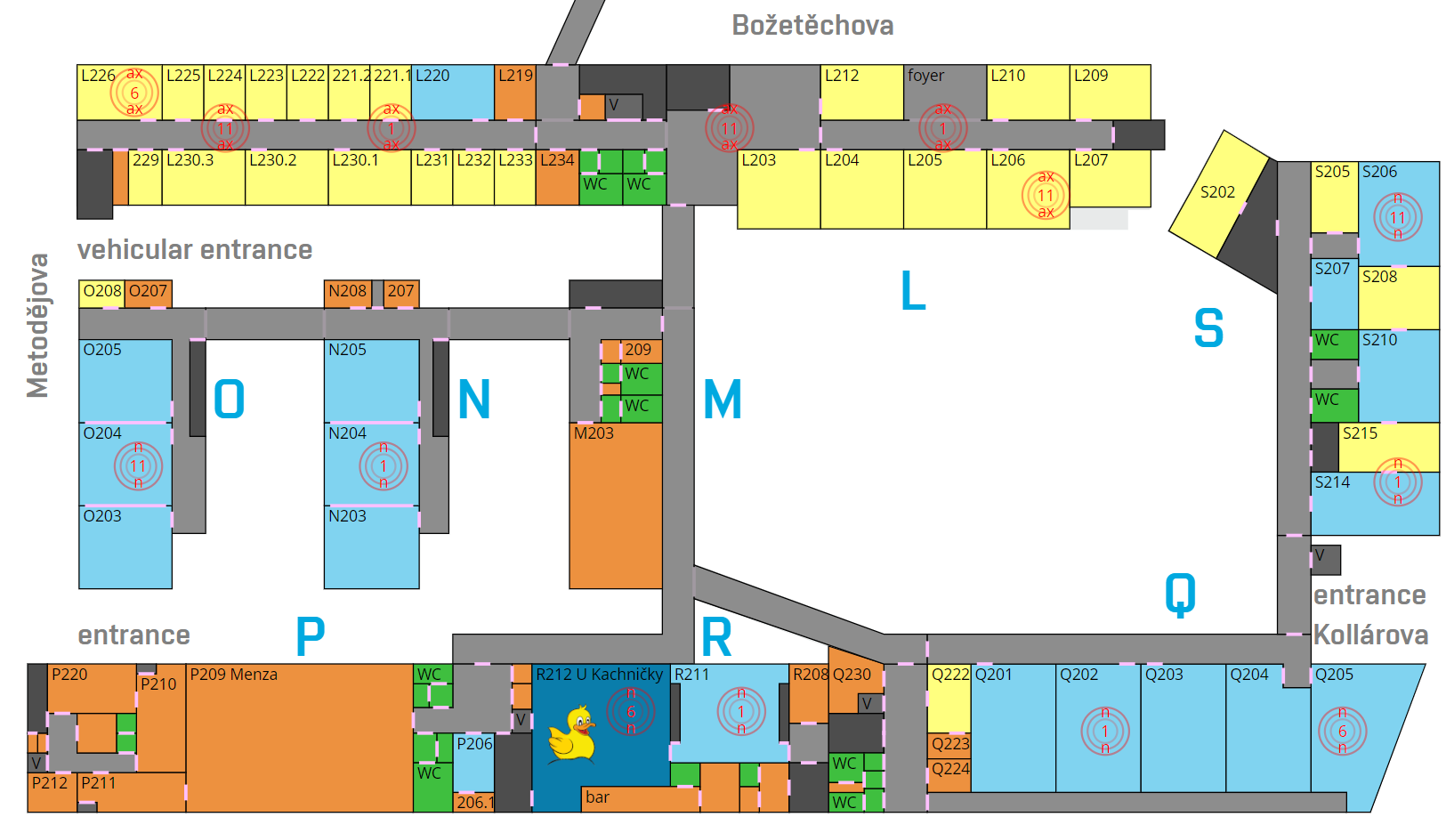
ISS
ISS
sekretariát
ISS
ISS
ISS
ISS

Slide 10
Agenda
Organization
Goals
A bit of motivation
Program of the course
Evaluation
Sources, technology and seeing each other

Slide 11
Goals of ISS
To learn and understand basic theory of signals and linear systems with continuous and discrete time. To introduce random signals. The emphasis of the course is on spectral analysis and linear filtering - two basic building blocks of modern communication systems.

Slide 12
Practically
Filtering – “how to change a signal”.
Spectral analysis - „how to look inside“
Random signals – „nothing around us is 100% sure“
ISS is probably the first course presenting you applied math – using mathematics to do something useful. There’ll be more of them. Knowing math and knowing how to apply it may differentiate you from people just writing code (that will be gradually replaced by AI…).
Notes:
Tady se moc nezakecat !

Slide 13
Agenda
Organization
Goals
A bit of motivation
Program of the course
Evaluation
Sources, technology and seeing each other

Slide 14
Speech encoding for GSM / 3GPP in billions of cellphones worldwide

Slide 15
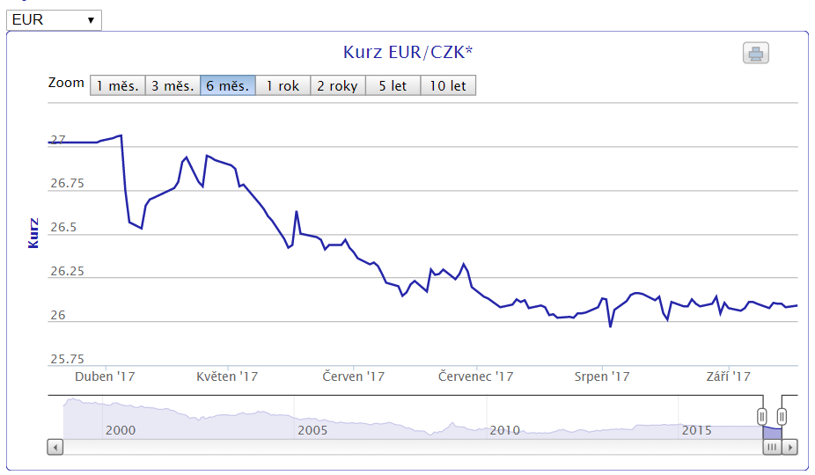
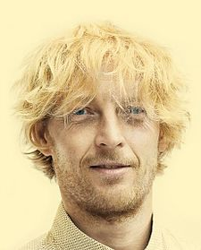
Financial markets are also signals …
Karel Janeček … is co-owner (23.6 %) and chairman of board of RSJ, net worth estimate in 2021: 3 bn CZK.

Slide 16
Demo - MP3
„Physical“ demonstration
Notes:
Play the sounds 0 no difference is audible.
Ask a student to say something and shout into it: demo of frequency masking Ask a student to say something and clap the door very loudly: demo of temporal masking.

Slide 17
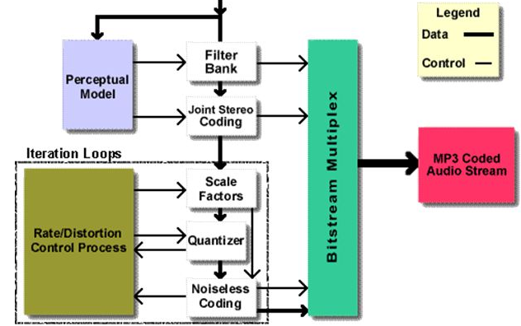
MPEG3 Layer 3 (MP3) encoding
Source: Frauenhofer Institut, Germany.
Notes:
Both are used in the mp3 encoding that has billion uses worldwide.

Slide 18
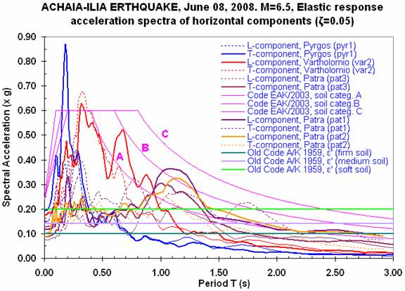
Not just audio and speech – geo-signals

Slide 19
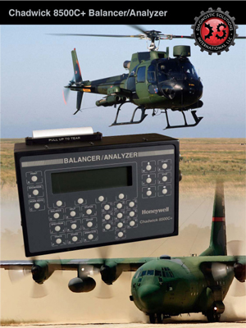
And it can save your life … vibration analysis

Slide 20
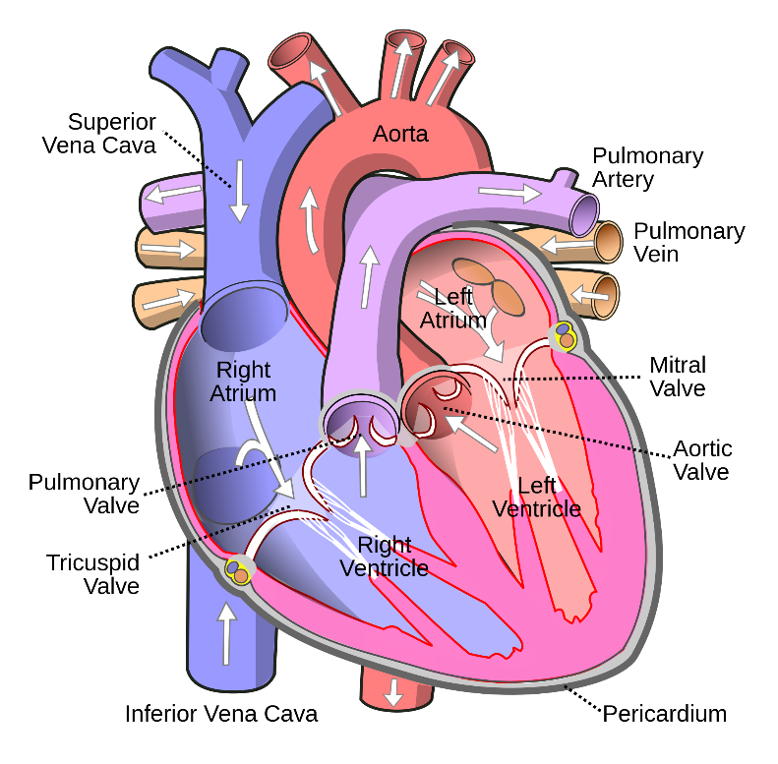
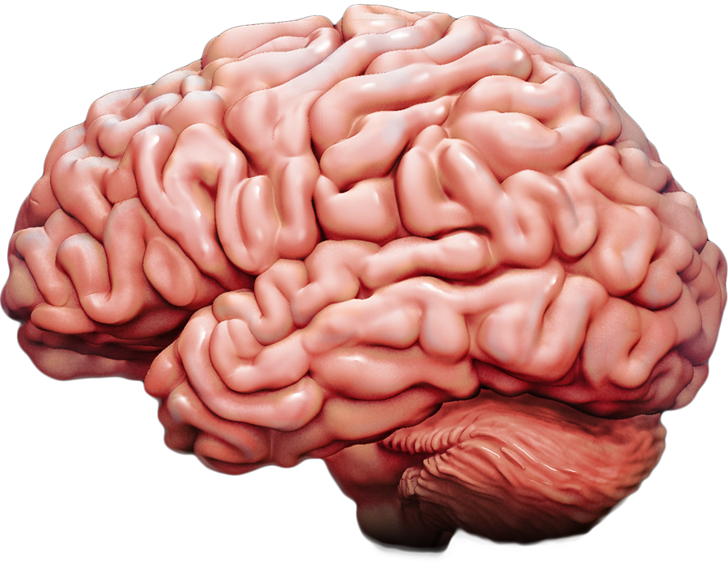
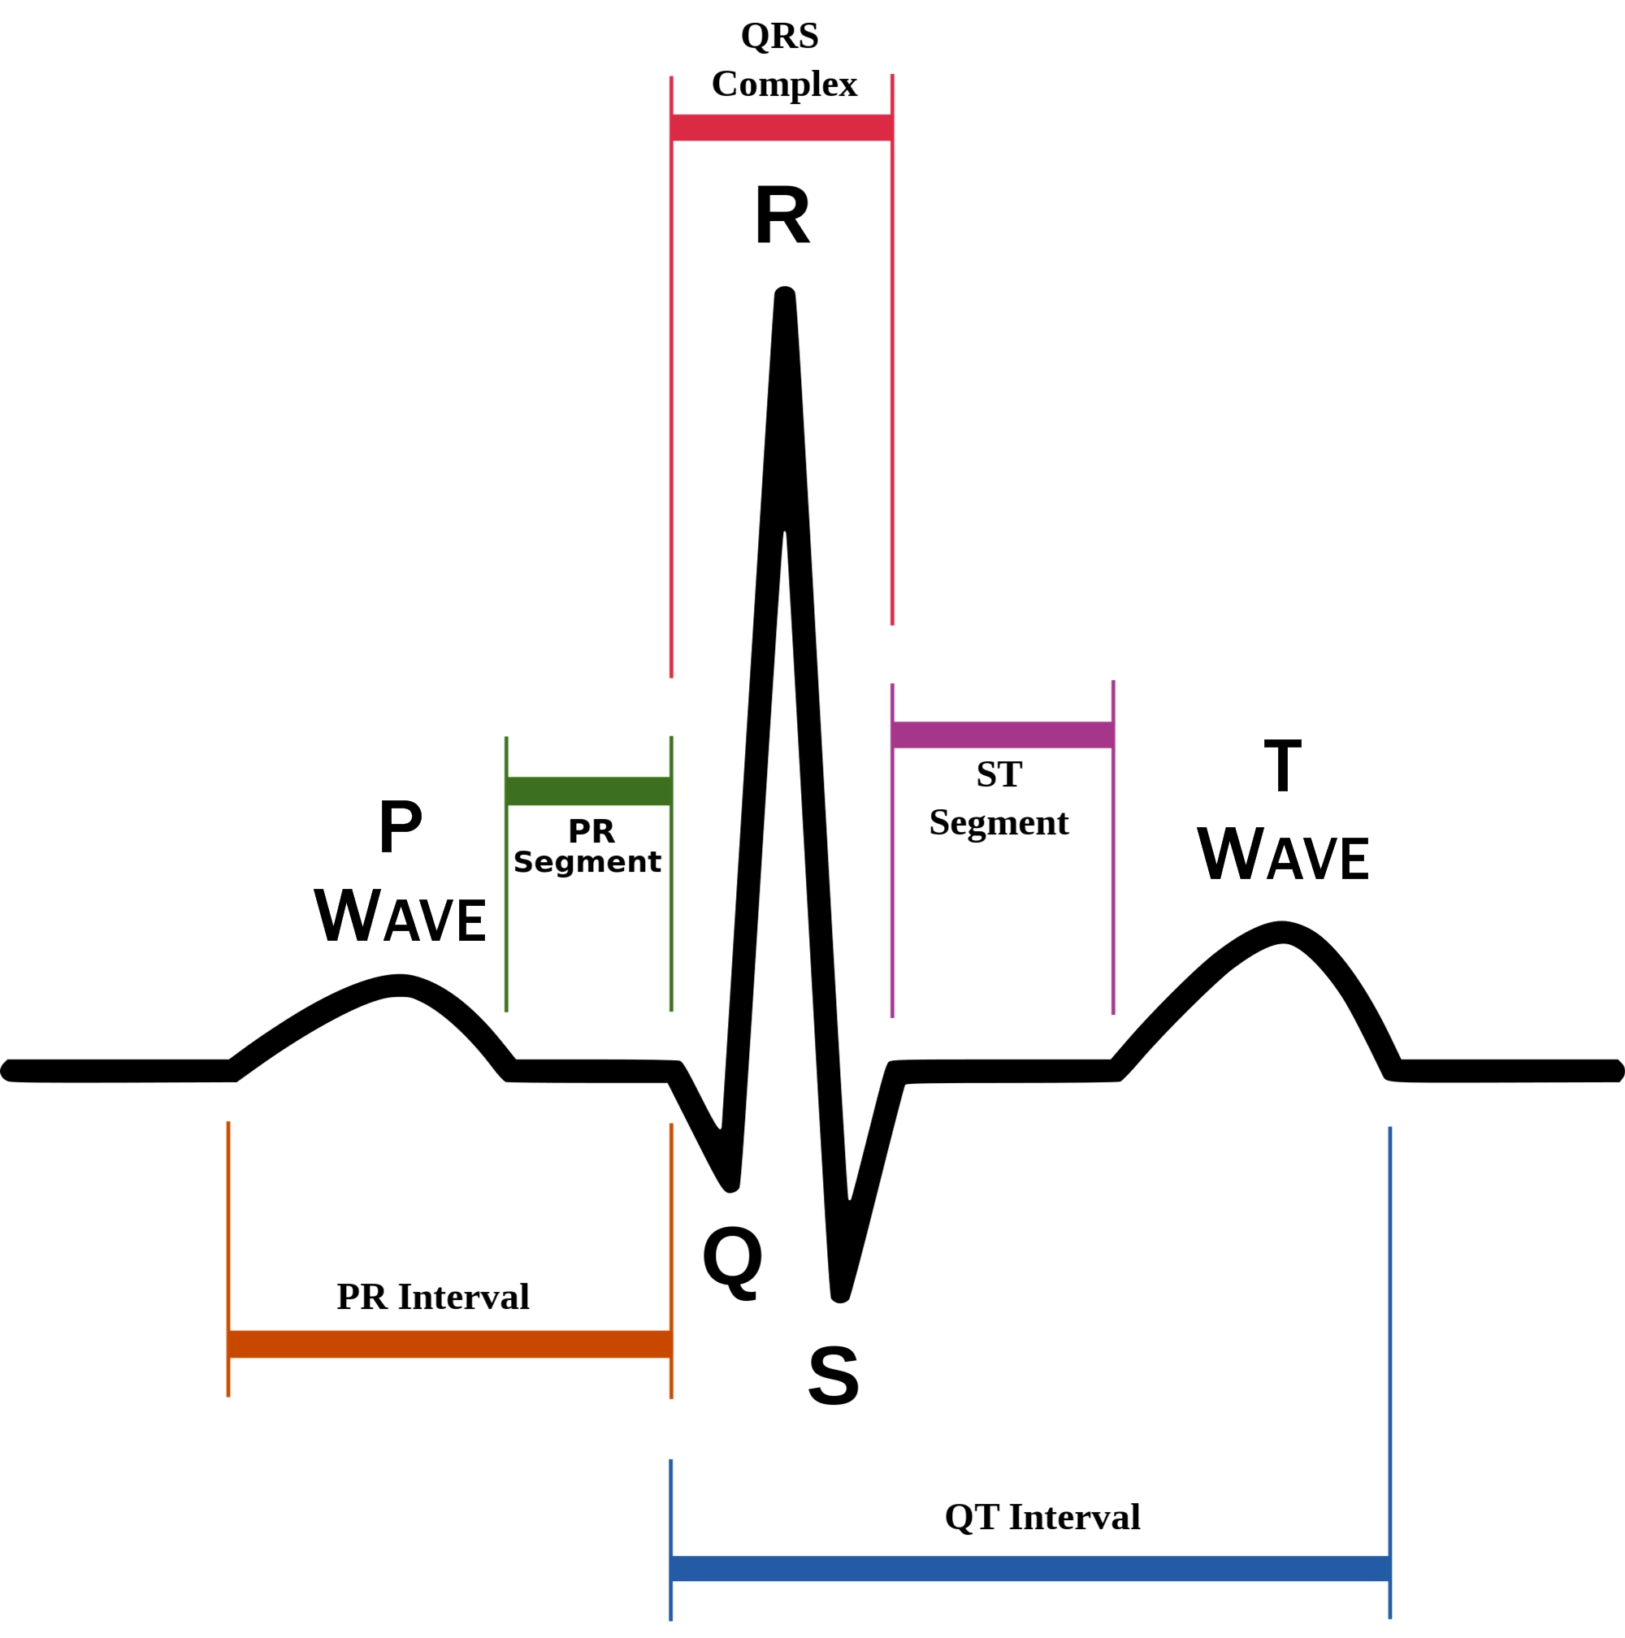
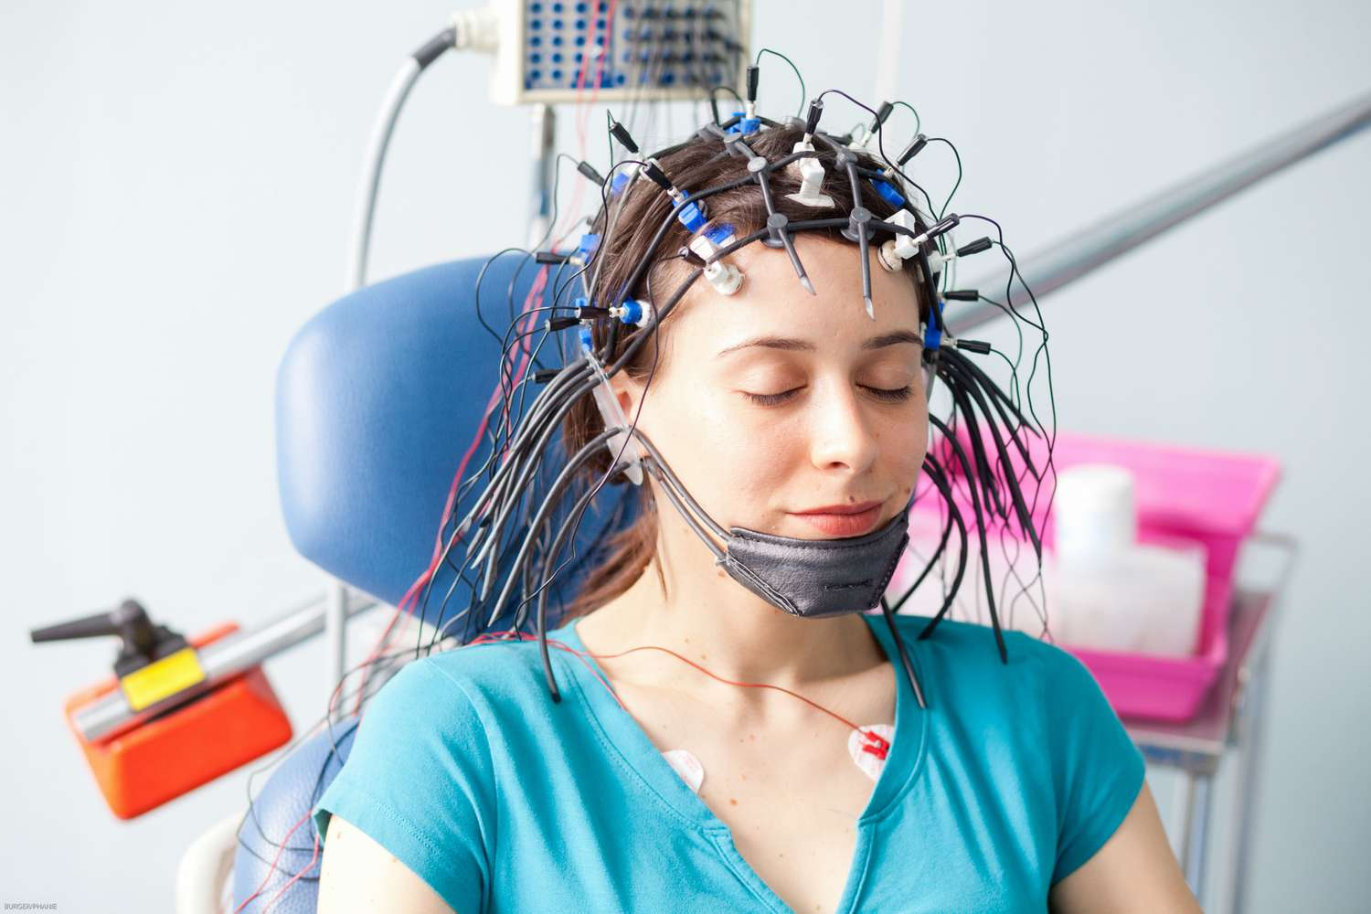
You can take signals from your body …

Slide 21
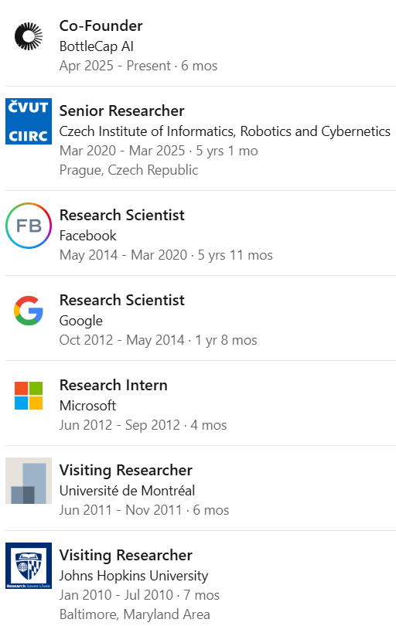
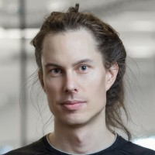
… or convert words to signal
MIKOLOV Tomáš, KARAFIÁT Martin, BURGET Lukáš, ČERNOCKÝ Jan a KHUDANPUR Sanjeev. Recurrent neural network based language model. In: Proceedings of the 11th Annual Conference of the International Speech Communication Association (INTERSPEECH 2010). Makuhari, Chiba: International Speech Communication Association, 2010, s. 1045-1048. ISBN 978-1-61782-123-3. ISSN 1990-9772.

Slide 22
ISS -> features for artificial intelligence
Models
Feature extraction
Evaluation of probabilities … likelihoods … scores … some values
“decoding”
input
output

Slide 23
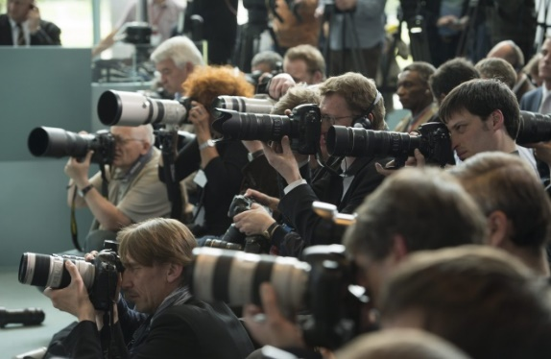

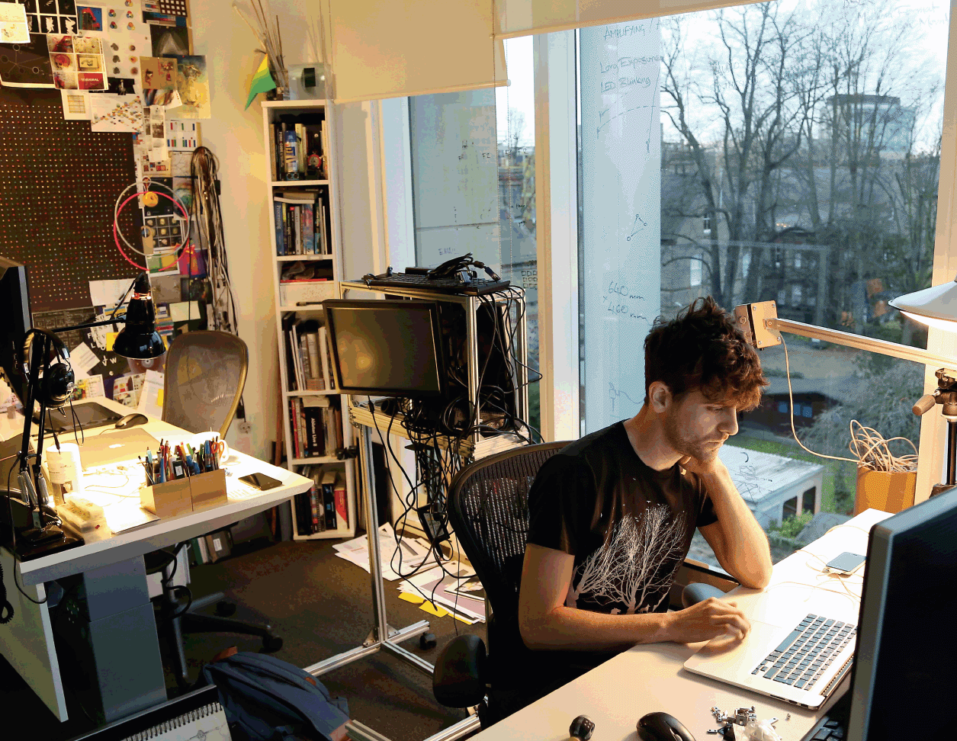
Today, everything is artificial intelligence (maybe time to rename FIT to “FAI”) !
Artificial intelligence !
Machine learning
Recognition, detection, classification, regression, Fourier transform, filtering…

Slide 24
Agenda
Organization
Goals
A bit of motivation
Program of the course
Evaluation
Sources, technology and seeing each other

Slide 25
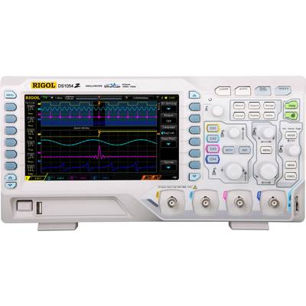
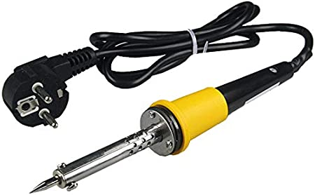
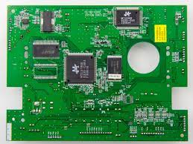

Classical program of signals and systems in electrical engineering programs
Analog world
Sampling
Digital world

Slide 26
ISS program at FIT – “Digital first”
Introduction and math behind.
Spectral analysis – from intuition on projections to derivation of Discrete Fourier Transform (DFT)
Practical use and properties of DFT
Introduction to digital filtering, differential equation, implementation of filters, convolution
Frequency response and stability of digital filter. Applications of filtering.
Random signals - introduction.
Random signals II - correlation, spectra, white noise.
Processing of 2D signals - images.
Analog world - continuous time signal, Fourier transform, estimation using DFT.
Fundamentals of systems - properties, impulse response, schematics, differential equation, frequency response, stability.
Analog to digital and vice versa - sampling and quantization
Summary of all filtering and frequency analysis – playing the Fourier game (or entering Fourier hell ?)
Notes:
You can also mention the IFJ project that is destroying pretty much the 2nd part of semester …

Slide 27
Lecture slides and Python notebooks
Attempt for self-containing slides.
Python notebook(s) accompanying every lecture are an integral part of it to show you that the math is actually very easy to implement !
Making them available as Google Colab notebooks.
Just open and Ctrl-Enter to run a box with code !
Or install Anaconda and run them locally.
Use it wherever you want
BP, DP, other courses
Your professional life, price list:
bottle of wine for your 1st million CZK made using these notebooks
big black Mercedes for the 1st billion CZK
Use them it in ISS project !

Slide 28
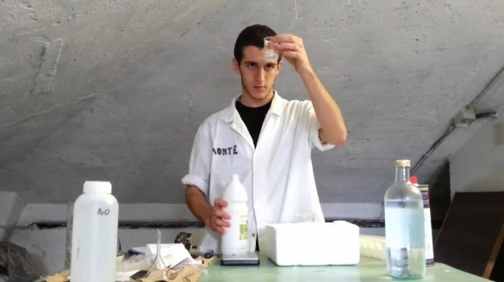
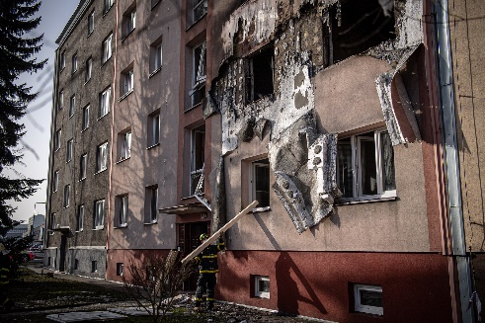
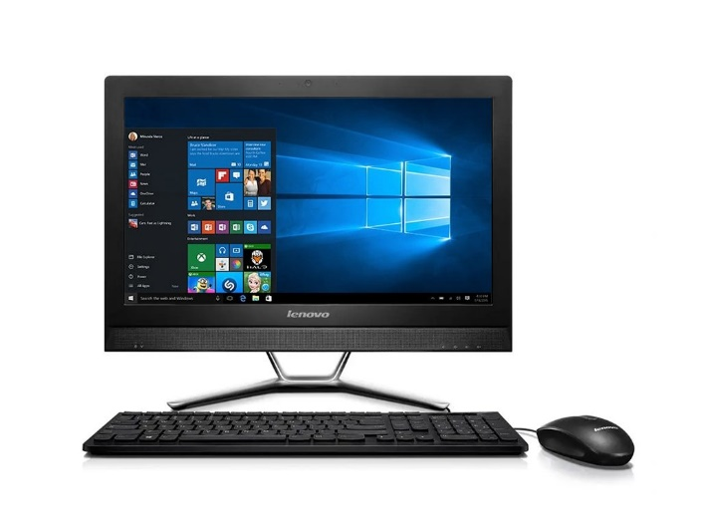
Python does not bite or explode !
Change the parameters, tweak the code, modify it, torture it …
Please don’t expect a beautiful object-oriented code (I am a stupid electrical engineer after all …)

Slide 29
Numerical exercises
Math: Complex numbers, cosines and complex exponentials and operations therewith
Discrete time Fourier transform
Digital Filters
Digital Filters II
Random signals
Continuous signals including sampling

Slide 30
Numericals – organization
No PCs, paper and pencil !
Well, a PC is handy in 2 of them – Google-sheets and some Python
Complete assignments and solutions on the Web.
Tests at the end of each exercise – 2 points each.
Simple classification rules:
No idea, nothing: 0
At least something: 1
Most of it correct: 2

Slide 31
Project
Study part – couple of Python NBs (but you should also play with the ones from lectures!)
The actual project
We prepare a Google Colab NB.
You solve the project, code and document in Colab.
We want an exported PDFs and a link to your Colab.
Masochists can use whatever other language / environment (we’ve seen also Matlab, Octave, C++, Java, C#) – needs to run on FIT Windows or Linux.
Some ideas in place, chase me so that it is assigned soon !

Slide 32
Project evaluation
Everything working and good doc – full number of points
Bonus exercise
Something harder for smart and curious students.
No points, but recognition for the best/most innovative solution
An option - individual project
Can be linked to BP, work for company, project practice, hobby, music …
Must include work on signals (not web, not e-shop …)
Contact me ASAP.

Slide 33
Agenda
Organization
Goals
A bit of motivation
Program of the course
Evaluation
Sources, technology and seeing each other

Slide 34
ISS evaluation
Tests in numerical exercises each 2 pts, total max 12 pts.
Half-semestral exam, NOTHING allowed, full text, max 19 pts. 46th calendar week (9th semester week).
project – max 18 pts.
Final exam – max 51 pts, NOTHING allowed, list of equations will be available. Full text.
Limit for passing: 17 pts.

Slide 35
Agenda
Organization
Goals
A bit of motivation
Program of the course
Evaluation
Sources, technology and seeing each other

Slide 36
Litterature and Internet sources
http://www.fit.vutbr.cz/study/courses/ISS/public/ - full set of slides and Python notebooks.
Oppenheim A.V., Wilski A.S.: Signals and systems, Prentice Hall, 1997.
Jan, J., Kozumplík, J.: Systémy, procesy a signály. Skriptum VUT v Brně, VUTIUM, 2000.
Šebesta V.: Systémy, procesy a signály I., Skriptum VUT v Brně, VUTIUM, 1997
Text for ISS being created – cca 1/3 ready + lots of Python code, on ISS web, slides are better...
Wikipedia
Youtube demos (see ISS web for some links)
Online lectures from elsewhere (MIT, Stanford)

Slide 37
Streaming and recordings
Both CZ and EN lectures are streamed and recorded
Standard FIT video servers https://video1.fit.vutbr.cz/index.php?categ_id=835
YT… TBD

Slide 38
personal remarks on being a student at FIT
Advices rather for freshmen, but the start to the 2nd year is critical:
#1 Don’t let the liberty catch you by surprise – we have no supervisor. No guard. You’re far from parents. Good results at FIT mean at least 100% involvement. The responsibility is on you.
#2 Consider the teachers as partners and equals – just a bit more experienced. FIT is no primary school, we like discussion, comments, and criticism and students that challenge us !

Slide 39
personal remarks on being a student at FIT contd.
#3 In case you’re here because
You want to learn from people that are doing top research in IT and have started top businesses in IT,
Want to work on yourself and be the best
Are ready to become the elite of this nation and in future manage companies, cities, maybe the state or the EU.
Want to actively build your social networks among other students and teachers.
Want to see how our partners abroad are doing IT …
Welcome ☺

Slide 40
personal remarks on being a student at FIT contd.
#4 If you’re here because
You think that you know everything and need just “the degree”.
You programmed one web portal or did some good ChatGPT prompts and think that this is the ultimate end of IT
Want to somehow survive till 26 years and have the health insurance paid by the state.
Want to survive without any math.
are you sure you’re at the right place ? ☹

Slide 41
personal remarks on being a student at FIT contd.
#5 Be very careful about working while studying
Holiday work is good but the companies will like to have you working full time also during the academic year.
We can’t forbid this to you but the studies is then for nothing and you’re losing your value on the labor market.
You’ll stay stupid and those who study harder will pass you.
They will be doing creative things and manage, you’ll obey and complain.
The star-graduates of FIT really DID study !

Slide 42
Don’t work while studying or does work on reasonable time-share in a company that is a partner of FIT.
Work 100% during studies
salary
study
Professional life
time

Slide 43
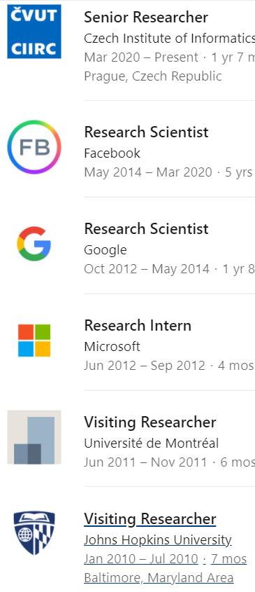

Bc. average 1,56
Mgr. average 1,78
Ph.D. thesis <4 years
Immediately hired by Google
After Zuckerberg’s personal call, move to FB
Did not work in any company during the studies !
Tom managed to have a complete freedom anywhere he was !

Slide 44
personal remarks on being a student at FIT contd.
#6 Attend the lectures and don’t pay attention to social nets and games, but to the subject taught
There’s an exam
You’ll use the knowledge in other courses and in your work
And even you don’t, it’s an excellent mental exercise !

Slide 45
personal remarks on being a student at FIT contd.
#7 Lecture recordings should serve as a tool when you miss lecture or study for exam, but not as a replacement of being in the lecture. Using the recordings as the only source for the course 2 days before the exam (I was told my coefficient is about 1.5x), is pathological and I strongly warn you against it !
Support for my claims ? Watch any video, or read any article or book by neurologist MUDr. Martin Jan Stránský …

Slide 46
Being physically @FIT pays off !

Slide 47
End of the introduction

