Slide 1
Spectral analysis II
Honza Černocký, ÚPGM
Please open Python notebook 03_spectral_2

Slide 2
Agenda
DFT refresher
DFT of typical signals
Properties of DFT
Some more math on DFT
Spectrogram and what can we do with it
Summary and “take-home” messages
<number> / 43

Slide 3
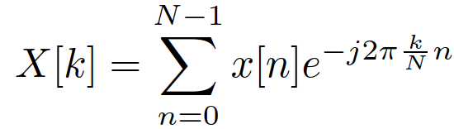
Discrete Fourier transform (DFT) analysis
Input: signal x[n] of N samples
Output: N complex coefficients X[k] providing the information on
  Frequency – index k, corresponds to normalized frequency k/N and regular frequency k/N F_{s}. Normalization and de-normalization of frequency involves a simple division or multiplication by sampling frequency F_{s}.
  How much ? Magnitude (absolute value, modul) |X[k]|.
  How shifted ? Phase (angle, argument, phase shift) arg X[k].
Easy to implement by definition but using FFT is much faster
(for N = 2^{b})
<number> / 43

Slide 4
DFT analysis II.
For real input signals x[n], coefficients X[k] are symmetrical (complex conjugate X[k] = X*[N-k]:
  |X[k]| = |X[N-k]| and arg X[k] = -arg X[N-k]
… so that it is enough to store and visualize the spectrum only from
k = 0 to k = N/2. This corresponds to normalized frequencies 0 … ½ and regular frequencies 0 … F_{s}/2.
Attention, the number of coefficients to retain is
NOT N/2 but N/2+1 !!!
#dft_anal
<number> / 43

Slide 5
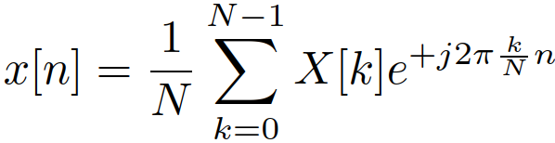
DFT synthesis - IDFT
Input: N complex coefficients X[k]
Output: N samples of signal x_{s}[n].
  In case we did nothing with the spectrum, x_{s}[n] is exactly the same as x[n].
Synthesis by DFT involves summing pairs of complex exponentials at k and N-k running “against each other”, creating one shifted cosine – see derivation in the last lecture.
  When computing, DFT/FFT can produce very small imaginary components, better to kill them using np.real().
#dft_synt
<number> / 43

Slide 6
Agenda
DFT refresher
DFT of typical signals
Properties of DFT
Some more math on DFT
Spectrogram and what can we do with it
Summary and “take-home” messages
<number> / 43

Slide 7
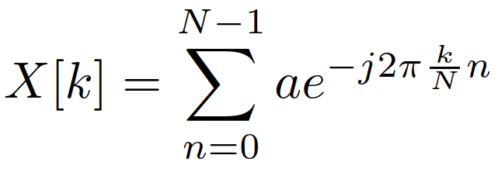
DFT of a D.C. (stejnosměrný) / constant signal
x[n] = a
For k=0, the sum is X[0] = Na.
For everything else, the sum of k “revolutions” of the complex exponential is zero.
Intuition check: D.C. has just zero frequency, everything else should be zero - OK
Very slow signal <=> narrow spectrum
#dft_of_constant
<number> / 43

Slide 8
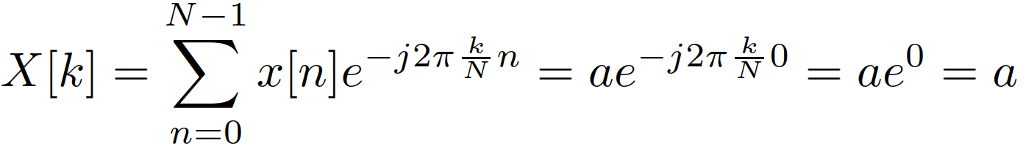
DFT of a pulse (impuls) at time zero
x[0] = a, otherwise x[n] = 0.
Only the term for n=0 will produce something - here, the complex exponential is exp(0) = 1, so X[k] = a for all k’s
Intuition check: the pulse is very fast (like a click), should contains lots of frequencies - OK
Very fast signal <=> wide spectrum
#dft_of_pulse
<number> / 43

Slide 9
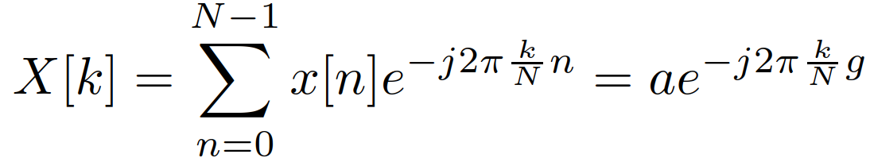
DFT of a shifted pulse (posunutý impuls)
x[g] = a, otherwise x[n] = 0. g is the position of the pulse.
Only the term for n=g will produce something - here, the complex exponential is exp(-2π g k / N), so
  X[k] = a exp(-2π g k / N).
  Magnitude is |X[k] | = a
  Phase is arg (a exp(-2π g k / N)) = -2π g k / N … linear with slope -2π g / N
For visualization, you might try using np.unwrap to see values of phase outside of –π … +π.
Intuition check: the signal only shifted, the magnitudes should not change, shift should be reflected in phases - OK
#dft_of_shifted_pulse
<number> / 43

Slide 10
DFT of a rectangular pulse (pravoúhlý / obdélníkový impuls)
x[n] = a for n = 0…g-1, zero otherwise (so it will have g non-zero samples).
No derivation (we’ll see this later) but remember that wide signal should have narrow spectrum and narrow signal should have wide spectrum …
#dft_of_rectangle
The function we see is sin(x) / x, so called cardinal sine (kardinální sinus). We’ll be seeing this a lot …
For narrow rectangles, the cardinal sine lobes (laloky) seem to be distorted as we move towards F_{s} /2 – this is caused by aliasing (more about it in the lecture on sampling)
<number> / 43

Slide 11
DFT of a “symmetrical” rectangular pulse
Trying to make the rectangle symmetrical so that the phase is not shifted.
Will work only for odd (liché) g by setting the same amount of samples for negative n as for positive n. For example, for g = 5, set
x[-2 … +2] = a
However, we can not work with negative indices, so we need to consider the end of input buffer as negative indices …
x[0 … 2] = a, x[N-2] = a, x[N-1] = a
#dft_of_symmetrical_rectangle
The phase is either 0 or ±π, this means that this spectrum is real – just positive or negative numbers !
Symmetrical signal <=> real spectrum
<number> / 43

Slide 12
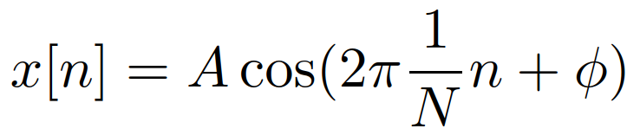
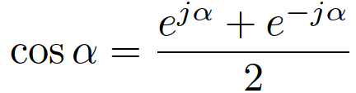
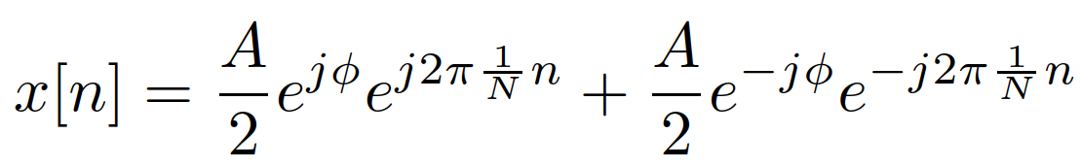
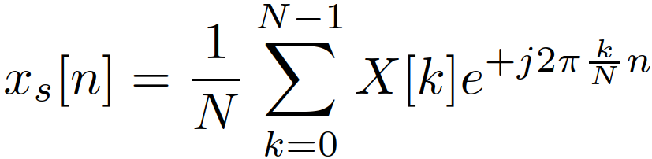
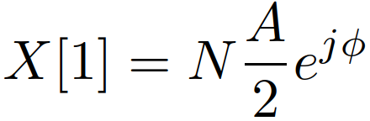
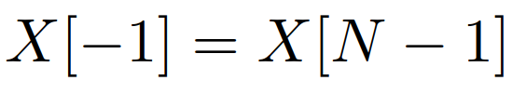
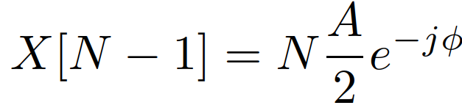
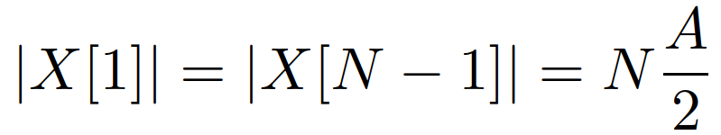

DFT of cosine with the period of N samples
We could run the DFT analysis, but let’s work the “lazy” way:
  Split the cosine using our well known formula
  Write the synthesis formula next to it and try to see if we can find respective coefficients
  We easily find
  The next one we could find is X[-1] which is not there (can use only indices from 0 … N-1) but we already know about the symmetry:
Coefficients X[1] and X[N-1] for a cosine are almost the same, except for the phase
#dft_of_cos1 - OMG, what’s going on with the phase ???
<number> / 43

Slide 13
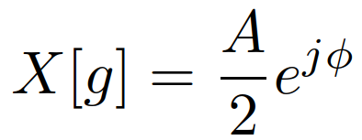
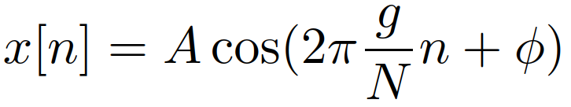
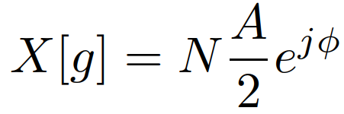
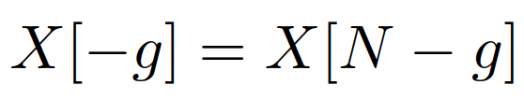
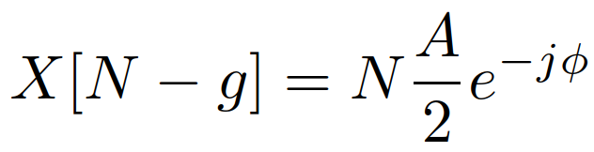
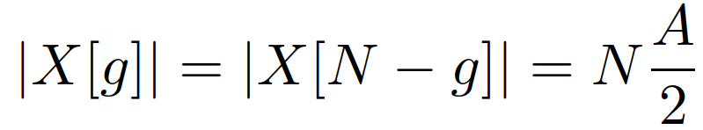

DFT of cosine with the more periods in N samples
We could find the values of coefficients exactly in the same way, just looking at index g instead of 1
Exactly the same, only the index will change:
  Magnitudes are the same, arguments opposite:
#dft_of_cos_multiperiod
<number> / 43

Slide 14
DFT of a cosine that does not fit exactly N samples …
In real life, we can not say “I’m going to analyze only signals with period od 128 samples”. We obtain an input and we have to go …
So it can happen (and it regularly happens) that our cos is “badly cut”.
Remember: any sharp edge in a signal generates high frequencies.
#dft_of_general_cos
For a period that does not fit into N exactly k times (“wrong cut” of cos), the spectrum is “leaking” to neighboring frequencies.
<number> / 43

Slide 15
Why ? Because we’re windowing our signal …
x[n] = w[n] s[n], where w[n] is the window function.
In case of multiplication of signals in time, we’ll have a convolution (konvoluce) of spectra in frequency.
More about convolution in the filtering lecture, for cosine signal, it simply means, that the spectrum of w[n] shifts to its frequency
So what is the spectrum of our window ?
  Analyzing N samples is not enough, we’d get a constant (and we know it’s spectrum is a single coefficient).
  Increasing N to more samples by zero padding: 256 -> N_{fft} = 4096 (16x)
  Zoom only on low frequencies to see details … and showing only magnitude
  … also showing where are the points of length N DFT !
#dft_rectangle_zeropad
<number> / 43

Slide 16
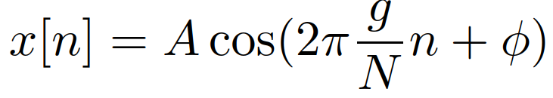
Better frequency resolution for a “good” cosine
#dft_of_cos_multiperiod_detail
Here, we see the cardinal sine, but the frequencies of the original DFT sample it exactly at zero values !
<number> / 43

Slide 17
Better frequency resolution for a “bad” cosine
#dft_of_cos_generalcos_detail
We see the cardinal sine, and we are not lucky, so the theoretical 1 line “leaks” into neighboring frequencies.
We can try to fix it by another window … Hamming
#dft_of_generalcos_Hamming
Less “messy” spectrum than the rectangular window (the edges resulting from “bad cutting” are attenuated) but also worse frequency resolution.
Remember: smoother signal <=> wider spectrum.
<number> / 43

Slide 18
DFT of something periodic
Periodic rectangular pulses with period N_{pulse}
Fitting N samples with an integer number of periods
#dft_pulsetrain
Compared to the spectrum of one rectangular pulse, the spectrum is sampled.
The positions of samples correspond to 1/ N_{pulse} (normalized frequency) and F_{s} / N_{pulse} (regular frequency) – more in a separate lecture on periodic signals.
Periodic signal <=> sampled “discrete” spectrum
<number> / 43

Slide 19
DFT of a periodic signal with a “wild” period
Periodic rectangular pulses with period N_{pulse}
Not fitting N samples with an integer number of periods (which is the usual situation …)
#dft_pulsetrain_general
It does something but there is a brutal “leaking” into neighboring frequencies impacting also the shape of the spectrum.
However, this is what we’re doing most of the time – see the speech signal #dft_anal at the beginning of this lecture
In case we know the period, or are able to measure it precisely, DTFT might be a safer option (ISS project).
<number> / 43

Slide 20
Agenda
DFT refresher
DFT of typical signals
Properties of DFT
Some more math on DFT
Spectrogram and what can we do with it
Summary and “take-home” messages
<number> / 43

Slide 21
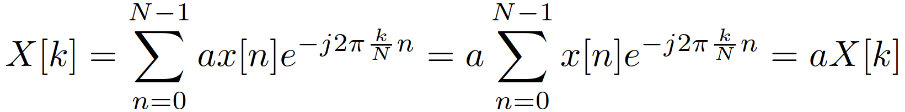
Scaling
If the signal is multiplied with a constant, y[n] = a x[n], the DFT coefficients will be Y[k] = a X[k]
Proof:
#dft_scaling
<number> / 43

Slide 22
Additivity
If
  DFT for signal x₁[n] is X₁[k]
  and DFT for signal x₂[n] is X₂[k]
Then, if we sum the signals: y[n] = x₁[n] + x₂[n]
The resulting DFT will be also the sum of the original ones:
Y[k] = X₁[k] + X₂[k]
Proof:
#dft_additivity
… why don’t the values of phases match at some points ?
<number> / 43

Slide 23
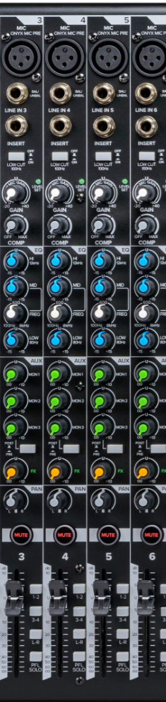
Linearity
Scaling and additivity together
If DFT for signal x₁[n] is X₁[k] and DFT for signal x₂[n] is X₂[k]
Then, if we do a weighted sum the signals:
y[n] = a₁ x₁[n] + a₂ x₂[n]
the resulting spectrum will be exactly the same weighted combination of the original ones: Y[k] = a₁ X₁[k] + a₂ X₂[k]
#dft_linearity
Linearity is absolutely crucial in many applications, and we
intentionally use non-linearities in others – neural networks.
<number> / 43

Slide 24
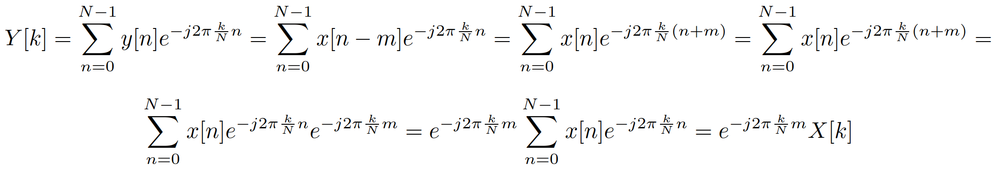
Shifts of short signals
Consider a relatively short signal x [n] that has DFT X[k].
What happens if this signal is shifted to the right (delayed) by m samples: y[n] = x[n-m] (let’s consider that the signal does not leave the interval 0 … N-1)
The complex exponentials “seeing” the signal will be m samples “older”, so that we can re-write the DFT as
<number> / 43

Slide 25

The resulting coefficient is the original one multiplied with a “correction factor”:
  The magnitude of the correction is 1, so
  The phase of the correction is shifted by a linear function.
The magnitude spectrum will be the same, the phase one will be inclined “downhill” for delay and “uphill” for advancing the signal.
#dft_shifted_lin
<number> / 43

Slide 26
Shift of a signal that covers the whole period
Consider a longer signal, for example a cosine nicely fitting in N samples
When shifted, “gaps” appear, and creates edges generating unwanted frequencies …
#dft_shifted_lin_long
Ooops, that’s a mess ☹
<number> / 43

Slide 27
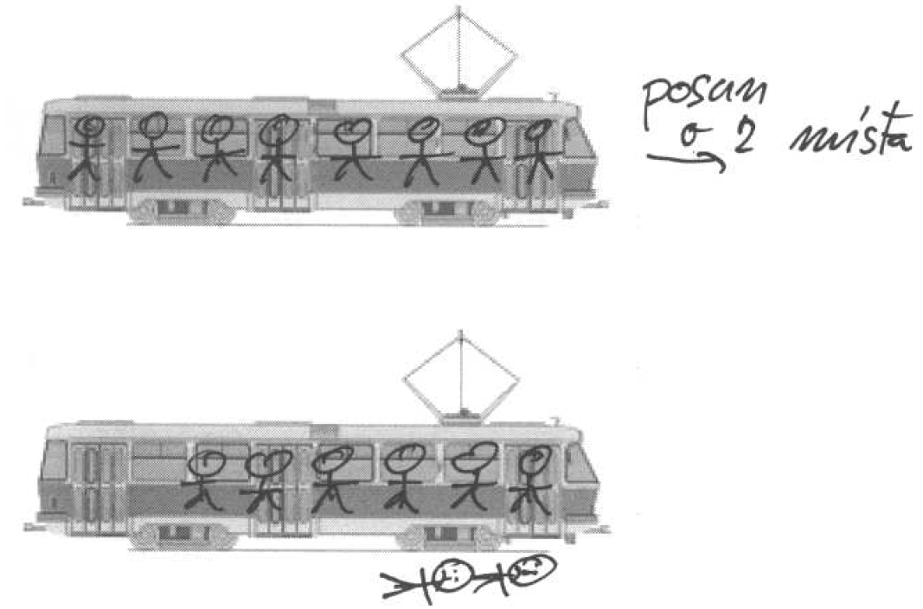
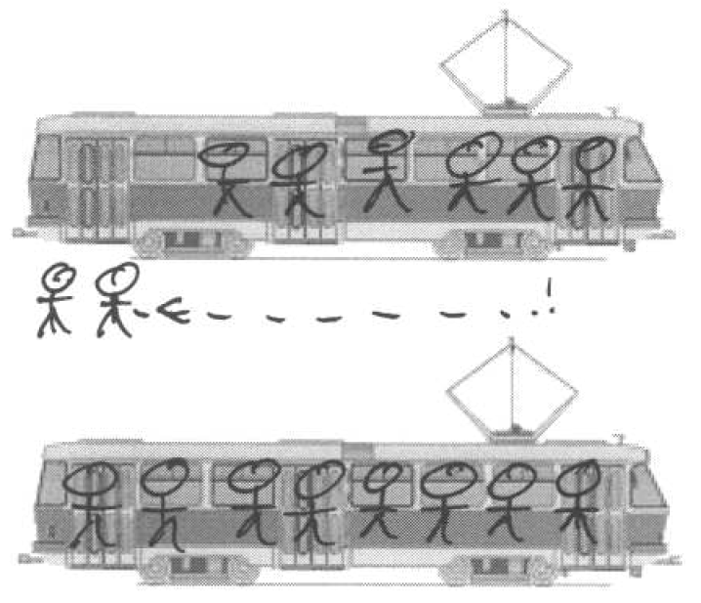
Correct way to shift signals for DFT …
Remember: we need to always stay in the buffer 0 … N-1
In case m samples of the signal are pushed out at the end, they need to return to the beginning.
<number> / 43

Slide 28
Circular shift mathematically
Modulo N function always returns values from 0 … N-1
Implementing circular shift by modulo indexing:
y[n] = x [ mod_{N} (n-m)]
For such a circular shift, we can safely use the correction computed above - the resulting coefficient is the original one multiplied with a “correction factor”:
  The magnitude of the correction is 1, so
  The phase of the correction is shifted by a linear function.
The magnitude spectrum will be the same, the phase one will be inclined “downhill” for delay and “uphill” for advancing the signal. #dft_shift_circular
<number> / 43

Slide 29
Agenda
DFT refresher
DFT of typical signals
Properties of DFT
Some more math on DFT
Spectrogram and what can we do with it
Summary and “take-home” messages
<number> / 43

Slide 30
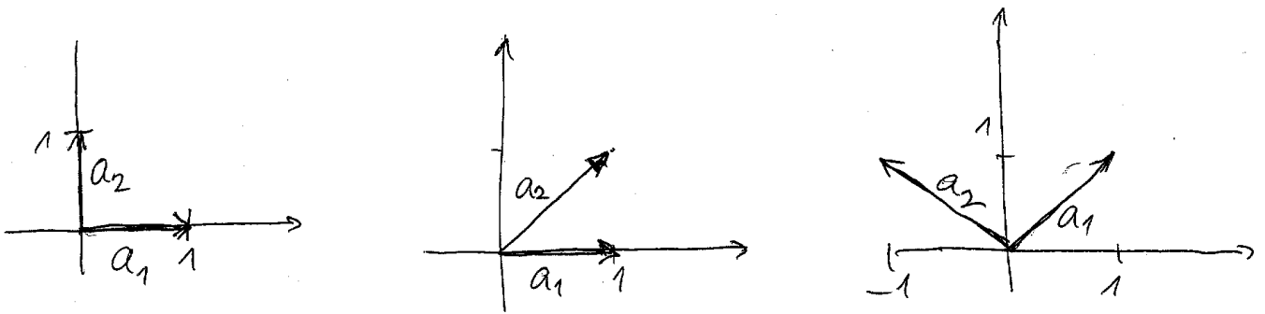
Orthogonality
For 2D, we can check the orthogonality (kolmost) by hand …
Mathematically, checking by dot-product
  [1 0] [0 1]^{T} = 1 x 0 + 0 x 1 = 0 orthogonal
  [1 0] [1 1]^{T} = 1 x 0 + 1 x 1 = 1 not orthogonal
  [1 1] [-1 1]^{T} = 1 x (-1) + 1 x 1 = 0 orthogonal
<number> / 43

Slide 31
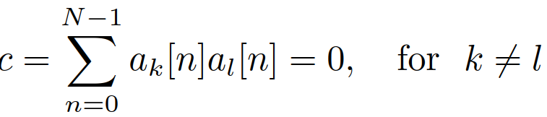
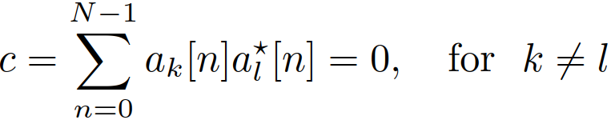
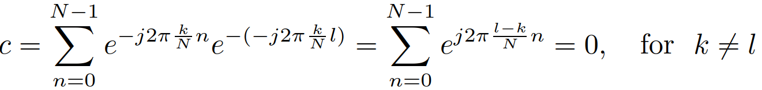
Are DFT bases orthogonal ?
We’ll check it by a standard dot-product over N samples.
But we have complex bases, so need to do complex conjugation (as for projection)
For DFT bases, we have
DFT bases ARE orthogonal
<number> / 43

Slide 32
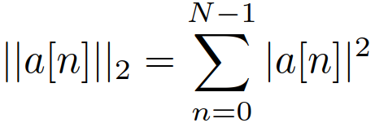
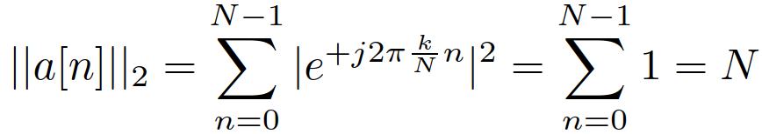
Are DFT bases normal ?
Norm of each basis must be 1 …
For DFT:
The norm is not 1, but N, so we need to correct in the IDFT when synthesizing the signal:
Remember the multiplication by N when computing coefficients for a cosine !
After IDFT fix, DFT bases are normal, so they are also orthonormal.
<number> / 43

Slide 33
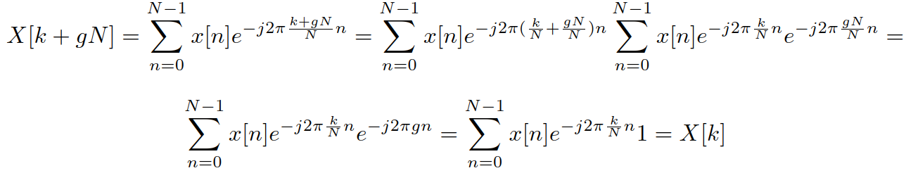
DFT extending beyond k=0 … N-1 – periodicity
We have defined DFT to strictly compute the spectrum for k=0 … N-1, this corresponds to
  Normalized frequencies from 0 to almost 1 (precisely (N-1) / N)
  Regular frequencies from 0 to almost F_{s} (precisely F_{s}(N-1) / N)
  And we usually visualize it only till N/2 (i.e. till ½ in normalized frequencies and F_{s}/2 in regular ones).
What happens if we go beyond interval k=0 … N-1 ?
Augmenting k by a multiple of the number of samples N:
<number> / 43

Slide 34
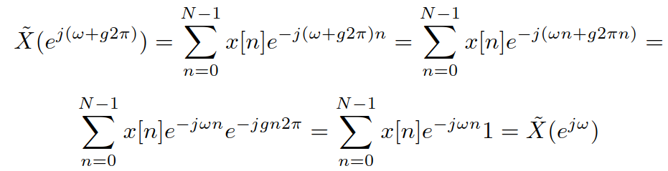
DFT is periodic with N samples. In frequencies, this corresponds to periodicity
  With period of 1 (normalized frequencies)
  With period of F_{s} (regular frequencies)
This is the “mathematical” proof of periodicity, we will see another one in the lecture on sampling !
We can do a similar proof for DTFT
#dft_periodicity
<number> / 43

Slide 35
Agenda
DFT refresher
DFT of typical signals
Properties of DFT
Some more math on DFT
Spectrogram and what can we do with it
Summary and “take-home” messages
<number> / 43

Slide 36
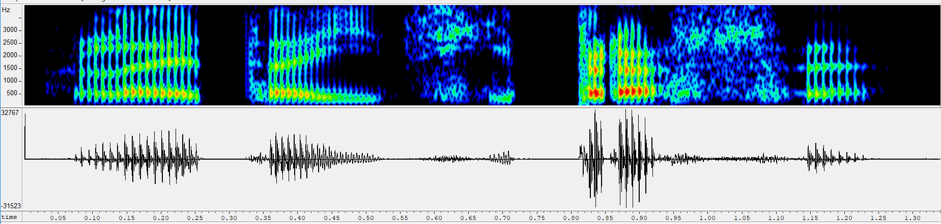
Spectrogram
We want to see the evolution of spectrum over time.
For our speech signal, want something like this:
Calling #spectrogram_blackbox without knowing what it really does.
We better learn what the spectrogram does exactly
<number> / 43

Slide 37
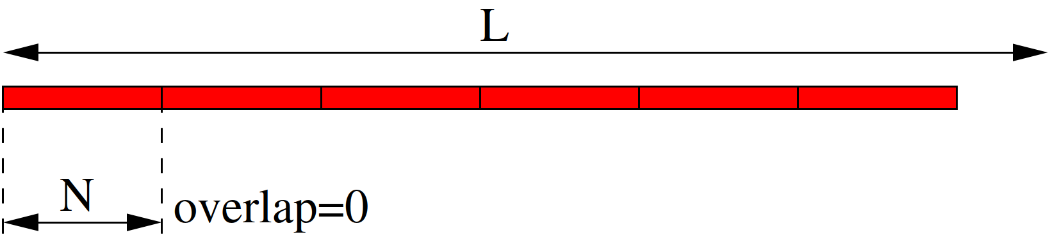
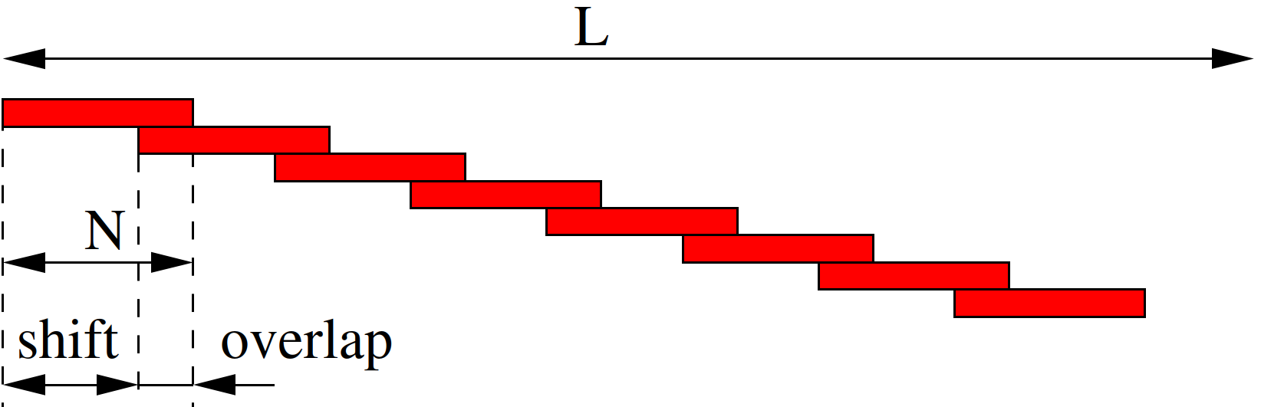
Pre-processing of the signal before computation
Division of a long signal into short segments – frames (rámce)
Segmentation without overlap
Segmentation with overlap (more usual)
<number> / 43

Slide 38
Windowing the frames and running DFT for all …
Window each frame by a selected window
  Rectangular – good frequency selectivity, more mess at higher frequencies.
  Hamming – worse frequency selectivity, less mess at higher frequencies.
  Hanning (or Hann) window – a sequence overlapping by N/2 sums up to 1 – see later. Beware of confusion ‘mm’ vs ‘nn’ …
If needed, zero-pad to reach the desired number of point N_{fft}.
As usual, select only 0… N/2, resp 0… N_{fft}/2 points.
Visualize
#spectrogram
<number> / 43

Slide 39
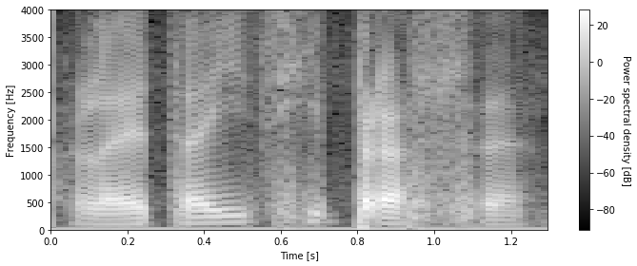
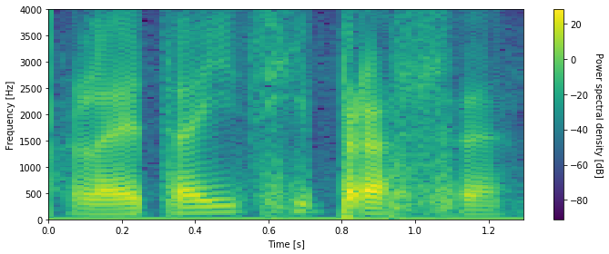
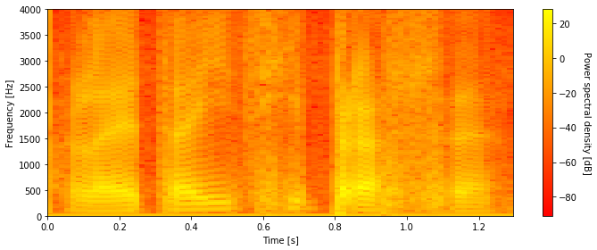
More on spectrogram visualization
We usually take the log of so called power spectral density – square of spectrum 10 log₁₀ |X[k]|² and claim it is in decibel [dB]
Selection of colormap …
Playing with brightness,
contrast, etc …
<number> / 43

Slide 40
Short-term vs long-term spectrogram
Wanted: more details in frequency => set longer frame length => however, less precision in time (averaging details over longer time…) – long-term spectrogram
Wanted: more details in time => set shorter frame length (eventually with more FFT points to have a nice figure) => however, less precision in frequency (the frame “sees” less signal) – short-term spectrogram
Wanted: more frames per second => set more overlap (less frame shift) => however, will not be able to detect short events (still averaged by the frame length…
#spectrogram_long_short_term
Setting good spectrogram parameters is a tricky business and there is no universal solution – ask colleagues and then tune the parameters.
<number> / 43

Slide 41
Synthesizing signal from spectrogram
Need to be careful with the analysis – define frames with ½ frame overlap and use Hanning (Hann) window – their sequence sums exactly to 1.
When synthesizing, initialize a buffer with the length of the resulting signal by zeros, then run a cycle:
  For each frame, take spectrum and complete the upper (from N/2+1 … N-1) by the symmetry X[k] = X*[N-k]
  Perform IDFT that generates the current frame.
  Add it to the buffer
  Move to the next frame, shift the position where signal will be added to the buffer by frame overlap.
#dft_synt
<number> / 43

Slide 42
Playing with spectrogram I – filtering
Without changes to the spectrogram, the Hanning window can be applied either in the analysis (before DFT) or in the synthesis (after IDFT)
However, if spectrogram is modified, it is good to perform the windowing on both ends. However, the whole thing needs to be still Hanning window, so:
  Apply sqrt of Hanning before DFT
  Apply sqrt of Hanning after IDFT
  sqrt Hanning * sqrt Hanning = Hanning.
#spectrogram_filtering – deleting part of spectrogram + up to you to try anything else
<number> / 43

Slide 43
Playing with spectrogram II – duration modification
Taking every 2nd frame from the spectrum – shortening 2x – “Ostrava accent”
Repeating every frame – lengthening 2x – “Prague accent”
#spectrogram_duration_modif
The quality of audio is not perfect – the phases would better processing (continuity of phase across frames).
<number> / 43

Slide 44
Agenda
DFT refresher
DFT of typical signals
Properties of DFT
Some more math on DFT
Spectrogram and what can we do with it
Summary and “take-home” messages
<number> / 43

Slide 45
SUMMARY
DFT (computed by FFT) is the basic tool for frequency analysis.
Basic truths on signals and spectra:
  Narrow signal <=> wide spectrum
  Wide (smooth) signal <=> narrow spectrum
  Periodic signal <=> discrete spectrum
  Discrete signal <=> periodic spectrum
Shifts of signals
  Delay => magnitude spectrum stays the same, phase goes downhill.
  Advance => magnitude spectrum stays the same, phase goes uphill.
  For DFT, we need to do circular shifts to stay in 0 … N-1

Slide 46
SUMMARY II.
Spectrogram is evolution of spectrum in time
  Contains magnitude and phase, only magnitude is shown
  Lots of tuning can be done by non-linearity (log), colormaps, and setting brightness and contrast of the image.
  Better frequency or better time resolution, but not both – long vs. short-term spectrogram
Synthesis of signal from spectrogram
  Analysis should be done carefully – shift is ½ of the frame-length, Hanning window.
  Spectrum needs to be completed by the 2nd half before IDFT.
  In case modifications are done, it’s safer to use sequence of sqrt(Hanning) and sqrt(Hanning)
Filtering is usually done by other means, but spectrogram modifications are of great use in machine learning (learned T-F masks, etc).
<number> / 43

