Slide 1
Filtering I
Honza Černocký, ÚPGM
Please open Python notebook filtering_1

Slide 2
Agenda
Terminology and motivation
Basic operations needed for filtering
A simple FIR filter
Convolution (and needed signal manipulations)
Filters with feedback - IIR
Summary
<number> / 57

Slide 3
Aliases
Numerical filters (číslicové filtry)
Discrete systems (diskrétní systémy)
Discrete-time systems (systémy s diskrétním časem)
etc.

Slide 4
What for I – Selecting some parts of spectrum
Demos on 5 secs of rock music (who knows the band ?)
#demo_lowpass – max frequency 500 Hz – low-pass filter (dolní propusť)
#demo_highpass – min. frequency 5000 Hz – high-pass filter (horní propusť)
#demo_terlephone – simulating the classical telephone network from 300 to 3400 Hz. – band-pass filter (pásmová propusť)

Slide 5
What for II – attenuating some nuisance components
#demo_1kHz_cleaning – signal polluted with a 1 kHz beep
Band-stop filter (pásmová zádrž) designed to kill 1 kHz frequency (and some around …)
<number> / 57

Slide 6
What for III – detection of signal in noise by a „matched“ filter
When trying to transmit signals through noisy channel, might need high energy to get them through the noise …
Or use a matched filter that is „looking“ for the signal in the noise.
#demo_matched_filter
<number> / 57

Slide 7

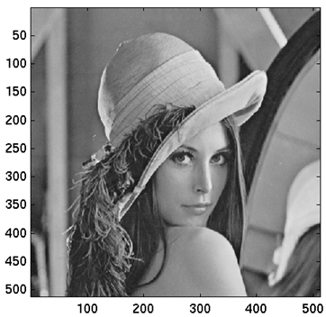
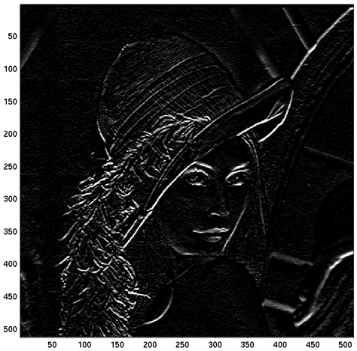
What for IV – images
<number> / 57

Slide 8
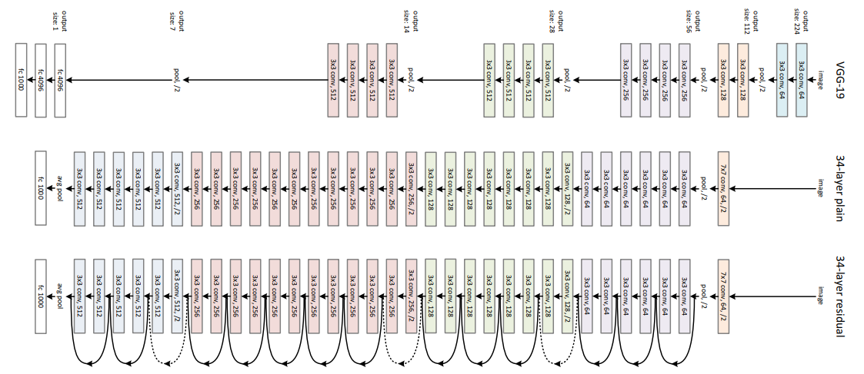
What for V. – Learned feature extraction for machine learning
<number> / 57

Slide 9
Agenda
Terminology and motivation
Basic operations needed for filtering
A simple FIR filter
Convolution (and needed signal manipulations)
Filters with feedback - IIR
Summary
<number> / 57

Slide 10
What do we need to implement filters in C ? wire.c
Sampled signal
  At some sampling frequency (most often 8kHz, 16kHz, 44.1kHz (CD), 48kHz, 96kHz)
  For visualization, will show it as continuous (stem vs. plot)
  For ISS no special formats (MP3, OGG, WAV), but a plain RAW
  No header, sequence of 16-bit shorts

Slide 11
#include <stdio.h>
#include <stdint.h>
#define MAXN 1000000
FILE *ifile, *ofile;
int16_t x[MAXN], y[MAXN];
uint32_t N;
main (int argc, char *argv[]) {
ifile = fopen(argv[1],"rb");
ofile = fopen(argv[2],"wb");
/* read it */
N = fread(x, sizeof(int16_t), MAXN, ifile); fclose(ifile);
/* write it */
fwrite(x, sizeof(int16_t), N, ofile); fclose(ofile);
}
<number> / 57

Slide 12
3 simple operations needed for filtering
Multiplication with a constant (násobení)*
Summation / addition (sčítání) +
Shift (posun, resp. zpoždění) – implemented by a memory.
Special signal processors even have instructions called MACD (multiply-accumulate-delay).

Slide 13
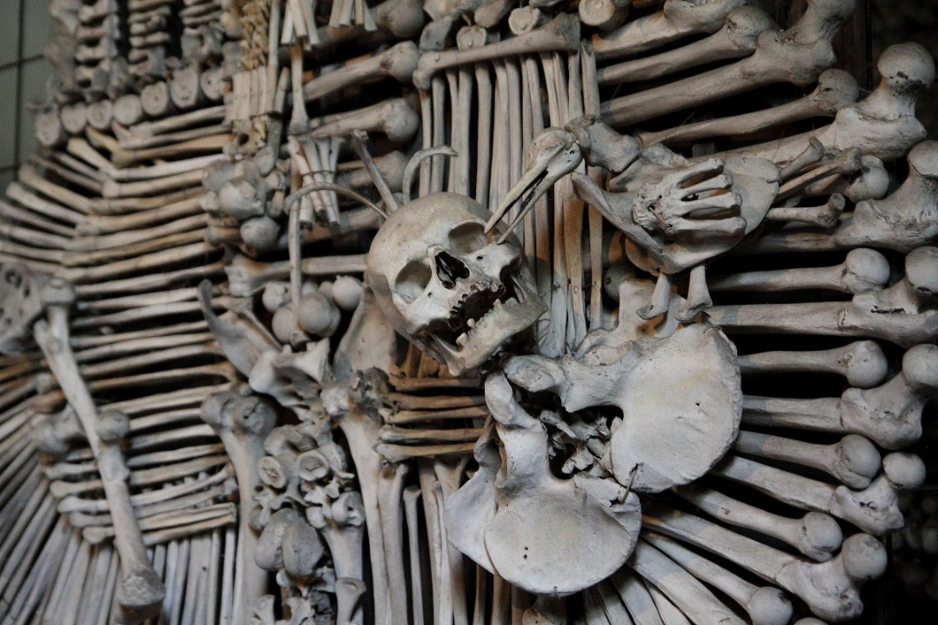
Shift ? Look only to the past !
x[n]
n
„now“, „presence“
past
future
Notes:
Definovat, že čas, kde jsme, je n.

Slide 14
Shift off-line
x[n-1]
x[n]
n-1
n
… just changing the value of the pointer.
Notes:
Definovat, že čas, kde jsme, je n.

Slide 15
Shift on-line
We have only x[n]
Function with a memory – making the past samples older (“staření” vzorků)
float filter (float xn) {
static float xn1, xn2;
… some processing …
xn2 = xn1;
xn1 = xn;
return something;
}

Slide 16
Agenda
Terminology and motivation
Basic operations needed for filtering
A simple FIR filter
Convolution (and needed signal manipulations)
Filters with feedback - IIR
Summary
<number> / 57

Slide 17
A simple filter
y[n] = b₀x[n] + b₁x[n-1] + b₂x[n-2] + b₃x[n-3]
… this is called difference equation (diferenční rovnice)
Attention !!! This is NOT differential equation (diferciální rovnice) – we’ll see these for continuous-time systems (systémy se spojitým časem)

Slide 18
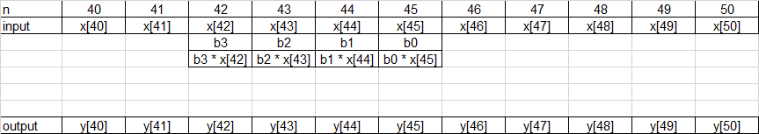
How does it work for sample n=45 ?
Σ
Notes:
CC do kreslitka, tam filtr a posouvat ho !

Slide 19
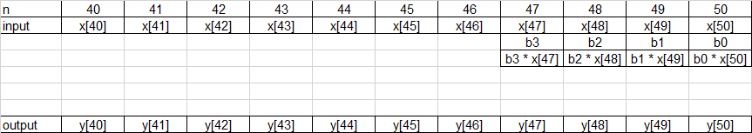
How does it work for sample n=50 ?
Σ
<number> / 57

Slide 20
Implementation off-line fir_offline.c
absolutely verbatim re-writing of the difference equation
for (n=3; n<N; n++) {
y[n] = b0 * x[n] + b1 * x[n-1] + b2 * x[n-2] + b3 * x[n-3];
}
… why do we begin from 3 ?

Slide 21
Implementation on-line fir_online.c
A function for filtering is called for every sample
It must memorize the past samples
float filter (float xn) {
static float xn1 = 0.0, xn2 = 0.0, xn3 = 0.0;
float yn;
yn = b0 * xn + b1 * xn1 + b2 * xn2 + b3 * xn3;
xn3 = xn2;
xn2 = xn1;
xn1 = xn;
return (yn);
}
+ a call in main:
for (n=0; n<N; n++) {
y[n] = filter (x[n]);
}

Slide 22
Trying our intuition – what will this filter do for:
 | b0 | b1 | b2 | b3
Filter1 | 0.25 | 0.25 | 0.25 | 0.25
Filter2 | 0.25 | -0.25 | 0.25 | -0.25
Filter3 | 1 | 0 | 0 | 0
Filter4 | 2 | 0 | 0 | 0
Filter5 | 0 | 0 | 0 | 1
Showing on a segment of noisy cosine …
#filter1 … #filter5

Slide 23
How to represent a filter ?
y[n] = b₀x[n] + b₁x[n-1] + b₂x[n-2] + b₃x[n-3]
… difference equation (diferenční rovnice)
scheme (schéma, diagram …)
z⁻¹ blocks are delays by 1 sample
(explanation to come later)
Triangles are mutliplicaitons
Big circle is summation.
x[n]
b₀
Σ
y[n]
z⁻¹
b₁
z⁻¹
b₂
z⁻¹
b₃

Slide 24
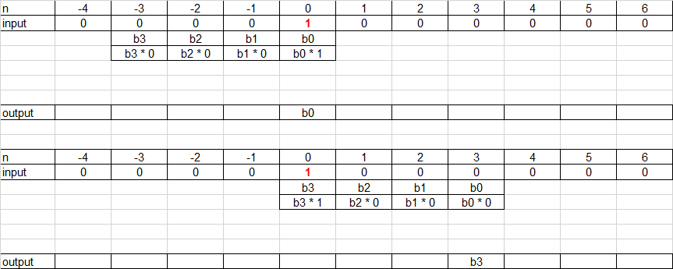
Impulse response (impulsní odezva) – reaction to unit pulse
Σ
Σ

Slide 25
Impulse response
the impulse response is exactly equivalent to the coefficients:
  h[k] = b_{k} for k = 0,1,2,3
  h[k] = 0 otherwise
The length of this impulse response is 4, so it is finite (konečná impulsní odezva) – FIR – finite impulse response filter
… What should we do to implement a filter with an infinite impulse reponse (nekonečná impulsní odezva) ?

Slide 26
Agenda
Terminology and motivation
Basic operations needed for filtering
A simple FIR filter
Convolution (and needed signal manipulations)
Filters with feedback - IIR
Summary
<number> / 57

Slide 27
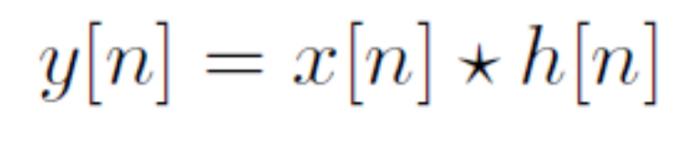
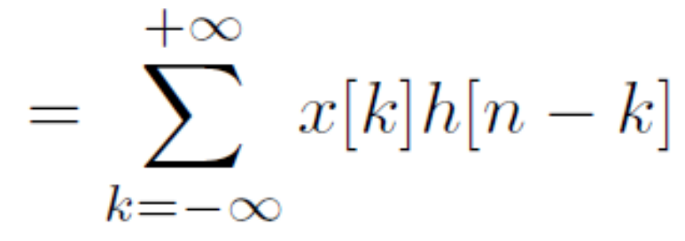
Convolution
… but let’s first train some basic operations on discrete signals.
Notes:
Ukazat na nasem filtru 1

Slide 28
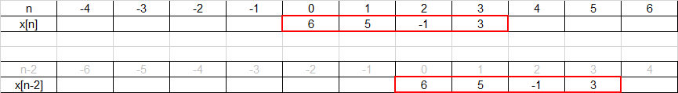
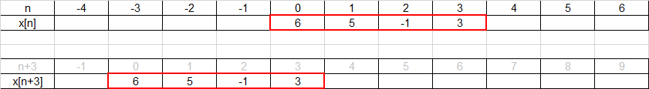
Delay (zpoždění) and advancing (předběhnutí)
y[n] = x[n-2]
y[n] = x[n+3]
2 samples delay
3 samples advance
<number> / 57

Slide 29
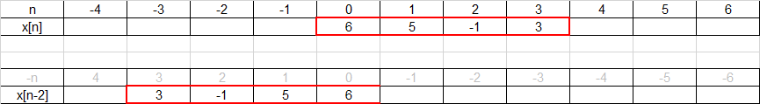
Flipping (otočení)
y[n] = x[-n]
<number> / 57

Slide 30
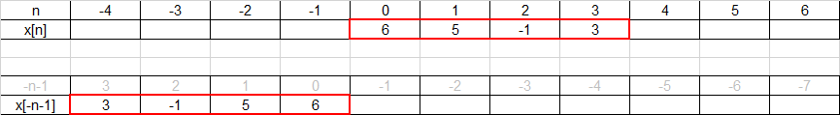
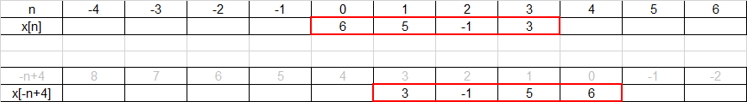
Flipping with a shift – counter-intuitive !!!
y[n] = x[-n-1]
Flipping + adding negative shift means advancing the flipped signal
y[n] = x[-n+4]
Flipping + adding positive shift means delaying the flipped signal
<number> / 57

Slide 31
Unsure ? Run a check !
Select an important sample in the signal
For the modified signal, evaluate the time modification for this sample
Look at the resulting time in the original signal.
  Same sample as in the modified one ? OK
  Different sample ? BAD, DO IT AGAIN
<number> / 57

Slide 32
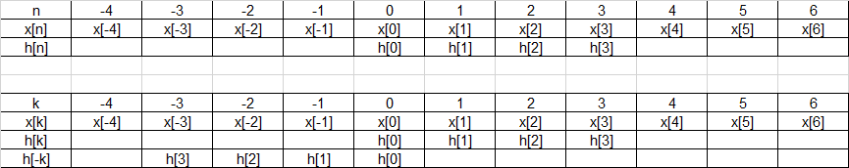
Now finally ready for the convolution …
k is an auxiliary variable, usually not running from -ꝏ to +ꝏ.
Let’s start with renaming the signals from x[n] and h[n] to x[k] and h[k] and flipping h[k] to h[-k]
<number> / 57

Slide 33
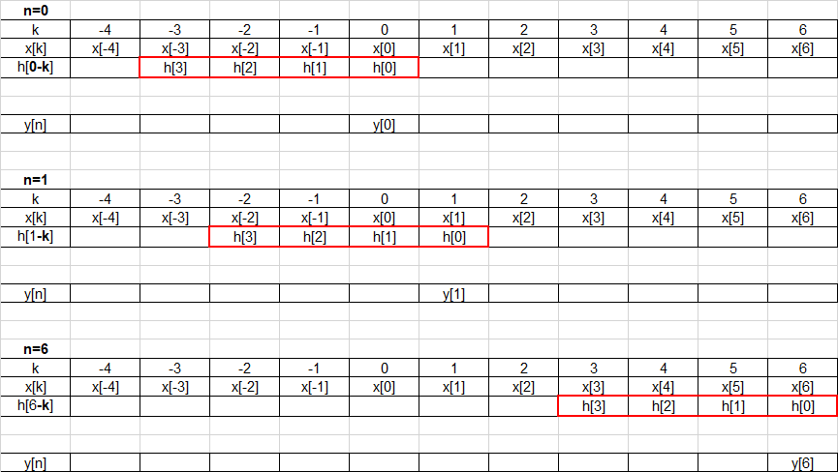
And proceed by computing output samples for different n’s
Σ
Σ
Σ
<number> / 57

Slide 34
Convolution - summary
Flip the impulse response
For all meaningful output samples n
  Shift flipped impulse response to given „n“
  Mutliply
  Add
  Write the result to y[n]
… „paper strip“ + Python #convolution for
x = [4 4 4 4 0 0 0 0]
h = [0.25 -0.25 0.25 -0.25]

Slide 35
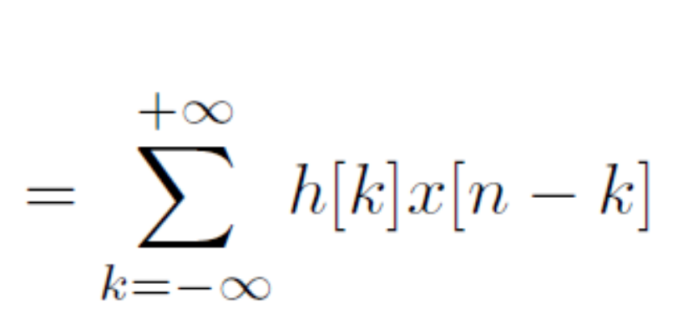
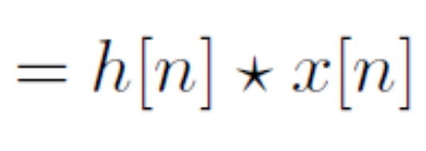
Convolution is commutative…
Try it on our example with the paper-strip method as a homework ☺

Slide 36
Agenda
Terminology and motivation
Basic operations needed for filtering
A simple FIR filter
Convolution (and needed signal manipulations)
Filters with feedback - IIR
Summary
<number> / 57

Slide 37
Recursive / IIR – infinite impulse response filters
Diference equation
y[n] = b₀x[n] + b₁x[n-1] + b₂x[n-2] + b₃x[n-3]
- a₁y[n-1] - a₂y[n-2] - a₃y[n-3]
Why not a₀ ?
Can’t use sample y[n] as it is being made.
Why do the feed-back coefficients have negative sign ?
Will complicate things now, but make them easier later …

Slide 38
Scheme
x[n]
b₀
Σ
y[n]
z⁻¹
b₁
-a₁
z⁻¹
z⁻¹
b₂
-a₂
z⁻¹
z⁻¹
b₃
-a₃
z⁻¹

Slide 39
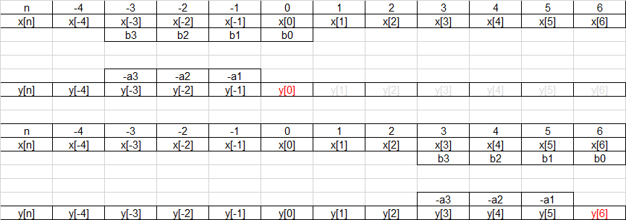
Operation – making use of filter output !
Σ
Σ

Slide 40
Implementation off-line … iir_offline.c
Digging also in the old outputs …
for (n=3; n<N; n++) {
y[n] = b0 * x[n] + b1 * x[n-1] + b2 * x[n-2]
+ b3 * x[n-3] - a1 * y[n-1]
- a2 * y[n-2] - a3 * y[n-3];
}

Slide 41
Implementation on-line… iir_online.c
The function has to memorize also the past outputs.
float filter (float xn) {
static float xn1 = 0.0, xn2 = 0.0, xn3 = 0.0;
static float yn1 = 0.0, yn2 = 0.0, yn3 = 0.0;
float yn;
yn = b0 * xn + b1 * xn1 + b2 * xn2 + b3 * xn3
- a1 * yn1 - a2 * yn2 - a3 * yn3;
xn3 = xn2; xn2 = xn1; xn1 = xn;
yn3 = yn2; yn2 = yn1; yn1 = yn;
return (yn);
}
+ a call in main:
for (n=0; n<N; n++) {
y[n] = filter (x[n]);
}

Slide 42
Infinite impulse response
For example for a simple, purely recursive filter (nothing done with the input)
#iir_response
x[n]
Σ
y[n]
-a₁
z⁻¹

Slide 43
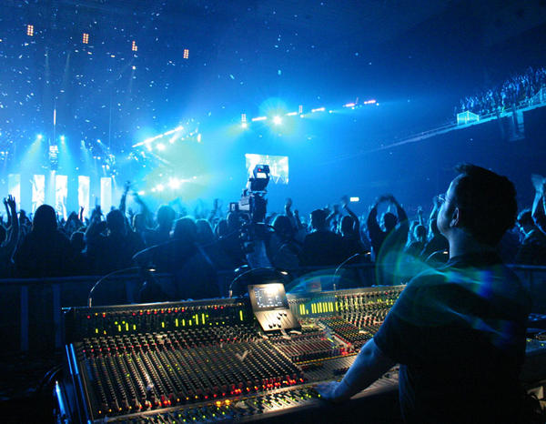
Stability
Mathematically „Bounded Input Bounded Output“
Popularly: “if reasonable stuff on the input expecting reasonable stuff on the output”
FIR filter can not be unstable
IIR can.

Slide 44
First order IIR
x[n]
Σ
y[n]
-a₁
z⁻¹
What must be respected for a₁?
In the following lecture, we’ll see the condition of stability for more complicated filters.
Notes:
Check pomoci impulsni odezvy a pomoci polu.

Slide 45
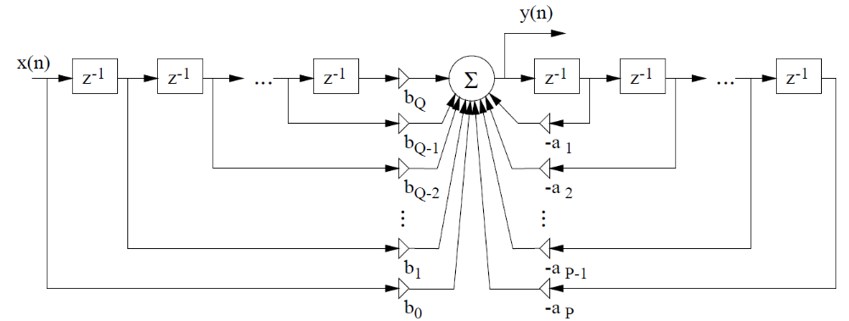
General IIR filter
Notes:
Use double screen and 2 computers to let this scheme in place !

Slide 46
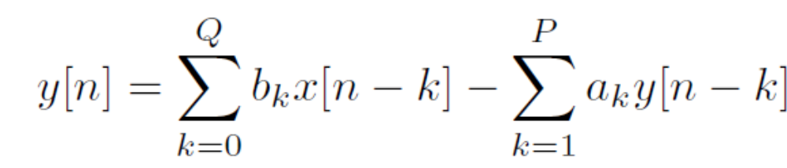
General filter
Order of input (řád vstupu) Q
Order of output (řád výstupu) P
Difference equation
y[n] = b₀x[n] + b₁x[n-1] + … + b_{Q}x[n-Q]
- a₁y[n-1] + … + a_{P}y[n-P]

Slide 47
Implementation off-line iirbig_offline.c
… still the same, this time with cycles
for (n=P; n<N; n++) {
sum = 0.0; /* zero the accumulator */
for (k=0; k<=Q; k++) {
sum += B[k] * x[n-k];
}
for (k=1; k<=P; k++) {
sum -= A[k] * y[n-k];
}
y[n] = (int16_t)sum;
}

Slide 48
Implementation on-line iirbig_online.c
float filter (float xn) {
definition of static double xbuf (x[n] … x[n-Q-1]) and ybuf (y[n] … y[n-P-1]) …
yn = 0.0;
xbuf[0] = xn;
for (k = Q; k >= 0; k--) {
yn += xbuf[k] * B[k];
xbuf[k+1] = xbuf[k];
}
for (k = P; k >= 1; k--) {
yn -= ybuf[k] * A[k];
ybuf [k+1] = ybuf [k];
}
ybuf[1] = yn;
return yn;
}

Slide 49
Implementation on-line - notes
The cycles must run backward (otherwise the old values rewrite the new ones)
Each body of cycle performs multiplication, addition and delay.
The cycle for the output must stop at index 1 (coefficient a₀ does not exist ! )
„Trash“ memory fields xbuf[Q+1], ybuf[P+1], ybuf[0] will never be used – makes indexing easier and save us some „if“s.
<number> / 57

Slide 50
Agenda
Terminology and motivation
Basic operations needed for filtering
A simple FIR filter
Convolution (and needed signal manipulations)
Filters with feedback - IIR
Summary
<number> / 57

Slide 51
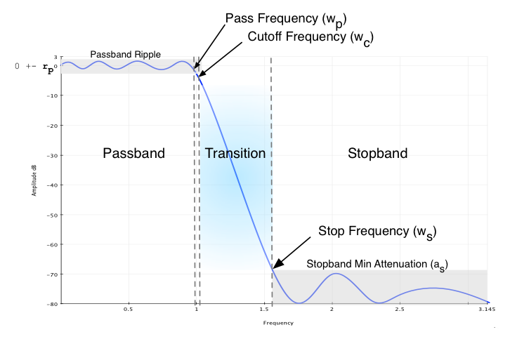
Representation of filter in frequency
Frequency response (frekvenční / kmitočtová charakteristika)
Interested, how the filter behaves in frequency
  i.e. how individual frequencies are amplified / attenuated
  and how they are shifted
Determining the type of filter
  Low-pass, High-pass, Band-pass, Band-stop
Filter design process - specifications
  pass-band should be from xx Hz to yy Hz
  stop-band should be from zz Hz to ww Hz
  attenuation should be minimum aa dB
  pass-band ripple max. bb dB.
We need the frequency response
to check whether the design worked.

Slide 52
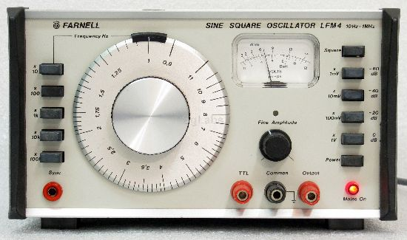
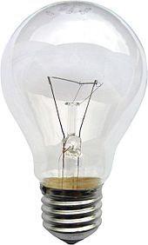
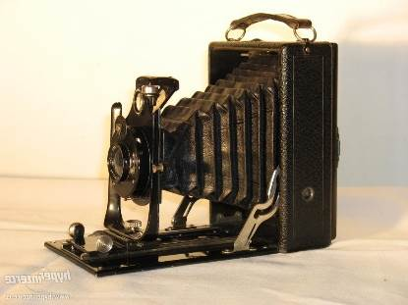
Frequency response historically – measure !
filter

Slide 53
Frequency response from impulse response
FIR filters:
  Generate impulse response
  Perform its frequency transform – DFT, DTFT
  Works, as the impulse response is finite.
  #freq_char_by_ft_of_impulse_response
IIR filters
  Can not get the impulse response precisely, as it is infinite.
  Can truncate it and run DFT / DTFT, but the result will not be correct
  We have better ways to do it – wait for the next lecture ☺

Slide 54
Agenda
Terminology and motivation
Basic operations needed for filtering
A simple FIR filter
Convolution (and needed signal manipulations)
Filters with feedback - IIR
Frequency response - an introduction
Summary
<number> / 57

Slide 55
Summary
Describing the filter by
Scheme
Difference equation
Impulse response
Transfer function
Frequency response

Slide 56
Summary II.
Types of filters
  FIR
  IIR
Implementation
  Mutliplication
  Summation
  Shifts
    Off-line
    On-line

Slide 57
Summary III.
Convolution
  Way to obtain the output of FIR filter for an input signal.
  Can be easily imagined and related to the difference equation.
  Try it out with the paper strips !

