Slide 1
Random signals
Honza Černocký, ÚPGM
Please open Python notebook random_1

Slide 2
Agenda
Introduction, terminology and data for the rest of this lecture
Functions describing random signals - CDF, probabilities, and PDF
Relation between two times - joint probabilities and joint PDF
Moments - mean and variance
Correlation coefficients
Stationarity
Ergodicity and temporal estimates
Summary and todo's
<number> / 72

Slide 3
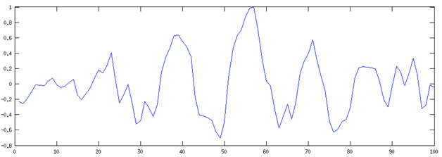
Signals at school and in the real world
Deterministic
Equation
Plot
Algorithm
Piece of code
Random
Don’t know for sure
All different
Primarily for „nature“ and „biological“ signals
Can estimate parameters
}
Can compute
Little information !

Slide 4
Examples
Speech
Music
Video
Currency exchange rates
Technical signals (diagnostics)
Measurements (of anything)
… almost everything

Slide 5





Mathematically
Discrete-time only (samples) – we won’t deal with continuous-time random signals in ISS.
A system of random variables defined for each n
For the moment, will look at each time independently
. . .

Slide 6
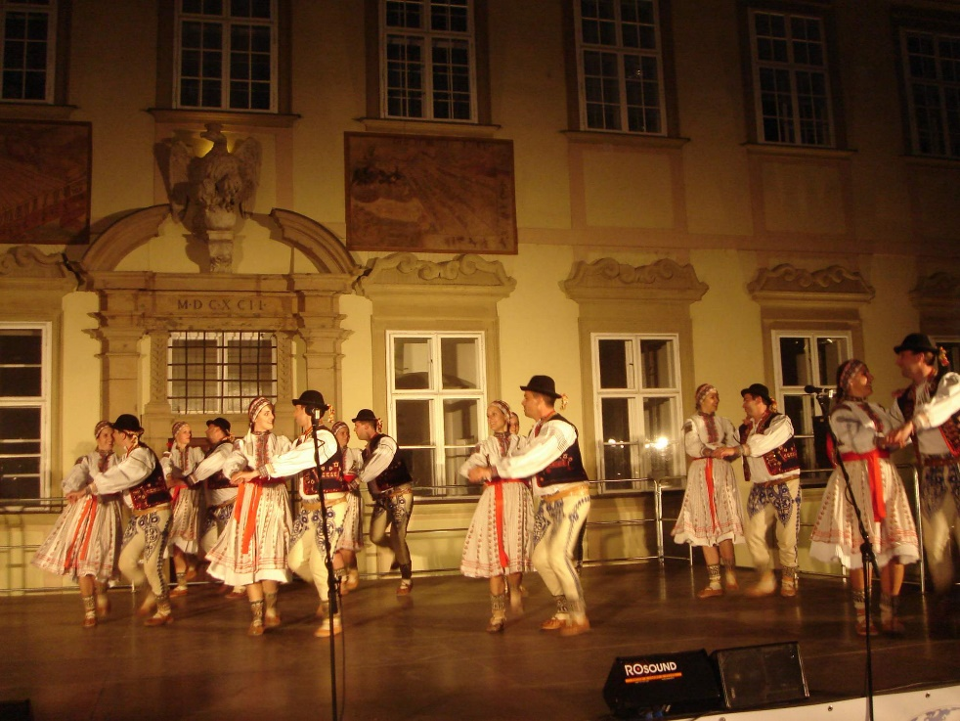
Set of realizations – ensemble estimates
Ideally, we have a set of Ω realizations of the random signal (realizace náhodného signálu / procesu)
Imagine a realization as a recordings
  In the old times, on a tape
  In modern times, in a file with samples.
We will be able to do ensemble estimates
(souborové odhady)
We can fix the time we investigate to a certain
sample n. Then do another n independently
on the previous one.
  This way, we can also investigate into dependencies
  between individual times – see later.

Slide 7




Set of realizations

Slide 8
n
Fix n and select all values
Estimate what is needed – the estimate will be valid only for this n

Slide 9
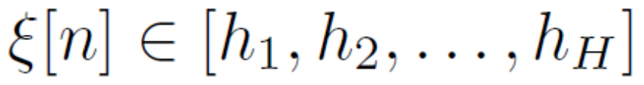
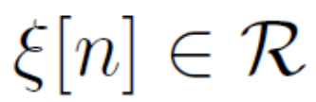
Range of the random signal
Discrete range
  Coin flipping
  Dice
  Roulette
  Bits from a communication channel
Real range
  Strength of wind
  Audio
  CZK/EUR Exchange rate
  etc

Slide 10


Examples of data I
Discrete data
50 years of roulette Ω = 50 x 365 = 18250 realizations
Each realization (each playing day) has N=1000 games (samples)
Goal: find if someone doesn’t want to cheat the casino
#discrete_data

Slide 11

Examples of data II
Continuous data
Ω = 1068 realizations of flowing water
Each realization has 20 ms, F_{s}=16 kHz, so that N=320.
Goal: find some spectral properties of tubing (eventually to use running water as a musical instrument)
#continuous_data

Slide 12
Agenda
Introduction, terminology and data for the rest of this lecture
Functions describing random signals - CDF, probabilities, and PDF
Relation between two times - joint probabilities and joint PDF
Moments - mean and variance
Correlation coefficients
Stationarity
Ergodicity and temporal estimates
Summary and todo's
<number> / 72

Slide 13
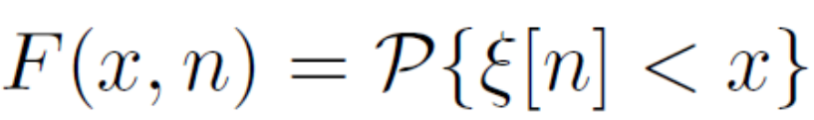
Describing random signal by functions
CDF - cummulative distribution function (distribuční funkce)
x is nothing random ! It is a value, for which we want to determine/measure CDF. For example, for „which percentage of population is shorter than 165cm?“, x=165

Slide 14
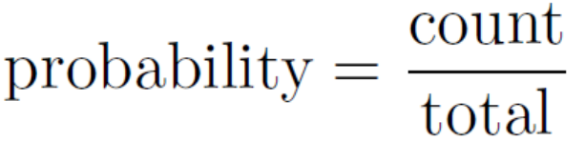
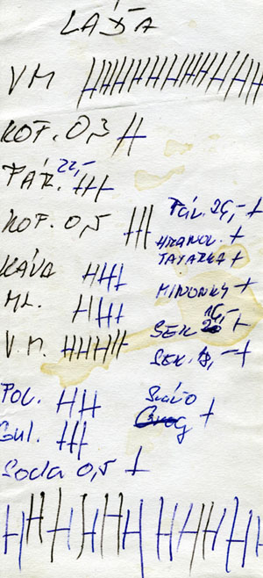
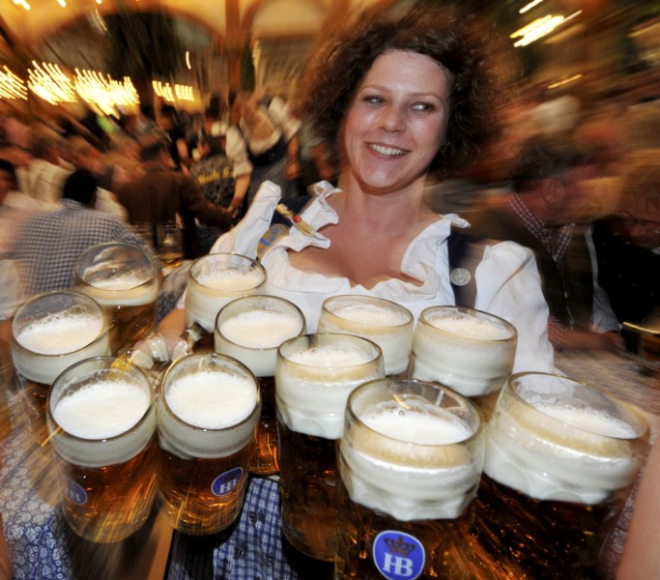
Estimation of probabilities of anything

Slide 15
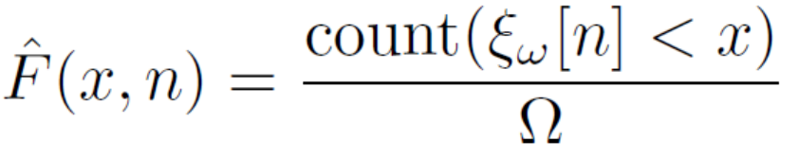
Estimation of CDF from data
F(x,n)
x
How to divide x axis ?
Sufficiently fine
But not useful in case the estimate is all the time the same.

Slide 16
n
How many times was the value smaller than x=165 ?
P = 4 / 10, F(x,n) = 0.4

Slide 17
Estimations on our data
Pick a time n
Divide the x-axis into reasonable intervals
Count, over all realizations ω = 1 … Ω, how many times the value of signal ξ_{ω}[n] is smaller than x.
Divide by the number of realizations
Plot the results
#cdf_discrete
#cdf_continuous

Slide 18
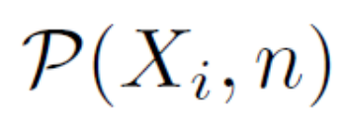
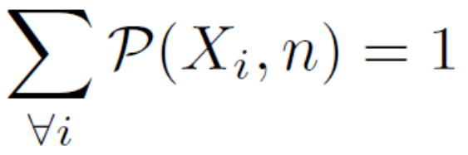
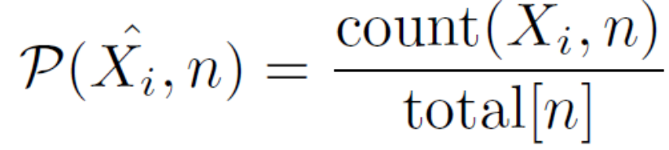
Probabilities of values
Discrete range - OK
The mass of probabilities is
Estimation using the counts

Slide 19
0
1
2
36

Slide 20
Estimations on our discrete data
Pick a time n
Go over all possible values X_{i}
Count, over all realizations ω = 1 … Ω, how many times the value
of signal ξ_{ω}[n] is X_{i}.
Divide by the number of realizations
Plot the results
Example for roulette: n = 501, possible values X_{i} are 0 … 36, in case the roulette is well balanced, we should see probabilities around 1 / 37 = 0.027
#proba_discrete
Don’t see the same values ?
Not enough data !

Slide 21
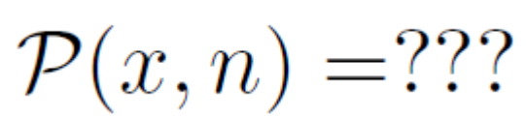
Continuous range
Nonsense or zero …
=> Needs probability density!

Slide 22

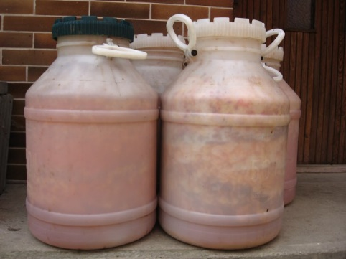
Real world examples
How many kms did the car run at time t ???
What is the mass of the ferment here, in coordinates x,y,z ???

Slide 23
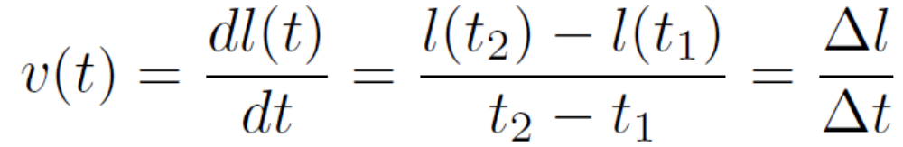
Velocity
Density

Slide 24
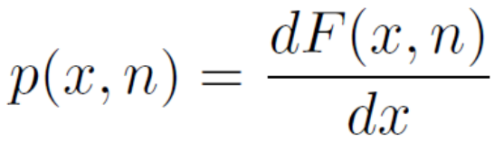
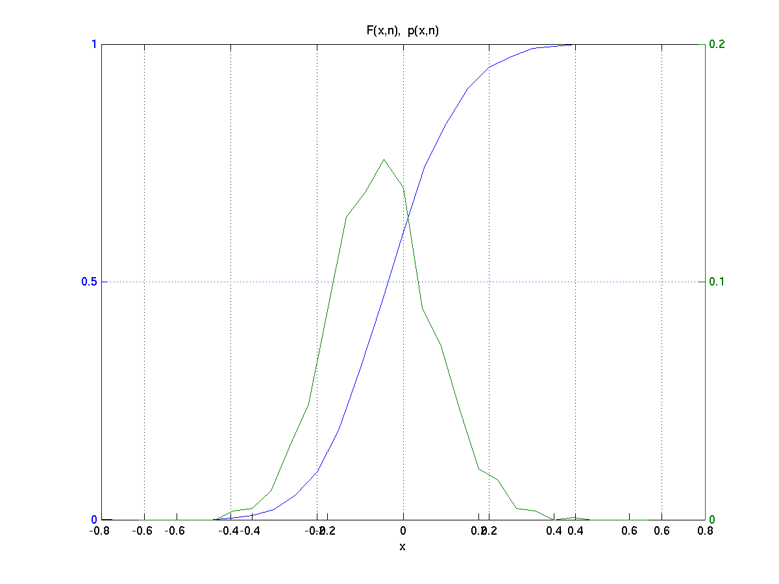
Probability density function – PDF (funkce hustoty rozdělení pravděpodobnosti)
Is defined as the derivation of cummulative distribution
function over x
Can be computed numerically
(remember the 1st lecture on the
math).
#pdf_continuous_derivation
However, we might need
something easier to estimate
PDF directly from the data

Slide 25
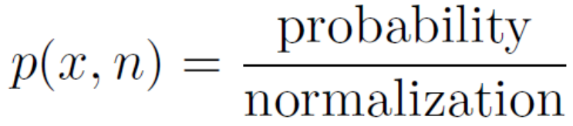
Can we estimate it more easily?
Let us use what we know about the other densities – we need to define intervals
Velocity can be estimated as distance driven over an interval of time (1D interval)
Physical density can be estimated as a mass over a small volume (3D interval)
Probability density can be estimated as probability over an interval on the axis x
Probabilities of values are nonsense, but we can use probabilities of intervals – bins !

Slide 26
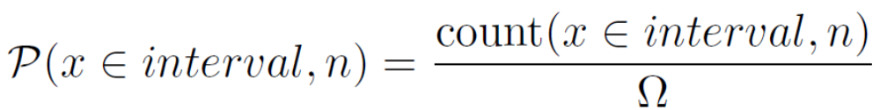
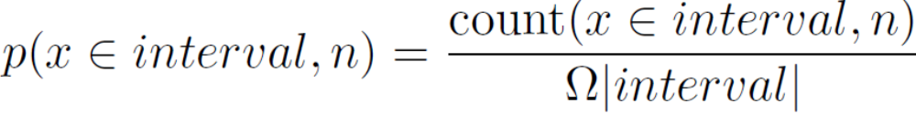
Steps of PDF estimation from data
Define suitable bins - intervals on the x-axis, uniform intervals with the width of Δ will make estimation easier.
Estimate a histogram – counts of data values in individual bins
Convert histogram to probabilities over individual bins – divide by the number of realizations
Convert probabilities to probability densities – divide by width
of bins:
#pdf_continuous_histogram

Slide 27

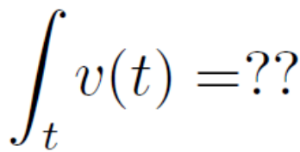

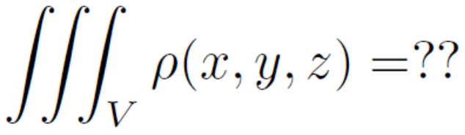
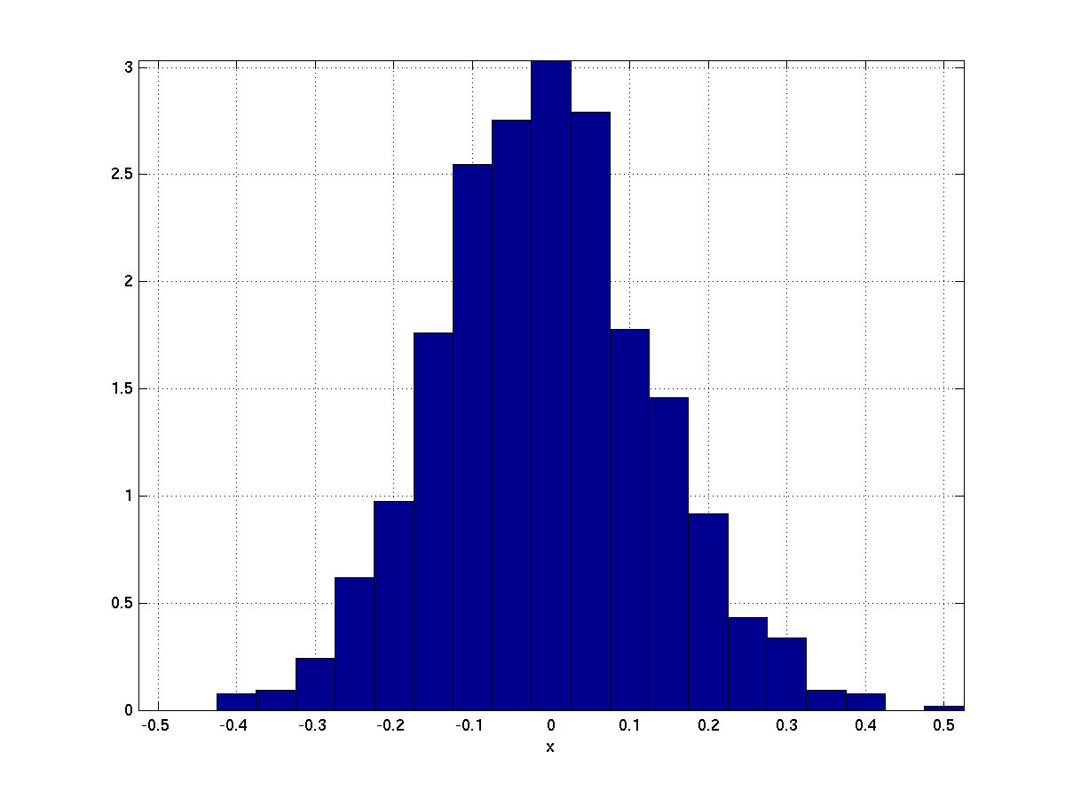
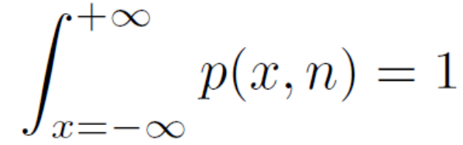
Check - the whole thing
How about the integral of density
over all values of the variable ?
Integral of velocity over the whole
time is the total distance
Integral of physical density over the
whole volume is the total mass
Integral of probability density
over all values of variable x is the
total mass of probability = 1
We can verify this numerically
#total_mass_check

Slide 28
Agenda
Introduction, terminology and data for the rest of this lecture
Functions describing random signals - CDF, probabilities, and PDF
Relation between two times - joint probabilities and joint PDF
Moments - mean and variance
Correlation coefficients
Stationarity
Ergodicity and temporal estimates
Summary and todo's
<number> / 72

Slide 29
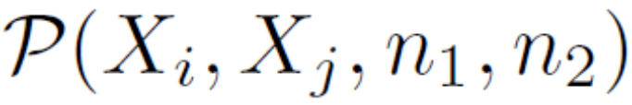
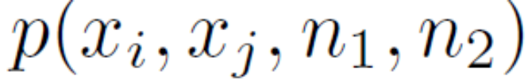
Joint probability or joint probability density function
We want to study relations between samples in different times
  Good for studying dependencies in time
  And later for spectral analysis
Are they independent or is there a link ?
We define joint probabilities (sdružené pravděpodobnosti) for signals with discrete values
and joint probability density function (sdruženou funkci hustoty rozdělení pravděpodobnosti) for signals with continuous values

Slide 30
Principle - counting in two different times
n₁
n₂

Slide 31
Estimations – questions, with “and”
Something at time n₁ and
Something at time n₂

Slide 32
Estimating joint probabilities P(X_{i} , X_{j} , n_{i} , n_{j}) for discrete data
Pick two interesting times: n_{i} and n_{j}
Go over all possible combinations of values X_{i} and X_{j}
Count, over all realizations ω = 1 … Ω, how many times the value of signal ξ_{ω}[n_{i}] is X_{i} and the value of signal ξ_{ω}[n_{j}] is X_{j}
Divide by the number of realizations
Plot the results in some nice 3D plot
Example for roulette: n_{i} = 10, n_{j} = 11, values of X_{i} are 0 … 36, and values of X_{j} as well 0 … 36
#joint_probabilities_discrete

Slide 33
Interpretting the results
n_{i} = 10, n_{j} = 11: values of P(X_{i}, X_{j}, n_{i}, n_{j}) are noisy but more or less around 1 / 37² = 0.00073 which is expected for a well balanced roulette.
n_{i} = 10, n_{j} = 10: we are looking et the same time, therefore, we will see probabilities of P(X_{i}, n) on the diagonal, 1 / 37 = 0.027
n_{i} = 10, n_{j} = 13: something suspicious ! Why is the value
of P(X_{i} =3, X_{j} =32, n_{i} =10, n_{j} =11) much higher than the others ?
  Try also for other pairs of n_{i} and n_{j} with n_{j} - n_{i} = 3 !
Don’t see the same values ?
Not enough data !

Slide 34
Continuous range – joint probability density function
Something at time n₁ and
Something at time n₂
As for estimation of probability density function for one time: p(x,n), probabilities will not work…
We will need to proceed with a 2D histogram and perform normalization.
Remember, we ask again a question about two times and two events.

Slide 35
Estimation of joint PDF in bins
An interval at time n₁ on axis x₁, and an interval at time n₂ on axis x₂, define a 2-dimensional (square) bin. Uniform intervals with the width of Δ will make estimation easier.
Estimate a histogram – counts of data values in individual bins
Convert histogram to probabilities over individual bins – divide by the number of realizations
Convert probabilities to probability densities – divide by surface
of bins:
#joint_pdf_histogram

Slide 36
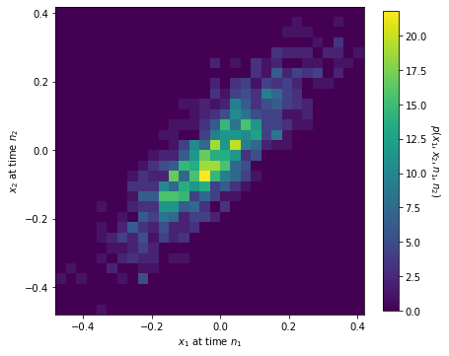
Example of joint PDF estimation for water
times n₁ = 10, n₂ = 11
Dividing both x₁ and x₂ with the step of Δ = 0.03
The 2D bins are therefore squares Δ x Δ, with
surface of 0.0009
Interpretation of joint PDF: in case the value at n₁ is positive, it is likely that value at n₂ is also positive –correlation.
2D bin

Slide 37
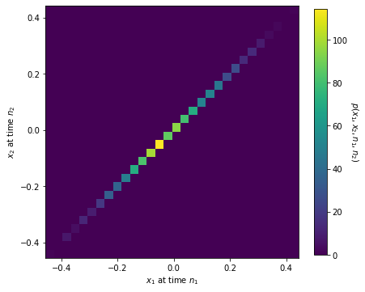
Joint PDF - n₁ = 10, and n₂ = 10
the same sample, the values of p(x₁, x₂, n₁, n₂) are on the diagonal and correspond to the standard (not joint) PDF p(x, n)

Slide 38
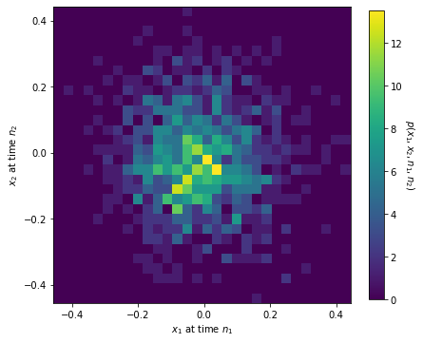
Joint PDF - n₁ = 10, and n₂ = 16
Can not say much about sample at time n₂ knowing the sample at time n₁ – no correlation.

Slide 39
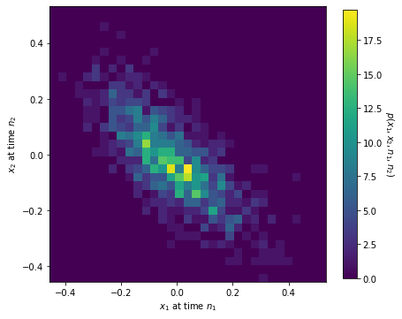
Joint PDF - n₁ = 10, and n₂ = 23
in case the value at n₁ is positive, it is likely that value at n₂ is negative – negative correlation, anti-correlation.

Slide 40
Agenda
Introduction, terminology and data for the rest of this lecture
Functions describing random signals - CDF, probabilities, and PDF
Relation between two times - joint probabilities and joint PDF
Moments - mean and variance
Correlation coefficients
Stationarity
Ergodicity and temporal estimates
Summary and todo's
<number> / 72

Slide 41
Moments (momenty)
Single numbers characterizing the random signal.
We are still fixed at time n !
A moment is an Expectation (očekávaná hodnota) of something
Expectation = sum _{all possible values of x} probability of x
times the thing that we’re expecting
  The computation depends on the character of the random signal
  Sum for discrete values (we have probabilities)
  Integral for continuous values (we have probability densities).

Slide 42
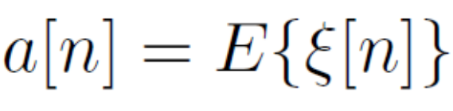
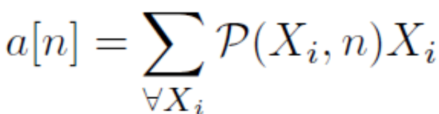
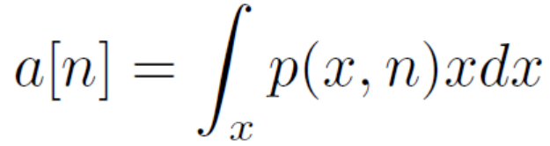
Mean value (střední hodnota)
Expectation of the value
  “what we’re expecting” is just the value.
Discrete case – discrete values X_{i}, probabilities P(X_{i}, n), we sum.
#mean_discrete
Continuous case – continuous variable x, probability density p(x,n), we integrate.
#mean_continuous
In the demos, pay attention to visualization of the
product “probability (or density) times the thing that we’re expecting” !

Slide 43
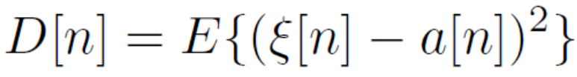
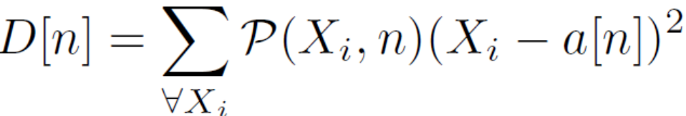
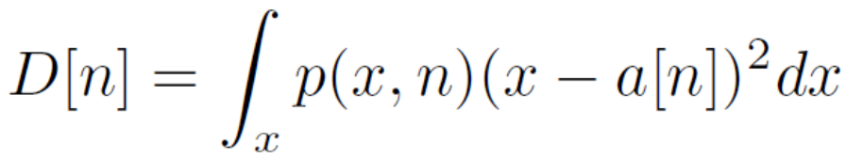
Variance (dispersion, variance, rozptyl)
Expectation of the zero-mean and squared value
  Related to energy, power …
Discrete case – discrete values (X_{i} - a[n])², probabilities P(X_{i} , n), we sum.
#variance_discrete
Continuous case – continuous values (x - a[n])², probability density p(x,n), we integrate.
#variance_continuous
In the demos, pay again attention to visualization of the
product “probability (or density) times the thing that we’re expecting” !

Slide 44
Ensemble estimates of mean and variance
n

Slide 45
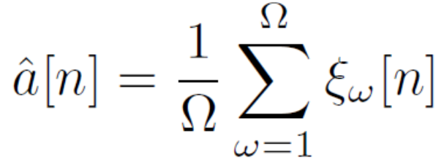
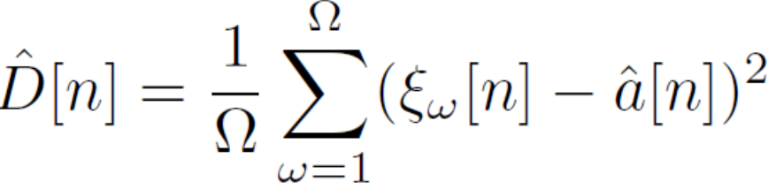
Just select data and use formulas known from high school !
Discrete values
#mean_variance_estimation_discrete
Continuous values
#mean_variance_estimation_continuous
Cool, the formulas are exactly the same !

Slide 46
Agenda
Introduction, terminology and data for the rest of this lecture
Functions describing random signals - CDF, probabilities, and PDF
Relation between two times - joint probabilities and joint PDF
Moments - mean and variance
Correlation coefficients
Stationarity
Ergodicity and temporal estimates
Summary and todo's
<number> / 72

Slide 47
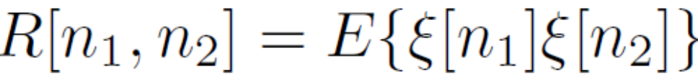
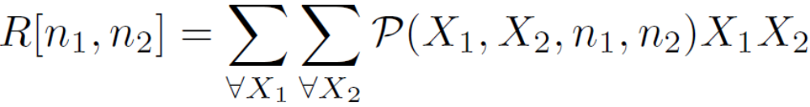
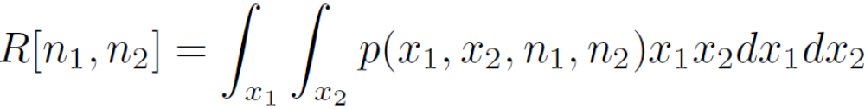
Correlation coefficient (korelační koeficient)
Expectation of the product of values at two different times
  One value characterizing the relation
  of two different times
Discrete case – discrete values X_{i} and X_{j,} joint probabilities P(X_{i} , X_{j} , n_{i} , n_{j}), we double-sum (over all values of X_{i} and over all values of X_{j} ).
#corrcoef_discrete
Continuous case – continuous values x_{i} and x_{j,} joint probability density function p(x_{i} , x_{j} , n_{i} , n_{j}), we double-integrate (over all values of x_{i} and over all values of x_{j}).
#corrcoef_continuous
In the demos, pay again attention
to visualization of the product “probability (or density) times the thing that we’re expecting” (this time in 2D) !

Slide 48
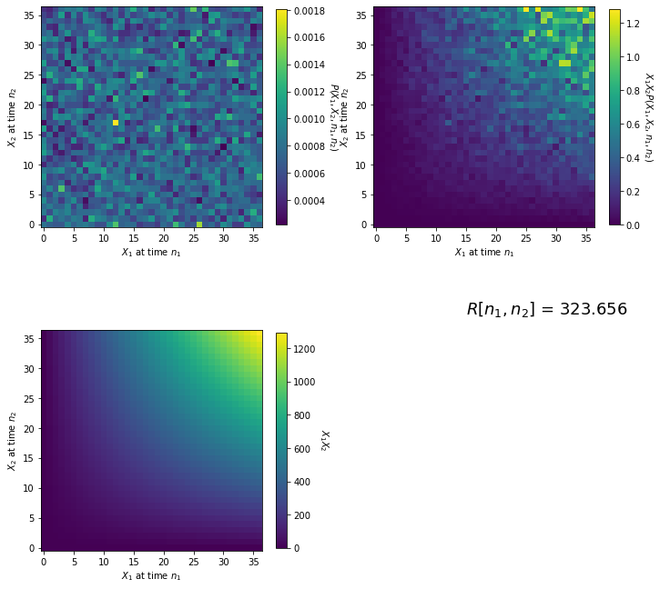
Discrete case
n₁ = 10, n₂ = 11
Some correlation
But the values have mean
value … if we remove it
323.6 – 18² = -0.4, this is
almost zero …
No correlation
<number> / 72

Slide 49
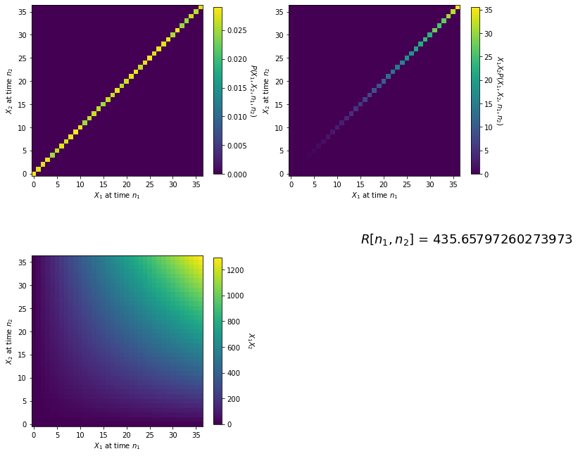
Discrete case
n₁ = 10, n₂ = 10
The same time
Maximum correlation
<number> / 72

Slide 50
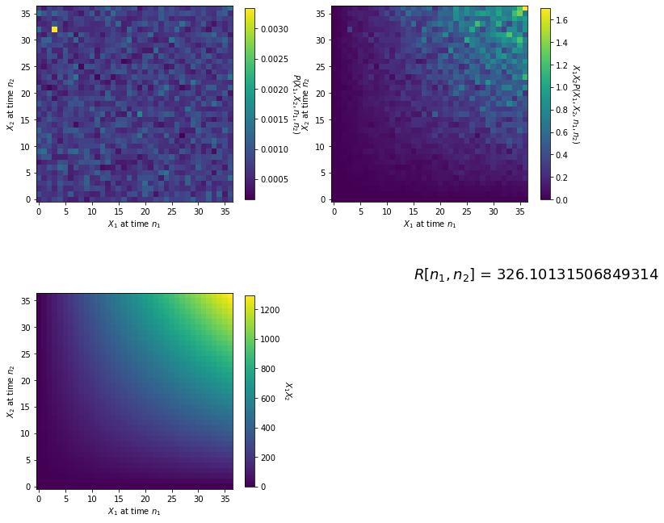
Discrete case
n₁ = 20, n₂ = 23
value … if we remove it
326.2 – 18² = 2.2,
This can mean something !
<number> / 72

Slide 51
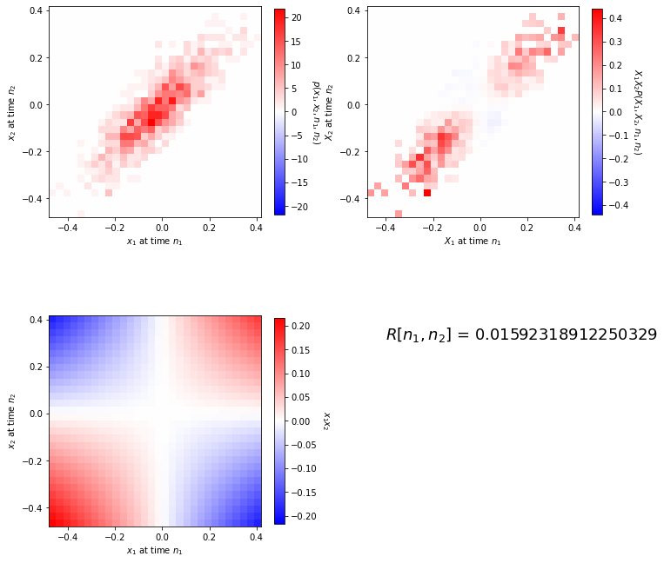
Continuous case
n₁ = 10, n₂ = 11
Try to imagine the product
x_{i} x_{j} – saddle function
(sedlová funkce)
The colormaps were
modified to show positive
values in red and negative
in blue
Positive parts prevalent
Correlated
<number> / 72

Slide 52
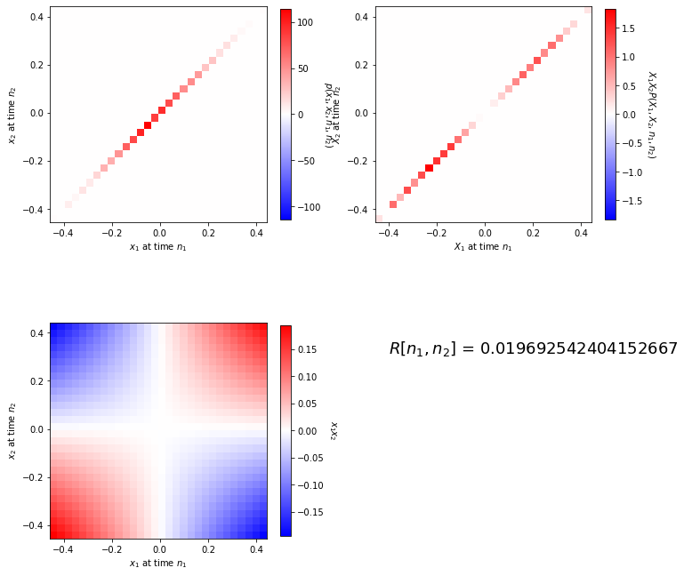
Continuous case
n₁ = 10, n₂ = 10
The same time
Maximum correlation
<number> / 72

Slide 53
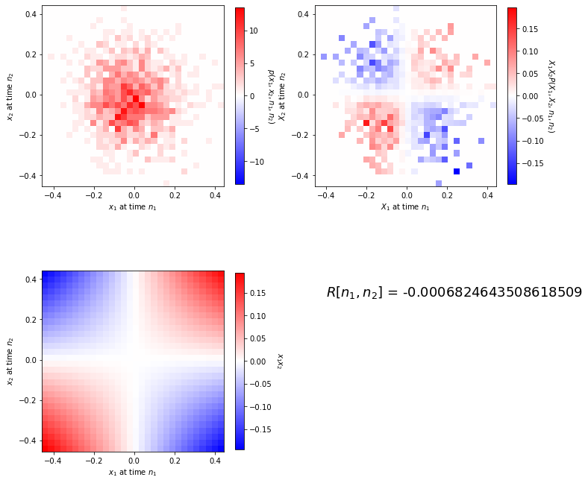
Continuous case
n₁ = 10, n₂ = 16
Can’t say anything about
sample at time n₂ knowing
the sample at time n₁
Positive parts cancel
the negative ones
No correlation
<number> / 72

Slide 54
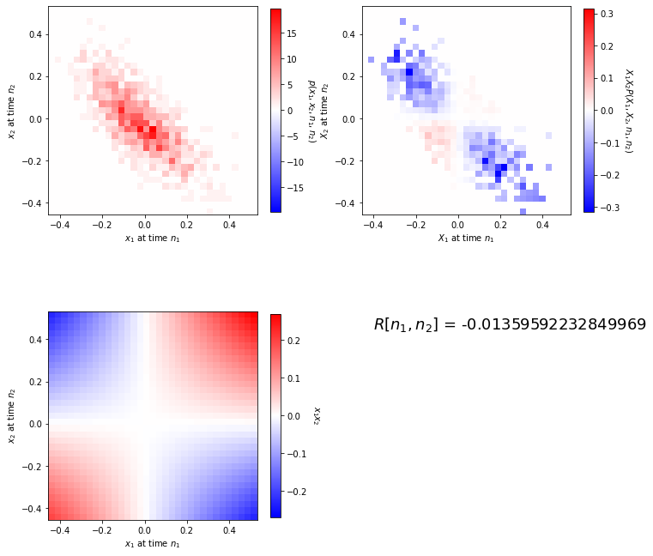
Continuous case
n₁ = 10, n₂ = 23
If sample at time n₁ is
positive, sample at time n₂
will be probably negative
and vice versa
Negative parts prevalent
Negative correlation,
anti-correlation
<number> / 72

Slide 55
Direct ensemble estimate of correlation coefficient
n₁
n₂

Slide 56
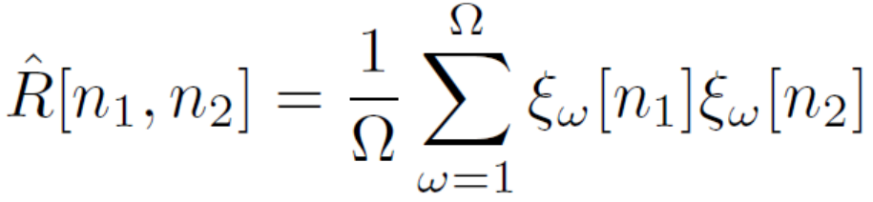
Just select data and multiply the two samples in each realization + normalize
Discrete values
#corrcoef_estimation_discrete
Continuous values
#corrcoef_estimation_continuous
Cool, the formulas are again exactly the same !

Slide 57
Computing a sequence of correlation coefficients: n₁ fixed and n₂ varying from n₁ to some value …
Discrete values – not sure if very useful …
#corrcoef_sequence_discrete
Continuous values – can bring interesting information about the spectrum.
#corrcoef_sequence_continuous

Slide 58
Agenda
Introduction, terminology and data for the rest of this lecture
Functions describing random signals - CDF, probabilities, and PDF
Relation between two times - joint probabilities and joint PDF
Moments - mean and variance
Correlation coefficients
Stationarity
Ergodicity and temporal estimates
Summary and todo's
<number> / 72

Slide 59
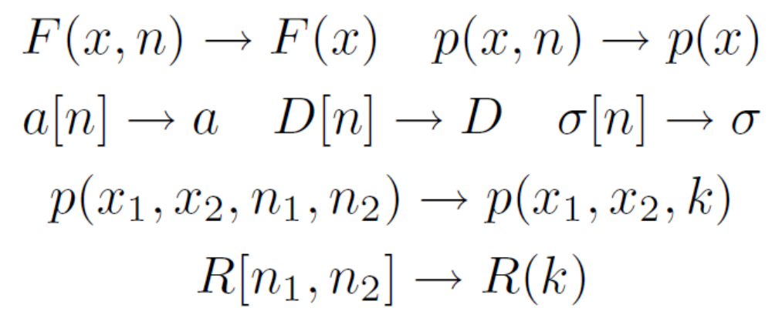
Stationarity (stacionarita)
The behavior of stationary random signal does not change over time (or at least we believe that it does not…)
Values and functions independent on time n
Correlation coefficients do not depend on n₁ and n₂, only on their difference k=n₂-n₁

Slide 60
Checking the stationarity
Are cumulative distribution functions F(x,n) approximately the same
for all samples n? (visualize a few)
Are probabilities approximately the same for all samples n? (visualize a few)
  Discrete: probabilities P(X_{i} , n)
  Continuous: probability density functions p(x, n)
Are means a[n] approximately the same for all samples n ?
Are variances D[n] approximately the same for all samples n ?
Are correlation coefficients depending only on the distance k = n₂ – n₁ and not on the absolute position ?

Slide 61
Results
#stationarity_check_discrete
#stationarity_check_continuous
Stationary
Stationary

Slide 62
Agenda
Introduction, terminology and data for the rest of this lecture
Functions describing random signals - CDF, probabilities, and PDF
Relation between two times - joint probabilities and joint PDF
Moments - mean and variance
Correlation coefficients
Stationarity
Ergodicity and temporal estimates
Summary and todo's
<number> / 72

Slide 63


Ergodicity
The parameters can be estimated from one single realization – temporal estimates (časové odhady)
… or at least we hope
… most of the time, we’ll have to do it anyway, so at least trying to make it as long as we can.
… however, we should have stationarity in mind – compromises must be done for varying signals (speech, music, video …)

Slide 64


Temporal estimates
All estimations will be running on one realization
All sums going over realizations will be replaced by sums running over time.
#ergodic_discrete
#ergodic_continuous
Temporal estimates similar to ensemble ones

Slide 65




We can even do temporal estimates of joint probabilities !
As above, replacing counting over realizations by counting over time.
#ergodic_joint_probabilities
For k = 0, 1, 2, 3
Notes:
Can run a similar exercise also on PDF estimation for continuous valued signals, up to you as a homework ☺

Slide 66
Agenda
Introduction, terminology and data for the rest of this lecture
Functions describing random signals - CDF, probabilities, and PDF
Relation between two times - joint probabilities and joint PDF
Moments - mean and variance
Correlation coefficients
Stationarity
Ergodicity and temporal estimates
Summary and todo's
<number> / 72

Slide 67
SUMMARY
Random signals are of high interest
  Everywhere around us
  They carry information
Discrete vs. continuous range
Can not precisely define them, other means of description
  Set of realizations
  Functions – cumulative distribution, probabilities, probability density
  Scalars – moments
  Behavior between two times
    Functions: joint probabilities or joint PDFs.
    Scalars: correlation coefficients

Slide 68
SUMMARY II.
Counts
  of an event „how many times did you see the water signal in interval 5 to 10?“
Probabilities
  Estimated as count / total.
Probability density
  Estimated as Probability / size of interval (1D or 2D)
In case we have a set of realizations – ensemble estimates.

Slide 69
SUMMARY III.
Stationarity – behavior not depending on time.
Ergodicity – everything can be estimated from one realization
  Temporal estimates

Slide 70
TODO’s
More on correlation coefficients and their estimation
Spectral analysis of random signals and their filtering
What is white noise and why is it white.
How does quantization work and how can random signals help us in determining the SNR (signal to noise ratio) caused by quantization.

