Slide 1
Image processing fundamentals
Honza Černocký, ÚPGM
Please open Python notebook images - thanks Petr Pálka for many Python hints!

Slide 2
Agenda
1D versus 2D signals
Basic operations with individual pixels
Image filtering
Spectral analysis of images - fundamentals
2D Discrete Fourier Transform (2D DFT)
2D Discrete cosine transform (2D DCT)
Summary

Slide 3
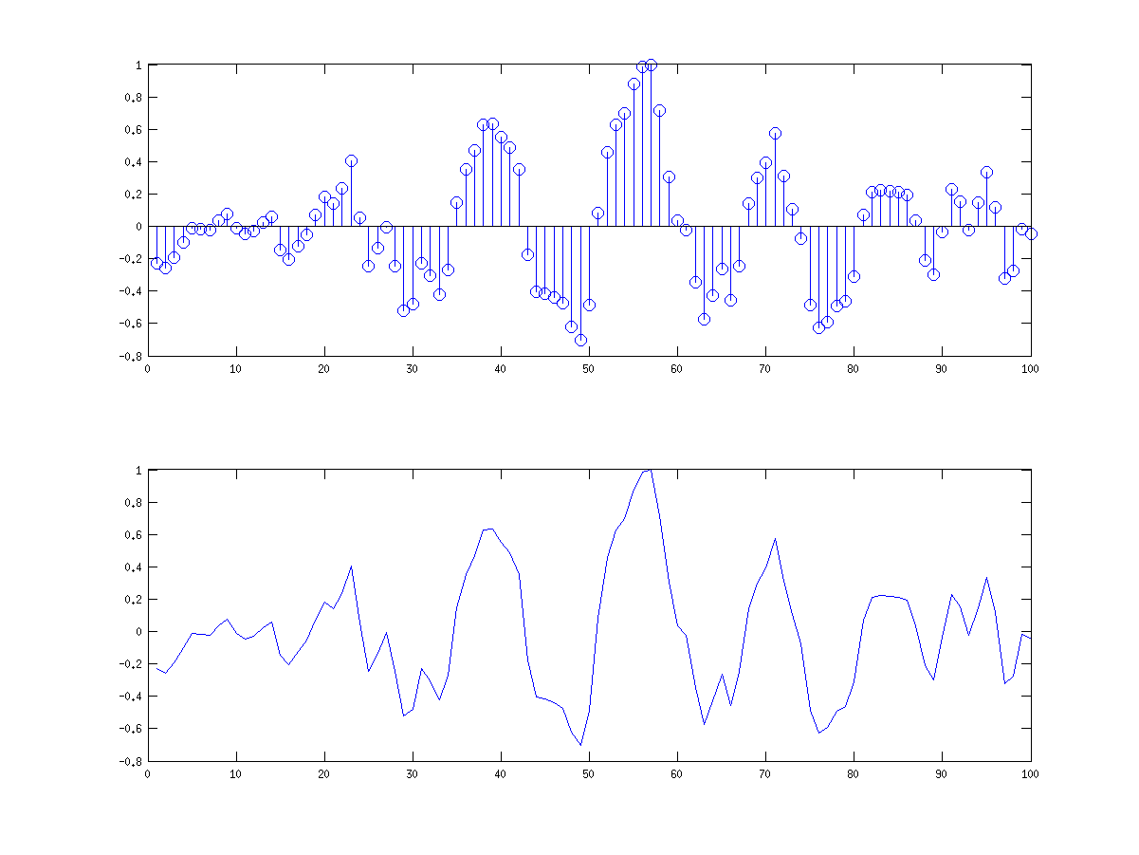
Reminder of 1D signal
We will stay with discrete-time signals x[n].
Typical 1D signal has N samples, from x[0] to x[N-1]
In C or Python, we represent it by an array.

Slide 4
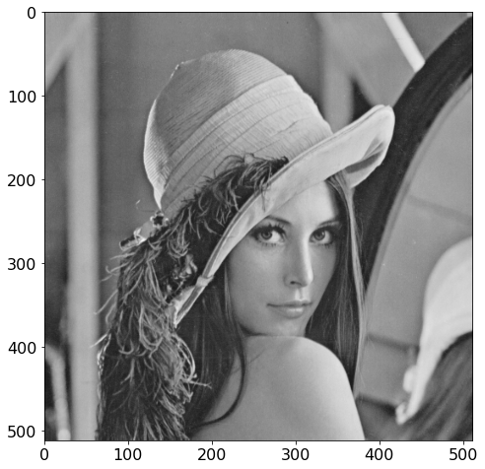
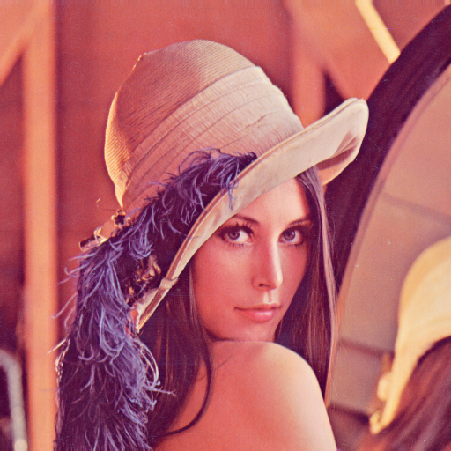

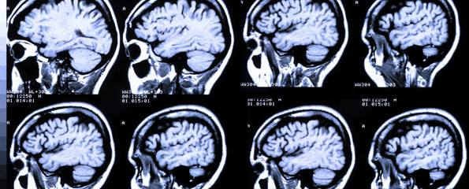
Images have more dimensions than 1D
2D – grayscale photo
Multiple 2D – color photo
3D – medical imaging, point-clouds (depth information, Kinect)
Video – time is another dimension

Slide 5
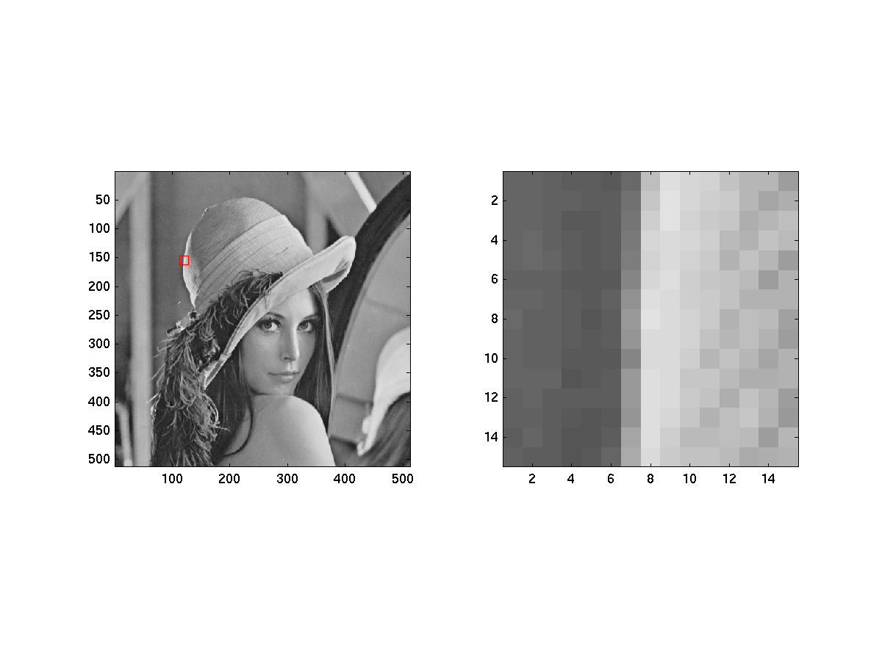
Representation of image as a matrix
x[k,l] are “picture elements” – pixels
Horizontal dimension – K rows
Vertical dimension – L columns
K
L

Slide 6
Representation of pixels
For storage – quantization
8 – standard bit-depth
16 or 24 bits – high dynamic range (HDR)
Color images – several different color models (RGB, CMYK, …) – too much for ISS, happy to let these to the specialized computer graphics and computer vision courses.
When reading it, values 0…255 (for 8 bits).
For computing, we better normalize to [0…1] and represent the values as floats
#reading_and_visualization

Slide 7
Agenda
1D versus 2D signals
Basic operations with individual pixels
Image filtering
Spectral analysis of images - fundamentals
2D Discrete Fourier Transform (2D DFT)
2D Discrete cosine transform (2D DCT)
Summary

Slide 8
Operations on individual pixels
Brightness (jas) – adding a constant to each pixel: y[k,l] = x[k,l] + a
More brightness for a > 0
Less brightness for a < 0
Contrast (kontrast) – multiplying each pixel by a constant: y[k,l] = a x[k,l]
More contrast for a > 1
Less contrast for a < 1
Inversion of colors (negativ): y[k,l] = 1 – x[k,l]
#pixel_operations_brightness #pixel_operations_contrast #pixel_operations_inversion

Slide 9
What about bad values ?
In case x[k,l] < 0 or x[k,l] > 1 after our computation, we can
Let them be … maybe they will get fixed in further computation
Do nothing and hope that the visualization functions will fix it (in case we specify lower and higher limit for the colormap, they will).
Clip them by hand

Slide 10
Thresholding (prahování)
Conversion of grayscale to black & white images (good for text, music scores, etc)
In case x[k,l] is above a threshold, set it to 1.
Otherwise zero.
#pixel_operations_thresholding

Slide 11
Histogram equalization (ekvalizace histogramu)
Very common image processing operation
We compute the histogram of values (we can use the original quantization or define intervals by hand)
We estimate a cumulative distribution function (CDF) – see the last lecture.
We estimate a mapping function that will “straighten” the CDF, this will give us the color mapping.
We map the colors using this mapping
… and we check the resulting histogram
#pixel_operations_histogram_eq

Slide 12
Agenda
1D versus 2D signals
Basic operations with individual pixels
Image filtering
Spectral analysis of images - fundamentals
2D Discrete Fourier Transform (2D DFT)
2D Discrete cosine transform (2D DCT)
Summary

Slide 13
Filtering
filter
signal
signal
Why ? to obtain a new signal with desired properties
Reminder of 1D filtering – FIR only !

Slide 14
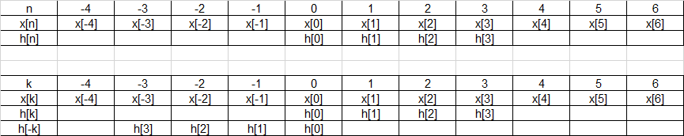
Reminder of 1D FIR filtering – convolution with impulse response
k is an auxiliary variable, usually not running from -ꝏ to +ꝏ.
Let’s start with renaming the signals from x[n] and h[n] to x[k] and h[k] and flipping h[k] to h[-k]

Slide 15
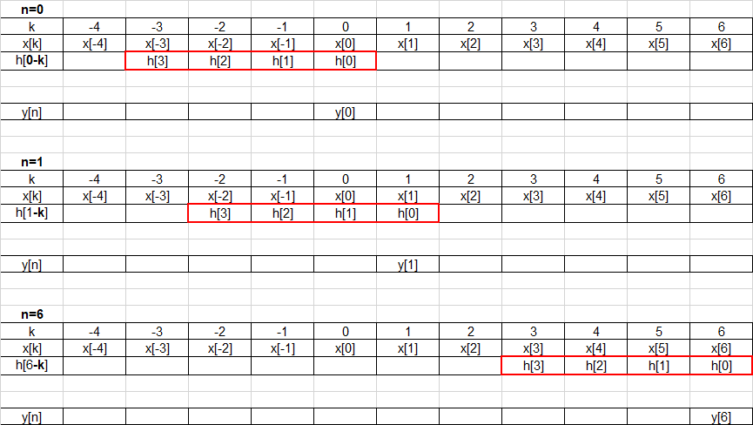
And proceed by computing output samples for different n’s
Σ
Σ
Σ

Slide 16
1D Convolution - summary
Flip the impulse response
For all meaningful output samples n
Shift flipped impulse response to given „n“
Mutliply
Add
Write the result to y[n]

Slide 17

2D filtering (2D filtrace) - convolution with 2D impulse response
Terminology – h[k,l] is called
Filter coefficients (koeficienty filtru)
Impulse response (impulsní odezva)
Mask (maska)
Convolution kernel (konvoluční jádro)
While for 1D, we respect the causality (h[n] = 0 for n < 0), for 2D, the mask h[k,l] is usually symmetrical.
We want coefficients h[k,l]
to have some sense and do what we want
not to change the dynamics of the signal

Slide 18
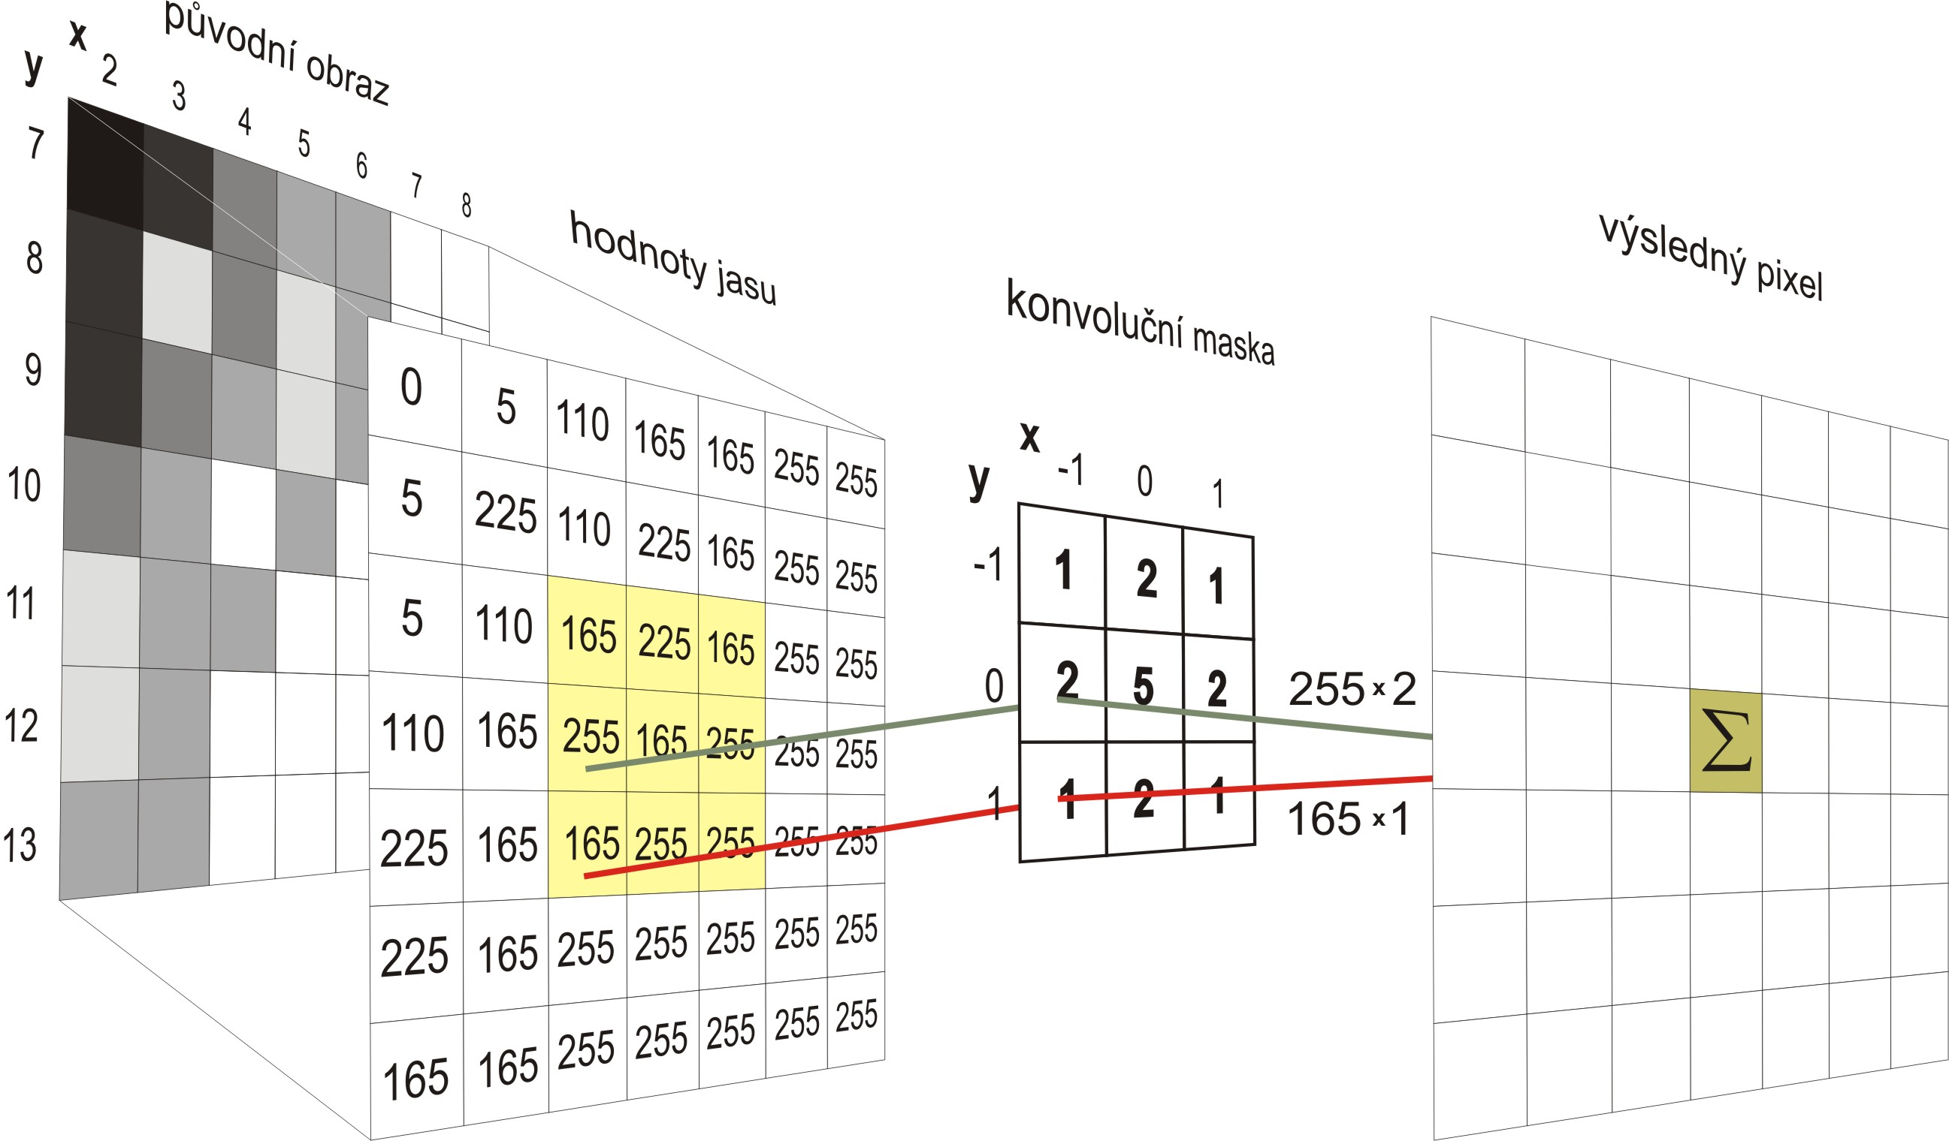
Source https://commons.wikimedia.org/wiki/File:Konvoluce_2rozm_diskretni.jpg

Slide 19
What to do with the edges ?
Accept that the resulting image will be smaller
Add zeros around the original image so that the convolution kernel has always samples to process – default functioning of filtering functions (both 1D and 2D).
Repeat 1st and last line and 1st and last column as many times as needed.
Wrap the image to “tube” line-wise and column wise.

Slide 20
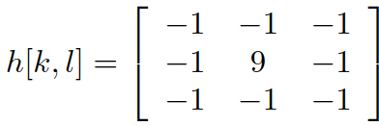
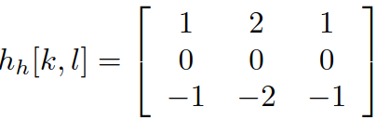
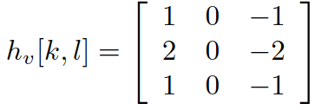
Examples of typical filters
Wire (drát)
Smoothing (vyhlazování) Sharpening (zaostřování)
Sobel operators – edge detectors (detektory hran)
Horizontal edges Vertical edges
We need to process samples smaller than zero – we can take absolute value
Both Sobel operators together
#2d_filter_examples

Slide 21
Denoising of images (odšumování)
Denoise but at the same time, preserve the edges in image…
Denoising with mask 9 x 9, and values 1/81 – removes noise but also blurs the edges.
Median filtering (mediánová filtrace) is a non-linear operation:
Reminder what is median:
Order all values in increasing order
Pick the one in the center
Median is not mean ! For x = [[1 1 1], [1 1 1], [0 0 0]]
Median is 1 – edges are preserved
Mean is 2/3 – edges are blurred
#denoising_mean_vs_median

Slide 22
Agenda
1D versus 2D signals
Basic operations with individual pixels
Image filtering
Spectral analysis of images - fundamentals
2D Discrete Fourier Transform (2D DFT)
2D Discrete cosine transform (2D DCT)
Summary

Slide 23
Spectral analysis (spektrální analýza)
Task:
Determine, what is in the signal on different frequencies
We always ask:
Where is the given frequency
How much of signal (image) at given frequency
Shift (phase) of signal (image) at given frequency
Why ?
Visualization,
Feature extraction (think of machine learning, resp. “artificial intelligence”)
Filtering (conversion to spectral domain and multiplication therein can be efficient)
Coding (think of JPEG)

Slide 24
Reminder, how we did spectral analysis for 1D signals
}
Correlation
Determination of similarity
Projection to bases
Notation
x[n] is the unknown signal
a[n] is a known (generated) analysis signal
c is the resulting coefficient quantifying correlation / similarity / strength of projection
The same !

Slide 25
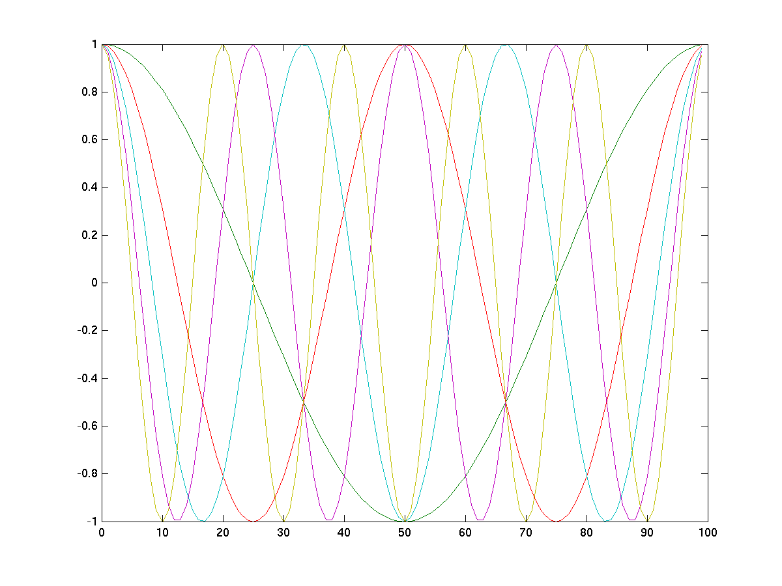
We first tried spectral analysis with cosine bases
But we soon found a problem with the phase – the signal “wave” does not necessarily have zero phase as the cosine …

Slide 26
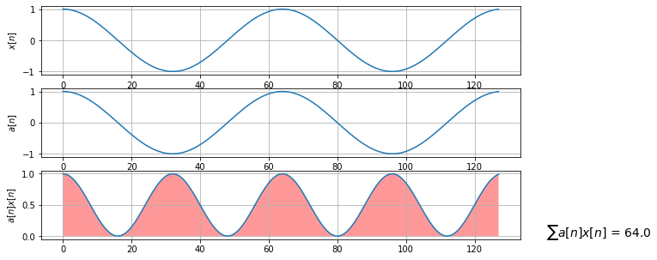
Illustration of correct behavior

Slide 27
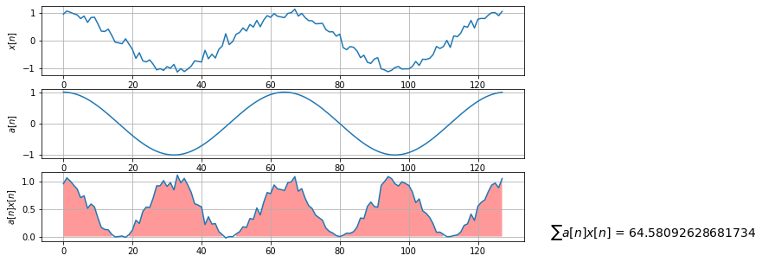
Still correct behavior

Slide 28
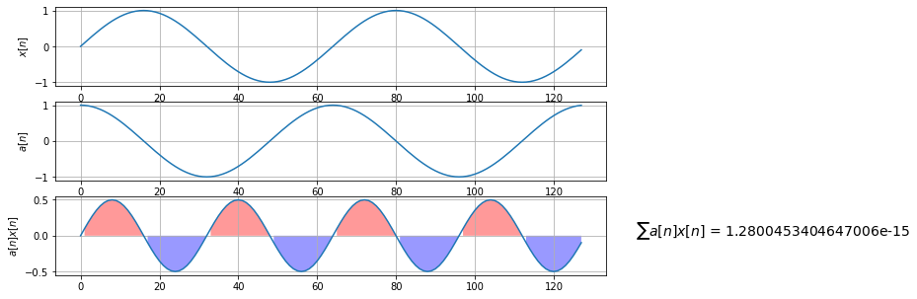
Bad – sine is not similar to cosine …

Slide 29
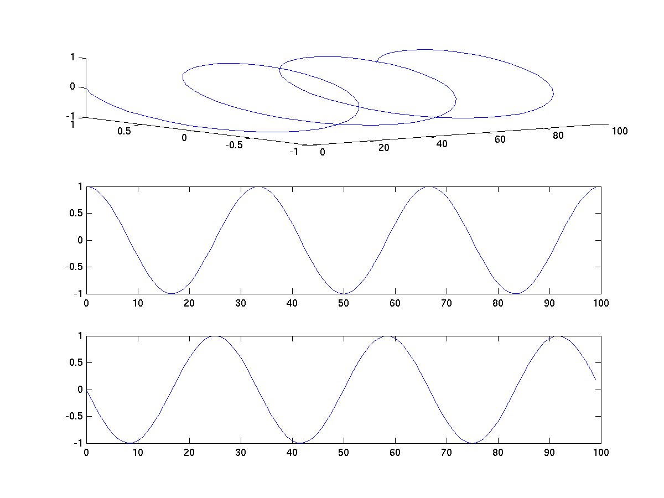
Solution - complex exponentials that contain both cosine and sine

Slide 30
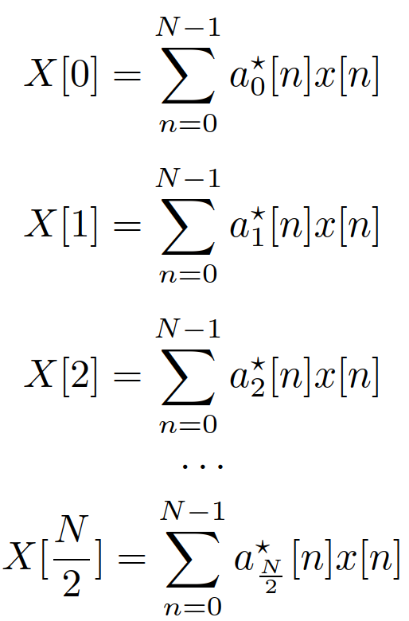
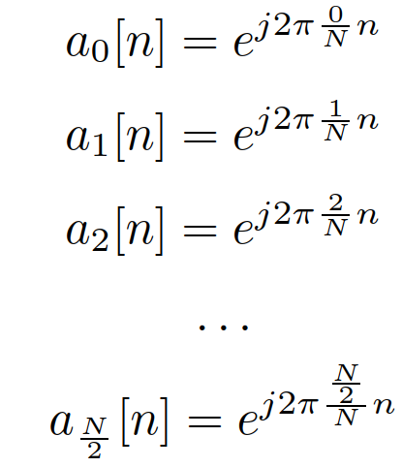
1D ultimate result – Discrete Fourier Transform (Diskrétní Fourierova transformace) - DFT
What does it tell us ?
Index k tells us which frequency
Magnitude (absolutní hodnota, modul) |X[k]| tells us how much
Phase (fáze, úhel, argument, fázový posuv) arg X[k] tells us how shifted
Symmetry of DFT: X[k] = X*[N-k],
|X[k]| = |X[N-k]|
arg X[k] = - arg X[k]
DFT is efficiently computed by FFT (for N = power of 2)

Slide 31
Now finally 2D
}
Correlation
Determination of similarity
Projection to bases
Notation
x[k,l] is the unknown signal (image)
a[k,l] is a known (generated) analysis signal (image)
c is the resulting coefficient quantifying correlation / similarity / strength of projection
We have seen this, it’s boring, it’s all the time the same … SORRY IT REALLY IS !
The same !

Slide 32
Analyzing an image with simple analysis signals
We define small 100 x 100 pixels images for demonstration.
We need to change the colormap to be able to visualize both positive and negative numbers.
D.C. analysis signal a[k,l] = 1: the most stupid but still able to determine the average brightness in an image #dc_image_analysis
Analysis with a cosine running in one direction
Cosine in each line – 1 period, all lines are the same
Cosine in each line – 2 periods, all lines are the same
Similarly for cosines in each column, all columns are the same
#cosine_analysis

Slide 33
Analyzing with cosines in both directions
So far, we have seen cosines in each direction separately, such as
but we can also run both by making the argument depending on both k and l:
#cos_both_directions
We can generalize this to
where
m/K – is the normalized vertical frequency
n/L – is the normalized horizontal frequency

Slide 34
What is reasonable ranges of frequencies ?
For m/K and n/L, values 0 … ½ are OK
Value = ½ will lead to the fastest cosine changing sign at every sample: cos (2 π ½ k) = cos (π k)
Therefore, we should limit m to 0…K/2 and n to 0…L/2
0
x[k,l]
X[k,l]
K
K/2
0
L/2
L

Slide 35





Notes on frequencies 1D
For 1D signals, the one axis is usually the time in seconds
For continuous time signals, we define frequency in Hz:
Sampling frequency is number of samples per second
Normalized frequency is the true one over sampling frequency
In 1D spectral analysis, we obtain the results – coefficients X[k] for normalized frequencies (N is the number of samples)
If needed, the true frequency is obtained by de-normalizing:
it is in [Hz]

Slide 36




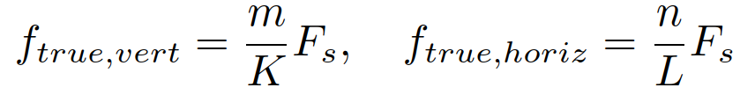
Notes on frequencies 2D
For 2D signals, the two axes are the dimensions of the image
For continuous images, we define the frequency as events per unit length – most often dots per inch (dpi)
Sampling frequency is number of pixels per inch
Normalized frequency is the true one over sampling frequency
In 2D spectral analysis, we obtain the results – coefficients X[m,n] for normalized frequencies (K is the vertical size of image, L is the horizontal size)
If needed, the true frequency in events per inch is obtained by de-normalizing:

Slide 37
Problem of analysis with cosines …
So far, we saw nice results, as we worked with “unknown” signals with zero phase.
In case the phase changes, we will encounter the same problem as for 1D – the similarity (correlation, projection) coefficients can be low for very similar signals !
#cosine_analysis_problem

Slide 38
Agenda
1D versus 2D signals
Basic operations with individual pixels
Image filtering
Spectral analysis of images - fundamentals
2D Discrete Fourier Transform (2D DFT)
2D Discrete cosine transform (2D DCT)
Summary

Slide 39
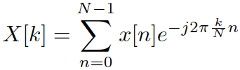
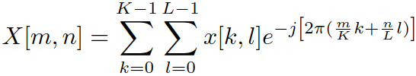
2D Discrete Fourier Transform – 2D DFT
The solution are (again) complex exponentials including both cos and sin components
From 1D DFT to 2D DFT
where
k,l are indices of input pixels
m,n are indices of frequencies of resulting coefficients X[m,n]
m/K are normalized vertical frequencies
n/L are normalized horizontal frequencies
numpy.fft.fft2, but let us see a few examples done “by hand”

Slide 40

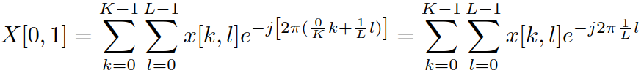
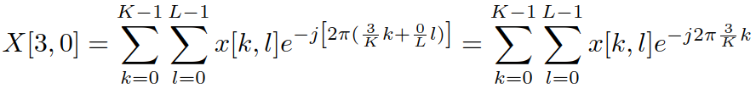
#2d_dft_examples
Visualizing x[k,l] and real and imaginary parts of a[k,l] and x[k,l] a[k,l]
m=0, n=0 – 2D DFT computes the sum of all pixels
m=0, n=1 – 2D DFT degrades to sum of 1D DFT in lines (1 turn of complex exp)
m=3, n=0 – 2D DFT degrades to sum of 1D DFT in columns (3 turns of complex exp).
m=4, n=7 – full 2D DFT

Slide 41
Does 2D DFT fix the problem with shifting of the phase ?
We have seen that simple analysis with a cosine has a problem with the same image that is shifted (cos vs sin).
Let us try some of the shifts and let us look at the resulting 2D-DFT coefficient.
#2d_dft_shifts
yes, 2D DFT fixes the problem
Magnitude of X[m,n] gives us correct answer to “how much”
Angle of X[m,n] informs us about “how shifted”

Slide 42
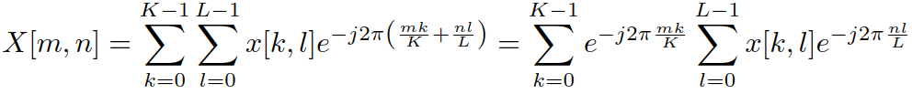
2D DFT is 2 x 1D DFT
With the known formula e^{a+b} = eªe^{b}, we can show that
… or the other way round.
So that 2D DFT can be implemented as
a sequence of 1D-DFT in rows followed by 1D-DFT in columns
or vice versa.

Slide 43
Examples of 2D DFT for real signals
Showing only the magnitude
Magnitudes have a high dynamic range – we need some tweaks …
Setting the color axis limits by hand
Taking logarithm …
Lena - real images tend to have frequencies concentrated around zero
To see significant proportion of high frequencies, we generate an artificial signal – squares + noise.
#2d_dft_lena_squares (back to the original size of 512 x 512 pixels)

Slide 44
DFT produces K x L points !
Remember – the range of “useful” normalized frequencies for 1D was from 0 to ½ (i.e. k = 0… N/2), but we compute it for full range k=0…N-1
The same holds for 2D DFT, we obtain the results also for full ranges of m = 0…K-1, and n = 0…L-1
x[k,l]
X[k,l]
K
K
L
L

Slide 45


Symmetries in 2D DFT
0
L/2
L-1
0
In 1D, we had symmetry
In 2D, we also have symmetry
Determining the number of valid values in 2D is more complicated but it is equal to the number of samples: K x L
By fftshift, we can re-arrange the values to have zero frequencies in the center.
#2d_dft_full
K/2
K-1
Source: http://www-personal.umich.edu/~hyunjinp/notes/n-dft.pdf

Slide 46
Inverse 2D DFT
Similarly to 1D inverse DFT, we can define 2D inverse DFT
Don’t forget the phase !
It can be used for filtering in frequency by multiplying 2D DFT Y[m,n] = M[m,n] X[m,n], where M[m,n] is called a mask
Beware about the symmetries – the resulting spectrum needs to be symmetrical before running it through 2D-IDFT !
#2d_dft_idft_filtering

Slide 47
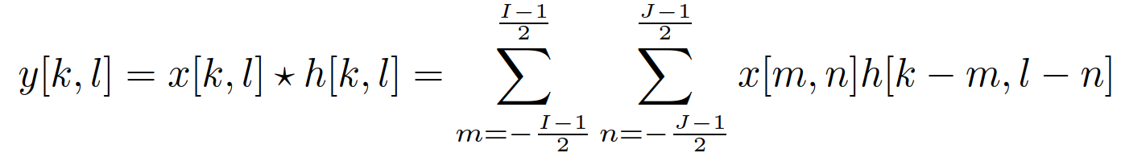
Filtering in image and spectral domains
In image domain, the filtering is done by convolution (see the 1st part of this lecture)
In frequency, we have done it by multiplication by a mask: Y[m,n] = M[m,n] X[m,n]
Why do we see stripes on the image resulting from rectangular mask ? See corresponding impulse response of a 2D filter
We can (of course) get it by 2D-IDFT + re-shuffling of samples so that 0 is in the center.
2D cardinal sine is responsible !
#filter_corresponding_to_rectangular_freq_mask

Slide 48
Agenda
1D versus 2D signals
Basic operations with individual pixels
Image filtering
Spectral analysis of images - fundamentals
2D Discrete Fourier Transform (2D DFT)
2D Discrete cosine transform (2D DCT)
Summary

Slide 49
Why ?
People don’t like complex exponentials
People don’t like symmetries and “useless” values …
For image K x L, we want K x L real values to fully represent the image.

Slide 50

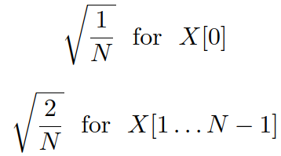
1D Discrete cosine transform (diskrétní cosinová transformace) – DCT
For DFT, the frequencies of complex exponentials were k/N – i.e. they did integer number of periods per N samples: 1,2,3, ...
The result is N complex numbers, only N/2 of these are unique.
DCT works with cosines that grow with half period, i.e. 0.5, 1, 1.5, …
The result of DCT are N real numbers, all are unique.
Normalization coefficients are also different from DFT
#dct_1d by hand and using scipy.fftpack.dct

Slide 51
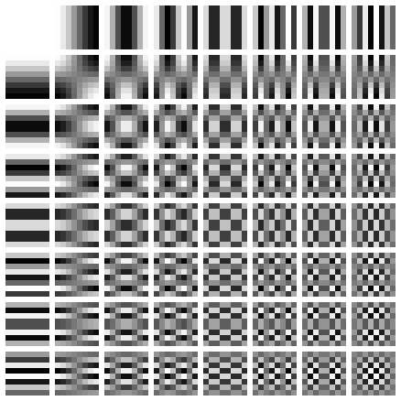
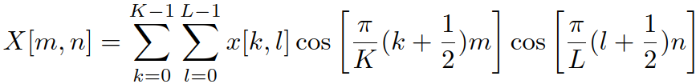
2D Discrete cosine transform
Similar as 2D-DFT – the bases run in both directions
Similarly as for 2D-DFT, 2D DCT can be implemented as
a sequence of 1D-DCT in rows followed by 1D-DCT in columns
or the other way round
The most known are 8x8 2D-DCT bases (JPEG)
scipy.fftpack.dctn
Source: https://en.wikipedia.org/wiki/Discrete_cosine_transform#Multidimensional_DCTs

Slide 52
Filtering in DCT domain
Obtain DCT coefficients X[m,n]
Apply a mask: this time it does not need to respect any symmetries: Y[m,n] = M[m,n] X[m,n]
Apply inverse DCT
#dct_filtering

Slide 53
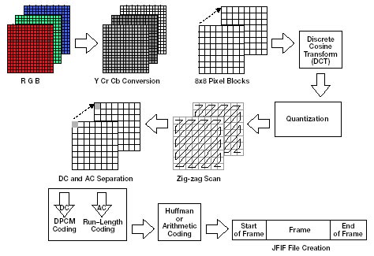
2D-DCT is a crucial operation in JPEG image compression
Segmentation of image into 8x8 pixel blocks
Selecting only to the most important DCT coefficients
Different techniques to encode the coefficients
More in image processing course
Beautiful demo in the study part of ISS project, part of Bachelor thesis by Petr Pálka)
#Petr’s file ‘image’
Source: http://www.eetimes.com/document.asp?doc_id=1225736

Slide 54
Agenda
1D versus 2D signals
Basic operations with individual pixels
Image filtering
Spectral analysis of images - fundamentals
2D Discrete Fourier Transform (2D DFT)
2D Discrete cosine transform (2D DCT)
Summary

Slide 55
SUMMARY
Image is a 2D signal
Filtering
2D convolution, analogy with 1D FIR filters
No feedback (IIR) in images
Sweeping mask over the image, multiplying everything that is underneath with its coefficients, adding.

Slide 56
SUMMARY II.
Frequency analysis in 2D
Similar to 1D – projection to bases
Image frequencies also have some sense.
Cos bases are a good exercise, but have a problem with the phases of the input image.
2D DFT
Projection/similarity/correlation with complex exponentials
The resulting coefficients X[m,n] are complex – magnitude and phase.
Lots of symmetries in the resulting DFT matrix
We can use spectrum for filtering, make sure to make the mask also symmetrical.

Slide 57
SUMMARY III.
2D DCT
2x „slower“ bases than DFT
Slightly more complicated definition
Produces real coefficients, low frequencies (only!) at the beginning.
Use in JPEG

