Slide 1
Continuous-time signals I.
Honza Černocký, ÚPGM
Please open Python notebooks continuous_1, fs, ft

Slide 2
Agenda
Basic information, operations with time
Important signals – with links to discrete ones
Periodic signals
Energy and power
Spectral analysis of periodic signals – Fourier series
FS of typical signals
Properties of FS and power by FS
Spectral analysis of non-periodic signals: Fourier transform
FT of typical signals
Properties of FT and energy by FT
Summary

Slide 3
Remember lecture 1 … functions and sequences
Signals with continuous time (analog, real world) are defined for all times t. Signály se spojitým časem, spojité signály.
From math point of view, they are functions x(t) ← round brackets
Signals with discrete time (computer, digital world), sampled signals are defined only for integer times (sample numbers) n. Signály s diskrétním časem, diskrétní signály, vzorkované signály.
From math point of view, they are sequences x[n] ← square brackets.

Slide 4
Continuous time signals
Time (horizontal axis) is in seconds [s]
Frequencies will be true ones - in 1/s – Hertz [Hz]
Continuous–time signals are really defined for all times.
When plotting, we’ll use some small time-step and we’ll definitely use plot.
Reminder – for discrete-time signals, we either emphasized that they are discrete and used stem, or did not care and used plot.
#continuous_plotting
When generating a signal in Python (or any other programming language), you can advantageously use indexing by results of conditions.
#use_conditions

Slide 5
Time modifications of continuous signals
Reversal of the time axis (otočení): y(t) = x(-t)
Basic time shifts
Delay (zpoždění) – shift to the right: y(t) = x(t – τ)
Advance (předběhnutí) – shift to the left: y(t) = x(t + τ)
Reversal of the time axis and time shifts:
Reversal and shift to the right: y(t) = x(-t + τ)
Reversal and shift to the left: y(t) = x(-t - τ)
Unsure ? Run a check:
Select an important event in the signal
For the modified signal, evaluate the time modification for this event
Look at the resulting time in the original signal.
Same event as in the modified one ? OK
Different event ? BAD, DO IT AGAIN
#time_modifications

Slide 6
Modifying the speed of time …
Contraction of time (kontrakce, zrychlení času): y(t) = x(mt) for m > 1 – everything will run faster
Dilation of time (dilatace, zpomalení času): y(t) = x(mt) for m < 1 – everything will run slower.
We rarely manage to slow-down or speed-up time in real world, but we can use this know-how to compute / draw a faster or slower signal provided we know the original one.
#time_contraction_dilation

Slide 7
Agenda
Basic information, operations with time
Important signals – with links to discrete ones
Periodic signals
Energy and power
Spectral analysis of periodic signals – Fourier series
FS of typical signals
Properties of FS and power by FS
Spectral analysis of non-periodic signals: Fourier transform
FT of typical signals
Properties of FT and energy by FT
Summary

Slide 8
Constant signal
Discrete: x[n] = const
Continuous: x(t) = const
Constant signals are very useful – remember charging your cell phone ☺
Constant signal has zero frequency.
#constant_signal

Slide 9


Unit step (jednotkový skok) and unit pulse (jednotkový impuls) – discrete
Unit step: all samples below n = 0 are zero:
Unit pulse: all samples except n = 0 are zero:
Unit pulse can be given as a difference of basic and shifted unit steps: δ[n] = σ[n] - σ[n-1]
#discrete_unit_step_pulse

Slide 10


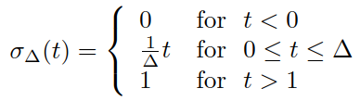
Unit step in continuous time
Unit step: signal below t = 0 is zero:
Unit pulse should be defined as:
But it is hard to derive unit pulse, as the derivation in t = 0 is not defined.
Therefore, we define approximate (smooth) unit step with width Δ and derive it:
#unit_step_derivation

Slide 11
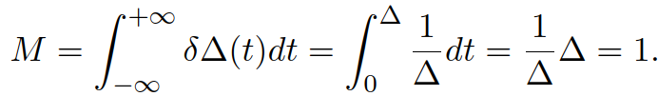

Dirac pulse (Diracův impuls)
The surface – “mighteness” (mocnost) is
We run Δ to zero, and we obtain the Dirac pulse:
The width is zero, the value is infinity.
The surface is however still one
Mathematicians often refuse to call this a function, and rather call it distribution.
We usually plot it with as a square with an arrow going to “infinity”.
Dirac pulse can not be generated – it is a (very useful!) theoretical construct
#dirac

Slide 12

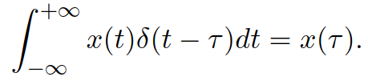
The sampling property of Dirac pulse
Dirac is relatively aggressive when multiplied with signal x(t): it sets everything to zero, except t = 0.
When integrated, the output value is x(0): the signal got sampled:
In case we shift the Dirac pulse to time τ, we obtain similar behavior
We will use this property when explaining the sampling.
#dirac_sampling

Slide 13
Agenda
Basic information, operations with time
Important signals – with links to discrete ones
Periodic signals
Energy and power
Spectral analysis of periodic signals – Fourier series
FS of typical signals
Properties of FS and power by FS
Spectral analysis of non-periodic signals: Fourier transform
FT of typical signals
Properties of FT and energy by FT
Summary

Slide 14


Periodic signals - continuous
Periodic signals have repetitive behavior …
We can find such T, that x(t + T) = x(t)
T is called period, but several T’s can exist …
T₁ is the smallest one, we call it fundamental period (základní perioda).
Periodic signals have fundamental frequency (základní frekvence) in 1/s (Hertz, Hz):
We often work with angular/circular frequency/velocity (kruhová/úhlová frekvence/rychlost)
#periodic_continuous

Slide 15


Periodic signals - discrete
We can find such N, that x[n + N] = x[n],
N is called period, but several N’s can exist …
N₁ is the smallest one: fundamental period (základní perioda).
Periodic signals have fundamental normalized frequency (základní normovaná frekvence) in []:
We often work with normalized angular/circular frequency / velocity (normovaná kruhová/úhlová frekvence/rychlost)
Conversion from N₁ to f₁ and ω₁ is straightforward, but not vice versa.
#periodic_discrete

Slide 16
Agenda
Basic information, operations with time
Important signals – with links to discrete ones
Periodic signals
Energy and power
Spectral analysis of periodic signals – Fourier series
FS of typical signals
Properties of FS and power by FS
Spectral analysis of non-periodic signals: Fourier transform
FT of typical signals
Properties of FT and energy by FT
Summary

Slide 17


Instantaneous power of a signal
Remember Ohm’s law:
Therefore, we define instantaneous power (okamžitý výkon) for both discrete and continuous signals as:
Magnitude is not needed when we work with real signals, but we should not forget it for complex ones … and we do have complex signals in ISS !

Slide 18
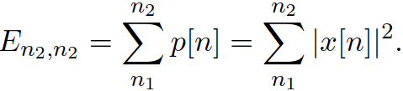



Energy and powers of signals
Energy (energie) is given as a sum (discrete signals) or integral (continuous signals) of instantaneous power over a time interval:
Mean power (střední výkon) is normalized by the length of the time interval:
Root mean square value (efektivní hodnota) is the magnitude of a d.c. signal with equivalent power:
#powers

Slide 19


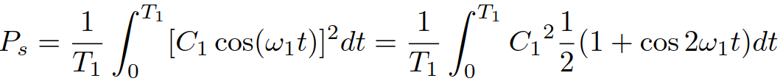
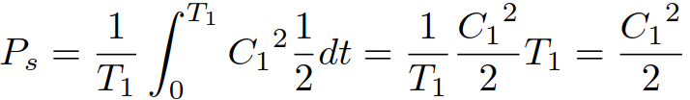
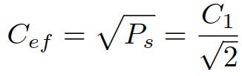
Powers of periodic signals and of a cosine
When determining power of periodic signals, it is wise to compute over (and normalize by) one period: N₁ (discrete) and T₁ (continuous ).
Computing power of a cosine is a basic task: T₁ and angular frequency ω_{1:}
With the help of basic formula , we can express the power as
The integral of any number of periods of cosine is 0, so the power is:
#cosine_power

Slide 20
Agenda
Basic information, operations with time
Important signals – with links to discrete ones
Periodic signals
Energy and power
Spectral analysis of periodic signals – Fourier series
FS of typical signals
Properties of FS and power by FS
Spectral analysis of non-periodic signals: Fourier transform
FT of typical signals
Properties of FT and energy by FT
Summary

Slide 21
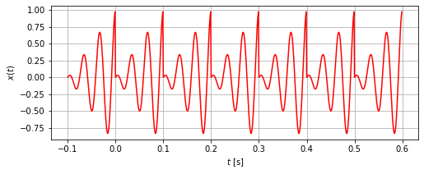

What do we require ?
From any spectral analysis, we want to know
Where are the frequencies in the signal
How strong is the signal at a given frequency – “how much”
What is the phase of the signal at a given frequency – “how shifted”.
We now have a periodic signal and we have seen that it can be composed of
The d.c. value
The slowest component (fundamental frequency)
Harmonically-related components at multiples of this frequency: kω₁
We will define Fourier series (Fourierova řada)
It is series, not a function, we will work with coefficients !
They will “sit” on a given frequency.

Slide 22
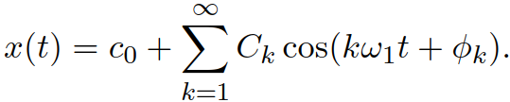
Real formulation of FS
We could write FS as a real function
c₀ is D.C. component
C_{k} is magnitude at frequency kω₁
Φ_{k} is phase at frequency kω₁
But this would make the computation of coefficients quite complicated
remember the problems with phase of cosine each time we tried to use them for analysis …

Slide 23
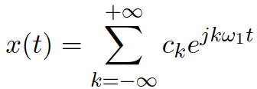
Complex formulation of FS
Complex form of FS is more practical and more frequent:
c₀ is D.C. component
c_{k} is a complex coefficient belonging to frequency kω₁
Its magnitude |c_{k}| determines the “strength” of signal at given frequency
Its phase arg c_{k} determines the “shift” of signal at given frequency.
We need c_{k} at kω₁ and c_{-k} at -kω₁ to sum up to one real cosine – same trick as we used for DTFT.
The formula above is called synthesis formula
The values and positions of coefficients c_{k} are called spectrum (remember “spectrum” is a generic term).
They are complex, so we will need 2 plots: magnitude and phase.

Slide 24
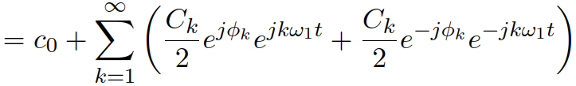
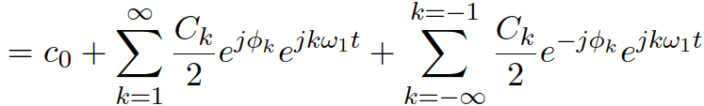


Relations between the real and complex forms
The conversion is easily done by breaking cos into a sum of two complex exponentials:
After re-arranging:
So we see the conversion real -> complex and vice versa:
For real signals x(t), there must be a symmetry of coefficients:
#cos_complex_exp

Slide 25




Computation of FS coefficients – analysis formula
By FS, we are actually decomposing the signal (projecting, computing similarity with, computing correlation with) into bases
We know that the projection can be done by a scalar product of the signal and the analysis signal.
Discrete: Continuous:
The signal is periodic, so it makes sense to integrate only over one period T₁ picked wherever we want:
0 to T_{1,} or -T₁ /2 to T₁ /2 or …
FS basis
is complex, so we need to take it in complex-conjugate form.
has norm T₁, (just try to compute the integral of its magnitude over one period T₁), so we need to divide by T₁.

Slide 26
Agenda
Basic information, operations with time
Important signals – with links to discrete ones
Periodic signals
Energy and power
Spectral analysis of periodic signals – Fourier series
FS of typical signals
Properties of FS and power by FS
Spectral analysis of non-periodic signals: Fourier transform
FT of typical signals
Properties of FT and energy by FT
Summary

Slide 27
Examples of FS computation
Examples
x(t) is complex exponential
x(t) is a cosine with magnitude and phase.
x(t) is a sequence of rectangular pulses
Computing FS – always respect the rule of maximum laziness !
Looking at the definition formula – can’t I find the FS coefficients directly ?
Integrating by hand (for “simple” deterministic signals, such as the rectangular pulses).
Integrating numerically – see next lecture, it will lead us to DFT.
Exercise your intuition
Slow changing signal has little high frequencies – few non-zero FS coefficients, narrow spectrum
Fast changing signal has lots of high frequencies – lots of non-zero FS coefficients, wide spectrum
An edge or pulse in the signal is a very fast change !

Slide 28





FS of a complex exponential and cosine
Plain complex exponential:
This is the simples case, as we can directly relate it to the synthesis formula. c₁ = 1, and it “sits” at ω₁
Complex exponential multiplied by a constant:
Dtto, the coefficient is the constant
Examples for ω₁ = 2000π rad/s
#fs_complex_exp
Cosine with a magnitude and phase
We have seen that we can break it into two complex exponentials at ω₁ and at -ω₁
#fs_cos

Slide 29
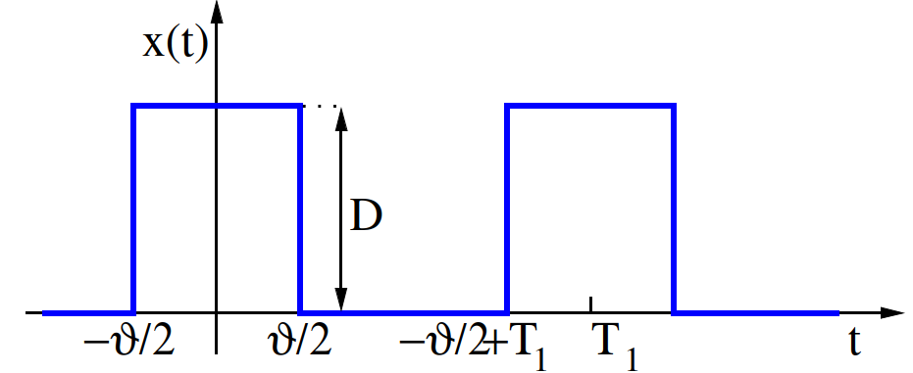
FS of a series of rectangular pulses
Period T₁ , height D and width of pulses ϑ.
The ratio ϑ / T₁ is called “duty cycle” (střída)
We will need to do some integration here … but first some intuition:
There are sharp edges, so the spectrum will have lots of high frequencies.
Narrow (fast) pulses will lead to even broader spectrum
Wide (slow) pulses will lead to narrower spectrum

Slide 30

Preparation I – cardinal sine
Cardinal sine is defined as
At zero, the fraction is not defined, so we define “by hand” sinc(0) = 1.
Also called “Mexican hat” function.
We will soon need to plot this function as complex numbers – split into magnitudes and phases.
#sinc – beware of difference between numpy’s and my definition !

Slide 31
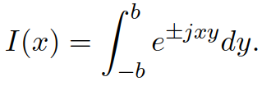

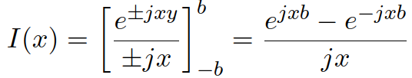


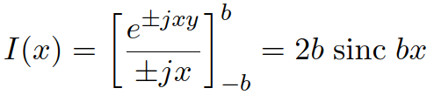
Preparation II – integral of e^{jxy}
We will soon need a finite integral
Dubbed “Euler’s integral” or “Šebesta’s tool” (Šebestova pomůcka - ŠP)
Some operations (primitive function, using and multiplying by b/b):
We can verify that it works also for x = 0, therefore:

Slide 32
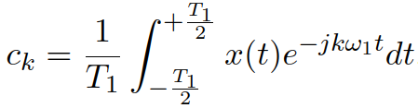
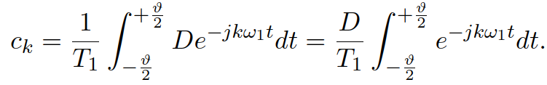
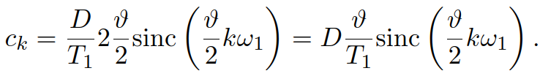
Now finally ready for FS coefficients of the sequence of rectangular pulses …
By definition:
But it is enough to integrate from –ϑ/2 to +ϑ/2:
And apply ŠP:
Now we could use our favorite mathematical program (Python, Excell) and let it stem the coefficients, but let us go step-by-step.

Slide 33



FS coefficients of the sequence of rectangular pulses – step 1
Let us start with an auxiliary function (pomocná funkce) with any angular frequency ω.
This function will intersect axis ω for argument of the function equal π (and its multiples)
That is for frequency and its multiples.
#fs_rectangles_auxiliary
… note the split of real cardinal sine into magnitudes and phases
positive real number a has magnitude a and phase zero (or, for masochists, any multiple of 2π).
Negative real number -a has magnitude a and phase +π or - π (or, for masochists, any odd multiple of π…).
We can pick phase π or –π voluntarily, but we will try to have positive ones for positive values of x and negatiove ones “on the left”

Slide 34
FS coefficients of the sequence of rectangular pulses – step 2
When the auxiliary function is ready, we can fill the FS coefficients under it – at multiples of the fundamental angular frequency ω_{1.}
Note that one coefficient c_{k} is given by both its magnitude and phase, therefore, we need to look into both plots.
#fs_rectangles_full
An example for f ₁ = 1 MHz, i.e. T ₁ = 1 μs, ω₁ = 2x10⁶ π rad/s = 2M π ☺ ϑ = T₁ / 2, so that the duty cycle is 50%. Height D = 6.
#fs_rectangles_1Mhz
… note that as ω_{x} = 2 ω₁, only odd coefficients are non-zero (plus c₀).

Slide 35
Synthesizing sequence of rectangular pulses from FS coefficients
We take the synthesis formula and keep adding components
Starting with k = 0: the d.c. component
Then going in pairs of coefficients c_{k} and c_{-k} to ensure that we are always adding cosines.
Omitting even coefficients k as the corresponding coefficients c_{k} are zero.
#fs_rectangles_1Mhz_synthesis

Slide 36
Agenda
Basic information, operations with time
Important signals – with links to discrete ones
Periodic signals
Energy and power
Spectral analysis of periodic signals – Fourier series
FS of typical signals
Properties of FS and power by FS
Spectral analysis of non-periodic signals: Fourier transform
FT of typical signals
Properties of FT and energy by FT
Summary

Slide 37
Simples changes of the signal
Changing the D.C. offset y(t) = x(t) – 3: only c_{k} changes
Making the signal negative y(t) = -x(t): all coefficients c_{k} go negative
The magnitude does not change
Phase will change from +π or –π to zero and vice versa.
Faster signal y(t) = x(2t): the whole spectrum will be wider, but the same values of c_{k} !
Narrower pulse ϑ = T₁ / 4, duty cycle 25%, otherwise the same:
the auxiliary function will be wider (as smaller ϑ leads to wider lobes (laloky)) of the cardinal sine.
The multiples of ω₁ will be the same as before.
The coefficients will be smaller (signal “working less”).
#fs_rectangles_1Mhz_zero_dc
#fs_rectangles_1Mhz_minus
#fs_rectangles_1Mhz_faster
#fs_rectangles_1Mhz_narrower

Slide 38



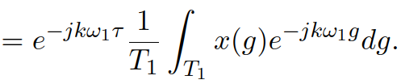

Shifts of signal
In case the signal is delayed y(t) = x(t-τ):
We can perform a change of variable g = t – τ and show that:
But this is the original coefficient multiplied with a “correction”:
Behavior in magnitudes and phases:
Magnitudes do not change:
Phases change by subtracting a linear function with slope –τ
#fs_rectangles_1Mhz_delayed #fs_rectangles_1Mhz_advanced

Slide 39

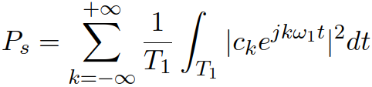
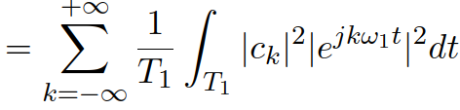
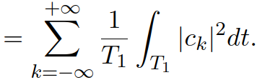
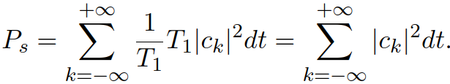
Power from FS – Parseval’s theorem
Remember that the power of periodic signal can be obtained:
And we can have the signal represented by the FS synthesis formula:
We will be able to obtain the power also by summing the powers of individual complex exponentials:
Integration of a constant over T₁ is this constant multiplied by T₁, so:
- power can be obtained from FS.

Slide 40
Agenda
Basic information, operations with time
Important signals – with links to discrete ones
Periodic signals
Energy and power
Spectral analysis of periodic signals – Fourier series
FS of typical signals
Properties of FS and power by FS
Spectral analysis of non-periodic signals: Fourier transform
FT of typical signals
Properties of FT and energy by FT
Summary

Slide 41
Fourier transform (Fourierova transformace) – what do we want
We want to analyze also non-periodic signals.
We are asking three usual questions:
Where will be the frequencies ? For non-periodic signals, we can not determine fundamental frequency ω₁ and its multiples => we will need to process the whole frequency axis ω
The result will not be coefficients, but a spectral function (spektrální funkce) X(jω).
“How much ?” will be answered by the magnitude of spectral function |X(jω)|
“How shifted ?” will be answered by the phase of spectral function arg X(jω).

Slide 42





Definition of FT
Direct FT (from time to frequency):
Inverse FT (from frequency to time):
We can also denote it as:
For real signals, as usual, we obtain a symmetrical spectrum:
As before, we are intrigued by this j in notation – why not simply X(ω) but X(jω) ?
Remember the DTFT case – for discrete signals, we did not denote it X(ω) but X(e^{jω}) !
As we are getting more experiences in frequency transforms, we note that direct and inverse transform look very similar, except for the sign.

Slide 43
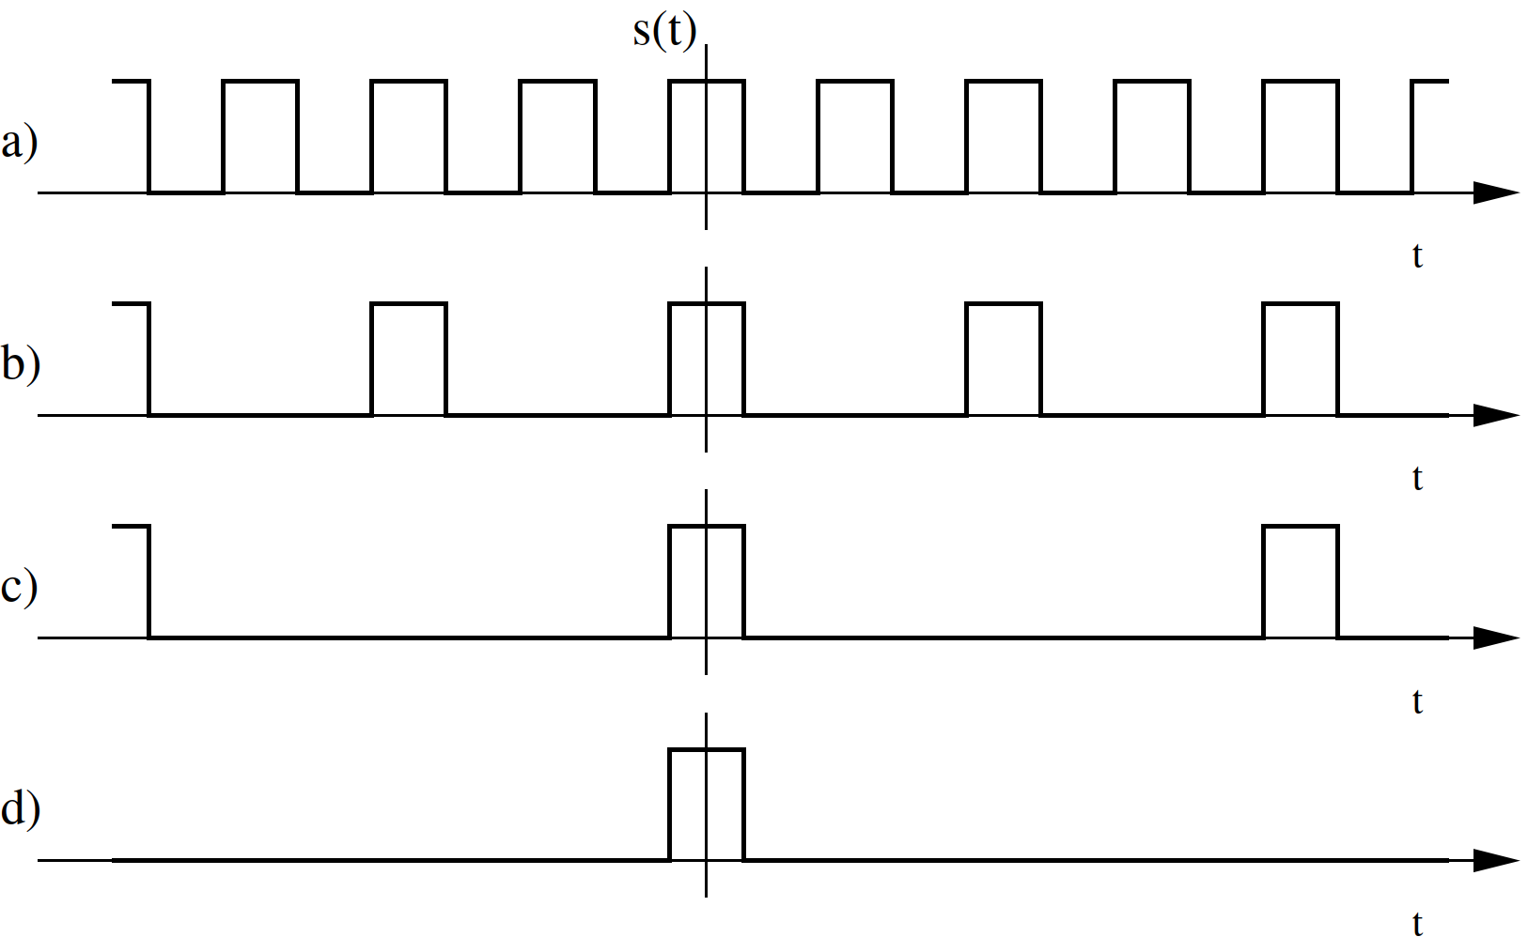
How did we get here ?
Trying to derive FT from FS by “diluting” periodic signals… push T₁ to infinity …

Slide 44
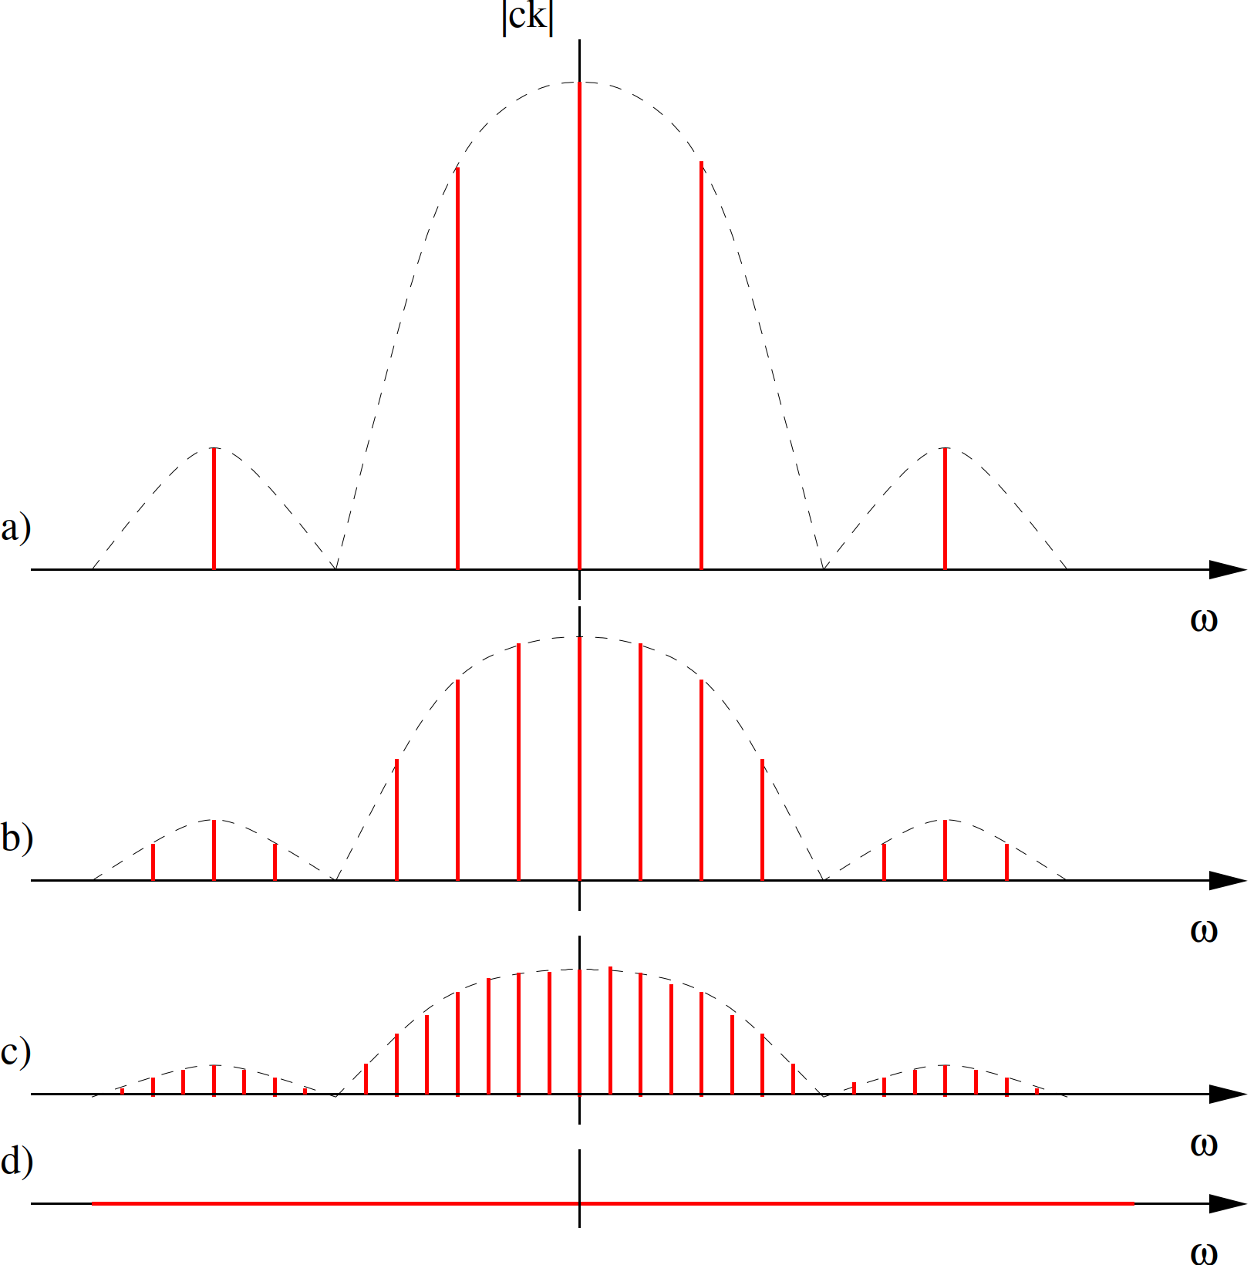
Does not really work, as the with more and more diluting, the coefficients are smaller and smaller
for T₁ = ꝏ, they become zero ☹

Slide 45
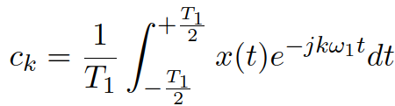






FS to FT correctly …
We depart from the definition of Fourier series:
We modify for in a smart way:
c_{k} will become an infinitely small increment of FS coefficient dc
the limits of integral will become –ꝏ and +ꝏ.
ω₁ will not become zero, but an infinitely small increment dω
with it, we can eliminate the period so
kω₁ will become any angular frequency ω.
When done, we obtain:
But calling the result “infinitely small increment of FS coefficient over infinitely small increment of angular frequency” would be stupid => spectral function.

Slide 46
Agenda
Basic information, operations with time
Important signals – with links to discrete ones
Periodic signals
Energy and power
Spectral analysis of periodic signals – Fourier series
FS of typical signals
Properties of FS and power by FS
Spectral analysis of non-periodic signals: Fourier transform
FT of typical signals
Properties of FT and energy by FT
Summary

Slide 47

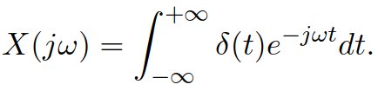

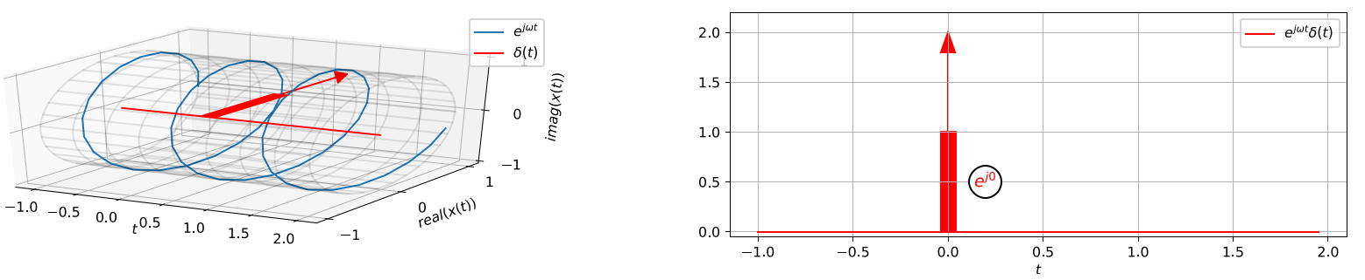
FT of Dirac pulse δ(t)
Remember that we defined the sampling property of Dirac pulse:
When standing in the definition of FT, it samples the complex exponential at t = 0.
The integral is thus reduced to

Slide 48
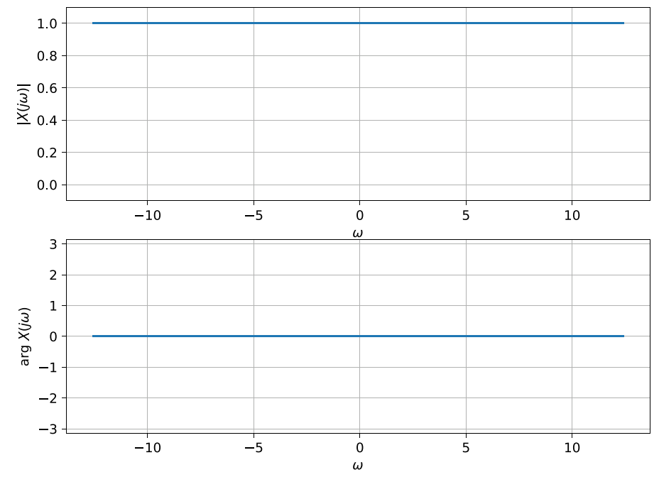
and the result is X(jω) = 1. This is a constant for all frequencies
Magnitude 1
Phase zero.
Intuition check: Dirac pulse is a very fast signal, so it should have a very wide spectrum.

Slide 49


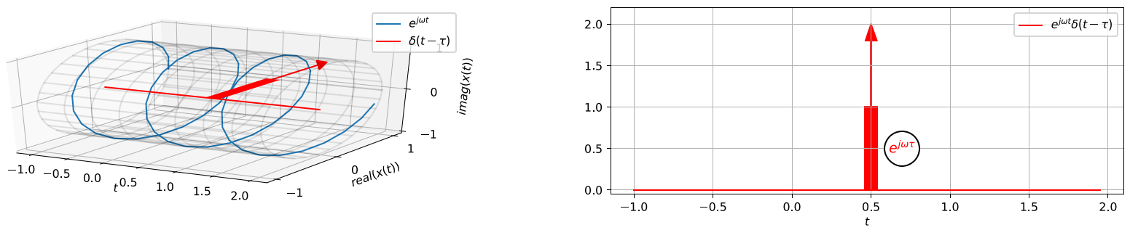
FT of shifted Dirac pulse δ(t - τ)
Using again the sampling property:
We will work only around time τ:

Slide 50


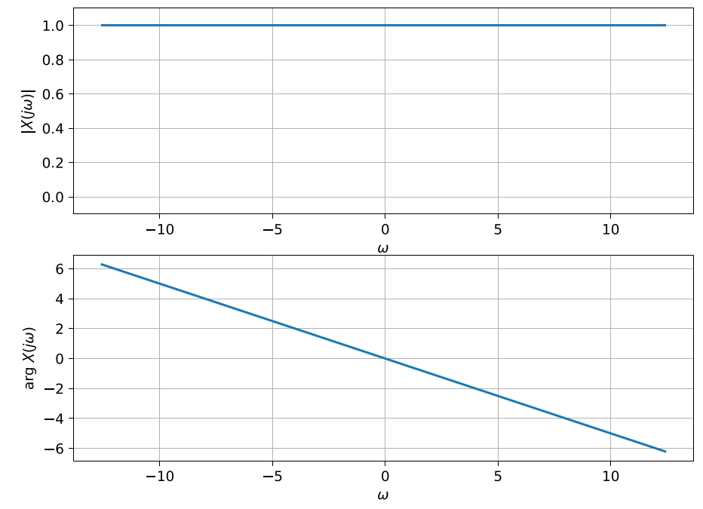
and the result is For this expression:
Magnitude is 1
Phase is linear with slope –τ:
Intuition check: shifted Dirac pulse is still a very fast signal, so it should have a very wide spectrum.

Slide 51
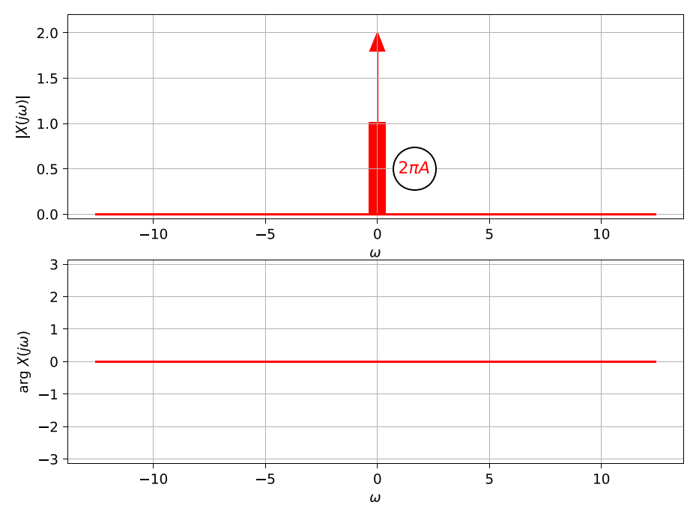

FT of a D.C. signal
Signal equal to a constant: x(t) = A.
Without derivation, we set X(jω) = 2πA δ(ω) and check that it is correct.
Dirac pulse has sampling property even in frequency, so the result will be
Therefore, x(t) = A.
Intuition: a very slow signal should have a very narrow spectrum.

Slide 52


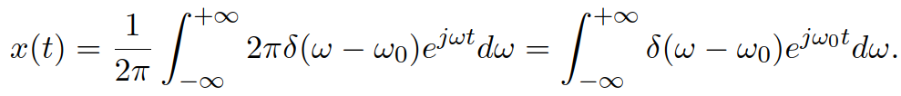
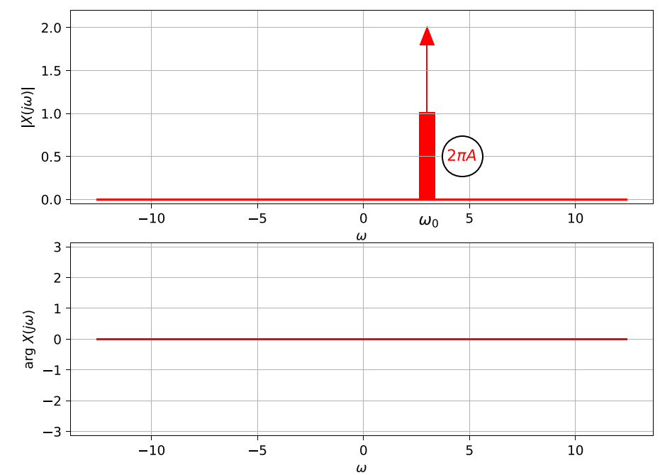
FT of a complex exponential
For
We define and we check again …
Intuition: a signal that has only one frequency should have a very narrow spectrum only at this frequency.

Slide 53
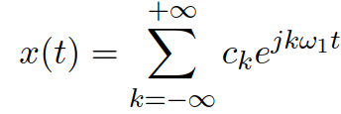
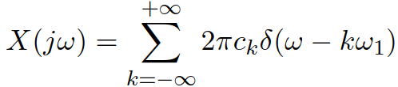
FT of a periodic signal decomposed by FS
A periodic signal with fundamental period T₁ and angular frequency ω₁ can be decomposed by Fourier series:
… and we learned that one complex exponential has spectral function
As all Fourier transforms, FT is linear, so the resulting spectral function will be series of shifted Dirac pulses, each multiplied by 2π and the respective coefficient of FS:
We will be using this trick when deriving the spectral function of a sampled signal.

Slide 54
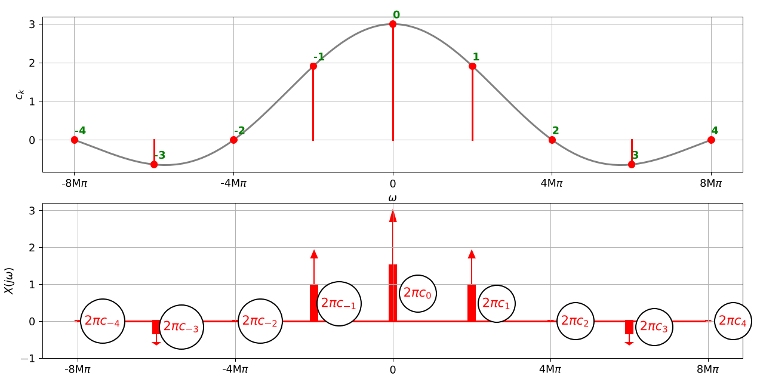

Slide 55
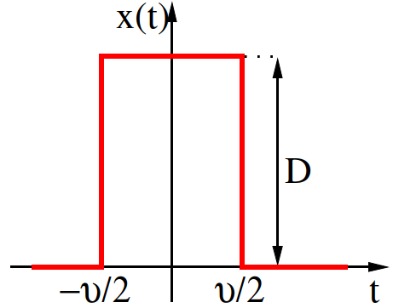
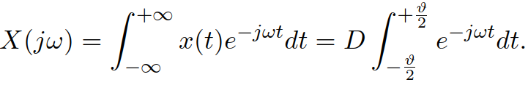
Rectangular pulse and its FT
Similar definition as above, but this time, the pulse is not periodic.
height D and width of pulse ϑ.
We will again need to do some integration here … but first some intuition:
There are sharp edges, so the spectrum will have lots of high frequencies.
Narrow (fast) pulse will lead to even broader spectrum
Wide (slow) pulse will lead to narrower spectrum
Using FT definition

Slide 56
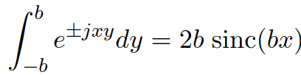

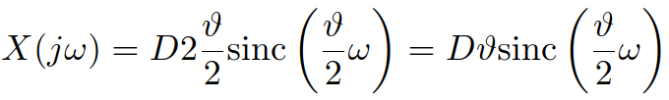


Spectral function of rectangular pulse
Making use of Šebesta’s tool with
We obtain
… cardinal sine again, but this time it is the ultimate result, not an auxiliary function.
We are again interested, where does sinc touch the frequency axis, we set: and find - same as for FS.
Plotting again as magnitude and phase, and “beautifying” the plot by using +π for positive frequencies and –π for negative ones.
#ft_rectangle

Slide 57
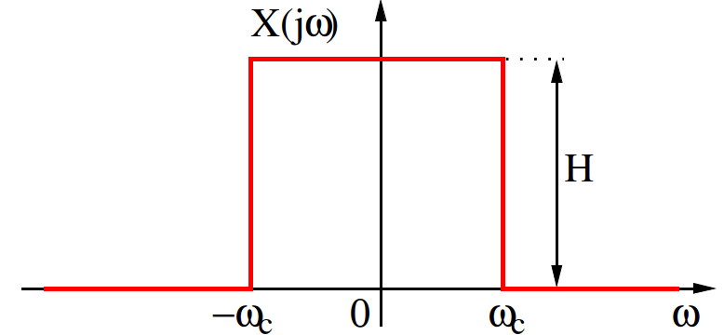





Signal with a square spectral function
Let’s try an inverse exercise … rectangular spectral function
Same process as above, but we need to run inverse FT:
Making use of Šebesta’s tool with
We obtain
The cardinal sine will intersect t axis for:
#ift_of_rectangular_spectral_function

Slide 58
Agenda
Basic information, operations with time
Important signals – with links to discrete ones
Periodic signals
Energy and power
Spectral analysis of periodic signals – Fourier series
FS of typical signals
Properties of FS and power by FS
Spectral analysis of non-periodic signals: Fourier transform
FT of typical signals
Properties of FT and energy by FT
Summary

Slide 59
Properties of FT
We will use rectangular pulse with parameters: ϑ = 0.5 μs and D = 600000 (to get reasonable values of spectral function).
#ft_rectangle_0.5us

Slide 60



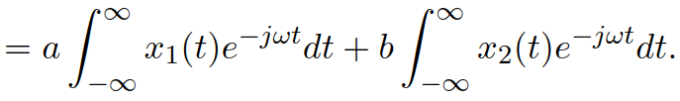


Linearity and inversion
FT is linear, in case we have independently
The FT of mix:
is exactly the same mix of original spectral functions:
Proof:
#ft_linearity
For inversion of signal: , we obtain the same inversion of spectral function:
The magnitude does not change
Phase will change from +π or –π to zero and vice versa.
#ft_negative

Slide 61




FT of a delayed signal
In case the signal is delayed y(t) = x(t-τ):
We can perform a change of variable g = t – τ and show that:
But this is the original spectral function multiplied with a “correction”:
Let us study the behavior in magnitudes and phases:
Magnitudes do not change:
Phases change by subtracting a linear function with slope –τ:
#ft_rectangles_0.5us_delayed

Slide 62



FT of time-contracted or time-dilated signal
Modifications of the time axis: speeding up (contraction) for m > 1, slowing down (dilation) for m < 1
By definition
Without derivation:
Interpretation:
For m > 1 (narrower signal), the spectrum should be wider and smaller (less signal to work)
For m < 1 (wider signal), the spectrum should be narrower and bigger (more signal to work)
#ft_rectangles_0.5us_contract_dilate

Slide 63


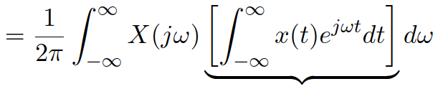





Energy from FT – Parseval’s theorem
The total energy of signal is given by (don’t try this for periodic or constant signals …)
We can try it with one x(t) let intact and another given by IFT:
By changing the order of integrations:
Square bracket is a weird FT, actually the value of spectral function for X(-jω) !
Knowing that we can:
is called two-sided energy spectral density #energy_density

Slide 64
Agenda
Basic information, operations with time
Important signals – with links to discrete ones
Periodic signals
Energy and power
Spectral analysis of periodic signals – Fourier series
FS of typical signals
Properties of FS and power by FS
Spectral analysis of non-periodic signals: Fourier transform
FT of typical signals
Properties of FT and energy by FT
Summary

Slide 65
SUMMARY I
Continuous-time signals are defined for all times … but we can always fake it
In plotting by using plot
In computing by using numerical integration (sum of values multiplied by time-step)
In addition to known time operation, we can speed-up or slow-down the time axis.
Unit step and Dirac pulse are non-existing but very useful signals, Dirac has:
zero width, infinite size, surface one
very useful for sampling things.
Periodic signals repeat
the smallest repetition time is called fundamental period.
and its inverse (both in continuous and in discrete time) is fundamental frequency.
Energy and power are just sums or integrals of squarred signal values
raw for energy
normalized by length for power

Slide 66
SUMMARY II
Spectral analysis of periodic signals: Fourier series (FS)
the result are complex coefficients sitting at multiples of fundamental frequency, must be plotted two plots: magnitude and phases.
two opposite coefficients are complex conjugate and make up for one cosine.
they are computed by projecting the signal on complex exponentials.
FS of typical signals
complex exponential has one FS coefficient.
cosine has two FS coefficients.
sequence of rectangles has infinity FS coefficients, decaying towards high frequencies according to cardinal sine.
Properties of FS
when the signal is shifted, nothing happens to the magnitudes, phases go downhill (delay) or uphill (advance)
in case the signal is contracted (dilated) the values of FS coefficients are the same, but they "sit" at different frequencies.
power can be computed from FS coefficients (Parseval).

Slide 67
SUMMARY III
Spectral analysis of non-periodic signals: Fourier transform (FT)
the result is spectral function defined for all frequencies
spectral function is computed by projecting the signal on complex exponentials.
Typical signals
Dirac has constant spectral function with flat (Dirac at zero) or inclined phase (Dirac not at zero)
spectral function of a D.C. signal is Dirac.
spectral function of a complex exponential is shifted Dirac.
periodic signal can be broken by FS which can be converted to Diracs at multiples of fundamental frequency.
rectangular signal has spectral function given by cardinal sine.
dtto in the inverse direction: signal corresponding to square spectral function is cardinal sine.
Properties of FT
FT (and FS) is linear
FT of a delayed signal has the same magnitude, phase shifts downhill (delay) or uphill (advance)
FT of time contracted signal goes in the opposite way: wider for narrower signal, narrower for wider signal.
Energy of a signal can be obtained from its FT (converted to energy spectral density).

Slide 68
Basic truths on signals and spectra
Spectrum of periodic signal is discrete (coefficients) – Fourier series
Spectrum of non-periodic signal is continuous (function) – Fourier transform
Spectrum of narrow (fast) signal is wide.
Spectrum of wide (slow) signal is narrow.
Any sharp edge will result in infinitely long spectrum.
Spectrum of delayed signal has the same magnitude as before, phase goes downhill.
Spectrum of advanced signal has the same magnitude as before, phase goes uphill.
Time and spectral domains are like fire and water: always do the opposite things!

