Slide 1
Systems (mostly continuous–time with links to discrete ones)
Honza Černocký, ÚPGM
Please open Python notebooks systems, freq_response, laplace

Slide 2
Agenda
Basic description of systems – difference and differential equations
Impulse response
Properties of systems
Connections of systems
Systems in frequency
Exercises when we are given the frequency response
Laplace transform and transfer function
Finally the frequency response !
Factorizing the transfer function and stability
Summary

Slide 3
What are systems good for
With a system, we want to process the input signal and produce an output signal with desired properties.
We have seen discrete-time systems (diskrétní systémy) – made of multiplications, additions and delays - algorithms, code.
Numerical filters (číslicové filtry)
Digital filters (číslicové filtry)
Discrete-time systems (systémy s diskrétním časem)
Now, we will see also continuous-time systems (systémy se spojitým časem) made of electronic components (resistors, capacitors, coils, operational amplifiers …)
Analog filters (analogové filtry)
Continuous systems (spojité systémy)
x[n]
Discrete system
y[n]
x(t)
Continuous system
y(t)

Slide 4
Getting a basic mathematical description of a system – discrete
In discrete time, we departed from a scheme of a filter or from code, and we wrote down a difference equation (diferenční rovnice)
y[n] = b₀x[n] + b₁x[n-1] + b₂x[n-2] + b₃x[n-3]
- a₁y[n-1] - a₂y[n-2] - a₃y[n-3]
straightforward correspondence between scheme, code and difference equation.
b₀
Σ
y[n]
x[n]
z⁻¹
b₁
-a₁
z⁻¹
z⁻¹
b₂
-a₂
z⁻¹
for (n=3; n<N; n++) {
y[n] = b0 * x[n] + b1 * x[n-1] + b2 * x[n-2]
+ b3 * x[n-3] - a1 * y[n-1]
- a2 * y[n-2] - a3 * y[n-3];
}
z⁻¹
b₃
-a₃
z⁻¹

Slide 5
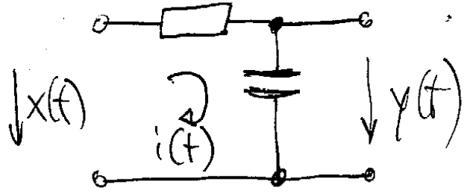



Getting a basic mathematical description of a system – continuous
We usually get a scheme of a circuit, with input x(t) and output y(t)
We will demonstrate on voltages (napětí) but also many other including mechanical systems – think about ailerons (křidélka) of an airplane
Remember that signals depend on (continuous) time: x(t), y(t).
Example on an RC circuit – no straightforward way to derive mathematical description but we can use basic know-how from electrical engineering course:
Loop current i(t) is defined as
And also as
Putting it together and grouping terms with x(t) on the left and y(t) on the right
The result is a differential equation (diferenciální rovnice)

Slide 6
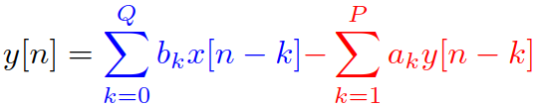
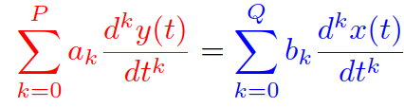
Difference equation and differential equation generally
Let’s get used to marking input parts by blue and output ones by red.
Discrete systems: we have the order of input Q and order of output P (order is the number of delays):
Coefficients b_{k} and a_{k} are simply given by looking at the code or at the scheme of filter
Continuous systems: we have the order of input Q and order of output P (order is the order of derivation):
Coefficients b_{k} and a_{k} are derived from the physical scheme, by hand, or by Micro-Cap, SPICE, PSPICE, SNAP …

Slide 7
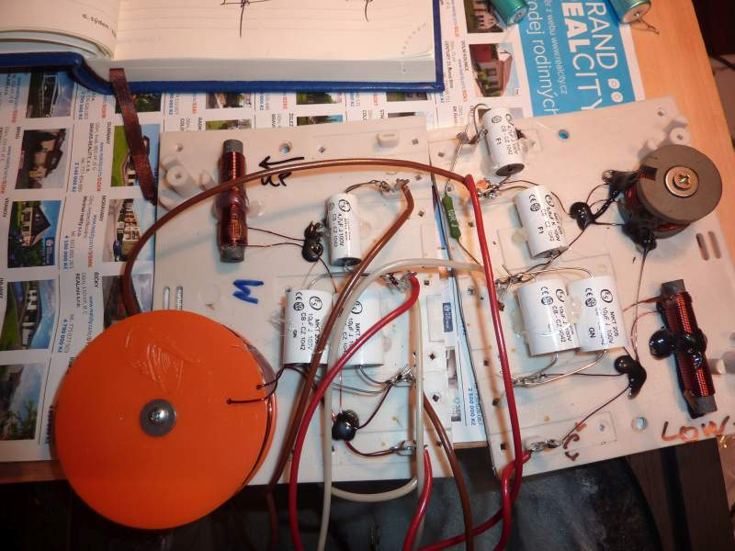

Slide 8
Agenda
Basic description of systems – difference and differential equations
Impulse response
Properties of systems
Connections of systems
Systems in frequency
Exercises when we are given the frequency response
Laplace transform and transfer function
Finally the frequency response !
Factorizing the transfer function and stability
Summary

Slide 9
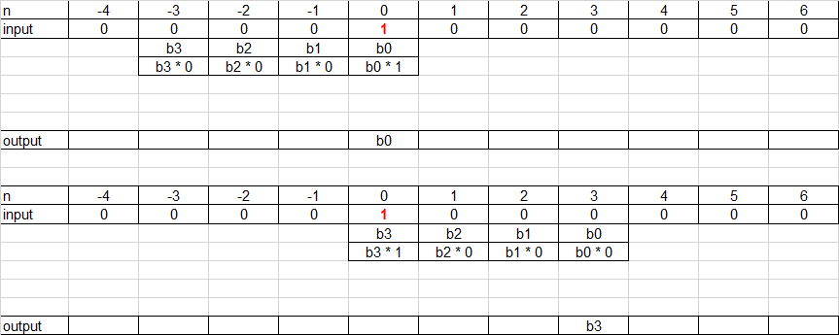
Impulse response (impulsní odezva) of discrete systems – reaction to unit pulse
Σ
Σ

Slide 10
Impulse response of discrete systems
For filters processing only the input, the impulse response is exactly equivalent to the coefficients:
h[k] = b_{k} for k = 0,1,2,3
h[k] = 0 otherwise
The length is 4, so it is finite – FIR – finite impulse response (konečná impulsní odezva)
For filters having feedback (non-zero coefficients a_{k}), the impulse response is infinite - IIR – infinite impulse response (nekonečná impulsní odezva).
We can easily generate h[k] – just excite the filter with unit pulse (jednotkový impuls) that everyone can generate in C / Python / Matlab / whatever.

Slide 11
Impulse response (impulsní odezva) of continuous systems – reaction to Dirac pulse
Impulse response h(t) needs to be continuous.
It needs to be a reaction to something extremely short in time with “unit size”.
We have defined Dirac pulse having such property
Width = 0
Height = ꝏ
Surface (mightiness, mocnost) = 1
No way to do this experimentally, but a very useful theoretical construct
In case you do want to do it experimentally, generate something very narrow and very high.
#dirac_h(t)

Slide 12
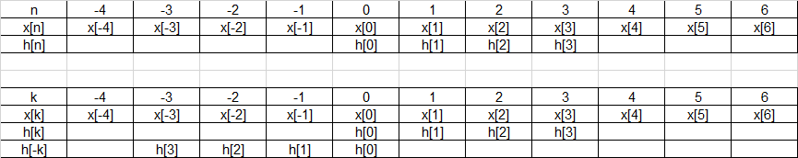
Output of a discrete system by convolution
k is an auxiliary variable, theoretically running from -ꝏ to +ꝏ, practically in a reasonable range “where do we have samples”
Let’s start with renaming the signals from x[n] and h[n] to x[k] and h[k] and flipping h[k] to h[-k]

Slide 13
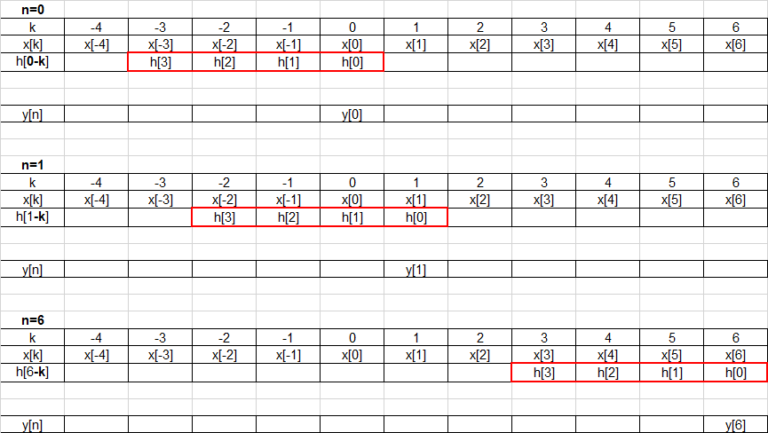
And proceed by computing output samples for different n’s
Σ
Σ
Σ

Slide 14
Convolution - summary
Flip the impulse response
For all meaningful output samples n
Shift flipped impulse response to given „n“
Multiply
Add
Write the result to y[n]
Convolution is commutative:
… „paper strip“ + Python #convolution
x = [4 4 4 4 0 0 0 0]
h = [0.25 -0.25 0.25 -0.25]

Slide 15


Output of a continuous system by convolution
Very similar to discrete convolution
But we need to modify it to continuous signals:
Replacing auxiliary counter of samples k by auxiliary time variable (pomocná časová proměnná) τ, theoretically running from -ꝏ to +ꝏ, practically in a reasonable range “where the signal is non-zero”.
Replacing the sum by integration over τ.
“Implementing it” – for all meaningful times t:
Shift flipped impulse response to given „t“
Multiply
Add
Write the result to y(t)
Theoretically, we need to do this for ꝏ times, but this does not happen in “pedagogical solutions”
#continuous_convolution

Slide 16


Selected properties of continuous-time convolution
It is commutative:
Convolution with a Dirac pulse is the original signal:
Convolution with a delayed Dirac pulse is the original signal delayed to the time where the Dirac is placed.
Convolution with series of Dirac pulses produces the sum of original signals
in case they are short enough, they can be recognized,
if not, they will produce something different
#convolution_diracs

Slide 17
Agenda
Basic description of systems – difference and differential equations
Impulse response
Properties of systems
Connections of systems
Systems in frequency
Exercises when we are given the frequency response
Laplace transform and transfer function
Finally the frequency response !
Factorizing the transfer function and stability
Summary

Slide 18
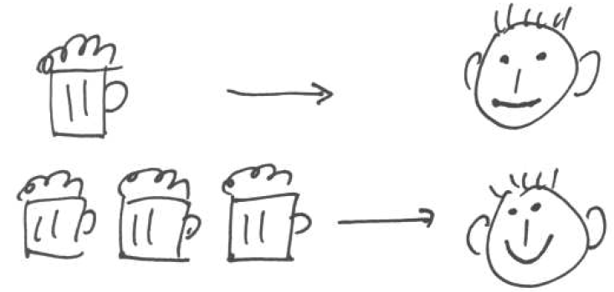
Demonstration of systems’ properties
In serious examples
… and on a typical Czech person loving beer:
The input is number of beers.
The output is his smile

Slide 19
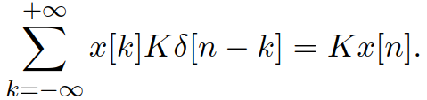


Systems with and without memory
Discrete: the system works just with a single input sample:
y[n] = K x[n]
No shifts, no memory.
Either an amplifier (zesilovač) or an atenuator (zeslabovač, atenuátor).
Impulse response of a memory-less system is a unit pulse: h[n] = [K]
Continuous: the system works just with the current value of input signal:
y(t) = K x(t)
No element to keep any previous information (no capacitor, no coil).
Dtto: Either an amplifier or an attenuator.
Impulse response of a memory-less system is a Dirac pulse: h(t) = Kδ(t)

Slide 20
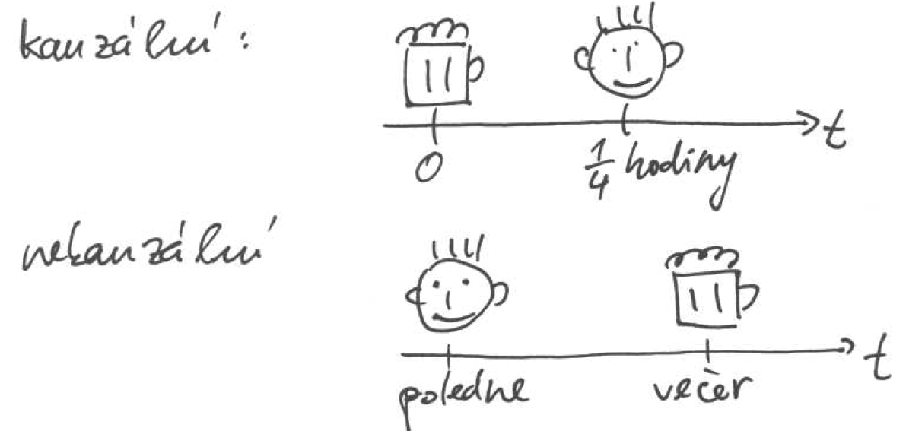
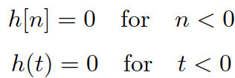
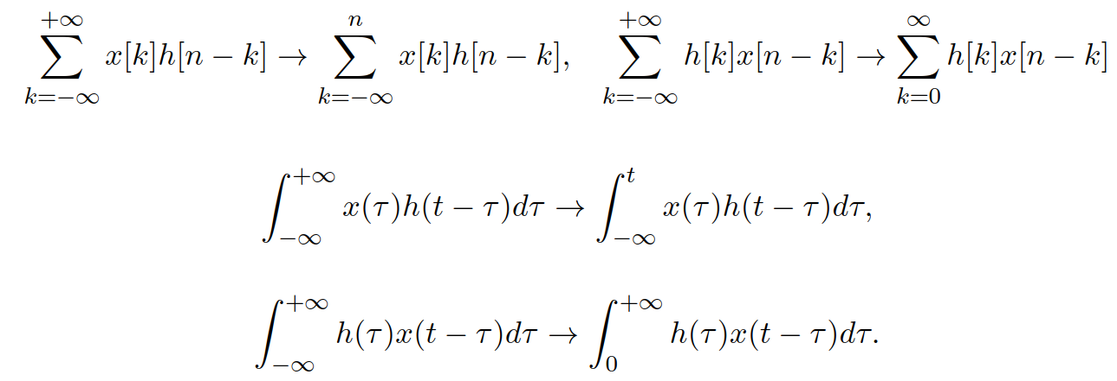
Causality (kauzalita)
The system must react only on its current and past input, can not see the future.
Causality represented by the impulse response:
Obvious, as the impulse response can not have non-zero values in the future.
Convolution sums/integrals then more reasonable limits

Slide 21
Causality - examples
y[n] = x[n] – x[n-1] this systems looks just to the past. => CAUSAL
y(t) = x(-t) for t=0.4, still OK, we are looking to the past.
for t = -1, bad, we are looking to the future !
=> NON-CAUSAL
#causality

Slide 22
Stability
For bounded input, the system should react by a bounded output.
discrete time: if |x(t)| < B, then |y(t)| < C
continuous time: if |x[n]| < B, then |y[n]| < C
Examples:
y(t) = t x(t) even for bounded input, this signal will be ꝏ as time approaches ꝏ => NOT STABLE
y(t) = 2^{x(t)} in case the input signal is limited to interval [-B, B], the output will be limited to [2^{-B} ,2^{+B}]. If we pick the greater value out of 2^{-B} and 2^{+B}, we have C. => STABLE
#stability

Slide 23
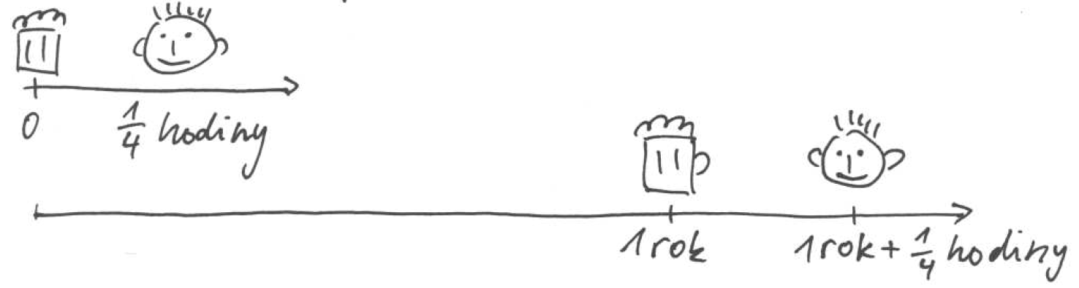
Time invariance (časová invariantnost, neměnnost)
If the system does not change its behavior over the time, we call it time-invariant.
If it produces an output now, it should produce the same output in case the input is delayed (or advanced) by any time.
Discrete: if x[n] -> y[n], then x[n-m] -> y[n-m]
Continuous: if x(t) -> y(t), then x(t – τ) -> y(t – τ)
Systems that we see in ISS are time-invariant.
However, we often meet systems that are not – think about speech coding!

Slide 24
Time invariance – examples
y(t) = sin [x(t)]. In case we compute it for t – τ, we use the modified time as argument, and we obtain y(t – τ) = sin [x(t – τ)] => TIME-INVARIANT
y[n] = n x[n] the output will depend on where the signal is located in time => NOT TIME-INVARIANT
#time_invariance

Slide 25
Linearity
If the signal reacts to input x₁ by output y₁ and to input x₂ by output y₂ , then, if it reacts to the linear combination of these inputs by the same linear combination of outputs, we call it linear.
Linear combination is just multiplication by 2 different constants and sum (think about a filter or computing a weighted average!).
Discrete: if x₁[n] -> y₁[n] and x₂[n] -> y₂[n], then ax₁[n] + bx₂[n] -> ay₁[n] + by₂[n]
Continuous: if x₁(t) -> y₁(t) and x₂(t) -> y₂(t), then ax₁(t) + bx₂(t) -> ay₁(t) + by₂(t)
Systems that we see in ISS are linear
However, many applications use non-linearities (distortion effects for guitars, artificial neural networks in machine learning, …).

Slide 26
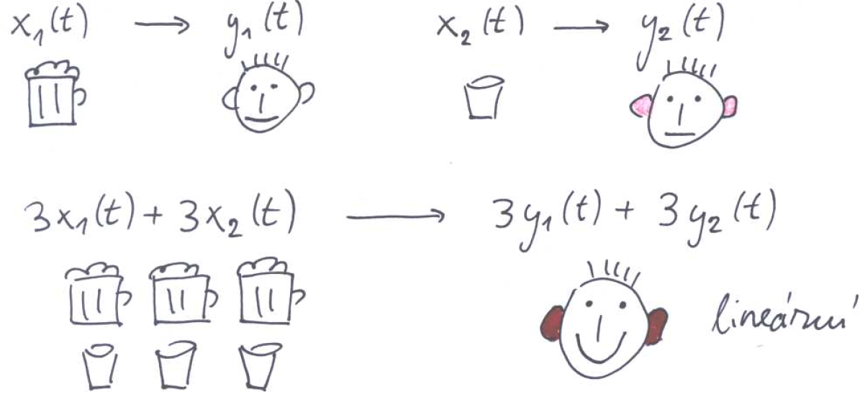
Linearity

Slide 27
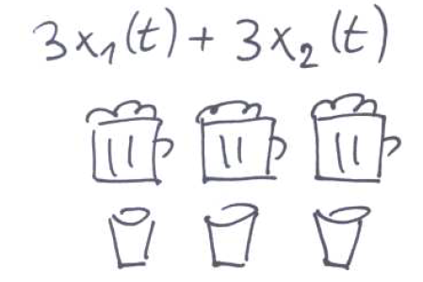
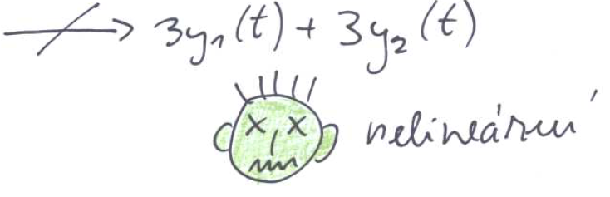
Non-linearity + examples
Serious examples:
y(t) = t x(t) for x₁(t), the output will be y₁(t) = tx₁(t), for x₁(t), the output will be y₂(t) = tx₂(t). For a mix: x(t) = ax₁(t)+bx₂(t), the output will be y(t) = tx(t) = t[ax₁(t)+bx₂(t)] = tax₁(t)+tbx₂(t) = ay₁(t)+by₂(t): condition fulfilled => LINEAR
y(t) = |x(t)| rectifier (usměrňovač) – we can easily find a pair of signals and constants a and b, for which the linearity condition does not hold => NON-LINEAR
#linearity

Slide 28
LTI systems
Linear and Time-Invariant.
All filters we deal with in ISS (both digital and analog) are LTI.

Slide 29
Agenda
Basic description of systems – difference and differential equations
Impulse response
Properties of systems
Connections of systems
Systems in frequency
Exercises when we are given the frequency response
Laplace transform and transfer function
Finally the frequency response !
Factorizing the transfer function and stability
Summary

Slide 30
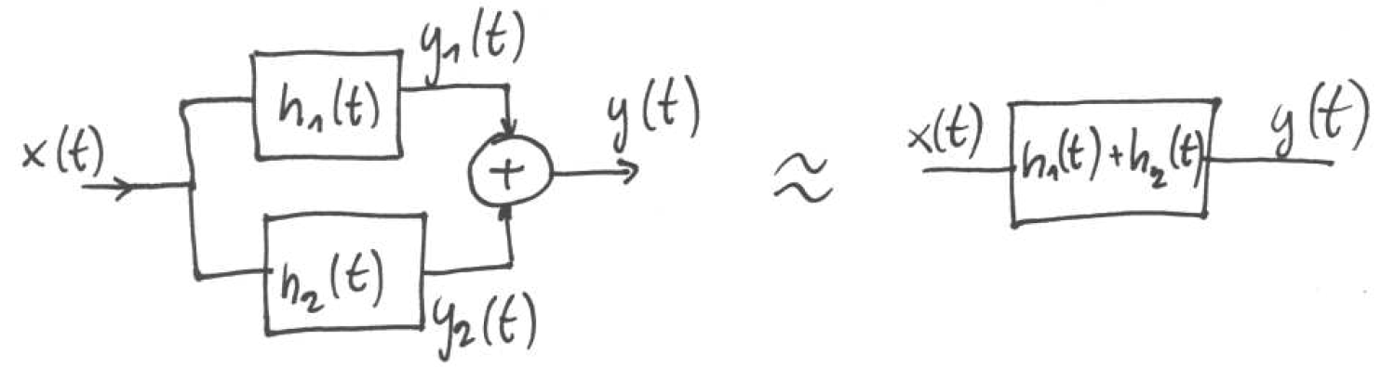


Parallel connection of two systems
The resulting impulse response is the sum of component ones:
Continuous: Discrete:
Proof:

Slide 31
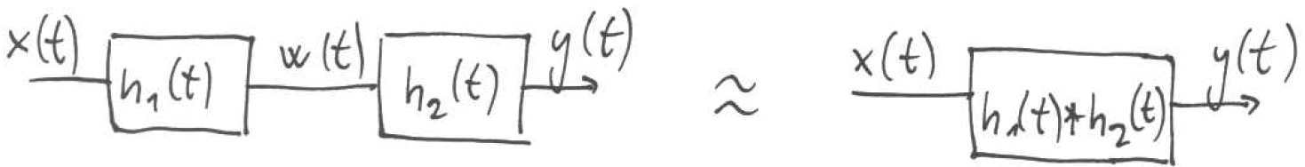



Connection of two systems in series
The resulting impulse response is a convolution of the two component ones:
Continuous discrete:
Proof: series of two convolutions: … see continuation in “Studijní opora”
Much simpler:
consider the input as x(t) = δ(t),
then the output of the first filter w(t) will be h₁(t) (remember that convolution with the Dirac pulse works as a copy machine).
And the output of the second one will be y(t) = h₁(t) * h₂(t).

Slide 32
Agenda
Basic description of systems – difference and differential equations
Impulse response
Properties of systems
Connections of systems
Systems in frequency
Exercises when we are given the frequency response
Laplace transform and transfer function
Finally the frequency response !
Factorizing the transfer function and stability
Summary

Slide 33
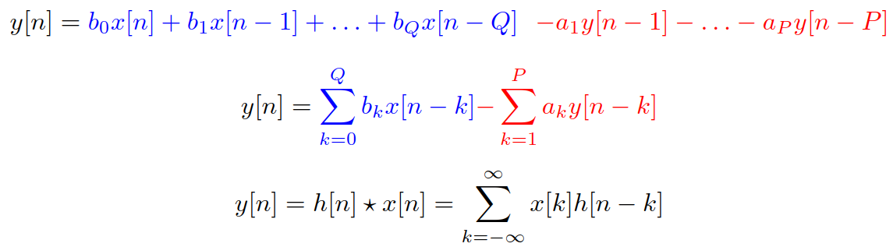
Filter in the time domain - discrete
Difference equation or convolution with impulse response
for FIR filters (working just with the input signal) – the same.
For IIR filters – convolution not doable (impulse response is infinite)

Slide 34
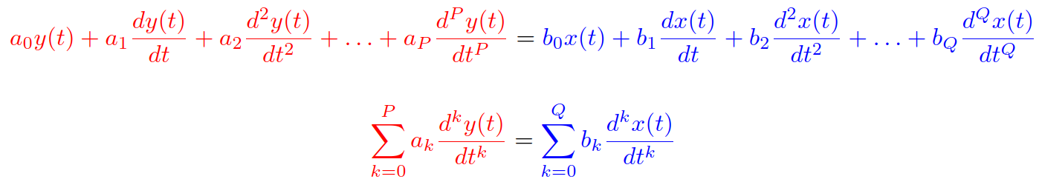
Filter in the time domain - continuous
Differential equation or convolution with impulse response

Slide 35

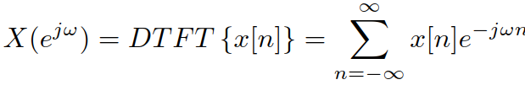
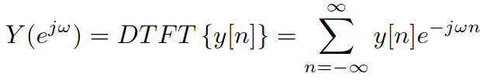
Filter in the frequency domain – discrete
Let’s make sure we know which frequencies we’ll be working with – normalized angular frequency (normovaná kruhová / úhlová frekvence) in radians
0 Hz corresponds to 0 rad
F_{s} / 2 corresponds to π rad
F_{s} corresponds to 2π rad.
Obtaining spectra of input and output signals by Discrete time Fourier transform – DTFT (Fourierova transformace s diskrétním časem)
Practically, always computed by DFT / FFT !

Slide 36



Filter in the frequency domain – continuous
Let’s make sure we know which frequencies we’ll be working with – regular angular frequency (kruhová / úhlová frekvence) in radians/s
Obtaining spectra of input and output signals by Fourier transform –FT (Fourierova transformace)
Practically, always approximated by DFT / FFT (see next lecture).

Slide 37



For one single frequency ω₁ … discrete
A complex exponential or cosine have only one frequency:
Transfer or transfer coefficient (přenos nebo činitel přenosu) – complex number
Its magnitude determines how much the signal will change
Its phase determines how much the signal gets shifted
However, we don’t want just a single frequency, we want them all !

Slide 38
Frequency response (kmitočtová / frekvenční charakteristika) - discrete
Determines the behavior of a system on all frequencies
Complex function of frequency H(e^{jω})
Magnitude frequency response (amplitudová / modulová kmitočtová / frekvenční charakteristika) is the most crucial – which frequencies will be attenuated or amplified ? |H(e^{jω})|
Phase frequency response (fázová / argumentová kmitočtová / frekvenční charakteristika) is sometimes important as well (think of Hi-Fi applications): arg H(e^{jω})
Frequency response must be symmetrical: H(e^{jω}) = H*(e^{-jω}), which means that |H(e^{jω})| = |H(e^{-jω})| and arg H(e^{jω}) = -arg H(e^{-jω})
… for discrete systems, it is also periodic.

Slide 39
For one single frequency ω₁ … continuous
A complex exponential or cosine have only one frequency:
Transfer or transfer coefficient (přenos nebo činitel přenosu) – complex number H(jω₁)
Its magnitude determines how much the signal will change: |H(jω₁)|
Its phase determines how much the signal gets shifted: arg H(jω₁)
However, we don’t want just a single frequency, we want them all !

Slide 40
Frequency response (kmitočtová / frekvenční charakteristika) - continuous
Determines the behavior of a system on all frequencies
Complex function of frequency H(jω)
Magnitude frequency response (amplitudová / modulová kmitočtová / frekvenční charakteristika) is the most crucial – which frequencies will be attenuated or amplified ? |H(jω)|
Phase frequency response (fázová / argumentová kmitočtová / frekvenční charakteristika) is sometimes important as well (think of Hi-Fi applications) arg H(jω)
Frequency response must be symmetrical: H(jω) = H*(-jω), which means that |H(jω)| = |H(-jω)| and arg H(jω) = -arg H(-jω).

Slide 41
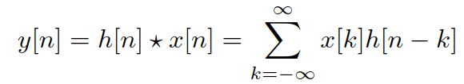


Relation of time and frequency - discrete
Time: convolution
Frequency: mutliplication
Remember we can obtain the spectra of input and output by DTFT:
So that it seems that we can obtain the frequency response by DTFT of the impulse response and we’re done

Slide 42
Frequency response by DTFT of impulse response - discrete
For FIR filters (finite impulse response) – perfectly DOABLE – DTFT (computed by DFT) of h[n].
Remember:
h[n] = b_{n} for n = 0 … Q
h[n] = 0 otherwise
For IIR (infinite impulse response) – NOT DOABLE – we can’t DFT infinite sequence of numbers !
=> we need a mechanism to determine H(e^{jω}) directly from the parameters b_{k} and a_{k} of filter’s difference equation.

Slide 43



Relation of time and frequency - continuous
Time: convolution
Frequency: mutliplication
Remember we can obtain the spectra of input and output by FT:
So that it seems that we can obtain the frequency response by FT of the impulse response and we’re done

Slide 44
Frequency response by FT of impulse response - continuous
Not done ☹ - determining impulse response h(t) of a continuous-time system is difficult
In real world – not doable – we can not generate a Dirac, we would need to approximate by something narrow and big.
In simulation: who likes solving differential equations for x(t) = δ(t) ?
Therefore, H(jω) = FT {h(t)} is HARDLY DOABLE
=> we need a mechanism to determine H(jω) directly from the parameters b_{k} and a_{k} of filter’s differential equation.

Slide 45
Agenda
Basic description of systems – difference and differential equations
Impulse response
Properties of systems
Connections of systems
Systems in frequency
Exercises when we are given the frequency response
Laplace transform and transfer function
Finally the frequency response !
Factorizing the transfer function and stability
Summary

Slide 46

Example – ideal Hi-Fi amplifier
It will amplify 100x from 0 to 20 kHz: |H(jω)| = 100 for ω = 0 … 40000π rad/s, 0 elsewhere
It will linearly shift the phase:
|H(jω)| needs to be symmetrical, so we make it 100 for angular frequencies -40000π to 40000π
#amplifier

Slide 47
Input = complex exponential
For a complex exponential, we just retrieve the one value of frequency response H(jω₁)
its magnitude will modify the magnitude of the complex exponential
its argument the argument of the complex exponential
The frequency will stay the same.
#amplifier_complex_exp

Slide 48

Input = cosine
We can split a cosine
into 2 complex exponentials:
and again, we find the values of frequency response for the two frequencies: H(jω₁) and H(-jω₁) (they will be complex conjugate)
After a bit of math
we find the same result - cosine
its magnitude multiplied by the magnitude of the frequency response.
its argument shifted the argument of the frequency response
the frequency will stay the same.
#amplifier_cosine

Slide 49
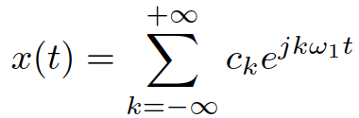
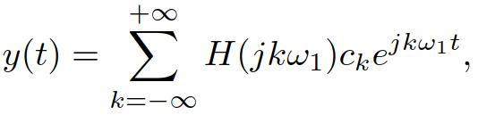
Input – periodic signal
We can decompose a periodic signal by Fourier series:
Each component can be multiplied by respective value of the frequency response H(jkω₁)
we can sum all components back:
#amplifier_2cosines

Slide 50
Input – a short rectangular pulse I.
Let us take a short rectangular pulse as the input: ϑ = 1 μs, D = 1.
#amplifier_pulse_1
We have the signal in time and frequency response in frequency, how to make them compatible ?
Compute impulse response by inverse Fourier transform of H(jω) and run convolution ☹
Convert the pulse to frequency by Fourier transform, multiply and convert back by inverse Fourier transform. Seems complicated, but will be doable.
Intuition: what will be the result ?
The edges will generate lots of high frequencies, spectrum of rectangle is sinc, therefore infinite !
The amplifier will cut these frequencies to +/- 20 kHz (+/-40kπ)
Therefore, the result will not be a rectangular pulse !

Slide 51


Input – a short rectangular pulse II.
Step 1 – determining the spectrum: the signal is a rectangle and we saw the derivation …
The cardinal sine will be touching the frequency axis at:
#amplifier_pulse_input_spectrum
Step 2 – multiply it with the frequency response of our amplifier.
The width of amplifier’s frequency response is only -40 kπ to 40 kπ
The main lobe of cardinal sine goes from -2Mπ to 2Mπ !
When multiplied, we can consider this short section of cardinal pulse as flat.
#amplifier_pulse_multiplication

Slide 52


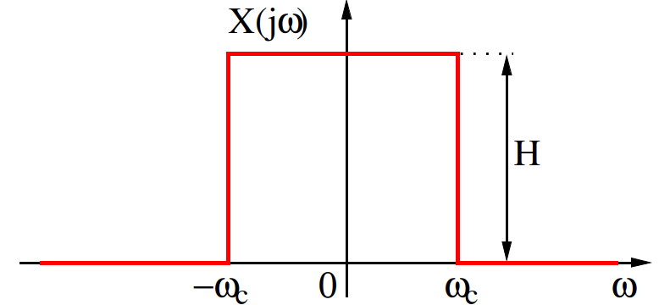



Input – a short rectangular pulse III.
Step 3: inverse Fourier transform of the resulting spectral function.
Let us first consider a simple case: signal y_{simple}(t) corresponding to a square spectral function with zero phase. Done it in the lecture on FT:
Here, we have H = 0.0001 and ω_{c} = 2Mπ, therefore
This cardinal sine intersects the time axis for:
#amplifier_pulse_output_simple

Slide 53
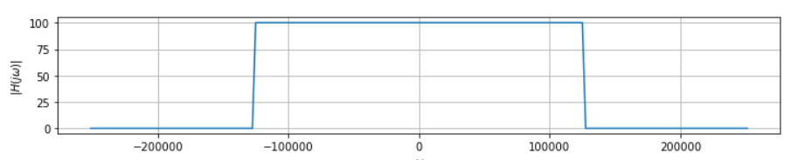
Input – a short rectangular pulse IV.
However, the phase is not zero, it is linear
remember, that our amplifier has arg H(jω) = -1 / 100000 ω (which got added to the zero phase of a small section of the central sinc lobe …)
We can remember, that FT for shifted signals has linear phase change Y(jω) = Y_{simple}(jω)e^{-jωτ}.
Therefore: y(t) = y_{simple}(t – τ).
#amplifier_pulse_output_full
Comments on the output signal:
Much longer than 1 μs (main lobe 50 μs!) – expected as the edges could not be preserved due to loss of high frequencies.
Much smaller than expected (4 instead of 100) – the amplifier filtered out significant part of spectrum …
But the amplifier is not causal ! The output signal starts well before -0.5 μs …
The amplifier was defined with sharp edges of its spectrum, this is not possible in practice (always a transition band with non-zero width).

Slide 54
Agenda
Basic description of systems – difference and differential equations
Impulse response
Properties of systems
Connections of systems
Systems in frequency
Exercises when we are given the frequency response
Laplace transform and transfer function
Finally the frequency response !
Factorizing the transfer function and stability
Summary

Slide 55

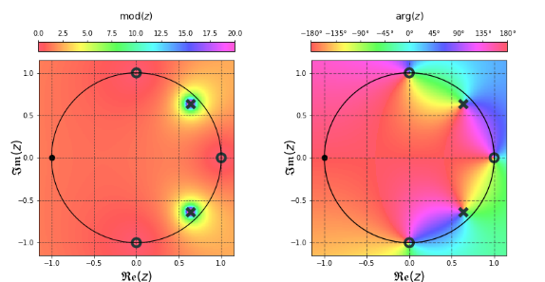

Discrete: z-transform (z-transformace)
z is a complex variable defined over the whole complex plane
z-transform maps discrete real signal to complex function over complex plane.
How to write it ?
How to imagine it ?
As “mountains” over a surface
Attention, these mountains are complex, so we need to visualize magnitude and phase …

Slide 56

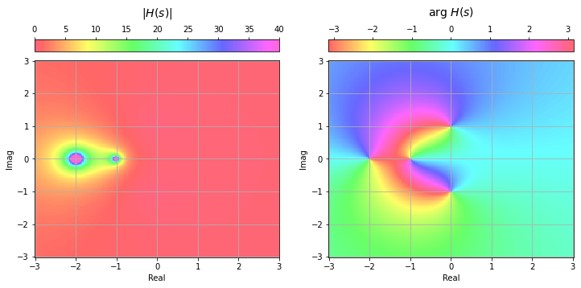

Continuous: Laplace transform (Laplaceova transformace)
s is a complex variable defined over the whole complex plane
Laplace transform maps discrete real signal to complex function over complex plane.
How to write it ?
How to imagine it ?
As “mountains” over a surface
Attention, these mountains are complex, so we need to visualize magnitude and phase …

Slide 57




Discrete: Properties of z-transform
For signal x[n]:
When we multiply with a constant:
Linear combination of 2 (or more) signals:
Delay of the signal:
The most important will be delay of 1 sample:
That’s why we mark the delay boxes in the scheme z ⁻¹
This box has one input and one output, not more !
z⁻¹

Slide 58




Continuous: Properties of Laplace transform
For signal x(t):
When we multiply with a constant:
Linear combination of 2 (or more) signals:
Derivation of the signal:
The most important is the first derivation:

Slide 59


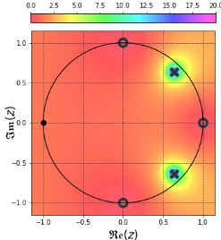



Discrete: Relation of z-transform and DTFT
Just write them next to each other … they look very similar
z-transform works over the whole complex plane, while DTFT works only for values e^{jω}.
Converting z-transform into DTFT is simple:
Or (in fancy mathematical writing)
Imagine this by taking a machine saw and cutting around the unit circle !

Slide 60

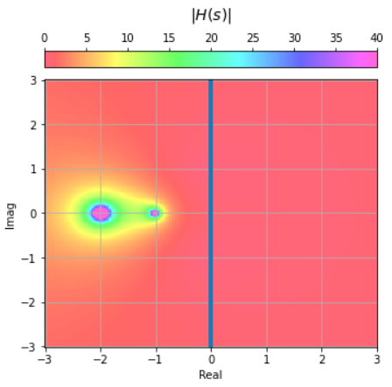


Continuous: Relation of Laplace transform and FT
Just write them next to each other … they look very similar
Laplace transform works over the whole complex plane, while FT works only for values jω.
Converting Laplace into FT is simple:
Or (in fancy mathematical writing)
Imagine this by taking a machine saw and cutting along the imaginary axis !

Slide 61

Discrete: Letting z-transform process the difference equation
Remember the z-rules:
See a signal ? Rewrite it as its z-transform.
See a constant ? Copy-paste
Is the signal delayed by k samples ? Multiply its z-transform by z ^{-k}
Our goal is to re-arrange it to obtain fraction
Why ? To obtain the ratio of output vs. input.

Slide 62

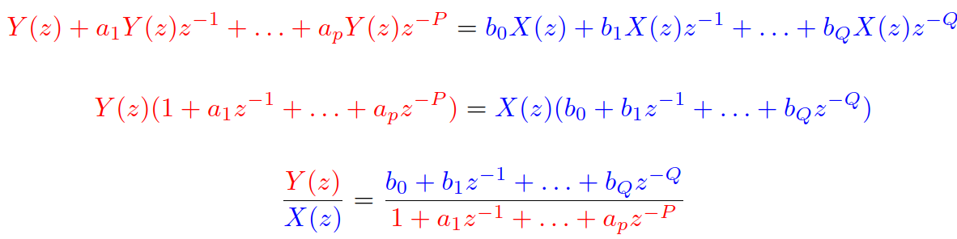
Discrete: Transfer function (přenosová / systémová funkce) H(z)
z-representation of the output over z-representation of the input
Output / input is a very common way to express system’s behavior
Amplification / attenuation = output voltage / input voltage
Currency exchange rate = target currency amount / source currency amount
Return of investment = how much I gained / how much I invested, etc.
For our filter:

Slide 63
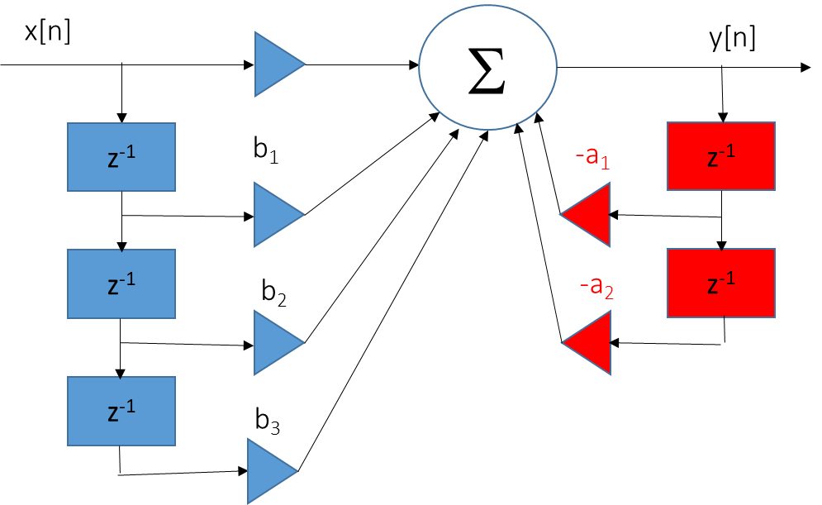
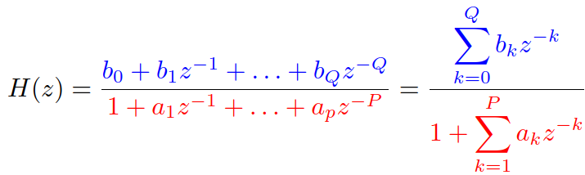
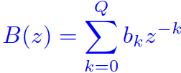
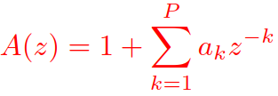
Transfer function II
Useful way to represent the filter:
Two polynomials (polynomy)
Numerator, fully determined by coefficients multiplying the inputs of filter
Denominator, fully determined by coefficients multiplying the outputs of filter
We define a₀ = 1

Slide 64

Continuous: Letting Laplace transform process the differential equation
Remember the Laplace rules:
See a signal ? Rewrite it as its Laplace transform.
See a constant ? Copy-paste
Is a kth derivation of the signal? Mutliply its Laplace transform by s^{k}.
Our goal is to re-arrange it to obtain fraction
Why ? To obtain the ratio of output vs. input.

Slide 65

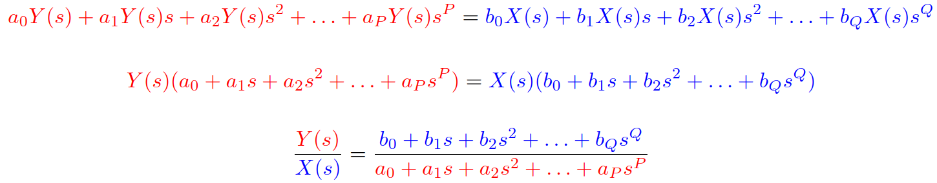
Continuous: Transfer function (přenosová / systémová funkce) H(s)
Laplace representation of the output over Laplace representation of the input
Output / input is a very common way to express system’s behavior …
For our system:

Slide 66
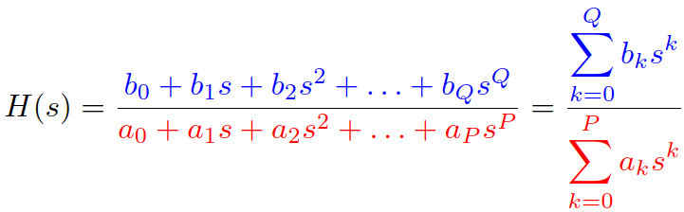
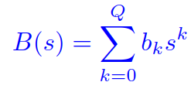
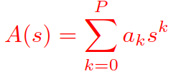
Transfer function II
Useful way to represent the filter:
Two polynomials (polynomy)
Numerator, fully determined by coefficients multiplying the inputs of filter
Denominator, fully determined by coefficients multiplying the outputs of filter
a₁ = 1, a₀ = 1/RC, b₀ = 1/RC

Slide 67
Agenda
Basic description of systems – difference and differential equations
Impulse response
Properties of systems
Connections of systems
Systems in frequency
Exercises when we are given the frequency response
Laplace transform and transfer function
Finally the frequency response !
Factorizing the transfer function and stability
Summary

Slide 68


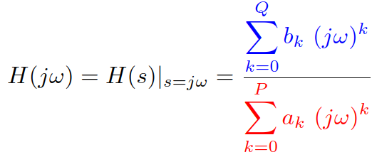
From transfer function to frequency response
We have H(s) but we want H(jω)
Fortunately, there is this relation of Laplace transform and FT …
So that we can replace
this means taking the machine saw and cutting along the imaginary axis
Mathematically:

Slide 69
How to visualize the frequency response ?
We can visualize it only for positive frequencies (from ω = 0 rad, corresponding to 0 Hz) up, or also for negative ones to emphasize symmetry.
Select a reasonable number of points (256 is good)
It is a complex function of frequency, so visualize
Magnitude: often in deciBells as
Phase.
scipy.signal.freqs(B,A): B is vector of numerator coefficients, A vector of denominator coefficients
In case we need frequencies in Hz, just divide ω by 2π.
#freqs

Slide 70
Agenda
Basic description of systems – difference and differential equations
Impulse response
Properties of systems
Connections of systems
Systems in frequency
Exercises when we are given the frequency response
Laplace transform and transfer function
Finally the frequency response !
Factorizing the transfer function and stability
Summary

Slide 71

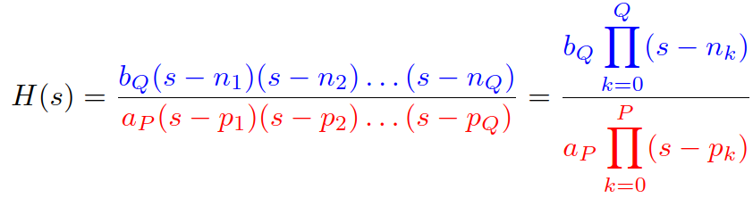
Factorizing the transfer function
Similarly as for digital filters, we can factorize (rozložit) the blue and red polynomials:
In case we find roots of polynomials (kořeny polynomů):
For low-order polynomials, we can do it by hand by setting the polynomial equal to 0 and solving.
For higher order polynomials, we better use np.roots
For any order, roots are real or complex in complex-conjugate pairs.

Slide 72

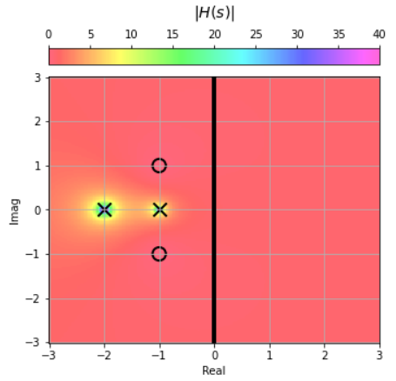
Understanding numerator and denominator roots
Let’s look at the behavior of complex function H(s) at the roots.
In case s falls into a root of the numerator, s = n_{1,} s = n_{2,} etc., the whole function H(s) will be zero. The roots are therefore called zero points or simply zeros (nulové body /nuly) and marked O.
In case s falls into a root of the denominator s = p_{1,} s = p_{2,} etc., the whole function H(s) will be infinity. The roots are therefore called poles (póly) and marked X.

Slide 73
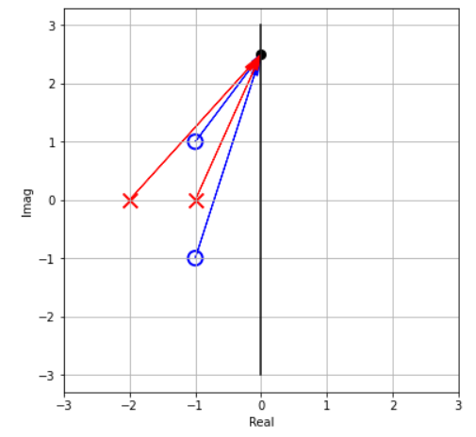

From zeros and poles to frequency response
With the factorization, frequency response can be written as
We can imagine
jω as a point on the imaginary axis. Its position corresponds to the frequency.
Each blue bracket as a vector starting in a zero point and going to jω
Each red bracket as a vector starting in a pole and going to jω

Slide 74


From zeros and poles to frequency response II
Each bracket is just a complex number, so the whole things is a multiplication and division of complex numbers. Remember:
For multiplication, we multiply magnitudes and add phases
For division, we divide magnitudes and subtract phases
So
When computing the magnitude of frequency response, take into account only the magnitudes (lengths of blue and red vectors).
When computing the phase of the frequency response, take into account only the phases (angles of blue and red vectors).

Slide 75
From zeros and poles to frequency response III
Magnitude:
Phase

Slide 76

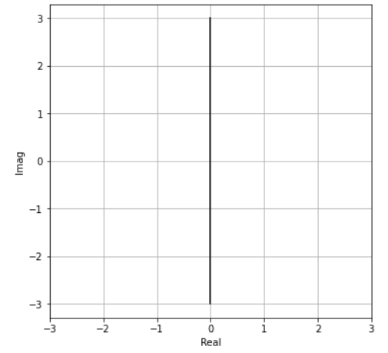
Stability of continuous-time systems
All poles must have negative real component:
Therefore, they must be in the left half of the complex plane.
OK
BAD
OK
BAD
OK
BAD

Slide 77
Agenda
Basic description of systems – difference and differential equations
Impulse response
Properties of systems
Connections of systems
Systems in frequency
Exercises when we are given the frequency response
Laplace transform and transfer function
Finally the frequency response !
Factorizing the transfer function and stability
Summary

Slide 78



Summary
scheme
Circuit analysis
Impulse response
Differential equation
Laplace transform
FT
Transfer function
Factorization of polynomials
Transfer function with zeros and poles
Frequency response
stability

