Slide 1
Sampling
Honza Černocký, ÚPGM
Please open Python notebooks sampling, changing_fs, fs_ft_by_dft

Slide 2
Agenda
Sampling in time and its impact on spectrum
Sampling theorem, aliasing and reconstruction
Sampling and reconstruction in practice – up- and down-sampling
Computing spectra of continuous signals
Fourier series numerically using DFT
Fourier transform numerically using DFT
Summary

Slide 3
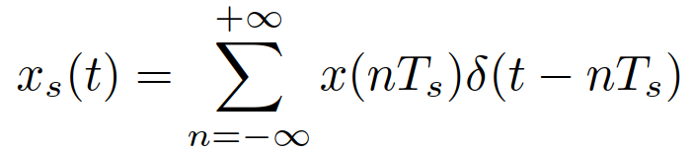
Sampling (vzorkování) in time
We have a continuous-time signal x(t) and we want to have its sampled (discrete) variant x[n].
We will define a sampling frequency F_{s} (that can be converted to angular sampling frequency Ω_{s}).
One sample is taken each sampling period T_{s} = 1 / F_{s}.
The resulting samples are stored, quantized, coded, encrypted, sent to a communication channel, analyzed, processed by the most recent AI algorithm, etc etc.
Mathematically, we need a sampling signal (vzorkovací signál) s(t), that can be multiplied with the original one to obtained the sampled version: x_{s}(t) = x(t) s(t).
Practically, s(t) will contain short pulses – they take values of x(t) in multiplication.
For theoretical development, it is good to consider the sampling signal a sequence of Dirac pulses – they will also take values of x(t) in multiplication.
#sampling_time

Slide 4
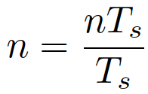
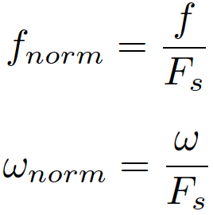
Handling the sampled signal
Mathematically, the sampled (discrete) signal is a sequence of Dirac impulses placed at multiples of sampling period T_{s} with sizes (mightenesses, mocnosti) representing the original signal.
Not very practical, so we just store the values of samples and we have the known discrete signal x[n]. This can be easily put into a C / Java / Python / … array.
However, we are loosing the information on time, we have actually normalized it by
The information on T_{s} must be sent as extra information (for example, in header of WAV file).
Normalizing time brings also normalizing the frequencies:

Slide 5
What does the sampling do in the spectrum ?
The original signal has spectrum given by its Fourier transform: X(jω)
Most signals are band-limited to some maximum frequency ω_{max}
It can be limited by the physical nature of signal (musical instruments can not vibrate at infinitely high frequencies, motor can not turn infinitely fast, …)
or we can be limited by the sensor (microphone membrane can not move infinitely fast, temperature sensor has inertia, cameras have these CCD elements that need some illumination time…)
or we limit it to the desired band by a low-pass filter (see later)
or we just believe that the input signal is band limited.
Theoretically, the spectrum is symmetrical, so we should also plot it for some negative frequencies.
We will use angular frequencies ω [rad/s] in this lecture but in practice, you often meet the ordinary ones in Hz.
#spectrum_orig

Slide 6
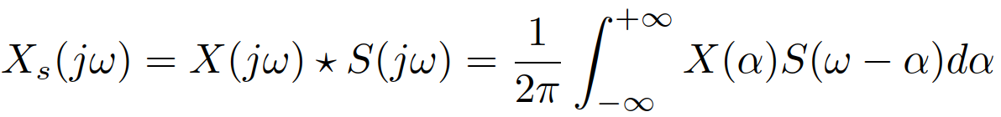
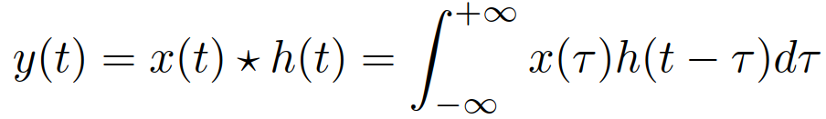
Obtaining the spectrum of sampled signal
The sampling signal has also its spectrum: S(jω)
In the time, we have a multiplication of the two signals: x_{s}(t) = x(t) s(t).
Therefore, we will face convolution in the frequency:
Remember, this is similar to convolution in time:
When convolving in frequency, we need to normalize by 2π as we are integrating over angular frequencies (remember inverse FT).
And we will drop j’s in the convolution for clarity.
=> We need spectrum of the sampling signal

Slide 7
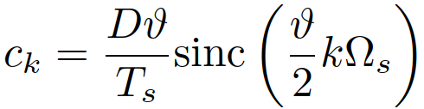
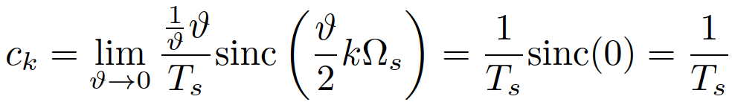
Spectrum of sampling signal – Step I.
This signal is periodic, so we first need to compute the coefficients of its Fourier series (Fourierova řada), FS.
We know, how to do it for impulses of finite length ϑ.
The width of pulses is ϑ.
The height is 1
The frequency is the sampling frequency Ω_{s}.
And we learned that the coefficients are given by:
#ck_rectangles
However, we have Diracs, so let us push ϑ to zero. At the same time, we modify the height so that the surface (mightnesess) of each Dirac is one:
We found that all coefficients of Fourier series are the same.
So this signal has a constant (discrete) spectrum – not surprising for Diracs !
#ck_diracs

Slide 8
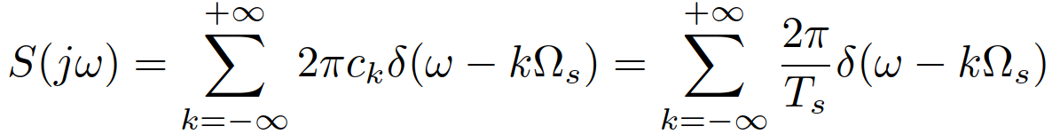
Spectrum of sampling signal – Step II.
However, we do not want Fourier series, but a Fourier transform of the sampling signal S(jω), so that we can convolve it with the the spectrum of input signal X(jω).
Fortunately, we learned, that this can be easily done by converting the coefficients of FS into series of Dirac impulses, each having the mighteness equal to 2π time the value of coefficient c_{k}
#spectrum_diracs

Slide 9
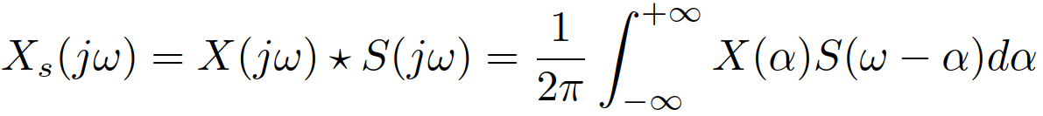
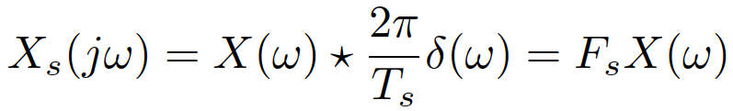
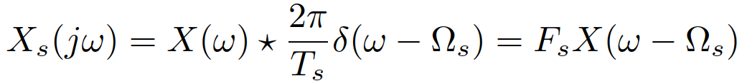
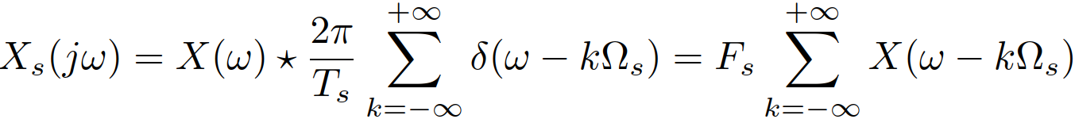
Obtaining the spectrum of sampled signal
To obtain the spectrum of sampled signal, we will need to run the convolution in frequency:
Convolution with series of Dirac pulses is a simple operation if we break it step-by-step (see last lecture on systems!):
Convolution of the original spectrum with one Dirac impulse is a copy the original spectrum, only multiplied by the sampling frequency F_{s}
Convolution with a Dirac at a different frequency copies to this frequency:
In case we have two Diracs, there is a sum of two original spectra:
Ultimately for all Diracs in frequency:
#spectrum_sampled

Slide 10
Sampling theorem
The resulting spectrum is a sum of shifted copies of the original spectrum.
Sampling can end up well – the copies do not overlap.
But it can also end up bad – the copies do overlap and they sum – this is called aliasing.
#aliasing
Condition for good sampling: the maximum frequency must be smaller than half of sampling frequency – Shannon / Kotelnikov / Nyquist / sampling theorem: angular frequencies: ω_{max} < Ω_{s} / 2 regular frequencies: f_{max} < F_{s} / 2

Slide 11
Agenda
Sampling in time and its impact on spectrum
Sampling theorem, aliasing and reconstruction
Sampling and reconstruction in practice – up- and down-sampling
Computing spectra of continuous signals
Fourier series numerically using DFT
Fourier transform numerically using DFT
Summary

Slide 12
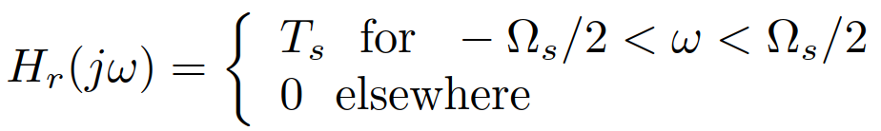
Reconstruction in spectrum
The inverse task to sampling is reconstruction – obtaining continuous-time signal x(t) from the sampled signal x_{s}(t) (or rather from its “digital” variant x[n]).
In spectrum, we can obviously do this by filtering the spectrum of sampled signal X_{s}(jω) by a reconstruction low-pass filter H_{r}(jω) zeroing anything but frequencies from –Ω_{s} /2 to +Ω_{s} /2:
The filtering in spectrum is a simple product:
X_{r}(jω) = X_{s}(jω) H_{r}(jω)
In case the sampling theorem is respected, we obtain exactly the original spectrum (so exactly the original signal) => perfect reconstruction
#reconstruction_spectrum_ok

Slide 13
Aliasing and anti-aliasing
In case the sampling theorem is not respected, the original spectra overlap and add during the sampling – aliasing => no way to obtain the original spectrum
#reconstruction_spectrum_bad
The high parts of spectrum (beyond +Ω_{s} /2 and below -Ω_{s} /2) are moved to the “useful” interval -Ω_{s} /2 … +Ω_{s} /2 and cause problems…
We can however pre-filter the original signal to remove parts higher than +Ω_{s} /2 and lower than -Ω_{s} /2 by an anti-aliasing filter, H_{aa}(jω) zeroing anything but frequencies from –Ω_{s} /2 to +Ω_{s} /2.
#anti-aliasing
The higher parts of spectrum are lost but at least they do not influence the useful ones.
Anti-aliasing filter has actually the same frequency response as the reconstruction filter (different gain).

Slide 14
Reconstruction in the time domain
We know what happens in frequency but how to perform the reconstruction in time ?
In frequency, we have a product: X_{r}(jω) = X_{s}(jω) H_{r}(jω)
This corresponds to a convolution in time: x_{r}(t) = x_{s}(t) * h_{r}(t)
We know that x_{s}(t) is a series of Dirac pulses, so convolution will be easy: just copying, pasting and summing.
We need h_{r}(t) – the impulse response of the reconstruction low-pass filter.

Slide 15
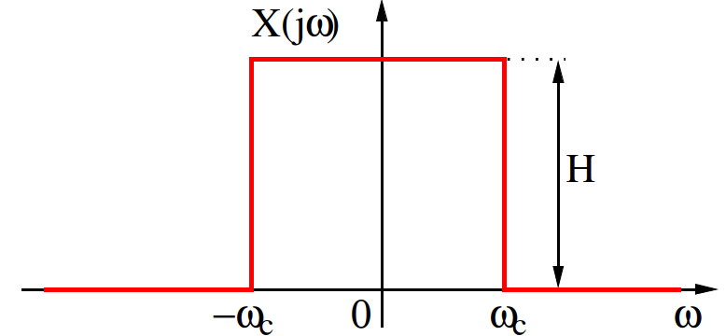

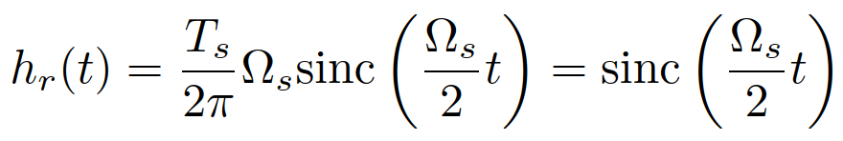
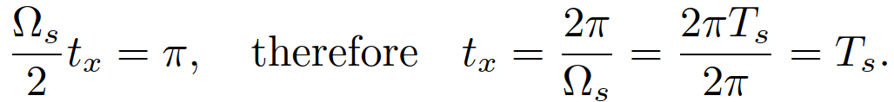
Impulse response of reconstruction filter
In the FT lecture, we have derived:
Here, we have H = T_{s} and ω_{c} = Ω_{s} /2, so:
The cardinal sines are crossing zero for
We see that this coincides with the multiples of sampling period.
#cardinal_sine_time

Slide 16
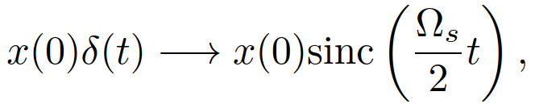
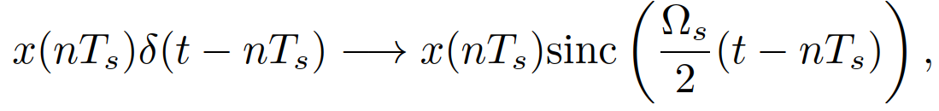
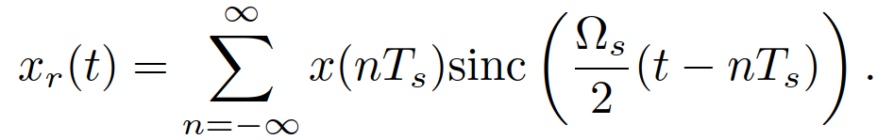
Finally the reconstruction in time domain
The reconstructed signal is obtained by convolution x_{r}(t) = x_{s}(t) * h_{r}(t):
Every sample “launches” its own cardinal sine.
Sample at time 0:
Sample at time nT_{s}:
All samples:
Notes:
For times t = n T_{s} , the reconstructed signal x_{r}(t) is fully determined by sample x[n].
For other times (between samples), the reconstructed signal x_{r}(t) is given as a sum of cardinal sines – theoretically infinity, practically, we crop the cardinal sines to several periods.
#reconstruction_time

Slide 17
Reconstruction in time when things go wrong
In the previous, the signal was artificially generated and respected the sampling theorem.
Let us show the result for a rectangular pulse.
#reconstruction_time_bad
The resulting signal is NOT the same as the original
Rectangular pulse has a an infinite spectrum, with ω_{max} = ꝏ, so the sampling theorem can not be respected => aliasing.

Slide 18
Agenda
Sampling in time and its impact on spectrum
Sampling theorem, aliasing and reconstruction
Sampling and reconstruction in practice – up- and down-sampling
Computing spectra of continuous signals
Fourier series numerically using DFT
Fourier transform numerically using DFT
Summary

Slide 19
Using the sampling and reconstruction know-how
Some of you will be developing sampling and reconstruction HW and SW (development of measurement cards, acquisition boards, sound cards, software defined radio, mixed-design …)
But we all should have in mind the sampling theorem when capturing signals – be especially careful about setting sufficiently high sampling frequency F_{s} !
We will however meet this theory when re-sampling signals
Increasing F_{s} (upsampling, nadvzorkování) – creating new samples.
Decreasing F_{s} (downsampling, podvzorkování) – selecting only some samples.
Plenty of available tools:
1D ffmpeg, sox, GoldWave, Audacity, WaveSurfer, …
2D any image processing tool.
But it is good to know how to do it correctly.

Slide 20
Downsampling a signal
We have a song of a bell on F_{s} = 48 kHz and we want to convert it for a really old cell-phone of grandma, that accepts only F_{s} = 8 kHz.
Looks easy: just select every 6th sample !
#downsampling_wrong
The sound is terrible, this is not a bell
it seems that the signal is “too fast” to have sampling at F_{s} = 8 kHz catching up (vzoky na F_{s} = 8 kHz “nestíhají”)
We need to analyze what happened using spectrograms.
#downsampling_wrong_spectra
Lots of mess in low frequencies that was not there in the original signal !

Slide 21
Downsampling in a correct way
There is lots of energy in the spectrum above Ω_{s} /2, so lots of aliasing.
We need to use anti-aliasing filter.
It can be a truncated cardinal sine crossing the time axis every 6th sample – exactly the spectral characteristics we need.
#aa_filter
Now we can
First apply the anti-aliasing filter
Then down-sample.
#downsampling_aa_solved
Sounds good, let us check on the spectrograms …
#downsampling_aa_solved_spectra

Slide 22
Up-sampling a signal
The inverse situation – we have a signal on low sampling frequency and want to convert it to higher F_{s} (for example to play telephone speech on studio equipment).
Example with recording on F_{s} = 8 kHz with target F_{s} = 48 kHz.
We need to somehow create the missing samples – idea No. 1: fill them with zeros.
#upsampling_zerofill
The result does not sound terribly good, let us analyze the spectra …
#upsampling_zerofill_spectra
We see repetitions of the basic spectrum above 4 kHz.
No surprise, remember basic truth about spectra: “signal gets sampled in time -> spectrum becomes periodic.” ! … and we actually did sampling of the signal !

Slide 23
Better ways to up-sample the signal
Holding the value for the duration of 6 samples = interpolation of 0th order.
#upsampling_steps
Still lots of artifacts above 4 kHz.
Connecting the samples linearly = interpolation of 1st order.
Can actually be done with a special “roof-like” impulse response and shifting the resulting signal – check the Python code ☺
#upsampling_lines
Artifacts still not removed !

Slide 24
Optimal way to up-sample the signal
The operation equals to reconstruction of a continuous-time signal from discrete one (just imagine infinity samples between original ones, not just 5).
We can therefore run the same cardinal sine filter that we used for down-sampling.
#upsampling_correct
Artifacts attenuated but not 100%, as we have a real (not ideal) filter (and we are using log for visualization)
The audio quality is good.
When visualizing the result, do not forget to shift the resulting signal, as the sinc filter causes delay.

Slide 25
Agenda
Sampling in time and its impact on spectrum
Sampling theorem, aliasing and reconstruction
Sampling and reconstruction in practice – up- and down-sampling
Computing spectra of continuous signals
Fourier series numerically using DFT
Fourier transform numerically using DFT
Summary

Slide 26
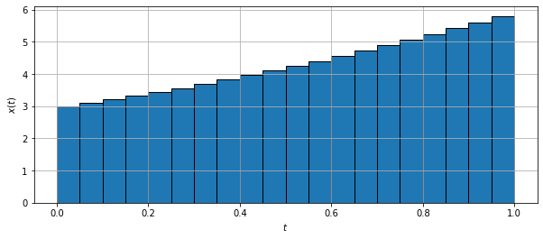
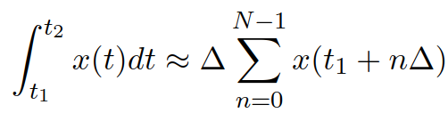
Numerical computation of Fourier series and Fourier transform
We will analyze how to compute FS and FT from sampled signals.
We will use numerical integration, remember:
It will always result in the Discrete Fourier transform (DFT), so let us review its definition and properties…

Slide 27
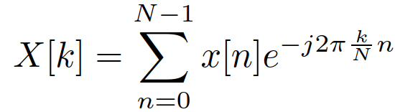
Discrete Fourier transform (DFT) analysis
Input: signal x[n] of N samples
Output: N complex coefficients X[k] providing the information on
Frequency – index k, corresponds to normalized frequency k/N and regular frequency k/N F_{s}. Normalization and de-normalization of frequency involves a simple division or multiplication by sampling frequency F_{s}.
How much ? Magnitude (absolute value, modul) |X[k]|.
How shifted ? Phase (angle, argument, phase shift) arg X[k].
Easy to implement by definition but using FFT is much faster (for N = 2^{b})

Slide 28
DFT analysis II.
For real input signals x[n], coefficients X[k] are symmetrical (complex conjugate X[k] = X*[N-k]:
|X[k]| = |X[N-k]| and arg X[k] = -arg X[N-k]
… so that it is enough to store and visualize the spectrum only from k = 0 to k = N/2. This corresponds to normalized frequencies 0 … ½ and regular frequencies 0 … F_{s} /2.
Attention, the number of coefficients to retain is NOT N/2 but N/2+1 !!!

Slide 29
To remember when using DFT …
The signal is sampled, so that the spectrum is periodic. We compute only one period: coefficients 0 … N-1
Regular frequencies 0 … almost F_{s} angular frequencies 0 … almost 2πF_{s}
Norm. frequencies 0 … almost 1 norm. angular frequencies 0 … almost 2π
… but the periodicity can betray us in case the sampling theorem is not respected.
The spectrum of DFT is sampled (we have only a discrete set of coefficients sitting at multiples of F_{s} /N, 2πF_{s} /N, 1/N or 2π/N (depending on the used frequency), so that the signal is periodic.
We actually compute Discrete Fourier Series (DFS, diskrétní Fourierova řada) of periodic repetitions of the N samples.
The signal was selected by a window, that will influence the spectrum. x(t) w(t) ---> X(jω) * W(jω)

Slide 30
Agenda
Sampling in time and its impact on spectrum
Sampling theorem, aliasing and reconstruction
Sampling and reconstruction in practice – up- and down-sampling
Computing spectra of continuous signals
Fourier series numerically using DFT
Fourier transform numerically using DFT
Summary

Slide 31
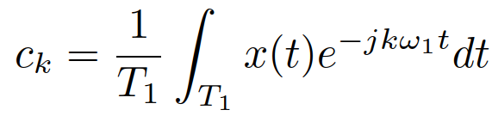
Fourier series numerically I.
Fourier series (Fourierova řada) serves for spectral analysis of periodic signals with period T₁.
The results are coefficients of FS: complex numbers c_{k} “sitting” at multiples of the fundamental frequency ω₁.
They can be computed by definition as
Let us consider that we can sample this signal with sampling period T_{s} and that we fit exactly N samples into one period T₁ (actually quite unrealistic assumption …)
In this case, the integral can be approximated numerically as:

Slide 32
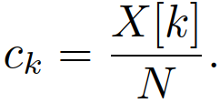
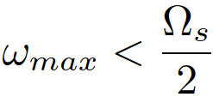
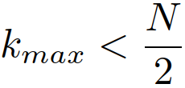
Fourier series numerically II.
The expression contains the definition of Discrete Fourier Transform (DFT) so that we can write:
It thus seems easy to numerically compute FS, but several conditions need to be met:
Only coefficients X[k] for k < N/2 can be used, the negative ones c_{-k} can be obtained by flipping the upper part of DFT spectrum due to periodicity: X[-k] = X[N-k]. This can be done fftshift. OK
The sampling theorem must be respected which means that the last non-zero FS coefficient must be OK
N samples must contain exactly one period of the signal (or several periods). This is hard – we are working with an unknown signal ! NOT OK

Slide 33
Examples of FS computation
Example 1: cosine x(t) = 10 cos (125πt + π/4) sampled on F_{s} = 1 kHz.
The true coefficients are c₁ = 5 e ^{jπ/4} and c₋₁ = 5 e ^{-jπ/4} .
We are lucky, as the period is T₁ = 2π / 125π = 0.016. We can therefore fit exactly N = 16 samples in one period and compute DFT.
#fs_cos_ok
Very nice, computation is equal to theoretical results.
Example 2: cosine x(t) = 10 cos(400 t) sampled on F_{s} = 1 kHz.
The true coefficients are c₁ = 5 and c₋₁ = 5.
The period is T₁ = 2π / 400 = 0.157, so we try it with N = 16 samples for DFT as well …
#fs_cos_bad, #fs_cos_bad_Hamming,
More coefficients are non-zero, and the “best” ones are not exactly at the positions of theoretical c₁ and c₋₁. We can try to fix the spread by Hamming window, but the magnitudes will be wrong.

Slide 34
Examples of FS computation II.
Exercise 3: Typical periodic signal – sequence of rectangular pulses. We will take the same parameters as in the FS lecture: f ₁ = 1 MHz, i.e. T₁ = 1 μs, ω₁ = 2x10⁶ π rad/s = 2M π, ϑ = T₁ / 2, so that the duty cycle is 50%. Height D = 6.
The theoretical FS coefficients are given by cardinal sine that touches zero for multiples of 2π/ ϑ = 4 Mπ.
Let us first consider sampling frequency F _{s} = 256 MHz, so there are N = 256 samples to compute DFT.
#fs_rectangles_1Mhz_ok
Nice results
Exercise 4: the same but with significantly lower F _{s} = 32 MHz, so there is N = 32 samples to compute DFT.
#fs_rectangles_1Mhz_bad
We start obtaining non-zero coefficients in wrong places – due to aliasing …

Slide 35
Agenda
Sampling in time and its impact on spectrum
Sampling theorem, aliasing and reconstruction
Sampling and reconstruction in practice – up- and down-sampling
Computing spectra of continuous signals
Fourier series numerically using DFT
Fourier transform numerically using DFT
Summary

Slide 36
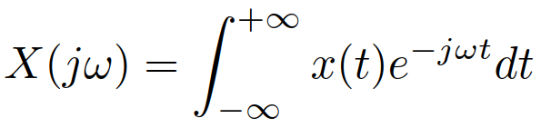
Fourier transform numerically
Fourier transform (Fourierova transformace) serves for spectral analysis of non-periodic signals.
The results is a spectral function X(jω) defined for all frequencies.
It can be computed by definition as
We will first need to make the signal limited in time – from 0 to some T_{1.}
if we can not make it time-limited, no way to use DFT ☹
If we can make it limited, but somewhere else, for example from t_{start} to T₁ + t_{start} , we shift it to T₁ and we remember t_{start} .
Then, we sample it with sampling period T_{s} , we obtain N samples.

Slide 37

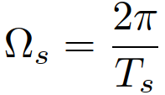
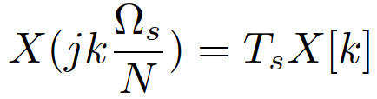
Fourier transform numerically II.
The FT integral can then be approximated numerically.
Obviously, we will not be able to compute for all frequencies, but only for multiples for where is he angular sampling frequency.
The expression contains again the definition of Discrete Fourier Transform (DFT) so that:

Slide 38
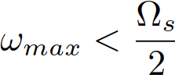
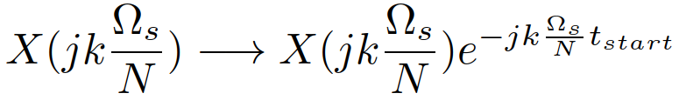
Conditions for computing FT
It seems easy to numerically compute FT, but several conditions need to be met:
Only coefficients X[k] for k < N/2 can be used, the negative frequencies can be obtained by flipping the upper part of DFT spectrum due to periodicity: X[-k] = X[N-k]. This can be done fftshift. OK
The sampling theorem must be respected OK
Improving the result
We will obtain frequencies but might want better resolution on the frequency axis – zero-padding (doplňování nulami) is an option.
In case we shifted the signal from its original starting time t_{start} to 0, we can correct the phase by remembering the formula for spectrum of a shifted signal:

Slide 39
Examples of FT computation
one rectangular pulse from the FS examples: ϑ = 0.5 μs, D = 600000.
The theoretical spectral function is given by cardinal sine that touches zero for multiples of 2π/ ϑ = 4 Mπ.
We can not work for negative times, so we need to shift the signal to start at zero. We remember t_{start} = -0.25 μs.
We can not take the signal only till 0.5 μs, this would compute FT of a constant, the FT needs to “see” the edges!
We can sample at F_{s} = 64 MHz.
#ft_rectangle_0.5us
Improving the frequency resolution by zero padding to N_{fft} = 512
#ft_rectangle_0.5us_zeropad

Slide 40
Agenda
Sampling in time and its impact on spectrum
Sampling theorem, aliasing and reconstruction
Sampling and reconstruction in practice – up- and down-sampling
Computing spectra of continuous signals
Fourier series numerically using DFT
Fourier transform numerically using DFT
Summary

Slide 41
Summary I
Sampling in time
involves multiplication with sampling signal - short pulses.
the best theoretical sampling signal is a sequence of Dirac pulses.
Spectrum of sampled signal is given by convolution of two spectra: of the original signal and of the sampling signal.
Spectrum of a sequence of Diracs is a sequence of Diracs.
When convolved with the original spectrum, Diracs work as a copy-machine.
Sampling / Shannon / Kotelnikov / Nyquist theorem
In case the sampling frequency is high enough, the copies will not mix.
In this case, we can perfectly reconstruct the original signal by a low-pass.
If the sampling frequency is not high enough, the copies will mix and we will not be able to reconstruct the original signal.
We can fix at least some damage by using anti-aliasing filter.

Slide 42
Summary II
Reconstruction in time
works by convolution of the sampled signal with a cardinal sine
in theory infinitely long, in practice truncated.
The theory comes to work while re-sampling signals:
for down-sampling, do not forget to run the original signal first by a low-pass filter.
for up-sampling, first fill new new samples by zeros, then run a low-pass filter - do not use 0th or 1st order interpolation - the sinc is the thoretically best option !
Fourier series and Fourier transform can be computed from sampled signals by DFT.
FS: coefficients are given by DFT divided by the number of samples.
FT: spectral function is given by DFT times the sampling period.
There are severe conditions to make it work:
can not go beyond sampling theorem
negative frequencies are given by fftshift of the DFT
for FS, we should theoretically fit N samples in one period - not doable in most scenarios.
For FT, we can beautify the result by zero-padding and fix the phase in case we had to shift the signal.

