Slide 1
Filtering II - frequency response and stability
Honza Černocký, ÚPGM
Thanks Petr Pálka (BP 2021/22) for great visualization functions in Python
Please open Python notebook filtering_2

Slide 2
Agenda
Example of an IIR filter
Time domain vs. frequency domain
z-transform and transfer function
Frequency response
Factorizing the transfer function
Stability
Summary
<number> / 42

Slide 3
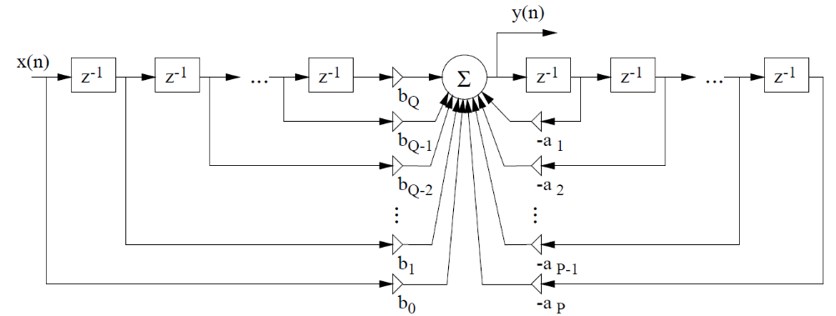
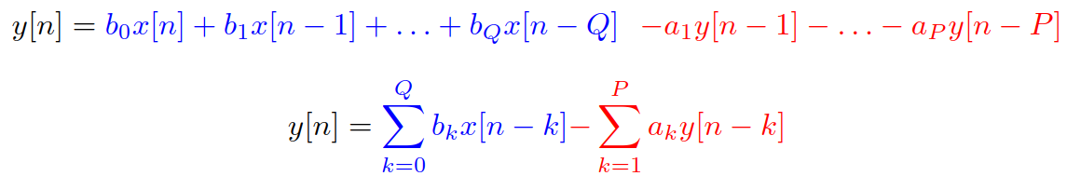
General digital filter - IIR
Scheme
Difference equation (diferenční rovnice)
<number> / 42

Slide 4
Example of a real filter
b₀ = 1, b₁ = -1, b₂ = 1, b₃ = -1
a₁ = -1.2723, a₂ = 0.81
x[n]
b₀
Σ
y[n]
z⁻¹
b₁
-a₁
z⁻¹
z⁻¹
b₂
-a₂
z⁻¹
z⁻¹
b₃
<number> / 42

Slide 5
It can really be programmed !
float filter (float xn) {
float b0 = 1, b1 = -1, b2 = 1, b3 = -1,
a1 = -1.2723, a2 = 0.81;
static float xn1 = 0.0, xn2 = 0.0, xn3 = 0.0;
static float yn1 = 0.0, yn2 = 0.0,
float yn;
yn = b0 * xn + b1 * xn1 + b2 * xn2 + b3 * xn3
- a1 * yn1 - a2 * yn2;
xn3 = xn2; xn2 = xn1; xn1 = xn;
yn2 = yn1; yn1 = yn;
return (yn);
}
<number> / 42

Slide 6
How does such a filter work ?
Visualizing spectrograms and listening to some signal …
#demo_filtering
Ok, seems that the filter accentuates frequencies at around 5000 Hz and attenuates around 11000, but we’d like to know exactly => we want frequency response (frekveční / kmitočtová charakteristika)
Also, we would like to know if the filter will behave reasonably, i.e. not produce (for reasonable input) +ꝏ or -ꝏ, that would lead to a destruction of our (expensive) audio equipment => we want to investigate stability (stabilita)
<number> / 42

Slide 7
Agenda
Example of an IIR filter
Time domain vs. frequency domain
z-transform and transfer function
Frequency response
Factorizing the transfer function
Stability
Summary
<number> / 42

Slide 8
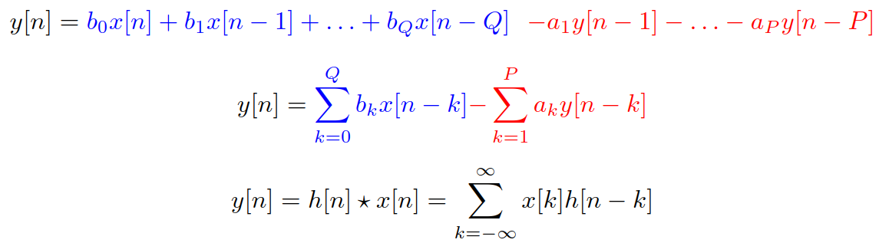
Filter in the time domain
Difference equation or convolution with impulse response
  for FIR filters (working just with the input signal) – the same.
  For IIR filters – convolution not doable (impulse response is infinite)
<number> / 42

Slide 9

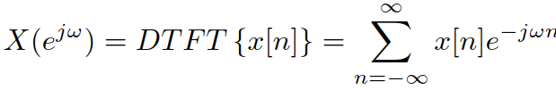
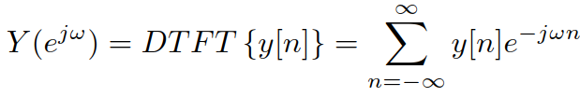
Filter in the frequency domain
Let’s make sure we know which frequencies we’ll be working with – normalized angular frequency (normovaná kruhová / úhlová frekvence) in radians
  0 Hz corresponds to 0 rad
  F_{s} / 2 corresponds to π rad
  F_{s} corresponds to 2π rad.
Obtaining spectra of input and output signals by Discrete time Fourier transform – DTFT (Fourierova transformace s diskrétním časem)
Practically, always computed by DFT / FFT !
<number> / 42

Slide 10



For one single frequency ω₁ …
A complex exponential or cosine have only one frequency:
Transfer or transfer coefficient (přenos nebo činitel přenosu) – complex number
Its magnitude determines how much the signal will change
Its phase determines how much the signal gets shifted
However, we don’t want just a single frequency, we want them all !
<number> / 42

Slide 11



Frequency response (kmitočtová / frekvenční charakteristika)
Determines the behavior of a system on all frequencies
Complex function of frequency
Magnitude frequency response (amplitudová / modulová kmitočtová / frekvenční charakteristika) is the most crucial – which frequencies will be attenuated or amplified ?
Phase frequency response (fázová / argumentová kmitočtová / frekvenční charakteristika) is sometimes important as well (think of Hi-Fi applications)
<number> / 42

Slide 12
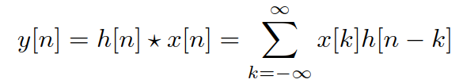


Relation of time and frequency
Time: convolution
Frequency: mutliplication
Remember we can obtain the spectra of input and output by DTFT:
So that it seems that we can obtain the frequency response by DTFT of the impulse response and we’re done
<number> / 42

Slide 13
Frequency response by DTFT of impulse response
For FIR filters (finite impulse reponse) – perfectly DOABLE – DTFT (computed by DFT) of h[n].
Remember:
  h[k] = b_{k} for k = 0 … Q
  h[k] = 0 otherwise
For IIR (infinite impulse response) – NOT DOABLE – we can’t DFT infinite sequence of numbers !
#iir_response
<number> / 42

Slide 14
Agenda
Example of an IIR filter
Time domain vs. frequency domain
z-transform and transfer function
Frequency response
Factorizing the transfer function
Stability
Summary
<number> / 42

Slide 15

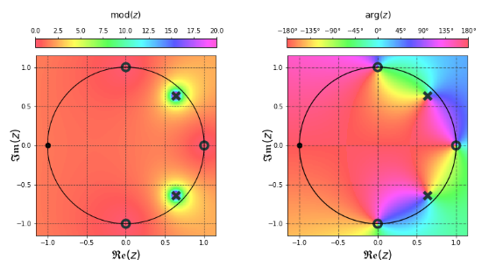

z-transform (z-transformace)
z is a complex variable defined over the whole complex plane
z-transform maps discrete real signal to complex function over complex plane.
How to write it ?
How to imagine it ?
  As “mountains” over a surface
  Attention, these mountains are
  complex, so we need to
  visualize magnitude and phase …
<number> / 42

Slide 16




Properties of z-transform
For signal x[n]:
When we multiply with a constant:
Linear combination of 2 (or more) signals:
Delay of the signal:
The most important will be delay of 1 sample:
That’s why we mark the delay boxes in the scheme z ⁻¹
  This box has one input and one output, not more !!!!!!!!!
z⁻¹
<number> / 42

Slide 17


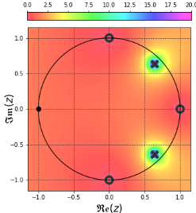



Relation of z-transform and DTFT
Just write them next to each other … they look very similar
z-transform works over the whole complex plane, while DTFT works only for values e^{jω}.
Converting z-transform into DTFT is simple:
Or (in fancy mathematical writing)
Imagine this by taking a machine
saw and cutting around the unit circle !
<number> / 42

Slide 18

Letting z-transform process the difference equation
Remember the z-rules:
  See a signal ? Rewrite it as its z-transform.
  See a constant ? Copy-paste
  Is the signal delayed by k samples ? Mutliply its z-transform by z ^{-k}
Our goal is to re-arrange it to obtain fraction
Why ?
<number> / 42

Slide 19

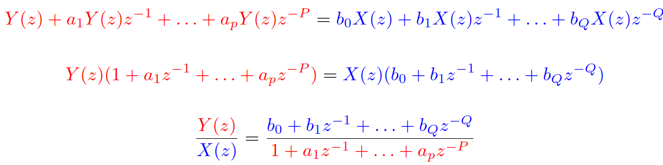
Transfer function (přenosová / systémová funkce) H(z)
z-representation of the output over z-representation
of the input
Output / input is a very common way to express system’s behavior
  Amplification / attenuation = output voltage / input voltage
  Currency exchange rate = target currency amount / source currency amount
  Return of investment = how much I gained / how much I invested, etc.
For our
filter:
<number> / 42

Slide 20
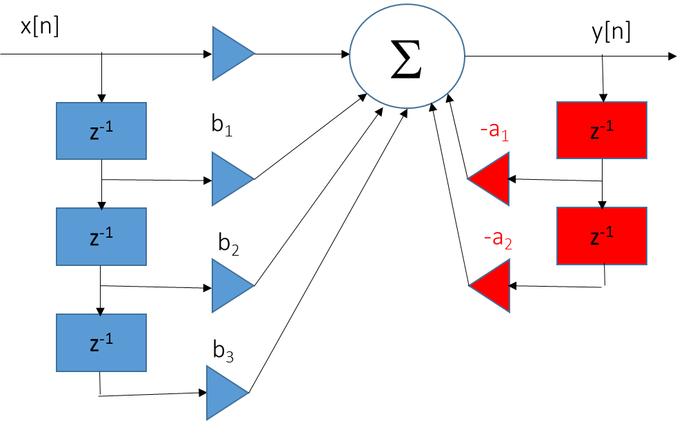
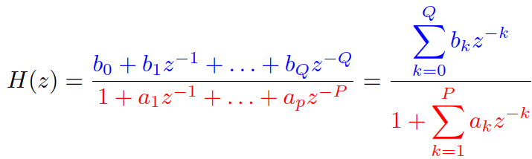
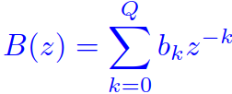
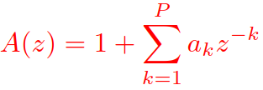
Transfer function II
Another way to represent the filter:
Two polynomials (polynomy)
  Numerator, fully determined by coefficients
  multiplying the inputs of filter
  Denominator, fully determined by coefficients
  multiplying the outputs of filter
  We define a₀ = 1
<number> / 42

Slide 21
Agenda
Example of an IIR filter
Time domain vs. frequency domain
z-transform and transfer function
Frequency response
Factorizing the transfer function
Stability
Summary
<number> / 42

Slide 22
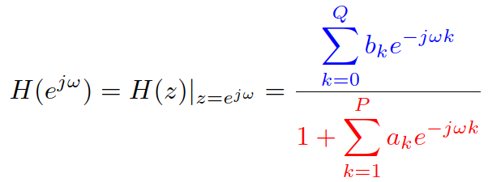
From transfer function to frequency response
We have H(z) but we want H(e^{jω})
Fortunately, there is this relation of z-transform and DTFT …
So that we can replace
this means taking the machine saw and cutting
around the unit circle.
Mathematically:
Numerator and denominator are actually the DTFTs
of coefficients ! Fortunately, we have scipy.signal.freqz
<number> / 42

Slide 23
How to visualize the frequency response ?
Run only from ω = 0 rad (corresponds to 0 Hz) till ω = π rad (corresponds to F_{s} / 2 Hz).
Select a reasonable number of points (256 is good)
It is a complex function of frequency, so visualize
  Magnitude: often in deciBells as | |
  Phase.
scipy.signal.freqz(B,A): B is vector of numerator coefficients, A vector of denominator coefficients (including a₀ = 1).
In case we need frequencies in Hz, just divide ω by 2π and denormalize by multiplying by F_{s}
#freqz
<number> / 42

Slide 24
Agenda
Example of an IIR filter
Time domain vs. frequency domain
z-transform and transfer function
Frequency response
Factorizing the transfer function
Stability
Summary
<number> / 42

Slide 25

Factorizing B(z) and A(z)
Let’s massage the fraction to have polynomials with positive powers of z:
We can now factorize (rozložit) the blue and red polynomials.
In case we find roots of a polynomial (kořeny polynomu),
we can write it in a factorized form:
<number> / 42

Slide 26

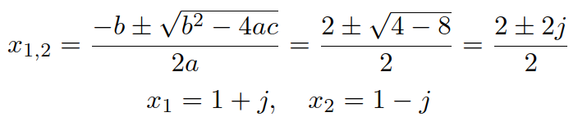
Exercises of factorization
Check results of these exercises with #roots obtained by np.roots
Sometimes, we remember some decomposition formula and we don’t need much work
For others, like we need to solve quadratic equation – we’re not at high school anymore, we can do square root of a negative number !
For higher order polynomials, we better use np.roots – for any order, roots are real or complex in complex-conjugate pairs.
<number> / 42

Slide 27
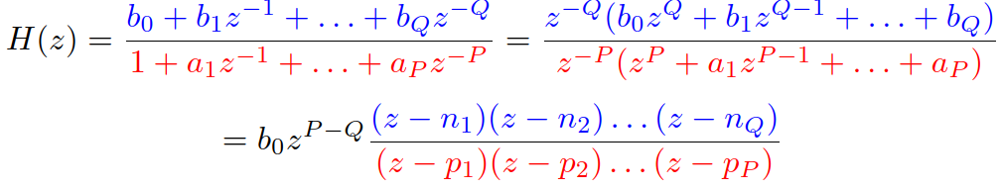
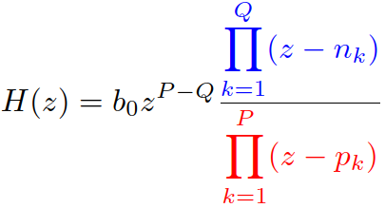
Factorizing the transfer function
Or, in fancy mathematical writing with Π denoting product:
Let’s take an example of our filter #roots_our_filter
b₀ = 1, b₁ = -1, b₂ = 1, b₃ = -1 → roots n₁ = j, n₂ = -j, n₃ = 1
a₀ = 1, a₁ = -1.2723, a₂ = 0.81 → roots p₁ = 0.9e^{jπ/4}, p₂ = 0.9e^{-jπ/4}
<number> / 42

Slide 28

Understanding numerator and denominator roots
Let’s look at the behavior of complex function H(z) at the roots.
In case z falls into a root of the numerator,
z = n_{1,} z = n_{2,} etc., the whole function H(z) will be zero. The roots are therefore called zero points or simply zeros (nulové body /nuly) and marked O.
In case z falls into a root of the denominator
z = p_{1,} z = p_{2,} etc., the whole function H(z)
will be infinity. The roots are therefore called poles (póly) and marked X.
<number> / 42

Slide 29
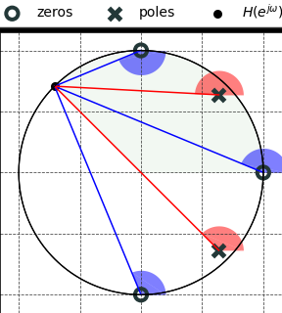

From zeros and poles to frequency response
With the factorization, frequency response
can be written as
We can imagine
  e^{jω} as a point on the unit circle. Its position
  corresponds to the frequency.
  Each blue bracket as a vector starting in a zero
  point and going to e^{jω}
  Each red bracket as a vector starting in a pole and
  going to e^{jω}
<number> / 42

Slide 30


From zeros and poles to frequency response II
Each bracket is just a complex number, so the whole things is just a multiplication and division of complex numbers. Remember:
For multiplication, we multiply magnitudes and add phases
For division, we divide magnitudes and subtract phases
So
  When computing the magnitude of frequency response, take into account only the magnitudes (lengths of blue and red vectors)
  When computing the phase of the frequency response, take into account only the phases (angles of blue and red vectors) .
<number> / 42

Slide 31

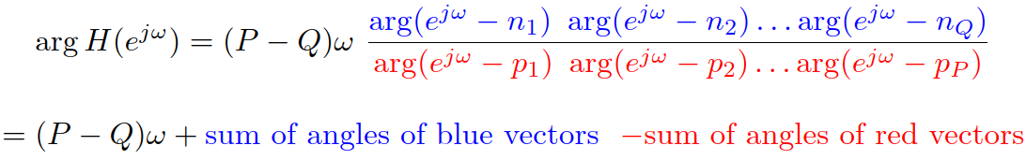
From zeros and poles to frequency response III
Magnitude (need to take into account b₀ if it is not 1):
Phase (need to take into account if P and Q are not the same):
<number> / 42

Slide 32


Exercise on our filter for 4 typical frequencies
Only magnitudes, but take a time and play also with phases !
#zeros_poles_to_freq_response
ω = 0
ω = π / 4
ω = π / 2
ω = π
<number> / 42

Slide 33
Agenda
Example of an IIR filter
Time domain vs. frequency domain
z-transform and transfer function
Frequency response
Factorizing the transfer function
Stability
Summary
<number> / 42

Slide 34
What is stability
Bounded input → bounded output.
If input x[n] is in interval [-C, C], we can find D such that the output y[n] is bounded in interval [-D, D]
  C is usually 1, as we are normalizing the input signal.
Unstable filter usually produces values +ꝏ or -ꝏ - you probably witnessed (for example at a rock concert) what it means, if a system becomes unstable.
<number> / 42

Slide 35
Stability of FIR filters
Filtering works with the difference equation processing only input samples (coefficients b_{k}), which is equivalent to convolution with impulse response (remember: for FIR filters, impulse response = coefficients)
y[n] = b₀x[n] + b₁x[n-1] + b₂x[n-2] + b₃x[n-3]
y[n] = h[0]x[n] + h[1]x[n-1] + h[2]x[n-2] + h[3]x[n-3]
Example for C = 1 (input signal normalized to +/-1) and 4 coefficients:
b₀ = 1.5, b₁ = 1, b₂ = 0.5, b₃ = -1.
the worst case happens if input samples have maximum magnitude and their sign matches the sign of the coefficient:
y_{max}[n] = 1.5 x 1 + 1 x 1 + 0.5 x 1 + (-1) x (-1) = 4
<number> / 42

Slide 36
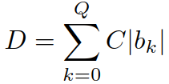
Stability of FIR filters II
Generally:
We can find output limitation D for any input limitation C
=> FIR filter is always stable
<number> / 42

Slide 37

Stability of IIR filters
Sum of impulse response does not work – it is infinite ☹
We can determine stability only for the simplest filter
  |a₁| < 1
But with the factorization
we can imagine the filter as a sequence of filters with just one coefficient – the poles are the coefficients ! Therefore, the condition is
x[n]
Σ
y[n]
-a₁
z⁻¹
<number> / 42

Slide 38
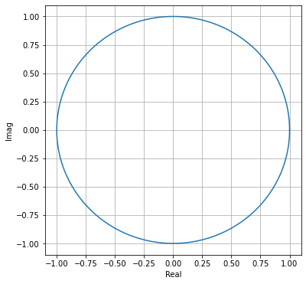
Stability of IIR filters II
BAD
BAD
All poles must be inside the unit circle
Beware when implementing IIR filters
with less precision (signal processors, FPGA)
  Even if your filter is stable with coefficients
  expressed as floats / doubles
  It can become unstable once they are quantized
  to less bits !
Check more advanced signal processing courses, for example CZSa.
OK
BAD
BAD
<number> / 42

Slide 39
Agenda
Example of an IIR filter
Time domain vs. frequency domain
z-transform and transfer function
Frequency response
Factorizing the transfer function
Stability
Summary
<number> / 42

Slide 40




Summary
scheme
Impulse response
Difference equation
z- transform
DTFT (only for FIR filters!)
Transfer function
Factorization of polynomials
Transfer function with zeros and poles
Frequency response
stability
<number> / 42

Slide 41
Summary II
As usual, be nice with visualization of your results:
Ask your colleague / boss / customer, how he/she wants the frequency axis:
  For normalized angular frequencies, go from ω = 0 rad to ω = π rad
  For regular frequencies, go from 0 Hz to Fs / 2 Hz.
Pick good number of points.
Show the result in linear or log (deciBell) scale.
Phase is not always requested, but be ready to provide it (np.angle)
<number> / 42

Slide 42
Summary III
Usual filter design functions produce stable filters
But better check it, especially when trying something own and/or special: poles must be inside unit circle.
Be careful when designing very sharp filters, their poles tend to be deadly close to the unit circle !
When modifying filter coefficients (representation with less bits), check again, quantization can kick the poles out of the unit circle.
<number> / 42

