Slide 1
Random signals II
Honza Černocký, ÚPGM
Please open Python notebook random_2

Slide 2
Agenda
Recap of the basics and reminder of data
Stationarity
Ergodicity and temporal estimates
Correlation coefficients in more detail
Spectrum of random signal - power spectral density
Powers of random signals
White noise
Coloring white noise and filtering random signals in general
Good and bad signals – signal to noise ratio
Quantization
Summary
<number> / 59

Slide 3




Set of realizations (soubor realizací) – think about the “play” button …

Slide 4
Ensemble estimates (souborové odhady)
n

Slide 5
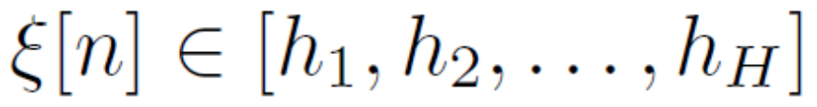
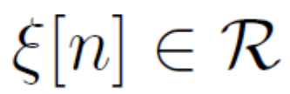
Range of the random signal
Discrete range – discrete random signal
diskrétní náhodný signál
Real range – continuous random signal
spojitý náhodný signál
Not to be confused with continuous-time random signal (náhodný signál se spojitým časem), this is not covered by ISS !

Slide 6
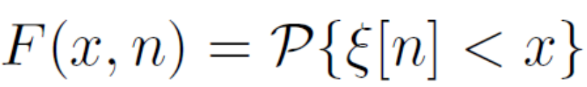

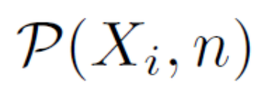

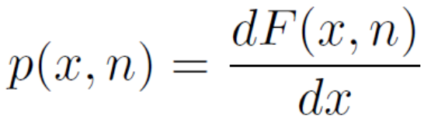

We can estimate functions
CDF - cummulative distribution function (distribuční funkce)
  How many times did we see the value of random signal smaller than x ?
Discrete: probabilities of values
  How many times did we see the value of random signal equal X_{i} ?
Continuous: probability density function
  How many times did I see the value of random signal in a given interval ?
1 normalization
1 normalization
2 normalizations !!!

Slide 7
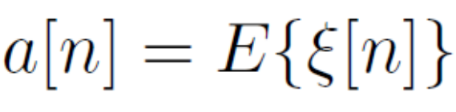
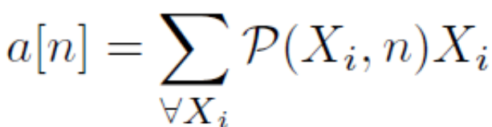

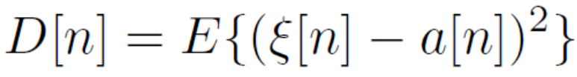
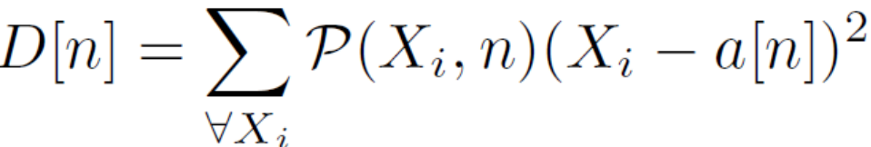
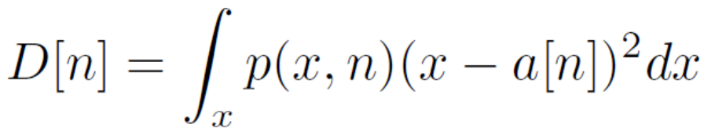
We can also determine moments (momenty)
Expectation = sum _{all possible values of x} probability of x
times the thing that we’re expecting
Summation and the nature of probability will depend on whether we have dicrete random signal or continuous one.
Mean value
  Discrete Continuous
Variance
  Discrete Continuous

Slide 8
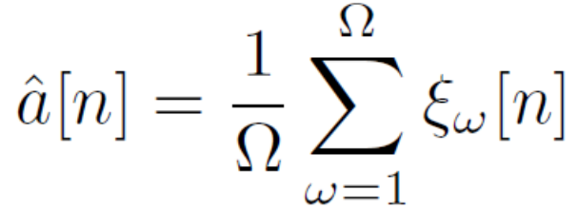
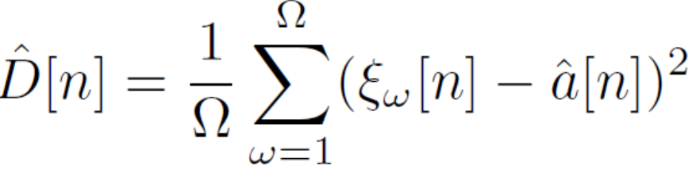
We can estimate moments directly from the ensemble of realizations
Ouff1: we know these from high school … ☺
Ouff2: we don’t have to care whether the signal has discrete or continuous values ☺

Slide 9
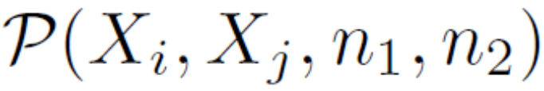


We can also estimate functions describing the relation of two different times: n₁ and n₂
Discrete case – joint probabilities (sdružené pravděpodobnosti)
  How many times did we see the value of random signal equal X_{i} at time n₁ and equal X_{j} at time n₂ ?
Continuous case - joint probability density function (sdružená funkce hustoty rozdělení pravděpodobnosti)
  How mamy times did we see the value of random signal in interval₁ at time n₁ and in interval₂ at time n₂ ?
1 normalization
2 normalizations !!!

Slide 10
Our data
Discrete data
50 years of roulette Ω = 50 x 365 = 18250 realizations
Each realization (each playing day) has N = 1000 games (samples)
#data_discrete
Continuous data
Ω = 1068 realizations of flowing water
Each realization has 20 ms, F_{s} = 16 kHz, so that N = 320.
#data_continuous

Slide 11
Agenda
Recap of the basics and reminder of data
Stationarity
Ergodicity and temporal estimates
Correlation coefficients in more detail
Spectrum of random signal - power spectral density
Powers of random signals
White noise
Coloring white noise and filtering random signals in general
Good and bad signals – signal to noise ratio
Quantization
Summary
<number> / 59

Slide 12
Does the random signal behave the same way over the time ?
So far, we did ensemble estimates for each time n or each pair of times n₁, n₂ independently.
This takes lots of time, and we would like to have one function or one value to describe the whole random signal.
Remember: the signal can NOT have the same or deterministic samples, it is random !
<number> / 59

Slide 13
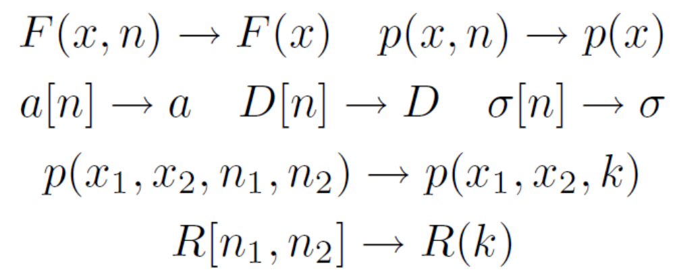
Stationarity (stacionarita)
If
  The behavior of stationary random signal does not change over time (or at least we believe that it does not…)
  Values and functions are independent on time n
  Correlation coefficients do not depend on n₁ and n₂ but only on their difference k = n₂-n₁
We declare the signal stationary (stacionární)

Slide 14
Checking the stationarity
Are cumulative distribution functions F(x,n) approximately the same
for all samples n? (visualize a few)
Are probabilities approximately the same for all samples n? (visualize a few)
  Discrete: probabilities P(X_{i} , n)
  Continuous: probability density functions p(x, n)
Are means a[n] approximately the same for all samples n ?
Are variances D[n] approximately the same for all samples n ?
Are correlation coefficients R(n₁ , n₂) depending only on the distance
k = n₂ – n₁ and not on the absolute position ?

Slide 15
Results
#stationarity_check_discrete
#stationarity_check_continuous
Stationary
Stationary

Slide 16
Agenda
Recap of the basics and reminder of data
Stationarity
Ergodicity and temporal estimates
Correlation coefficients in more detail
Spectrum of random signal - power spectral density
Powers of random signals
White noise
Coloring white noise and filtering random signals in general
Good and bad signals – signal to noise ratio
Quantization
Summary
<number> / 59

Slide 17


One single realization of random signal
Having a set of realizations is a comfort we rarely have …
Most often, we have only one single realization (recording, WAV file, array, …) of the random signal.
  The partner / customer / boss does not know that he / she should give us more realizations.
  and/or it is not possible – think of a unique opera performance or nuclear disaster
<number> / 59

Slide 18
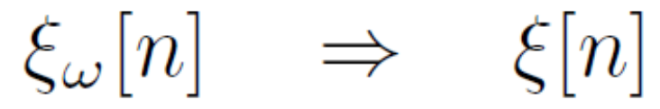

Ergodicity
If the parameters can be estimated from one single realization, we call the random signal ergodic (ergodický) and perform temporal estimates (časové odhady)
… we hope we can do it.
… most of the time, we will have to do it anyway, so at least we are trying to make the signal as long as we can.
… however, we should have stationarity in mind – compromises must be done for varying signals (speech, music, video …)

Slide 19
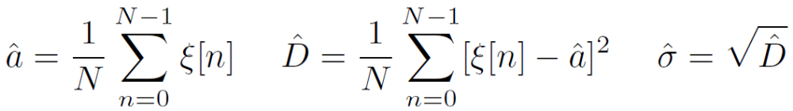
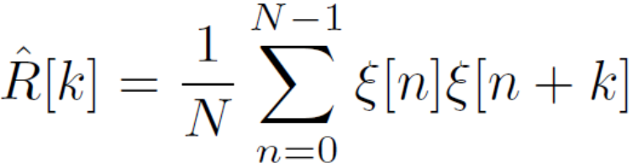
Temporal estimates
All estimations will be running on one realization
All sums going over realizations will be replaced by sums running over the time.
#ergodic_discrete
#ergodic_continuous

Slide 20

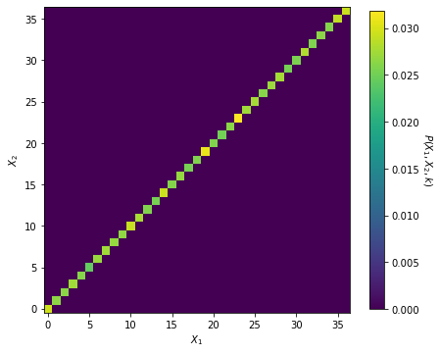
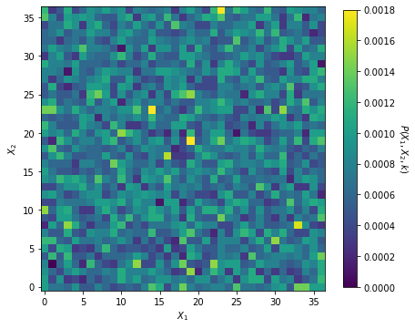
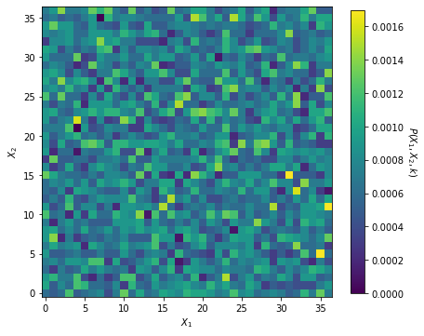
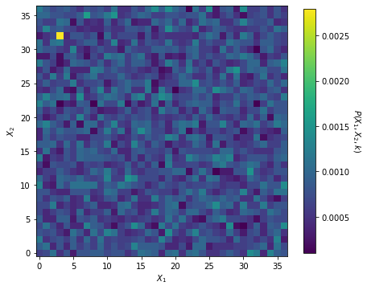
We can even do temporal estimates of joint probabilities and joint PDF
As above, replacing counting over realizations by counting over time.
#ergodic_joint_probabilities
For k = 0, 1, 2, 3
Notes:
Can run a similar exercise also on PDF estimation for continuous valued signals, up to you as a homework ☺

Slide 21
Checking ergodicity
In case we have the comfort of several realizations and ensemble estimates, we can compare the temporal estimates to the ensemble ones.
If they are the same (or similar, remember, we are in random signals!) we believe that the signal is ergodic.
For our signals (roulette and water), they are, so …
See a counter-example #stationary_non_ergodic
Ergodic

Slide 22
Checking stationarity and ergodicity in the (usual) case of just one random signal
Divide the signal into segments (frames, rámce).
Estimate some parameters or functions (at least mean value a and variance D)
  For every frame
  For the whole signal.
If frame estimates match, the signal is stationary
If frame estimates match the global estimate, the signal is also ergodic.
#stationary_signal
#non_stationary_signal

Slide 23
Agenda
Recap of the basics and reminder of data
Stationarity
Ergodicity and temporal estimates
Correlation coefficients in more detail
Spectrum of random signal - power spectral density
Powers of random signals
White noise
Coloring white noise and filtering random signals in general
Good and bad signals – signal to noise ratio
Quantization
Summary
<number> / 59

Slide 24


Estimation of correlation coefficients
Estimating correlation coefficients involves
  Copying the signal
  Shifting the copy by k
  Multiplying both copies
  Adding all
This is also called autocorrelation (autokorelace) - similarity of the signal with itself R_{xx}[k].
We can also estimate cross-correlation (křížová korelace) of two different signals, good for example for
  Estimating correlation between tsunami wave and radiation levels in Fukushima
  Turnover of a company and its stock price…
np.correlate()
x[n]
x[n+k]
<number> / 59

Slide 25
Biased estimate (vychýlený odhad) of R[k]
Signal has samples 0 … N-1, we can run k from –(N-1) to N-1
We divide by the same number of samples N,
k = 0: highest number of samples (N) for the estimation
=> high value
Small k: still plenty of samples for the estimation
=> still high value
Big k: few samples for the estimation
=> low value
#biased_Rk_estimate
x[n]
x[n+k]
x[n]
x[n+k]
x[n]
x[n+k]
<number> / 59

Slide 26

Unbiased estimate (nevychýlený odhad) of R[k]
Dividing always by N penalizes the values of R[k] for higher values of k.
Change the definition of R[k] so that we always divide
only by the number of “active” samples.
  N-k works for positive k’s
  k can also be negative, so N-|k| is more general
Unbiased estimate of correlation coefficients
Justice for correlation coefficients !
<number> / 59

Slide 27

Danger of unbiased estimation
k = 0: highest number of samples (N) for the estimation,
normalizer = N
=> high value, reliable estimate
Small k: still plenty of samples for the estimation
normalizer = N - k – high number
=> still high value, reliable estimate
Big k: few samples for the estimation
normalizer = N - k
– low number
=> high value, unreliable estimate
#unbiased_Rk_estimate
x[n]
x[n+k]
x[n]
x[n+k]
x[n]
x[n+k]
<number> / 59

Slide 28
Agenda
Recap of the basics and reminder of data
Stationarity
Ergodicity and temporal estimates
Correlation coefficients in more detail
Spectrum of random signal - power spectral density
Powers of random signals
White noise
Coloring white noise and filtering random signals in general
Good and bad signals – signal to noise ratio
Quantization
Summary
<number> / 59

Slide 29

Spectrum of a random signal – power spectral density (spektrální hustota výkonu)
We will again work with normalized angular frequency (normovaná kruhová / úhlová frekvence) in radians
  0 Hz corresponds to 0 rad
  F_{s} / 2 corresponds to π rad
  F_{s} corresponds to 2π rad.
In the time domain, we can not define the signal precisely, we need to use functions (probability density, …). In the spectrum, it is similar – we need to define power spectral density - PSD (spektrální hustota výkonu) G(e^{jω})
  Theoretically, we want to have it computed for ω = -π … π,
  It is power so it should not be negative
  It is density so when integrated over all frequencies, it should give signal’s power (more on this later)
<number> / 59

Slide 30
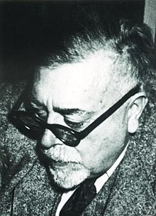
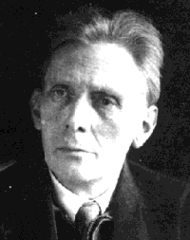
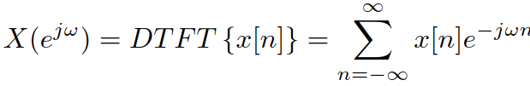
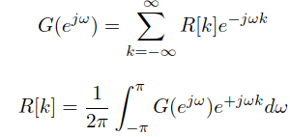

Estimating G(e^{jω})
Remember that in classical spectrum computation, we used Discrete time Fourier transform – DTFT (Fourierova transformace s diskrétním časem)
For random signals, we need a reliable representation of the signal in time – we use correlation coefficients R[k].
Conversion of R[k] to G(e^{jω}) is given
by Wiener-Khinchin (Хинчин) theorem:
PSD is symmetrical for positive and negative frequency:
<number> / 59

Slide 31

Practical hints for estimating G(e^{jω}) from R[k]
DTFT - will be of course computed by DFT/FFT.
Number of correlation coefficients is usually not a power of 2 – good to limit it to power of two.
DFT does not accept negative coefficients, but we can flip R[-k] to R[N-k] by np.fft.fftshift
As the input is symmetrical, the result should be real, but we better force it to be real by np.real
When DFT is computed, it gives us output for ω = 0 … 2π, we can use np.fft.fftshift, if we want the symmetric picture.
As correlation coefficients for higher k’s can be noisy, we can set them to zero - attention, if zeroing R[k], we need to zero also R[N-k] to preserve the symmetry.
Your boss / customer / partner will probably ask just for frequencies
from 0 to F_{s} /2 and in Hz
#power_spec_density_from_Rk
<number> / 59

Slide 32

Estimating PSD directly from the signal
It is possible to estimate PSD directly by DFTying the signal.
Zero padding of signal to N_{fft} = power of 2 might be needed.
The normalization should be done by original length (not N_{fft} !)
#power_spec_density_from_signal
However, the robustness might be a problem.
  We can gather more signal to fix this
  But the way is NOT to increase the number of DFT points at the same time,
  as this will make it even more noisy !
#power_spec_density_from_longer_signal
<number> / 59

Slide 33
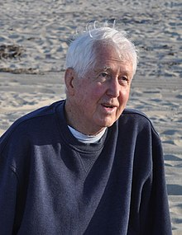
Making DFT estimation of PSD more robust
Welch technique
Divide the signal into segments (frames) – can work
without or with overlap.
Estimate PSD for each frame by DFT and average them.
Leads to more robust estimation.
#power_spec_density_welch
x[n]
frame₀
frame₁
frame₂
…
frame_{Nfr-1}
PSD₀
PSD₁
PSD₂
…
PSD_{Nfr-1}
PSD
<number> / 59

Slide 34
Agenda
Recap of the basics and reminder of data
Stationarity
Ergodicity and temporal estimates
Correlation coefficients in more detail
Spectrum of random signal - power spectral density
Powers of random signals
White noise
Coloring white noise and filtering random signals in general
Good and bad signals – signal to noise ratio
Quantization
Summary
<number> / 59

Slide 35

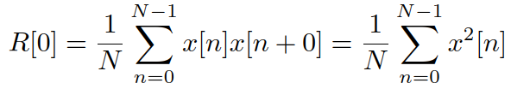

Several ways to compute power of random signal
Basic definition: normalized sum of squares of samples
Zeroth correlation coefficient
Variance for random signals with mean value of 0:
Power for those that do not have mean value of 0:
Variance D and mean a can be computed from the probability density
of random signal, this will serve us in cases we can guess the distribution but we have never seen a single sample of the signal!
<number> / 59

Slide 36


Several ways to compute power of random signal II
From power spectral density – it is a density, so if we integrate over all frequencies, we obtain the power.
  Attention1: in the numerical integration, the step size in normalized angular frequency is 2π / N_{fft} , so we need to multiply by it.
  Attention 2: Wiener-Chinchin includes division by 2π.
#powers
<number> / 59

Slide 37

Power of random signal in a frequency band
Similar as the total power, but the integration runs only in the desired frequencies from ω₁ to ω₂.
PSD contains also negative frequencies (that we never show!), but fortunately, it is symmetrical: it is enough to integrate once and take it 2 times:
#power_band
<number> / 59

Slide 38
Agenda
Recap of the basics and reminder of data
Stationarity
Ergodicity and temporal estimates
Correlation coefficients in more detail
Spectrum of random signal - power spectral density
Powers of random signals
White noise
Coloring white noise and filtering random signals in general
Good and bad signals – signal to noise ratio
Quantization
Summary
<number> / 59

Slide 39

Random signal with uncorrelated samples
In case samples of a random signal do not depend each on other (are uncorrelated), only correlation coefficient R[0] is non-zero, others are zero.
When power spectral density of such signal is computed, it gives a constant (flat) PSD for all frequencies:
White light has also constant power at all wavelengths, therefore, we call such signal white noise (bílý šum)
Remember that white noise is very unnatural, and mostly only the result of computer generation – things around us tend to have dependent samples, as inertia (setrvačnost) is the basic property of everything!
<number> / 59

Slide 40

Uniform white noise
The values of samples follow uniform distribution, from some –Δ/2 to Δ/2.
#uniform_white_noise
<number> / 59

Slide 41

Gaussian white noise
The values of samples follow standard normal (Gaussian) distribution, with mean μ and standard deviation σ.
#gaussian_white_noise
<number> / 59

Slide 42
White noise with discrete values
Even binary noise producing values -1 and +1 can be white !
Probabilities P(-1) = 0.5, P(+1) = 0.5.
#binary_white_noise
Whiteness does not depend on the distribution of the samples, it is given by the independence (non-correlation) of samples !
<number> / 59

Slide 43
White noise PSD estimation by DFT from signal
By taking one DFT, the estimate is so unreliable, that we are not able recognize the theoretical (flat) PSD !
Using Welch method is obligatory
  Split in frames
  Compute PSD for each
  Average
#white_noise_psd_by_dft
<number> / 59

Slide 44
Agenda
Recap of the basics and reminder of data
Stationarity
Ergodicity and temporal estimates
Correlation coefficients in more detail
Spectrum of random signal - power spectral density
Powers of random signals
White noise
Coloring white noise and filtering random signals in general
Good and bad signals – signal to noise ratio
Quantization
Summary
<number> / 59

Slide 45
Processing white noise by a digital filter
White noise has no dependencies of samples
A filter adds dependencies – its output is a linear combination of several input samples, so they can not be independent anymore !
The output signal is not white
noise anymore, it is “colored”
We can process any random
signal with a filter.
The filter will change the
power spectral density
of the input
x[n]
b₀
Σ
y[n]
z⁻¹
b₁
-a₁
z⁻¹
z⁻¹
b₂
-a₂
z⁻¹
z⁻¹
b₃
<number> / 59

Slide 46


Influence of filter on the spectrum
Lecture on filtering:
However, this involves signals, for which we can compute DTFT.
For random signals, we have only power spectral density G(e^{jω}).
Similar behavior of filter for random signals, we only need to “powerize” its frequency characteristics:
#filtering_random_signal
<number> / 59

Slide 47
Agenda
Recap of the basics and reminder of data
Stationarity
Ergodicity and temporal estimates
Correlation coefficients in more detail
Spectrum of random signal - power spectral density
Powers of random signals
White noise
Coloring white noise and filtering random signals in general
Good and bad signals – signal to noise ratio
Quantization
Summary
<number> / 59

Slide 48

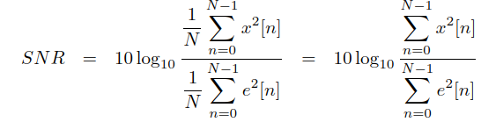
Signal to noise ratio
Good signal x[n] often gets polluted by noise (distortion, artefacts, …) e[n].
A simple way to determine how bad is the distortion, is to estimate signal to noise ratio – SNR (poměr signálu k šumu)
Simply ratio of power of the “good” signal to the power of “bad” signal, computed in decibels (dB):
Most often, we would really compute the powers:
<number> / 59

Slide 49
SNR practical know-how
The signal is stronger than noise: P_{s} > P_{e} , fraction P_{s} /P_{e} > 1, log is > 0
=> Positive SNR.
10dB is 10x bigger power, 20dB is 100x bigger power, etc.
The signal is weaker than noise: P_{s} < P_{e} , fraction P_{s} /P_{e} < 1, log is < 0
=> Negative SNR.
-10dB is 10x weaker power, -20dB is 100x weaker power, etc.
The signal has the same power as noise: P_{s} = P_{e} , fraction P_{s} /P_{e} = 1,
log 1 = 0 => SNR = 0 dB
SNR is not almighty (not perceptually based, requires alignment of signals, etc), but simple to compute and widely used.
SNR can be easily inverted and we can noise a signal at a specific SNR.
#SNR_examples
<number> / 59

Slide 50
Agenda
Recap of the basics and reminder of data
Stationarity
Ergodicity and temporal estimates
Correlation coefficients in more detail
Spectrum of random signal - power spectral density
Powers of random signals
White noise
Coloring white noise and filtering random signals in general
Good and bad signals – signal to noise ratio
Quantization
Summary
<number> / 59

Slide 51
Principles of quantization (kvantování)
q_{L-1}
We need to represent input signal x[n] with continuous range of values by a limited number of bits b.
We define L = 2^{b} quantization levels (kvantovací hladiny / úrovně) q_{i} to which the signal is rounded.
The simplest solution is to define quantization levels with a uniform quantization step (kvantovací krok) Δ. We call this uniform quantization (uniformní, rovnoměrné, kvantování).
The quantized signal x_{q} [n] will have a discrete set
of values: quantization levels q_{i}
The error we can commit is from -Δ/2 to +Δ/2: remember any physics or chemical labs at high school.
x[n]
x_{q}[n]
Δ
q₁
q₀
<number> / 59

Slide 52

How much do we harm the signal by quantization ?
By changing the signal from continuous values x[n] to quantized version x_{q} [n], we introduce quantization error (kvantovací chyba, chyba kvantování)
e[n] = x_{q} [n] - x [n]
This signal has a power and we can compare it to the power of the original signal by SNR:
#quantization
<number> / 59

Slide 53
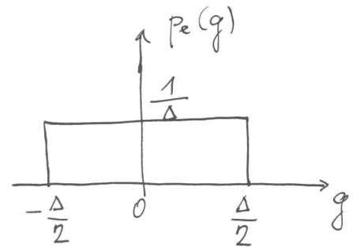
Estimation of SNR without seeing the signal
Computation for a cosine fully using the dynamic range of quantizer: x[n] = A cos(ω n).
We can derive, or compute numerically or graphically, that the power of such cosine is P_{x} = A² / 2
The range from –A to +A will be fully covered by L quantization levels, so that Δ = 2A / L
We know that the quantization error e[n] will be between
–Δ/2 and +Δ/2, but that’s all we know.
We expect the probability density function
of the error signal to be uniform
  We have used g as the independent variable
  to limit confusion, as x is used for the signal …

Slide 54

Determining the power of the error signal
The error signal has mean value a = 0, which means that its power will be its variance: P_{e} = D_{e}
We can compute this variance by the definition formula:
And show how it depends on magnitude A and number of quantization levels L:
<number> / 59

Slide 55

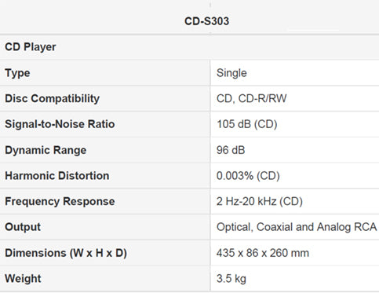
Obtaining the SNR
Now we have the “good” power and “bad” power and we can plug them in SNR computation:
Remember, we have b bits and L = 2^{b} quantization levels, so that we can further massage the SNR to:
The constant 1.76 depends on the signal
(will be different for other signals than cosine)
But 6 dB is an important value for quantization:
  Adding 1 bit => improving SNR by 6 dB
  Removing 1 bit => deteriorating SNR by 6 dB
#quant_SNR
<number> / 59

Slide 56
Agenda
Recap of the basics and reminder of data
Stationarity
Ergodicity and temporal estimates
Correlation coefficients in more detail
Spectrum of random signal - power spectral density
Powers of random signals
White noise
Coloring white noise and filtering random signals in general
Good and bad signals – signal to noise ratio
Quantization
Summary
<number> / 59

Slide 57
Summary I
Stationarity – behavior of random signal is not depending on time.
Ergodicity – everything can be estimated from one realization
  Ensemble estimates are replaced by temporal ones.
Correlation coefficients R[k] can be easily estimated from the signal
  Biased – they will fade for high values of k
  Unbiased – mathematically correct but very unrealiable for high values of k.
Spectrum of random signals is given by power spectral density (PSD)
  Can be estimated from correlation coefficients by DTFT (Wiener-Khinchin)
  … or directly from the signal, robustness can be an issue, so think about averaging several estimates (Welch).

Slide 58
Summary II
Power of a random signal can be estimated in several ways
  By definition, R[0], variance D, integration of PSD.
  We do not need to see the signal to estimate its power.
  Power in a frequency band is given by integration of PSD, multiply by 2.
White noise has a flat PSD
  As PSD is DTFT of correlation coefficients, it can be flat only for R[0] nonzero and all others zero.
  This can be true only for random signal with uncorrelated samples.
  Whiteness is not given by the values of samples of random signal.
Random signals (as well as any others) can be filtered
  “powerized” frequency characteristics |G(e^{jω})|² modifies the PSD of the random signal
  After filtering, white noise is no more white.

Slide 59
Summary III
Signal to noise ratio (SNR) gives the ratio of good vs. bad signals, it is in decibels.
  Positive SNR: good signal is stronger.
  Negative SNR: bad signal is stronger
  Zero SNR: they have the same powers.
Quantization introduces quantization noise that does harm the signal
  SNR can be determined by computation or theoretically
  Magic value of 6 dB for 1 bit.

