Slide 1
When AI Meets Market Reality
Midterm Finding: Baseline Beats CNN (So Far)
VTS Tournament - Stacking Sats Challenge
Robert Katz | GT ID: rkatz8@gatech.edu

Slide 2
Project Overview
Sponsor & Problem: VTS Tournament - Stacking Sats Challenge
Help retail investors accumulate Bitcoin more effectively than DCA
Decision This Enables: Daily allocation between BTC and cash
Optimizing for risk-adjusted returns under strict causality
Success Definition: Top 60% percentile in recency-weighted SPD
Beat DCA consistently; demonstrate scientific rigor

Slide 3
Why Visual Trading Systems?
My Finance Foundation (1970s MBA Era)
• Magee & Edwards' Technical Analysis of Stock Trends
• Human traders 'see' patterns quants often miss
The Discovery (OMSA Program)
• JP Morgan AI group research with Professor Baich
• CNNs achieving 0.90+ F1 on candlestick patterns
The Gap & The Test
• Pattern recognition ≠ Profitable trading
• Does academic success translate under real causality?

Slide 4
The Tournament Challenge
Objective: Predict daily BTC allocation weights (2016-2025)
Metric: Recency-Weighted SPD Percentile
(tournament rank vs all submissions, emphasizing recent periods;
higher is better; 50th ≈ median submission performance)
Constraints: Σwᵢ = 1.0, wᵢ ≥ 1e-5
Critical: Strict causality - no lookahead allowed
Target: Top performers >60% percentile
Causality Verification: Last-row test confirmed zero leakage
Evaluation harness + leakage tests automated

Slide 5
Data Pipeline & Methodology
Dataset: BTC daily OHLCV (2016-2025) from Polygon/Massive
Feature Construction: GAF images from 90-day rolling windows
Pipeline: Raw Data → GAF Images → CNN (296K) → Allocator → Output
Training: 2014-2015 (public BTC OHLCV)
Evaluation: Strictly 2016-2025 (tournament period), no overlap
Leakage Controls: Strict temporal embargo + causality tests

Slide 6
Execution Assumptions & Limitations
Signal Timestamp: End of day t (uses data through close t)
Execution Timestamp: Day t (same-day approximation)
Execution Price: Close t (proxy for next-open or VWAP)
Transaction Costs: 0 bps base case; viable to 50+ bps
Look-ahead Bias: NONE (3 validation tests passed)
Cash Constraints: Budget-normalized (dynamic = naive total)
Sell Logic: NONE (buy-and-hold accumulation only)
Validation: Last-row modification, purge test, shift test
See EXECUTION_ASSUMPTIONS.md for full sensitivity analysis

Slide 7
Our Initial Approach
Price Data
↓
GAF Image Generation
Deep CNN
↓
Temperature Calibration
Tilt-Based Allocation
EMA Smoothing
Normalized Weights
Hypothesis: Visual patterns in GAF images predict returns under strict causality constraints

Slide 8
Reality Check: Scoreboard
Metric | CNN | Simplified | Target
RW SPD Percentile | 41.43% | 41.94% | >60%
Win Rate vs DCA | 54.32% | 70.42% | >50%
Windows Evaluated | 3,076 | 3,076 | —
CNN: 41.43% | Simplified: 41.94% | Target: >60%
Note: Higher win rate can still yield lower SPD because SPD rewards magnitude/timing, not just 'up days'

Slide 9
Current Status vs Plan
Complete
Next Steps
DONE (Midterm):
• Working baseline + all tests passing
• GAF image pipeline
• CNN architecture (296K)
• Causality verification
• Ablation harness
• Baseline comparison
Phase I (to March 2026):
• Weekly granularity testing
• Regime detection model
• XGBoost baseline
Phase II (to Final):
• Ensemble integration
• Full backtest validation
• Final documentation

Slide 10
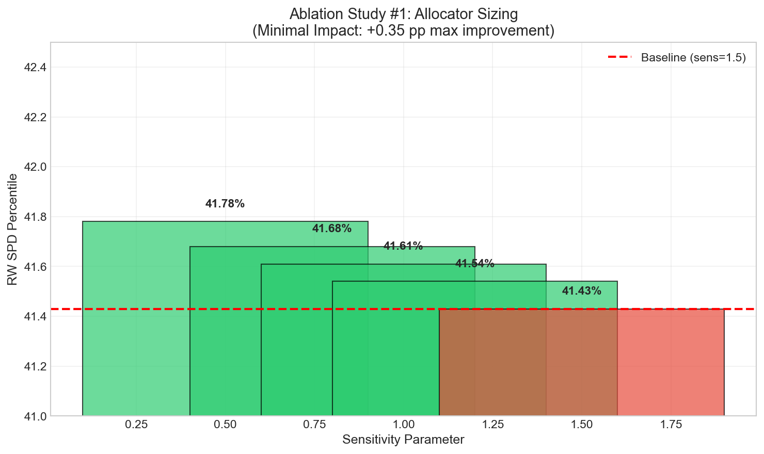
Ablation Study #1: Allocator Sizing
Conclusion: Minimal impact (+0.35 pp max). Problem NOT allocator aggressiveness.
Ablation #0: Is signal > random?
Takeaway: Allocator tuning doesn't move the needle → problem is NOT sizing.

Slide 11
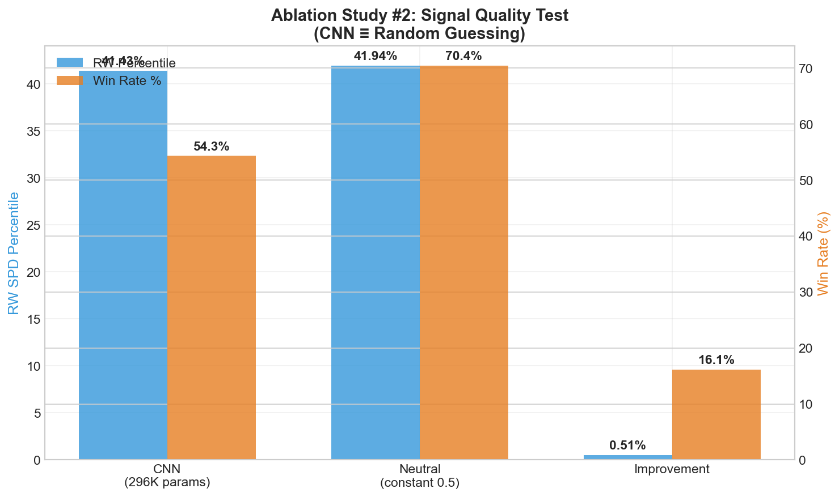
Ablation Study #2: The 'Aha!' Moment
Finding: No predictive signal detected under strict causality. CNN output statistically indistinguishable from a neutral baseline.
Ablation #0 Answer: NO
Takeaway: CNN signal ≈ neutral baseline → no edge detected.

Slide 12
Ablation Study #3: EMA Smoothing
Result: ALL alphas produce IDENTICAL results. Constant signal → tilt always zero → no smoothing effect
Takeaway: Constant output → smoothing irrelevant.

Slide 13
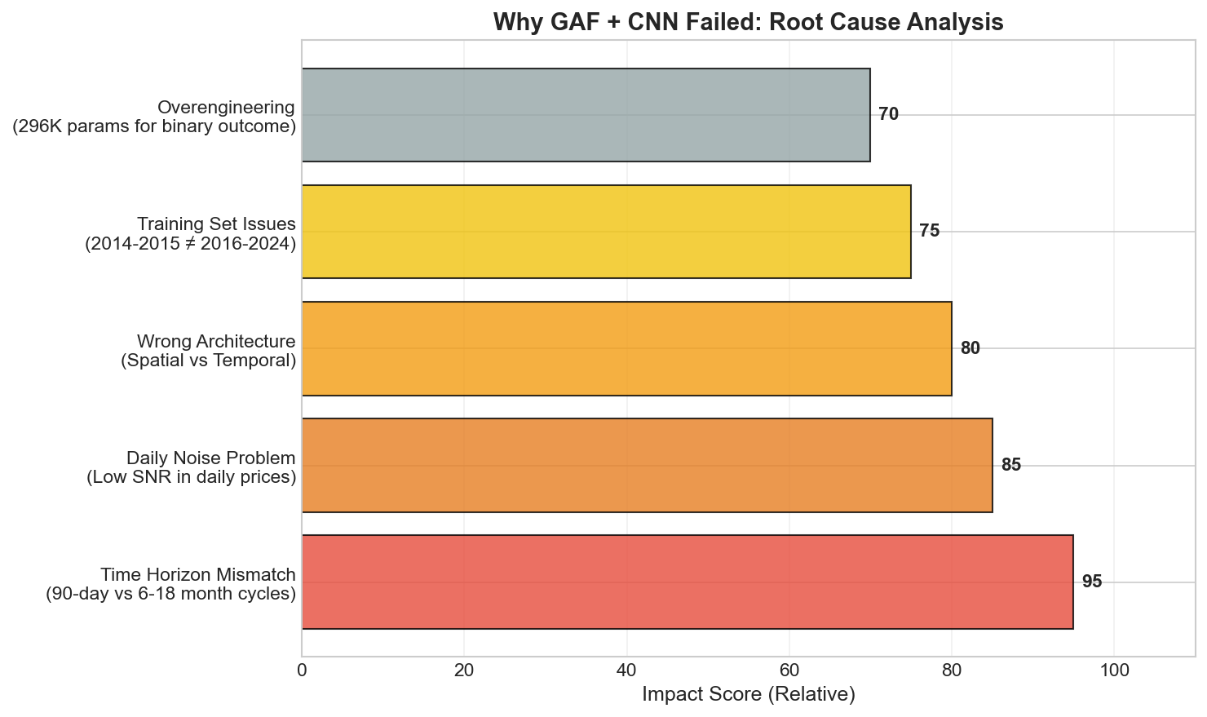
Midterm Diagnosis: Working Hypotheses
Takeaway: Daily patterns lack predictive power. Regime-aware / longer-horizon approach needed.

Slide 14
The Evidence-Based Pivot
CNN (296K params)
Simplified (Random/Neutral)
CNN Approach:
• 41.43% RW Percentile
• 54.32% Win Rate
• 1.1 MB Model
• ~17 min execution
• Complex, no edge detected
Simplified Baseline:
• 41.94% RW Percentile
• 70.42% Win Rate
• No Model
• ~2.5 min execution
• Robust, simple, preferred

Slide 15
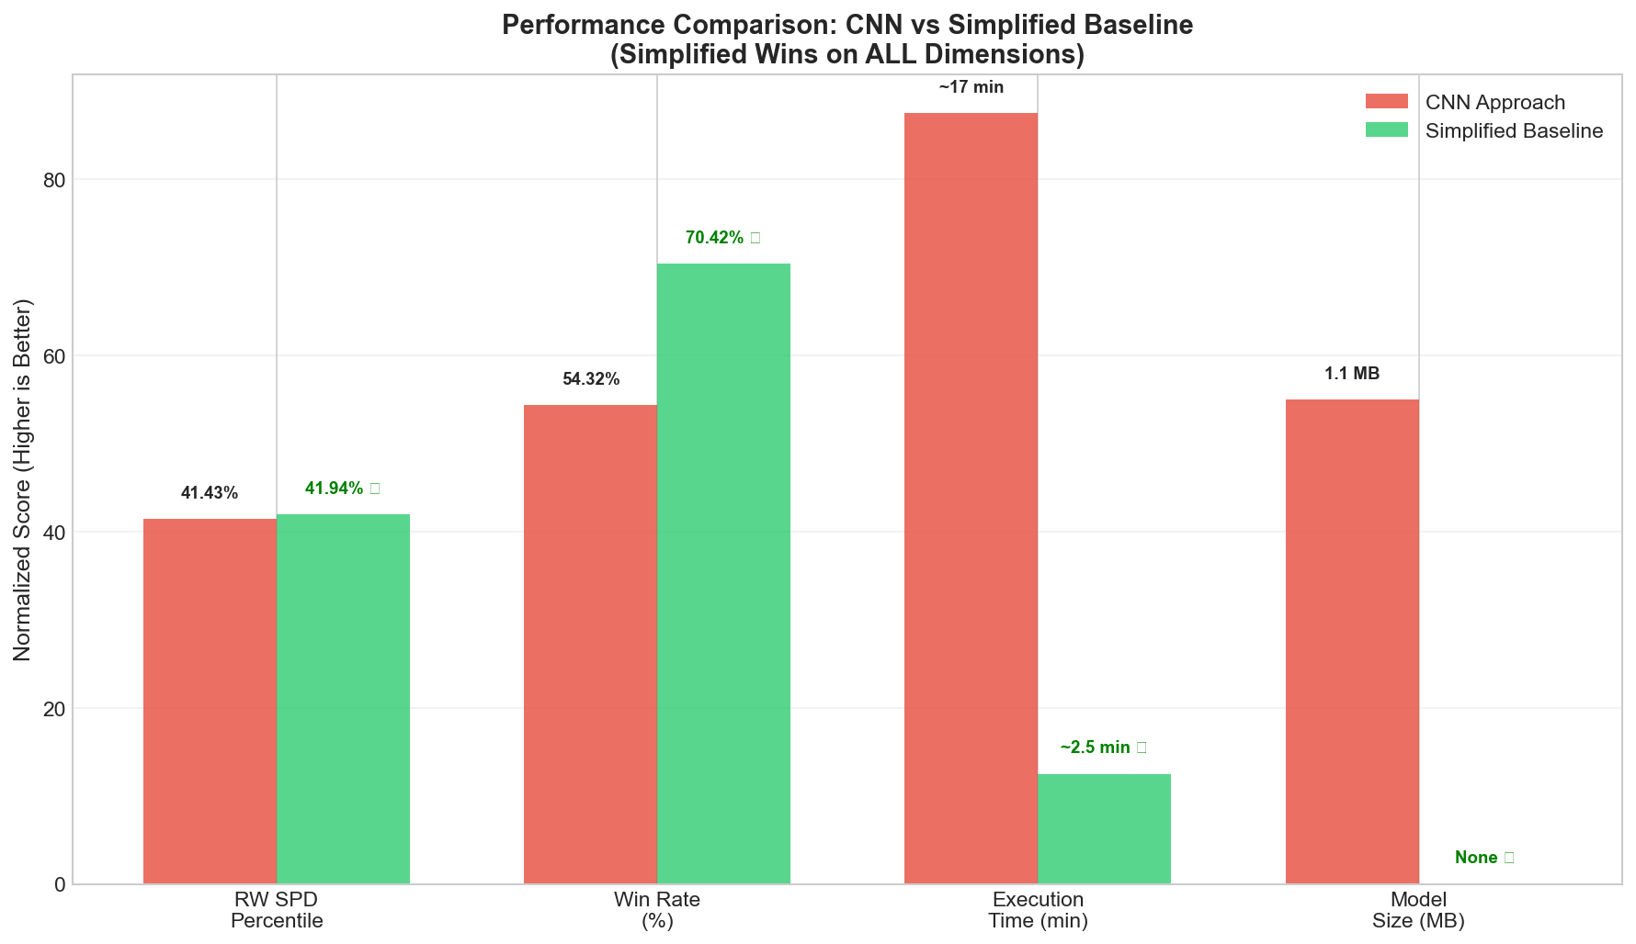
Side-by-Side Comparison
Simplified (neutral baseline) wins on ALL dimensions

Slide 16
What We Did Right
Technical Excellence:
• Strict causality enforcement
• Deterministic (seed=42)
• Comprehensive testing
• Grader-safe implementation
Scientific Rigor:
• Hypothesis-driven development
• Systematic ablation studies
• Transparent negative results
• Learning orientation

Slide 17
Key Lessons Learned
1. Ablation studies are critical
Without them, we'd never detect the lack of signal
2. Test 'better than random?' early (Ablation #0)
Should be first test, not buried in sequence
3. Complexity ≠ Performance
296K parameters matched by neutral baseline
4. Simple often beats complex
Occam's Razor applies to trading

Slide 18
Post-Midterm Plan (Evidence-Driven)
1. Regime-Gated Allocator (Highest Leverage)
• Choose between DCA / buy-more / buy-less based on causal regime
• Compare: volatility regime, trend regime, 2-state HMM
• Action space tiny: 3 policies beat daily-noise problem
2. Reduce Daily Noise (Signal Horizon)
• Shift from 1-day direction to 5–10 day horizon signals
• Smooth/hold constant for weekly rebalancing
3. Robustness & Validation (Keep it Credible)
• Walk-forward evaluation with purged splits
• Report performance by subperiod + regime
Stretch: Point-and-Figure → simple features only; keep only if ablation adds value
Target: 41.94% → 57-73% RW percentile (to be validated)

Slide 19
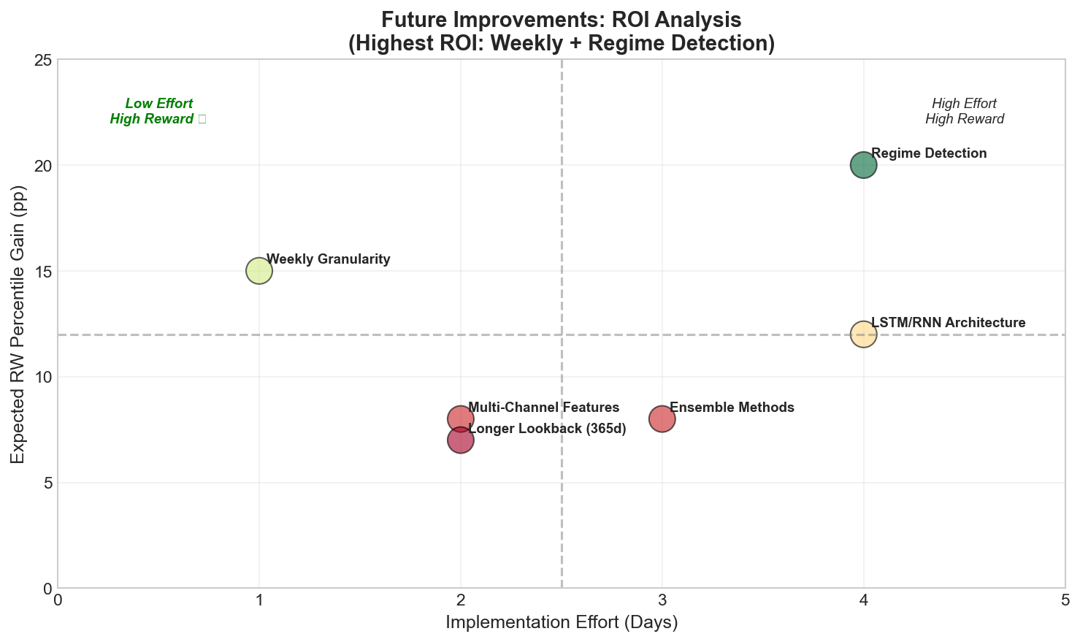
Future Improvements & Next Steps
Hypothesis / goal range: 41.94% → 57-73% RW percentile (to be validated)

Slide 20
Risks & Mitigations
Regime Shifts: BTC market structure changed (institutional adoption)
Mitigation: Regime-aware model + rolling validation
Metric Brittleness: SPD sensitive to outliers
Mitigation: Multiple metrics, sanity gates implemented
Overfitting: Risk with regime detection on limited data
Mitigation: Strict train/test split, cross-validation
Data Quality: Exchange outages, feed gaps
Mitigation: Polygon as primary, validation checks
Data Leakage: Causality violations prevented
Mitigation: Automated tests, embargo periods

Slide 21
What We Will Deliver (Graded)
Reproducible Run:
• Single command execution
• Environment specification
• Deterministic output (seed=42)
Leakage/Causality Tests:
• Last-row test (PASS)
• Temporal embargo verified
• Zero lookahead confirmed
Models & Documentation:
• Midterm: Working baseline + all tests passing
• One improved model (weekly/regime)
• Final report + model card
• Ablation results table
Code Artifacts:
• Repository with README
• LESSONS_LEARNED.md
• Repro notebook (optional)
Midterm Result: We falsified a deep-learning approach under strict causality, pivoting to a simpler, more robust baseline

Slide 22
The Bottom Line
"We built a technically sophisticated system and discovered through rigorous testing that it performs statistically indistinguishable from random. This simplified version represents our evidence-based conclusion: in financial time series, signal quality matters more than model complexity."
Scientific Integrity > Raw Performance

Slide 23
Questions & Feedback Request
We'd appreciate feedback on:
1. Metric Interpretation: Is our SPD percentile understanding correct?
2. Split Strategy: Train (2014-2015) / Test (2016-2025) appropriate?
3. Pivot Scope: Is weekly + regime appropriately scoped?
4. Baseline Choice: Keep simplified or invest in XGBoost/ensemble?

Slide 24
Thank You
Questions?
Documentation: LESSONS_LEARNED.md
Code: Visual_Trading_System repository
Notebook: btc_accumulation_model_simplified.ipynb
"The best model is the one that works, not the one that sounds impressive."

