Slide 1
When ML Meets Market Reality
Stacking SATS: How a 296K-Parameter CNN Got Beat by a Coin Flip
GT OMSA Practicum · Trilemma Foundation · Bitcoin Accumulation Tournament
Robert Katz · rkatz8@gatech.edu
Spring 2026

Slide 2
The Tournament: Daily Bitcoin Allocation
📊 OBJECTIVE
Predict daily BTC allocation weights
across 2016–2025 (~3,300 trading days)
🎯 METRIC
Recency-Weighted SPD Percentile
Target: top 60% of all submissions
⚖️ CONSTRAINTS
Σ wᵢ = 1.0 · wᵢ ≥ 1e-5
No shorting · Full budget each day
🚫 CRITICAL RULE
Zero lookahead — strict causality
Features use only data through day t

Slide 3
Why Visual Trading Systems?
📚 FINANCE ROOTS
MBA-era chart reading
(Magee & Edwards)
Human traders 'see' patterns
that quants miss
🔬 RESEARCH SIGNAL
Industry reports show
high F1 on candlestick
classification tasks
Explored in OMSA with
Prof. Baich
❓ THE HYPOTHESIS
Pattern recognition ≠
Profitable trading
Does academic success
survive strict causality?
Hypothesis: GAF images encode price patterns that a CNN can exploit for superior BTC accumulation under strict causality constraints

Slide 4
Our Initial Approach: The Pipeline
BTC Price Data
← 90-day rolling window
↓
GAF Image Generation
← Polar-coordinate encoding
↓
Deep CNN (296K params)
← Pattern classification
↓
Temperature Calibration
← Probability calibration
↓
Tilt → EMA → Normalize
← Allocation weights
OUTPUT: Normalized daily weights · Σw = 1.0 · seed = 42 · Zero lookahead

Slide 5
Reality Check: First Results
The 296K-parameter CNN barely outperforms a constant neutral signal — and both fall well short of the 60% target
Metric
CNN (296K)
Simplified
Target
RW SPD Percentile
41.43%
41.94%
> 60%
Win Rate vs DCA
54.32%
70.42%
> 50%
Execution Time
~17 min
~2.5 min
—
Model Size
1.1 MB
None
—
Reproducibility
seed=42
seed=42
✓
📌 Neutral baseline = constant prob_up = 0.5 → allocator pipeline unchanged; no model involved
⚠️ RW-SPD rewards when and how much you deviate from neutral — not just direction

Slide 6
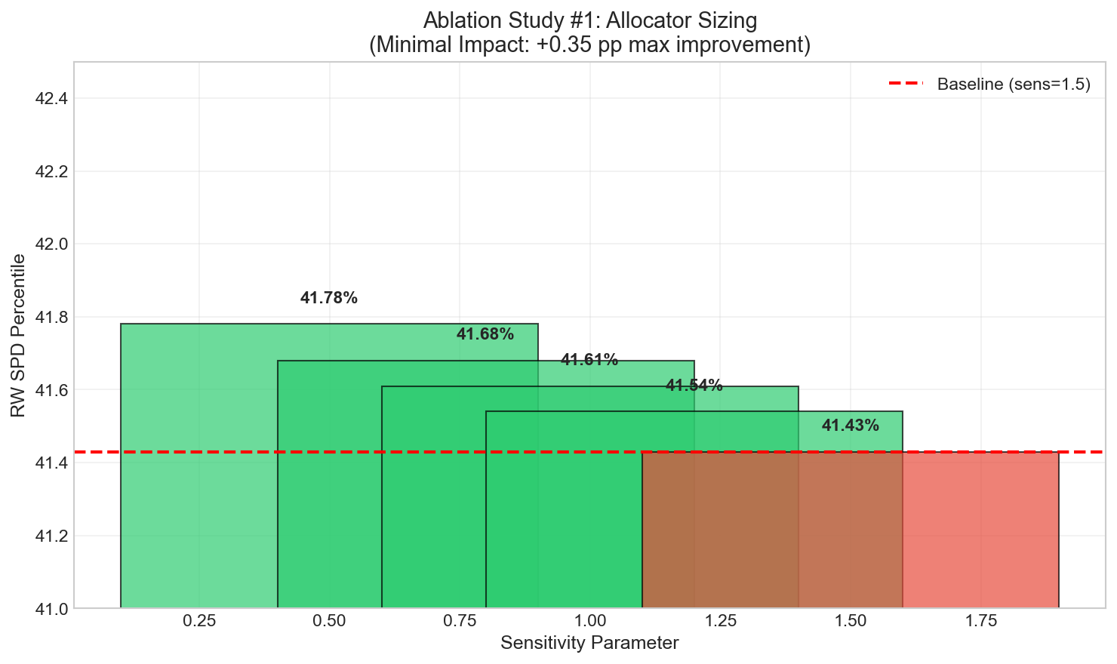
Ablation #1 — Allocator Sensitivity
Verdict: Sweeping allocator aggressiveness moves RW percentile < 0.4 pp → NOT the root cause

Slide 7
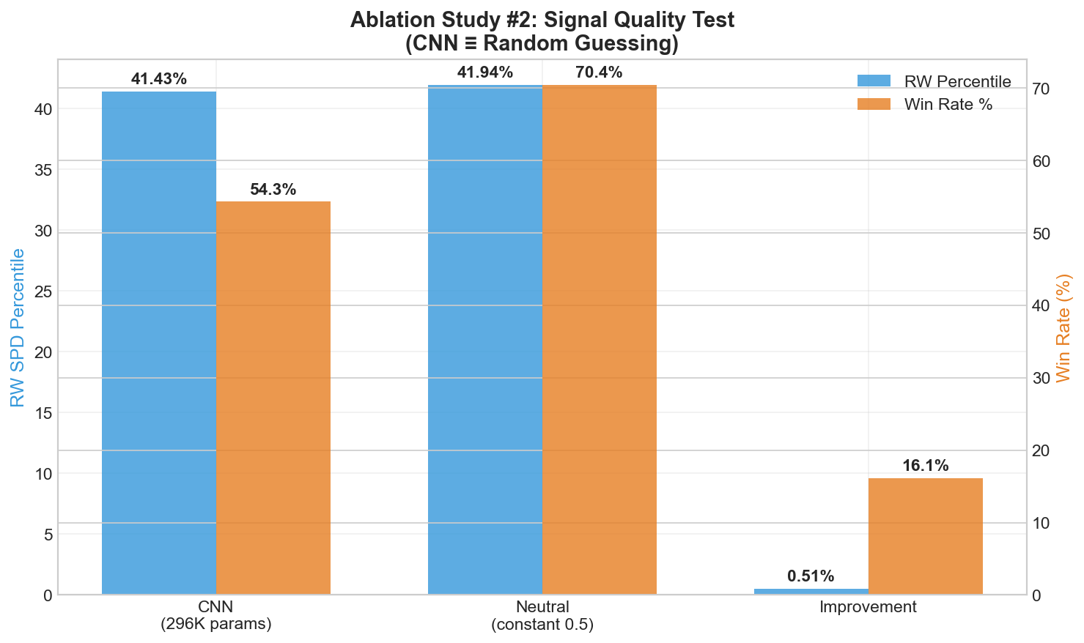
Ablation #2 — The "Aha!" Moment
🚨 CNN signal ≈ neutral baseline → no predictive edge detected
✅ Neutral: +16 pp win rate · simpler · 7× faster

Slide 8
Midterm Diagnosis: Why GAF + CNN Failed
⏰ TIME HORIZON MISMATCH
GAF lookback: 90 days
BTC cycles: 6–18 months
Misses bull/bear regime shifts
📉 DAILY NOISE
Daily prices = low SNR
Tournament forces daily decisions
Amplifies noise, destroys signal
🏗️ WRONG ARCHITECTURE
CNN exploits spatial patterns
Finance needs temporal modeling
Translation invariance irrelevant
📅 TRAINING MISMATCH
Train window: 2014–2015 (available historical)
Test: 2016–2025 (tournament span)
Out-of-distribution: regime shift post-2016

Slide 9
What We Learned (Technical)
📊 DAILY SNR IS LOW
Daily price moves are dominated
by noise, not signal
Any model exploiting day-to-day
patterns likely fits noise.
Weekly or regime-horizon signals
have better SNR.
🏗️ WRONG ARCHITECTURE
GAF + CNN exploits spatial
patterns via 2D convolutions
BTC accumulation needs temporal
and regime modeling, not
translation invariance.
Problem is sequential, not visual.
⚙️ ALLOCATOR CAN'T RESCUE WEAK SIGNAL
Sweeping tilt & EMA params
gave < 0.5 pp improvement
Garbage in → garbage out:
allocator amplifies signal,
it doesn't create it.
Test signal quality first.
Implication: Test 'does this signal beat random?' before optimizing any downstream component

Slide 10
The Evidence-Based Pivot
CNN (296K params)
Simplified (neutral)
RW Percentile
RW Percentile
41.43%
41.94%
Win Rate
VS
Win Rate
54.32%
70.42%
Exec Time
Exec Time
~17 min
~2.5 min
Model Size
Model Size
1.1 MB
None
🏆 Simplified wins on ALL dimensions

Slide 11
What We Did Right
✅ STRICT CAUSALITY
Last-row test · Purge test
Shift test — all PASSED
Zero lookahead confirmed
✅ DETERMINISTIC
seed = 42
Fully reproducible output
Grader-safe implementation
✅ SCIENTIFIC RIGOR
Hypothesis → test → conclude
Systematic ablation studies
Transparent negative results
✅ 62/62 TESTS PASSING
Unit + integration + ablation
Budget accounting tests
All results documented

Slide 12
Roadmap Forward
✅ MIDTERM
Status: DONE
─────────────────
• Neutral baseline
• 62/62 tests passing
• All ablations complete
• Causality verified
🔄 PHASE I
→ March 2026
─────────────────
• Regime-gated allocator
• (HMM / volatility regime)
• Weekly signal horizon
• XGBoost baseline
🎯 PHASE II
→ Final Submission
─────────────────
• Ensemble integration
• Walk-forward backtest
• Final report + model card
• Full documentation
Goal: attempt to exceed 60%+ RW percentile via regime gating + weekly signals (to be validated in Phase I)

Slide 13
THE BOTTOM LINE
"We built a technically sophisticated system and discovered through rigorous testing that it performs statistically indistinguishable from random under the RW-SPD tournament metric. In financial time series, signal quality matters more than model complexity."
COMPLEXITY ≠ BETTER
296K params matched
by a constant signal
PROCESS IS THE VALUE
Scientific integrity
even with null results
SIGNAL FIRST
Test 'beats random?'
before optimizing

Slide 14
Questions & Discussion
Q1 · Metric Interpretation
Is our understanding of RW-SPD percentile vs win rate correct?
Q2 · Dataset Shift
How would you recommend handling regime shifts / non-stationarity under strict causality?
Q3 · Pivot Scope
Is weekly signals + regime detection appropriately scoped for Phase I?
Q4 · Baseline Choice
Keep simplified neutral baseline, or invest in XGBoost / ensemble?
rkatz8@gatech.edu · github.com/Katzup/bitcoin-analytics-capstone-template

