Slide 1
Car Parking Application
Sprint 2 – Team 4

Slide 2

Team Members
Aditya Kumar Maurya
Mosin Sheikh
Kaumudi Tyagi
Rituj Pratap Singh
Ishan Khanduja

Slide 3

Problem Statement
Traffic congestion and insufficient parking space
Inadequate current transportation infrastructure
In Asia, roads narrow compared to west
Proliferation in count vehicles on the road
To alleviate the aforementioned problems The Car Parking System.

Slide 4

Actors (from Case Study)
Admin: Add/Edit/Delete/View.
Manager: Who will manage parking with allocation, availability and billing etc
Security: Who will be monitoring vehicles , issuing tokens etc.
Customer: Can have a preference to search for near by parking and park the vehicle.

Slide 5
Module’s Functionality

Slide 6

Authentication/Authorization
Encrypts/Decrypts/Validates User Password
Provides Restricted Authorization to :-
Admin
Manager
Security

Slide 7

Admin
Add Manager to the Database
Add Security to the Database
Add Slots to the Database
Delete Manager from the Database
Delete Security from the Database
Delete Slot from the Database
Update Slot Status for a Range
Update Slot Status for a Single Slot

Slide 8

Customer
Add Customer to the Database
Get Available Slots from the Manager and Select the preferred Slot
Get Token From the Security

Slide 9

Manager
View All Slot
View Available Slot
View Nearest Ten Parking Slot
Generate Receipt
Generate Bill and Free Parking Slot

Slide 10

Security
View All Tokens
Issue Token to the Customer
Verify Parking Slot for Customer

Slide 11
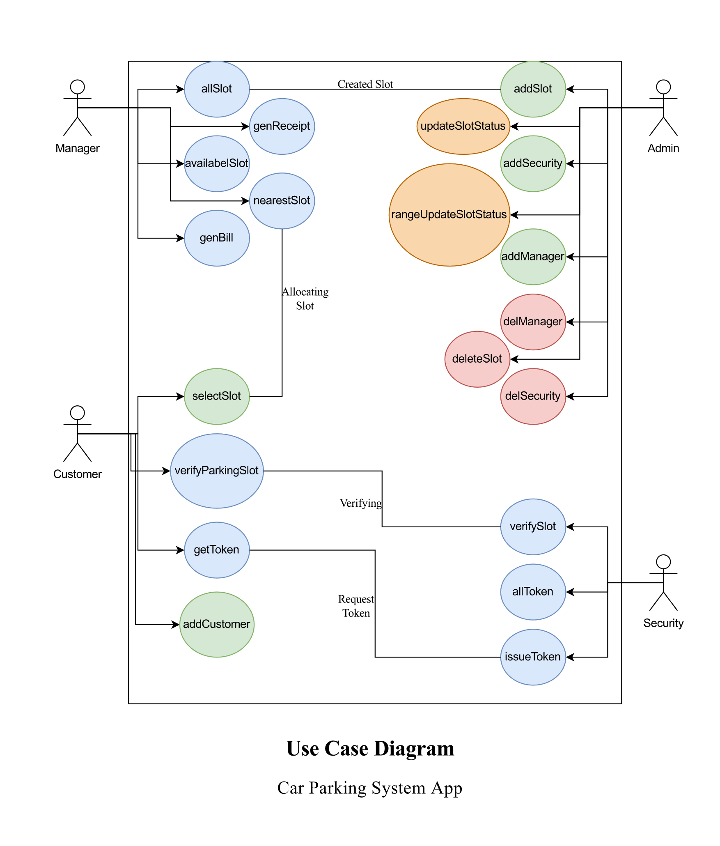
Use Case Diagram

Slide 12
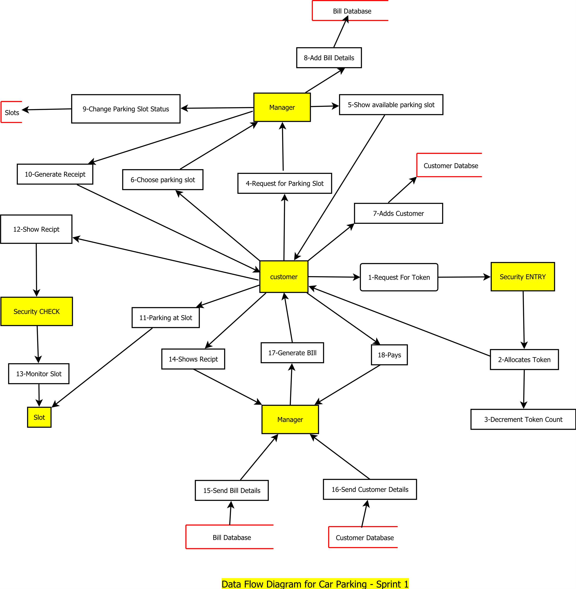
Data Flow Diagram

Slide 13
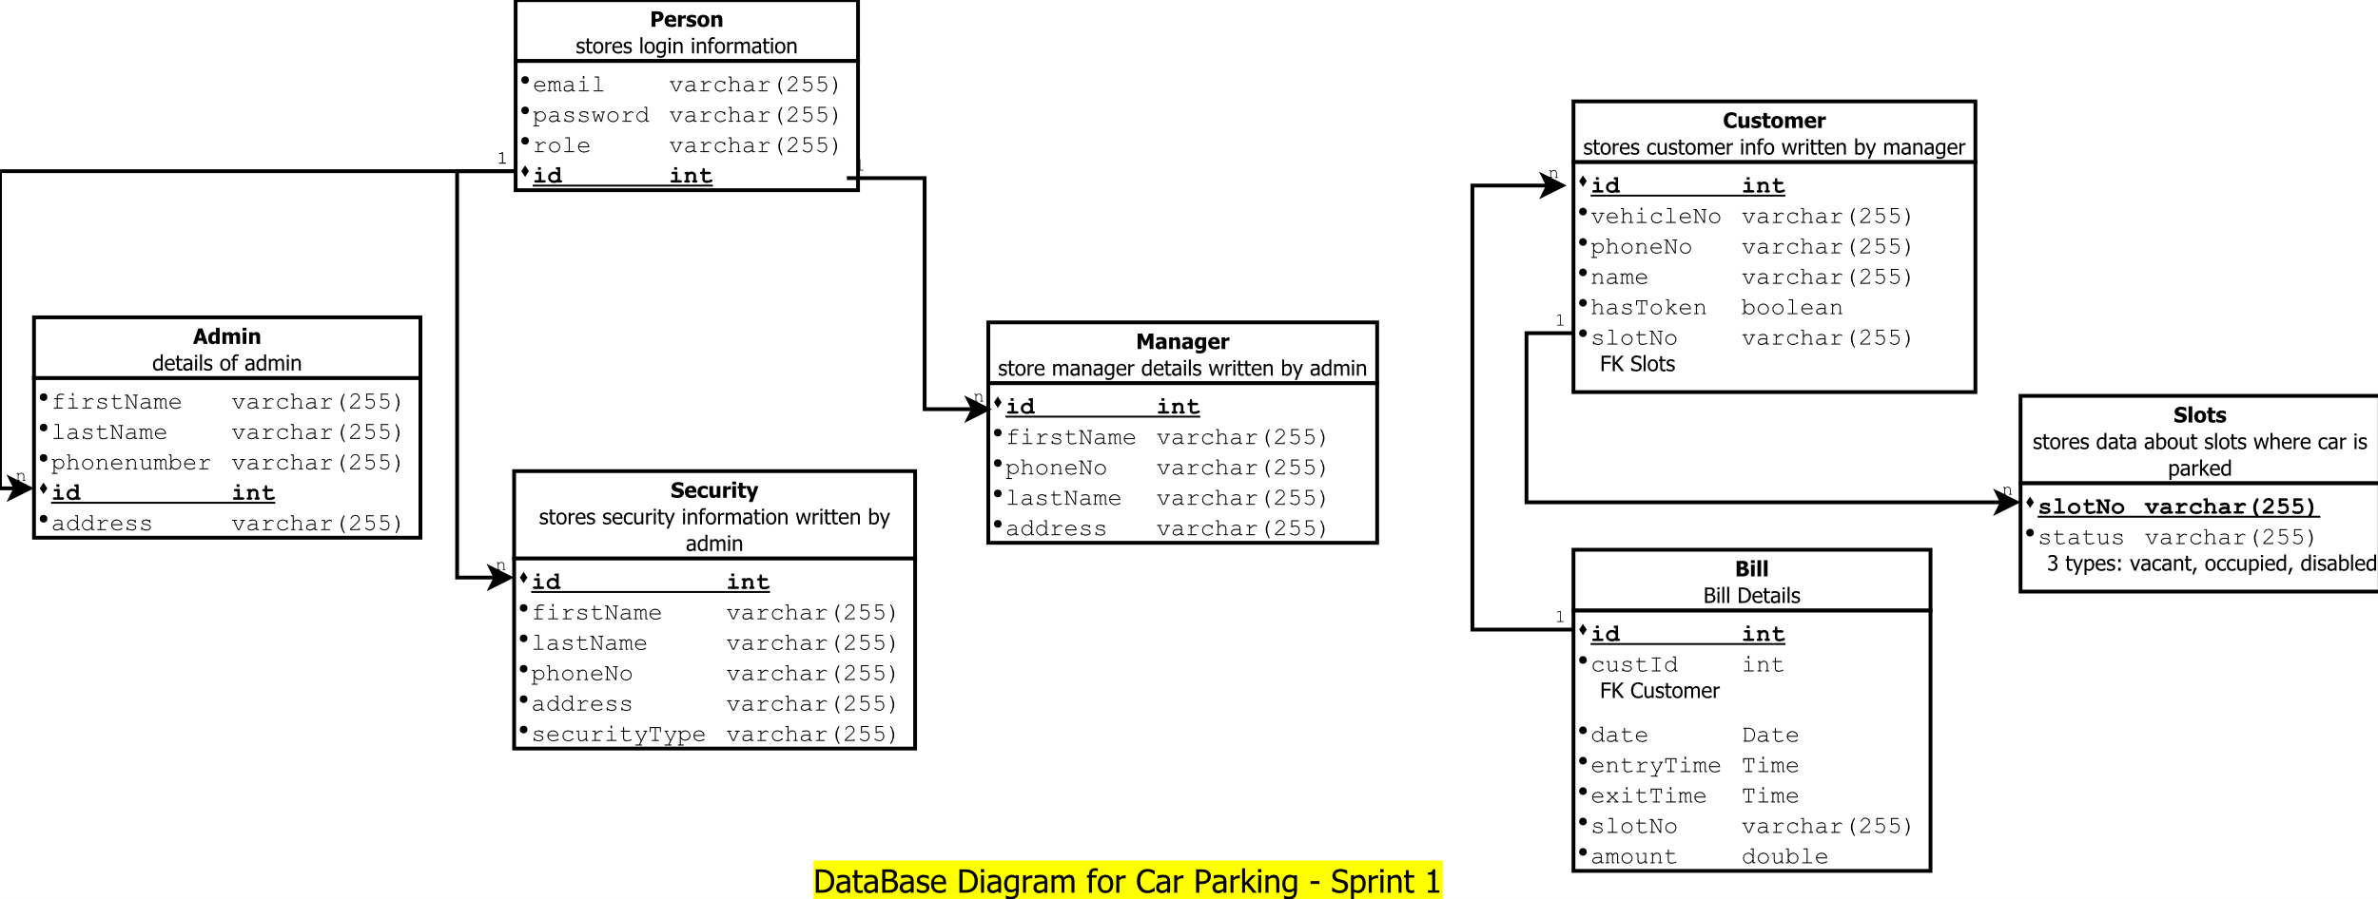
Database Diagram

Slide 14
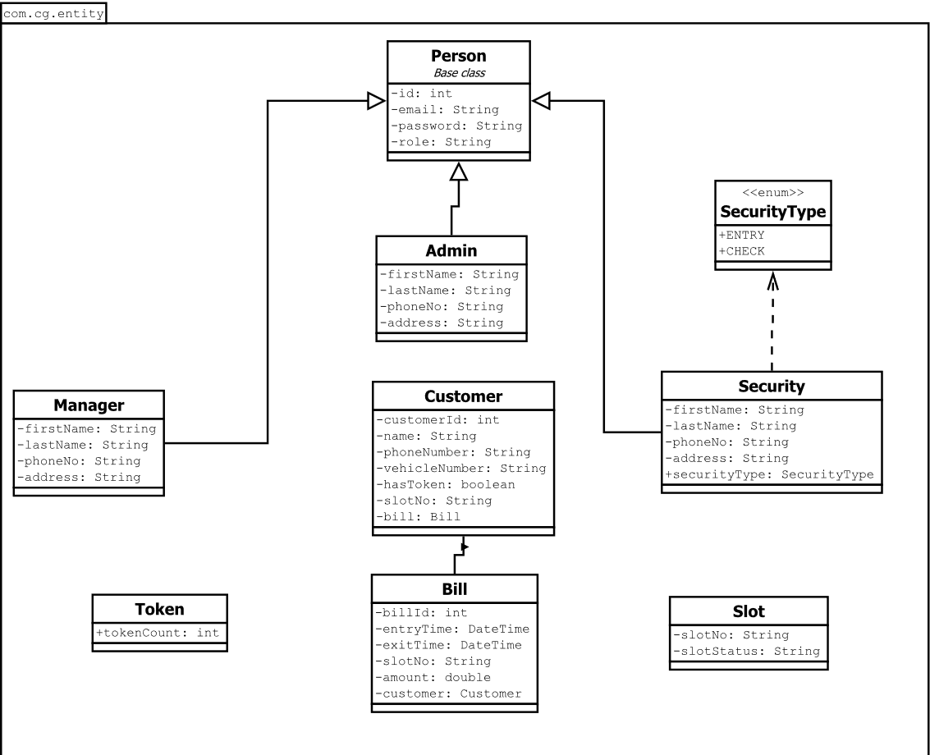
Class Diagram

Slide 15

TECHNOLOGY/TOOLS USED
Spring
Spring Data JPA
Spring Boot
Spring REST
Spring Security
Spring Logger
Postgres SQL
Java 8
Gradle
Junit
Sonar Lint
Git
AWS
Kubernetes
Docker

Slide 16
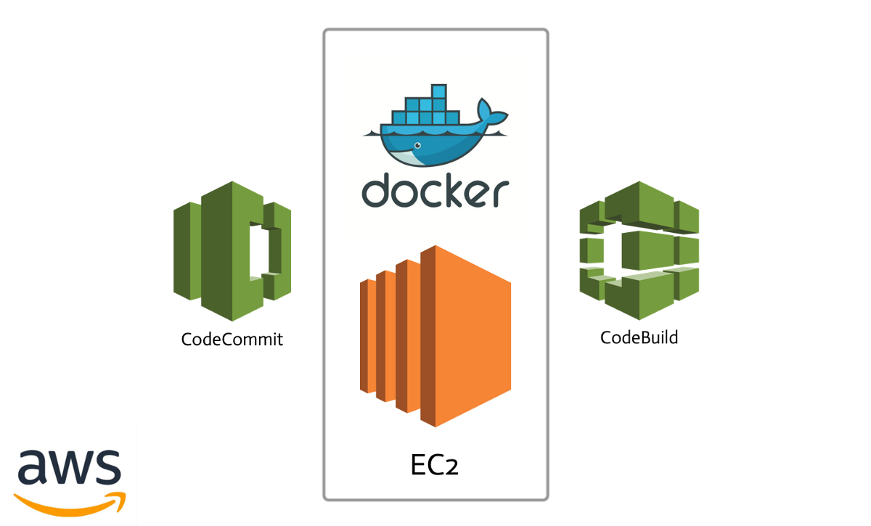
Deployment: On AWS using Docker
Created Amazon EC2 instance
Installed required softwares
Cloned project repo from github
Created Dockerfile for the project
Created docker-compose file to build and manage postgres and Application image.

Slide 17

Deployment: On AWS using Kubernete
Created Amazon EC2 instance
Installed required softwares
Cloned project repo from github
Build docker image of application
Pushed on Dockerhub
Created deployment and service files.
Deployed application using kubectl

Slide 19
THANK YOU

