Slide 1


Slide 2
Stock market prediction using news headlines
Shravan Chintha
Adithya Job

Slide 3
Problem definition
Using historical news, predicting the stock market movement
Stock prices are usually determined based on supply and demand
Negative news will normally cause individuals to sell stocks, this will cause in a decrease in the price of a stock
Positive news will normally cause individuals to buy stocks, this will cause in an increase in the price of a stock

Slide 4
Overview
Negative news
“The S&P 500 fell for a third straight day after President Donald Trump said the U.S. would slap tariffs on steel and aluminum. As Fred Katayama reports, that sparked fears of higher prices and a trade war.”

Slide 5
Overview
Positive news
“The Dow soared 257 points and brushed up against lifetime highs, as investors came to term with win for Donald Trump in the US Presidential election. The S&P 500 and the Nasdaq rose 1.1 per cent apiece.”

Slide 6
Dataset
Dataset contains top 25 headlines of each day’s news from 2008-08-08 to 2016-07-01
News articles are acquired from Reddit News and Stocks data is of DJIA (Dow Jones Industrial Average) acquired from Yahoo Finance
News headlines are ranked from top to bottom on the basis of reddit users’ votes
News and DJIA have been combined to form a single dataset with its columns as: Date, Label, Top 1 up to Top 25

Slide 7
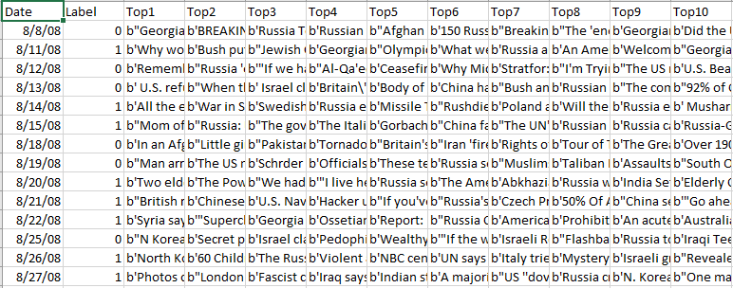
Dataset

Slide 8
Dataset
Date: date of each day of the news
Label: 1 or 0,
“1” when DJIA close value rose or stayed at same
“0” when DJIA close value decreased
Top 1: column that contains top 1 ranked news of that day
Top 2 to Top 25: columns that contain top 2 to top 25 ranked news from top to bottom on that day

Slide 9
Dataset
Sample news:
Top 1 news on 8/8/08:
b"Georgia 'downs two Russian warplanes' as countries move to brink of war"

Slide 10
Data Preprocessing
Combined all the sentences in a row to a single string.
Then used CountVectorizer function to preprocess the data.

Slide 11
Data Preprocessing
CountVectorizer
Removed extra characters and meaningless words.
Such as quotes, extra letters coming between (‘b)
Converted the words into lower case letters.
Divided the sentences into words and created a table with count of those words.

Slide 12
Exploratory data analysis
Data is divided into 2 parts based on labels
Top 1 to top 25 news are combined for entire data labeled with “0” i.e., news that had negative impact on stocks
Top 1 to top 25 news are combined for entire data labeled with “1” i.e., news that had positive or no impact
Word clouds for both the parts are created to check the impact of words that had more influence on the stocks

Slide 13
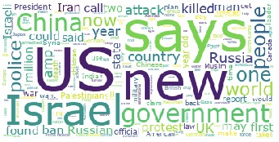
Exploratory data analysis
Positive word cloud

Slide 14
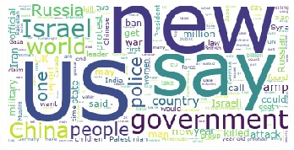
Exploratory data analysis
Negative word cloud

Slide 15

Baseline model
Training and Testing datasets
Data is divided into 75/25 split based on dates
Training data is from dates 08/08/2008 to 07/14/2014,
test data is from dates 07/15/2014 to 07/01/2016
1492 records in train set and 497 records in test set

Slide 16
Baseline model
Logistic Regression
Statistical method that analyzes the data, in which there are one or more independent variables determines the outcome. The outcome has only two possible values.
Ex: to classify a boy or girl in data

Slide 17
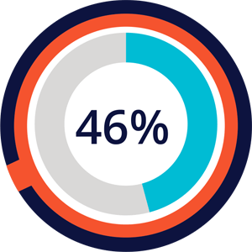

Baseline model
Logistic Regression
Used bag of words
Or 1-gram model
Used CountVectorizer
Accuracy:

Slide 18
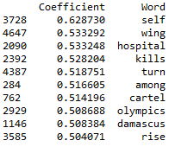
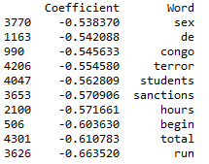
Baseline model
Top 10 Positive words
Logistic Regression
Words are listed from top to bottom based on their model coefficients
Top 10 Negative words

Slide 19
Other models
Logistic Regression with bi-grams:
Used bi-grams
Used TfidfVectorizer
term-frequency times inverse document-frequency
To offset the frequency generated by the most repeated words yet very less meaning (such as ‘a’, ‘the’, ’is’ etc.,) in a large corpus by re-weighting the count features to values suitable for using in the classifier.

Slide 20


Other models
Logistic Regression with bi-grams:
TfidfVectorizer with ngram range as (2,2) – bigram
Improvement in accuracy

Slide 21
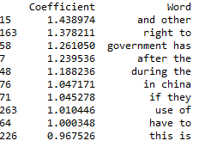
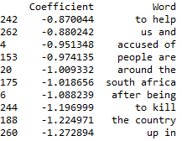
Other models
Logistic Regression with bi-grams:
Words are listed from top to bottom based on their model coefficients
Top 10 Positive words
Top 10 Negative words

Slide 22
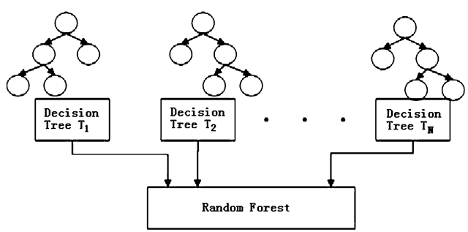

Other models
Random forest with bi-grams:
A Random Forest n-gram model is a collection of randomly constructed decision tree n-gram models.
Random Forest models in language modeling are used to deal with the data sparseness problem
Accuracy:

Slide 23
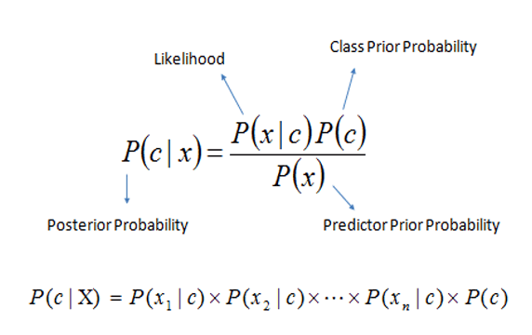

Other models
Naïve Bayes with bi-grams:
The probabilistic model of naive Bayes classifiers is based on Bayes’ theorem. Naïve Bayes classifiers are linear classifiers which are known to be simple and efficient models.
Accuracy:

Slide 24
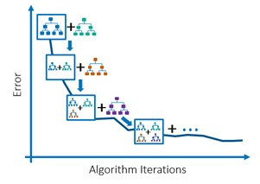

Other models
Gradient Boosting model with bi-grams:
Gradient boosting involves three elements:
A loss function to be optimized.
A weak learner to make predictions.
An additive model to add weak learners to minimize the loss function.
Gradient boosting is one of the most powerful techniques for building predictive models
Accuracy:

Slide 25


Other models
Logistic Regression with tri-grams:
Used tri-grams with TfidfVectorizer
Accuracy reduced over bigrams
Accuracy:

Slide 26
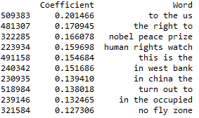
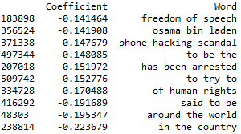
Other models
Top 10 Positive words
Logistic Regression with tri-grams:
Words are listed from top to bottom based on their model coefficients
Top 10 Negative words

Slide 27
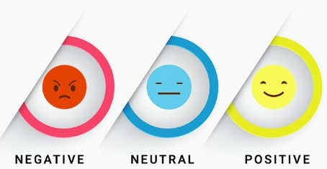
Sentiment Analysis
Assuming that news articles have impact on stock market
Taking non quantifiable data and predicting its future stock trend with news sentiment classification.

Slide 28
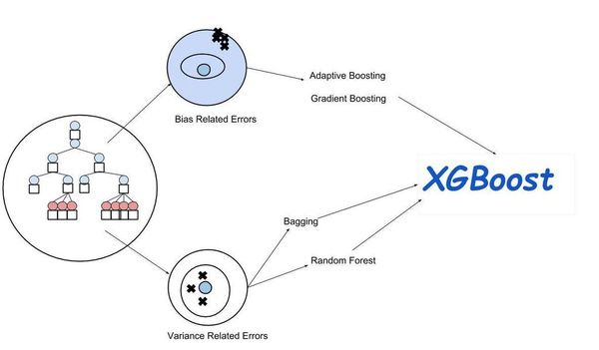
Sentiment Analysis
Computed polarity for each news article on each day, that varies from -1 to 1
Data frame now converted into a numerical representation and applied XGBoost algorithm.
Accuracy:

Slide 29
Model Comparison
Model | Accuracy
Baseline model (Logistic regression with bag of words) | 46.07%
Logistic Regression with bigrams | 53.11%
Random Forest with bigrams | 54.52%
Naïve Bayes with bigrams | 52.91%
Gradient Boosting machines with bigrams | 55.33%
Logistic Regression with trigrams | 51.71%
Sentiment analysis | 62.77%

Slide 30

Conclusion
Baseline accuracy: 46%
Improved accuracy: 55.33%, achieved with gradient boosting machines using bigram approach in TfidfVectorizer
Best accuracy: 62.7%, achieved with sentiment analysis

Slide 31


