Slide 1
AI Murder Mystery: The Blackwood Mansion
Multi-Agent Adversarial AI Game

Slide 2
Table of Contents
01
02
03
04
05
06
Problem
Architecture
Multi-Agent
Why build an adversarial AI game?
Tech stack and system design
Three specialized agent types
Prompting
Demo
Conclusions
Techniques for deceptive agents
Game mechanics and interface
Key learnings and future work

Slide 3
01
Problem
Why build an adversarial murder mystery game?

Slide 4
Motivation & Problem Statement
Adversarial AI Challenge
Most LLM applications are cooperative. We wanted to explore adversarial dynamics where AI agents actively work against the user's goals.
Information Hiding Problem
Can LLMs reliably hide information while staying in character? This tests prompt engineering limits and requires novel safety guardrails.
Interactive Storytelling
Murder mystery games require complex reasoning, consistent personas, and dynamic responses—a compelling test for modern LLMs.

Slide 5
02
Architecture
Tech stack and system design

Slide 6
LLaMA 3.1 8B & 3.3 70B
5 Agents
30 Turns
Model via Groq API for fast inference
3 suspects + critique + evaluation agents
Maximum questions before accusation

Slide 7
System Architecture
Streamlit web app with dark noir theme, real-time chat, and detective notepad
Frontend
Agno library for multi-agent orchestration and state management
Agent Framework
Pipeline
Groq API with LLaMA 3.3 70B for fast, high-quality responses
LLM Backend
Critique agent filters responses to prevent information leaks
Safety Layer

Slide 8
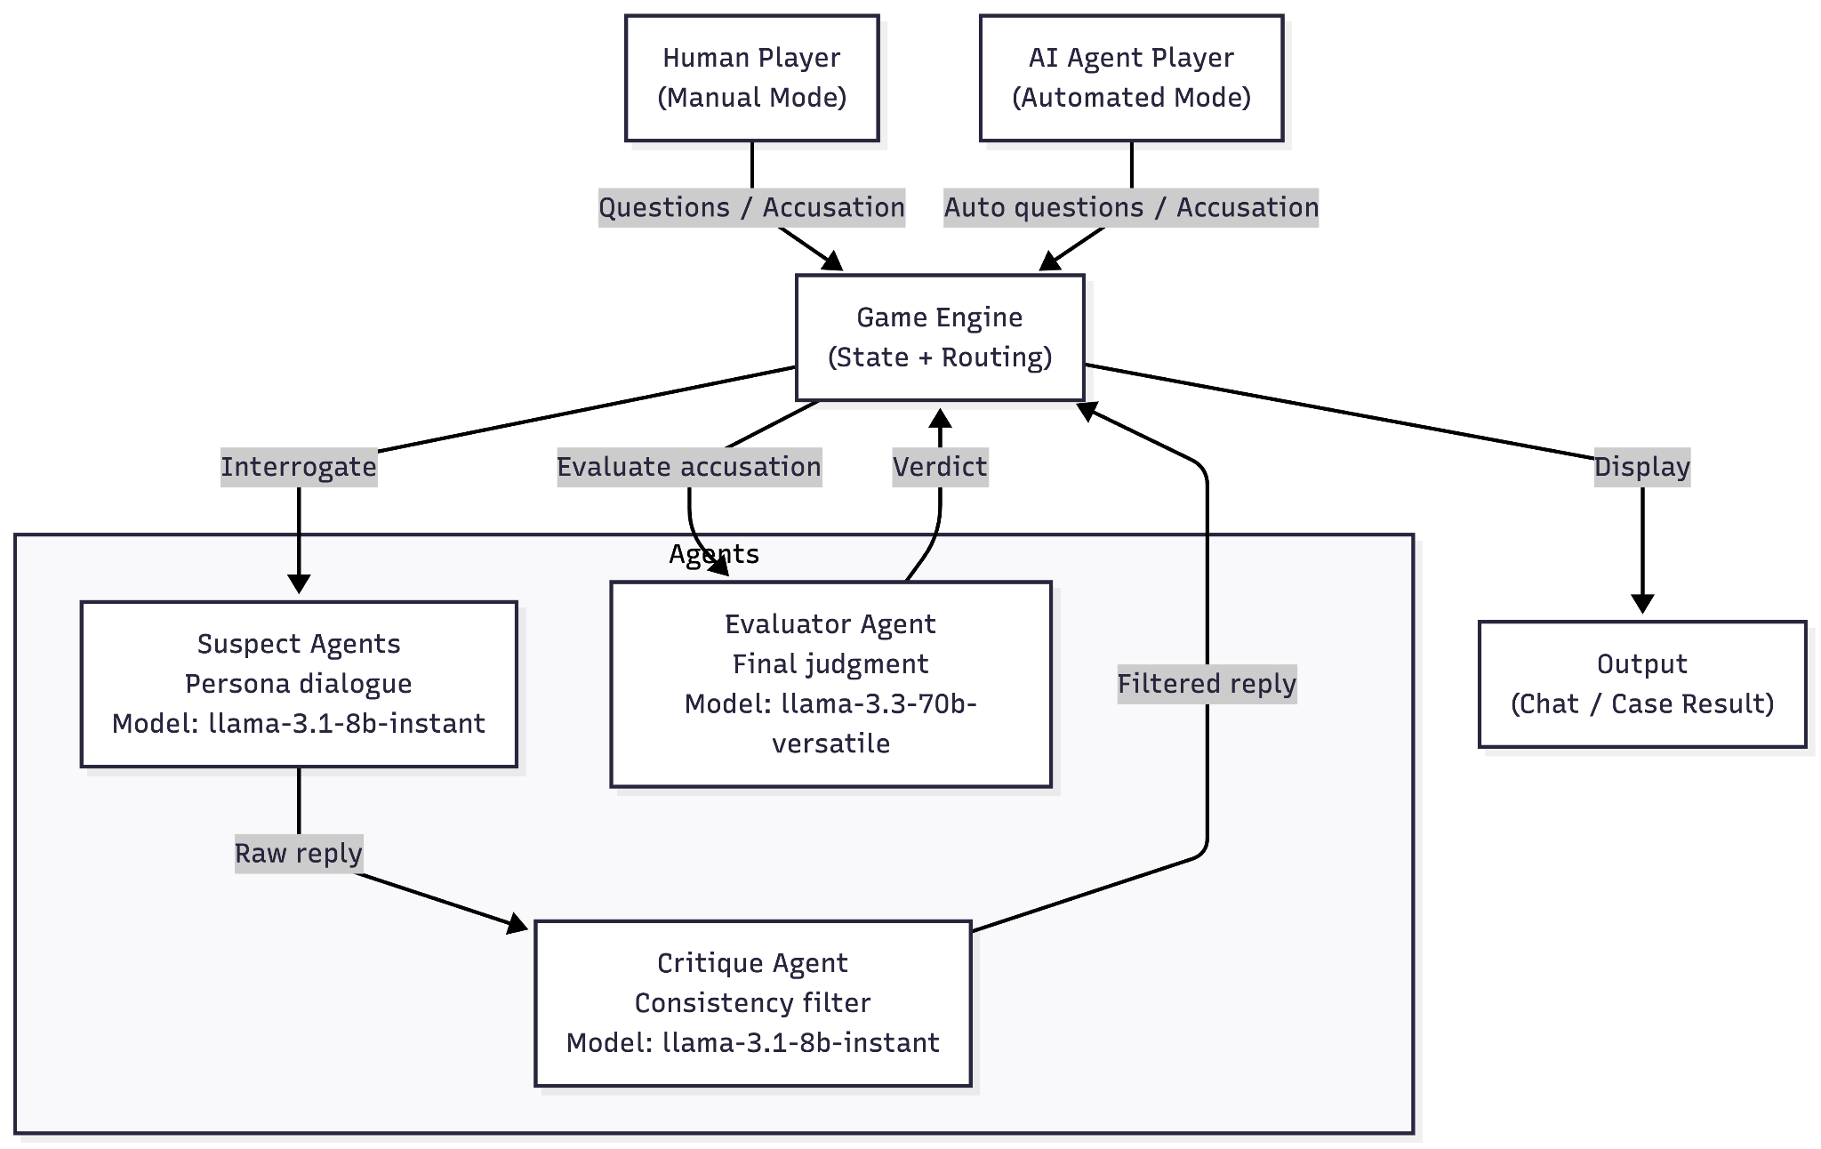
System Architecture

Slide 9
03
Multi-Agent Design
Three specialized agent types working together

Slide 10
Agent Types
Suspect Agents (3 instances)
Each has unique persona, alibi, secrets, and hard redlines. Roles: Killer, Accomplice, Innocent witness.
Critique Agent
Safety filter that detects and sanitizes leaks where suspects accidentally reveal too much information.
Accusation Agent
Evaluates final accusations, calculates scores, and provides narrative case resolution.

Slide 11
04
Prompt Engineering
Techniques for building deceptive AI characters

Slide 12
Prompt Engineering Techniques
Hard Redlines
Layered Context
Two-Pass Filter
Explicit forbidden phrases that agents must never say, even paraphrased
Public info, private secrets, and persona traits in structured prompts
Raw response → Critique check → Safe output to prevent accidental leaks

Slide 13
05
Demo
Game mechanics and noir-themed interface

Slide 14
Game Mechanics
The Case
01
02
03
Victor Hale murdered at 23:15 in the library of Blackwood Mansion. Cause: blunt force trauma. Player must find killer, weapon, and motive.
Lydia
Dr. Vale
Eleanor
Elegant heiress. Evasive and controlled.
Charming doctor. Deflects with sarcasm.
Nervous housekeeper. Knows more than she says.
Suspects

Slide 15
06
Conclusion
Key findings, challenges, and future work

Slide 16
Key Findings
Information Hiding Works
Character Consistency
With proper prompt engineering and two-pass filtering, LLMs can maintain secrets reliably
Distinct personas remained stable across extended interrogations with varied questioning
Engaging Gameplay
Safety Layer Essential
Without critique agent, suspects occasionally leaked information under pressure
The adversarial dynamic creates genuinely challenging and fun detective experience

Slide 17
Challenges & Future Work
Challenges Faced
Future Work
Building adversarial AI required careful prompt engineering to balance deception with playability. Key challenges included:
Preventing prompt injection attacks
Maintaining persona under aggressive questioning
Balancing difficulty—too easy or impossible?
Latency with multi-agent pipeline
Add on the fly case generation, voice input/output, and multiplayer cooperative investigation modes.
Extensions
Apply adversarial agent patterns to other domains: negotiations, debates, educational simulations.

Slide 18
Thanks!

