Slide 1

Accident Prediction : Data Driven Analysis of Traffic Accidents
Virajdatt Kohir
Rudraksh Mishra
Lakshmi Kavuri
Arnav Gupta
Manish Ranjan
Sameer Mahajan
Data Driven Decision Making (Spring 2, 2022)

Slide 2


Content
Abstract
Introduction
Method/Approach
Experimental section/Code Demo
Discussion
Conclusions

Slide 3
Abstract
Accidents cause a lot of damage. Which dents people’s earnings, government resources, people lose lives because of this as well as roads and vehicles are harmed due to this.
The objective of this project is to compile a comprehensive study of past accidents and perform a systematic study and data analysis to gain insights into what caused them.
Data Driven Decision Making algorithms will be applied to establish a framework that can be used to take preventive measures to avoid these catastrophic incidents to a great extent.

Slide 4
Introduction
Accidents cause a lot of harm to people, government, roads and vehicles leading to lot of losses.
These losses can be in form of money, lives or infrastructure.
If accidents can be mitigated, it can result in better lives and safety of the areas would also increase.
Through this project using Data Driven Decision making we try to analyze accidents and gain detailed insights on what causes them and then give solutions to help reduce total number of accidents in the whole country.

Slide 5
Method
1. Variable Selection
As mentioned in the Introduction, we are trying to gain insights into the data and as these insights are not available in country (as there is only one country) , 1st_road_number and 2nd_road_number (having similar values these variables are dropped) .
2. Feature Engineering and Transformation
As per our business problems one of the important factor we wanted to gain insight was on what time does accidents occur the most and the risk associated with the accident. Also label encoders are used on categorical variables which will help us to mitigate the issues of explosion of model and helps in easier modeling dimensions.
3. Data Reduction
Performing Data Reduction techniques will cause the model to lose its accuracy , hinder our predictions , lose interpretability with principal components and as a result for effective delivery of our model we will not be using any data reduction techniques.

Slide 6
Approach - We are following below approach to create our accident prediction model which is capable of predicting the number of casualties as per business requirements.
Linear Regression
We start with Linear Regression to setup a baseline for our work and then use advanced modeling algorithm of increasing complexity.
Random Forest Regressor
Next we have moved to a more complicated model random forest, in which multiple decision trees are built. Each tree uses a subset of data and builds simple weak decision trees.
AdaBoost Regressor
It is a boosting algorithm which mostly uses decision trees like Random Forest but the Adaboost algorithm is based on the boosting principles which helps in building better decision trees over each iteration of building a model.
Hyperparameter Tuning
We would be using GridSearchCV or RandomizedSearchCV to optimise the parameters of our models. The model which performs the best among LinearRegression, Random Forest Regressor, and AdaBoostRegressor will be considered for hyperparameter tuning

Slide 7

Experimental section/Code Demo
Finding the right model is important as mentioned previously and hence we are going to choose model, Linear Regression, Random Forest Regressor and AdaBoost Regressor. PyCaret is being used to create the ML models.
Defining the right metrics is also important so that the stakeholders will be able to get informed insights about the problem and hence the dataset is divided into train set and test set, one to build the model and other to test metrics on it.
As we can see from the values, Train test split is correctly implemented.

Slide 8
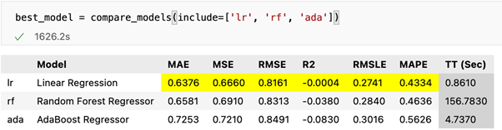
Experimental section/Code Demo
Comparisons of Models :
To get relevant insights about the business solutions metrics are defined and models are tested and the best models are found using this technique.
Applying this to our project we were able to find that Linear Regression results out to be the best model out of all the models available.

Slide 9
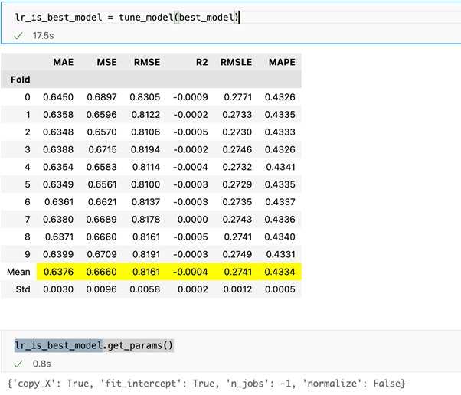
Experimental section/Code Demo
Model performance can be improved from the initial testing which can help us impress the stakeholders and also effectively improve the results of the business problem.
Hence we used the tune_model function to tune the models and after that we checked the parameters of the best model.
The best hyperparameters for model are:
Fit intercept being true.
Input variables should not be normalized.

Slide 10
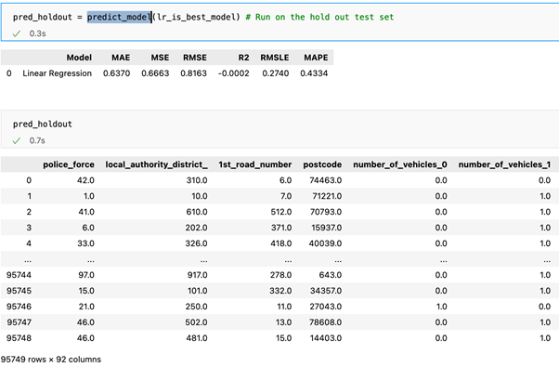
Experimental section/Code Demo
RMSE is the most important metric for the problem and as mentioned in the introduction it helps us to understand whether our solution is bad or a very good solutions impacting a lot of lives.
The RMSE for the training and testing data are almost equal.
Similar to RMSE other metrics are also quite similar to the training data and hence we can say that the model has done very well in predictions and can be used to save lives and help in preventing losses caused because of accidents.

Slide 11
Discussion
In order to meet all business requirements, we are optimizing our accident prediction model output with hyperparameter tuning.
After tuning hyperparameters and testing performance of our best models, we would like to make the following pointers:-
As a result of our huge dataset and running 10k fold, a lot of time is spent fitting complex models like Random Forest and Adaboost compared to a linear model.
Random Forest took 156 seconds per fold for training and in total 1560 seconds (26 mins) for all the 10 folds.
Our best model, Linear Regression, trained in under 10 seconds in comparison to AdaBoost's 4 seconds per fold and 40 seconds in total.

Slide 12
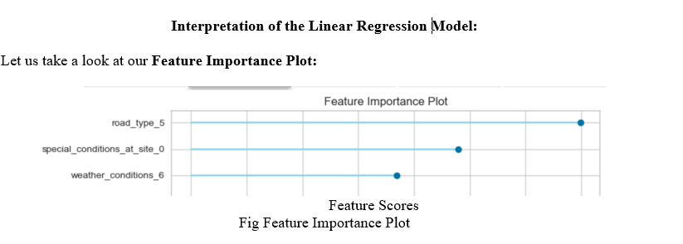
Conclusions
We have seen that in our accident prediction model Linear Regression performed better on all of the other popular regression metrics tested (MSE, RMLE, R2, MAPE).
Both validation sets and test sets demonstrate similar performance. In other words, our accident prediction model cannot be overfit, as it is designed to work well for all tasks.
From above accident model input feature importance plot ,We can say that that road type and weather are considered to be among the top 3 features of importance.The descriptive questions also ask about this.
According to our linear regression RMSE shown in the previous slides, we are very likely to be able to predict the casualty number based on road type and weather conditions.

Slide 13
Any Questions ?

Slide 14
Thank You

