Slide 1

HOW ISIS USES TWITTER
Geethika Marru
Lakshmi Kausalya Kavuri
Sai Surya Sudha Soundarya Mantha

Slide 2
Project Objective
Who are the major players in the ISIS twitter network
What are the keywords that are commonly used by ISIS fanboys
Is there any trend we observe in the tweets pattern
What is the sentiment we observe in the tweets

Slide 3
Introduction
With the increased use of social media by all communities, Twitter plays prominent role in interaction and expression of ideas.
ISIS is one of the most barbaric and technology savvy armed forces that is using media to project political and religious institutions.
ISIS has a new pool of potential supporters in social media. This project focuses on analysis of tweets by ISIS fanboys in 2016 following the Brussels attacks.

Slide 4
Data
Data from over 17,000 tweets from 100+ pro-ISIS fanboys is scraped from all over the world post the November 2015 Paris Attacks.
The data is collection of large number of Arabic tweets, translated to English referring to ISIS. The project uses this data to check the networks, most frequent words and the sentiment of each tweet.

Slide 5
Characteristics of dataset
Source: https://www.kaggle.com
Size: 17410 rows, 8 columns
Data Description: Columns present -
Name
Username
Description
Location
Number of followers at the time the tweet was downloaded
Number of statuses by the user when the tweet was downloaded
Date and timestamp of the tweet
The tweet itself
The ‘tweets’ column is the main column to perform text analytics.

Slide 6
Data pre-processing steps
· Convert to lower case
· Remove punctuation
· Remove special characters
· Convert numbers
· Remove stop words
Remove blank spaces

Slide 7
Time series Analysis
The data set considered has tweets collected/ scraped over 2016 over a span of 5 months.

Slide 8
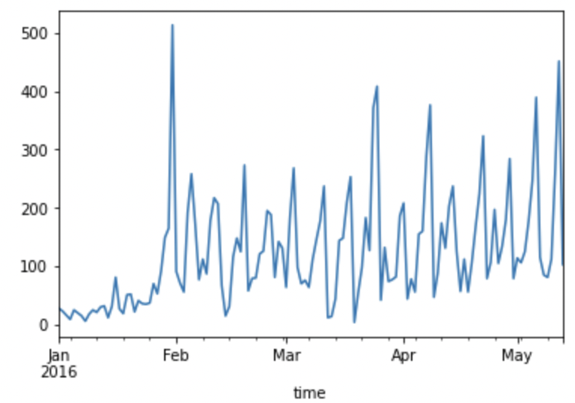
The number of tweets per day across the time span:

Slide 9
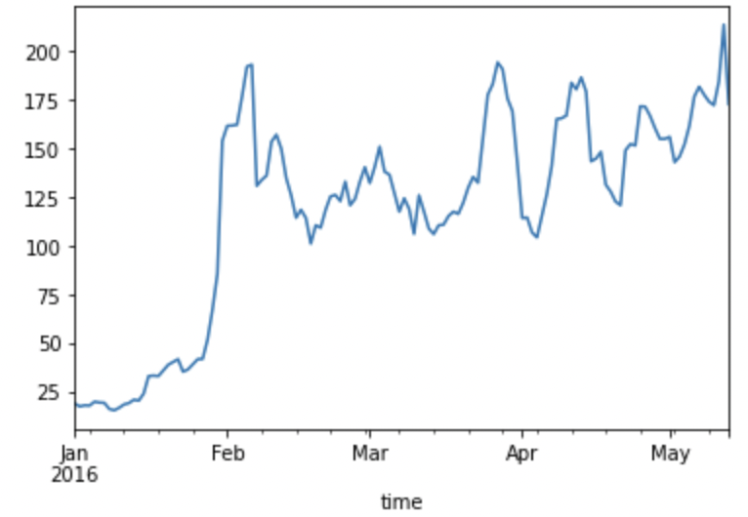
Identifying the trend using rolling average to check if there is any possible trend:

Slide 10
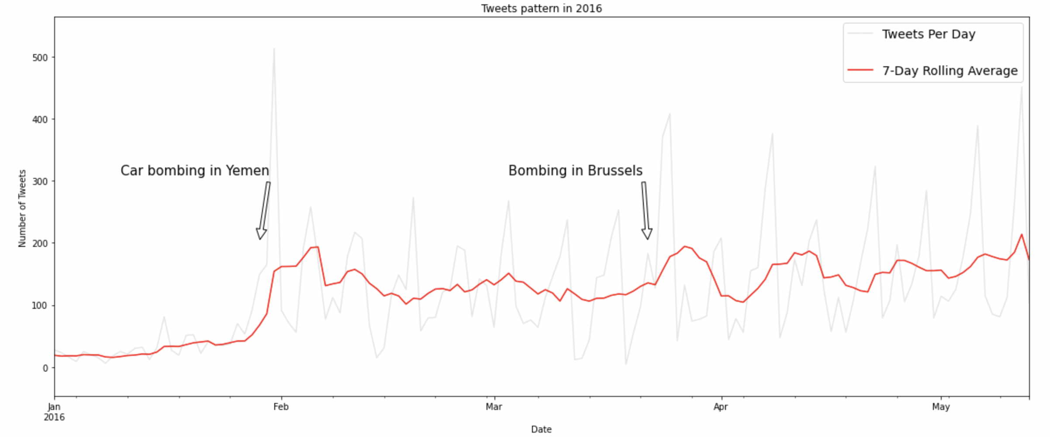
Time series Analysis
Increasing trend in the number of tweets made over the considered time period.
Extreme spike in the number of tweets that are being made during the immediate days of the attack.

Slide 11
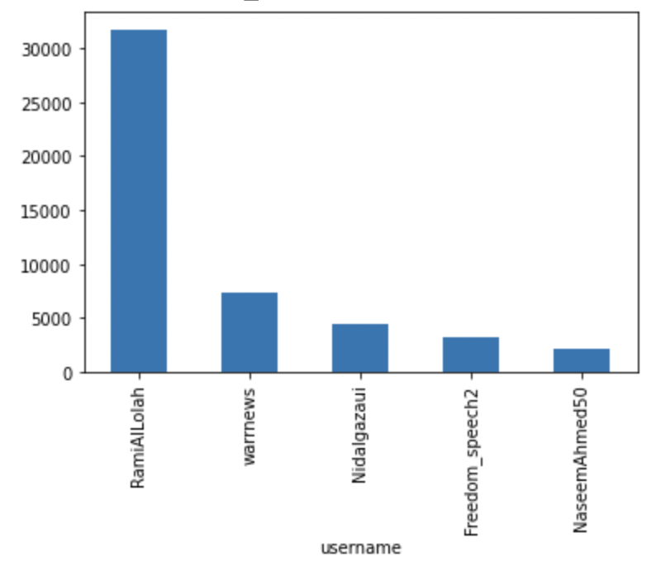
Users with tweets having the maximum followers

Slide 12
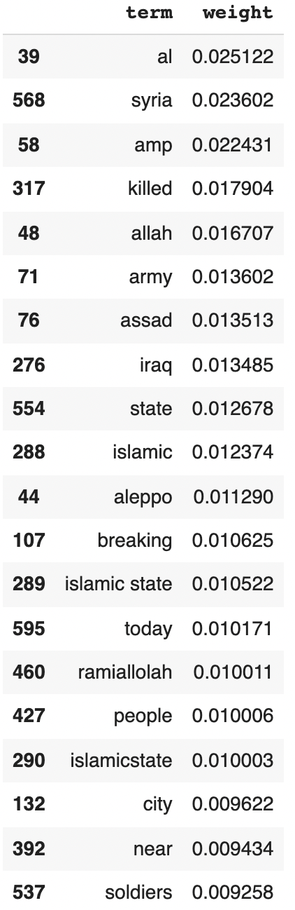
TF-IDF
Term Frequency-Inverse Document Frequency is a statistical measure that evaluates how relevant a word is to a document in a collection of documents.

Slide 13
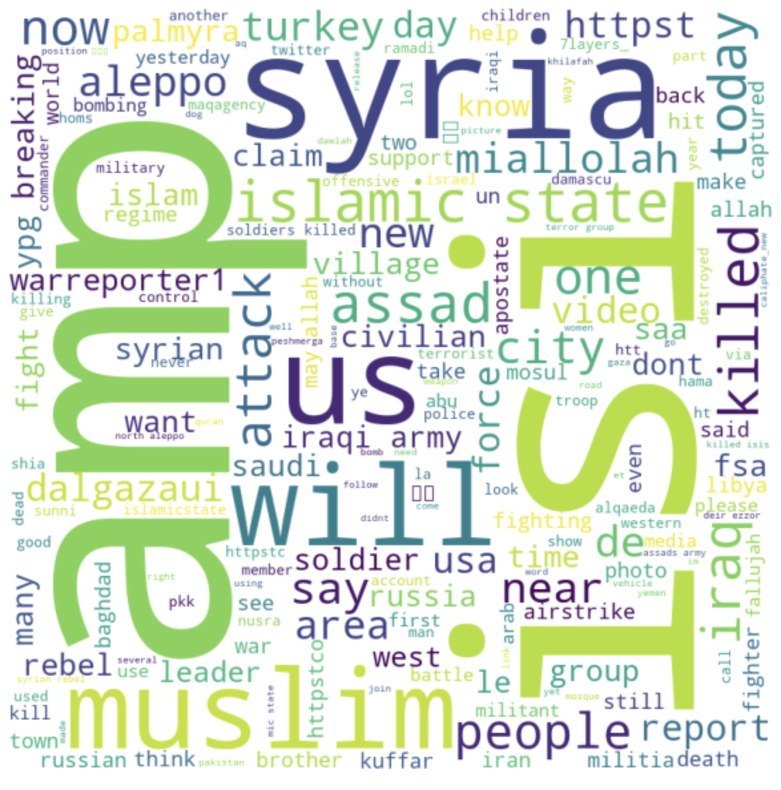
Word Cloud
Word clouds are valuable way to communicate important underlying raw text-based data

Slide 14
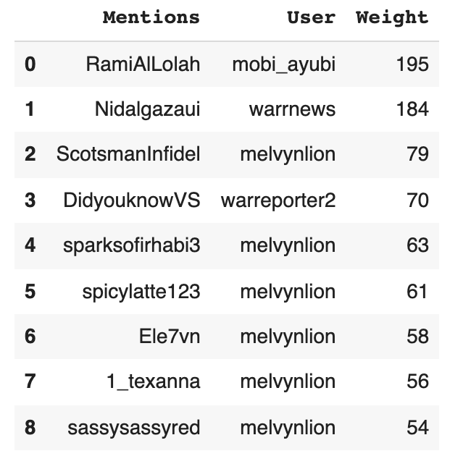
Network Analysis
Top Ten Frequent pairs of taggers and mentions

Slide 15
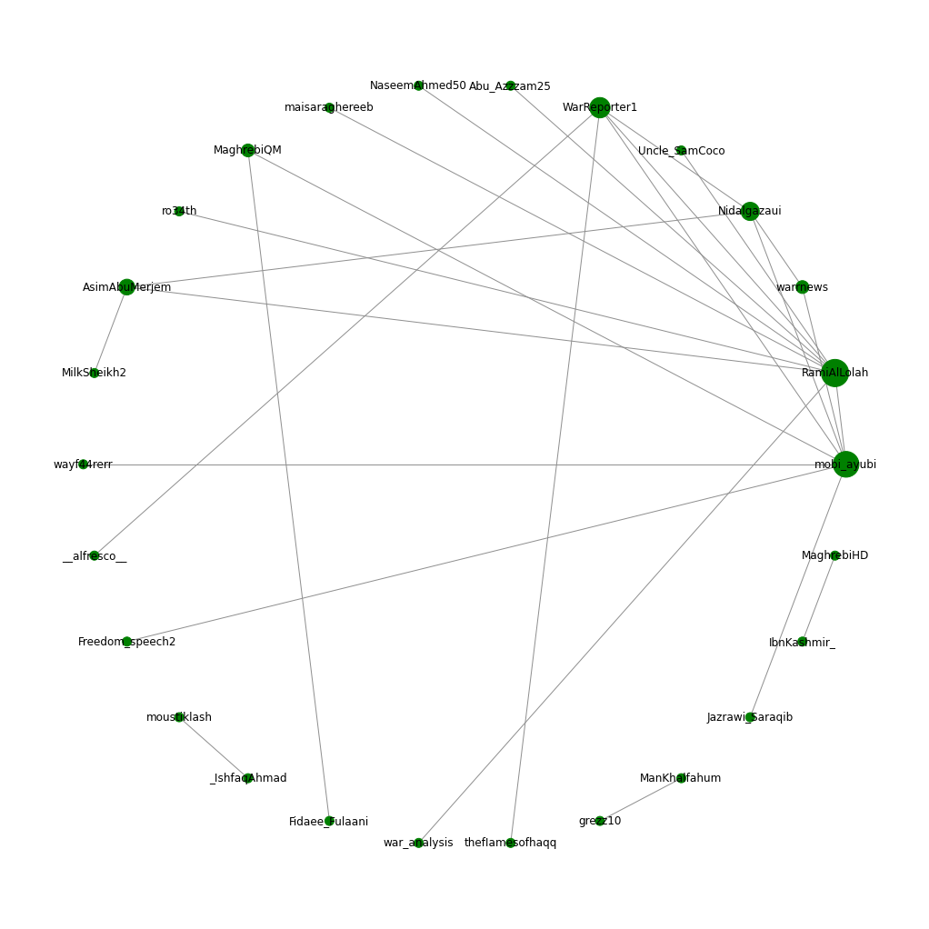
Network Graph of ISIS Tweets
Most mentioned user is RamiAlLolah with 565 times mentioned by the other users.
Most active user is Uncle_SamCoco with 1578 times mentioning other users.

Slide 16
Tweets Classification
This analysis focuses on classifying the tweets as a positive tweet/ negative tweet or neutral using set of negative and positive words
# Positive tweets = 1200
# Negative tweets = 6858
# tweets with both positive and negative words = 6179
# tweets with no negative and positive words = 3173
Eg:
SHEIKH FATIH AL JAWLANI 'FOR THE PEOPLE OF INTEGRITY, SACRIFICE IS EASY'

Slide 17
Results
Major Players:
RamiAlLolah
Warreporter
Nidalgazaui
Mohi_ayubhi
Trend:
There is no specific trend observed in the number of tweets being tweeted each day
Keywords used:
Syria
Amp
Killed
Islamic
Sentiment:
Highest percentage of tweets have negative words
We can also observe tweets with aggressive, violent and religious

Slide 18

Thank You

