Slide 1

Causality Analysis between Google Trends and BTC-ETH-ADA Prices
Team II:
Ashwath Ramesh
Kavuri Lakshmi Kausalya
Rohit Muralitharan
Predictive Analytics(Spring II, 2022)
Dr. Youakim Badr

Slide 2
Introduction:
With the introduction of the internet, everything in this world has changed, even including the introduction of new digital currencies(cryptocurrencies) for the exchange of goods and services.
This in fact, attracted lot many investors, some of whom do not have previous knowledge and are looking for a guide.
That aside, there are also people and companies who lose money due to the sudden change in the prices of these currencies.
So, our project’s main purpose is to predict and analyze the cryptocurrencies (Bitcoin, Ethereum, Cardano) and to find the cause and effect (Causality) between Google Trends and these cryptocurrencies.
We want to build a model that predicts the percentage change in each of the cryptocurrencies (BTC-ETH-ADA), with the help of ARIMA (Auto-Regressive Integrated Moving Average), XGBoost (Gradient Boosting) and LSTM (Long Short Term Moemory), while also considering the factors that affect their values.

Slide 3
Problem Statement and Challenges:
There are a lot of market investors, who invest in the digital currencies, and they tend to look for guides who could get them to profit.
So, the objective of our project is to design a model for predicting the percentage returns in the cryptocurrencies with the help of ARIMA, XGBoost and LSTM, while also considering the factors that affect their value. We also help the traders in determining whether to take a long or short call for a given trading day.
One of the major challenges faced in the causal analysis of cryptocurrency is that normal causes like the country’s GDP, world stock market etc. according to some research papers carried out, do not seem to have any significant impact on their price. On the other hand, non-typical factors such as Google trends, social media etc. seem to have some effect.
The problem that this issue poses is that, normally it might be comparatively easy to deal with sources like GDP and similar causes, since they offer more data and clear insights regarding prices than indirect sources like web searches, thus making it more difficult to build a model to predict the value.

Slide 4
Problem Statement and Challenges:
Another challenge we face is, the prices of cryptocurrency tend to be highly volatile. It is difficult to develop an accurate enough model to predict the prices due to this issue, combined with the significant fluctuations in exchange rates.
We faced issues in obtaining the data for trend of cryptocurrencies as Google trends only provides data on a month wise granularity. This not only reduces our data points but also predicting for such a long time period is not an effective way based on our studies on cryptocurrency.

Slide 5
Related Solutions/ State of Art:
(Kristoufek et al. 2013) In this research paper, they are studying the relationship between digital currency and search queries by connecting two of the main phenomena in the recent years – digital currency, Bitcoin and seach queries on Google Trends and Wikipedia to show that the search queries and the prices are connected and also to prove that there exists a pronounced asymmetry between them.
We can see from the research work carried out by Vasily Derbentsev et.al. that the use of Binary Auto Regressive Tree (BART) has allowed them forecasting the prices of cryptocurrency highly accurately even during dynamic rise and falls in prices.
From the research done by Muhammad Ali Nasir et.al., Toan Luu Duc Huynh et.al., Sang Phu Nguyen et.al., Duy Duong et.al., we can see that the data series is checked to be stationary using Dickey-Fuller tests. Akaike Information Criteria is used to choose the lag for the process and Granger causality test to determine the direction of causality. Impulsive response function analysis is performed to have a broader perspective on association among the variables.

Slide 6
Related Solutions/ State of Art:
There were many works related to predicting based on the Google searches/ and Google trends but there are only a few works that actually worked on predicting a Cryptocurrency based on the Google Trends but something that makes our Project unique and better is that all the previous works mostly focused on the most famous Cryptocurrency, BITCOIN, whereas in our project, we are also including prediction of some other crypto currencies, like Ethereum and Cardano.
Another standout point is that, in our Project, rather than just making direct Predictions, we will be calculating the Percentage change in each of the Cryptocurrencies, which will make the user or the trader, understand the situation of the currency and the transaction better.
As we read through the existing solutions and how they used Causality in their studies, we realized that the Granger’s Causality Analysis works the best for any time-series model such as our Project ‘Causality Analysis between Google Trends and BTC – ETH – ADA’.
And though, we looked at multiple projects using models like SARIMA, the average method, naive method, bats model etc., we think that ARIMA might be the best fit.

Slide 7
Survey of Scientific papers and journals:
Survey papers finding the relationship between Bitcoin and the search queries, like Google, Wikipedia, were very helpful to understand the gist of the parameters considered and the entire process going on.
Papers discussing about the relationship between social media conversing and the web searches to understand the impact of word-of-mouth(in an electronic way - three social media platforms (Instagram, Twitter, Tumblr)) on the web search engine, Google.
We can see from the research work carried out by Vasily Derbentsev et.al. that the use of Binary Auto Regressive Tree (BART) has allowed forecasting the prices of cryptocurrency highly accurately, even during dynamic rise and falls in prices.
From Guandong Xu et.al. research, we can understand the use of causality analysis.
From Stefan Haufe et.al. we can see the use of Vector Auto Regressive models to get the causal analysis of a multivariate time series data.

Slide 8
Overview of solution/ Contributions:
Our aim is to determine if search trend data can be used as a signal to predict Bitcoin prices. Since Google trends data for such a long duration of time is only obtained at a month level granularity, we were able to process and develop a prediction model at a day level granularity.
The model is designed to predict the returns a cryptocurrency would generate on a daily basis. Though failing to do so accurately because of reasons like covid impact on the market we were still able to predict a long or short call which will help the traders in making money in the market.
We forecast the direction in which the cryptocurrencies price will shoot up thus helping the traders to go for call or put options thus helping the traders earn money when the market goes both ways say when the returns are positive as well as negative.

Slide 9
Data Collecting:
The project is focused on mainly the three major cryptocurrencies currently in the market, Bitcoin, Ethereum and Cardano.
We have a dataset focusing on the market prices of each of the bitcoin containing time series data from 2013 to 2021. This data was handed to us at the start of the project.
Since the project is focused on the causal links between the market prices and the effect the search on google has on them, we obtained the data from Google Trends for web search in the United States between 2013 to 2021.
Since we require Google Trends data for a long-time frame, the data could be obtained only in the units of month rather than the preferred days. So, we performed data transformation to obtain the data to day granularity level. We queried multiple 9-month period with significant overlapping periods to have consistent scaling.

Slide 10
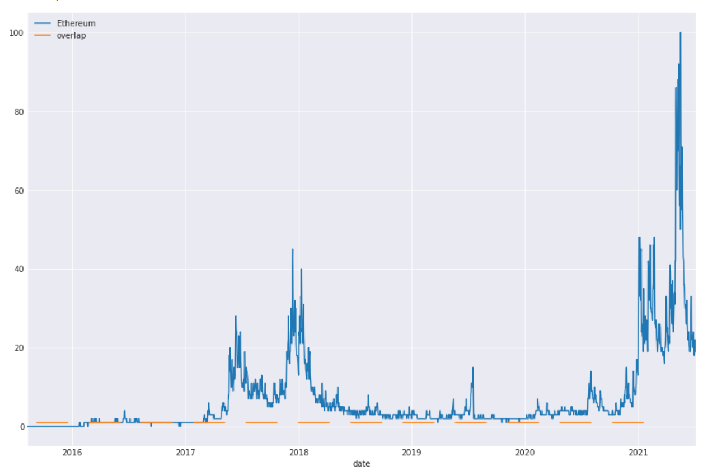
Data Collecting:
Overlapping data

Slide 11
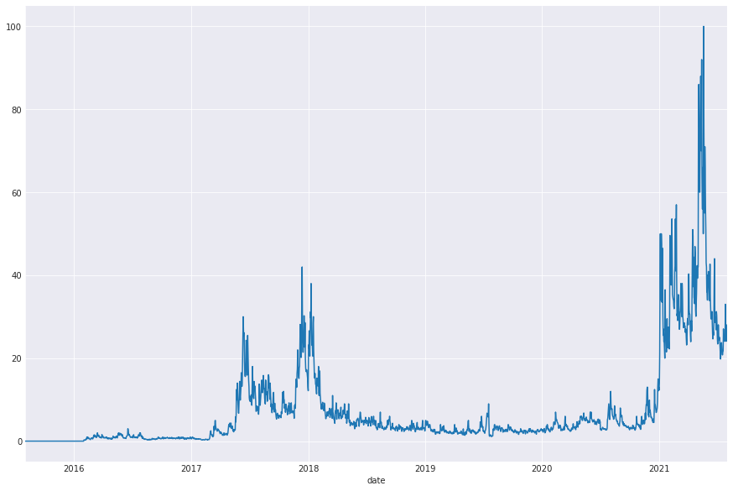
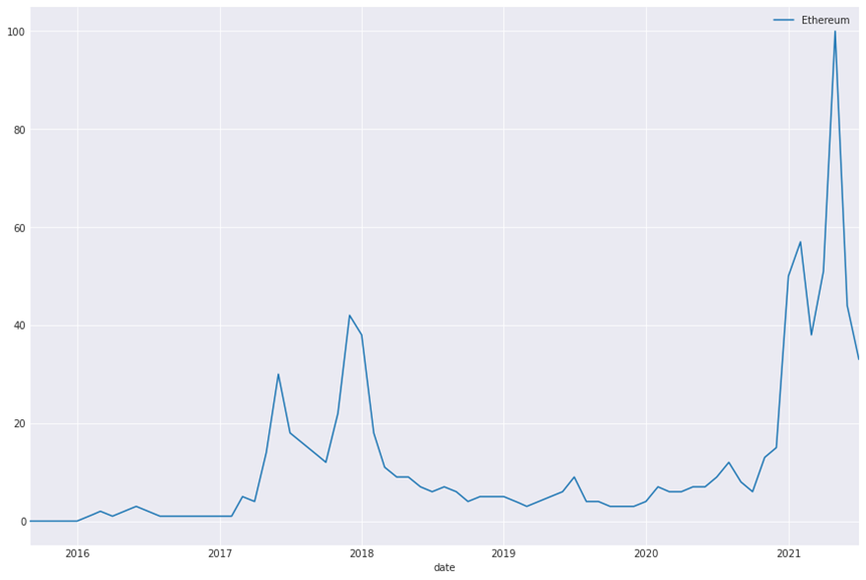
Data Collecting:
Daily Data
Weekly Data

Slide 12
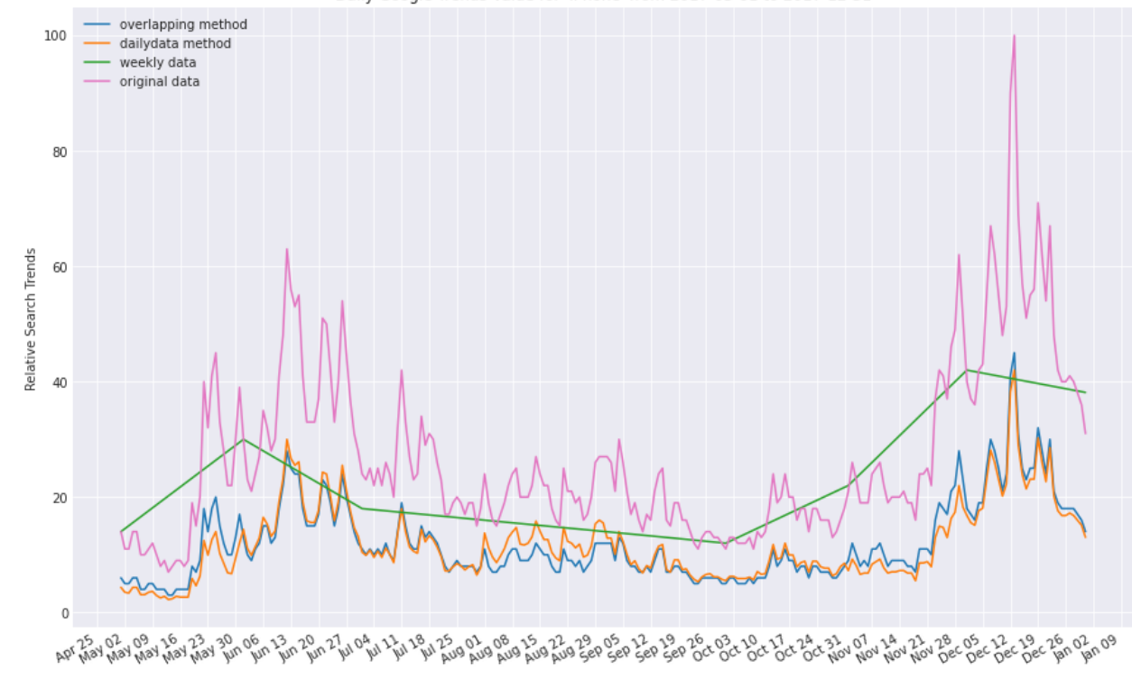
Data Collecting:
Different methods vs original data

Slide 13
Dataset Description:
The market dataset consists of 9 attributes and has 2922 data entries for Bitcoin, 2160 for Ethereum and 1374 for Cardano. The attributes are:
Attributes | Data Type | Example
Name | String (Object) | Bitcoin
Symbol | String (Object) | BTC
Date | DateTime (Object) | 4/29/2013 23:59
High | Float (Float64) | 147.488
Low | Float (Float64) | 134
Open | Float (Float64) | 134.444
Close | Float (Float64) | 144.54
Volume | Float (Float64) | 0
Marketcap | Float (Float64) | 1603768865
The Google trend datasets consist of the trends from web searches and News searches obtained from Google trends.
Attributes | Data Type | Example
date | DateTime (Object) | 5/1/2013
Trend | Integer (Int64) | 1
Data description of Google trends dataset
Data description of market price dataset

Slide 14
Data Preprocessing:
We checked for any null values in both the trends dataset and the Cryptocurrency dataset and found to have no null values.
We checked for outliers within the dataset and found that the data didn’t have any outliers.
The column ‘SNo’ is removed from the cryptocurrency dataset as it is just an identifier and does not have any meaningful insight.
The ‘Date’ column is transformed to Date-time field.
We obtained rolling window for 3 and 7 days for both price and trends while also generating the lag values up to 3 days.
We generated a categorical feature for the close value having 0 and 1 with 0 relating to negative returns and 1 relating to positive returns.
And we used MinMaxScaler which scales and translates each feature individually such that it is in the given range on the training set, e.g., between zero and one.

Slide 15
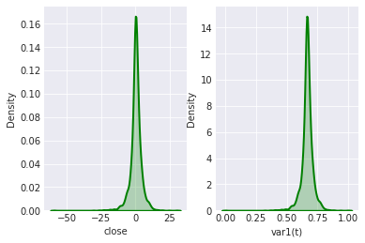
Data Preprocessing:
Normal Distribution of Close Price Before and after Pre-Processing for Bitcoin
Similar distribution to the figure above was found in Cardano and Ethereum.

Slide 16
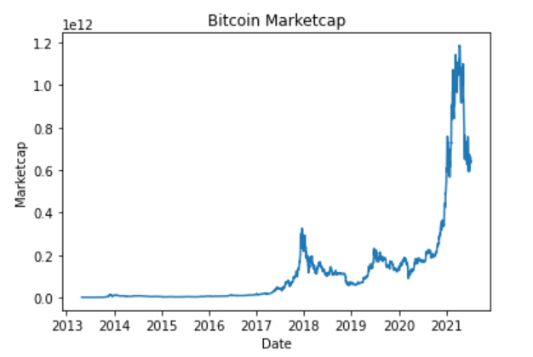
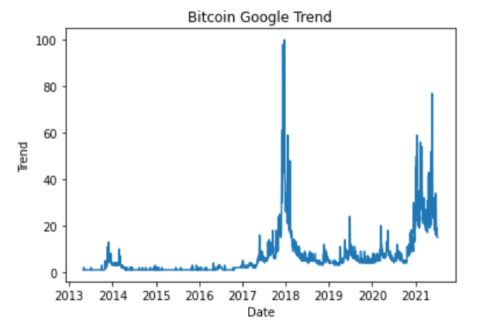
Data Exploration:
From the data exploration we were able to find that the trends had a relatively strong positive linear relationship with market cap of the cryptocurrency.
Bitcoin Market price
Bitcoin Google Trend
We also did the descriptive statistics of the dataset and were able to get a description of the data we were dealing with.

Slide 17
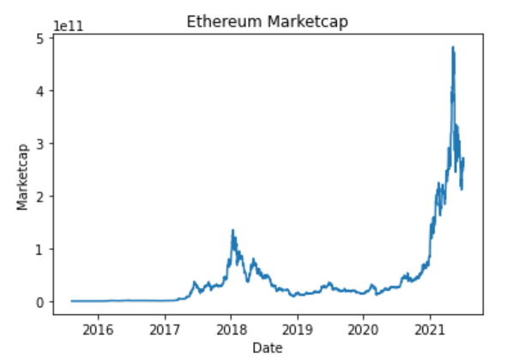
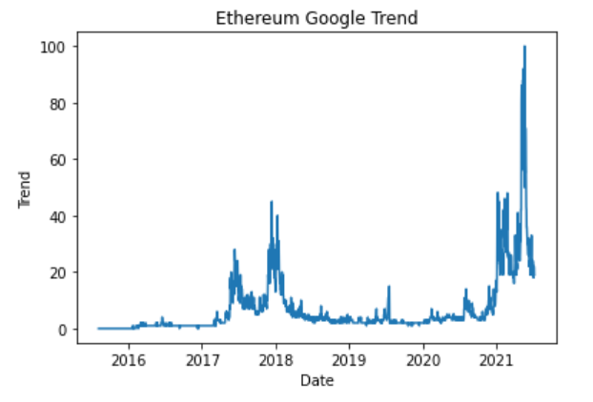
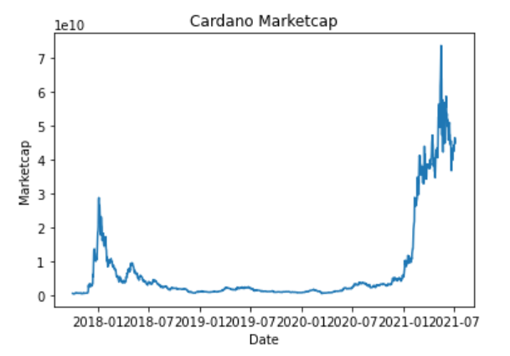
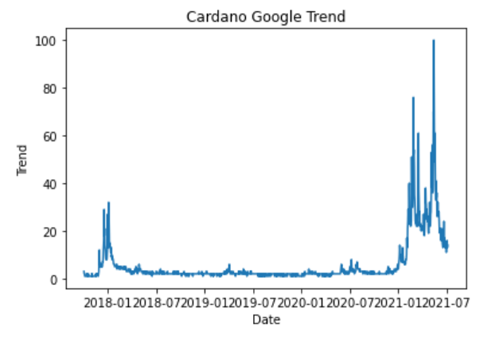
Data Exploration:
Ethereum Market price
Ethereum Google Trend
Cardano Market price
Cardano Google Trend

Slide 18
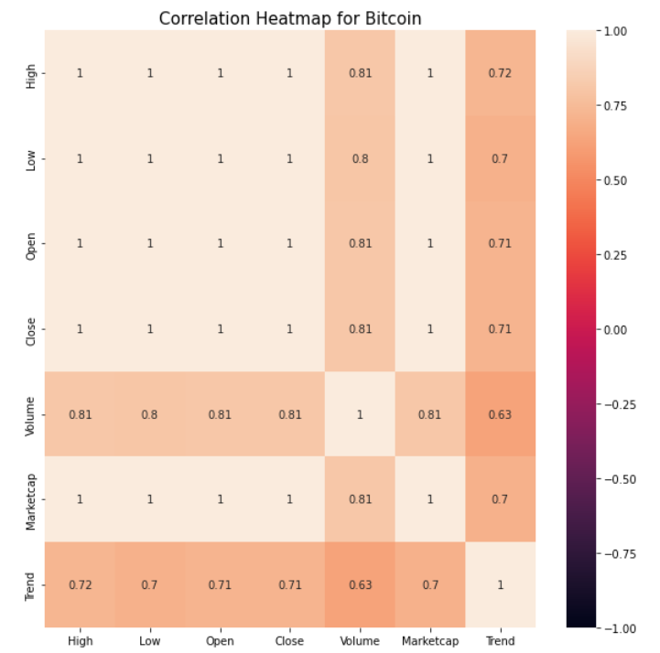
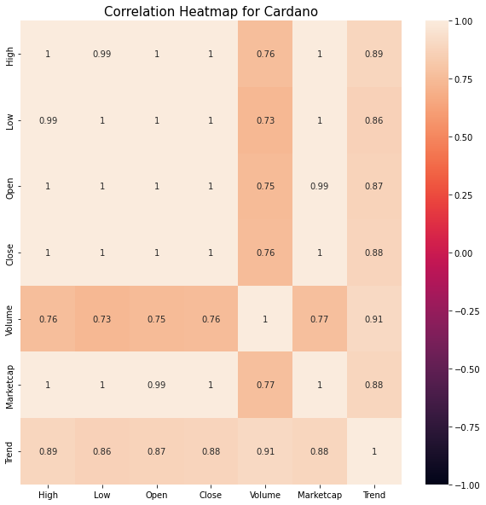
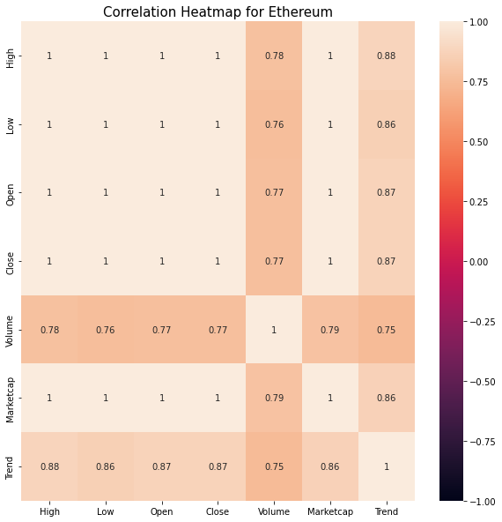
Data Exploration:
The data we are handling is a time series data. After plotting the correlation matrix, we were able to find that the correlation between the trends and close price was around 0.71, denoting it has a strong positive correlation.
Correlation Heatmap for Bitcoin
Correlation Heatmap for Cardano
Correlation Heatmap for Ethereum

Slide 19
Data Exploration:
The correlation of trends with other attributes seemed to be the same as with market cap, except for volume which reduced to 0.63.
This shows that there might be a causal relationship between trends and the price of the currency which has to be explored.

Slide 20
Methodology:
We first used Granger Causality Analysis to determine the causality effect on month level and day level data between Google trends and Cryptocurrency prices.
From this, we chose the best granularity level and checked their performances with three different models [ARIMA, XGBoost, LSTM].
Since it’s a time series dataset the random split was ignored, and 2021 data is taken as test set and the rest is used for training.
We propose two approaches, the first approach is to predict the daily price returns.
The second approach is to forecast long and short options based on increase and decrease in the returns respectively.

Slide 21
Model (Granger Causality Analysis & Arima):
Granger causality analysis was undertaken to find the causal link between Trend and the prices of the crypto currencies. F statistics is used for the analysis.
The Null hypothesis is that trend does not cause changes in prices (p > critical value) and the Alternative hypothesis is that trend does cause changes in prices (p < critical value).
We took the critical value as 0.05 and did the analysis with both monthly and daily trends.
We used auto_arima function to determine the best (p, d, q) values for the ARIMA model and we use it to predict the price returns of the cryptocurrency for the year 2021 and forecast long and short options based on increase and decrease in the returns respectively.

Slide 22
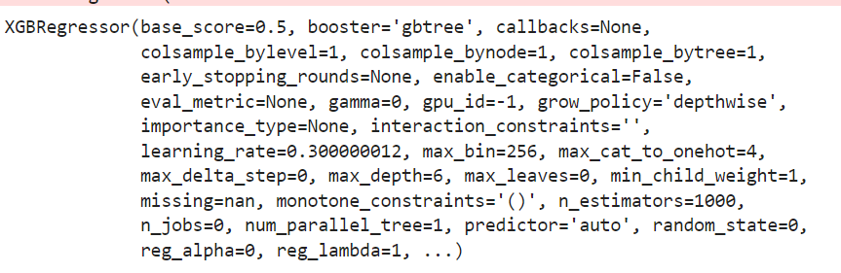
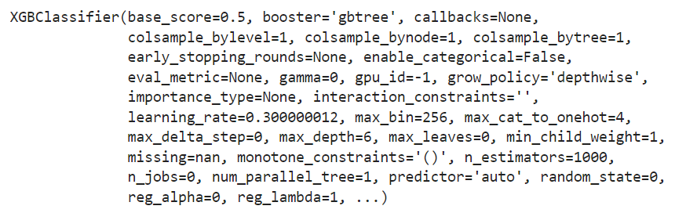
Model (XGBoost):
We used XGBoost Regressor which is a boosting model to predict the price returns of the cryptocurrency for the year 2021, and XGBoost Classifier to forecast long and short options based on the increase or decrease in the returns, respectively.
XGB Regressor
XGB Classifier

Slide 23
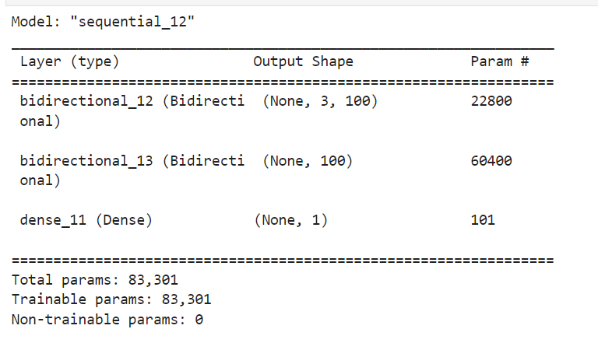
Model (LSTM):
We used Bidirectional LSTM, which uses neural network to understand the pattern within the data and remember the previous values during modelling, to forecast long and short options based on the increase or decrease in the returns, respectively. The activation function used was Relu and we used the Adam Optimizer.
LSTM Model

Slide 24
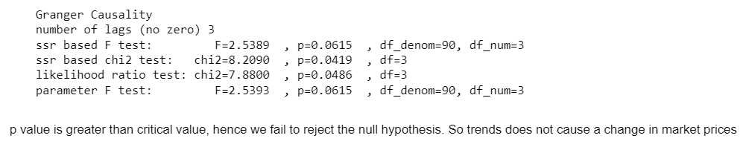
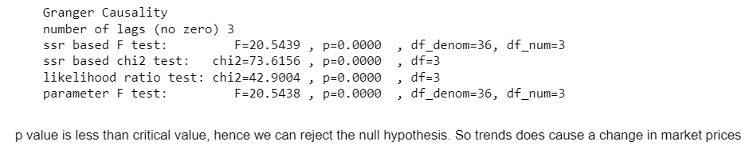
Model Outcomes(Granger Causality Analysis):
Monthly Trend:
Results of Causal Analysis of Bitcoin for monthly trends
Results of Causal Analysis of Cardano for monthly trends

Slide 25
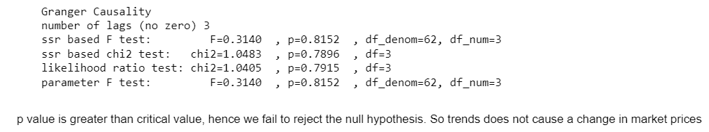
Model Outcomes (Granger Causality Analysis):
Results of Causal Analysis of Ethereum for monthly trends
Here, with the monthly data, we failed to reject the null hypothesis for Bitcoin and Ethereum, which tells us that there is no causal relationship.

Slide 26
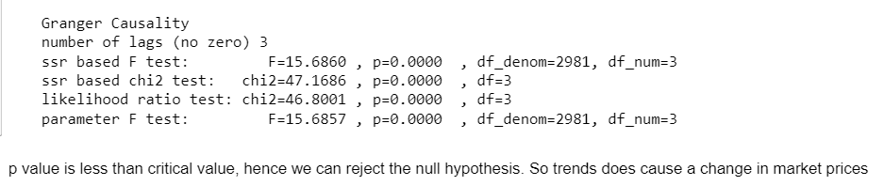
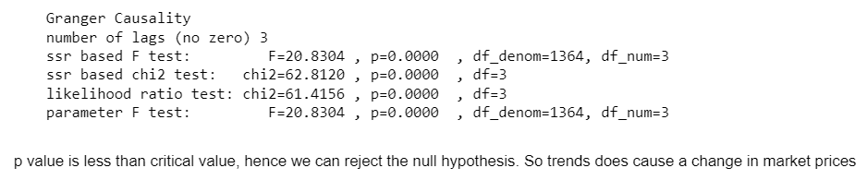
Model Outcomes (Granger Causality Analysis):
Daily Trend:
Results of Causal Analysis of Bitcoin for daily trends
Results of Causal Analysis of Cardano for daily trends

Slide 27
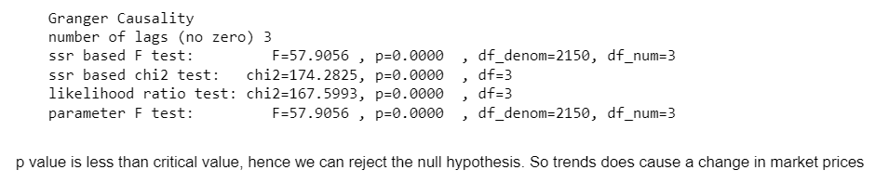
Model Outcomes (Granger Causality Analysis):
Results of Causal Analysis of Ethereum for daily trends
On the other hand, the analysis with daily trends, we rejected the null hypothesis in all three crypto currencies which tells us that there is causal relationship between Google trends and the prices.
With that we decided to proceed with the daily trends data for our modelling.

Slide 28
Model Outcomes (Arima):
We found the best (p,d,q) for close price prediction to be (0,0,0), (0,0,0) , (0,0,0) for Bitcoin, Cardano and Ethereum respectively and for long-short option forecasting (0,0,1), (5,1,0), (1,0,2), respectively.
The accuracy for long-short option forecasting was found to be 50.27% for Bitcoin, 53.53% for Cardano and 42.78% for Ethereum.
The RMSE and MAPE values are given in the below slides.

Slide 29
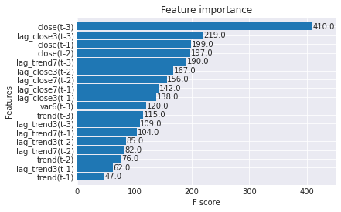
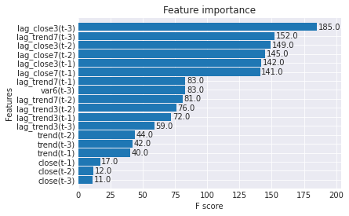
Model Outcomes (XGBoost):
Bitcoin :
Feature Importance for Close price prediction
Feature Importance for Long-Short Option Forecasting

Slide 30
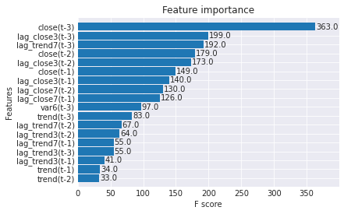
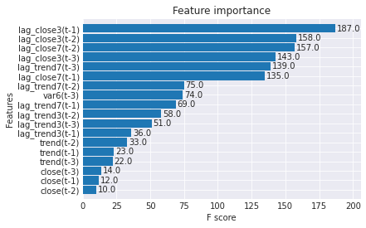
Model Outcomes (XGBoost):
Cardano :
Feature Importance for Close price prediction
Feature Importance for Long-Short Option Forecasting

Slide 31
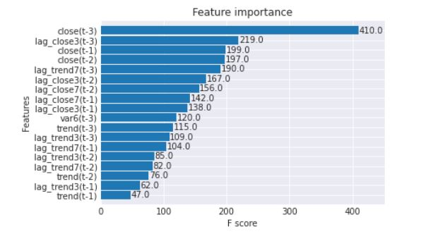
Model Outcomes (XGBoost):
Ethereum :
Feature Importance for Close price prediction
Feature Importance for Long-Short Option Forecasting
The accuracy for long-short option forecasting was found to be 48.13%, 48.83% and 47.06% percentage for Bitcoin, Cardano and Ethereum, respectively.

Slide 32
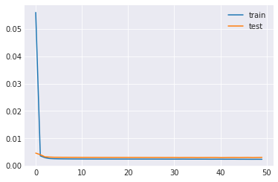
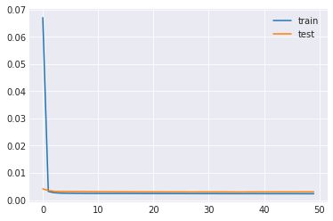
Model Outcomes (LSTM):
Bitcoin :
Loss and Validation Loss for train and test for Close price prediction
Loss and Validation Loss for train and test for Long-Short Option Forecasting

Slide 33
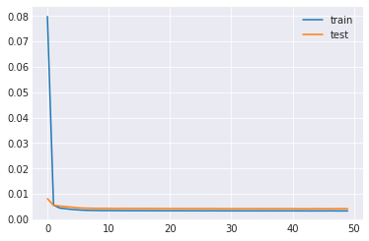
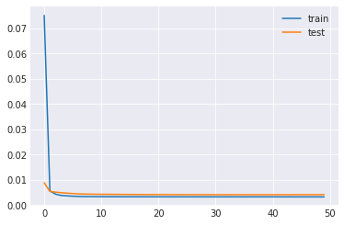
Model Outcomes (LSTM):
Cardano :
Loss and Validation Loss for train and test for Close price prediction
Loss and Validation Loss for train and test for Long-Short Option Forecasting

Slide 34
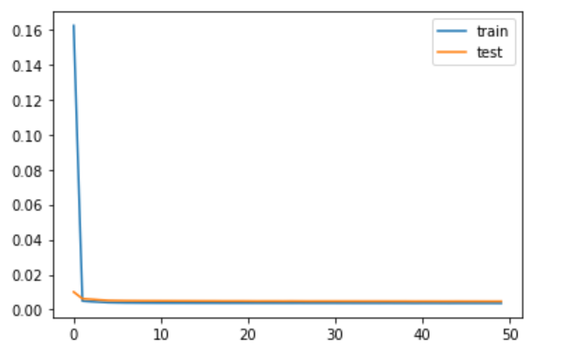
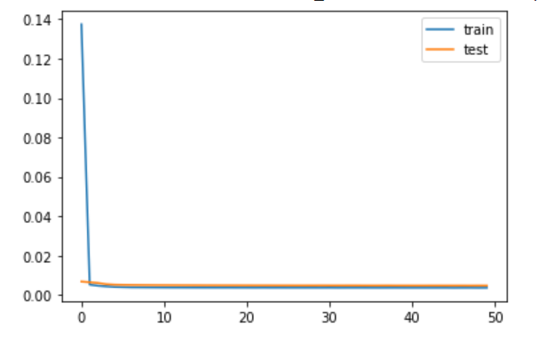
Model Outcomes (LSTM):
Ethereum :
Loss and Validation Loss for train and test for Close price prediction
Loss and Validation Loss for train and test for Long-Short Option Forecasting

Slide 35
Model Outcomes (LSTM):
The Loss and Val Loss for the model was (0.0023,0.0030), (0.0033,0.0041), (0.0036,0.0047) for Close price prediction for Bitcoin, Cardano and Ethereum, respectively.
The Loss and Val Loss for the model was (0.0023,0.0030), (0.0023,0.0030), (0.0036,0.0047) for Close price prediction for Bitcoin, Cardano and Ethereum respectively.
The accuracy for long-short option forecasting was found to be 48.13, 53.53 and 49.73 percentage for Bitcoin, Cardano and Ethereum respectively.

Slide 36

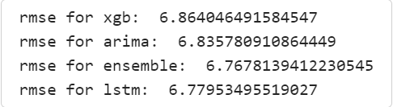

Evaluation – Performance (RMSE):
Bitcoin:
Ethereum:
Cardano:

Slide 37

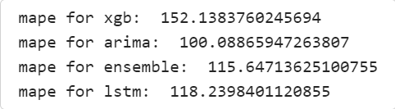

Evaluation – Performance (MAPE):
Bitcoin:
Ethereum:
Cardano:

Slide 38
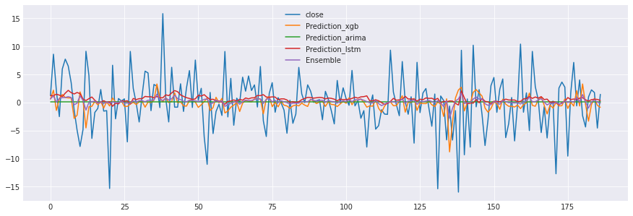
Evaluation – Performance:
Bitcoin:

Slide 39
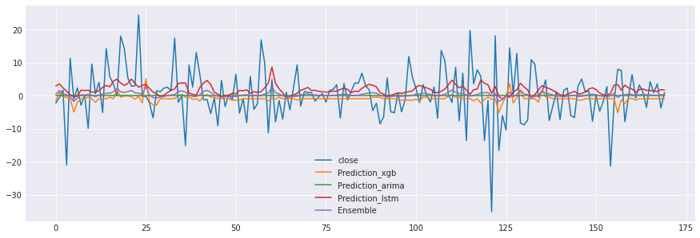
Evaluation – Performance:
Cardano:

Slide 40
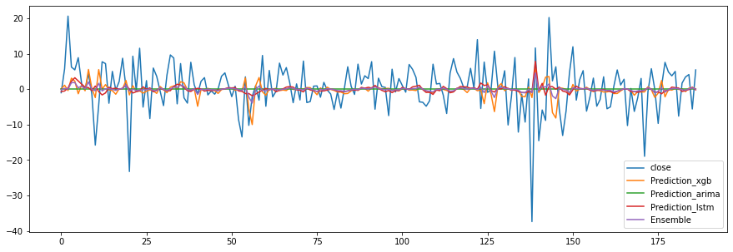
Evaluation – Performance:
Ethereum:

Slide 41
Evaluation – Performance (Long-Short):
ARIMA:
The accuracy for long-short option forecasting was found to be 50.27, 53.53 and 42.78 percentage for Bitcoin, Cardano and Ethereum respectively.
XGBoost:
The accuracy for long-short option forecasting was found to be 48.13, 48.83 and 47.06 percentage for Bitcoin, Cardano and Ethereum respectively.
LSTM:
The accuracy for long-short option forecasting was found to be 48.13, 53.53 and 49.73
percentage for Bitcoin, Cardano and Ethereum respectively.

Slide 42
Further Improvement/ Lessons Learned:
Though failing to predict the price returns with high accuracy, because of reasons like covid impact on the market (which made the stock market extremely volatile) and lacking in perfectly understanding the mood of the public, as all those who search about cryptocurrency on google don’t always buy a cryptocurrency.
The surge in usage of social media platforms recently has effect on our predictions too. But the approach of predicting the positive and negative returns and thus recommending long and short options is what makes our model stand out where the traders could earn money on the market going in both directions.
From the causality analysis, we can see that, the lower the granularity level, the higher is the cause effect.
Thus, moving forward, we plan to work on hour level granularity which will have a better impact in our prediction values.
Using data from Twitter and Reddit will also have a significant impact on our model as these
data will not only show the trends of the public but also the sentiment of those trends

Slide 43
Bibliographical References:
1. Forecasting cryptocurrency prices time series using machine learning approach | SHS Web of Conferences (shs-conferences.org)
2. [2006.16789] Causality Learning: A New Perspective for Interpretable Machine Learning (arxiv.org)
3. Challenges in Causality Volume 1 (mlr.press)
4. Mukherjee, Partha; Jansen, Bernard J. Conversing and searching: the causal relationship between social media and web search, Internet Research; Bradford Vol. 27, Issue. 5, (2017): 1209-1226. DOI:10.1108/IntR-07-2016-0228.
5. Yang, X., Yang, X., Pan, B., Evans, J.A., & Lv, B. (2015). Forecasting Chinese tourist volume with search engine data. Tourism Management, 46, 386-397.
6. Arratia, A., López-Barrantes, A.X. Do Google Trends forecast bitcoins? Stylized facts and statistical evidence. J BANK FINANC TECHNOL 5, 45–57 (2021).
7. Nasir, M.A., Huynh, T.L.D., Nguyen, S.P. et al. Forecasting cryptocurrency returns and volume using search engines. Financ Innov 5, 2 (2019).
8. Chaos 30, 063116 (2020).

