Slide 1
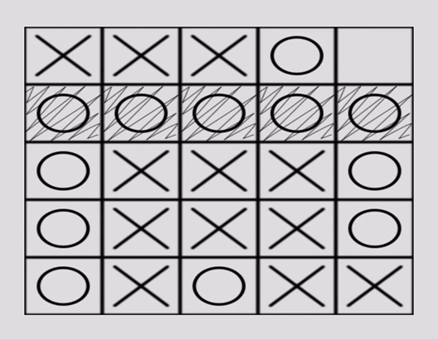
‘Tic Tac Toe’ Game
Abhay Chamu Haridas (ffa5177@psu.edu)
Basem Barbary (bpb5322@psu.edu)
Lakshmi Kausalya Kavuri (lkk5341@psu.edu)
Group 1
Foundations of AI (Spring, 2022)

Slide 2
Introduction
An artificial intelligence system that implements Epsilon-Greedy Algorithm and Role Based Learning System to develop a 5x5 Tic-Tac-Toe game with the objective to win.
To build a 5x5 Tic Tac Toe game using Python and its libraries at its disposal, such that, the game can be played against a self-learning Artificial Intelligence system.
Our project is mostly focused on the third type mentioned above, which is, the players will be given a 5 x 5 grid and they will have to place 5 X’s or 5 O’s in a row.

Slide 3
Considerations
At the beginning, we considered different algorithms to aim for the desired results, including the Wynn algorithm, the Block algorithm, the Block opponents Fork algorithm, the Fork algorithm and one of the most famous algorithms, the Minimax algorithm.
But in our project, we are using the Rule Based Learning System based on which, the AI will be taking rule-based actions.
So, we will be using the Epsilon Greedy Algorithm, which chooses between exploration and exploitation i.e. either of the answers by estimating the highest rewards.

Slide 4
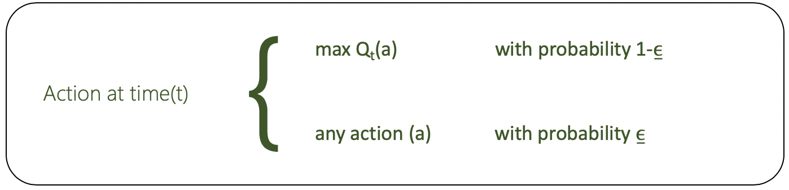
Epsilon Greedy Algorithm
In Epsilon Greedy Algorithm, we set a variable Epsilon, E, that represents the AI’s chance of taking a random action.
However, initially, the value of E = 1, implying that the AI agent takes random actions at first, in order to learn.
Then, we will be determining a random number, A, that lies between 0 and 1.
If the value of the random number taken, A < E, the epsilon value, a random state space is selected.
If A > E then, it implies that the move pertaining to the highest valued state space is then selected, which is, the AI does not make a random move, but an educated one.

Slide 5
Epsilon-Greedy Algorithm
Initial state: The initial position of the board is an empty 5x5 grid at position (0,0). Epsilon is set to 1 at the initial state and at the start position.
Player(s): The game can be played by two players. There are two options for them:
(a) Player 1- User starts the game with the first move in the state space
(b) Player 2- Computer starts the game with the first move in the state space.
Action space: The model will loop through every spot and, if it's empty, record the state that would come from the player moving in that spot. If the current players value for this state is higher than the top recorded value, set the top value to the value of this state and set action = the spot that will lead to this state. It is important to keep in mind that no user input is a possibility. Or, if the user does not pick an action, the algorithm will return a random action.
Result (s, a): The AI identifies the space as a result of the action a on state s, in the environment and continues to update results based on rules until the algorithm reaches the end state.
Reward/Payoff: A payoff function generates a numeric value for the outcome of the game for a player with the end state. For tic-tac-toe, the outcomes are a win, loss, or draw, the utility values are +1, -1, and 0 respectively.

Slide 6
Rule Based Learning System
The pseudocode for this implementation to assign rules for the AI is as follow:
Rule 1: Check whose turn it is.
Rule 2: Find all the next possible states that the player can be in.
Rule 3: Perform ε greedy to either take a random action or be greedy(take the best action).
Rule 4: If greedy, loop through the next possible states and find the state with the highest value.
Rule 5: Try to perform this action, but if the agent doesn’t have any of these states in its table then do a random action.

Slide 7
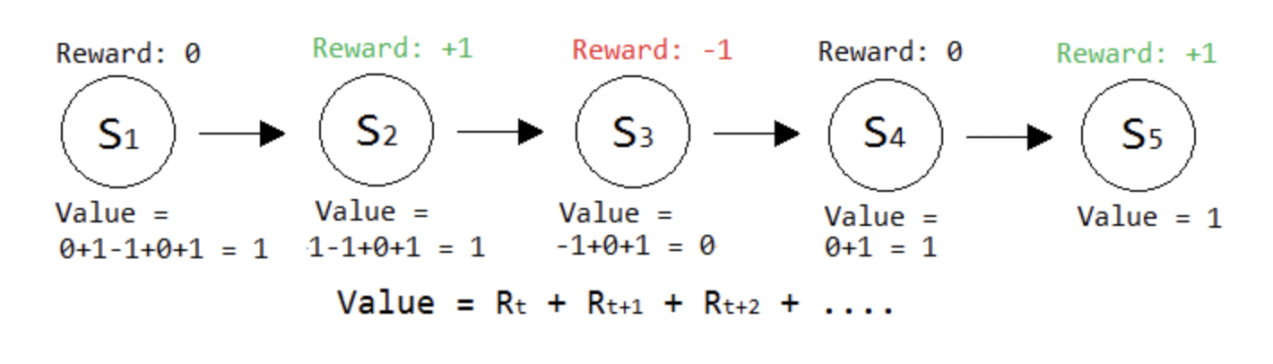

Discussion of Results
Number of state space runs - 59604644775390625
Reinforcement Learning –
Rewards are given to the agent after performing an action. They are just numbers, so if the agent does something bad, we may give it a punishment of -1. If it does something good, we would give it a reward of +1.

Slide 8
Experimental Discussion
Experiment: The game was run back-to-back for 20 times. The computer won 10/20 games. The more games the AI played, the more the AI learns and is able to have better chance at winning.
Runtime: The runtime of the 5x5 Tic-Tac-Toe algorithm developed is very long. Comparing the load time between 3x3, 4x4, and 5x5, 3x3 of course has the fastest runtime. With more added positions in the grid, the increase in runtime can be seen and can become quite an issue when dimensions are very high.
Limitations: The runtime of the 5x5 is disappointing and not desirable. The 3x3 runtime is very quick but with the added spots in the matrix, the system takes longer to be processed because of the increase in possible outcomes. Another limitation is the AI only playing offense and not playing defensively. When experimenting the AI’s oblivious to the users chance of winning in the next move and it is ignored by the AI’s next move. The AI should be able to see at the very least the chance of the user winning.

Slide 9
Conclusion
We are making an agent play the game of tic tac toe repeatedly while documenting every phase of the game
We give each state a value and use the value update function to update that value
The agent will always relocate to the state with the highest value when he is seeking to win.
We found that the epsilon value balances the exploration and exploitation of the game
An Epsilon value between 0.5 and 0.01 motivates the Computer to win 30% of the time

Slide 10
Final Thoughts
Overall, in our reflective opinion, building this AI system was very eye opening to the fact that it is very important to spend time choosing a model and considering runtime as an obstacle depending on the size of the system being built and its system demands.
It was indeed very educational and knowledgeable to learn and implement the algorithms and very interesting to analyze results and make key determinations from experimentations which.
Working on this project, we gained a lot of knowledge about how AI functions and about Deep Reinforcement Learning.

Slide 11
References
[1] How to play Tic Tac Toe https://www.youtube.com/watch?v=USEjXNCTvcc
[2] Sandlund, B., Staley & Butler, S. (2014). Numerical Tic-tac-toe on the 4×4 board. Lecture Notes in Computer Science, 537–546. https://doi.org/10.1007/978-3-319-08783-2_46
[3] 3.1 The Agent-Environment Interface, http://www.incompleteideas.net/book/ebook/node28.html.
[4] How to play 5 x 5 TTT
[5] AM Zain et al 2020 IOP Conf. Ser.: Mater. Sci. Eng. 864 012090
[6] BEN-EL-MECHAIEKH, H. I. C. H. E. M., & DIMAND, R. O. B. E. R. T. W. (2010). Von Neumann, Ville, and the minimax theorem. International Game Theory Review, 12(02), 115–137.
[7] Dalffa, Mohaned Abu, Bassem S. Abu-Nasser and Samy S. Abu-Naser. “Tic-Tac-Toe Learning Using Artificial Neural Networks.” (2019).
[8] Ferraco, Alex, Yuchen Wang and Christopher Todd. “5 x 5 x 5 Tic-Tac-Toe AI Implemented by Genetic Algorithm.” (2011).
[9] Garg, R. (2017). Game of tic-tac-toe: Simulation using Min-Max Algorithm. International Journal of Advanced Research in Computer Science, 8(7), 1074–1077.
[10] Paul, A. J. (2020). Randomized fast no‐loss expert system to play tic‐tac‐toe like a human. Cognitive Computation and Systems, 2(4), 231–241.
[11] Rajab, Abubakarsidiq Makame & Hassan, Nadhira & Rajab, Abdul-Rahimsidiq. (2020). Tic-Tac-Toe Learning Using Artificial Neural Networks. Vol. 3. : 1-6.
[12] Randomized fast no-loss expert system to play tic tac toe like a human by Aditya Jyoti Paul1,2

