Slide 1
Credit card deFault risk analysis
Developed By:
Tarun Kaushik
Swapnali Bhide
Umabala Kakani

Slide 2

Agenda
A Case Study of 3 Classification Algorithms
Introduction
Purpose of the Project
Points to Consider
Industries Affected
Approach
Data
Part1 Analysis
Variables
Part2 Predictive Modelling
Variables
Limitations and Future Work
Conclusions
ThankYou

Slide 3

Introduction
Credit risk has always remained by far the biggest risk taken by the banking and credit card industries, involving large sums of Capital. Time and again this has been provedby industry business reports and statistical data. For example, the 30-day delinquency rate (or the number of consumers who are currently at least 30 days late with their credit card payment) rose from 1.85% to 2.08% in the third quarter of 2022.“The Federal Reserve Bank of New York measures credit card delinquencies based on the percent of balances that are at least 90 days late. Therefore, assessing, detecting and managing default risk is the key factor in eliminating losses for the banking and credit card industry and increasing their bottom line. Despite machine learning models have been adopted by the banking industry, the current applications are mainly focused on credit score predicting. The disadvantage of heavily relying on credit score is banks would miss valuable customers who come from developing nationsthat are traditionally under banked with no credit history or immigrants who have repaying powerbut lack formal credit history. The purpose of this project is to conduct quantitative analysis on credit card default risk

Slide 4
Purpose of the Project: Conduct quantitative analysis on credit default risk by applying three interpretable machine learning models without utilizing credit score or credit history.
Points to Consider: ● ML applications focused on credit score predicting. ● Relying on credit scores and credit history. ● Miss valuable customers with no credit history. I.e. immigrants. ● Regulatory constraints on industry forbids some ML algorithms.

Slide 5

Who Should Care?
Credit Card Companies Commercial Banks
* Image source: Google image 3

Slide 6
Approach Overview
Data Cleaning
Data Exploration
Predictive Modeling
Understand and Clean
Find information on undocumented columns values
Clean data to get it ready for analysis
Graphical and Statistical
Exam data with visualization
Verify findings with statistical tests
Machine Learning
Logistic Regression
Random Forest
XGBoost
4

Slide 7
Data Acquisition
Source
Default Payments of Credit Card Clients in Taiwan from 2005
Source: Public dataset from Kaggle.
Original Source: UCI Machine Learning Repository*
Why This Dataset?
Real credit card data
Comprehensive and complete
30,000 customers
Usage of 6 months
Age from 20-79
Demographic factors
No credit score or credit history
*Lichman, M. (2013). UCI Machine Learning Repository [http://archive.ics.uci.edu/ml]. Irvine, CA: University of California, School of Information and Computer Science. 5

Slide 8
Part 1 | What demographic factors impact payment default risk?
Exploratory Data Analysis
 |  | 6

Slide 9
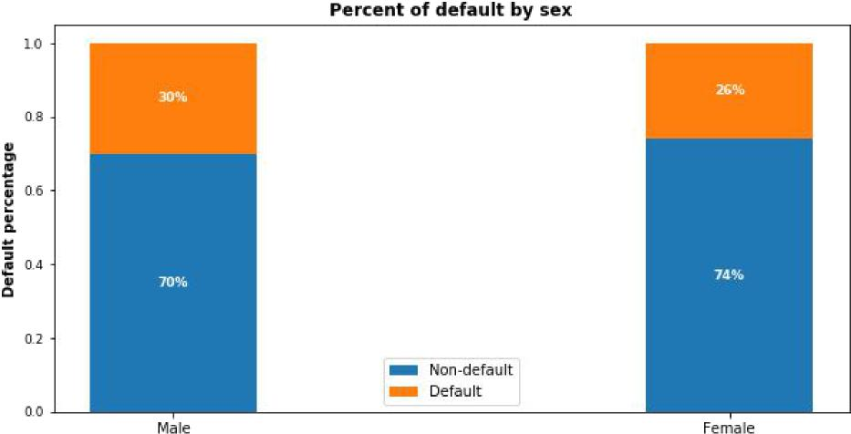
Gender Variable
 | 30% of males and 26% of females have payment default.
7

Slide 10
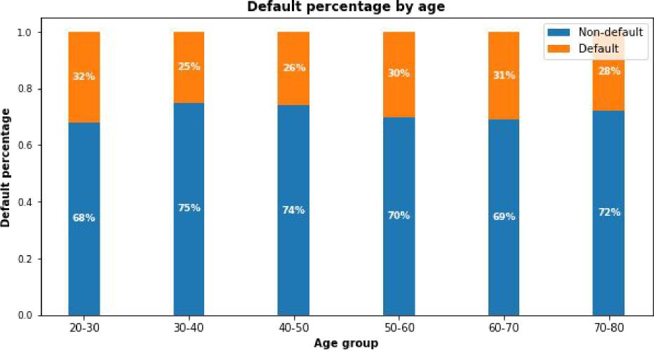
Age Variable
 | 30-50: Lowest risk < 30 or >50: Risk increases
9

Slide 11
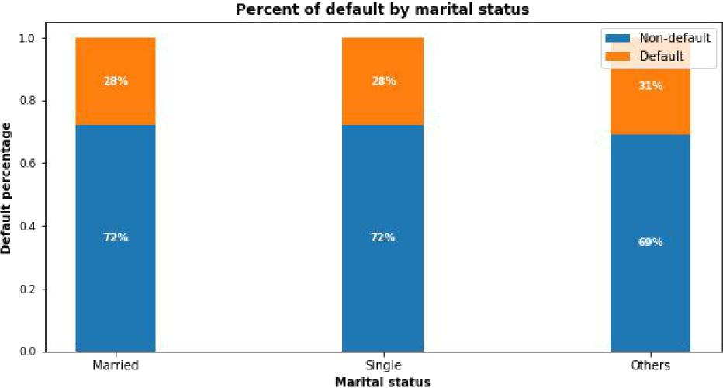
Marital Status Variable
 | No significant correlations of default risk and marital status
10

Slide 12
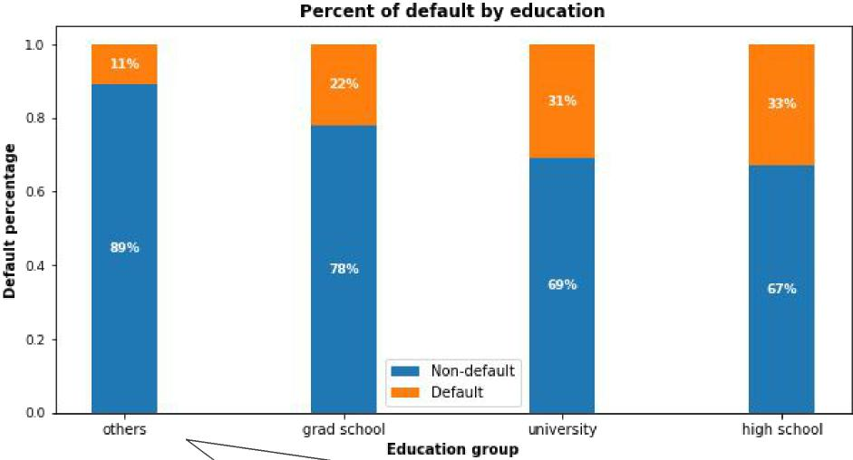
Education Variable
 | Higher education level, lower default risk.
“Others” only consists 1.56% of total customers even if they appear to have the least default. |  | 8

Slide 13
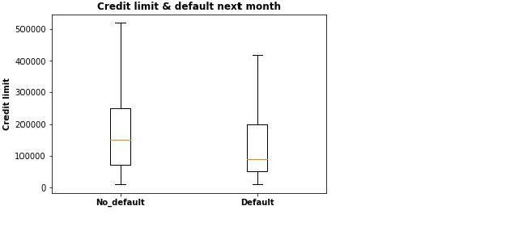
Credit Limit Variable
Higher credit limits, lower default risk.
11

Slide 14
Limitations & Future Work
Future Work
Limitations
● Best model Random Forest can only
detect 51% of default.
● Model can only be served as an aid in
decision making instead of replacing human decision.
● Used only 30,000 records and not
from US consumers.
● Models are not exhaustive. Other
models could perform better.
● Get more computational resources to
tune XGBoost parameters.
● Acquire US customer data and more
useful features.I.e.customer income.

Slide 15
Data Acquisition
Credit Card usage Data
Choice Of DataSet
Default Payments of Credit
Card Clients in Taiwan from
2005
Source: Public dataset from
Kaggle.
Original Source: UCI Machine
Learning Repository*
Real credit card data
Comprehensive and complete
30,000 customers
Usage of 6 months
Age from 20-79
Demographic factors
No credit score or credit history

Slide 16
Conclusions: ● Recent 2 payment status and credit limit are the strongest default predictors. ● Dormant customers can also have default risk. ● Random Forest has the best precision and recall balance. ● Higher recall can be achieved if low precision is acceptable. ● Model can be served as an aid to human decision. ● Suggest output probabilities rather than predictions. ● Model can be improved with more data and computational resources.
Credit Card Default Risk

Slide 17
Credit Limit Variable
Higher credit limits, lower default risk.
11

Slide 18
EDA Summary
Demographic factors that impact default risk are:
Education: Higher education is associated with lower default risk.
Age: Customers aged 30-50 have the lowest default risk.
Sex: Females have lower default risk than males in this dataset.
Credit limit: Higher credit limit is associated with lower default risk.
12

Slide 19
Part 2
Predictive Modeling
What precision and recall scores can the models achieve?
13

Slide 20


Modeling Overview
Supervised learning / binary classification 78% non-default vs. 22% default
Define Problem:
Imbalanced Classes:
Tools Used: | Scikit learn library and imblearn
Models Applied: | Logistic Regression / Random Forest / XGBoost
 |  | 14

Slide 21
Modeling Steps
Data Preprocessing
Fitting and Tuning
Model Evaluation
Feature selection
Feature engineering
Train-test data splitting (70%/30%)
Training data rescaling
SMOTE oversampling
Start with default model parameters
Hyperparameters tuning
Measure ROC_AUC on training data
Models testing
Precision_Recall score
Compare with sklearn dummy classifier
Compare within the 3 models
15

Slide 22
Correct Imbalanced Classes
Fit every model without and with SMOTE oversampling for comparison.
Training AUC scores improved significantly with SMOTE.
Models | AUC Without SMOTE | AUC With SMOTE
Logistic Regression | 0.726 | 0.797
Random Forest | 0.764 | 0.916
XGBoost | 0.762 | 0.899
16

Slide 23
Hyperparameters Tuning
K-Fold Cross Validation to get average performance on the folds.
Randomized Search on Logistic Regression since C has large search space.
Grid Search on Random Forest on limited parameters combinations.
Randomized Search on XGBoost because multiple hyperparameters to tune.
17

Slide 24
Model Comparisons
Compare the models to Scikit-learn’s dummy classifier.
All models performed better than dummy model.
Models | Precision | Recall | F1 Score | Conclusion
Dummy Model | 0.217 | 0.500 | 0.303 | Benchmark
Logistic Regression | 0.384 | 0.566 | 0.457 | Best recall
Random Forest | 0.513 | 0.514 | 0.514 | Best F1
XGBoost | 0.444 | 0.505 | 0.474
18

Slide 25
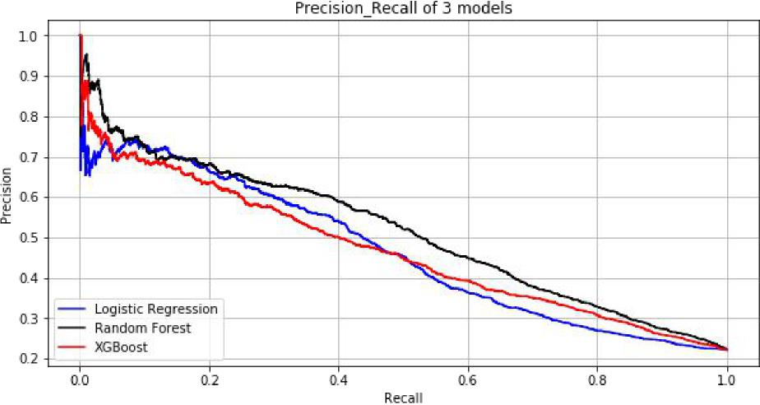
Model Comparisons
Compare within 3 models.
Random Forest (black line) has the best precision_recall score.
 | Terminology: * Recall: how many 1s are being identified? * Precision: Among all the 1s that are flagged, how many are truly 1s? * Precision and recall trade-off: high recall will cause low precision | 19

Slide 26
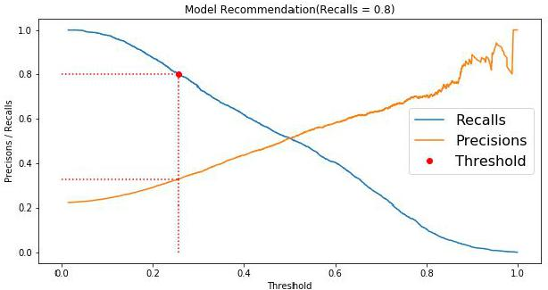
Model Usage - Recommendation
I.e. recall = 0.8. Threshold can be adjusted to reach higher recall.
 | 20

Slide 27
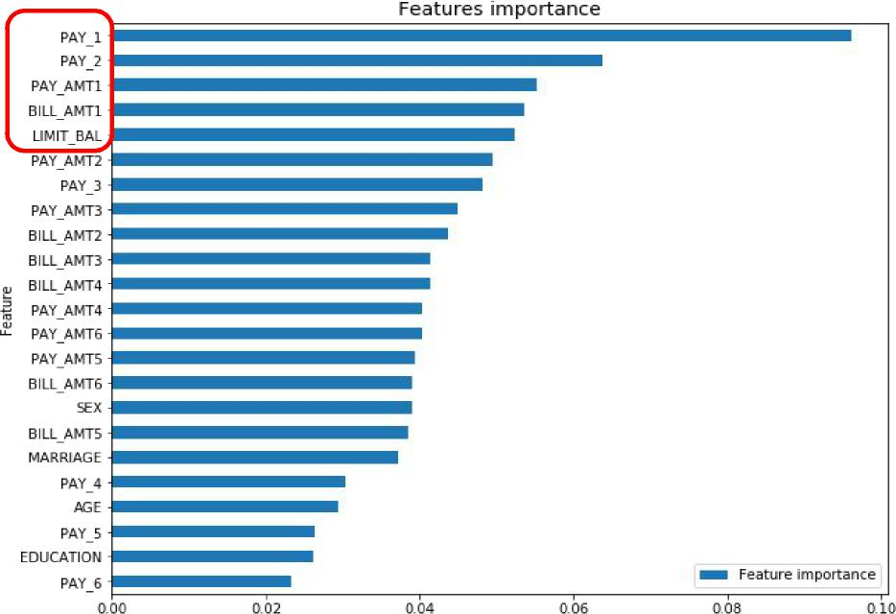
Feature Importances
 | Best model Random Forest feature importances plot. * PAY_1: most recent month’s payment status. * PAY_2: the month prior to current month’s payment status. * BILL_AMT1: most recent month’s bill amount. * LIMIT_BAL: credit limit | 21

Slide 28






Limitations & Future Work
Limitations
Future Work
Best model Random Forest can only detect 51% of default.
Model can only be served as an aid in
decision making instead of replacing
Models are not exhaustive. Other models could perform better.
Get more computational resources to tune XGBoost parameters.
Acquire US customer data and more useful features.I.e.customer income.
human decision.
Used only 30,000 records and not from US consumers.
22

Slide 29
Conclusions
Recent 2 payment status and credit limit are the strongest default predictors.
Dormant customers can also have default risk.
Random Forest has the best precision and recall balance.
Higher recall can be achieved if low precision is acceptable.
Model can be served as an aid to human decision.
Suggest output probabilities rather than predictions.
Model can be improved with more data and computational resources.
23

Slide 30




Thank you
Tarun Kaushik
Swapnali Bhide
Umabala Kakani

