Slide 1

Social Media Sentiment Analysis
Group - 12
Group Members: Guided By:
38 – Om Deokar Prof. S. A. Shivarkar Sir
47 – Tushar Gaikwad Prof. V. N. Nirgude Sir
50 - Kaushal Gawali Prof. Mujumdar Sir
51 – Piyush Ghanghav

Slide 2
Overview
Introduction to Social Media Sentiment Analysis
Understanding Sentiment Analysis
Data Collection and Preprocessing
Machine Learning Approaches
Methodology for Social Media Sentiment Analysis
Scope and Objectives
Requirements
Challenges in Sentiment Analysis
Applications of Sentiment Analysis
Conclusion and Future Trends

Slide 3
Introduction to Social Media Sentiment Analysis
Social media has become a powerful platform for individuals and businesses to share their thoughts, opinions, and experiences. Sentiment analysis leverages natural language processing to understand the emotional tone and sentiment expressed in this vast trove of online data.
The social media networks have evolved quickly and many people often use these services to communicate with others and categorize themselves by sharing their opinions, views and concepts. It is usually dispensed by winnowing the corresponding or interlinked events mentioned on social media websites like Twitter, Facebook, YouTube and Pinterest etc.
This paper centers on the pattern location and examine the feelings communicated in a particular sentence, passage or archive.

Slide 4
Understanding Sentiment Analysis
Concept
Importance
Sentiment analysis is the process of identifying and classifying the emotions and sentiments expressed in text, such as positive, negative, or neutral.
Sentiment analysis provides valuable insights into customer opinions, social trends, and brand reputation, enabling businesses to make data-driven decisions.
Techniques
Applications
Sentiment analysis can be performed using lexicon-based approaches, machine learning, or a combination of both to accurately classify the sentiment of text.
Sentiment analysis has a wide range of applications, including customer service, marketing, social media monitoring, and political analysis.

Slide 5
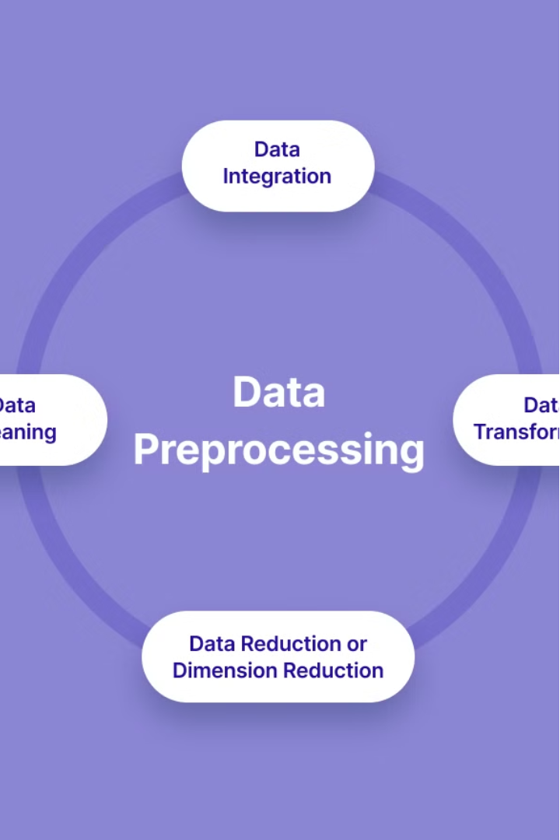
Data Collection and Preprocessing
Gather relevant data from social media platforms like Twitter, Facebook, and Instagramt using APIs or web scraping techniques.
Preprocess the raw data by cleaning, filtering, and formatting it to prepare for sentiment analysis. This may include removing noise, such as URL’s, special characters, emojis, and handling missing values.
Apply label encoding to convert categorical text attributes into numeric labels, enabling inclusion in quantitative analyses.

Slide 6
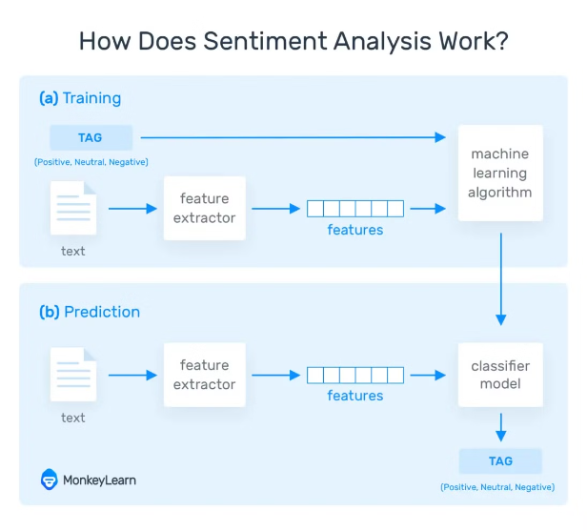
Machine Learning Approaches
Machine learning techniques have emerged as powerful tools for sentiment analysis. These algorithms can automatically learn patterns from large datasets, enabling more nuanced and accurate classification of sentiment.
Common machine learning models used include Support Vector Machines(SVM), Random Forest, Naive Bayes Classifier and Decision Tress. These models can capture complex linguistic features and context to predict sentiment with high accuracy.

Slide 7
Methodology for Social
Media Sentiment Analysis
Data Collection and Preprocessing:
Gather social media data containing textual attributes relevant to the sentiment analysis task.
Preprocess the data by removing noise, such as URLs, special characters, and emojis.
Apply label encoding to convert categorical text attributes into numeric labels, enabling inclusion in quantitative analyses.
Correlation Analysis and Heatmap Generation:
Conduct correlation analysis on the dataset to explore relationships between attributes.
Generate a heatmap visualizing the correlation matrix to identify significant correlations.
Analyze the heatmap to gain insights into the interplay between different attributes and their impact on sentiment.
Min-max Scaling:
Convert label-encoded values into continuous values within the range of 0 to +1 using min-max scaling.
Linearly scale the values while preserving their relative distances, facilitating quantitative analysis and comparison.
Decision Trees:
Utilize decision trees as a classification algorithm to predict sentiment labels based on input features.
Train decision tree models on the preprocessed dataset, recursively partitioning the feature space.
Interpret the resulting decision trees to understand the factors influencing sentiment predictions.

Slide 8
Naive Bayes Classifier:
Implement the Naive Bayes classifier for sentiment classification tasks.
Utilize Bayes' theorem to calculate the probability of sentiment labels given the input features.
Train the Naive Bayes model on the labeled dataset and evaluate its performance using appropriate metrics.
Random Forest:
Apply Random Forest as an ensemble learning technique for sentiment analysis.
Construct multiple decision trees during training and combine their predictions through voting.
Train the Random Forest model on the dataset and assess its accuracy and robustness through cross-validation.
.
Support Vector Machines (SVM):
Employ SVM as a powerful supervised learning model for sentiment classification.
Train the SVM model to find the optimal hyperplane separating data points of different sentiment classes.
Evaluate the SVM model's performance on the test dataset and compare it with other classifiers.
Evaluation and Interpretation:
Evaluate the performance of each sentiment analysis model using metrics such as accuracy, precision, recall, and F1-score.
Interpret the results of correlation analysis, heatmap visualization, and model predictions to gain insights into social media sentiment trends.
Identify key attributes and features influencing sentiment polarity and strength.

Slide 9
Scope & Objectives
Scope
Objectives
Data Collection
Data Acquisition
Text Preprocessing
Text Preprocessing
Feature Extraction
Feature Extraction
Sentiment Analysis
Model Development
Model Evaluation
Ethical Compliance
Data Visualization
Scalability and Efficiency

Slide 10
Requirements
Normal Requirements:
Data Collection: Define the social media platforms to be analyzed (e.g., Twitter, Facebook, Instagram).
Preprocessing: Text cleaning, Remove noise such as URLs, special characters, and emojis.
Sentiment Analysis Model: Select an appropriate sentiment analysis model (e.g., lexicon-based, machine learning, deep learning).
Evaluation: Split the dataset into training, validation, and test sets.
Interpretation: Analyze the sentiment distribution across different social media platforms.
Deployment: Develop user-friendly interfaces for accessing sentiment analysis results.
Maintenance and Updates: Monitor model performance over time and retrain as necessary. Incorporate user feedback to improve the accuracy and relevance of sentiment analysis results.

Slide 11
Expected Requirements:
Scalable Data Processing: Ability to handle large volumes of social media data efficiently.
Real-time Data Ingestion: Capability to ingest streaming data from social media platforms in real-time.
Interactive Visualization: Development of interactive dashboards or visualizations for exploring sentiment trends.
Contextual Understanding: Use of contextual embeddings or transformer models for capturing proper meanings.
Robustness and Reliability: Implementation of error handling mechanisms to ensure robustness against data inconsistencies or failures.
Compliance and Security: Adherence to data privacy regulations and best practices for handling sensitive user information.

Slide 12
Challenges in Sentiment Analysis
Data Quality: Social media data can be noisy, unstructured, and prone to spam, sarcasm, slang, and misspellings, making it challenging to extract accurate sentiment.
Data Privacy and Ethics: Ensuring compliance with data privacy regulations and ethical considerations, such as obtaining consent for data collection and protecting user anonymity.
Language and Context: Social media content often includes multiple languages, dialects, and cultural nuances, requiring robust language processing and context understanding for accurate sentiment analysis.
Scalability: Analyzing large volumes of social media data in real-time or near real-time requires scalable and efficient algorithms and infrastructure to handle the computational load.
Class Imbalance: Imbalanced datasets, where one sentiment class is more prevalent than others, can bias model training and evaluation, requiring techniques to address class imbalance.

Slide 13
Applications of Sentiment Analysis
Customer Experience
Social Media Monitoring
Financial Forecasting
Political Analysis
Understand public opinion on policies, candidates, and current events to guide political strategy.
Analyze customer feedback to improve products, services, and brand reputation.
Track brand sentiment, identify influencers, and respond to customer issues on social platforms.
Gauge investor sentiment to predict stock market trends and inform investment decisions.

Slide 14
Conclusion and Future Trends
Continued Growth
Sentiment analysis will become increasingly prevalent
Advancements in AI
Machine learning models will become more sophisticated
Ethical Considerations
Privacy and bias concerns will require ongoing attention
In conclusion, social media sentiment analysis has become a powerful tool for businesses, governments, and researchers to gain valuable insights into public opinion and behavior. As the field continues to evolve, we can expect to see continued growth, advancements in AI and machine learning, and an increased focus on addressing the ethical considerations surrounding this technology. The future of sentiment analysis holds great promise, but also requires vigilance to ensure it is used responsibly and for the betterment of society.

Slide 15
THANK YOU !!!

