Slide 1
MENTORNESS
National Rural Employment Guarantee Act (NREGA)

Slide 2
INDEX
Introduction
Data Preprocessing
Exploratory Data Analysis (EDA)
Regional Disparities Analysis
Correlation Analysis
Key Factors Analysis
Conclusion

Slide 3


Slide 4


Slide 5
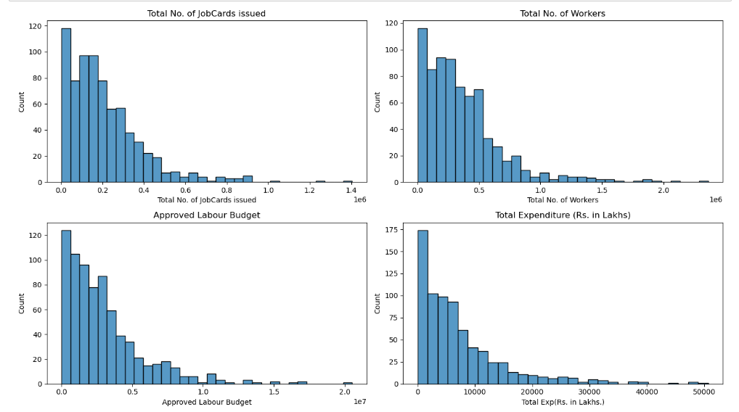

Slide 6
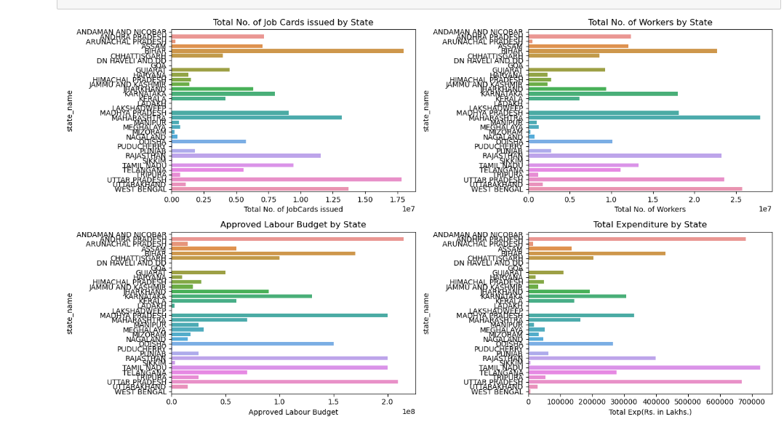

Slide 7
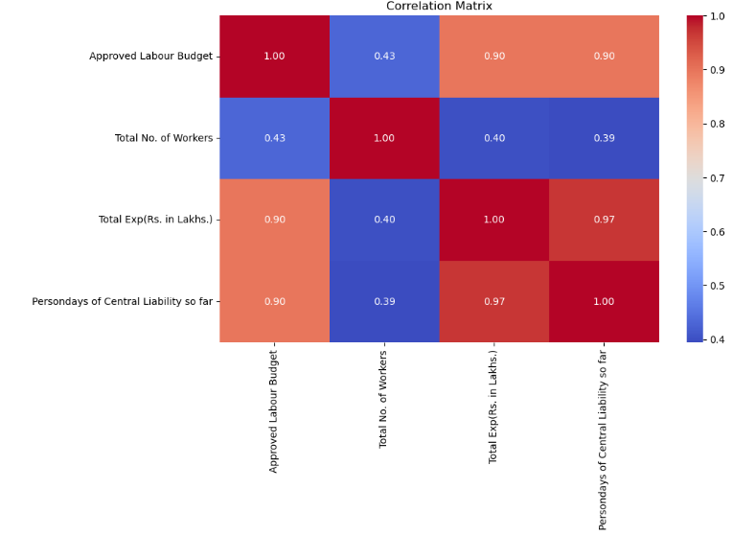

Slide 8
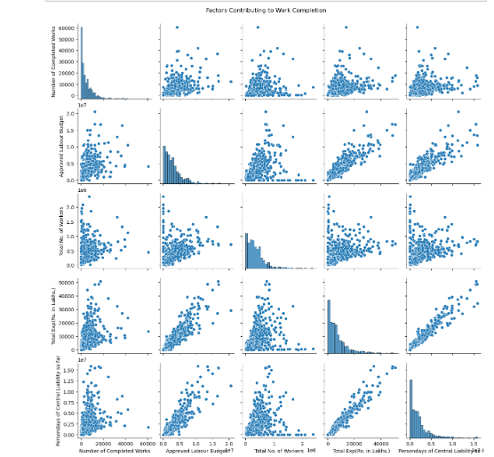

Slide 9


Slide 10


