Slide 1

Price Forecasting for Castor Crop
Submitted by:
Satyam Kumbhar
ID: 202319005
Mit Borda
ID: 202319008
Kaushal Kathiriya
ID: 202319013
Submitted To:
Dr. Prity Kumari
Assistant Professor & Head
Department of Basic Science
Anand Agricultural University, Anand
Gujarat - 388 110

Slide 2
Introduction
Castor thrives in tropical and subtropical climates, with moderate irrigation needs and well-drained soils for optimal growth.
Castor oil, derived from seeds, is widely used in cosmetics, pharmaceuticals, and industrial applications, while plant residues are utilized for biofuel and compost.
Its demand and price are highly influenced by seasonal factors, global trade, and market dynamics, leading to significant fluctuations.
Accurate price prediction is crucial for providing valuable insights to stakeholders, given its economic importance in agribusiness.
Predicting castor crop prices empowers farmers with better cultivation, storage, and selling decisions, ensures market stability for policymakers, helps businesses optimize procurement and supply chains, and enhances global competitiveness by anticipating price trends.
Reference https://www.researchgate.net/publication/375251286_Time_series_analysis_of_castor_crop_for_price_forecasting_in_Gujarat_A_comprehensive_study

Slide 3
Objective
Analyze time-series price data for castor crop.
Implement advanced statistical and machine learning models to predict prices.
Evaluate the accuracy of different models.

Slide 4
Dataset
 | MARKET: A | MARKET: B
Commodity | Castor | Castor
State | Gujarat | Gujarat
District | Patan | Patan
Market | Patan | Siddhpur
Time period | 1 Jan 2010 to 20 Nov 2024 | 1 Jan 2010 to 20 Nov 2024
Price/ Arrival | Both | Both
Data available | 3902 Rows | 3001 Rows
Minimum Price (Rs/Quintal) | 2450 | 2685
Maximum Price (Rs/Quintal) | 7615 | 7607

Slide 5
Statistics of Data
 | Price | Arrival
Mean | 4505.714 | 328.8302
Standard Error | 15.75651 | 4.026665
Median | 4150 | 240.2
Mode | 3450 | 1624.7
Standard Deviation | 1161.929 | 296.9375
Sample Variance | 1350079 | 88171.89
Kurtosis | -0.21306 | 5.284625
Skewness | 0.825757 | 2.043336
Range | 5165 | 2241.57
Minimum | 2450 | 0.23
Maximum | 7615 | 2241.8
Sum | 24502071 | 1788179
Count | 5438 | 5438
Largest(1) | 7615 | 2241.8
Smallest(1) | 2450 | 0.23
Confidence Level(95.0%) | 30.88906 | 7.893875

Slide 6
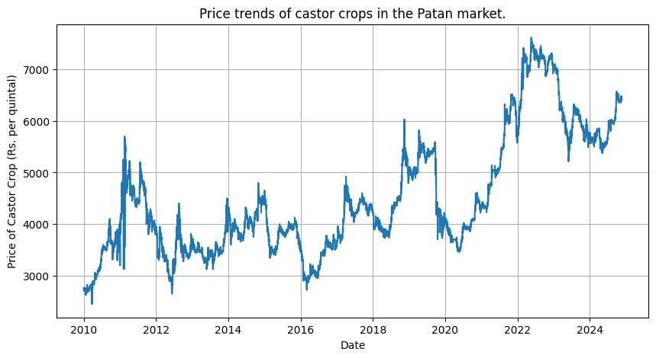
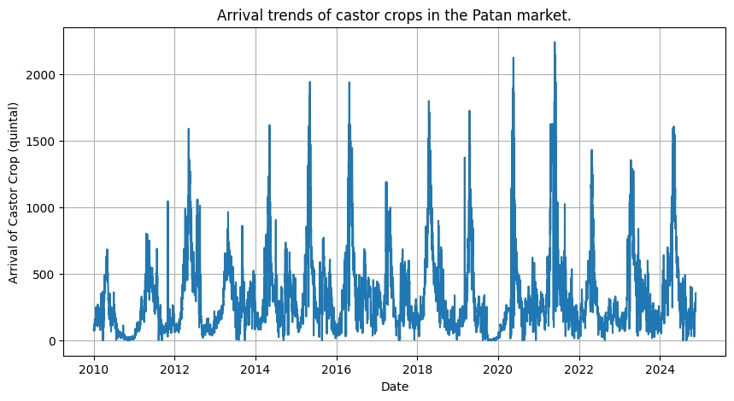
Data Source
Source - https://agmarknet.gov.in/
The dataset consists of:
Price and arrival data of castor crop of Patan and Siddhpur APMC.
It consists of around 15 years of data from 2010 to 2024.

Slide 7
Flow Chart
DATA SOURCE (AGMARKNET)
MARKET(A) - PATAN, GUJARAT
MARKET(B) - SIDDHPUR, GUJARAT
RANDOM FOREST
LSTM
ARIMA
ARIMAX
SARIMA
SARIMAX
ARCH
GARCH
VAR
VARMAX
DATA SOURCE (AGMARKNET)
DATA DOWNLOADING AND PREPROCESSING
COMPARING ALL MODELS BY RMSE, MSE, AIC, BIC SCORE
VISUALIZATION USING GRAPHS

Slide 8
ARIMA (Auto-Regressive Integrated Moving Average) :
It is time series model for forecasting future values based on historical data.
Components:
- Auto-Regression (AR): is the relationship between the current value and its previous values, denoted by "p" in ARIMA.
- Integrated (I): Differencing to make data stationary, denoted by “d" in ARIMA.
- Moving Average (MA): Models relationships with past errors, denoted by “q" in ARIMA.
Its is suitable for univariate time series without external factors.
ARIMAX (Auto-Regressive Integrated Moving Average with Exogenous Variables):
It extends ARIMA by including external factors (e.g., arrival, market demand).
Exogenous Variables (X): External factors that influence the target variable (Arrivals).
It helps to improve forecasting accuracy by accounting for the effect of these variables on the target series.

Slide 9
SARIMA (Seasonal Auto-Regressive Integrated Moving Average):
It extends ARIMA to handle seasonal patterns in time series data. It adds seasonal parameters (P, D, Q, m):
Components:
- Seasonal Autoregressive (P): Models seasonal dependencies.
- Seasonal Differencing (D): Removes seasonality via seasonal differencing.
- Seasonal moving average (Q): Accounts for seasonal error patterns.
- m: Specifies the length of the seasonal cycle.
It is suitable for data with strong seasonal fluctuations (e.g., annual crop cycles).
SARIMAX (SARIMA with Exogenous Variables):
SARIMAX extends ARIMAX by adding seasonality to forecast recurring patterns (e.g., crop price trends) and external factors like rainfall and exports for better accuracy.
It Combines non-seasonal (AR, I, MA) and seasonal (SAR, SI, SMA) elements with external variables (X) to model price influences.
m: Length of the seasonal cycle (e.g., 12 for monthly data with yearly seasonality).

Slide 10
ARCH (Autoregressive Conditional Heteroskedasticity):
It models a time-varying volatility (variance) in time series data.
It captures periods of high or low volatility, crucial for forecasting price fluctuations.
Conditional Variance: ARCH models assume that the variance of the error term at each time point is a function of past observations.
Heteroskedasticity: ARCH models address the issue of heteroskedasticity, which refers to the phenomenon where the variance of the errors in a time series is not constant over time.
GARCH (Generalized Autoregressive Conditional Heteroskedasticity):
GARCH extends ARCH by including lagged values of both past variances and errors.
It models volatility clustering, where large changes are followed by more large changes.
Provides greater flexibility and accuracy in predicting volatility than ARCH.
Suitable for modeling persistent volatility patterns over time.

Slide 11
VAR (Vector Autoregressive):
VAR is multivariate time series model capturing relationships between multiple variables over time.
It models an interdependencies (e.g., castor crop prices, rainfall, demand) without external predictors.
Each variable depends on its own and other variables on past values.
It is suitable for modeling on economic factors influencing crop prices
VARX (Vector Autoregressive with Exogenous Variables):
It extends VAR by including external factors (e.g., weather, policies) for improved accuracy.
It models an internal dynamics (crop prices) and external influences (global trends, input costs).
VAR (Vector Auto Regression) : It captures the relationships between multiple time series variables using their past values.
MA (Moving Average) : It models the influence of past forecast errors.
X (Exogenous Variables) : It includes external factors that may impact the dependent time series

Slide 12
LSTM (Long Short-Term Memory):
LSTM is an advanced RNN designed to handle sequential data and long-term dependencies, ideal for time series forecasting.
It utilizes memory cells and gates (input, forget, output) to store and regulate information over time.
- Forget Gate: It decides what information to discard.
- Input Gate: It determines what new information to store.
- Output Gate: It controls what information to output.
Captures complex patterns and trends in time series data, such as castor crop price movements.
It models long-term dependencies, incorporates past prices, market trends, and seasonality for accurate predictions.
Handles missing or noisy data, adapts to non-linear relationships, and integrates external factors (e.g., weather, global trends).

Slide 13
RANDOM FOREST :
Random Forest is a supervised machine learning algorithm used for classification and regression tasks. It builds multiple decision trees and combines their outputs for more accurate predictions.
Process:
- Each tree is trained on a random subset of data (bootstrap sampling) and features.
- Reduces over fitting by averaging multiple predictions.
For classification, predictions are based on the majority vote and for regression, predictions are based on the average of all tree outputs.
Effective at capturing non-linear relationships between input features and target variables.

Slide 14
RESULT

Slide 15
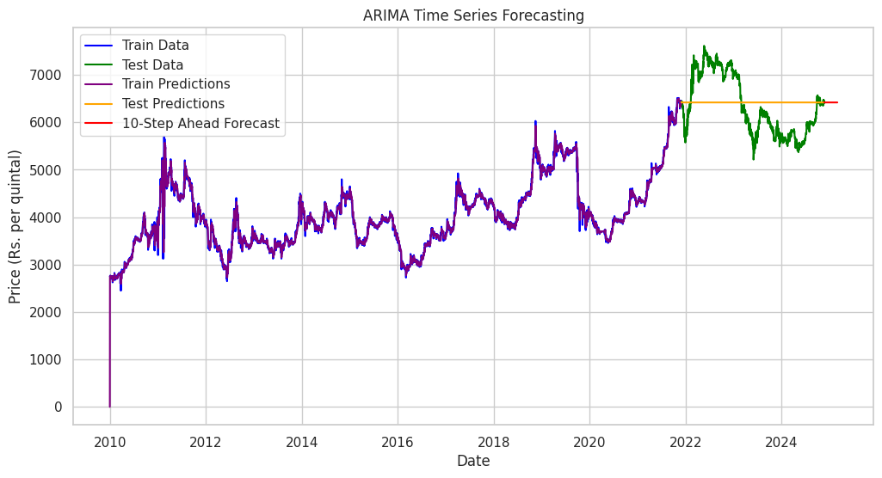
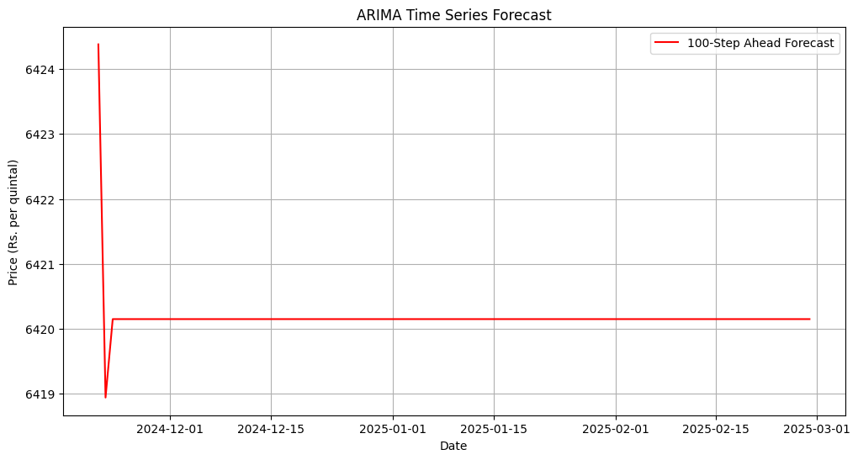
ARIMA
p = 0
d = 1
q = 3

Slide 16
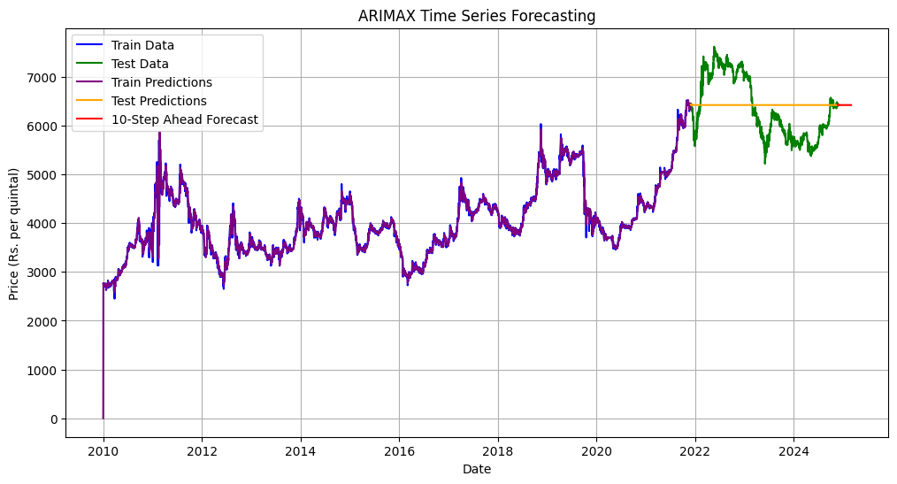
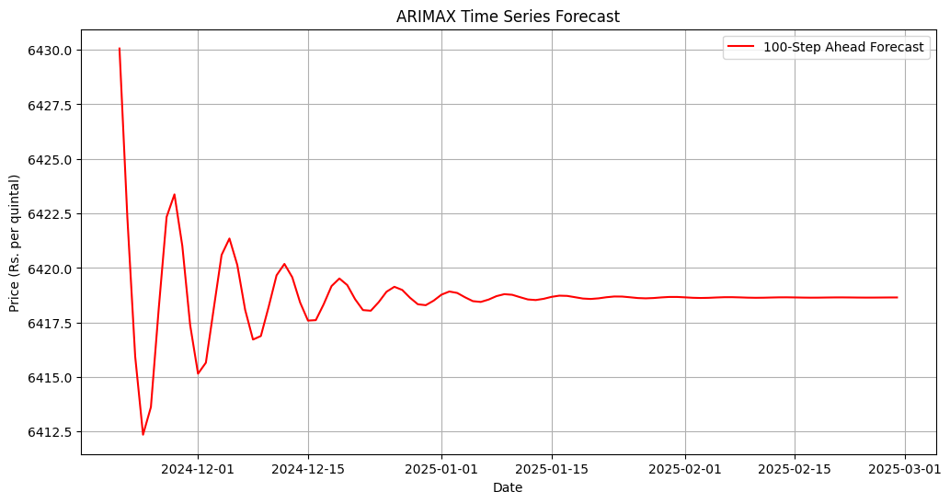
ARIMAX
p = 2
d = 1
q = 4

Slide 17
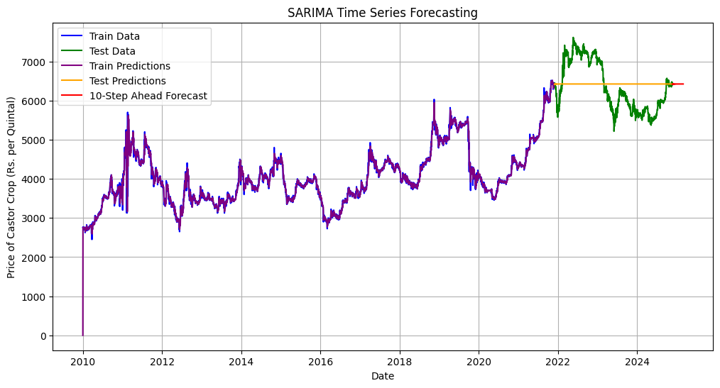
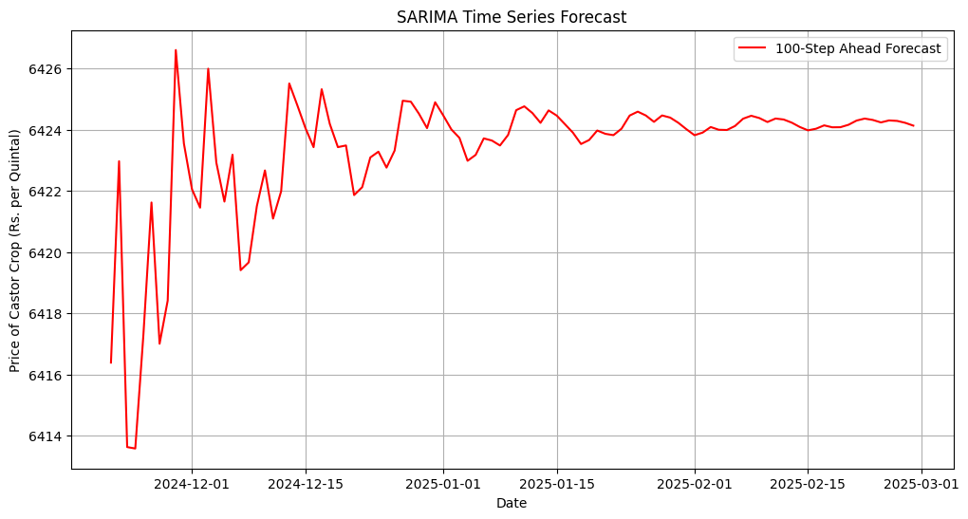
SARIMA
p = 1
d = 1
q = 2
P = 2
D = 0
Q = 2
m = 7

Slide 18
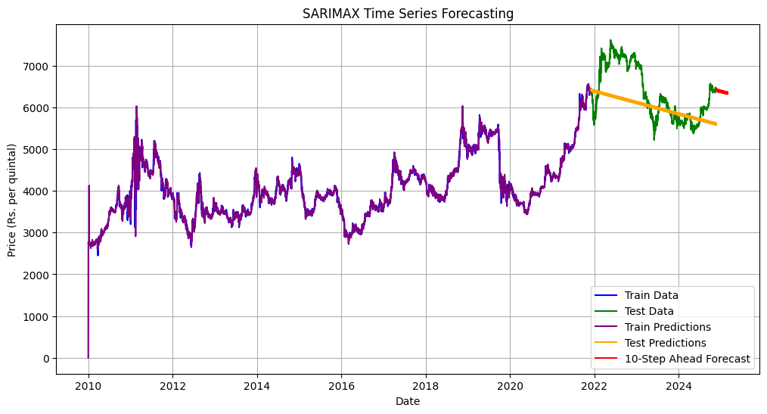
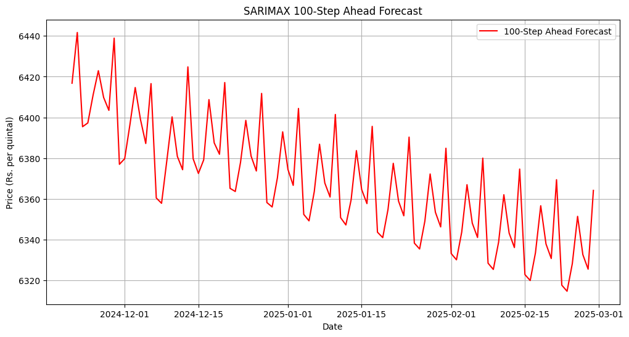
SARIMAX
p = 3
d = 1
q = 0
P = 3
D = 1
Q = 0
m = 7

Slide 19
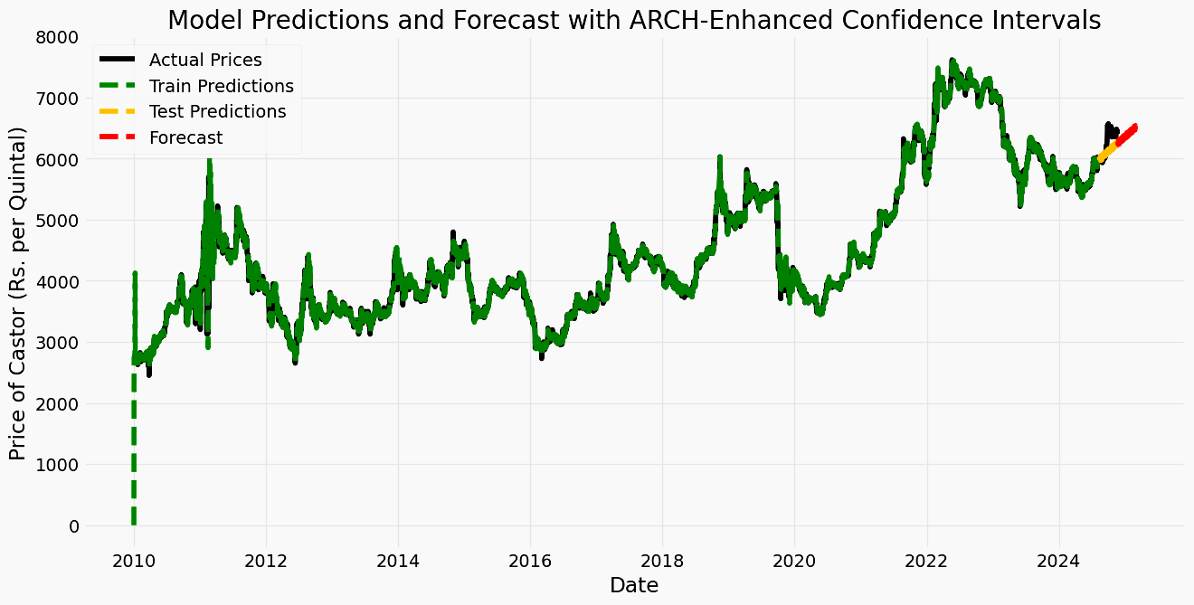
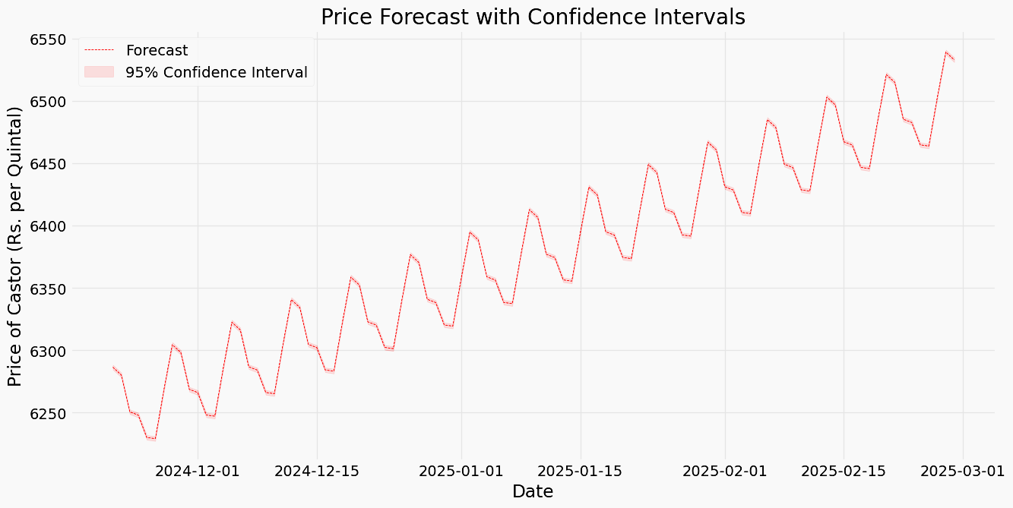
ARCH
p = 3
q = 0

Slide 20
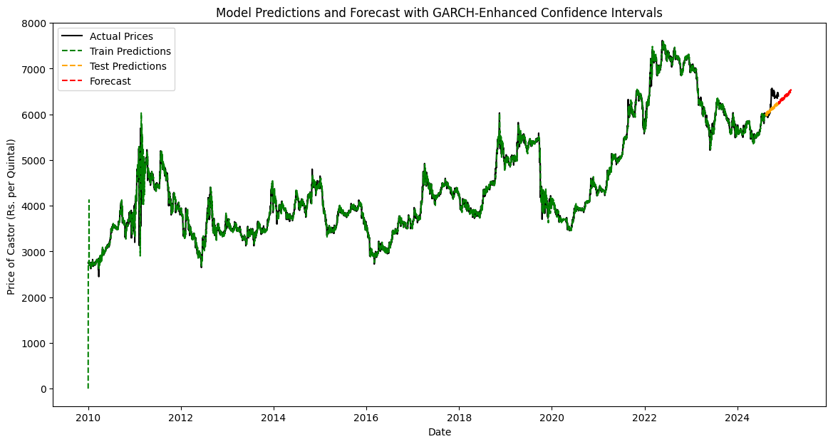
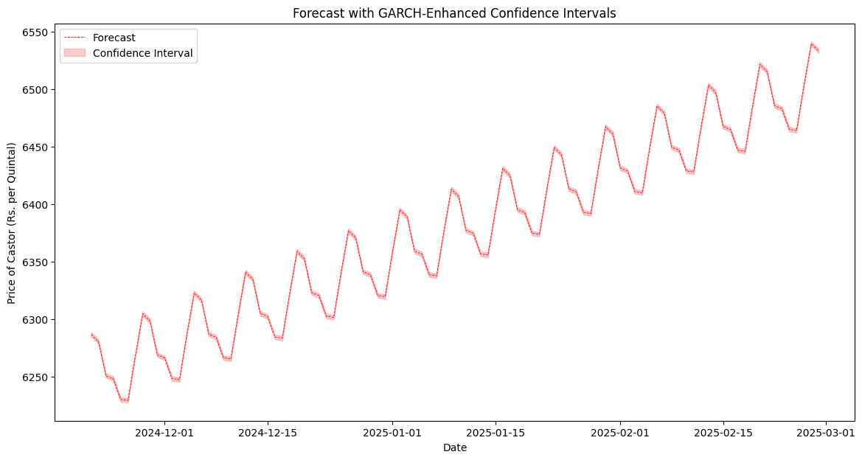
GARCH
p = 3
o = 1
q = 0

Slide 21
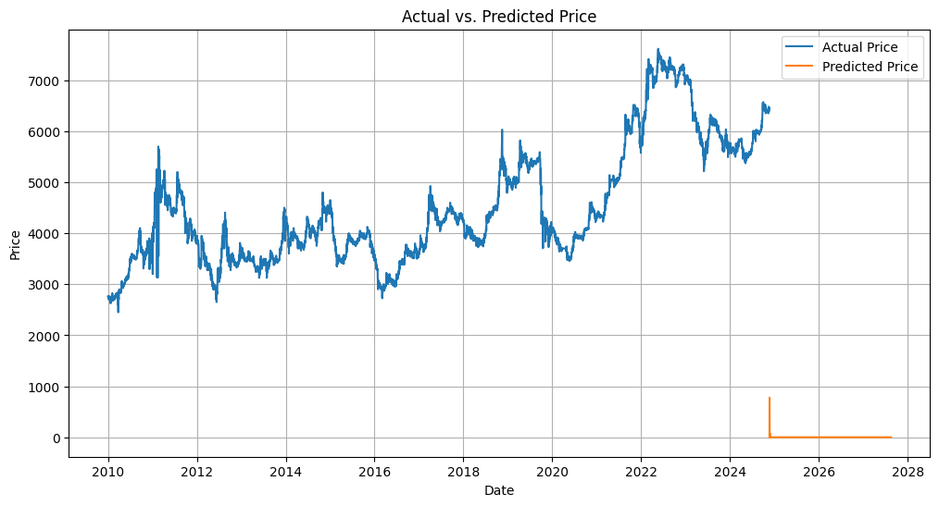
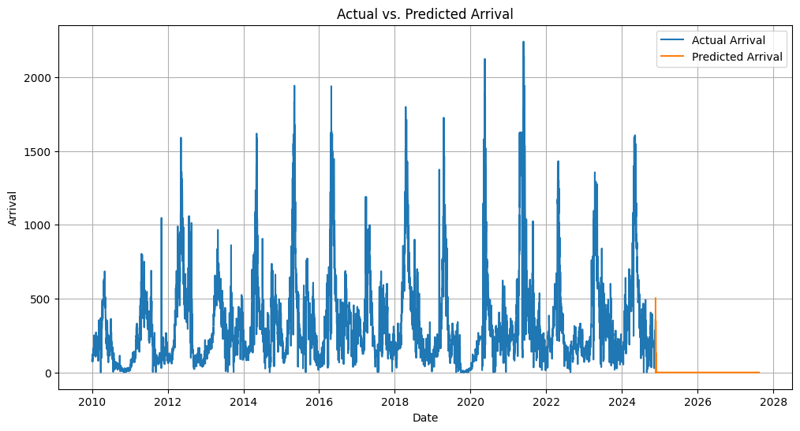
VAR
order = 13
ar_lag = 20
exogenous = Arrival
endogenous = Price

Slide 22
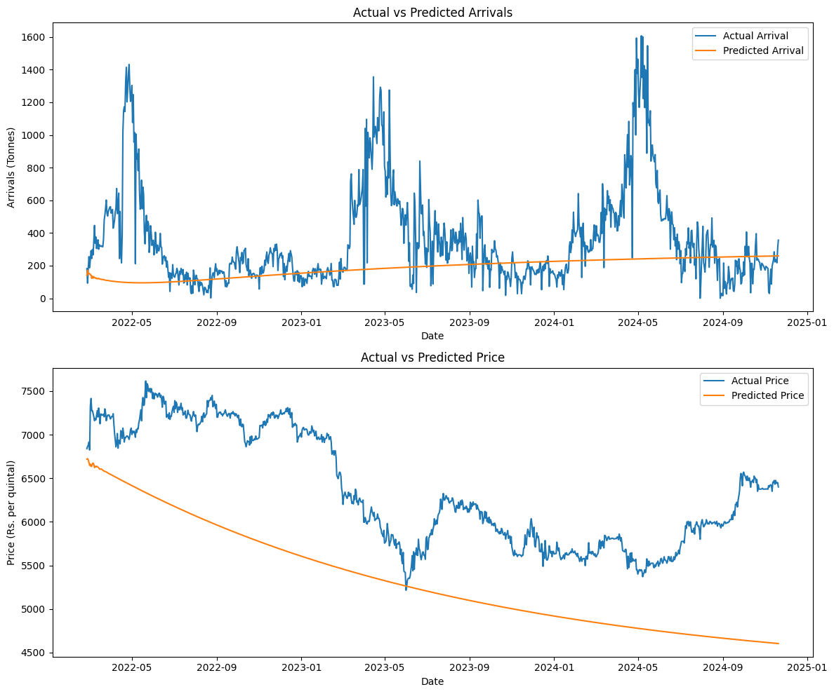
VARMAX
order = 13
ar_lag = 20
exogenous = Arrival
endogenous = Price

Slide 23
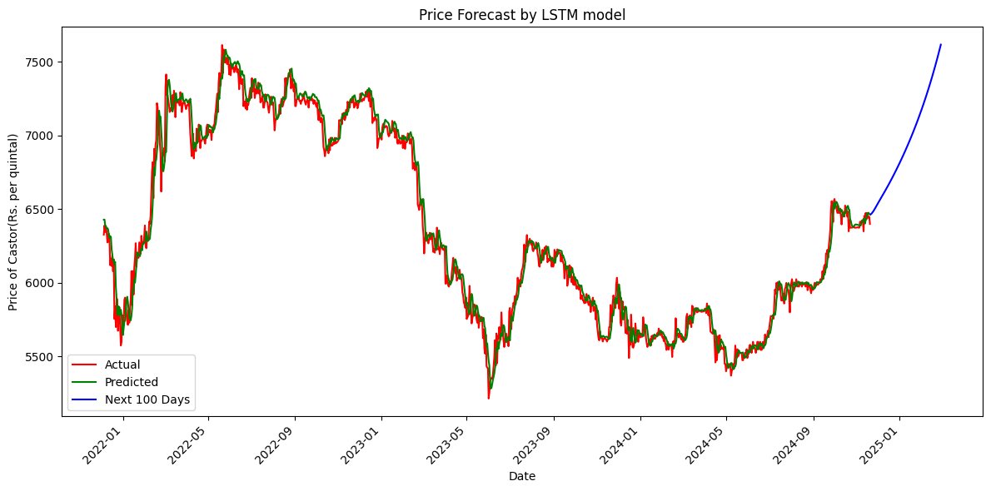
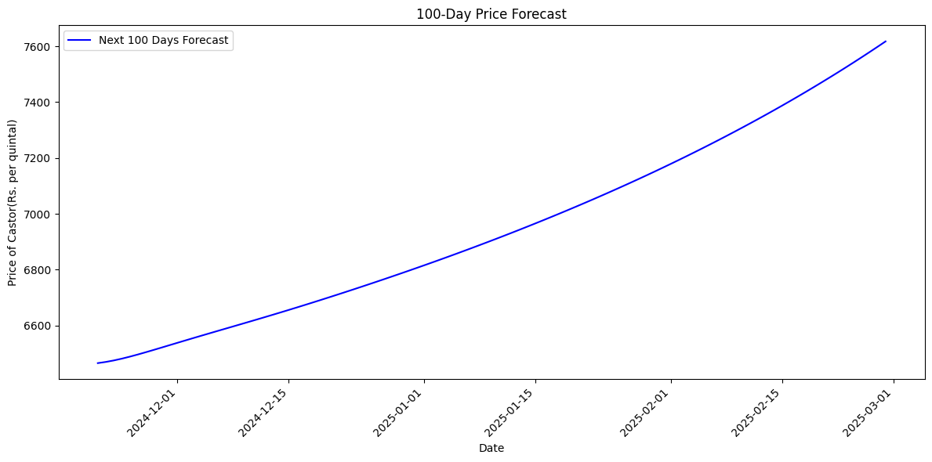
LSTM
optimizer = Adam
loss = ‘mean_squared_error’
epoch = 50
batch_size = 64
learning rate = 0.001
number of neurons = 50
number of layer = 1

Slide 24
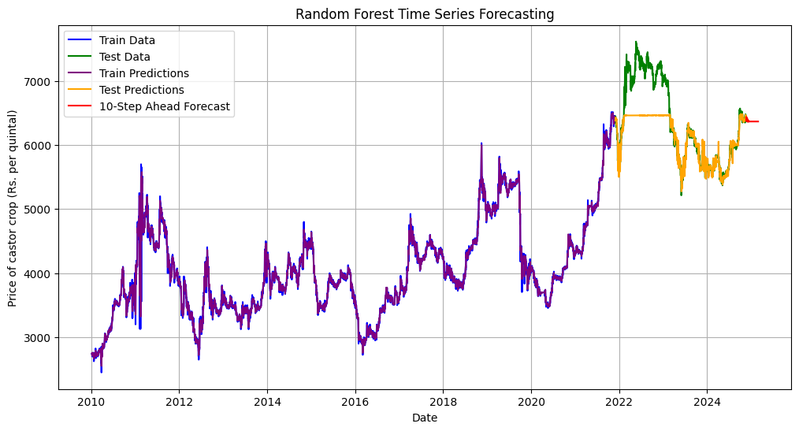
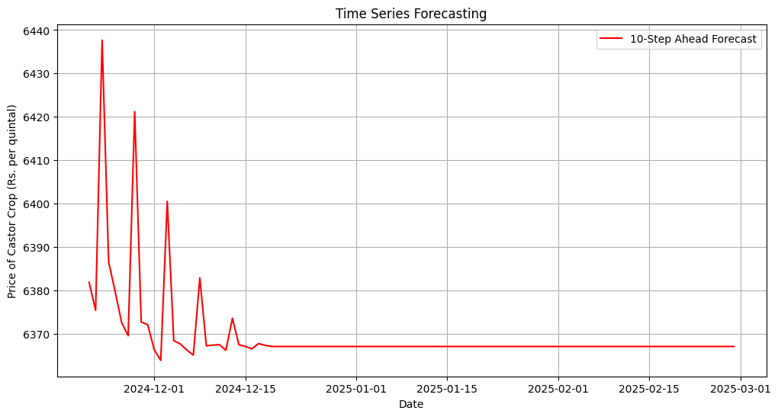
RANDOM FOREST
lag = 7
bootstrap = True
criterion = squared_error
max_features = 1
min_samples_leaf = 1
min_samples_split = 2
n_estimators = 100
oob_score = False
random_state = 42
verbose = 0
warm_start = False

Slide 25
COMPARISION OF MODELS :
Model | AIC | BIC | MSE | RMSE | NRMSE %
ARIMA | 51473.523 | 51499.034 | 420216.06 | 648.24 | 27.01
ARIMAX | 51327.428 | 51372.071 | 419990.44 | 648.07 | 27.00
SARIMA | 51456.233 | 51494.500 | 420826.47 | 648.71 | 27.03
SARIMAX | 52162.208 | 52206.841 | 394303.05 | 627.94 | 26.16
ARCH | 63599.795 | 63645.862 | 47898.47 | 218.86 | 34.20
GARCH | 12352.4 | 12365.5 | 47898.47 | 218.86 | 34.20
VAR (Price) | 19.0181 | 19.0268 | 40778463.08 | 6385.80 | 100.51
VAR (Arrival) |  |  | 214078.969 | 462.686 | 129.98
VARMAX (Price) | 108777.141 | 109141.824 | 6353.292 | 1080.926 | 17.01
 |  |  | 355.97 | 342.449 | 96.20
VARMAX (Arrival)
LSTM | - | - | 13025.904 | 114.13 | 1.80
RANDOM FOREST | - | - | 178919.97 | 422.99 | 17.62

Slide 26
Conclusion
ARIMA, ARIMAX, SARIMA, and SARIMAX:
- These models have relatively high AIC and BIC values, indicating lower performance compared to others.
- SARIMAX has the lowest RMSE (627.94) among them, making it slightly better.
ARCH and GARCH:
- Both have the same RMSE (218.86) and NRMSE (34.20%), but GARCH has a significantly lower AIC and BIC, making it more efficient.
VAR and VARMAX:
- VAR (Price) has very high RMSE and NRMSE values (6385.80 and 100.51%, respectively), shows poor performance.
- VARMAX (Price) has low RMSE (1080.926) and NRMSE (17.01%), showing better predictive performance.
- VARMAX (Arrival) outperforms other VAR/VARMAX models in RMSE (342.449) but has higher NRMSE (96.20%).
LSTM and Random Forest:
- LSTM shows the best performance overall with the lowest RMSE (114.13) and NRMSE (1.80%), indicating strong predictive capabilities.
- Random Forest also performs well with an RMSE of 422.99 and NRMSE of 17.62%, making it a good alternative.

Slide 27
Conclusion (cont..)
LSTM is the best-performing model for price prediction based on the lowest RMSE and NRMSE.
- Reason: It excels in capturing temporal dependencies and patterns in time-series data, making it particularly effective for complex, nonlinear trends.
GARCH is the most efficient among traditional models, while VARMAX (Price) performs well for multivariate predictions.
- Reason: It is designed to model time-series data with volatility clustering, making it suitable for financial or price prediction.
Models like VAR (Price) are less reliable due to high RMSE and NRMSE values.
- Reason: It is effective in handling multivariate time-series data, making it ideal when multiple variables (e.g., price and arrival) influence the target variable.

Slide 28
THANK YOU

