Slide 1
Machine Learning
Mid Semester Project Presentation
Kaushal Patil AU1841040
Arpitsinh Vaghela AU1841034
Prachee Javiya AU1841032
Vrunda Gadesha AU2049007

Slide 2
INTRODUCTION
Predicting the stock price trend by interpreting the seemly
chaotic market data has always been an attractive topic to
both investors and researchers. Among those popular methods
that have been employed, Machine Learning techniques are
very popular due to the capacity of identifying stock trend
from massive amounts of data that capture the underlying
stock price dynamics. In this project, we have applied nu-
merous machine learning techniques to build a model for
stock classification - BUY, SELL or HOLD

Slide 3
Problem Statement
Predicting stock performance for the next quarter based on quarterly fundamental financials.

Slide 4
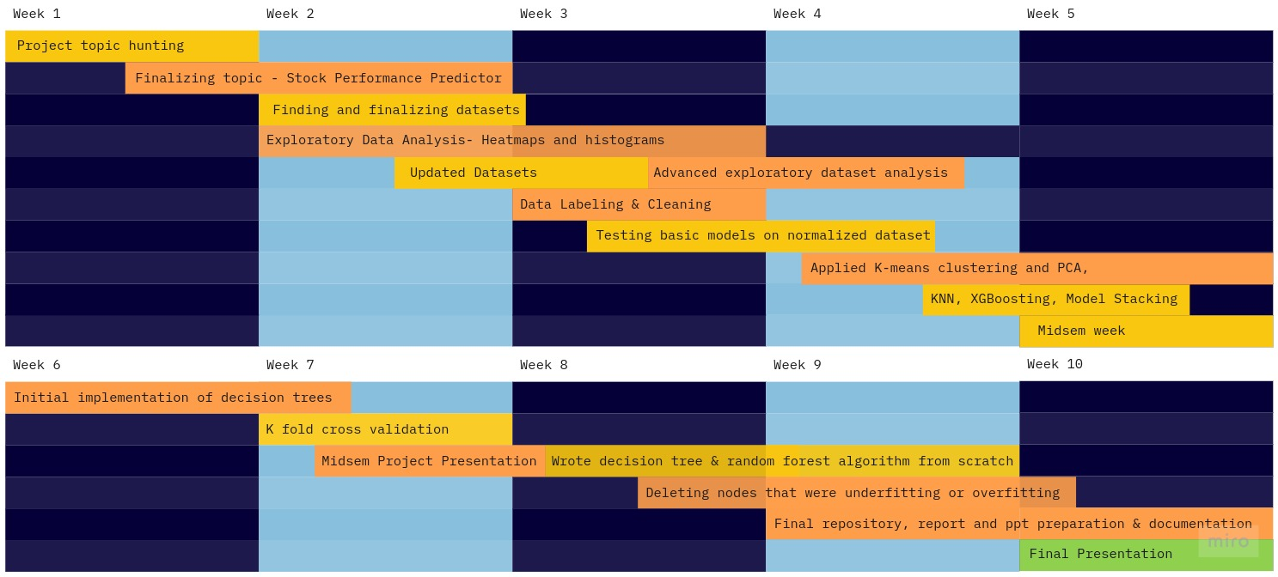
Gantt Chart - Project Progress

Slide 5

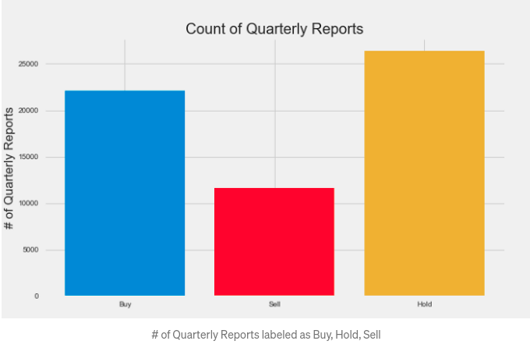
Existing work
The Decision (deciding if Buy, Hold, Sell) on the Present quarterly report (QR) takes in information using both the Past and Future quarters
Classification of training data (Data labelling) based on their dataset.
Top features (feature engineering) - P/B ratio, Assets, Shares splits, P/E ratio, Asset turnover, liabilities, current assets, cash at the end of period, revenue
Models used - AdaBoost, Decision Tree, Dummy (Baseline model), Gradient Boost, K Nearest Neighbors (KNN), Logistic Regression, Naive Bayes, Random Forest, Support Vector Machine (SVM), Extreme Gradient Boosting (XGBoost)

Slide 6
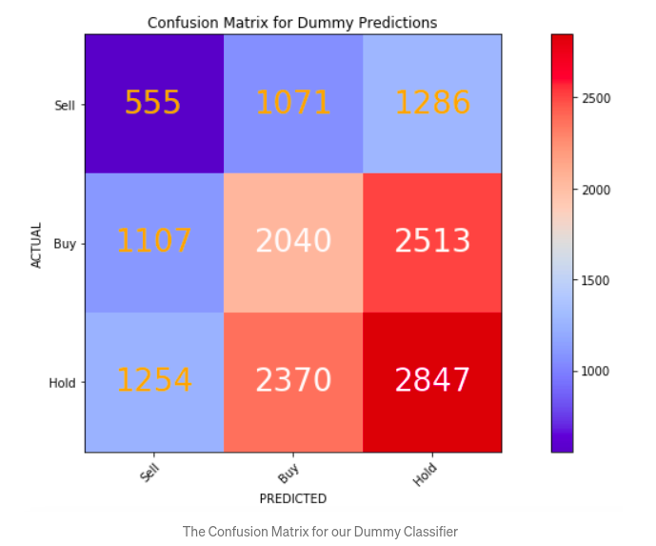
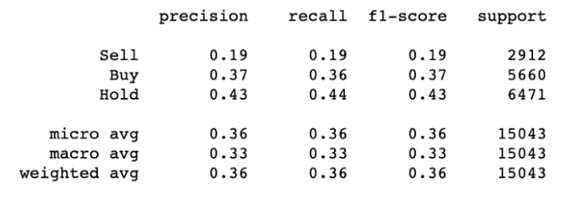
Existing work
Creating dummy classification model
This is their baseline model (dummy classifier) in order to set the standard to beat
Create the Dummy classifier by instantiating the classifier, then fitting it to their training sets.
Evaluation metrics for the dummy classifier
Writing different models by altering the baseline models and adding respective codes

Slide 7
Our Approach
Data collection
Data CLeaning
Data Labelling & EDA
Model Implementation
Results
- Various fields had “bad” values; changed them to 0
- Dropped columns which did not contribute to the learning learning
- Classifying the data into 3 classes buy, sell, hold
- We collected the data from us stock fundamentals
- Quarterly data with ~65000 unique entries and 30 features
- Quarterly report, 24 Hour Prices Dataset
- Data visualization through heatmaps & histograms
- K means clustering with 2 component PCA
Models tested - Logistic regression, KNN, XGBoosting, Model stacking, random forest classifier
Wrote decision tree & random forest model from scratch
Killed nodes that led to overfitting and gave them a 4th label “IDK” - I don’t know
We found results and training plots for all models tested along with testing models for various parameters and hyperparameters.
Compared results for RFC - Inbuilt, Implementation and Auto Sklearn
Built evaluation metrics report

Slide 8
Our Approach: Models
Decision Trees & Logistic ReGression
Random Forest (Decision tree Ensemble)
Histogram Plots to See Feature Distribution
Correlation Heatmap Plots to Observer Feature Dependance
PCA Analysis and Scatter Plot
Accuracy, F1 Score, Recall
Confusion Matrix Heatmap Plot
Decision Tree: Overfitting Node KIll & Custom Random Forest Implementation
XGBOOST(Decision Tree Ensemble)
Our Approach: EDA & Evaluation
As Baseline for our model we first trained a simple decision tree and logistic regression models.
To improve performance on the baseline model, we moved towards ensemble machine learning algorithms such as random forest(Bagging & Pasting).
To further understand what was going on under the hood we tried to tweak internal tree properties such as impurity scores and labels and also implemented custom RandomForest class.
To improve performance on the baseline model, we moved towards ensemble machine learning algorithms such as random forest(Gradient Boosting).

Slide 9
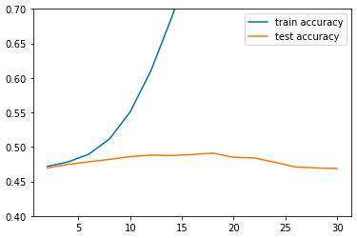
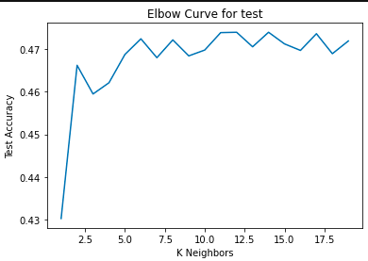
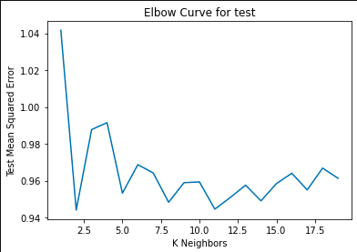
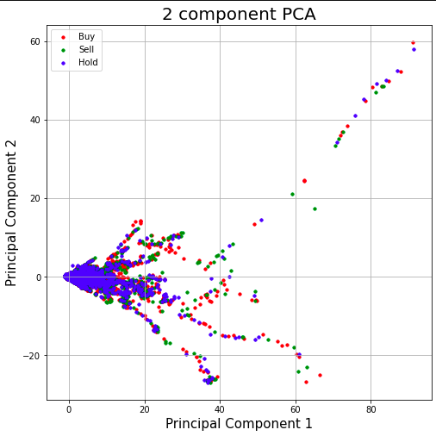
Results
Random Forest test train accuracy
K nearest Neighbours
We get the optimal output at K=11
PCA Analysis

Slide 10
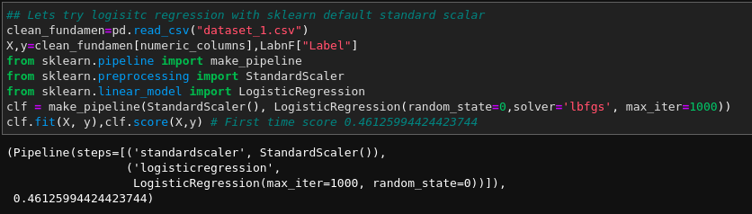
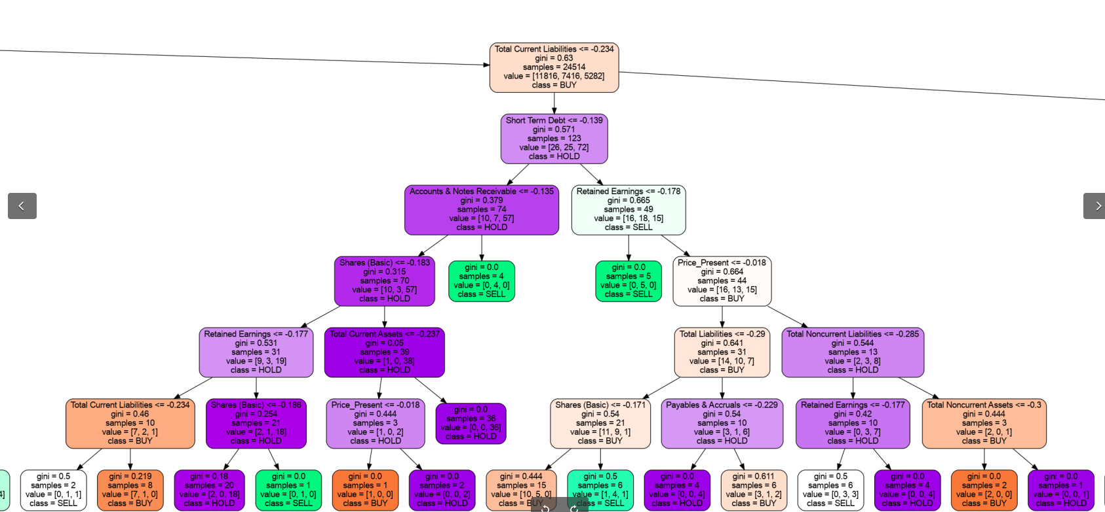
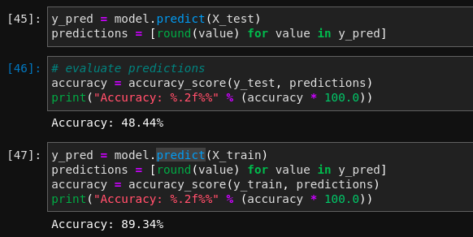
Logistic Regression with Standard Scalar
XGBoosting
Snippet of Decision tree.

Slide 11
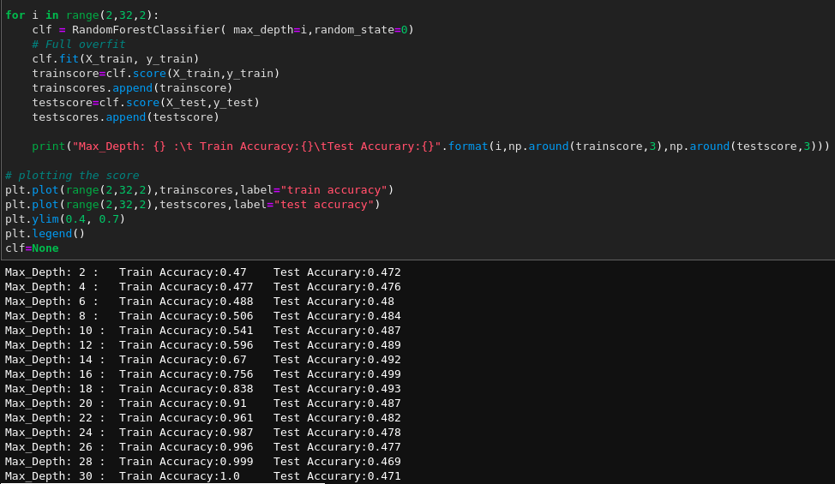
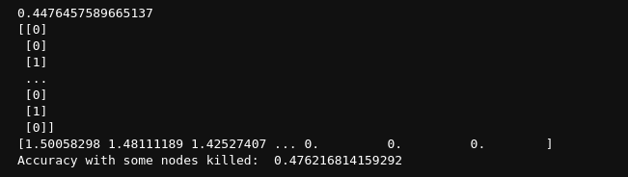
Results
Comparison of Library function, RFC Implementation and Auto sklearn
Custom Random Forest Classifier gives ~48% accuracy
Auto ML gives Random forest as the best classifier
Accuracy is increased by 0.3 when the nodes that overfit the data are killed
RFC from Sklearn library gives ~49.9xxxx% accuracy at max depth = 16

Slide 12
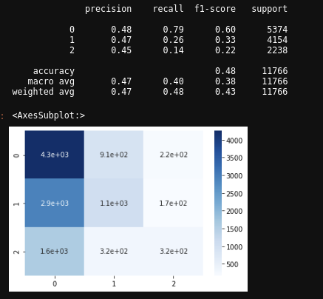
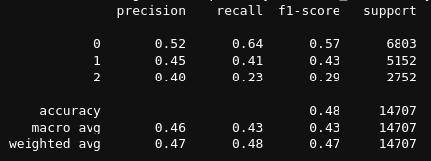
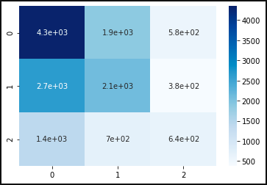
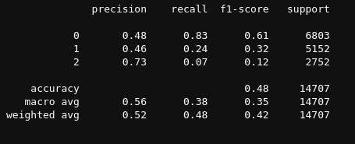
Custom Random Forest Results
XG Boosting results
Auto Sklearn results

Slide 13
Prachee Javiya
Kaushal patil
arpitsinh vaghela
Vrunda gadesha
Data cleaning & data normalization
Model Stacking
Decision trees from scratch
Reports & Presentations
Readme
Logistic regression
Random forest classifiers
PCA
Decision trees, Random forest from scratch
Node kill approach on decision tree
Final notebook
Readme
ROLES
Data preparation
Naive Bayes (incomplete)
AutoML
Evaluation metrics
Final notebook
Readme
K Nearest Neighbours

Slide 14
References
https://medium.com/swlh/teaching-a-machine-to-trade-stocks-like-warren-buffett
https://link.springer.com/chapter/10.1007/978-981-13-1819-1_38
http://cs229.stanford.edu/proj2013/DaiZhang-MachineLearningInStockPriceTrendForecasting.pdf
https://scikit-learn.org/stable/index.html
https://pandas.pydata.org/
https://numpy.org/

Slide 15
THANKYOU

