Slide 1
Machine Learning
Mid Semester Project Presentation
Kaushal Patil AU1841040
Arpitsinh Vaghela AU1841034
Prachee Javiya AU1841032
Vrunda Gadesha AU2049007

Slide 2
INTRODUCTION
Predicting the stock price trend by interpreting the seemly
chaotic market data has always been an attractive topic to
both investors and researchers. Among those popular methods
that have been employed, Machine Learning techniques are
very popular due to the capacity of identifying stock trend
from massive amounts of data that capture the underlying
stock price dynamics. In this project, we have applied nu-
merous machine learning techniques to build a model for
stock classification - BUY, SELL or HOLD

Slide 3
Problem Statement
Predicting stock performance for the next quarter based on quarterly fundamental financials.

Slide 4

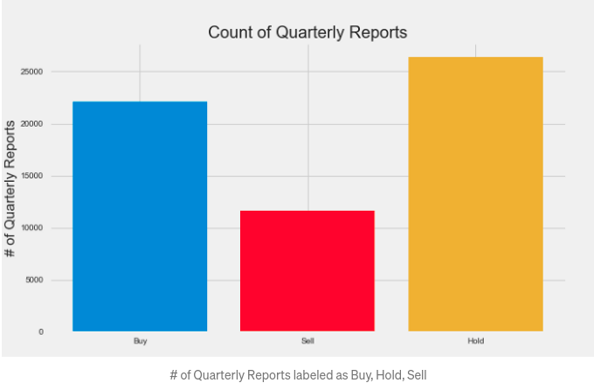
Existing work
The Decision (deciding if Buy, Hold, Sell) on the Present quarterly report (QR) takes in information using both the Past and Future quarters
Classification of training data (Data labelling) based on their dataset.
Top features (feature engineering) - P/B ratio, Assets, Shares splits, P/E ratio, Asset turnover, liabilities, current assets, cash at the end of period, revenue
Models used - AdaBoost, Decision Tree, Dummy (Baseline model), Gradient Boost, K Nearest Neighbors (KNN), Logistic Regression, Naive Bayes, Random Forest, Support Vector Machine (SVM), Extreme Gradient Boosting (XGBoost)

Slide 5
Our Approach
Data collection
Data CLeaning
Data Labelling & EDA
Model Implementation
Results
- Various fields had “bad” values; changed them to 0
- Dropped columns which did not contribute to the learning learning
- Classifying the data into 3 classes buy, sell, hold
- Quarterly report, 24 Hour Prices Dataset
- K means clustering with 2 component PCA
- We collected the data from us stock fundamentals
- Quarterly data with ~65000 unique entries and 30 features
Models tested - Logistic regression, KNN, XGBoosting, Model stacking, random forest classifier
We found results and training plots for all models tested along with testing models for various parameters and hyperparameters.

Slide 6
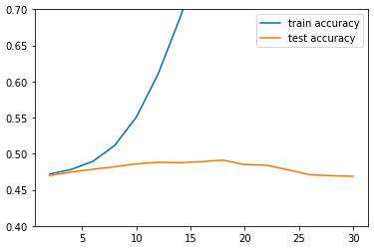
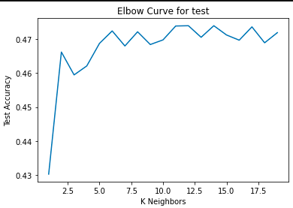
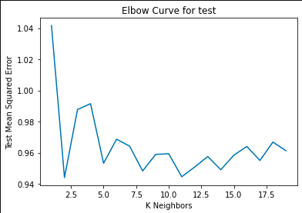
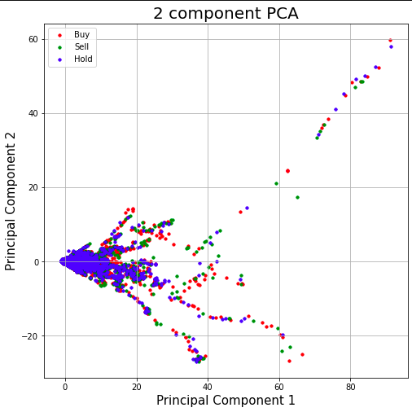
Results
Random Forest
K nearest Neighbours
We get the optimal output at K=11
PCA Analysis

Slide 7
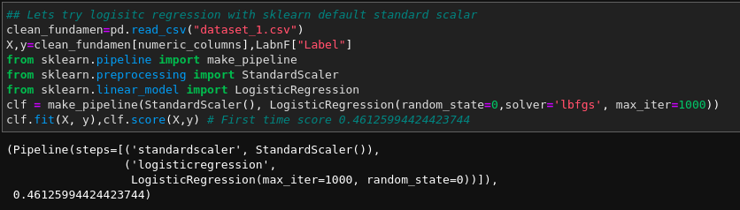
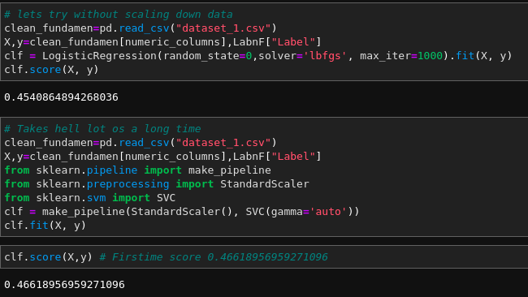
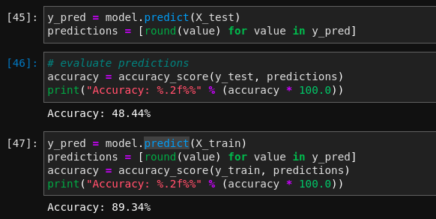
Logistic Regression with Standard Scalar
Logistic Regression & SVC
XGBoosting

Slide 8
Prachee Javiya
Kaushal patil
arpitsinh vaghela
Vrunda gadesha
ROLES
Data cleaning & data normalization
Model Stacking
Logistic regression
Random forest
K mean clustering and PCA
K Nearest neighbors
Data preparation
Naive Bayes (incomplete)
Model Stacking
K Nearest Neighbours

Slide 9
Future Work
K fold cross validation
Naive Bayes
Non linear kernel in SVC
Confusion matrix & precision recall
F1 score

Slide 10
References
https://medium.com/swlh/teaching-a-machine-to-trade-stocks-like-warren-buffett
http://cs229.stanford.edu/proj2013/DaiZhang-MachineLearningInStockPriceTrendForecasting.pdf
https://scikit-learn.org/stable/index.html
https://pandas.pydata.org/
https://numpy.org/

Slide 11
THANKYOU

