Slide 1

A presentation on
‘E-Notes Application’
Submitted to :-
Dr. Mukesh Gupta
Ms. Anjana Sangwan
Submitted by :-
Kaushal Saraswat - 17ESKCS076
Jahnavi Sachdeva – 17ESKCS070
Department of Computer Science & Engineering
Swami Keshvanand Institute of Technology, Management and Gramothan, Jaipur
Rajasthan Technical University, Kota

Slide 2
Contents
1. Introduction
1.1 Objective of Proposed System
1.2 Problem Definition of the Proposed System
2. Tools and Technology Used
3. Design and Database
4. About Project
4.1 Introduction
4.2 Working
5. Scope Of the Proposed System
6. Conclusion

Slide 3
Introduction
Objective
The objective is to make an web application 'E-NOTES', that will assign assignments and provide notes to the students according to their branch and section. Admin will register teacher and students . Teacher have the authority to upload notes and given assignments to the students of their subjects only. Initially, the student will be authenticated, Once the student is authenticated it can download the notes and submit the solution to assign assignments by the teachers, once all the verification are succeeded for submission , then the assignment is submitted . The objective is to provide the convenient way to the students and the teachers to handle the assignment.

Slide 4

In this pandemic times, the major issue faced by teachers was the management of assignments. This application will help the students to get the study material and help the teachers to keep a check on assignments in the most efficient way.
Problem Statement

Slide 5
Tools and Technology Used
Technology used:
Backend: Django
Frontend: HTML, Bootstrap , CSS ,Javascript
Database: MySQL
Tools used:
VS Code
Postman
Bitbucket

Slide 6

Design and Database
The application is designed to be very interactive and easy to use. Flexbox layout has been used so that application can be used on devices of various dimensions.
The CSS3 Flexible Box, or flexbox, is a layout mode providing for the arrangement of elements on a page such that the elements behave predictably when the page layout must accommodate different screen sizes and different display devices.

Slide 7
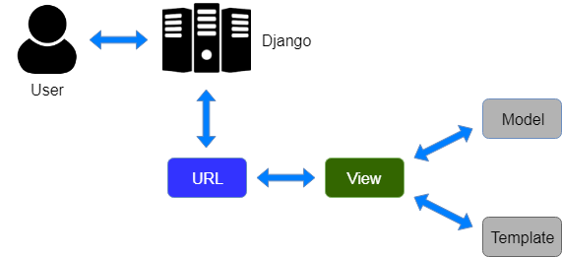
MVT Architecture

Slide 8
About Project
Introduction
E-notes application is a web app, developed for schools/colleges to provide the notes and
assignments to the students.
It contains three modules:-
• Admin
• Teacher
• Student
The teacher can upload notes and assignments (branch wise). Students can download the notes to check the assignment and upload the solution of the assignment. The teacher will be able to keep track of the student's assignments.

Slide 9
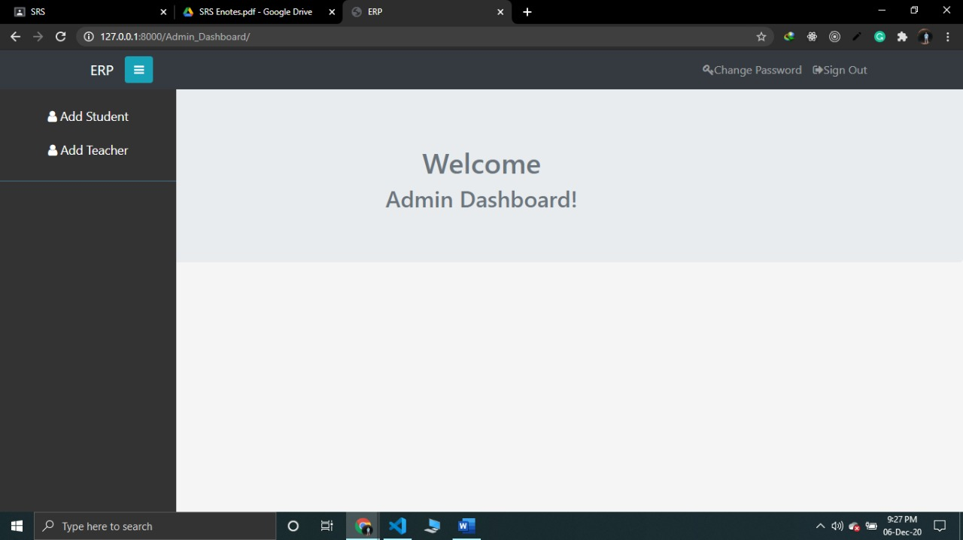
Admin Dashboard

Slide 10
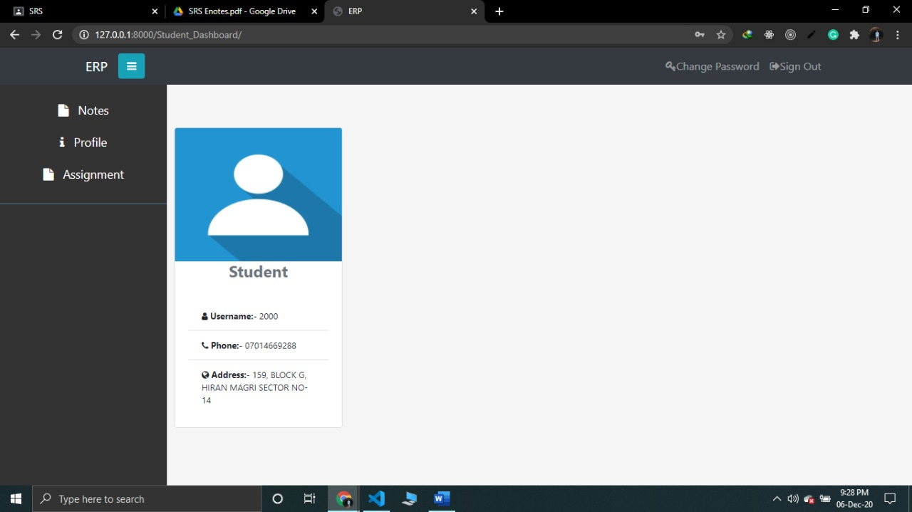
Student Dashboard

Slide 11

Teacher Dashboard

Slide 12
Working
Admin will Add Students and Teachers.
Teacher will upload the assignments and add the notes for the students of their respective subjects.
Students will submit the solution of the assigned assignments.
Students can also take a look to the notes.
Teacher can check the status of the students for the assignments.

Slide 13
Scope Of The Proposed System
In coming Future we can add the following functionalities:-
Uploading Attendance on daily basis
Adding Lecture Videos for Students
Creating Live Class Feature
Adding Online Payment method for Fee Payments

Slide 14
Conclusion
It is a tool which is based on the technology Django Framework helps us to bring assignments and notes online. Our tool is a web-based tool which is easy to use and is user friendly. There is no CLI, so no command line knowledge is required. It offers many features like Uploading Assignments and Notes for teacher and student can use notes for learning purpose and Submit the Assignments to the teachers. Nowadays, This tool is very helpful for the Students for distance learning and teacher can easy make a track on Assignments

