Slide 1

Feature Extraction and Price Prediction for Mobile Phones
Project 4
KAUSHAL KUMAR
Deadline: 10th March 2026

Slide 2
Project Objective
• Understand key features affecting mobile prices
• Perform feature extraction analysis
• Build machine learning model for price prediction
• Provide pricing strategy recommendations

Slide 3
Dataset Description
• Model
• Colour
• Memory
• RAM
• Battery Capacity
• Rear & Front Camera
• Processor
• AI Lens
• Price (Target Variable)

Slide 4
Data Exploration
• Checked data types and structure
• Identified numerical and categorical features
• Checked missing values
• Analyzed price distribution

Slide 5

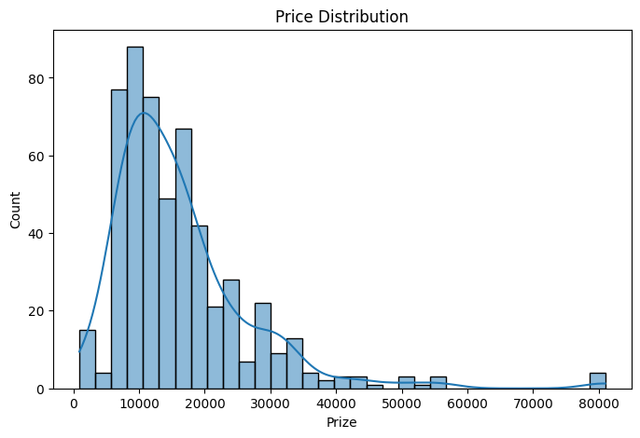
Data Exploration Graph
The right-skewed histogram will have a long tail on the right-hand side

Slide 6
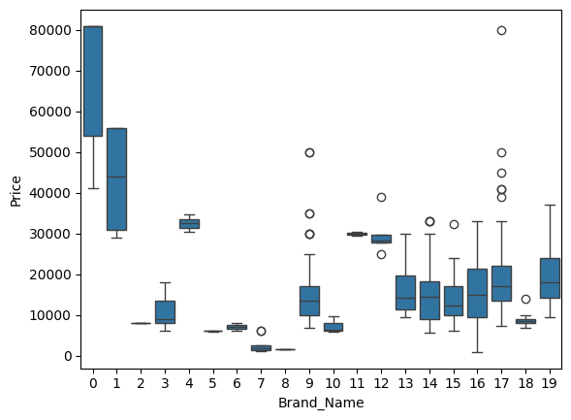
BRAND VS PRICE
Some brands tend to have higher price ranges compared to others.

Slide 7
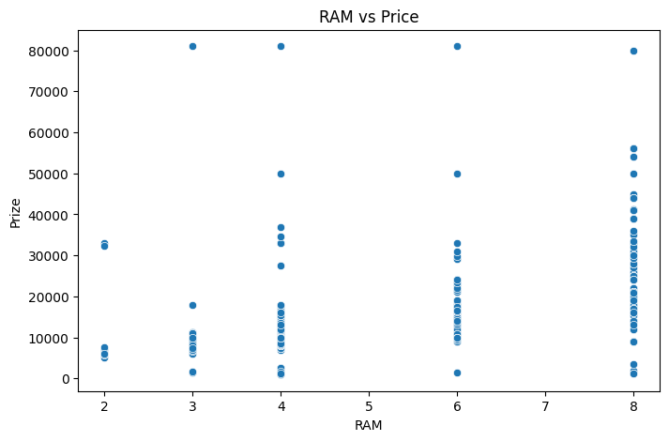
RAM VS PRICE
Phones with higher RAM generally have higher prices.

Slide 8
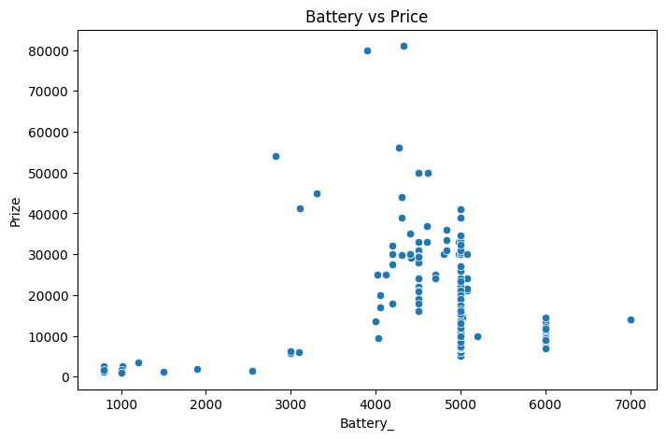
BATTREY VS PRICE
Phones with larger battery capacity often fall in higher price categories.

Slide 9

Data Preprocessing
Handled missing values
Removed outliers
Converted categorical variables using One-Hot Encoding
Prepared dataset for modeling

Slide 10
Feature Extraction Techniques
• Correlation Analysis
• Heatmap Visualization
• Random Forest Feature Importance
• Selected most influential features

Slide 11
Most Important Features
• RAM – Very High Impact
• Internal Memory – High Impact
• Processor – High Impact
• Rear Camera – Medium to High Impact
• Battery Capacity – Medium Impact
• Colour – Low Impact

Slide 12
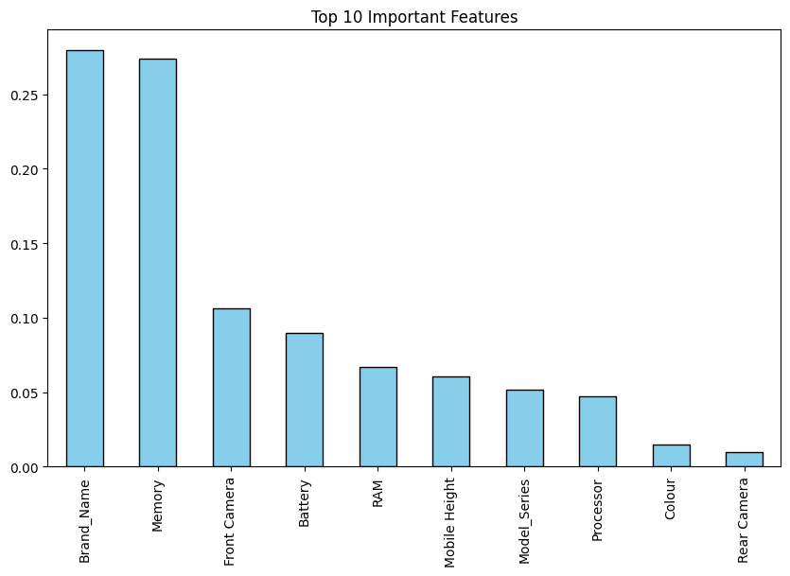
Feature Importance Graph
This graph shows the top 10 features that influence the price the most according to the model.

Slide 13
Model Building
• Train-Test Split (80-20)
• Linear Regression Model
• Random Forest Regressor
• Compared performance metrics

Slide 14
Model Evaluation Metrics
• Mean Absolute Error (MAE)
• Root Mean Squared Error (RMSE)
• Random Forest performed better
• Model provides accurate price predictions

Slide 15
Key Insights
• Technical specifications drive pricing
• Higher RAM & Processor increase price significantly
• Camera improvements increase premium pricing
• Cosmetic features have minimal impact

Slide 16
Business Recommendations
• Focus pricing strategy on RAM & Processor
• Promote high camera specs for premium segment
• Battery capacity as supporting feature
• Do not overprice based on colour variants

Slide 17
Conclusion
• Successfully built price prediction model
• Identified key influential features
• Random Forest model gives best results
• Insights help improve pricing strategy

Slide 18
THANK YOU NEXTHIKE GIVE ME OPPORTUNITUY

