Slide 1

Diabetic retinopathy prediction in patients
P152 Group 6
Madishetti Rajashekar
Bapuram Pallavi
07/10/22

Slide 2
Business Problem:
Objective:
Business Objective:
The variable to be predicted has two values (positive or negative on diabetic retinopathy). Thus, this is a binary classification project. The goal here is to predict whether a patient will suffer from diabetic retinopathy or not, conditioned on blood test features.
Architecture level analysis:
Understand the business statement how we can approach
EDA should be done on the given dataset.
Need to perform clustering to summarize customer segments.
Deployment through Streamlit

Slide 3
Data set details
Target variables has two values in a classification project type: 0 (false) or 1 (true). The number of instances (rows) in the data set is 6000, and the number of variables (columns) is 6.
The following list summarizes the information of the variables
1)ID: Numeric
2)age: (numeric).
3)systolic_bp: (normal range: below 120mmHg). When the heart beats, it squeezes and pushes blood through the arteries to the rest of the body. This force creates pressure on the blood vessels, and that is the systolic blood pressure.
4)diastolic_bp: (normal range: lower than 80mmHg). It is the pressure in the arteries when the heart rests between beats. This is the time when the heart fills with blood and gets oxygen.
5)cholesterol: (normal range: between 125 and 200 mg/dl). It is a waxy, fat-like substance found in every cell in the body.
6)prognosis: (0 or 1) (Target). It is 1 if the patient has retinopathy and 0 if he doesn't.

Slide 4
Exploratory Data Analysis (EDA)
Data Understanding
Data Shape – (6000,5)
Null Value Check – NO null value are observed in the data. (data is clean)
Data Preparation
Dropping ID column
Encoding the Target column to 0’s and 1’s.
Rounding the Age column to 1 decimal
Rounding the systolic bp, diastolic bp and cholesterol to 0 decimal.

Slide 5
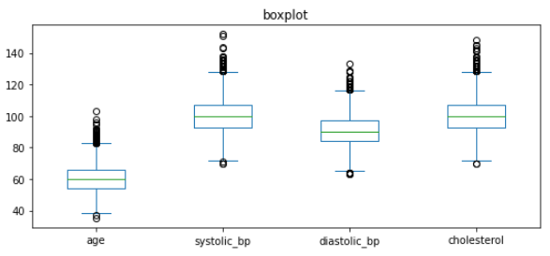
Exploratory Data Analysis (EDA)
Outlier Check

Slide 6
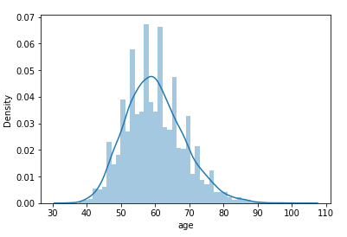
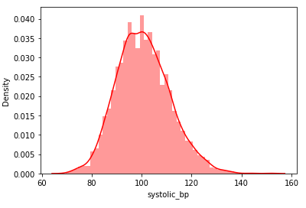
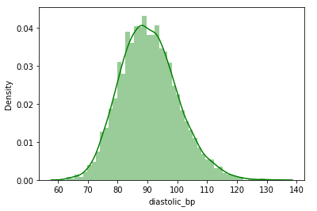
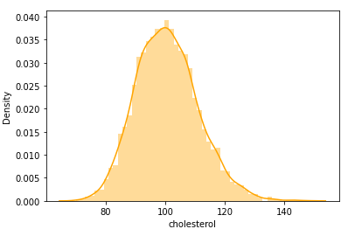
Exploratory Data Analysis (EDA)
Normality Check
For Given data, Skewness and Kurtosis values are showing the data is normally distributed and no outliers
We have Performed the Shapiro Wilk test to check the normality of the data.
All the input are normally distributed

Slide 7
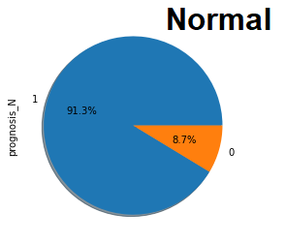
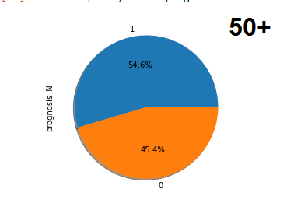
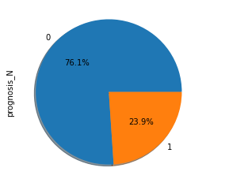
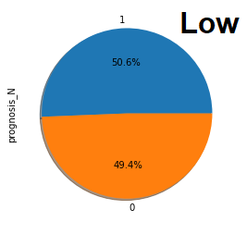
Feature Engineering
AGE wise EDA
cholesterol wise EDA

Slide 8
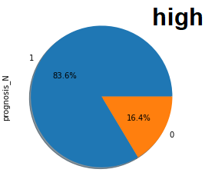
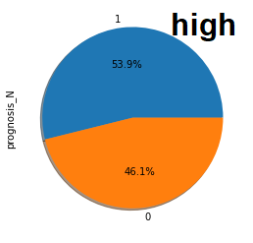
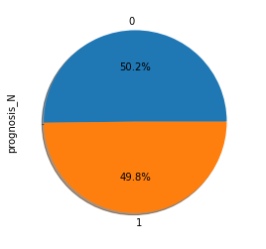
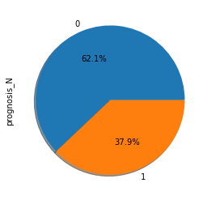
Feature Engineering
systolic_bp wise EDA
diastolic_bp wise EDA

Slide 9
Model Building

Slide 10
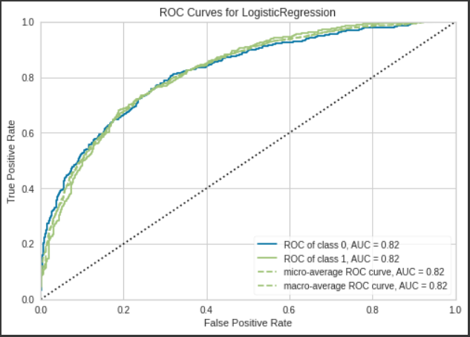
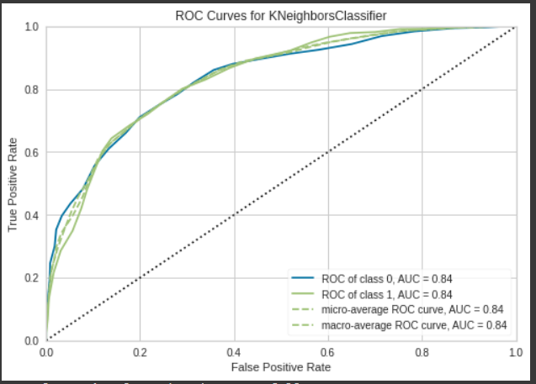
ROC Curves of different models
LR model with Accuracy of 73.08
KNN model with Accuracy of 74.43

Slide 11
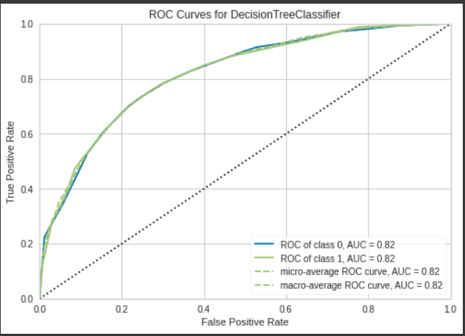
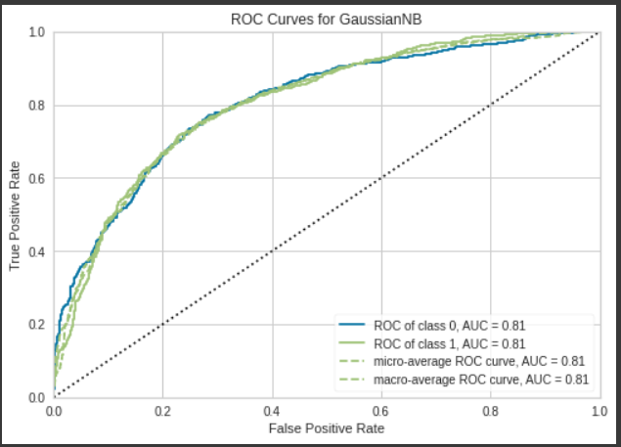
ROC Curves of different models
DT model with Accuracy of 71.75
NB model with Accuracy of 72.41

Slide 12
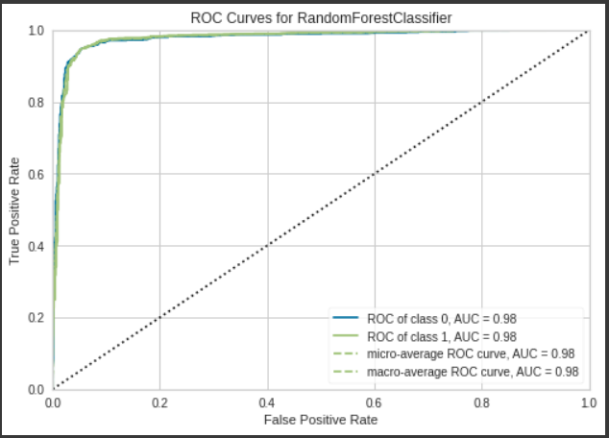
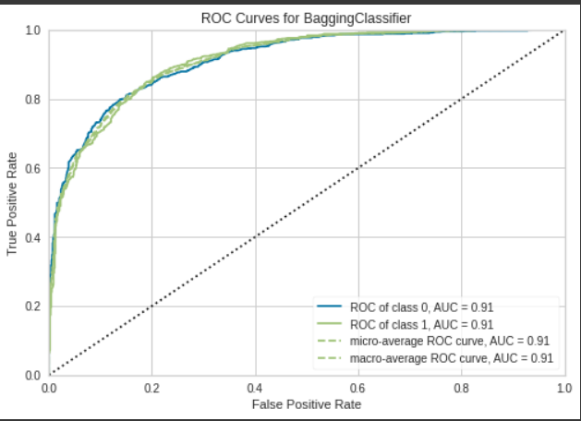
ROC Curves of different models
RF model with Accuracy of 71.91
Bagging Classifier model with Accuracy of 74.00

Slide 13
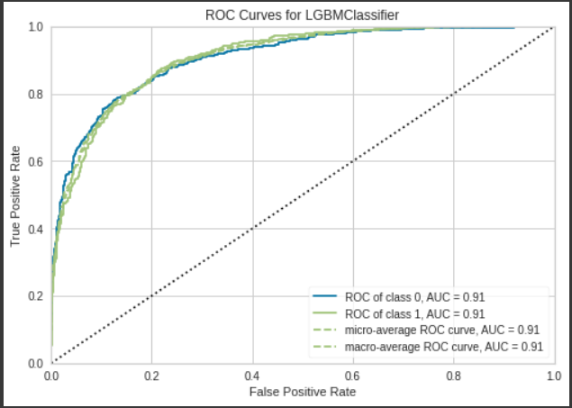
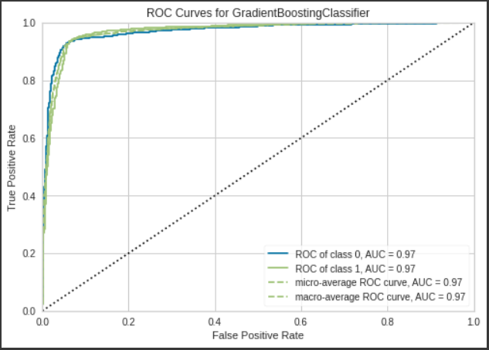
ROC Curves of different models
LGBM model with Accuracy of 71.91
GBC model with Accuracy of 73.08

Slide 14
Pycaret Models with Accuracy
MODELS | ACCURACY
Logistic Regression | 73.08
KNeighborsClassifier | 74.43
DecisionTreeClassifier | 71.75
Support Vector Classifier | 74.78
Naïve Bayes | 72.41
RandomForestClassifier | 71.91
VotingClassifier | 73.16
BaggingClassifier | 74
XGBClassifier | 73.66
LGBMClassifier | 71.91
GradientBoostingClassifier | 73.08

Slide 15
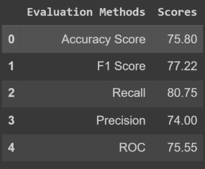
Template for Model results presentation
Model - SVM
Data Partition details – using sk learn test train split with ratio of 80:20
SVM Model Details – SVM model is trained on linear, poly, rbf and sigmoid kernel, from performance as criteria rbf is used for final model
Then this rbf model is optimized by grid search cv for hyper tuning the c and gamma value

Slide 16
Challenges faced?
Data Understanding
Deployment
1.streamlit
Working in team
How did you overcome?
Git hub usage for file sharing dynamic work progress update
Technical challenges

Slide 17

Web App Deployment using Steamlit

Slide 18
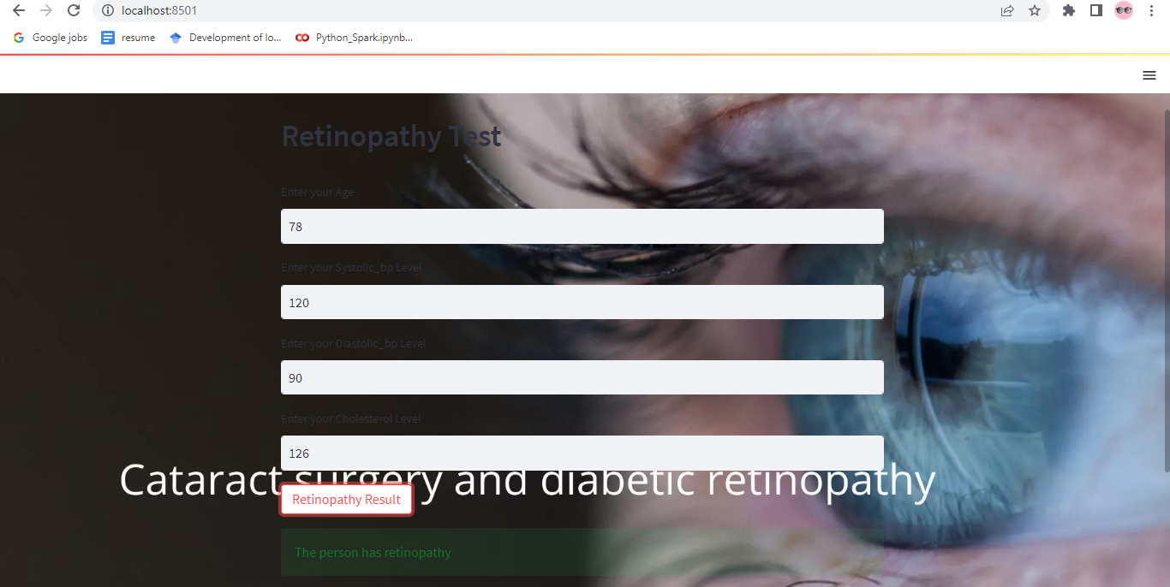
Web App Deployment using Steamlit

Slide 19

Web App Deployment using Steamlit

Slide 20
Thank you

