Slide 1
AIAAS: Architecture & Technical Overview
Visual Technical Tour: Engineering Decisions, Safe Orchestration, and Qualitative Analysis
Notes:
Welcome everyone. This presentation provides an illustrated, visual-first technical tour of the AIAAS architecture, core engineering decisions, and agentic dynamics.

Slide 2
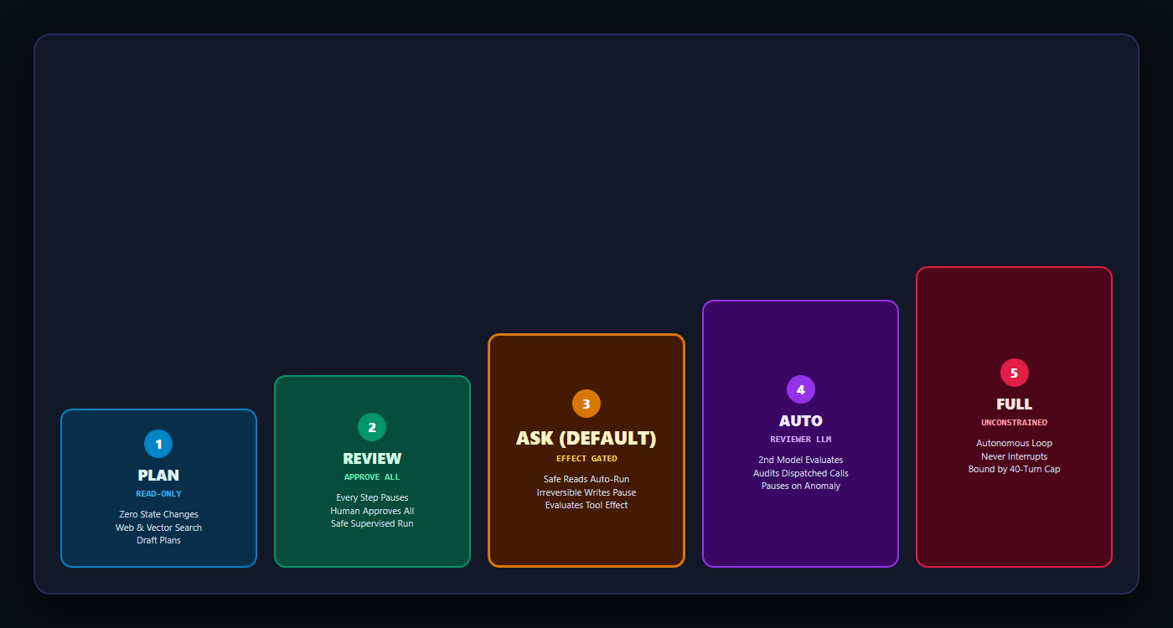
The 5-Tier Autonomy Spectrum
Granular human-in-the-loop policies replacing binary 'ask or never ask' fatigue
2
Notes:
AIAAS builds a 5-tier autonomy ladder. The default 'Ask' tier inspects tool effects: safe reads auto-run, while irreversible writes pause for approval.

Slide 3
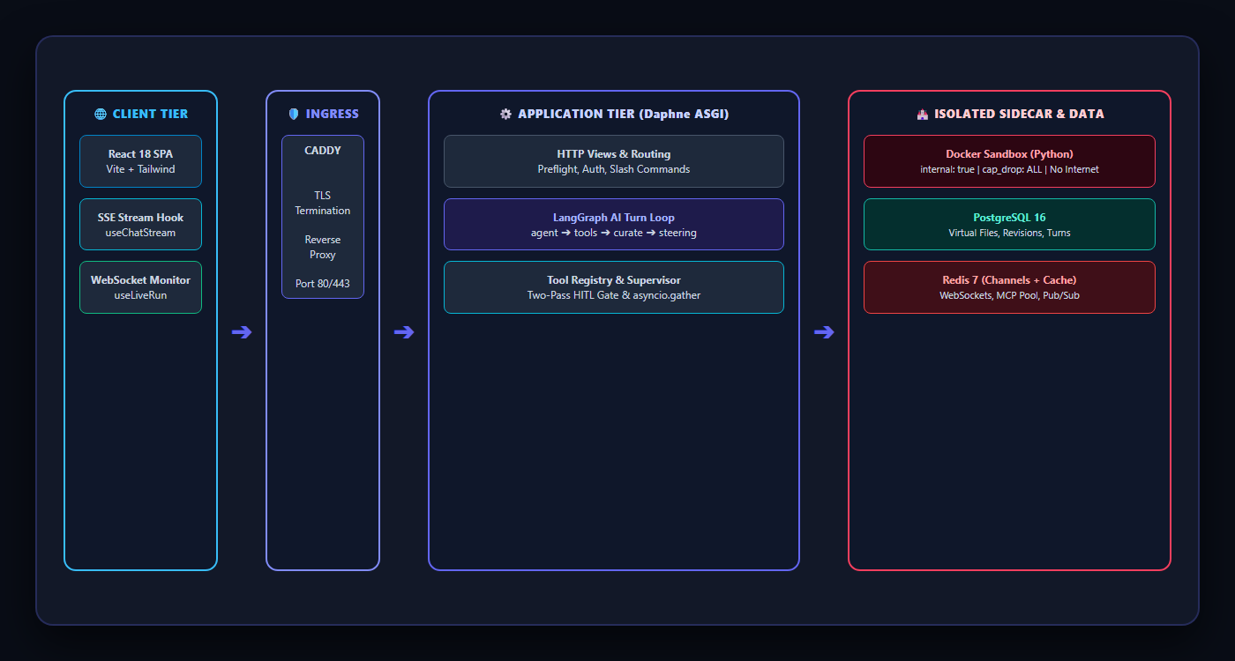
Distributed System Topology & Ingress
Multi-protocol streaming ingress, decoupled compute sidecars, and state persistence
3
Notes:
Notice the separation of concerns: React SPA consumes SSE for interactive chat and WebSockets for background worker telemetry. The sandbox runs in an isolated container with zero internet egress.

Slide 4
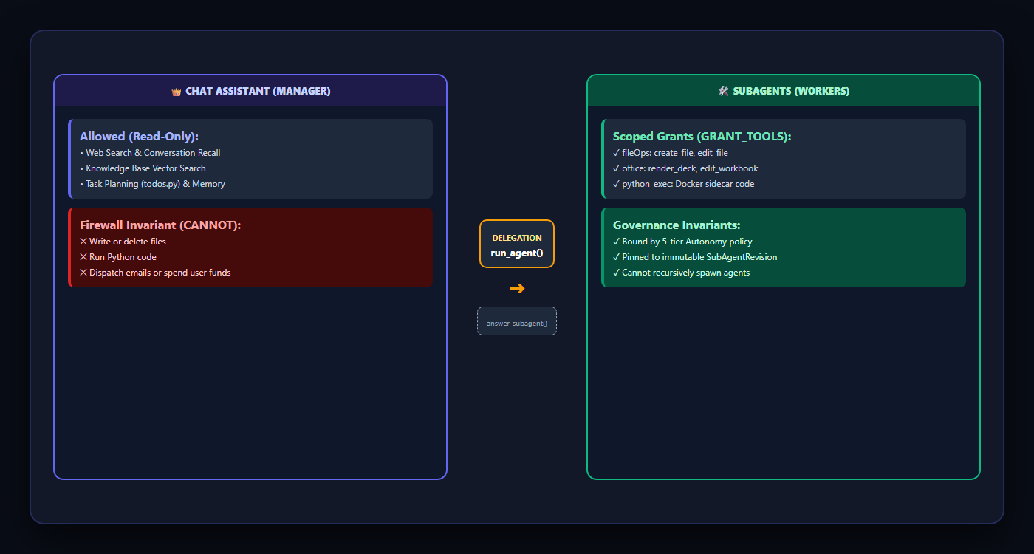
Dual-Loop Topology: Manager vs Workers
Structural capability partitioning between conversational planning and scoped execution
4
Notes:
The Chat Assistant is a Manager: it can read, plan, and supervise, but holds no write grants. SubAgents carry explicit grants and execute state mutations.

Slide 5
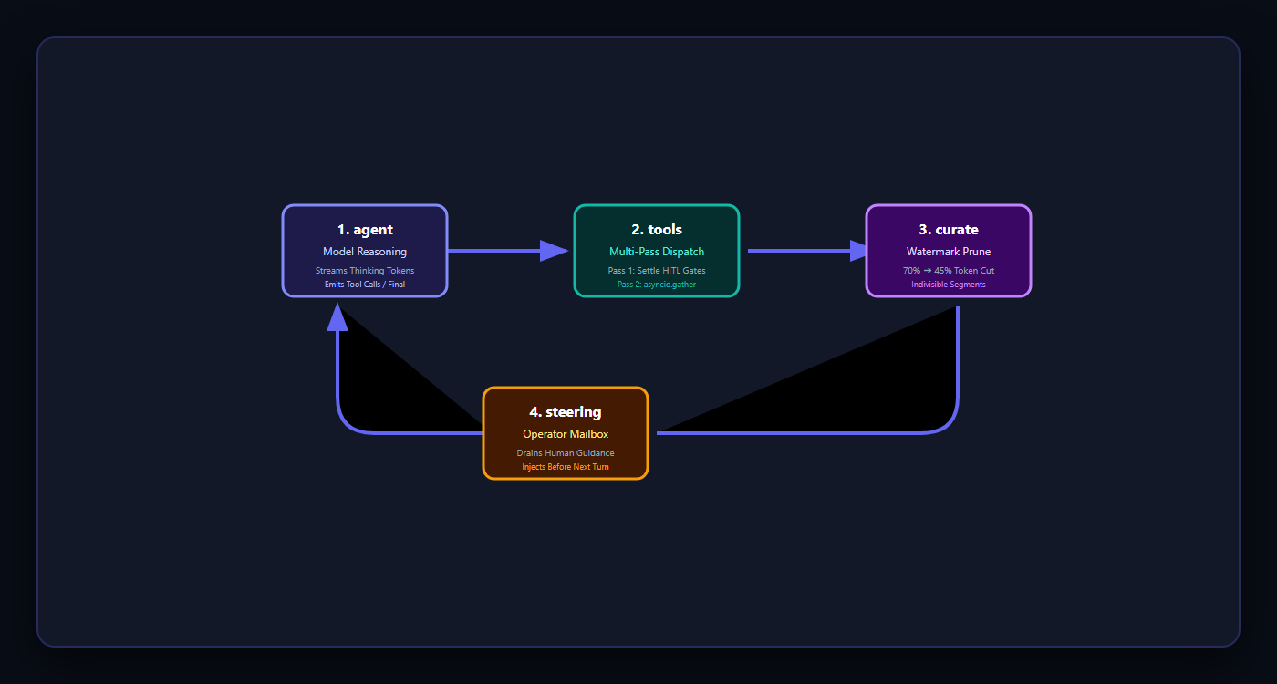
Inside the Unified AI Turn Loop
LangGraph cyclical state machine: agent ➔ tools ➔ curate ➔ steering ➔ agent
5
Notes:
Both interactive chat turns and background autonomous agents run on this exact 4-node cyclical LangGraph loop.

Slide 6
Decision 1: OOM Prevention & Process Supervisor
RAM impact: 8 Cold MCP starts (850 MB spike) vs AIAAS DB Catalogue & Supervisor (195 MB)
6
Notes:
Notice the 850MB spike that caused the 2026-09-16 kernel OOM kill. AIAAS decouples tool listings into a Postgres catalogue (0MB spawn) and enforces megabyte-based admission with LRU eviction.

Slide 7
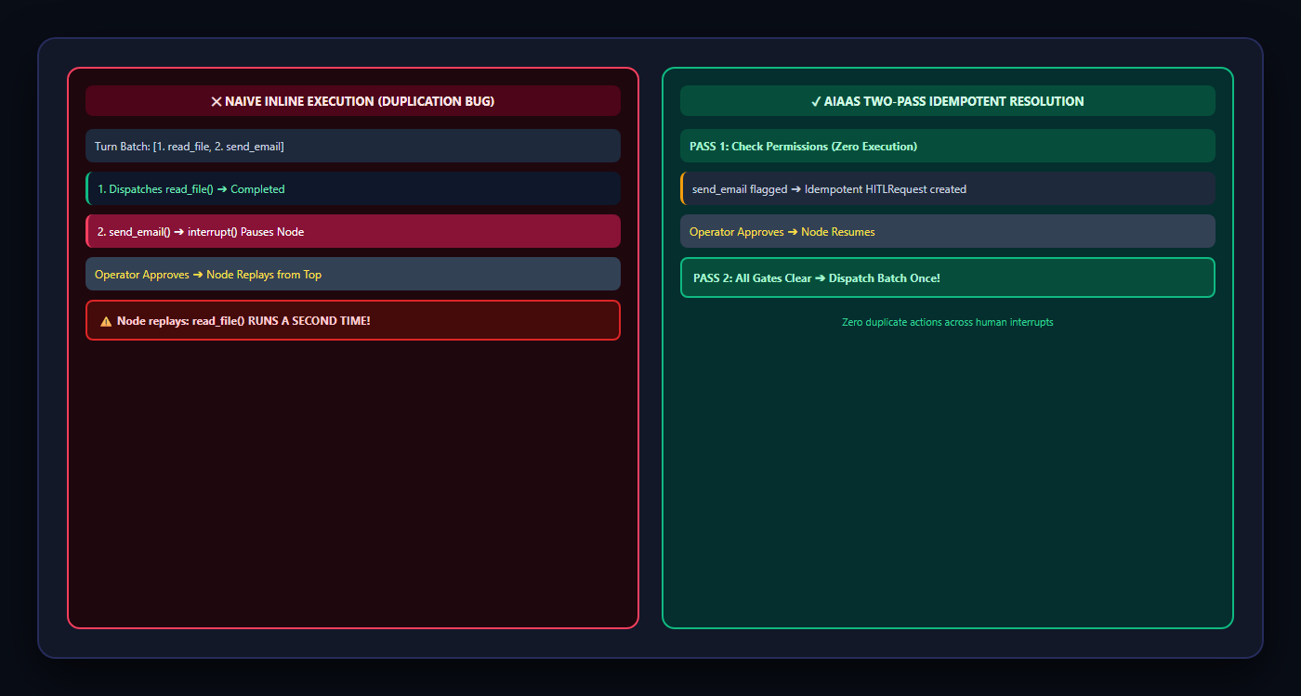
Decision 2: Idempotent HITL Under Rollbacks
Solving LangGraph's interrupt replay trap: Two-Pass resolution prevents duplicate side effects
7
Notes:
By decoupling permission evaluation (Pass 1) from tool dispatch (Pass 2), AIAAS prevents accidental duplicate side effects during human-in-the-loop pauses.

Slide 8
Decision 3: Indivisible Context Curation
Token lifecycle over 40 iterations: Unbounded linear bloat vs Watermark-capped curation
8
Notes:
Trimming indivisible Segments at 70% high-watermarks down to 45% keeps 40-iteration runs well within context windows while preserving provider prompt caching.

Slide 9
Decision 4: Deterministic Parallel Tool Calling
Latency benchmark: Sequential execution vs asyncio.gather parallel dispatch
9
Notes:
Safe independent tools run concurrently via asyncio.gather, reducing turn latency by over 40%. Results are sorted strictly by call index to guarantee reproducible execution traces.

Slide 10
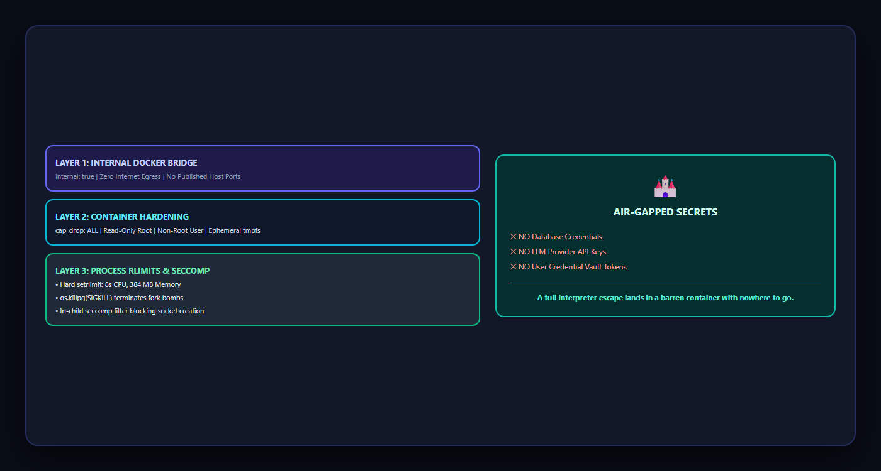
Decision 5: Defense-in-Depth Sandbox
Quarantining untrusted LLM-authored Python in an air-gapped container sidecar
10
Notes:
The sandbox container lives on an air-gapped internal Docker network with zero egress. Even an interpreter breakout lands in an empty, resource-capped container.

Slide 11
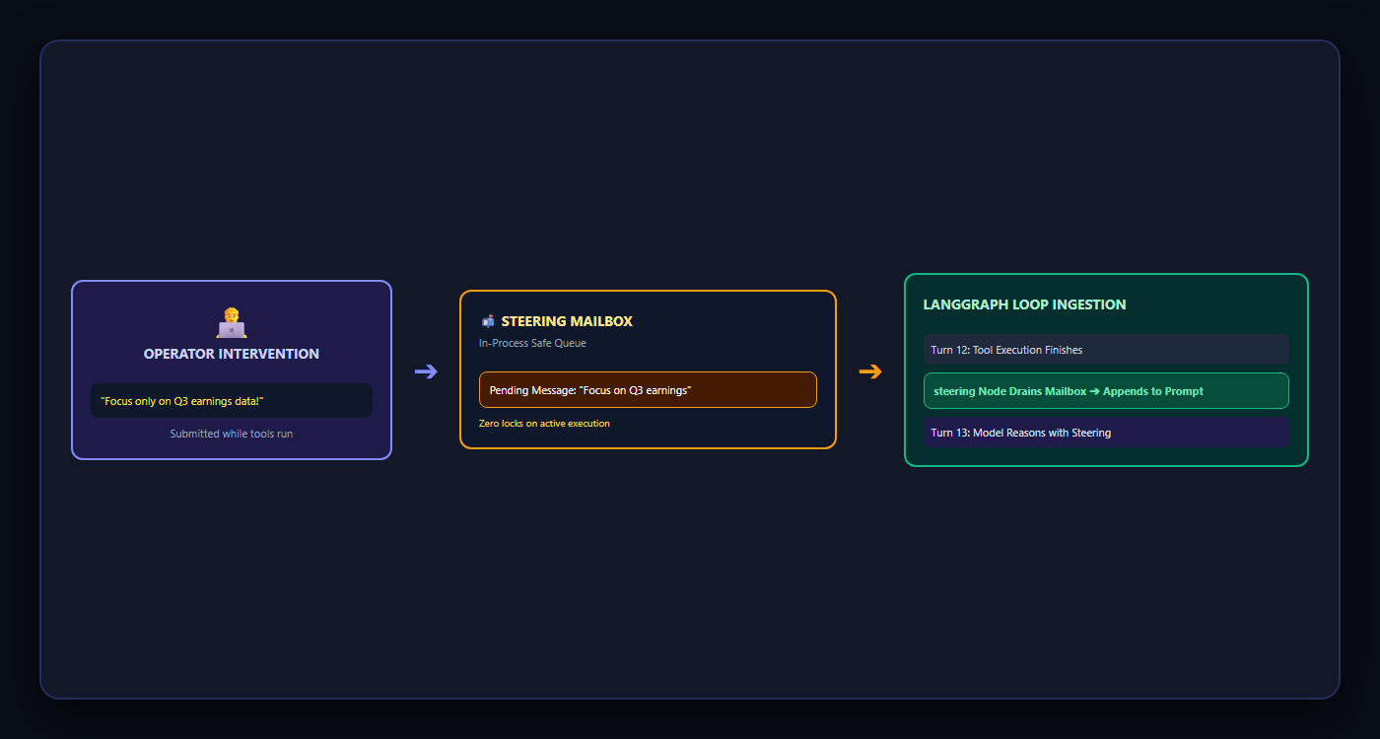
Qualitative Analysis: Mid-Flight Steerability
Eliminating fire-and-forget black boxes: Real-time operator guidance during live runs
11
Notes:
Steerability gives human operators active oversight during long agent runs, preventing wasted tokens and drift.

Slide 12
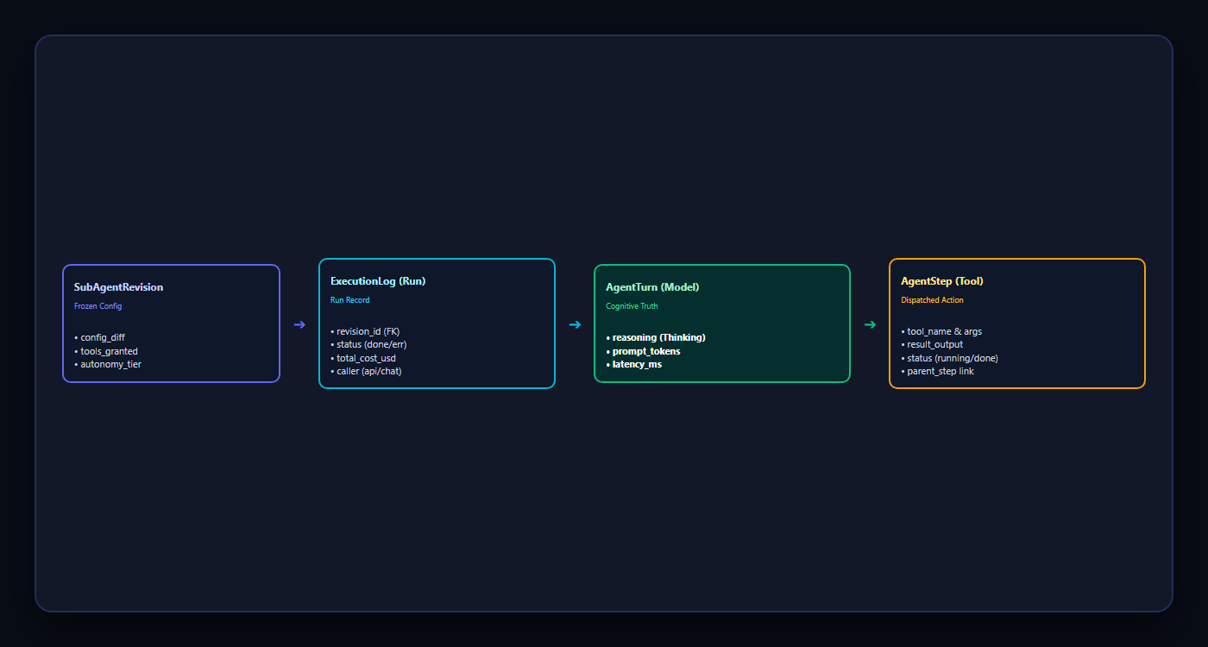
Qualitative Analysis: Relational Observability
Structuring execution traces around cognitive turns rather than inferred DAG steps
12
Notes:
Observability revolves around the Turn, not the Step. Models reason once per turn, so storing reasoning at the turn level preserves accurate semantic attribution.

Slide 13
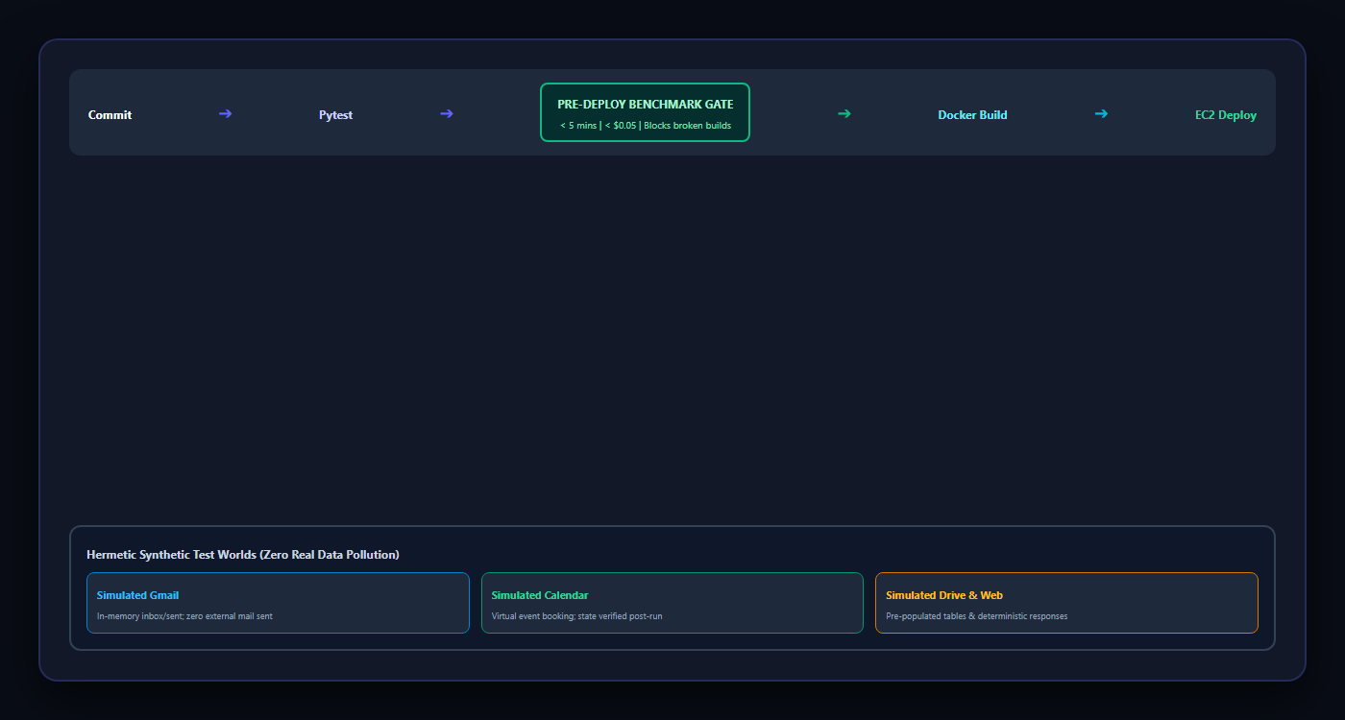
Qualitative Analysis: Evaluation Engine
Hermetic mock testing worlds, unoverwritable auto-grades, and pre-deploy CI gates
13
Notes:
By evaluating agents through the exact same runtime entry point and using hermetic mock environments, AIAAS avoids synthetic evaluation drift.

Slide 14
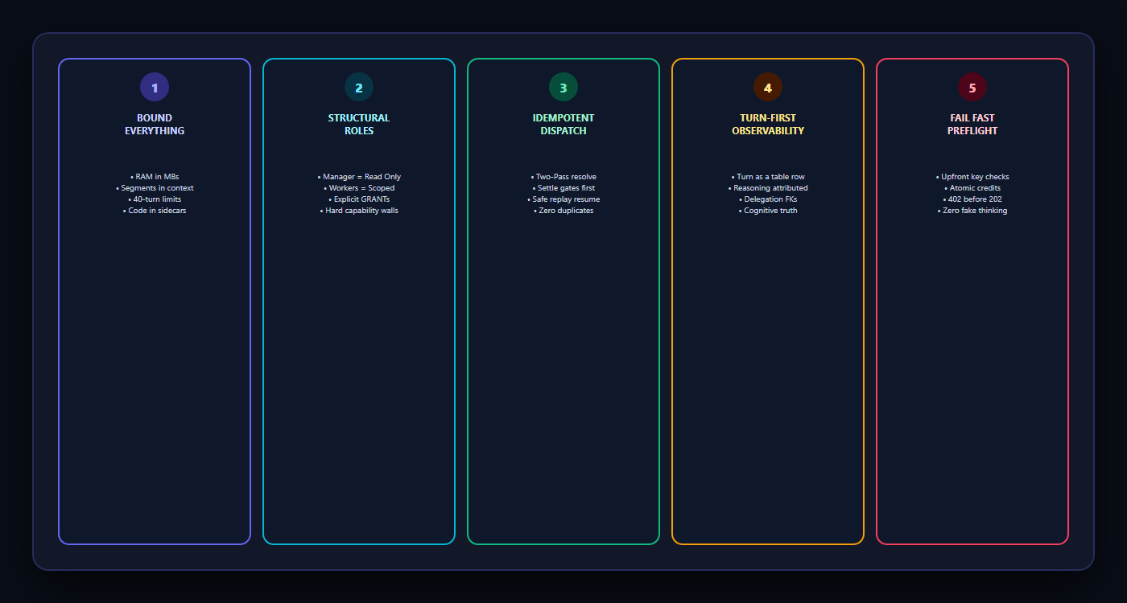
The Five Pillars of Industrial Agentic Engineering
Proven architectural principles separating toy agent wrappers from enterprise automation
14
Notes:
These principles summarize the engineering discipline of AIAAS: bound all resources, enforce structural role safety, ensure idempotence, and trace cognition.

Slide 15
Architectural Bottlenecks & Evolution Roadmap
Component | Current State | Bottleneck Cause | Target Architecture
Run State | In-Process Memory | Single replica memory | Redis Streams + PubSub
Database | Co-located Postgres | Shares 913 MB RAM host | AWS Managed RDS + PgBouncer
Connectors | Node.js Stdio | 70-150 MB per session | Native REST API Connectors
Pre-Model | Sequential ORM | 20 async thread hops | Batched Pre-Model Queries
15
Notes:
Transparent engineering limits: current deployment on a 1GB EC2 instance transitions to managed databases and Redis-backed state for horizontal scale.

Slide 16
AIAAS: Built for Real Work
Technical Discussion, Architecture Q&A, and Code Walkthrough
16
Notes:
Thank you. Let's move to questions, code walkthrough, and live demonstration.

