Slide 1



APPLICATION INFRASTRUCTURE REPOSITORY
Training Document
Version 1.02

Slide 2

The Training Guide for Application Infrastructure Repository (AIR) is the first presentation the reader should consult when learning about AIR.
Introduce the first-time user to the Application Infrastructure Repository.
Provide a description of the available tools and how to use them.
Supply the information required to search the documentation of IT relevant components like applications, server or server rooms and their interconnections as well as connections to business processes.
This presentation is intended to be an overview and to understand the functionality of the AIR application.
Scope

Slide 3
About AIR
The Application Infrastructure Repository (AIR) is a web based application provided by Bayer Business Services GmbH. It support the documentation of IT relevant components like application, server or server room and their interconnections as well as connections to business processes.
In this application we are managing information of all IT components like application, middleware, Hardware system, building, area, sites, terrain, room, position, transient system platform, application platform and also display individual login CWID related information Like last login, role and he is owner ,manager or delegates of some IT components.
AIR is standalone web application it has no interrelation with other application. It is basically using Transbase database to get and save the information for CI component.

Slide 4
What you can expect from this training session
You will learn…
…how to use key functionalities of our AIR application
…important things to consider when using this application
…how you can maintain information on AIR application

Slide 5
Contact
AIR is a web based application and only authorized users have access to this application. User access is granted on request. This requires logged a request on IT Service portal. To creating user access request follow the link: (See references for complete guidelines to create request for user access on IT Service Portal)
https://itserviceportal.intranet.cnb/spo/faces/bay/portal?execution=e1s1
We would like to thank you for using AIR Applications and this user guide. We value your comments and feedback. You can write back to us and can explain what you like or dislike about AIR Applications or this user guide. Mail your comments to the below mail address.
ITILcenter@bayer.com

Slide 6
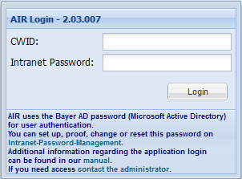
Starting Application
To start the application you need to enter one of the following URL in your web browser, it should meet the requirements as mentioned in the System Requirements section.
https://air.de.bayer.cnb (Production)
https://air-q.de.bayer.cnb (QA-System)
After starting AIR application, the first windows you see is the sign-on window. Enter your Bayer LDAP username and password. The LDAP password can be changed or requested on
https://by-password.bayer-ag.com
User
Password
Roles and Rights
AIR uses a concept of Roles for various functions, designed to give the permissions to perform certain operations which are assigned to specific roles. All roles and descriptions can be found in AIR User Manual. Authentication is implemented a single sign on. Once roles have been assigned, nor further authentication is required.

Slide 7
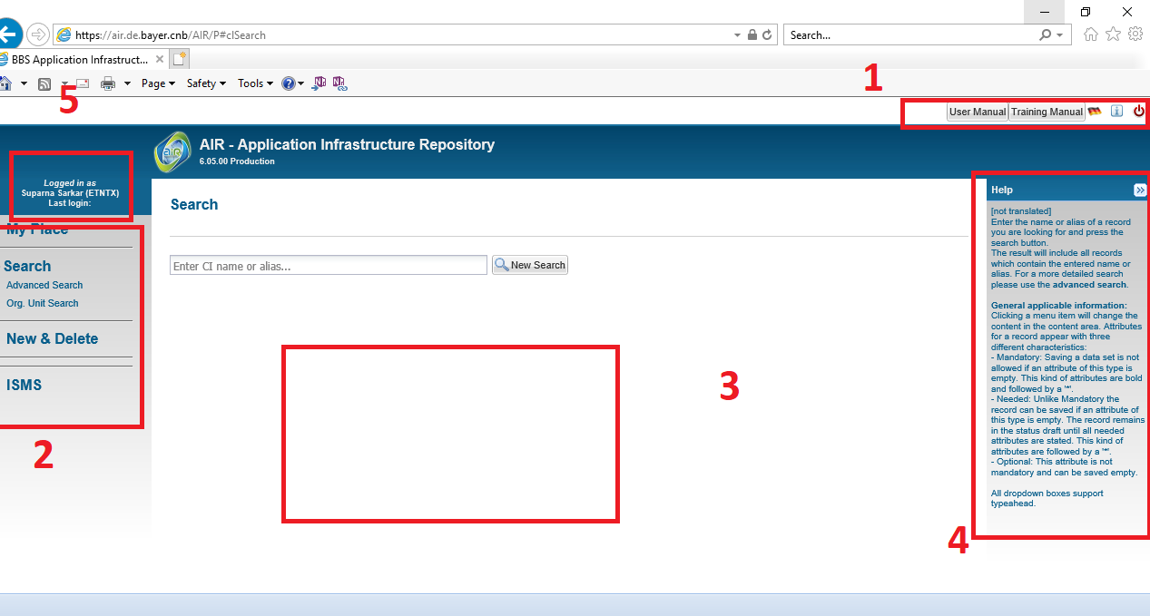
Understand AIR Workspace
After successful login to the Applications, the first window you see is GUI based user interface. This can be explained in five different sections.
1) Head Menu
2) Navigation Pane
3) Contents
4) Help Pane
5) Login Details

Slide 8
AIR Objectives
1
My Place
2
Search Components
3
Create & Delete Components
4
View & Edit Components
5
Help Me

Slide 9
My Place
In this section, we will cover 3 topics
User Roles and Settings
I’m Owner / Manager
I’m Steward / Delegate

Slide 10
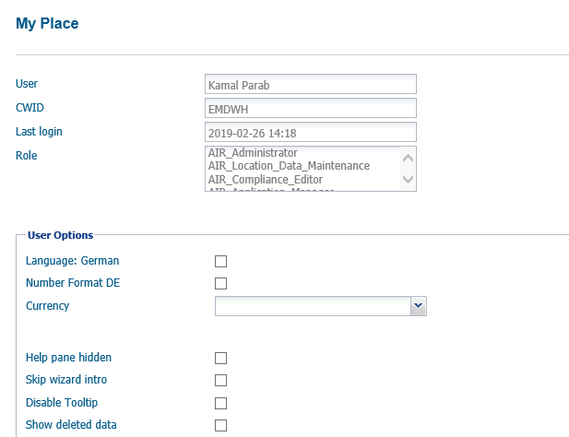
User Roles and Settings
User Roles and Settings display the information about user and associated roles, also here you can change the application features by selection of available options.

Slide 11
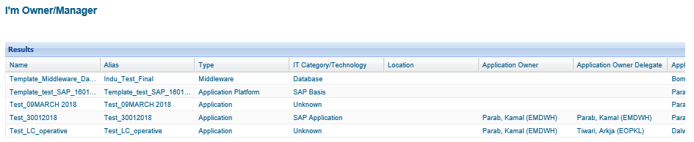
I’m Owner / Manager
By clicking on I’m Owner/Manager we can see the all records where logged-in user is CI Owner Primary Person/Group or Application Owner Primary Person/Group. Groups are resolved into appropriate CWIDs

Slide 12
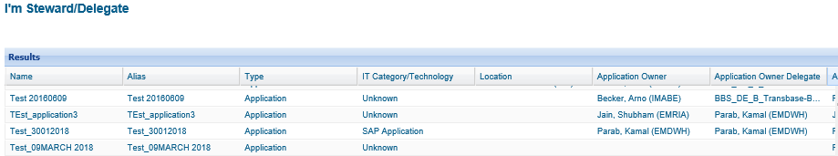
I’m Steward / Delegate
By clicking on I’m Steward/Delegate we can see all records where logged-in user is CI Owner Delegate Person/Group or Application Owner Delegate Person/Group. Groups are resolved into appropriate CWIDs

Slide 13
Search Components
This Section will provide you an overview of the Search component from AIR navigation pane. You will learn how the search feature is structured Search contains two submenus Advance Search and Org.Unit Search to allow users to different methods for searching CI names and alias of existing records.
In this section, we will cover 4 topics
Search
Advanced Search
Mass Update
Org. Unit Search

Slide 14
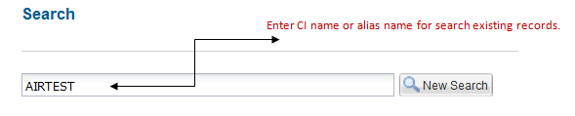
Search
This is start page. Here you can search for the name or alias of existing records. The result will display all records containing the entered name/alias. Depending on the associate roles the record type (e.g. application, server, room, etc.) is considered for the result.
The results are displayed in a table and are ordered by name. Though the table allows to sort per column. Click on the column header to choose the order direction.

Slide 15
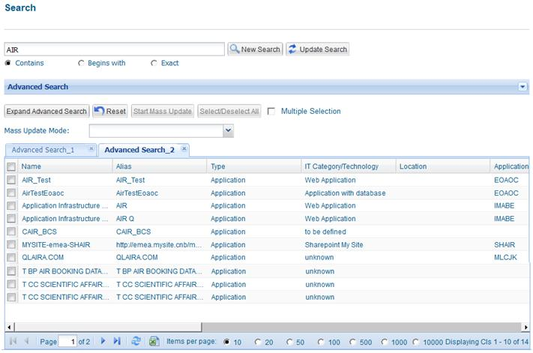
Advance Search
The Advance search form lets you focus your search, giving you more control over the results. For experienced users the Advance Search menu offers a number of options for users interested in more complex searches. Advanced Search can be used for a more detailed search. Unlike the standard search a name or alias must not be entered. So, the owner (CWID) or description can be used as search criteria. It is possible to choose the “not” checkbox to negate the selection.

Slide 16
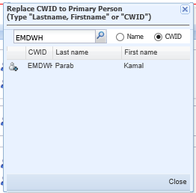
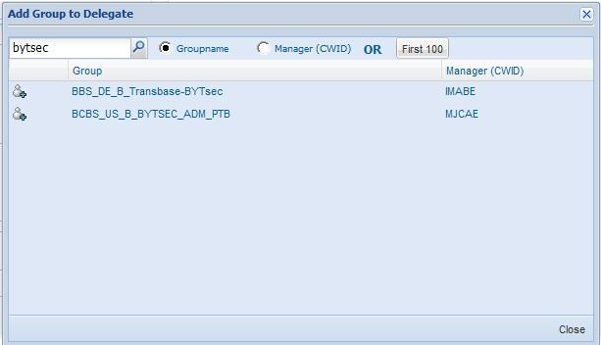
Advance Search Cont..
Click on person-picker to add the CI owner in the respective fields on advance search. It will show you the dialogue box where you can search a single CWID or last name. Results are displayed soon as the first two characters have been entered and the search icon will be pressed.
Clicking into a row will add the entry to the appropriate field.
Click on group-picker to add the Group in the appropriate fields on advance search. You can search either (according to the selection: Group name or Manager (CWID)) by a group name or the manager of a group using the managers CWID.
For group name results containing the entered characters are displayed soon as the first three have been entered. For manager (CWID) results are displayed soon as the CWID is entered completely

Slide 17
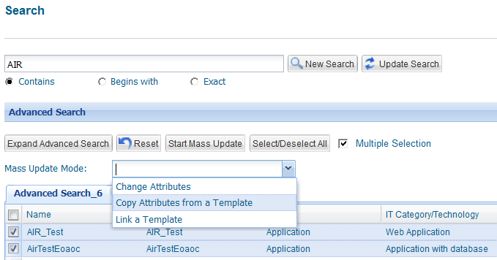
Mass Update
The mass update actualizes the same data of the same types of CIs in a process. Mass update can be done to update the attributes directly for multiple CIs, you can use an existing CI as template to copy its attributes in selected CIs, and also you can link an existing CI to the selected CI.
As this process is not reversible (other than modifying each relevant CI), so to do the mass update secured preliminary steps are created.
The selection of the individual elements is done very carefully to avoid overwriting of the element data. Restoring the old data is only manually possible.

Slide 18
Mass Update Cont…
Mass Update Modes
Change Attributes using this mode user can directly update the attributes against the multiple CIs selected in the list.
Copy attributes from a template using this mode user can copy all or selected attributes from a specify template against the multiple CIs selected in the list
Link a Template using this mode user can directly link a template (CI) to the multiple CIs selected in the list.

Slide 19
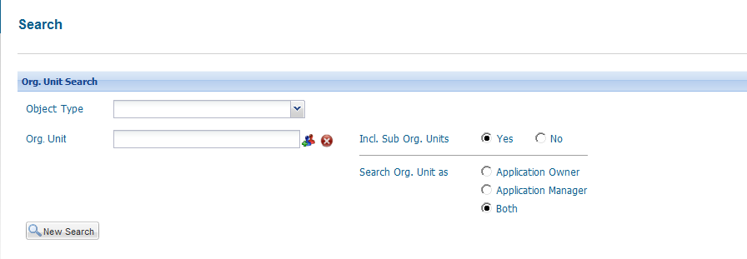
Org. Unit Search
The Org. Unit Search can be used to search the elements related to Organizations - Objects which refers to the Cl-types function, Contract, SLA-Class, and SLA. Enter the name or alias of a record you are looking for and press the search button

Slide 20
Create & Delete Components
This section will provide an overview of creating New & Delete components. You will learn how to create new CIs manually using wizard, copying existing item and updating information, also you will learn how to delete existing items.
In this section, we will cover 3 topics
New by Wizard
New by Copy
Delete

Slide 21
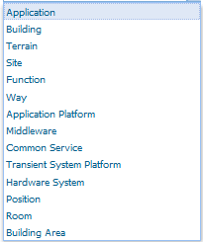
New by Wizard
For the CI-types, application platform, middleware, common service, system platform, storing position, room, route, SLA and Contract, it is possible, to manually create a new element.
Creating a new record is supported by a wizard. Based on Application Type selection required fields can be varied.
For creating new CI, the pre-requisites are the rights for new-creation and that the role of the user or the type of CI must be specified. For newly created configuration items (CIs, the currently logged in user is entered in the role as effective read-write authorizer.
For creating new CI first select desired CI-Type from Type field. It allow use to create different types of CIs, different CI-Type require different information to be filled.
CI-Types

Slide 22
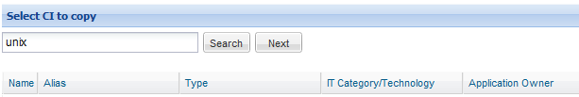
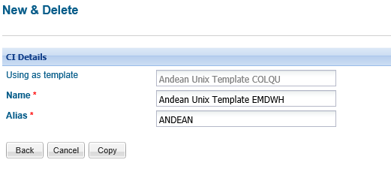
New by Copy
Existing CI templates can be assigned to a new CIs. This can be done by entering the desired CI in text area and click on Search. If no records were found that matched your search criteria, the message “Nothing found or no filter set” appears. Using this function you can copy an existing CI and later you can update set its attributes
Select specific record and click on next to copy the particular template.
Enter CI name and alias to which the template would be assigned. Click on Copy to assign the same template to selected CI. Once the template is copied user can edit the attribute information and save it.

Slide 23
Delete
Pre-requisites for deletion of CIs:
The user role must also be assigned to the rights for deletion
The CI-type must allow the deletion
Those CIs need not be handled, which are imported from a source-system.
Initially [Delete] will not be activated, for deleting individual elements select the CI from the list and then click on click [Delete] on top left of the result pane.

Slide 24
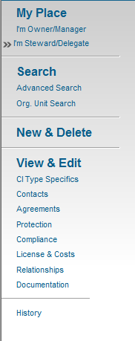
View & Edit Components
This section will provide an overview of the View & Edit of components. The View and Edit menu includes several sub-menu items depending on the record type and user rights.
View & Edit menu appears on selection of CI form the search result. It includes several sub menus depending on the record type and user rights.
This section allows us to view information applied to specific CI. If users have proper rights then also users can do edition in existing information. If user doing edition then switching between the sub-menu items changes made are retained.
When exiting the menu you will be prompted to save if something has changed.
The Name and Type is displayed within the header of the content pane.

Slide 25
View & Edit Components Cont…
CI Type
This section contains all general attributes specifying the records. Every CI type should be defined with some general information. CI Name must be unique values through all existing records.
Contacts
Contacts is in an early stage of development. For ‘Application’ type the contact types are available and can be filled using the Person-and Group-Picker. Contacts can search either by CWID or last name. Results are displayed soon as the first two characters have been entered. Within the Group-Picker you can search either by a group name or the manager of a group using the managers CWID. For group name results containing the entered characters are displayed soon as the first three have been entered.
For manager (CWID) results are displayed soon as the CWID is entered completely. Clicking into a row will add the entry to the appropriate field.

Slide 26
View & Edit Components Cont…
Agreements
All concluded agreements can be specified for agreement type CI. The Service Contract depends on the chosen SLA/OLA.
In some cases no Service Contract has been defined for a particular SLA/OLA. All other attributes have no dependencies.
The Attribute Business Essential is only editable for users with role “Business Essential Editor”.
.
Protection
The Documentation of protection relevant values can be edited on this page
The Protection class is calculated by the Information class and Application Protection is calculated by Integrity and Confidentiality.
.

Slide 27
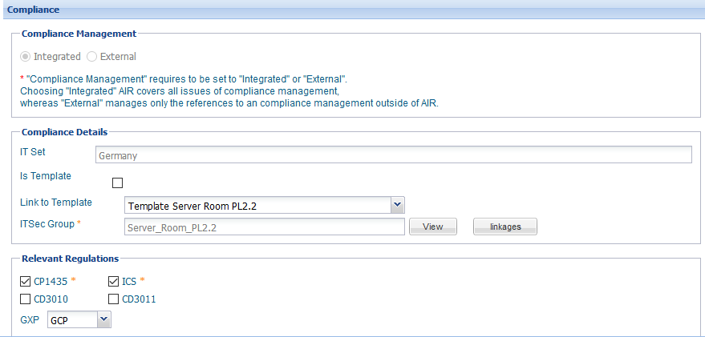
View & Edit Components Cont…
Compliance management shows the documentation of the compliance relevant values. Documentation ensures that a set of people are following a given set of rules. The rules are referred to as the compliance standard or compliance benchmark, while the process is what manages their compliance.
.
Compliance

Slide 28
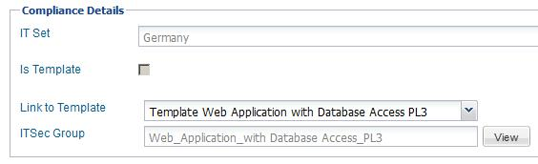
View & Edit Components Cont…
It defines whether the compliance management for a CI is “integrated”, so that AIR covers all issues of compliance management, whereas “External” manages only the references to compliance management outside of AIR. Define whether the record is CP1435, CD3010, ICS,CD3011 or GXP relevant or not and if a formal risk analysis is available. The ITSet is calculated using the CIOwner Primary Person’s country.
If Use as BYTsec Template is selected given compliance statements (Figure 13) can be linked to other records of the same type. If a record is used by another one, this attribute is dis-abled.

Slide 29
View & Edit Components Cont…
At the current version the group Controls cannot be edited. With choosing the Button “View”, the controls.
Compliance Control Detail
The compliance details list shows all controls, ordered by status and ident.
The icon indicates that this control can be linked to a function. Choose the “Link – CI Type” and the “Link – CI”. The Statement changes to read only mode. The “Compliant” and the “Justification” show the Statement from the linked CI

Slide 30
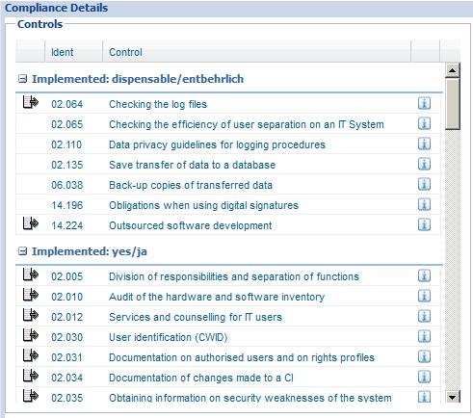
View & Edit Components Cont…

Slide 31
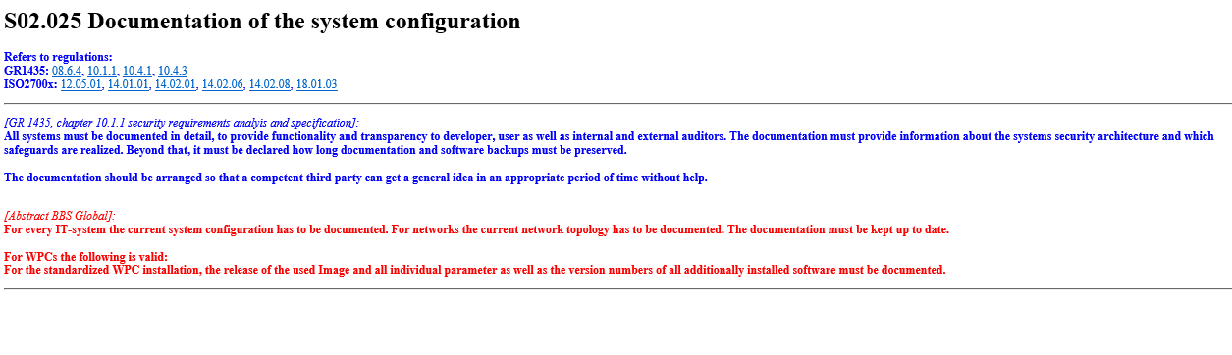
View & Edit Components Cont…
The information button opens a new window and displays the documentation.

Slide 32
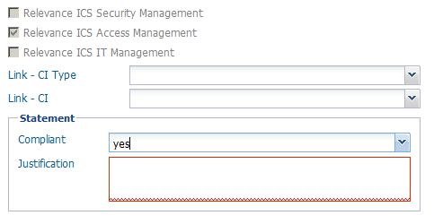
View & Edit Components Cont…
To change the status control, select the control in the left window and change the compliant to new status. For all answers (without “untreated”) a justification is needed.

Slide 33
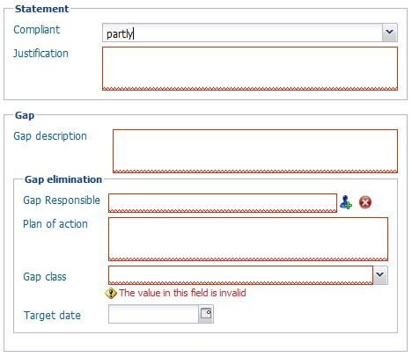
View & Edit Components Cont…
The answers “no” and “partly” demand more information about the GAP. The text description about the actual state of the gap must be entered in the field “Gap description”.

Slide 34
View & Edit Components Cont…
The gap must be assigned to a person, who is responsible to solve the gap. This person can be chosen with the person picker in the field “GAP Responsible”. The planned actions to solve the gap can be documented in the field “Plan of action”.
After selecting a gap class with values (“short-term”, “mid-term” or “long-term”) the “Target Date” will be calculated.
If the selected value for the gap class is “technically not solvable” or “economically not solvable” the details risk analysis and management information are required.

Slide 35
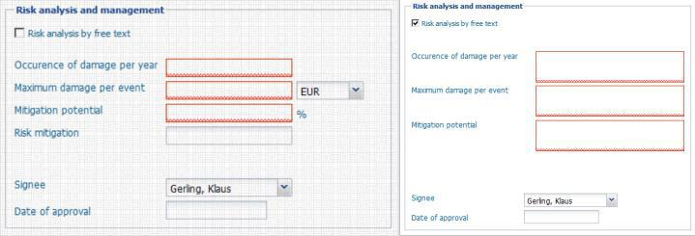
View & Edit Components Cont…
By selecting the checkbox “Risk analysis by free text” changes the data fields from calculated to text fields.
The selected person as “signee” is the only person who is able to set the “Date of approval”.

Slide 36
View & Edit Components Cont…
Document annual costs for run and changes as well as general properties of a license as extend or part of a contractual provisions.
Use Using Regions to specify the region(s) where the majority of belonging companies is using the application. Multiple selections can be done. Click one-time to select a second-time to unselect.
.
License & Costs
Relationships
Shows all connections to directly attached business processes and other records.
.
Attributes for documentation purpose are free-text. If a URL is entered it can be validated by
.
Documentation

Slide 37
View & Edit Components Cont…
The history function displays the database history information about the selected CI.
.
History
Relationships
Shows all connections to directly attached business processes and other records.
.

Slide 38

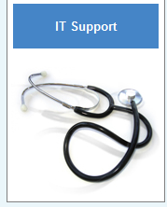
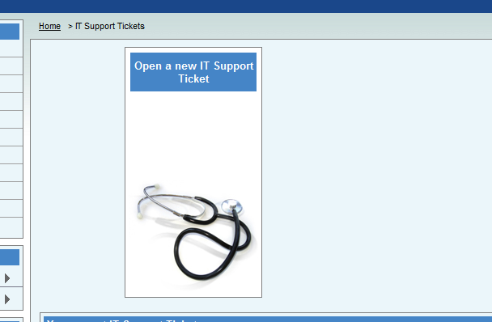
Help Me
IT Service Portal is assigned to provide the complete support on AIR application.
.
Need Help
https://itserviceportal.intranet.cnb/spo/faces/bay/portal?execution=e1s1
Open a new IT support ticket
.

Slide 39

Thank you!

