Slide 1
cosc 4730
Android Fragments

Slide 2
Activity vs Fragments
If you only have one screen for an app
  You never need to launch another activity or even a dialog screen (other then some simple default ones). Then you don’t need Fragments
Once you need two or more screen or complex applications (say swipe to the left or right), then you need fragments.
But you will always have at least one single activity.

Slide 3
Fragments
You can think of a fragment as a modular section of an activity, which has its own lifecycle, receives its own input events, and which you can add or remove while the activity is running (sort of like a "sub activity" that you can reuse in different activities).
There is a the Support Library so your app remains compatible with devices running system versions as old as Android 1.6.

Slide 4
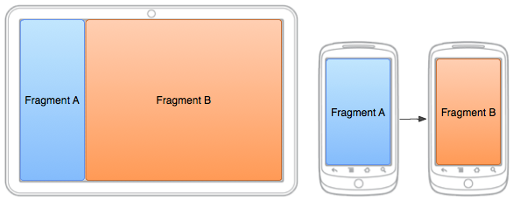
Fragments (2)
We’ll start off very simple, using only a tablet size screen, so that our fragments will be shown
Second we move onto supporting smaller size screens, where the both fragments don’t show at the same time
We’ll start with native API 11+ and then come back to supporting older android devices

Slide 5
Basics
The main activity is created as normal with a layout. The code the main activity is reduced to the onCreate, menu, and fragments controls.
  Otherwise, everything else is handled in the fragments.
Fragments come in a couple of varieties like activities
  Fragment, ListFragment (like a listView), DialogFragment, PreferenceFragment, and WebViewFragment, even a FragmentTabHost

Slide 6
XML layout
In the xml, we using fragment and associate each fragment with a java class of fragment
Our example layout:
<fragment
android:id="@+id/frag_titles" android:layout_weight="1"
android:layout_width="0dp" android:layout_height="match_parent"
class="edu.cs4730.frag1demo.titlefrag" />
<fragment
android:id="@+id/frag_text" android:layout_weight="2"
android:layout_width="0dp" android:layout_height="match_parent"
class="edu.cs4730.frag1demo.textFrag" />
frag_titles uses titlefrag.java class
Note, this layout will have two fragments, the LinearLayout of was left off for space.

Slide 7
Fragment code
In the Fragment, you have the same callback methods as an activity
  onCreate(), onStart(), onPause(), and onStop()
And OnCreateView()
  The system calls this when it's time for the fragment to draw its user interface for the first time. To draw a UI for your fragment, you must return a View from this method that is the root of your fragment's layout.
  You can return null if the fragment does not provide a UI.
OnAttach() and OnDetach()
  This is when a fragment becomes associated with an activity.

Slide 8
Fragment code (2)
You should implement at least these three
OnCreate(), onCreateView()
  The onCreate() is for setup of variables
  OnCreateView()
    Android also says the OnPause().
See http://developer.android.com/guide/components/fragments.html for the Fragment life cycle and the other callback methods.

Slide 9
Fragment
The OnCreateView() returns a view and calls the layout associated with this fragment
  R.layout.text is the layout being used for this view.
@Override
public View onCreateView(LayoutInflater inflater, ViewGroup container, Bundle savedInstanceState) {
View view = inflater.inflate(R.layout.text, container, false);
TextView tv = (TextView) view.findViewById(R.id.text);
tv.setText(“Hi”);
return view;
}
We can use getView() in other methods (in this fragment), so we can find and use the varying widgets into the layout. Example:
  TextView tv = (TextView) getView().findViewById(R.id.text);

Slide 10
ListFragment
Displays a list of items that are managed by an adapter (such as a SimpleCursorAdapter), similar to ListActivity.
It provides several methods for managing a list view, such as the onListItemClick() callback to handle click events.
It returns a ListView, instead of view and does not need to be implemented. Instead it can be done in the OnActivityCreate with setListAdapter()

Slide 11
ListFragment (2)
Example:
@Override
public void onActivityCreated(Bundle savedInstanceState) {
super.onActivityCreated(savedInstanceState);
  ArrayAdapter<String> adapter = new ArrayAdapter<String>(getActivity(), android.R.layout.simple_list_item_1, Shakespeare.TITLES);
setListAdapter(adapter);
}

Slide 12
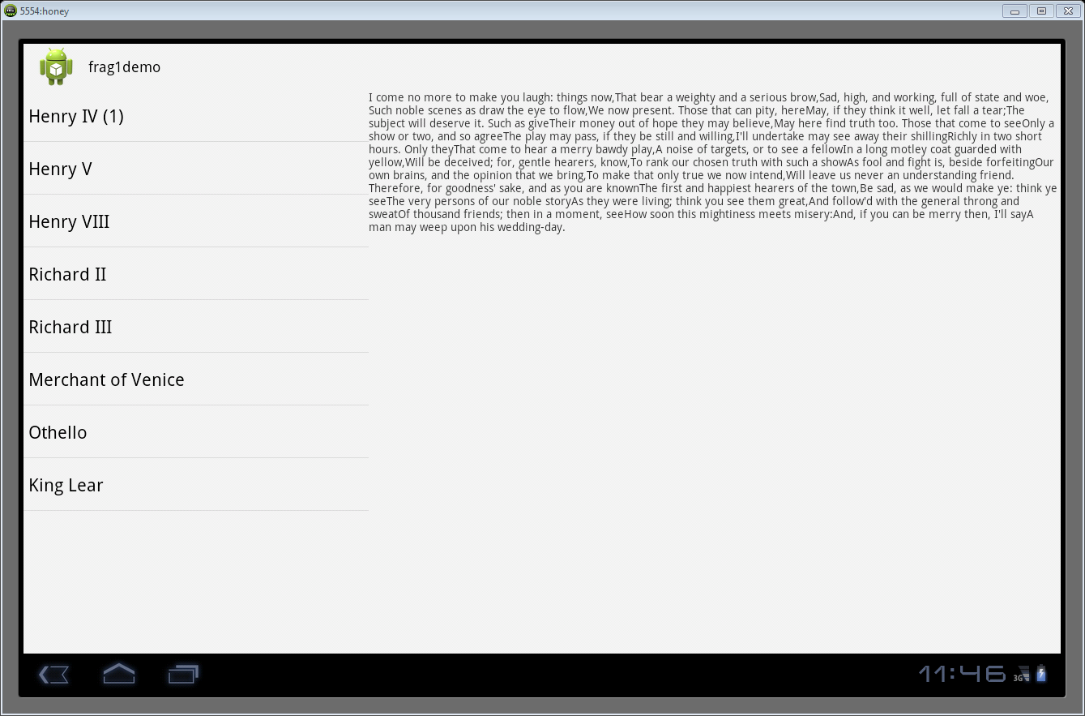
Pulling it all together
Source: Frag1demov11

Slide 13
Supporting multiple sizes.
We can easily support multiple size screen, with fragments and layouts.
  We are going to let the device do most of the work.
    We will need to create layouts for the different sizes, in this case, three layouts: two pane, and one for each A and B.

Slide 14
Supporting multiple sizes (2)
We already have the two pane layout from before (main.xml).
  We’ll need to move this to res/layout-large or res/layout-land or res/layout-sw600dp
      Really depends on when you want this layout to be used.
      I used layout-land, so I switch between landscape and portrait.
Create a new main.xml in the res/layout directory for listfragment.
  Note they need to have the same name, that way the device picks the correct layout.
  We can also use resource aliases and kept all the layouts in the layout directory with different names
    This can be more confusing.

Slide 15
Res/layout/main.xml
<fragment xmlns:android="http://schemas.android.com/apk/res/android"
xmlns:tools="http://schemas.android.com/tools"
android:id="@+id/frag_container"
android:name="edu.cs4730.frag2demo.titlefrag"
android:layout_width="match_parent"
android:layout_height="match_parent"
android:layout_marginLeft="16dp"
android:layout_marginRight="16dp"
tools:context=".Fd2v11"
tools:layout="@android:layout/list_content" />

Slide 16
In the activity
In the first version, we had nothing in the activity and most the work in the fragments
  Since we knew they were both always on the screen.
Now we are going to setup a callback for the ListFragment OnListItemClick and the activity will communicate between the fragments.
  In portrait mode, it will launch the textfrag.

Slide 17
titlefrag changes
The code creates a public interface called Callbacks
  This is then implemented in the activity
The OnListItemClick calls the callbacks, which is then sent to the activity.
  Also use onAttach and onDetach method to ensure then when the fragment is not visible we don’t get any errors.
  See the code fragdemo2v11 and fragdemo2

Slide 18
Activity changes
class Fd2v11 extends FragmentActivity implements titlefrag.Callbacks
The onCreate sets the layout as main
It then checks for the R.id.frag_container
  If NULL, then the two fragment version of main.xml is in use.

Slide 19
One more change.
Google standard is when there is a single fragment showing, to use an activity.
  So a textActivity has been created with a separate layout as well
    It’s a framelayout and the textActivity then puts the fragment in the framelayout.

Slide 20

Navigation
In portrait mode, in the textActivity, the back button will take back to the titles.
We can also provide a navigation button as well via the menu/Action bar
First turn it on in OnCreate.
    getActionBar().setDisplayHomeAsUpEnabled(true);
Using the Support NavUtils in onOptionsItemSelected(MenuItem item)

Slide 21
Navigation (2)
The Parent Activity class
@Override
public boolean onOptionsItemSelected(MenuItem item) {
switch (item.getItemId()) {
case android.R.id.home:
Intent upIntent = new Intent(this, Fd2v11.class);
// This ID represents the Home or Up button. In the case of this
// activity, the Up button is shown. Use NavUtils to allow users
// to navigate up one level in the application structure. For
// more details, see the Navigation pattern on Android Design:
// http://developer.android.com/design/patterns/navigation.html#up-vs-back
//
NavUtils.navigateUpTo(this,upIntent);
return true;
}
return super.onOptionsItemSelected(item);
}

Slide 22
Navigation (3)
We also need to add this information into the AndroidManifest.xml
<activity
android:name="edu.cs4730.frag2demo.textActivity"
android:label="@string/app_name"
android:parentActivityName=".Fd2v11" >
<meta-data
android:name="android.support.PARENT_ACTIVITY"
android:value=".Fd2v11" />
</activity>

Slide 23
Issue.
the way I’m doing this
  It switches between two fragments (landscape) and one fragment (portrait) layout
  But when the textActivity is showing and change from portrait to landscape mode, the textActivity stays.
    This is not a surprise, instead it is what you would expect. But it is not the what I want.

Slide 24
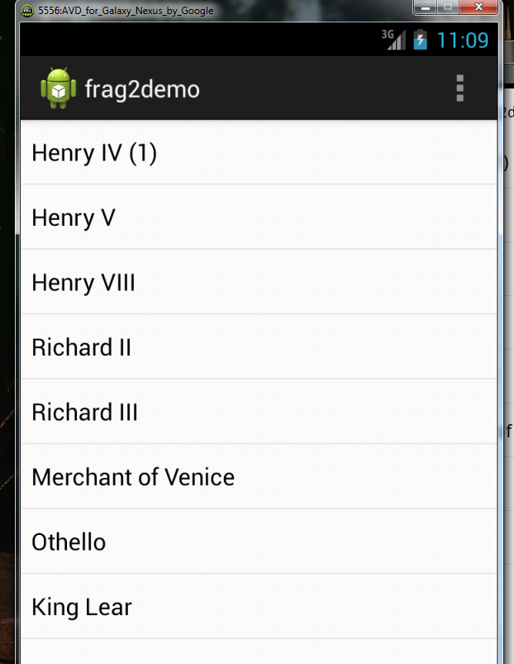


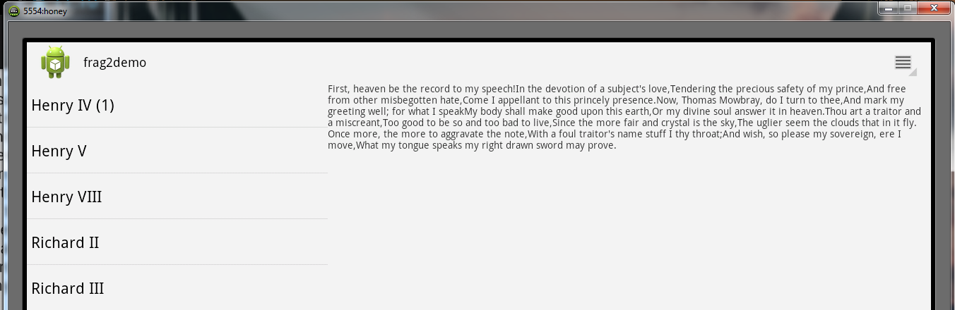
Both devices.

Slide 25
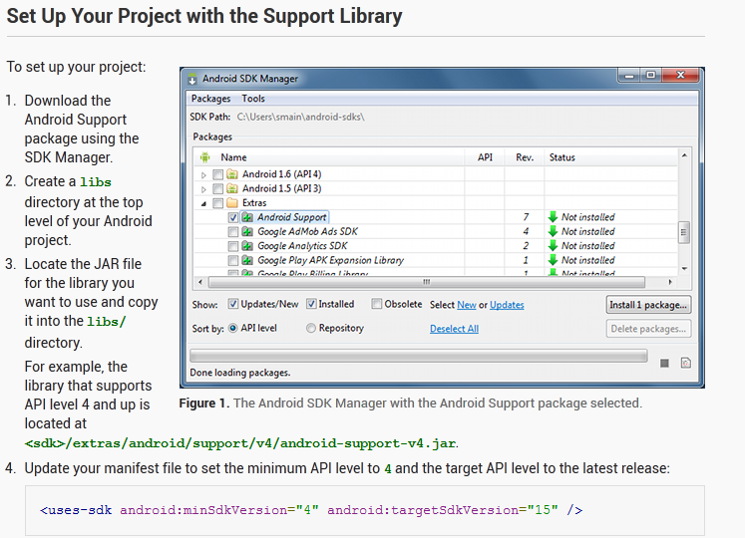
Support library for 2.X

Slide 26
Support library for 2.X (2)
Now make sure that any you use fragment it is importing the correct fragment.
import android.support.v4.app.Fragment;
import android.support.v4.app.FragmentManager;
Import android.support.v4.app.ListFragment;
...
  Instead of android.app.Fragment
Change the activity to a FragmentActivity
And import android.support.v4.app.FragmentActivity;

Slide 27
Support library for 2.X (3)
Another odd problem.
Using getSupportFragmentManger() vs getFragmentManger()
  Use getSupportFragmentManger() in a FragmentActivity.
  Use getFragmentManager() in a fragment, even if it is
    import android.support.v4.app.Fragment;
      Or others like a listFragment.

Slide 28
A note
On the demo code.
  There is frag1demo and frag1demov11
  There is frag2demo and frag2demov11
  The v11 means it is NOT using the support library, in other words it works only api 11 onwards (honeycomb)
  Well the others should works on api 8+ (froyo)
    After the support explanation, all examples will use the support library.

Slide 29
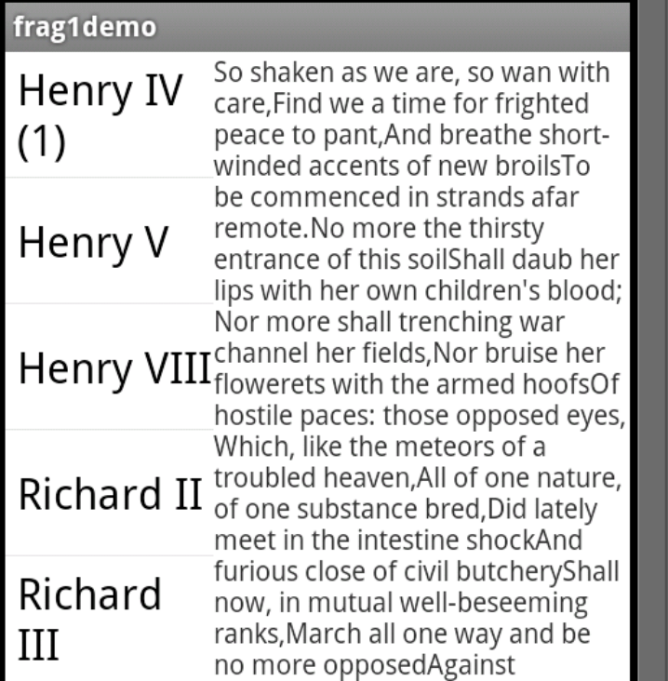
Support library for 2.X (3)
And now on a 2.3.3 we get
uses frag1demov11 as the base code
frag1demo

Slide 30
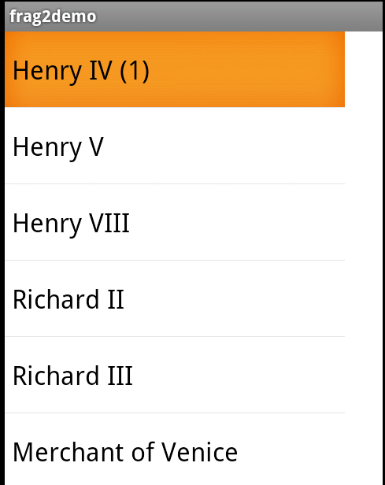
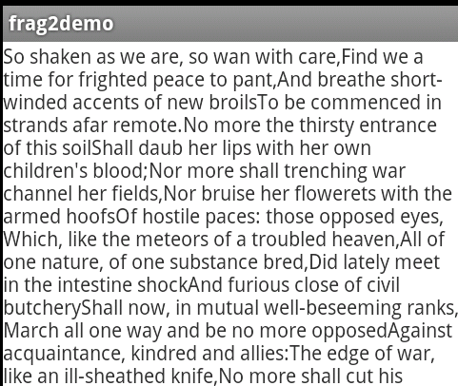
Support library for 2.X (4)
And we get
Frag2demo.

Slide 31
A note on navigation.
It doesn’t work until Honeycomb (api 11+)
So in the code,
if (Build.VERSION.SDK_INT>=Build.VERSION_CODES.HONEYCOMB) {
getActionBar().setHomeButtonEnabled(true);
}
There is a ActionBarCompat, which I can’t seem to make work.
  <android sdk folder>/samples/android-15/ActionBarCompat/src/com/example/android/actionbarcompat/
Also see http://actionbarsherlock.com/ which is a library to do an Actionbar in all versions as well.

Slide 32
FrameLayouts
In both demo before, the layout specified the fragment to be displayed.
We also have a layout called FrameLayout.
  It is a generic layout that we can use to display fragments in and we can decide at runtime.
  We think of this as a container.
  Frag3demo uses a framelayout instead of a fragment for the portrait layout.
    Also removed the textActivity, since we won’t need it.
    The two fragments are unchanged from frag2demo.

Slide 33
res/layout/main.xml
<FrameLayout xmlns:android="http://schemas.android.com/apk/res/android"
android:layout_width="match_parent“
android:layout_height="match_parent"
android:id="@+id/frag_container">
</FrameLayout>

Slide 34
Activity code.
So still check for two or one pane in oncreate
If frag_container exists, then one pane and we need to create and display the fragment.
firstFragment = new titlefrag();
getSupportFragmentManager().beginTransaction().add(R.id.frag_container, firstFragment).commit();
  Where R.id.frag_container is the “view” or container where the fragment is to be displayed
  firstFragment is the fragment to display.
If that is skipped, then nothing we be displayed on the screen (ie a blank white screen).

Slide 35
Activity code (2)
Second change is to the onItemSelected
  We need to change to the text fragment to display the text.
  secondFragment = new textFrag();
  Bundle args = new Bundle();
  args.putInt("position", id);
  secondFragment.setArguments(args);
  FragmentTransaction transaction = getSupportFragmentManager().beginTransaction();
  // Replace whatever is in the fragment_container view with this fragment,
  transaction.replace(R.id.frag_container, secondFragment);
  // and add the transaction to the back stack so the user can navigate back
  //using the back button.
  transaction.addToBackStack(null);
  // Commit the transaction
  transaction.commit();

Slide 36
Activity code (3)
There are other changes in the code as well, but I’ll well look at the code.
Now the nice effect of all this is there is no TextActivity, so an orientation change switches between the two layouts as I wanted.
  We can also change between many different fragments now as well.
As note, this code may sometimes force close on exit (assuming I haven’t fixed it).

Slide 37
View pagers.
The easist way to do a screen slide is to use a ViewPager.
  You add fragments to the ViewPager (via an adapter) and then the user can swipe left or right to change pages.
  You can also add custom animations
    Not shown here.

Slide 38
ViewPager
The viewpager is setup in the layout and can be the only view or included with other widgets.
<android.support.v4.view.ViewPager
xmlns:android="http://schemas.android.com/apk/res/android"
android:id="@+id/pager"
android:layout_width="match_parent" android:layout_height="match_parent">
</android.support.v4.view.ViewPager>

Slide 39
ViewPager (2)
You can also include a tab strip to give the user reference and click those instead of swiping.
<android.support.v4.view.ViewPager
xmlns:android="http://schemas.android.com/apk/res/android"
android:id="@+id/pager"
android:layout_width="match_parent" android:layout_height="match_parent">
<android.support.v4.view.PagerTabStrip
android:id="@+id/pager_header“
android:layout_width="match_parent" android:layout_height="wrap_content" android:layout_gravity="top"
android:background="#000" android:paddingBottom="4dp"
android:paddingTop="4dp" android:textColor="#fff" />
</android.support.v4.view.ViewPager>

Slide 40
FragmentPageAdapter
Basically, you add/put fragments in an adapter and then add the adapter to the viewpager.
The FragmentPagerAdatper requires an override of
  GetItem which says which fragment to display
  getCount which says how many fragments/pages are there.
  You need a constructor as well.
  For the PagerTabStrip to work, you also need to override getPageTile as well.

Slide 41
FragmentPageAdapter example
public class ThreeFragmentPagerAdapter extends FragmentPagerAdapter {
public ThreeFragmentPagerAdapter(FragmentManager fm) { super(fm); }
@Override
public int getCount() { return 3; }
@Override
public Fragment getItem(int position) {
switch (position) {
case 0: return leftfrag; //these are fragments.
case 1: return midfrag;
case 2: return rightfrag;
default: return null;
}
}
}

Slide 42
Activity
In the OnCreate
Get the ViewPager from the layout
viewPager = (ViewPager) findViewById(R.id.pager);
Set the adapter.
viewPager.setAdapter(new ThreeFragmentPagerAdapter(fragmentManager));
That’s it, now the veiwpager handles everything else.

Slide 43
“Saving” fragments
Frag6demo shows how to save the state of fragments between orientation changes
Fragments are simply a screen and data encapsulated, so it can be “saved” like data.

Slide 44
frag7demo
This demo is purely to show that you can have two viewpager on the same layout
Plus it deals with landscape and protriat differences.
We go through the code.

Slide 45
References
The fragdemo.zip contains all the code covered in this lecture.
http://architects.dzone.com/articles/android-tutorial-using (Viewpagers)
http://developer.android.com/training/animation/screen-slide.html
http://www.techrepublic.com/blog/app-builder/get-started-with-android-fragments/1050
http://developer.android.com/training/basics/fragments/creating.html
http://developer.android.com/guide/components/fragments.html

Slide 46
Issues.
What I can not get working yet is two different layouts with fragments switching between landscape and portrait.

Slide 47
ListFragment (titlefrag)
Now we need to put the text fragment on top when an item is clicked.
textFrag frag = (textFrag) getFragmentManager().findFragmentById(R.id.frag_text);
if (frag != null && frag.isInLayout()) { //layout-large
frag.setText(position);
} else { //smaller devices, it’s not showing, so we need to create it.
frag = new textFrag();
Bundle args = new Bundle();
args.putInt("position", position);
frag.setArguments(args);
// Replace whatever is in the fragment_container view with this fragment,
// and add the transaction to the back stack so the user can navigate back
FragmentTransaction transaction = getFragmentManager().beginTransaction();
transaction.replace(R.id.frag_container, frag );
transaction.addToBackStack(null); //null is for the tag name, which we do not need.
// Commit the transaction
transaction.commit();
}

Slide 48
Other changes.
Since the titlefrag has not been inflated yet, a bundle was sent to it with the position and in onCreate() for titlefrag, it loads the position out of the bundle to display text.
See source code for other minor changes.

Slide 49
Q
A
&

