Slide 1

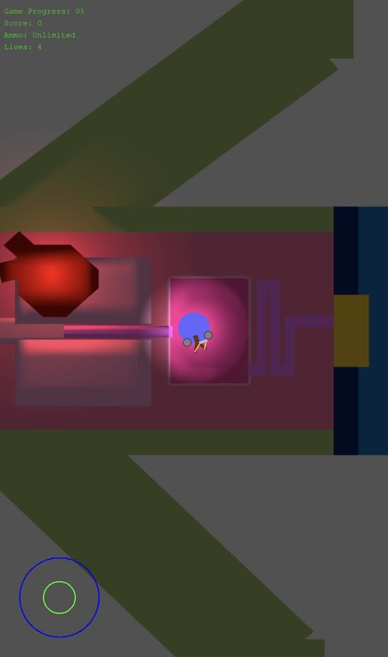
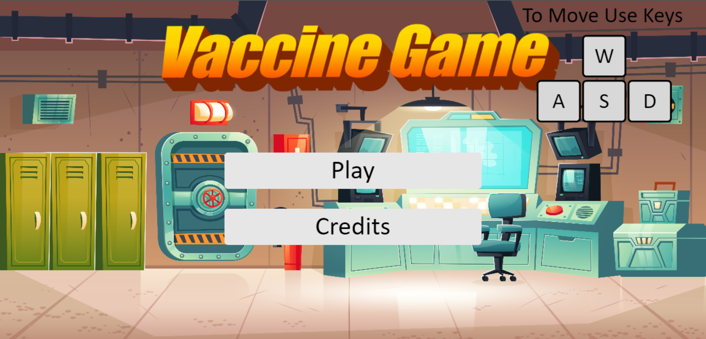
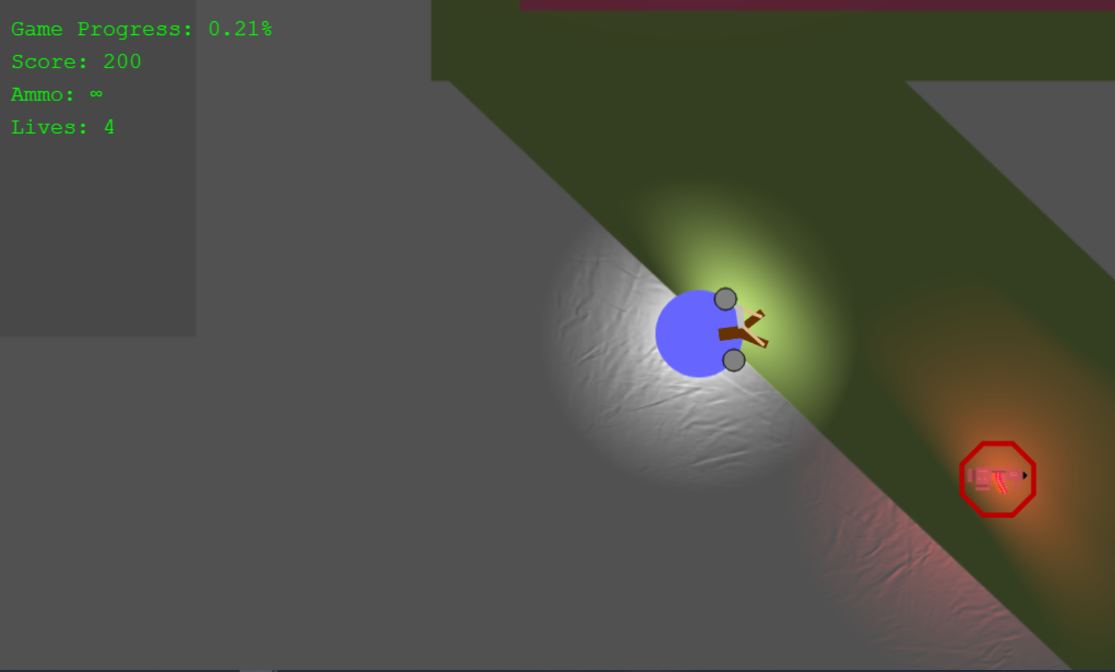
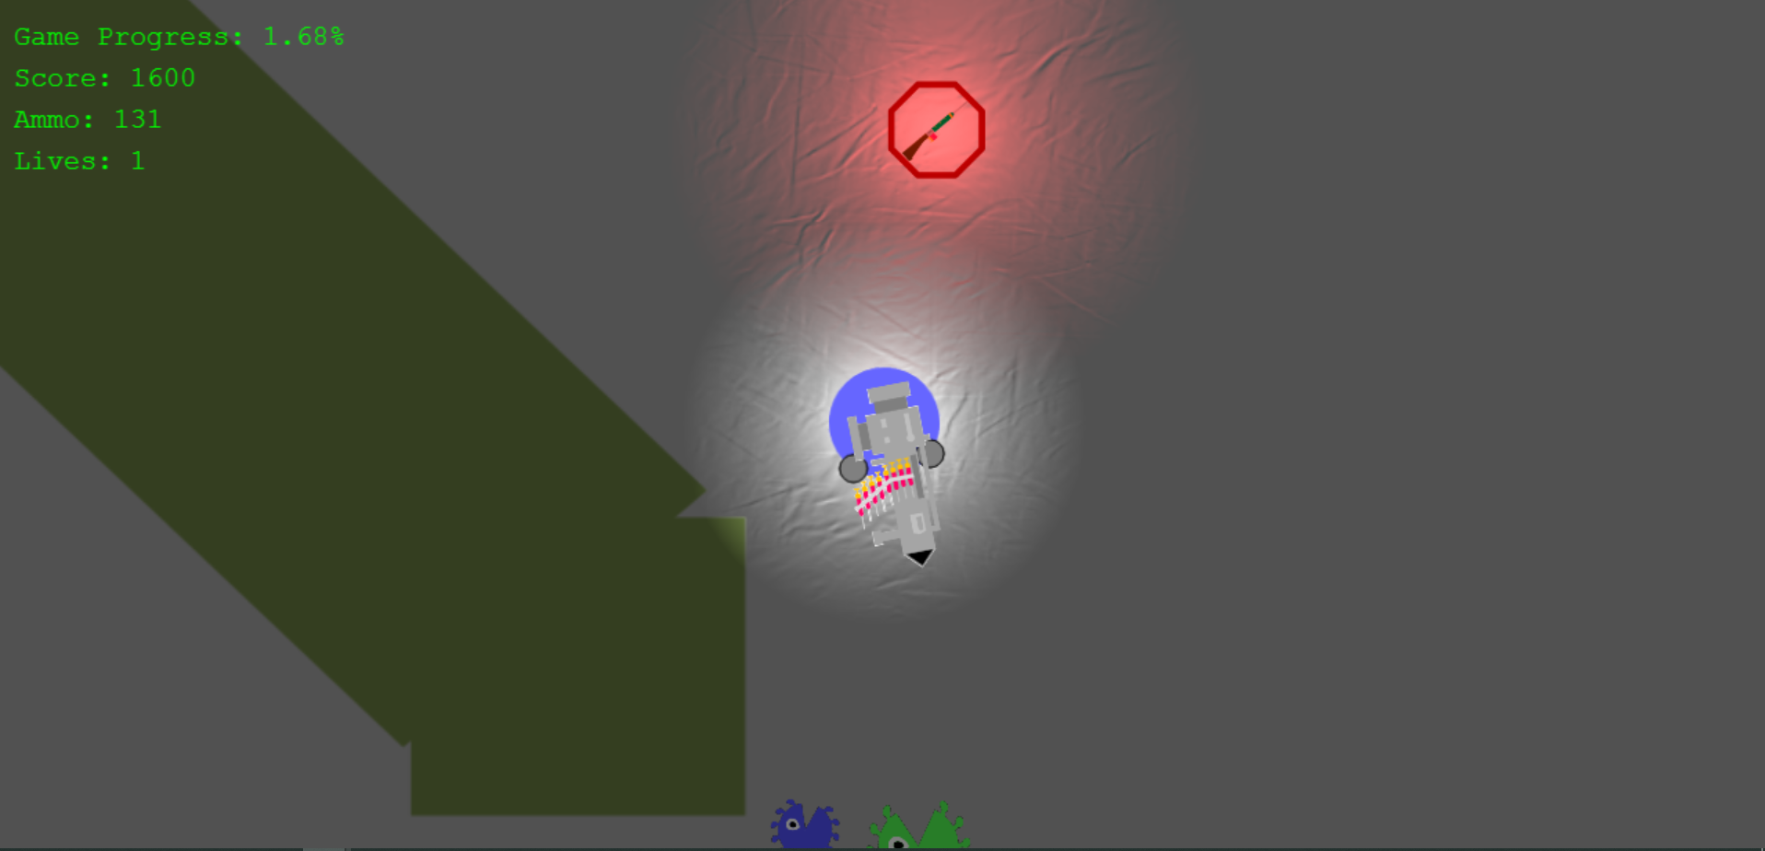
Vaccine Hesitancy Game
for
Texas A&M’s PEER Program
Team: InsertNameHere
Benjamin Hawn
Bhogesh Maddirala
Catherine Shen
Liuyi Jin
Identify the Project
Defining User Stories
Development and Production
Given a list of potential projects and clients, we chose the top 5 that interested us, then client was assigned.
Our client gave us the creative freedom on designing a vaccine hesitancy game
First meeting with client established the goal and key features of the project
Met with client almost weekly during the second half of semester to update on progress and obtain feedback
Implemented client’s user stories mentioned and discussed features to improve
Assigned roles and user stories accordingly
Communicated with client, created and completed user stories, demo’ed game, & recorded progress over 4 iterations
Primarily BDD was done with manual testing
Our Client
Non-Profit Organization: The Partnership for Environmental Education & Rural Health (PEER) Program at Texas A&M College of Veterinary Medicine & Biomedical Sciences (CVMBS)
Client Name: Dr. Walker
Stakeholders: PEER Program, students who will play the game
Problem to Solve
Create a JavaScript-based game that can be deployed to PEER Program WordPress site by Samiksha
Game should do the following:
Bring awareness towards benefits of vaccines, particularly that of COVID-19, for those who are vaccine hesitant
Be fun to play with a theme around vaccines
Be compatible and working on all major browsers on desktop and mobile
Main Features Implemented
Player moves, shoots and kills converging enemy viruses
Killing viruses drop different vaccine weapons that increase the amount of ammunition player can shoot at once
More viruses spawn, move faster, and are more difficult to kill as difficulty increases
Win game after reaching a certain number of points, lose game if you lose all of your lives
Challenges Encountered
JavaScript and Phaser: Unfamiliarity with the JavaScript language for development allocated much time spent on choosing a framework and learning and adjusting to a new environment.
User stories: Since we were given creative control over the game, we spent more than a week to plan and design it, causing us to change the user stories often.
TDD/BDD: Tests are usually written before implementation, but for a game that was built with the phaser framework and had changing implementations depending on customer input, we couldn’t really do TDD. We had to have users manually test and document the features in the game because normal testing frameworks doesn’t work with phaser. Thus, less TDD and more BDD was used in testing.
Time: Not all user stories could be implemented in the short timeframe available (~1 month)
Development Environment
Familiarity with the language, framework and development environment is important to have prior to development.
Communication with client and documenting helps us understand the client’s needs and stay on the right path.
Testing
Testing is essential in making the game works as implemented however since it’s not compatible with TDD, we had to manually test and use mostly BDD. Testing by playing the game makes sure the features work as implemented, makes finding glitches faster and also we gain knowledge on possible improvements to the game.
Prioritization
Learning how to prioritize the features important to our client is key to delivering a working product that meets the client’s needs within a short timeframe.
Mobile Version
Start Page
Beginning of Game
Vaccine Item Drops
Notes:
Outline of poster:
Who the client is
What is the problem we are solving for them
What was our solution to these problems
What was the design process like
What specific design choices we made
Challenges we faced
Lessons we learned about the software engineering process from those challenges
Need to be able to talk about the poster for 5 minutes before doing a live demo

