Slide 1
API AutoTest
Hack Elite
Team:
Apurv Shah
Jiten Chovatia
Kaushal Shah
Urmil Wani

Slide 2
Business Problem
At the moment during release time, lot of time goes into testing of RESTAPI applications.
How to reduce testing time and increase the productivity & Quality by automating repetitive kind of work?

Slide 3
Solution
We came up with an idea to overcome manual testing efforts by automating testing of RESTAPIs.

Slide 4
Benefits
Able to pass various type of parameters (i.e. URL, credentials, method names, input parameters etc.).
Able to run all API subsequently without any human interaction and reduce QA efforts.
Can run as a schedule task and run in background.
Execution of all test cases can be performed in minimal time.
Response can be easily compared with expected output with specific text or values.

Slide 5
Technology Used
C#
.Net Framework

Slide 6
Future Scope
Generic application and can be used across organization for all API projects.
Validation of output parameters with actual database values.
Convert application to schedule task or a windows service.

Slide 7
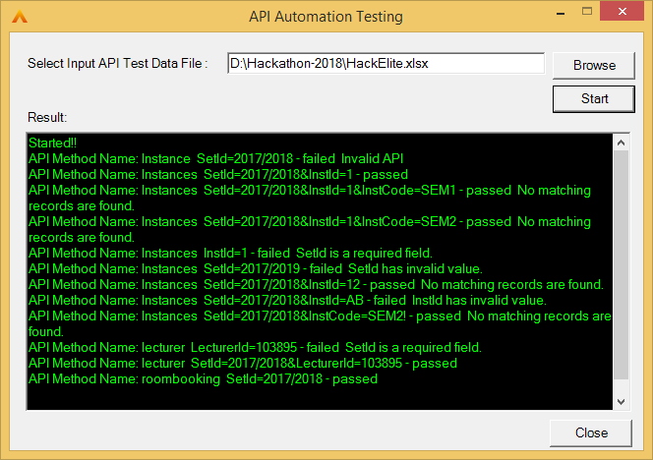
Demo

Slide 8
Thank You

