Slide 1

IILM UNIVERSITY GREATER NOIDA, UTTAR PRADESH
ACADEMIC CREDENTIALS
Kaushal Sharma
B.Tech CSE • Batch 2026-27
CODEC TECHNOLOGIES · AICTE NATIONAL INTERNSHIP PORTAL
Web Development
Roll Number 25SCS1003004035 Designation Web Developer Intern
Internship Presentation Report
Codec Technologies • Internship Completed
INTERNSHIP DURATION 02 July 2026 – 02 August 2026 (1 Month)
An Internship Report submitted in partial fulfilment of the requirement for the degree of B.Tech CSE (Computer Science and Engineering)

Slide 2


Candidate & Program Overview
Candidate Details
Internship Profile
STUDENT NAME Kaushal Sharma
PROGRAM Codec Technologies – AICTE National Internship Portal
ROLL NUMBER 25SCS1003004035
DESIGNATION Web Developer Intern
DEGREE B.Tech CSE (Computer Science and Engineering)
DURATION 1 Month (02 Jul 2026 – 02 Aug 2026)
ACADEMIC BATCH 2026 – 2027
LOCATION & MODE Pan India, Hybrid
UNIVERSITY IILM University, Greater Noida, U.P.
NCS ID / AICTE ID E19E86-0116588288923

Slide 3



Organization Profile: Codec Technologies
Codec Technologies is a global platform empowering learners and connecting diverse talent to meaningful career opportunities. It is an ISO 9001:2015 certified organization delivering IT and business consultancy services across 27+ countries, and is recognized as a Google for Education partner.
AICTE Collaboration
Operates internship programmes under the AICTE National Internship Portal (NIP) framework, empowering engineering talent across India.
Industry Alignment
Delivers dedicated IT and business consultancy services across 27+ countries, bridging academia and industry practice.
Core Focus Domains
Web Development, IT Consultancy, Business Automation, and Enterprise Strategy for global clients.

Slide 4


Problem Statement & Project Context
The Industry Challenge
The Project Scope
While academic curriculum extensively covers building static, single-page academic web projects, students often lack hands-on exposure to the challenges of building responsive, production-grade web applications.
Real-world web development requires addressing concerns largely absent from academic projects — responsive UI/UX, client-server state sync, and secure API integration.
This internship addressed the practical end-to-end web development workflow: requirement analysis, UI/component design, backend API integration, testing, and structured review under an assigned Project Head.
The goal was mastering industry practice — turning a web application concept into a reviewed, documented, and production-ready solution.

Slide 5




Core Project Objectives
Frontend Development
API & Integration
Build responsive, component-based user interfaces using modern frontend frameworks like React.js.
Learn how frontend applications consume and integrate with backend services through RESTful APIs.
Version Control & Workflow
Review & Quality Assurance
Develop proficiency in version control workflows using Git and GitHub for collaborative development.
Incorporate feedback from weekly performance reviews conducted by the assigned Project Head.

Slide 6




Technologies & Tooling
Frontend
Backend & APIs
Database & State
Tools & Deployment
HTML5, CSS3, JS (ES6+)
Node.js, Express.js
MongoDB
Git, GitHub, VS Code, Postman
React.js, Tailwind CSS
RESTful APIs
Context API, Redux
Vercel, Netlify

Slide 7

Web Application Architecture
Client/Presentation Layer
Responsive UI built with React.js components styled using Tailwind CSS, rendered in the browser.
Routing & Middleware Layer
Client-side routing between views and Express.js middleware for requests, auth checks, and validation.
Business Logic/Controller Layer
Express.js controllers implementing core application logic and orchestrating API routes and the database.
Database/Persistence Layer
MongoDB used for structured storage and retrieval of application data via the backend service layer.
Review Layer
Assigned Project Head reviews progress via weekly performance reviews.

Slide 8
Internship Timeline (Week 1 to 4)
Week 1
Week 3
Onboarding, Setup & Wireframing
Backend API Integration & Testing
Onboarding with Codec Technologies, dev environment setup, Git workflow configuration, and wireframing.
Building and consuming RESTful API endpoints, managing state, and testing endpoints with Postman.
Week 2
Week 4
Frontend Component Development
Documentation & Final Submission
Hands-on development of responsive, component-based UI, translating wireframes into layouts.
Cross-browser testing, performance optimization, documentation, and final submission to the Project Head.

Slide 9

Key Skills & Demonstrated Outcomes
Responsive Web Development
Contributed to the development of a responsive web application as part of an industry team.
Frontend-Backend Integration
Practical understanding of integrating frontend interfaces with backend services through RESTful APIs.
Debugging & Testing
Improved proficiency in debugging component-level and API-level issues in a full-stack application.
Responsive Design Compliance
Demonstrated compliance with responsive design principles across device breakpoints.
Hybrid Team Collaboration
Hands-on experience with Git-based version control workflows in a collaborative team setting.

Slide 10
Certification & Official Verification
Verification Metric | Official Record / Credential Details
Internship Title | Web Development Internship (Project Intern)
Issuing Organization | Codec Technologies Pvt. Ltd. (ISO 9001:2015 Certified)
Academic Patronage | AICTE National Internship Portal
NCS ID | E19E86-0116588288923
AICTE ID | CORPORATE6759d549ce59e1733940553
Duration | 02 July 2026 – 02 August 2026 (Date of Issue: 02 Jul 2026)

Slide 11
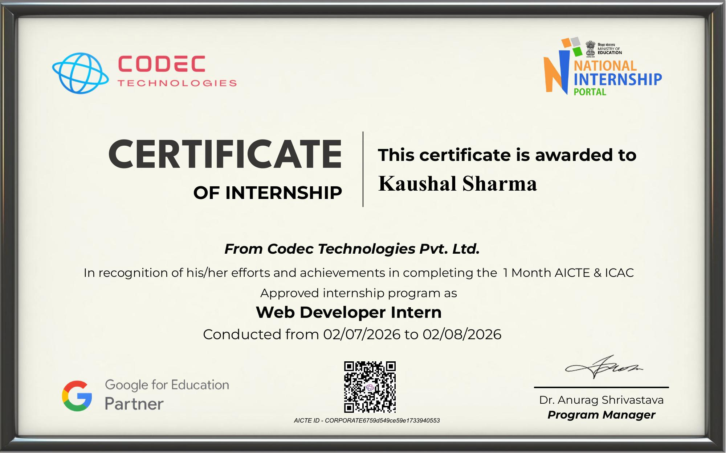
Certificate of Internship

Slide 12
Thank You!
Kaushal Sharma Roll No: 25SCS1003004035
School of Computer Science & Engineering IILM University, Greater Noida, U.P.

