Slide 1
CH-2
Validation Controls

Slide 2
ASP.NET Validation Controls
Validation is important part of any web application. User's input must always be validated before sending across different layers of the application.
Validation controls are used to:
To validate user input data.
Data format, data type and data range is used for validation.
Validation is of two types:
Client Side
Server Side

Slide 3
Continue….
Client side validation is good but we have to be dependent on browser and scripting language support.
Client side validation is considered convenient for users as they get instant feedback.
The main advantage is that it prevents a page from being postback to the server until the client validation is executed successfully.
For developers point of view server side is preferable because it is not dependent on browser and scripting language.

Slide 4
Contiue….
There are different validation controls for specific types of validation in ASP.NET, such as range checking, pattern matching etc.
With client-side validation, any errors are detected on the client end when the form is submitted to the server.
If any of the validators are found to be in error, the submission of the form to the server is cancelled and the validator's ErrorMessage property is displayed.
This permits the user to correct the input before submitting the form to the server.

Slide 5
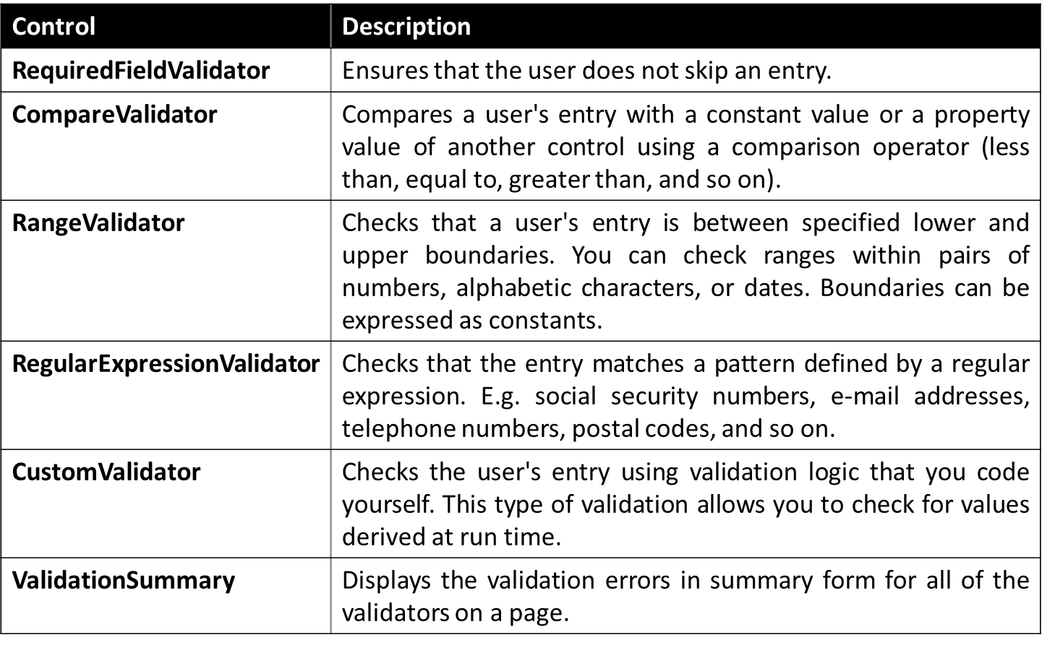
ASP.NET Validation Controls Cont..

Slide 6
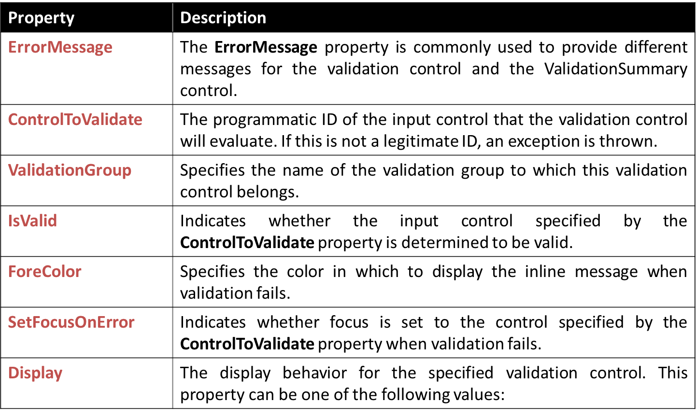
Common Properties : Validation Controls

Slide 7
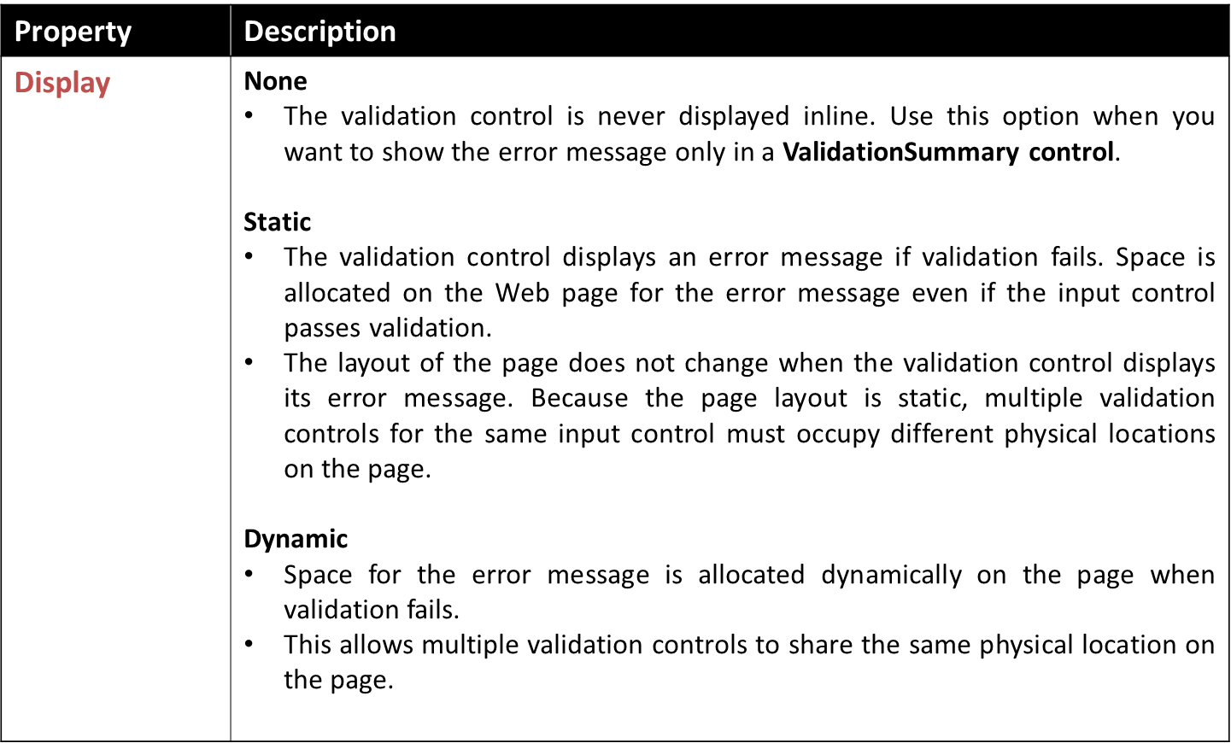
Common Properties : Validation Controls

Slide 8
RequiredFieldValidation Control
The RequiredFieldValidator control is simple validation control, which checks to see if the data is entered for the input control or not.
You can have a RequiredFieldValidator control for each form element on which you wish to enforce mandatory Field rule.
Example
Output
<asp:RequiredFieldValidator ID="rfvPassword" runat="server" ErrorMessage="Password Required" ControlToValidate="txtPassword">
</asp:RequiredFieldValidator>

Slide 9

CompareValidator Control
The CompareValidator control allows you to make comparison to compare data entered in an input control with a constant value or a value in a different control.
It can most commonly be used when you need to confirm password entered by the user at the registration time. The data is always case sensitive.
Example
Output
<asp:CompareValidator ID="cmpComfirmPassword" runat="server" ErrorMessage="Password Mismatch" ForeColor="Red" ControlToValidate="txtConfirmPassword" ControlToCompare="txtPassword"></asp:CompareValidator>

Slide 10
CompareValidator Control Cont..
Important Properties
Property | Description
Type | Specifies the data type of the values being compared.
Operator | The Operator property allows you to specify the type of comparison to perform, such as greater than, equal to, and so on.
ValueToCompare | Instead of comparing the values of two input controls, you can compare the value of an input control to a constant value. Specify the constant value to compare with by setting the ValueToCompare property.
ControlToCompare | If you want to compare a specific input control with another input control, set the ControlToCompare property with the name of the control to compare.

Slide 11
RangeValidator Control
The RangeValidator Server Control is another validator control, which checks to see if a control value is within a valid range.
The attributes that are necessary to this control are: MaximumValue, MinimumValue, and Type.
Example
Output:
<asp:RangeValidator ID="rngCPI" runat="server" ErrorMessage="CPI Must Be In 0 to 10" ForeColor="Red" ControlToValidate="txtCPI" MaximumValue="10" MinimumValue="0"></asp:RangeValidator>

Slide 12
RegularExpressionValidator Control
A regular expression is a powerful pattern matching language that can be used to identify simple and complex characters sequence that would otherwise require writing code to perform.
Using RegularExpressionValidator server control, you can check a user's input based on a pattern that you define using a regular expression.
If you don't find your desired regular expression, you can create your custom one.

Slide 13
RegularExpressionValidator Cont..
<asp:RegularExpressionValidator ID="rgeEmail" runat="server" ErrorMessage="Enter Proper Email" ForeColor="Red" ControlToValidate="txtEmail"
ValidationExpression="\w+([-+.']\w+)*@\w+([-.]\w+)*\.\w+([-.]\w+)*">
</asp:RegularExpressionValidator>
Example
Output

Slide 14
CustomValidator Control
You can solve your purpose with ASP.NET validation controls. But if you still don't find solution you can create your own custom validator control.
The CustomValidator Control can be used on client side and server side. JavaScript is used to do client validation and you can use any .NET language to do server side validation.
Example
<asp:CustomValidator ID="cvTerms" runat="server" ErrorMessage="Sorry ! You must accept our terms & condition" ClientValidationFunction="ValidateCheckBox" ForeColor="Red" />

Slide 15
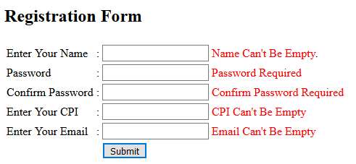
Example – Validation Control

Slide 16
ValidationSummary Control
The ValidationSummary control is reporting control, which is used by the other validation controls on a page.
You can use this validation control to consolidate errors reporting for all the validation errors that occur on a page instead of leaving this up to each and every individual validation control.
The validation summary control will collect all the error messages of all the non-valid controls and put them in a list.
Example
<asp:ValidationSummary ID="valSummary" runat="server" ValidationGroup="Save" ForeColor="Red"/>

Slide 17


