Slide 1
State Managemant
VIDHI SETA

Slide 2
State Management
A new instance of the Web page class is created each time the page is posted to the server. In traditional Web programming, this would typically mean that all information associated with the page and the controls on the page would be lost with each round trip.
For example, if a user enters information into a text box, that information would be lost in the round trip from the browser or client device to the server.
To overcome this inherent limitation of traditional Web programming, ASP.NET iProvide feature called State Management.
State management means to preserve state of a control, web page, object/data, and user in the application explicitly because all ASP.NET web applications are stateless, i.e., by default, for each page posted to the server, the state of controls is lost.
Nowadays all web apps demand a high level of state management from control to application level.

Slide 3

Types of State Management
Client Side State management
Cookies
Hidden Fields
View State
Query String
Server Side Management:
Session State
Application State

Slide 4
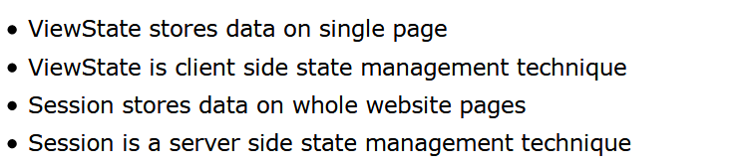
Viewstate
ViewState is a important client side state management technique. ViewState is used to store user data on page at the time of post back of web page.
ViewState can hold the value on single web page, if we go to other page using response.redirect then ViewState will be null.
ViewState syntax same as Session, Session is a server side object while ViewState is a client side object. Session can stores values across on multiple pages while ViewState stores values on single page.

Slide 5
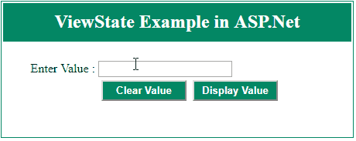
Continue….
Store the value in viewstate
Retrieve information from viewstate
Here, we have two button control one for a clear textbox value and second one for a retrieve the same textbox value after clearing it. Before clearing textbox value store it in ViewState[“name”] and after clearing it get value from ViewState[“name”] and display in label while clicking display value button.
ViewState[“name”]=”VIDHI”;
string value=ViewState[“name”].ToString();

Slide 6
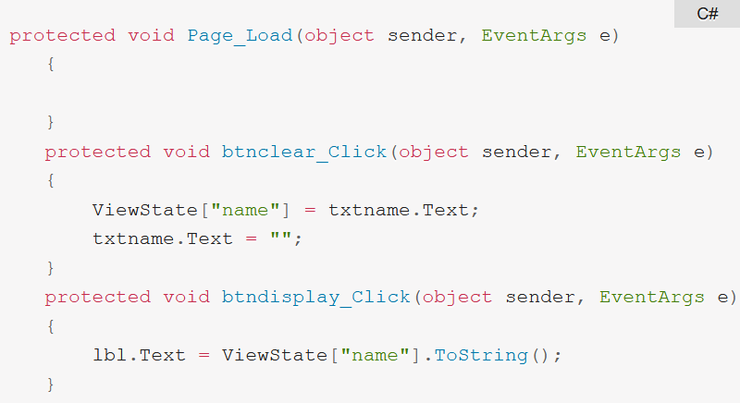
Code for above Example

Slide 7
Query String in ASP.Net
Query string is a simple way to pass some information from one page to another. The information cab be easily pass to one page to another or to same page.
With query string method the information passed in URL of page request.
This method many browsers supports only 255 character length of URL in query string. The value passed will be visible so some time it cause security issue.
For send information to other page Response.Redirect() method used and for retrieve information from URL use Request.QueryString() method used.
In Query String method we can sent value to only desired page, and value will be temporarily. So Query string increase the overall performance of web application.

Slide 8
Continue….
Syntax of Query String:
Send information to other page
Retrieve information from other page

Slide 9
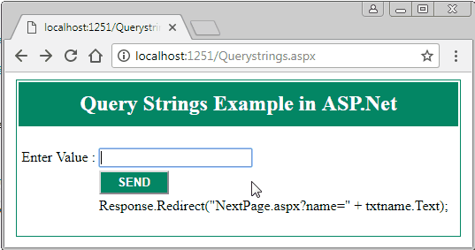
Example…
Design asp.net web form with a button control along with a textbox control. We will pass textbox value to nextpage.aspx using query string method and retrieve information from url in nextpage and display it in label control.

Slide 10
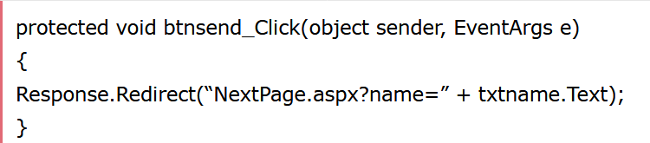
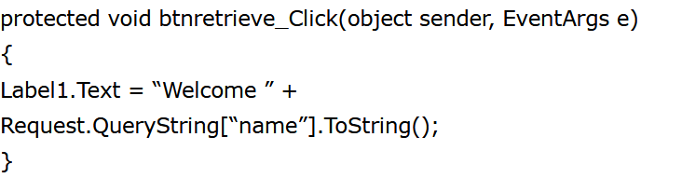
Continue….
Write below code on SEND button click events on first page for pass information to other page:
Write below code on Retrieve button for retrieve information from url and display it in label on Nextpage.aspx.

Slide 11
Cookie
Cookies is a small pieces of text information which is stored on user hard drive using users browser for identify users.
Cookie consists of “key”which is the name of the cookie and “value”which is the information stored in cookie.
It may contain username, ID, password or any information. Cookie does not use server memory.
Whenever a user makes a request for a page the first time, the server creates a cookie and sends it to the client along with the requested page and the client browser receives that cookie and stores it on the client machine either permanently or temporarily (persistent or non persistence).
The next time the user makes a request for the same site, either the same or another page, the browser checks the existence of the cookie for that site in the folder. If the cookie exists it sends a request with the same cookie, else that request is treated as a new request.

Slide 12
Continue…
Types of Cookies
1. Persistence Cookie: Cookies which you can set an expiry date time are called persistence cookies. Persistence cookies are permanently stored till the time you set.
2. Non-Persistence Cookie: Non persistence cookies are not permanently stored on the user client hard disk folder. It maintains user information as long as the user accesses the same browser. When user closes the browser the cookie will be discarded. Non Persistence cookies are useful for public computers.
Example to create cookie:
We can also create same cookies as like below:
Response.Cookies[“name”].Value = “vidhi”;
Response.Cookies[“vidhi”].Expires = DateTime.Now.AddMinutes(10);
HttpCookie C = new HttpCookie(“vidhi”,”seta”);
C.Expires = DateTime.Now.AddMinutes(10);
Response.Cookies.Add(C);

Slide 13
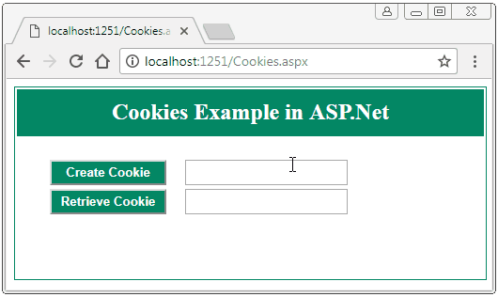
Cookie Example..
Design web form as shows below figure for create cookie and retrieve cookie information:
Create Cookie Button C# Code:
protected void btncreate_Click(object sender, EventArgs e)
{
Response.Cookies["name"].Value = txtcreatecookie.Text;
Response.Cookies["name"].Expires = DateTime.Now.AddMinutes(1);
Label1.Text = "Cookie Created";
txtcreatecookie.Text = "";
}

Slide 14
Continue…
Here, we create cookie with name parameter and assign textbox values to name cookie and also set expiry time 1 minute. The cookie destroyed after 1 minute.
Retrieve Cookie Button Code:
On retrieve cookie button checks if cookie value not null then display cookie value in result, but after 1 minute the cookie expires, after 1 minute cookie value will be null and result will be “No cookie found”.
protected void btnretrieve_Click(object sender, EventArgs e)
{
if (Request.Cookies["name"] == null)
{
txtretrieve.Text = "No cookie found";
}
else
{
txtretrieve.Text = Request.Cookies["name"].Value;
}
}

Slide 15

Session state management
State management is a important part of any application. The Session is the important features of asp.net.
Session state is a period of time to visit a website for a particular user. Session can store the client data on a server. Session is a best state management features to store the client data on server separately for each user.
Session value can be accessible from all pages from website. We can store some information in session in one page and can access same information on rest of all page by using session.
By default, Session state is enabled for all ASP.NET applications.

Slide 16

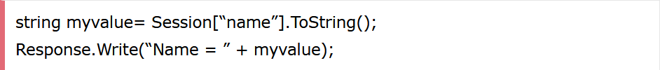
Continue
When you login to any website with username and password. your username shows on all other pages.The username will be stored in session and on page we access session value to display username.
Syntax of session:
Declare session in asp.net:
Retrieve session value on other page:

Slide 17
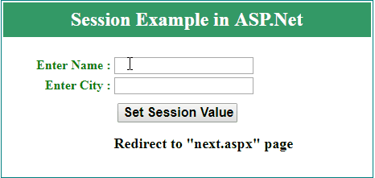
Session Example on ASP.Net
Design two web page, one for assign value to session and other for retrieve value from session.
Code for set session value on first page “default.aspx” on button click events. After assigning a value to session we redirect to other page “next.aspx” using response.redirect method.
Here, we assign textbox name value to Session[“name”] and city value to Session[“city”] and redirect to next.aspx page.

Slide 18
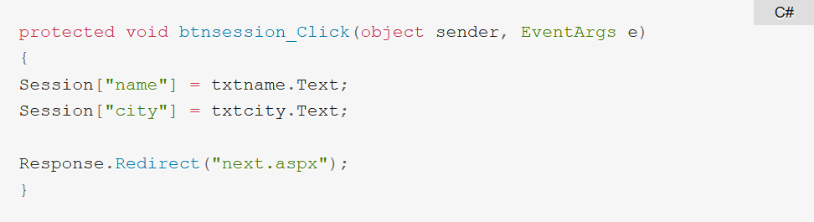
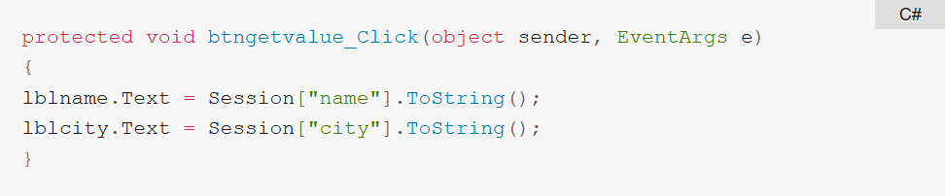
Continue..
On “next.aspx” page we retrieve and display session value on web page using label control. code on “next.aspx” page for retrieve session value.

Slide 19
Application State:
ASP.Net Application state is a server side state management technique.
Application state is a global storage mechanism that used to stored data on the server and shared for all users, means data stored in Application state is common for all user.
Data from Application state can be accessible anywhere in the application. Application state is based on the System.Web.HttpApplicationState class.
The application state used same way as session state, but session state is specific for a single user session, where as application state common for all users of asp.net application.

Slide 20
Continue…
Generally application state is used for calculate how many times a given page has been visited by various clients.
Syntax of Application State
Retrieve information from application state
Application[“name”] = “Vidhi”;

