Slide 1
Search engine optimization
Developed By :
Seta Vidhi

Slide 2
Content
The Mission of Search Engine
The Market Share of Search Engines
The Human Goals of Searching
Determining Searcher Intent: A challenge for Both Marketers and Search Engines
How People Search?
How search engine drive commerce on the web?
Eye tracking
Click tracking

Slide 3
What is search engine..??
A search engine is a software program or script available through the Internet that searches documents and files for keywords and returns the results of any files containing those keywords.
Search engines are programs that search documents for specified keywords and returns a list of the documents where the keywords were found
Today, there are thousands of different search engines available on the Internet, each with their own abilities and features.

Slide 4
The first search engine ever developed is considered Archie, which was used to search for FTP files and the first text-based search engine is considered Veronica.
Today, the most popular and well known search engine is Google.

Slide 5
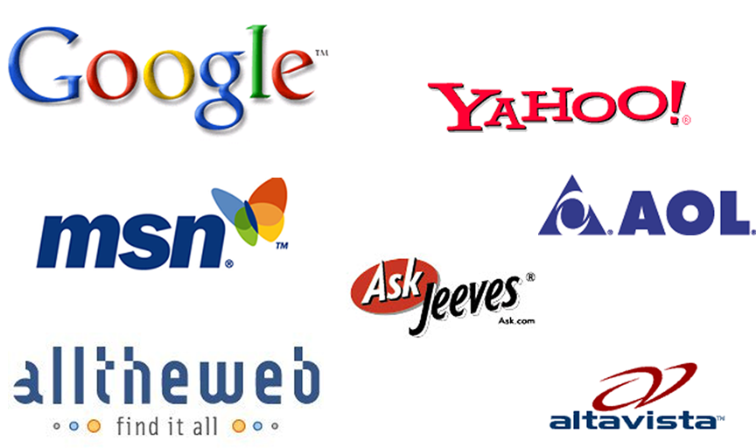
Examples of popular search engines

Slide 6
What is search engine optimization?
Whenever you enter a query in a search engine and hit 'enter' you get a list of web results that contain that query term. Users normally tend to visit websites that are at the top of this list as they perceive those to be more relevant to the query. If you have ever wondered why some of these websites rank better than the others then you must know that it is because of a powerful web marketing technique called Search Engine Optimization (SEO).
Search engine optimization is a methodology of strategies, techniques and tactics used to increase the amount of visitors to a website by obtaining a high-ranking placement in the search results page of a search engine (SERP) -- including Google, Bing, Yahoo and other search engines.

Slide 7
What is search engine optimization?
SEO is a technique which helps search engines find and rank your site higher than the millions of other sites in response to a search query. SEO thus helps you get traffic from search engines.
SEO is all about optimizing a web site for Search Engines.
SEO is the process of designing and developing a web site to rank well in search engine results.
SEO is to improve the volume and quality of traffic to a web site from search engines.
SEO is a subset of search engine marketing.
SEO is marketing by understanding how search algorithms work and what human visitors might search.
So, we can say that SEO is the cost effective method of increasing traffic & popularity of the website.

Slide 8
Search Engines statistics
1.Google – 41.6%
2.Yahoo – 31.5%
3.MSN – 27.4%
4.AOL – 13.6%
5.Ask Jeeves – 7.0%

Slide 9
mission Of Search Engine:
Since web searchers are free to use any of the many available search engines on the Web to find what they are seeking, the burden is on the search engines to develop a relevant, fast, and fresh search experience.
For the most part, search engines accomplish this by being perceived as having the most relevant results and delivering them the fastest, as users will go to the search engine they think will get them the answers they want in the least amount of time.
As a result, search engines invest a tremendous amount of time, energy, and capital in improving their relevance. This includes performing extensive studies of user responses to their search results, comparing their results against those of other search engines.

Slide 10
Continue..
This includes performing extensive studies of user responses to their search results, comparing their results against those of other search engines.
At last, mission of the search engines is to quickly and efficiently provide you, the user, with relevant and spam-free results through the organic & sponsored listing.
A search engine meets human goals where it can provide enough information
In a SERP to get users to click through and find what they intended within a matter of seconds.

Slide 11
Market Share..
Market share refers to the percentage of the overall volume of business in a given market that is controlled by one company in relation to its competitors.
For example, if the total sales of a certain product in a market is 100, 000, and the company in question sold 20, 000 worth of that product, then the company had 20 percent market share.
Market share is most meaningful in a relative sense; that is, when a company compares the market share it commands to the percentage held by its largest competitors.

Slide 12
Continue..
To calculate market share, a small business owner first needs to determine the total sales of a product in a target market over a determine the total sales of a product in a target market over specific time period, usually one year.
It may also be useful to find out the sales level achieved by the company's largest competitors and then use that information to compute relative market share.

Slide 13
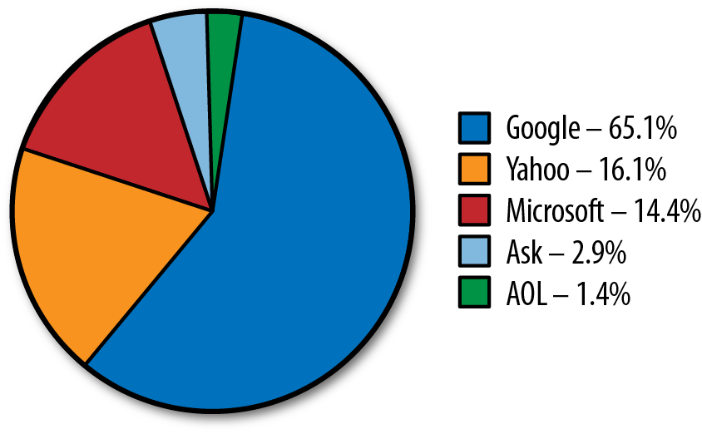
Continue..

Slide 14
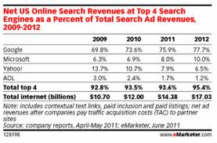
Continue..

Slide 15
Human goal of searching
The basic goal of a human searcher is to obtain information relevant to an inquiry.
1)The need for an answer, solution or piece of information.
2)Formulate that need in a string of words, and phrases(the query)
Generally this query consists of one or two words.
Average query length is 2.9 according to comscore in 2009.

Slide 16
Determining Search intent:
Good marketers are empathetic. Smart SEO practitioners and the search engines have a common goal of providing searchers with results that are relevant to their queries. Therefore, a crucial element to building an online marketing strategy around SEO and search rankings is understanding your audience. Once you grasp how your target market searches for your service, product, or resource, you can more effectively reach and keep those users.

Slide 17
Continue..
Search engine marketers need to be aware that search engines are tools—resources driven by intent. Using the search box is fundamentally different from entering a URL into the browser’s address bar, clicking on a bookmark, or picking a link on your start page to go to a website.
Searches are performed with intent; the user wants to find something in particular, rather than just land on it by happenstance.

Slide 18
How people search?
Search engines invest significant resources into understanding how people use search, enabling them to produce better search engine results.
For website publishers, the information regarding how people use search can be used to help improve the usability of a site as well as search engine compatibility.

Slide 19
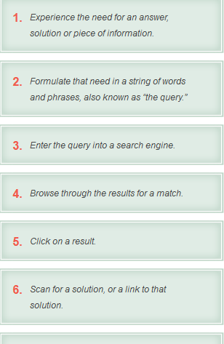
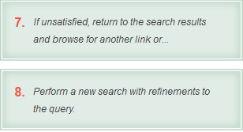

Slide 20
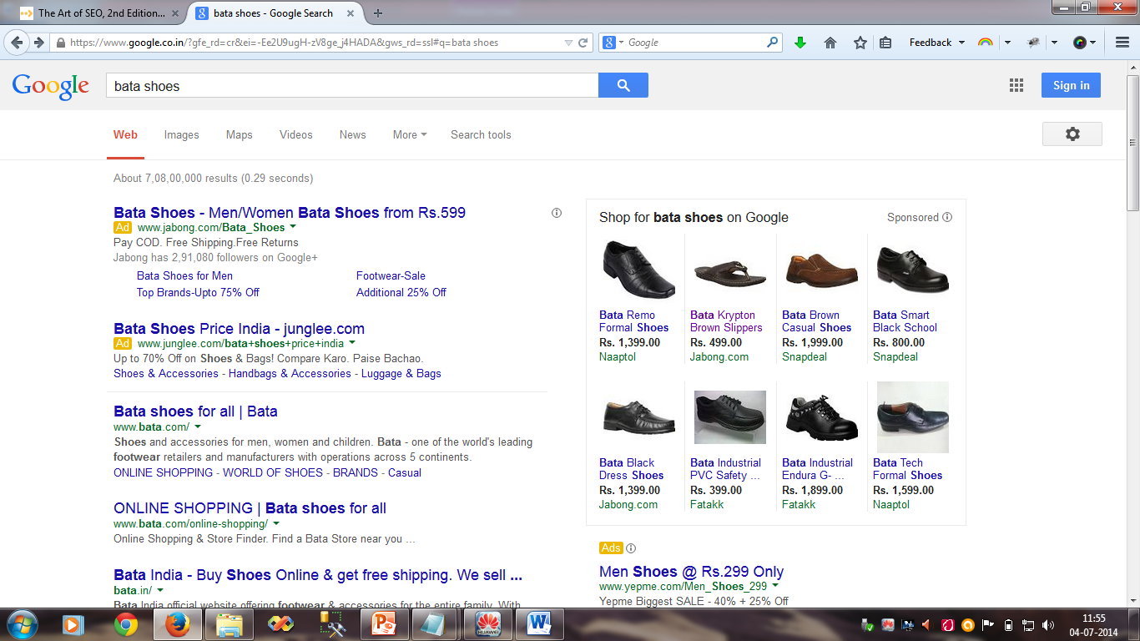
Continue..

Slide 21
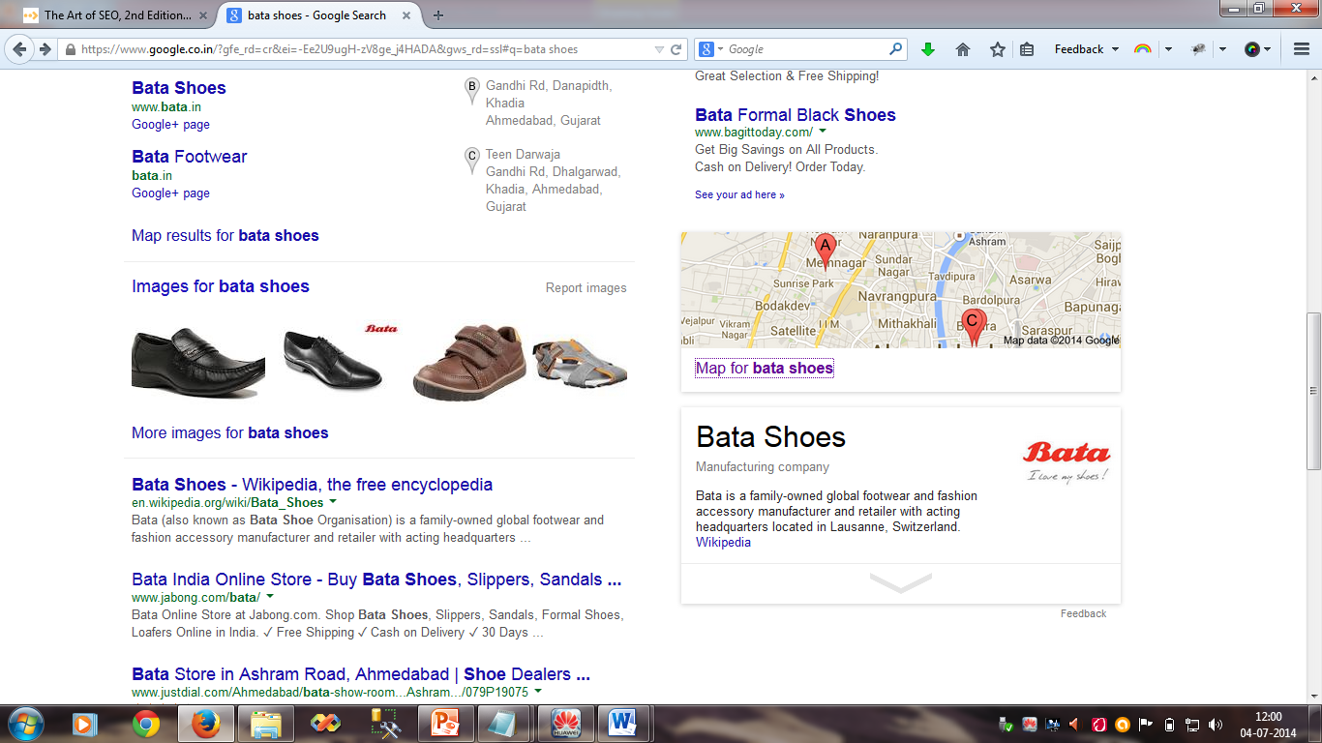
Continue..

Slide 22
How Search Engine Drive Commerce on the web..
People make use of search engines for a wide variety of purposes, with some of the most popular being to research, locate, and buy products.
Increasing your website visibility on the Internet helps drive more traffic to your business, prompts more inquiries for your goods and services, increases leads, and potentially generates more sales.
To understand how we can increase poductivity,first we understand the term Search Engine Marketing.

Slide 23
How Search Engine Drive Commerce on the web..
The goal of search marketing is to attract targeted traffic to a website. Consumers conduct searches by entering a search word or phrase (referred to as a keyword) into a search engine such as Google® or Yahoo!
Two types of results are then generated -- free "organic" search results appear and paid, or "sponsored" results.
Search Engine Optimization (SEO) refers to the efforts to generate free organic listings high on the results page, while search engine marketing, also known as Pay Per Click advertising (PPC) involves paid listing placement.

Slide 24
Eye Tracking
Eye-tracking involves the "tracking of eye movements". It is a method where the scan path of a person's gaze, while looking over a picture, is traced and recorded.
Determining what a user looks at.
Eye-tracking analysis documents precisely what people notice - and what not.
This is possible in many areas: during shopping, while reading an advertisement, looking over a catalogue, or surfing the net.

Slide 25
Continue..
This is possible in many areas: during shopping, while reading an advertisement, looking over a catalogue, or surfing the net.
This type of technology will have a big impact in computing.
The research above will allow users to effectively research on what areas people focus. This can help when developing websites or displaying information.

Slide 26

Continue..

Slide 27
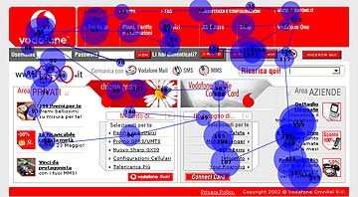
Continue..

Slide 28
Continue..
The lines trace the path that the eye travelled across the test media.
Fixed points are represented in the form of circles. The larger the point, the longer the subject fixed onto the corresponding point, indicating that the test subject showed greater interest in this area.

Slide 29
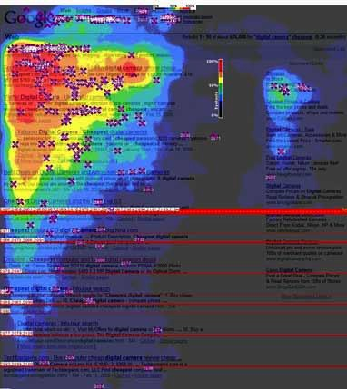
Continue..

Slide 30
Click tracking:
Click tracking is a technique used to determine and record what computer users are clicking with their mouse while browsing the Web.
The clicking action is then sent and logged by the client, Web browser or server while the computer user continues to explore and click around the ad application or Web page.
This method is quite useful for determining the effectiveness and productivity of market research and software testing, among other things.

Slide 31
Click tracking:
There are two methods of click tracking:
1)Natural Click
2)Pay Per Click
Organic search results are the Web page listings that most closely match the user’s search query based on relevance. Also called “natural” search results, ranking high in the organic results is what SEO is all about.
Free listing are displayed on the main area of the results page. Most search engine pages display 10 results per page; but there can be thousands of listings and hundreds of pages.

Slide 32
Click tracking:
Paid results are basically advertisements — the Web site owners have paid something for it.
Pay per click (PPC) is an online advertising model in which revenue is earned via qualifying sponsored click-through advertisements. PPC is a search advertising component where advertisers bid on relevant keywords.
PPC is a type of sponsored online advertising that is used on a wide range of websites, including search engines, where the advertiser only pays if a web user clicks on their ad. Hence the title, ‘pay per click.’

Slide 33
Click tracking:
On a search results page, you can tell paid results from organic ones because search engines set apart the paid listings, putting them above or to the right of the organic results, or giving them a shaded background, border lines, or other visual clues.
The following figure shows the difference between paid listings and organic results.

Slide 34
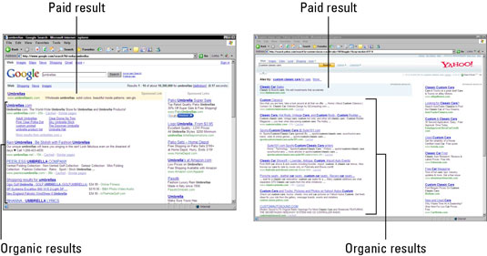
Click tracking:

Slide 35
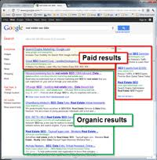
Continue..

Slide 36
THANK YOU . . .

