Slide 1
Search engine optimization
Developed By :
Seta Vidhi

Slide 2

Keyword research

Slide 3
What is keyword research??
Keyword research' is a practice used by search engine optimization professionals to find and research actual search terms people enter into the search engines when conducting a search.
Keyword research is the process of finding popular search terms and subsequently using them to perform SEO for a website.
Search engine optimization professionals research keywords in order to achieve better rankings in search engines.
Keyword research is one of the most important, valuable and high return activities in the search marketing field.

Slide 4
Continue..
Ranking for the “right keyword” can make or break your website.
It's not always about getting visitors to your site, but about getting the right kind of visitors.
The usefulness of this intelligence cannot be overstated - with keyword research you can predict shifts in demand, respond to changing market conditions, and produce the products, services, and content that web searchers are already actively seeking.

Slide 5
Importance of keyword..
Do you know what keywords your website is currently ranking for online? Keywords are very important for every business website as they drive targeted web traffic to your business for free. When done well, using the right keywords can skyrocket your business to sales success online.
Keywords are the words and phrases that Internet users type into search box of a search engine, such as Google, to find what websites that match what are looking for.

Slide 6
For example, if a patient types in "Plastic Surgeons, Long Island," those are the keywords.
The search engine will then supply you with a list of pages, with content relevant to what was typed in. SEO content is all about choosing words that accurately describe what your practice offers. When you are building a website, you want to make sure that the name of your practice appears at the top of the search engine's result list.

Slide 7
Continue..
In choosing a keyword for your business, it is very important to put some time and thought into researching keywords.
To decide which keywords should be used on your web site, you can start by asking yourself the most simple, but relevant question “who needs the services that I offer?”
Following ex.shows that.
For ex.if you were marketing specialty soaps, you would want to use words such as soap, speciallity soap, bath products,luxary bath products.

Slide 8
Continue..
It is also important to remember to use word that real people use when talking about your products. For ex. using the term “cleanning supplies” as a keyword wouldn’t result in a good ranking because people thinking for personal cleanliness don’t search for “cleaning supplies” they search for “soap” or something even more specific,like “chemomile soap”
So, choose proper,relavant and meaningful keyword. Keywords that have no monthly searches will not generate any traffic therefore rendered useless for SEO.

Slide 9
Continue..
For ex. A very popular and highly competitive keyword on google search engine is “making money”.it has 289000000 search results, meaning that millions of website are competing for that keyword.
keyword research start with finding all possible word combinations that are relavant to it.
For ex. keyword “acquiring money” has significantly less search results, only 4790000,but it has same meaning as “making money”

Slide 10
Theory behind keyword research
Keyword research is one of the most important, valuable and high return activities in the search engine marketing field.
We can say that it is good to deal with keywords that have 5000 searches per day, or even 500 searches per day, but in reality these “popular” search terms actually comprise less than 30% of the overall searches performed on the web.
The remaining 70% lie in what’s commonly called the “long tail” of search.

Slide 11
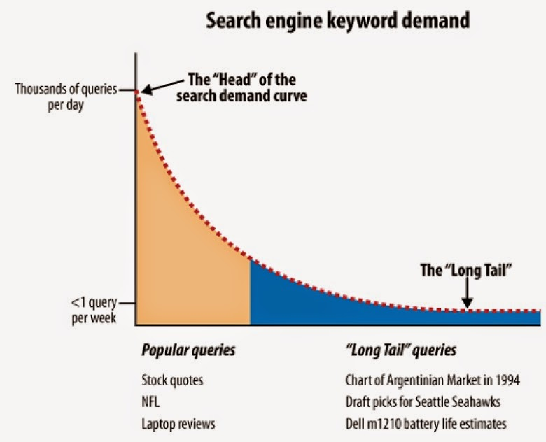
Continue..

Slide 12
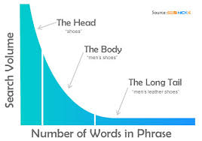
Continue..

Slide 13
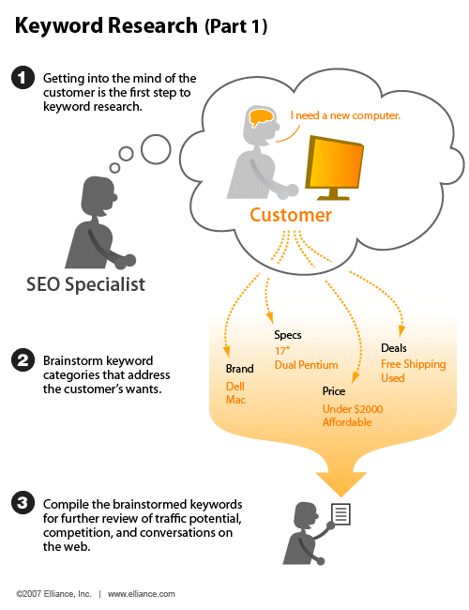
Process of keyword research

Slide 14
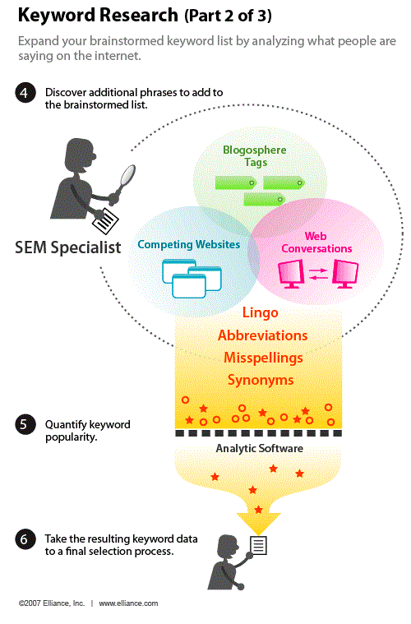
Continue..

Slide 15
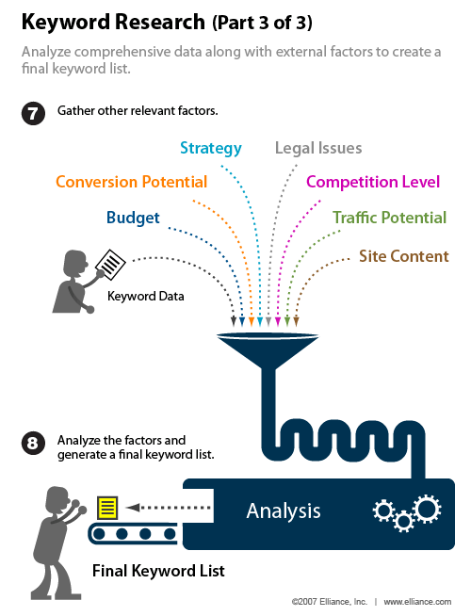
Continue..

Slide 16
Traditional approaches
One of the smartest things you can do when initially conducting keyword research is to use automated tools to brainstorm original ideas with the participants in the business. This can be surprisingly effective for coming up with numerous critical keywords.
Start by generating a list of terms and phrases that are relevant to your industry and pertain to what your site or business offers.
The brainstorming phase should ideally result in a list of several dozen to several hundred or more keyword searches that will bring relevant, qualified visitors to your site.

Slide 17
Continue..
1)Produce a list of key one to three word phrase that describe your product, services.
2)Spend some time coming up with synonyms that your potential customers might use for those products.
3)Create a texonomy of all areas of focus in your industry.
4)Broaden your list by thinking of higher-level terms of which your products or services are subset.
5)Review your existing site,and extract what appear to be keyphrase from your site.

Slide 18
6)Review industry association and/or media sites to see what phrases they use to discuss your topic area.
7)List all your various brand name.
8)List all your products. If your site has a large(massive) no.of products, consider it.
9)Have your team step back and imagine they are potential customer, and ask them what they would type into search engine if they were looking for something similar to product or services.

Slide 19
10)Supplement this by asking some people outside your business what they would search for.
11) Use your web analytic tool to see what terms people are already using to come to your site.

Slide 20
Competitive analysis
Review your competitor's website and see what key phrases they use for their products and services that compete with yours.
Record what non brand terms they use for their business.
Read any articles they have written that are published on sites other than own.
Observe what the media may have had to say about them.

Slide 21
Keyword research tools
A wide variety of options are available for performing keyword research, including tools provided by the search engines, tools developed by the third party, and tools for complex keyword analysis of terms choosing during research.

Slide 22
Keyword research data from the Engines:
The search engines provide a no.of tools that can help you with keyword research.
Many of these are not designed specifically for that purpose, but they can be used to obtain interesting keyword research information if they are used in the right manner.

Slide 23
Blog search counts..
Blog search data is terrific for picking out hot topics or keyword in the blogosphere and the realm of social media.
Since blog search often incorporates forums and other social media properties(anyone with feed, really),it is a great way to see how a term/phrase is looking in the social space.

Slide 24
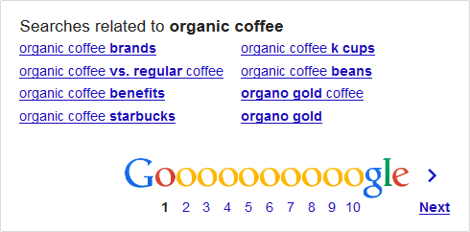
Related terms..
Did you ever notice that when you scroll to the bottom of Google’s search results there’s a section called, “Searches related to…”?
It looks like this:

Slide 25
Common usage and phrase combination
Using a search with the * character can give you a good idea of what terms/phrase commonly precede or follow a given term/phrase.
For ex. using * ringtones can show you phrase that are commonly associated with the term ringtones.

Slide 26
Frequency of recent usage..
Using the very cool google date range operator,you can determine how many in the past day,week,month,or year your term has appeared.

Slide 27
Keyword research tools
It is important to keep in mind when you are using the various research tools to brainstrom keywords that they are all based on relatively limited data.
In addition each tool will provide different search counts rather than the others.
Rather than focusing on the exact search counts of various terms, you should think of each tool as a good way to get a general comperison of two search terms.
However ,we consider that the search counts as only estimate.

Slide 28
Google’s adword keyword tool
Google’s adword keyword tool provide related terms,search volume estimates,search trends,and ad cost estimates for any keyword or url.
This tool provide two ways to search: based on words/phrase or based on website.
Keyword search volume:
Display the keywords, related terms, search volume from the past month, advertiser competition, and match type.
Cost and ad position estimates:
Displays each keyword’s estimated average cost per click and estimated ad position.

Slide 29
Continue..
Search volume trends:
Displays each keyword’s average search volume, search volume trends over the course of one year, and in which month the highest search volume occurred.
Possible negative keywords:
Allows you to add a negative keyword for any keyword phrase that does not pertain to your business.

Slide 30
Traffic Estimator
Within Google adword is a tool called the traffic estimator that allows you to get estimates of traffic on different keywords.
When you enter one or more keyword in this tool, this will return estimates of the search volume for each term, their average cost per click, their ad position, the no.of click per days, the cost per day.
You can enter your keyword in the following ways:
1)Broad match
2)Exact match
3)Phrase match
4)Negative match

Slide 31
Continue..
Where the tools get their data:
Both of these tool get their data from Google's search query database.
Cost:
Both are free to use.

Slide 32
Microsoft's ad center keyword generation tool
Microsoft’s adcenter keyword generation tool generates keyword suggestion based on a search term or website you enter.
Entering a keyword in the search bar will return data that is divided into two tabs: contain terms & similar terms.
The contains term tab includes search phrases that contain the keyword you provided, along with the preceding month and the current month of search data figures.

Slide 33
Continue..
The similar term tab includes search phrases that contain the keyword which are synonyms of that keyword, along with the preceding month and the current month of search data figures.
The export to excel option allows you to pull the collected data into a spreadsheet.
Where it gets its data:
The adcenter keyword generation tool obtain its data from Microsoft's bing search query database.
Cost:
It is free, although you have to create an account with Microsoft ad center.

Slide 34
wordtracker
Wordtracket is one of the better known keyword tools available that the search engines themselves do not provide.
It is free keyword suggestion tool.
It offer features like
Keyword researcher:
When you enter a keyword or phrase in the search box under the research section,wordtracker displays the most popular search terms that include the keywords you provided, the no.of searches per day recorded for those terms and a prediction of how many searches are typically performed per day.

Slide 35
Continue..
This tool also provide feature that allow you to evaluate competing search listing with the evaluate tab which allows you to analyze competition data from Google, Microsoft,Yahoo! & etc.
You get this data by selecting the search engines you want to Compare and then clicking the research button.

Slide 36
Continue..
Keyword Universe:
Keyword universe provide a list of keywords and phrases that are related to the search term you provide, then gives you a search count for those terms in its popularity search.
This differs from the other tools in that it can produce terms that are not part of the original seed term you provide.
So, if you enter a term such as search engine optimization you may get back internet marketing in the output.

Slide 37
Continue..
Full search
Based on the single generic term you provide, full search will return a list of similar keywords and a count of the number of times those keywords appeared in the meta tags of 200 related web pages.

Slide 38
Continue..
Keyword projects:
Keyword projects stores your keyword research projects.
At any given time, you are allow to one project and four stored projects.
Reports:
The sort-term report provides the top 1000 search terms from the preceding 48 hours.

Slide 39
Continue..
Where it gets its data:
Wordtracker compiles a database of 330+ million search terms from dogpile.com and metacrawler.com
This database is updated every week.
Wordtracker also provides an option to pull data from the Google adword keyword tool.

Slide 40
Continue..
Cost:
Wordtracker provide different Subscription offering that range from a one month membership for $69.00 to a one year membership for $379.00.
The free tool with limited features is also available.

Slide 41
Yahoo! Search marketing
Yahoo! Also provides a tool to help find keywords for paid search campaigns: Yahoo!search marketing.
Unlike another tool it provide lot of useful data for your organic search optimization campaigns.
Where it gets its data:
Yahoo! Search marketing gets it data from Yahoo’s search query database.
Cost:
It is not free.

Slide 42
Google trends
Google trends allows you to compare two or more search terms to each other to see relative popularity and seasonality/trending over time..
If you enter the terms into the search bar and separate them with a comma, you will see the requested terms’ trend history depicted in different colors on a graph spread over a certain time period.
With Google trends, user can also see Google's estimate of which cities, regions, and languages performed the largest number of searches for a particular keyword.

Slide 43
Continue..
Where it gets its data:
Google trends gets its data from searches performed on Google.
Cost:
Google trends is free to use.

Slide 44
Hitwise..
Experian Hitwise offers a wide range of competitive and web statistics via its service.
One component of the Hitwise suite,hitwise search intelligence, is a powerful keyword research tool for analyzing the long tail of search data.
It provides extensive insights into how people have successfully searched for products and services across all major search engines, including the breakdown of paid and organic traffic.
Hitwise seearch intelligence provides the following features:

Slide 45
Continue..
Timely information on search terms your specific competitors are.
Market-specific results, for taking advantage of cultural difference in how people search locally.
Where it gets its data:
Hitwise derive its data from more than 25 million people’s interaction with the internet(10 million from the US).
Cost:
Hitwise is not an inexpensive tool.
The website doesn’t list pricing information, but you should be ready to spend $20,000 if you plan to engage with this tool.

Slide 46
Comscore..
Like hitwise,comscore search planner is a tool that provides a wide range of data as a result of monitoring the behavior of actual users on the internet.
This data includes details on search term used,as well as competitive search term analysis.
It provide such type of tools like site profile & profile search terms.
Site profile(for site[s]x):
This module tells you what search terms and search engines are driving the most traffic to your site, to one or more of your competitor's site,& within your category.

Slide 47
Continue..
Profile search term
This module tells the demographic profile of people searching on a set of search terms,as well as what sites these searches tend to visit.
Where it gets its data:
Comscore monitors the behavior of approximately 2 million users.
These user have voluntarily joined comscore’s research panels in return for free software.

Slide 48
Enquisite optimizer
It is a tool that provides some great insights into your long tail search volume.
One of its neat features is that it allows you to group terms(all terms that include the word seo) and see how those terms performed as a group.

Slide 49
Keyword discovery:
Another popular third party tool for keyword research is keyword discovery.
It offers these features.
Keyword research:
When you enter a keyword or phrase in the search bar under the research section,it display the most popular search terms that include the keywords you provided,along with a count of how many searches performed for those keywords in the past 12 monthes.

Slide 50
Continue..
Seasonal search trends:
You can also see the no.of searches performed along with season.
Spelling mistake research:
Typing the query spell: optimization returns results such as optimation, optimization and
Optimisation.
Where it gets its data :
It use a panel of 4.4 million users to collect its global premium data.

Slide 51
Continue..
Cost:
It offers different subscirption option that range from a standard monthly subscription for $ 69.95 to a yearly $4752.

Slide 52
Determining keyword value..
When judging the value of a keyword,you should consider how useful the term is for your site.
How will your site benefit from targetting these keywords.
For ex. In a sentence some keyword is more valuable. without this keyword it become meaningless.
“I am best”

Slide 53
To identify relevant, high-quality keywords, please keep following points in your mind:
How relevant is the term/phrase to the content, service, products or information on your site?
Assuming a visitor who searches for that term clicks on your result in the SERPS,what is the likelihood that he/she will perform a desired action on your site(make a purchase, subscribe to a newsletter,etc).create a link to your site.
How many people who searches for this term will come to your site and leave dissatisfied?

Slide 54
It is important to categorize your keywords into high and low relevance. Generally keywords of higher relevance will be more beneficial to your site in that they best represent your site as a whole.
Keyword with lower relevance than those that lead to conversions can still be great terms to target.A keyword may be relevant to your site’s content but have a law relavance to your business model.

Slide 55
Determining conversion rates
One of the most important parts of paid inclusion campaigns, the conversion rate of a website is the measurement of the success of a paid inclusion campaign.
A conversion rate is measured by the number of potential visitors performing the desired action, whether the action is buying a product, filling out a form, or some other goal of the web pag
For example, if there are 100 visitors to a particular web page via a pay per click ad, and one of those 100 buys the product the website sells, then the conversion rate for that particular ad is 1%.
The larger the conversion rate of a web page means the more successful the website will be as well as how successful the paid inclusion campaign is.

Slide 56
Continue..
To get a rough idea of the level of competition faced for a particular term or phrase, the following metrics are valuable.
Search demand volume:
Number of paid search competitiors and bid prices to get in the top four positions.
Strength
Number of search results
Testing Ad campaign runs and third party search data:

Slide 57
Extracting terms from relevant web pages..
One source for long tail terms is web pages that do well for searches that are relevant to your target market.
Here is a basic process of finding those pages and extracting that information for them.
1)Extract the top 10 to 50 most common search phrase at the head of the distribution graph from your existing keyword research in the industry.
2)Search Google, Yahoo! And Bing for each term.
3)For each page in the top 10 to 30 results, extract the unique usable text on your page.

Slide 58
Continue..
4)Remove stop words &filter by phrase size.
5)Remove instances of terms/phrases already in your keyword research database.
6)Start through the most common remnants first and comb as far down as you feel is valuable.
Through this process, you are basically text-mining relevant documents on the subject of your industry.

Slide 59
what is Keyword Mining..?
Keyword mining is the process of creating a list of keywords or keyword phrases that are relevant and popular for a particular site.
The more targeted and effective the mined keywords are the more successful the site will be.
Mining keywords and optimizing a site for these keywords will increase the traffic generated from search engines.

Slide 60
Mining keyword research tool…
Although you looking into keyword research tools for long tail data has significant limitations, there are still ways to do for it.
For ex. if you own a chain of pizza restaurant in 50 cities across the country and you want to discover long tail terms, you can.
Let’s look at the tail end of word tracker’s output for a combined search on orlando pizza,san diego pizza and san jose pizza.

Slide 61
What Do We Mean By User Generated Content?
User-generated content is, quite simply, any content that is created and submitted by your website visitors.
It might be a blog comment, a product review, an uploaded image, social networking updates, or other ideas.
We see user-generated content everyday, particularly on e-commerce sites, and we tend to take it for granted. But UGC can actually play a significant part in a business’ SEO campaign.

Slide 62
UGC Is a Great Source for Long Tail Keywords
Allowing visitors to your site to leave comments, post reviews, upload images, and participate in forum discussions, gives you the opportunity to see exactly how consumers are talking about your products and services.
This can be invaluable when researching keywords and phrases for your SEO campaign.
By looking at the language your customers use, and the phrases that get repeated across a number of different postings, you will be able to identify new long tail keywords that will be invaluable in your on-page optimization strategies.

Slide 63
Conclusion..
Search engines thrive on a steady stream of unique content, but it can be difficult for SEOs and webmasters to continually feed that need.
User-generated content is one way to produce a steady flow of unique content, making your website more attractive to both customers and search engine bots.
Opening up your website to user-generated content will not only contribute to your SEO strategy, it will ultimately help you better connect with the visitors to your site, building brand loyalty and online success.

