Slide 1
Search engine optimization
Developed By :
Seta Vidhi

Slide 2
Content
Determining Search Intent
Navigational Search query
Informational Search query
Transactional Search query
Fresh Content
Country Specific Search Engine

Slide 3
Ch-3
SEO gives surprisingly effective results in a short time if done efficiently.
SEO is used for generating traffic to site but there are also other applications of SEO like branding, marketing and ideological influence of the website.
SEO has proven to be an effective tool in achieving a number of important marketing objectives, making it a universally-beneficial marketing tactic for a wide variety of organizations, regardless of their objectives. SEO, once the domain of specialists, has now become a mainstream marketing activity.
SEO, once a highly specialized task relegated to the back rooms of a website development team, is now a mainstream marketing activity. This dramatic rise can be attributed to three emerging trends:

Slide 4

Ch-3

Slide 5
Like any other marketing activity, it is important to set specific goals and objectives — and if the goal is not measurable, it is not useful. As you can see, increased website traffic is rated as the most effective objective for SEO and increased brand or product awareness is also rated extremely well.
Setting goals and objectives for your SEO strategy is the first step in determining the keywords on which you want to build the content of your website.
1)Visibility(Branding):
Making you brand more visible in the market is a gigantic effort, especially if you have a new or refreshed website.
Branding means brand recognition or brand awareness among people.

Slide 6
Continue..
A website pages which are consistently at the top of search engine ranking get traffic, popularity and profit. There may be certain terms that are closely related to your brand that you want to dominate in the search rankings.
For your brand visibility to be very high, it must have the following attributes:
It is distinctive and unique.
It serves an important niche and provides clear solutions.
The product is original and much better than the competition.
It is widely available for customers and has maximum points of sale.
It helps your business achieve its financial goals.

Slide 7
Continue..
2)Website Traffic:
Today’s environment is highly competitive, and you need great SEO to ensure targeted, high-quality traffic to your site.
Of course, a business that engages with many of its customers through offline channels can tell them to visit their website to drive traffic.
Content that is keyword targeted produces direct traffic to your website. Content provides great results in less time.
SEO generates direct traffic to your website when your site is optimized for relevant keywords typed by user.
Keywords should be unique, not common, because competition is very high for common and popular keywords rather than unique and different keywords.

Slide 8
Continue..
Essentially having a higher search ranking will provide more traffic to a website. More traffic to a website can lead to more customers, revenue and profit.
SEO is an important aspect of an online marketing campaign because it can help improve search engine ranking. It's a relatively low-cost way to increase traffic and generate revenue. A small firm with good SEO skills can rank higher in the search results than larger competitors.

Slide 9
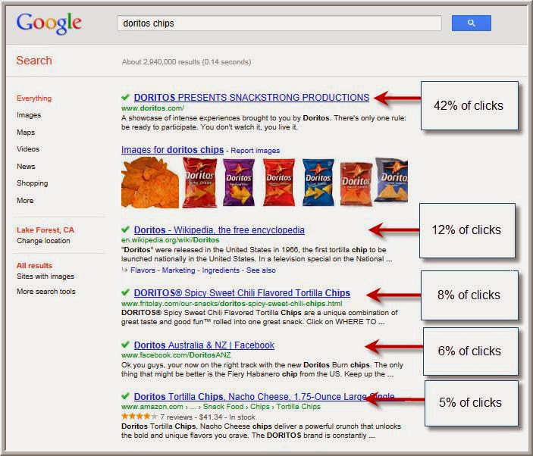
continue

Slide 10
High ROI:
Branding and traffic are nice, but the most important goal is to achieve the goals of your organization.
For most organizations, that means sales, leads, or advertising revenue. An important component of SEO is to deliver not just traffic, but relevant traffic that has the possibility of converting.
ROI means Return on Investment (ROI).
Return on Investment (ROI) is what every client wants from a search marketing agency. It’s an easy thing to calculate if you’re doing Pay-Per-Click (PPC) advertising. If your revenue is higher than your spend, PPC management fees and cost of goods, then your client is getting a return on their investment.

Slide 11
High ROI:
Whether you are selling products & services, advertising and looking for branding value, or trying to promote a specific viewpoint to the world, a well designed SEO strategy can result in a very high return on investment when contrasted with other methods of marketing.
For many Organizations, SEO brings a higher ROI when compared to TV, Print & Video.
Thus SEO ROI can show you the effectiveness of any SEO campaign.

Slide 12
THANK YOU . . .

