Slide 1
Search engine optimization
Developed By :
Seta Vidhi

Slide 2
Content
Understanding Search Engine Results
Algorithm Based Ranking System:Crawling,Indexing,Ranking
Determining Searcher Intent and Delivering Relevant Fresh
Content
Analyzing Ranking Factors
Using Advanced Search Techniques
Vertical Search Engines
Country Specific Search Engines

Slide 3
How search engine works?
When talking about search engines it is important to remember that search engines are not humans but text-driven computers, they do not care about how your website looks but what is written on it. When talking about the search engine process there is a difference in the crawling, indexing, and retrieving process.

Slide 4
crawling
Crawling - is the process of fetching all the web pages linked to a web site.
This task is performed by a software, called a crawler or a spider.
First, search engines crawl the Web to see what is there. This task is performed by a piece of software, called a crawler or a spider (or Googlebot, as is the case with Google).
This means the crawler will look at the text on a website and looks for links to different pages from that website.
Spiders follow links from one page to another and index everything they find on their way.

Slide 5
indexing
Indexing - is the process of creating index for all the fetched web pages and keeping them into a giant database from where it can later be retrieved.
After a page is crawled, the next step is to index its content.
The crawler will look for the page title, headings and meta tags and other information to be stored in index databases, the rest of the content will be stored in other databases.
The main purpose of indexing is to identify a website and assign keywords that best describe the website.

Slide 6
Retrieving
When a search engine user looks for keywords their search strings will be matched to the index database and the search engine will return a list of best-matching pages with a short description.
Possible million if not billion pages will be matched to the search string and therefor does the search engine need to calculate which pages are the most relevant.
Each search engine has his own algorithm to define which page is more relevant and deserves a higher rank in the search result. These algorithm are closely kept secret from the public else everyone would be ranked number one and the algorithm would have no use.

Slide 7
Algorithm based ranking system..
On-page algorithm:
Algorithm that measure on-page factors look at the elements of a page that would lead a user to think the page is worth or not.
This includes how keywords are used in correct as well as how other words on the page relate.
On-site algorithms look at the relationship of words and content on a page.
This includes providing good content, good keywords selection, putting keywords on correct places, giving appropriate title to every page etc.
Off-Page Algorithm:
This includes link building, increasing link popularity by submitting in open directories, search engines, link exchange etc.
A good incoming link is the equivalent of a vote of confidence for your site, and a high level of confidence will also help boost your page ranking.

Slide 8
Continue..
Whole site Algorithm:
Whole site algorithm look at the relationship of pages on a site.
For ex. Does the home page content relate to the content on other pages?
To ensure that your website is what it claims to be, the whole site algorithm looks at the relationship of site elements such as the architectural of page, the use of anchor text, and how the pages on your site are linked together.

Slide 9
Additional algorithm…
List search:
A list search algorithm searches through specified data looking for a single key.
The data is searched in very linear, list-style method.
Tree search:
This algorithm searches a data set from either the broadcast to the most narrow or from the most narrow to the broadcast.
It is conducted in hierarchical manner.

Slide 10
Continue…
SQL search(See-quel)
One of the difficulties with a tree search is that it is conducted in hierarchical manner.
A SQL search enables data to be searched in a nonhierarchical manner, which means that data can be searched from any subset of data.
Adversarial search:
This algorithm looks for all possible solutions to a problem, much like finding all the possible solutions in a game.
It is difficult to use.

Slide 11
Continue…
Constraint satisfaction search:
This algorithm is most likely to satisfy your need to find something.
In this type of search algorithm, the solution is discovered by meeting a set of constraints,and the data set can be searched in a variety of different ways that do not have to be linear.

Slide 12
Analyzing ranking factors..
With the help of ranking factors we can improve rank of our website.
There are mainly three types of ranking factors:
1)positive ranking factor
2)Negative ranking factor
3)other
Positive ranking factors:
Keyword use in title tag
Anchor text of inbound links
Age of site
Link popularity within the site’s internal link structure
Keyword use in body text

Slide 13
Continue….
Topical relevance of inbound links
2)Negative factors:
Server is often inaccessible to crawler
Duplicate content/titles/meta tags on many pages
External links to low quality
3)Other:
Rate of acquisition of links
Usage data

Slide 14
Common types of searches..
There are mainly 4 types of searches:
1)Proximity searches
2)Fuzzy logic
3)Boolean searches
4)Term weighting
Fuzzy logic:
It technically refers to logic that is not categorically true or false.
For ex. A day is sunny or not.

Slide 15
Proximity searches..
Use to: make a search more specific and exclude irrelevant records
Some databases use 'proximity operators.
It use the order of the search phrase to find related documents.
This makes a search more specific and excludes irrelevant records.
For instance, if you were searching for references about women in Africa, you might retrieve irrelevant records for items about women published in Africa.
Performing a proximity search will only retrieve the two words in the same sentence, and so exclude those irrelevant records.

Slide 16
Continue..
Boolean Searching:
Most searches will return too many or too few records. It takes a long time to look at hundreds of records. By putting a little effort into constructing search strings you can save a lot of time. The database can do a lot of work for you if you take the trouble to add a little sophistication to your search strings.
To do this with databases you need to know about the Boolean system. By the use of a few simple linking words, called operators, you can make your searches much more precise.

Slide 17
Continue..
1)And Operator:
AND retrieves records containing both words.
Document must have both words (or both phrases) .
It narrows your search.
Some databases automatically connect keywords with and.
In this example the shaded area contains records with both women and africa in the text.

Slide 18

Continue..
It is called Narrowing Searching also because search results will include all documents that contain both the first term and the second term.

Slide 19
Continue..
2) OR Operator:
OR retrieves records containing either word.
Document can have either word (or either phrase)
It Expand your search.
It is also called as Broadening Searches because search results will include all documents that contain either the first term or the second term or both.
You can use this to include synonyms in your search.

Slide 20

Continue..
In this example the shaded area contains records with women, or gender, or both words in the text.

Slide 21
Continue..
3)Not Operator:
NOT retrieves your first word but excludes the second.
Document must have first term. Must not have second
Beware! By using this operator you might exclude relevant results because you will lose those records which include both words.
In this example the shaded area indicates that only records containing just Africa will be retrieved (not those with both Africa and Asia)

Slide 22
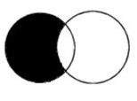
Continue..
It will exclude an idea/concept from your search because it will find documents that contain the first word, but do not contain the second.
For Ex. love NOT war

Slide 23
Nested Searching:
Nested searches are used to create more complex Boolean logic statements.
For example:{pets NOT (cats OR dogs)} AND behaviour
This statement would be used to search for material on the behaviour of all pets except cats and dogs.
This type of searching is supported in many resources, often with the use of brackets or separate search boxes. For example:
Example search: Transferable skills of research students

Slide 24
Continue..
Example search: Transferable skills of research students
{"transferable skills" NOT ("study skills" OR "presentation skills")} and "research students“
This statement would be used to search for material on the transferable skills of research students excluding material that mentioned study skills or presentation skills.

Slide 25
Term weighting..
Term weighting refers to the importance of a particular search term to the query.
The idea is to weight particular terms more heavily than others to produce superior search results.

Slide 26
Document Analysis & semantic connectivity..
In this type of analysis, search engine look at whether they find the search engine terms in important areas of the document like the title, the metadata, the heading tags and the body of text.
Document analysis alone is not enough for today, so they also look at semantic connectivity.
Semantic connectivity refers to words or phrase that are commonly associated with each other.
SE build their own thesaurus & dictionary to help them determine how certain terms and topics are related.

Slide 27
Understanding Search Engine Results:
In the search marketing field, the pages the engines return to fulfil a query are referred to as search engine results pages (SERPs).
Each engine returns results in a slightly different format .
In order to understand SEO and design the structure of a website, it is important to understand the components of a search result.
The main parts of the SERPs are described here:

Slide 28
Understanding Serp..
1)Verticle navigation:
Each engine offers the option to search different vertices such as images,news,video or maps. Following these links will result in a query with a more limited index.
2)Horizontal navigation:
The search engine also offers other type of navigation elements horizontally.
3)Search Box:
Near the top of the result page, where you can see your query and modify it or enter a new one.

Slide 29
Understanding Serp..
4)Result Information:
This section provide small amount of meta information about the results that you are viewing,including an estimate of the no. of pages relavent to that particular query.
5) PPC(Paid)Ads:
Results appearing in right hand column, and sometimes at the top of the results in a colored box.
These Results appear because someone paid for them to be there and only appear if they are relevant to your search. They always are marked with the word “Ads", so you can identify paid result.

Slide 30
Continue..
6)Natural Results:
These results are not paid for by anyone and can not be bought.these results are pulled from the search engine’s primary indexes of the web &ranked in order to relevance and popularity according to their complex algorithm.
7)Query refinement suggestion:
It is offered by Google, Bing &Yahoo. The Purpose of these links is to search with a more specific and possibly more relevant query that will satisfy their intent.

Slide 31
Continue..
8)Shopping search results:
Shopping results incorporate offers from merchants into the results so that searchers that are looking to buy something can do so quite easily.

Slide 32
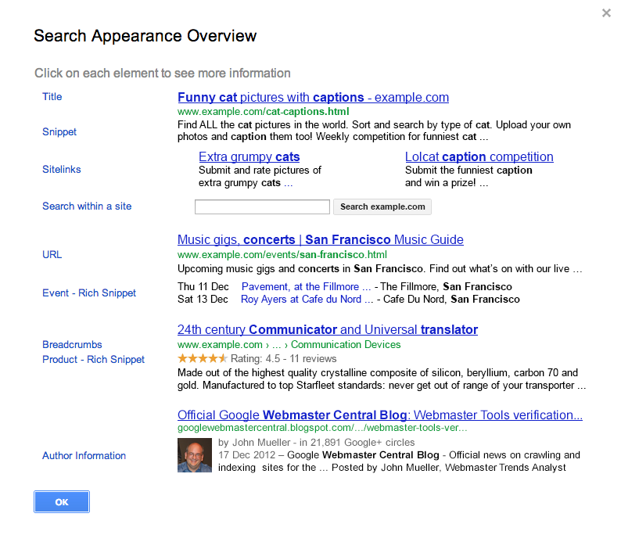
Continue..

Slide 33
Continue..
Title
The Title of the search results is usually directly related to the tag on a webpage and the words that match the search query are highlighted in bold. In the first search result you can see that funny, cat, and captions are bolded in the Title meaning that these words relate to words that are entered in the search.
If the word caption was used in the query for example, the plural captions is also highlighted.
The Title tags should be placed in the header section between the tags at the top of the page.

Slide 34
Continue..
Snippet
The Snippet is descriptive of the content of the page.
In the Snippet any related words that were used in the query are also highlighted like in the Title.
The text may relate to the meta tag information in the section of a web page. Google may however select different text that appears to be more closely related to the query that was used.

Slide 35
Continue..
Sitelinks
Sitelinks are additional links that Google has determined are useful pages inside the webpage.
As a webmaster you have no control over when and what Sitelinks Google will display for your site.
If inappropriate Sitelinks are displayed, the website’s owner may request to have Sitelinks demoted in Google webmaster tools.

Slide 36
Continue..
Although you are unable to specify what links to include as Sitelinks, a clear site structure that the Google bot can easily navigate will help Google identify any links it may include. It is important to include your most important pages in main menus or other easy to navigate elements if you hope to have these included as Sitelinks.

Slide 37
Continue..
Search within a site
A “Search within a Site” box may be included in search results where Google determines that for the resulting site the user is likely to want to search the resulting site.
Websites which are likely to have a “Search within a Site” field displayed include large directories and online stores. More commonly the result will include a “More results from xxx »” link that simply links to a google search where the “site:” parameter has been inserted.

Slide 38
Continue..
URL
The uniform resource locator, abbreviated as URL (also known as web address, particularly when used with HTTP), is a specific character string that constitutes a reference to a resource.
A Universal Resource Locator is a human-friendly way of reading and understanding Internet addresses.

Slide 39
Continue..
Event - Rich Snippets
If Google is able to understand the context of the web page, it may be able to provide additional rich information or “Snippets” under the search results.
In the example above, the website has implemented event-related rich markup to allow Google to understand that the type of information on the page is related to events. The direct links to upcoming events result from the content author implementing Structured Data markup on their web site.

Slide 40
Continue..
This additional rich information can add a lot of value to a search result, and makes it easier for searchers to find the exact information they seek.

Slide 41
Continue..
Breadcrumbs
Breadcrumbs typically appear horizontally across the top of a Web page, often below title bars or headers.
They provide links back to each previous page the user navigated through to get to the current page or—in hierarchical site structures—the parent pages of the current one.
Breadcrumbs provide a trail for the user to follow back to the starting or entry point. A greater-than sign (>) often serves as hierarchy separator, although designers may use other glyphs (such as » or ›), as well as various graphical treatments.

Slide 42
Continue..
Typical breadcrumbs look like this:
Home page > Section page > Subsection page
or
Home page : Section page : Subsection page
or
home page : section page 1 : section page 2

Slide 43
Continue..
Product - Rich Snippets
As with the Event related Rich Snippets, Product related Rich Snippets are a result of structured data markup to identify the content on the page as products as well as product related information such as ratings and reviews. Not surprisingly, ratings and reviews can significantly affect click-through rates.

Slide 44
Continue..
Author information
An important thing for professionals and blogs is the Authorship structured data which identifies the author of the content on the resulting page.
The image and links to the author’s profile add authority to the content and makes it easy to track an author’s influence and statistics. In the Google Webmaster Tools you can track all the content across different sites to which an author contributes

Slide 45
Using Advanced Search Technique:
Search more effectively and get better results by using some of these techniques.
The techniques explained here will help you become the fast, effective searcher you really need to be as a distance learning student relying on online information sources.
These technique will save lot of time and frustration.

Slide 46
Content
-keyword:
Excludes the keyword from the search results. For example, loans -student shows results for all types of loans except student loans.
+keyword
Allows for forcing the inclusion of a keyword. This is particularly useful for including stopwords.For example, ,if you are looking for Patrick Powers, who was from Ireland, you would search for patrick powers + Ireland to avoid irrelevant results for Patrick Powers.

Slide 47
Content
“key phrase”
It shows search results for the exact phrase-Seo company.
Keyword1 or keyword 2
Shows results for at least one of the keywords.
For ex.Google or Yahoo.

Slide 48
Understanding Serp..(jfyk)
Some of these techniques are:
1)Using Operator
2) Phrase searching
3) Boolean Searching
4) Nested Searching
5) Proximity Searching
6) Truncation searching
7) Wild card searching

Slide 49
Phrase Searching:
Phrase searching is a useful technique which can increase the relevance of your results. Sometimes your search may comprise common words which, when combined in an AND search, retrieve too many irrelevant records. Databases use different techniques to specify phrase searching - check the online help.
Some web search engines and databases allow you to specify a phrase using inverted commas. eg "agricultural development" eg "foot and mouth"

Slide 50
Continue..
Proximity searching
Use to: make a search more specific and exclude irrelevant records
Some databases use 'proximity operators'. These enable you to specify how near one word must be to another and, in some cases, in what order. This makes a search more specific and excludes irrelevant records.
For instance, if you were searching for references about women in Africa, you might retrieve irrelevant records for items about women published in Africa. Performing a proximity search will only retrieve the two words in the same sentence, and so exclude those irrelevant records.

Slide 51
Continue..
Proximity searching allows you to specify that records found by your search contain one search term near another.
The near operator requires that a record has terms close together in the text, making it more likely that there is a meaningful link between the terms in the record.

Slide 52
Continue..
Truncation
This is useful when searching for the singular and plural form of a word as well as for terms that can be reduced to a common stem. Often the asterisk (*) is used but other characters can also be inserted, including the exclamation mark (!).
To increase the number of hits retrieved, you might consider using a truncation symbol. Truncation will pick up variations of a word stem
A search for skill*
would retrieve skill, skills, skilling, skilled, etc.

Slide 53
Continue..
Wildcard
You may be able to replace none, one or more letters within a word by using a character, often a question mark (?) or an asterisk (*).
Wildcards are rather like truncation, but rather than allowing for variation at the end of a word, it allows for variation in a character in the middle of a word.
Wild cards are especially useful for taking into account variations in spelling. For example, many words can be spelt with an s or a z, e.g. realise/realizereali*e

Slide 54
Continue..
In the example above, any character can appear between the i and e. Again, syntax can vary between databases, sometimes ? is used - check the help pages!
You could use the or operator to get around this, but wild cards are much neater:
A search for Transfer?able
would retrieve transferable and transferrable

Slide 55
Vertical Search Engine:
A vertical search engine, as distinct from a general web search engine, focuses on a specific segment of online content.
They are also called specialty or topical search engines. The vertical content area may be based on topicality, media type, or genre of content.
It focus on a limited Data set.
Examples of vertical search solutions provided by the major search engines are image,video,news and blog searches.
These may be standard offerings from these vendors,but they are distinct from the engine’s general web search functions.

Slide 56
Vertical Search Engine:
Vertical search from the major search engines:
The big three search engines offer a wide variety of vartical search products. Here is a partial list:
1)Google
Google Maps, Google Images, Google Product Search, Google Video, Google News, Google Blog Search etc.
2)Yahoo!
Yahoo!News, Yahoo!Local, Yahoo!Images,Yahoo!Video, Yahoo!Shopping etc.

Slide 57
Vertical Search Engine:
3)Bing
Bing Image, Bing News, Bing Maps, Bing Health,etc.
Image Search:
All these three big search engine offer image search capability.
Basically it limit the data,that they crawl,search and return in results to images.
This means files that are in the GIF,JPG,JPEG,TIF &other similar format.
To determine an image’s content,search engines have had to relay on text surrounding the image,the alt attribute within the image tag & the image file name.

Slide 58
Vertical Search Engine:
Video search:
It focus on searching specific type of files on the web-in this case video files in formats such as MPEG,AVI &others.
A very large no.of searches are also performed in video search engines.
YouTube is the dominant video search engine, with over large searches performed.
News Search:
News Search is also unique. News search results operate on a different time schedule, as they must be very, very timely.

Slide 59
Vertical Search Engine:
News search engine must be able to retrieve information in real time and provide nearly instantaneous responses. This means generating timely, topical news stories on a regular basics.
As with the other major verticles,there is a lot of search volume used.
Local Search engines:
Local search engines through databases of locally oriented information, such as the names, phone no, and locations of local business around the world or just provide service, such as offering directions from one location to another.

Slide 60
Continue…
Book search:
The major search engines also offer a number of specialized offerings.
One highly vertical search engine is Google book search, which specifically searches only content found within books.
Job search:
Yahoo! Also has no.of vertical search products.
Yahoo! Hot jobs is an ex.of a product designed to allow people to search for jobs.
Blog search:

Slide 61
Determining Search Intent
Search queries :
The words and phrases that people type into a search box in order to pull up a list of results – come in different flavours.
It is commonly accepted that there are three different types of search queries:
1. Navigational search queries
2. Informational search queries
3. Transactional search queries

Slide 62
Navigational Search Query:
Navigational Search Query:
A navigational query is a search query entered with the intent of finding a particular website or webpage.
For example, a user might enter "youtube" into Google's search bar to find the YouTube site rather than entering the URL into a browser's navigation bar or using a bookmark.
In fact, “facebook” and “youtube” are the top two searches on Google, and these are both navigational queries.

Slide 63
Continue..
Thus, navigational queries have very clear intent,because the user has an exact site in mind and if you’re not that site, you’re not relevant to their needs.
Google, which classifies this type of query as a "go query" according to some reports, has even taken the step of reducing the total number of results on the first page for navigational brand queries, leading to a 5.5% reduction in overall organic first-page listings.

Slide 64
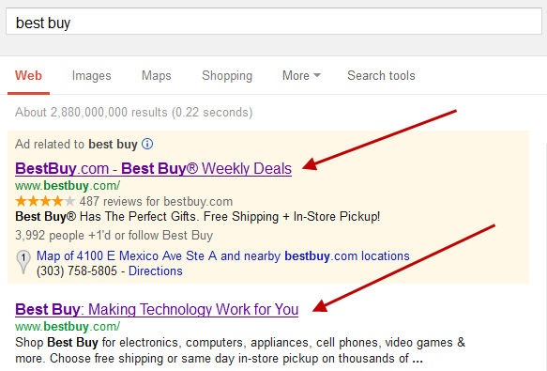
How search engine works?

Slide 65
Informational search queries:
Informational Search Query:
Wikipedia defines informational search queries as “Queries that cover a broad topic for which there may be thousands of relevant results.”
When someone enters an informational search query into Google or another search engine, they’re looking for information – hence the name.
They are probably not looking for a specific site, as in a navigational query, and they are not looking to make a commercial transaction. They just want to answer a question or learn how to do something.

Slide 66
Continue..
The best way to target informational searches is with high-quality SEO content that genuinely provides helpful information relevant to the query.
It is also known as “Know query”.

Slide 67
Transactional search query
Transactional Search Query:
A transactional search query is a query that indicates an intent to complete a transaction, such as making a purchase.
Transactional search queries may include exact brand and product names (like “samsung galaxy s3”) or be generic (like “iced coffee maker”) or actually include terms like “buy,” “purchase,” or “order.”
It is also known as “Do query”.
Ex. Online bill payment

Slide 68
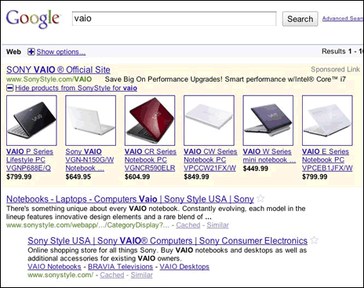
Continue..

Slide 69
Fresh Content
In SEO terminology, it is content that is new or dynamic in nature and gives people a reason to visit your Web site.
Fresh content would be a webpage that’s been recently updated, SEOs have argued there needs to be enough changes to make a webpage fresh to Google, but in essence make some content changes.
Many SEO experts believe that using fresh content on your Web site will help your page obtain better placement on search engine results page.

Slide 70
Continue
What Content can search engines “SEE” on a Web Page?
Once a web page is found by the search engine spider (robot, web crawler) it takes a look at the head section (the tags between the <head> and </head> tags) of the web page for:
The title of the page
The keyword and description meta tags
Meta keyword tag
Web page content is everything between the <body> and </body> tags.

Slide 71
Continue..
What search engine can not “SEE”?
Flash and shockwave - spiders do not pick up these files
Image only sites - spiders do not pick up images
Image maps - spiders cannot read image maps. Do not use them on your home page or critical pages.
Frames – such as <frame> and <iframe tag.> - If the spider cannot read the complete page , it will not be indexed properly.
Can not read Audio/Video files.

Slide 72
Country specific search engine
Nowadays Search become global. Google is the dominant search engine in many countries, but not all of them.
In the world of Search Engine Optimization, Location is important. Search engines like to bring relevant results to a user, not only in the area of keywords and sites that give the user exactly what they are looking for, but also in the correct language as well.
It doesn't do a lot of good for a Russian-speaking individual to continually get websites returned in a search query that are written in Egyptian or in Chinese. So a search engine has to have some way to be able to return the results the user is looking for in the right

Slide 73
Country specific search engine
language, and a search engine's goal is also to try and get the user as close to home as possible in the realm of their search results.
1)China:
Baidu is the no. 1 search engine in china. It whole in Chinese language.
Baidu holds more traffic than Google and yahoo in foreign countries. It had more than 75%market share in china in 2010.

Slide 74
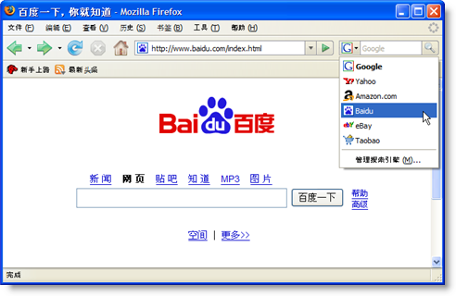

Slide 75
Continue..
2)Russia:
Yandex is arguably the most well-known search engine in Russia.
Millions of Russian speakers use it each day to find search results for what they are looking for.
According to figures announced by it,the company,s market share in Russia comprized about 65% of all searches in 2011.

Slide 76

Continue..

Slide 77
Country specific search engine
South korea:
Naver (Hangul: 네이버) is a popular search portal in South Korea, which holds a market share of over 70% at least since 2011, continuing to 2013.
Naver was launched in June 1999 by ex-Samsung employees, and it debuted as the first Web portal in South Korea that used its own proprietary search engine.

Slide 78
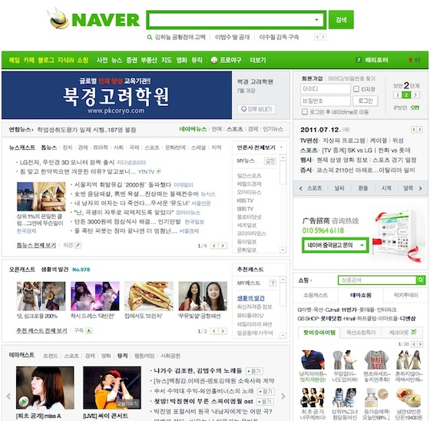
Country specific search engine

Slide 79
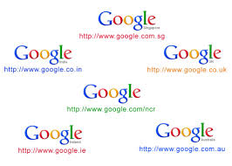
Continue..

