Slide 1
Water Quality Prediction
By:
Kaushal vasava
Jay Chawla
Hardik Bhilvala
Khushal pambhar

Slide 2
Abstract
Water cover about 70% of the earth’s surface and is one of the most important sources vital to sustaining life. Rapid urbanization and industrialization have led to a deterioration of water quality at an alarming rate. Water quality has been conventionally estimated through expensive and time-consuming. Using supervised machine learning algorithms to estimate the water quality index (WQI) and water quality class(WQC) is quicker and inexpensive.

Slide 3
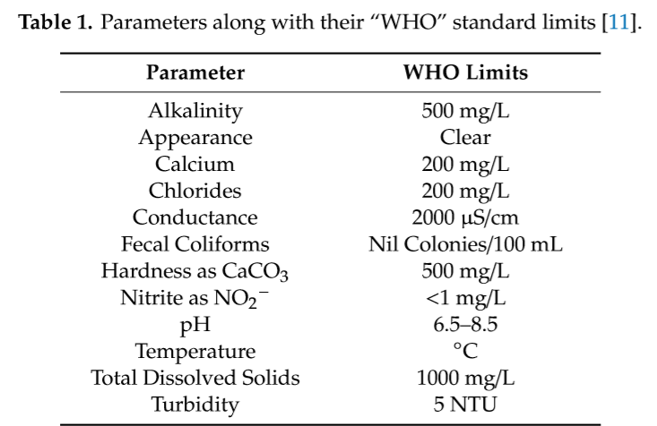

Slide 4
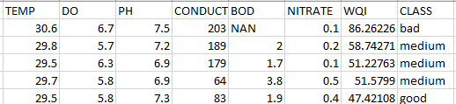
Dataset

Slide 5
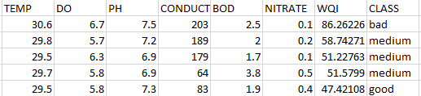
Cleaned Dataset
Replacing Null values with column mean value.
There is no constant column in dataset

Slide 6
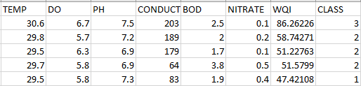
Data Transformation

Slide 7
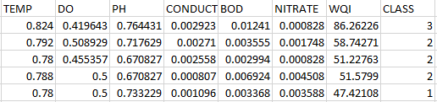
Data Normalization
Using Min-Max normalization

Slide 8
Data co-relation analysis
Using co-relation analysis we found that no features are related with each other.

Slide 9
Features selection
Mutual information gain
Anova test.
Roc-Auc
F-score
Exhaustive Feature Selector
Sequential Feature Selector

Slide 10
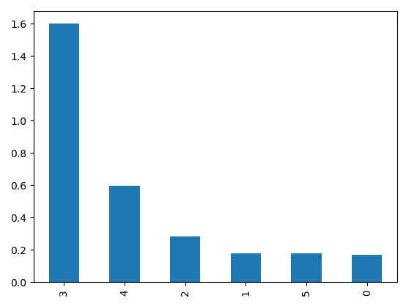
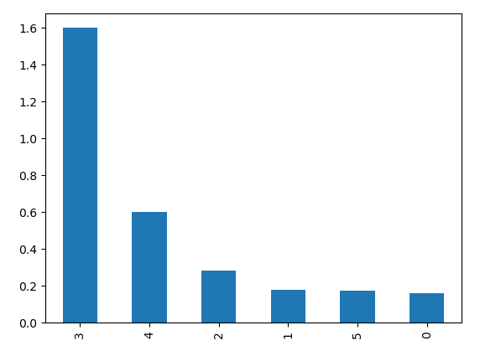
Mutual information gain
Anova test.

Slide 11
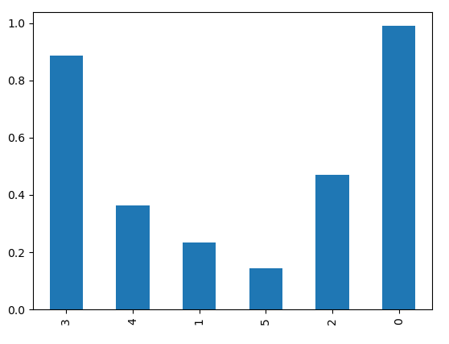
F-score
We found that label are highly dependent on PH and Conductivity and slightly dependent on BOD, DO,Temperature and Nitrate but BOD,Temperature and DO are not negligible.

Slide 12
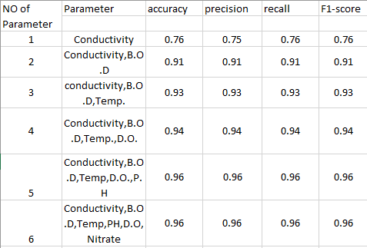
Sequential feature selection

Slide 13
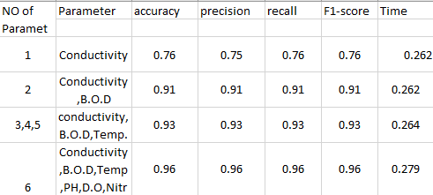
Exhaustive feature selection

Slide 14
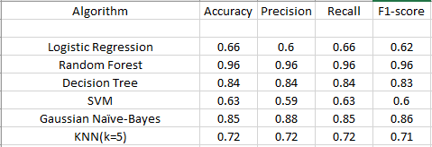
Algorithm analysis(Classification)

Slide 15
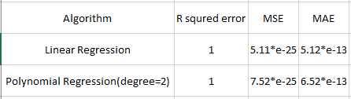
Algorithm analysis(Regression)
This project explored an alternative method of machine learning to predict water quality using minimal and easily available water quality parameters. The data used to conduct this study where acquired from online government website that contain 1900 sample of different river of India. A set of representative supervised machine learning algorithms were employed to estimate WQI. This showed Linear Regression in Regression and Random Forest in Classification outperformed other algorithms.

Slide 16
Thank you!

