Slide 1
Agentic RAG Chatbot for Multi-Format Document QA using Model Context Protocol (MCP)
An implementation of a decoupled microservice architecture using the Model Context Protocol (MCP)
Kaushal Kumar | ykaushalkumarwork@gmail.com

Slide 2
Architecture: Agents as Decoupled Microservices
The system uses a robust client-server model, with a React frontend and a FastAPI backend, fulfilling the UI requirement.
The backend implements an agentic architecture as a set of independent microservices, where each agent is a distinct API endpoint.
IngestionAgent: A dedicated API service that parses and preprocesses uploaded documents.
RetrievalAgent: An API service that handles advanced semantic retrieval, including query rewriting and re-ranking.
LLMResponseAgent: An API service that takes context and a query to generate the final answer.
A central CoordinatorAgent orchestrates the workflow by calling the other agent services.
MCP via HTTP: We implement the Model Context Protocol (MCP) using RESTful API calls as the message-passing mechanism. The Coordinator makes asynchronous httpx calls to other agent endpoints, with each request/response cycle acting as a structured MCP message.

Slide 3
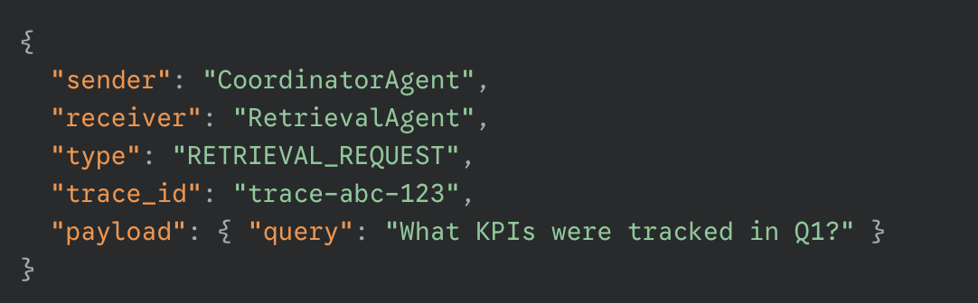
System Workflow & MCP Message Passing
The workflow is a sequence of API calls, with each call representing an MCP message.
User Uploads Document: The React UI POSTs the file to the CoordinatorAgent.
Coordinator -> IngestionAgent: The Coordinator sends an internal HTTP request (an MCP message) to the IngestionAgent to parse the file.
IngestionAgent -> Coordinator: The agent returns a JSON response containing the text chunks.
User Asks Question: The UI POSTs the query and session_id to the CoordinatorAgent.
Coordinator -> RetrievalAgent: The Coordinator sends an MCP message to the RetrievalAgent to find relevant context.
RetrievalAgent -> Coordinator: The agent returns the re-ranked chunks.
Coordinator -> LLMResponseAgent: The Coordinator sends the final prompt context to the LLMResponseAgent.
Final Answer: The chatbot shows the final answer along with precise source context.

Slide 4
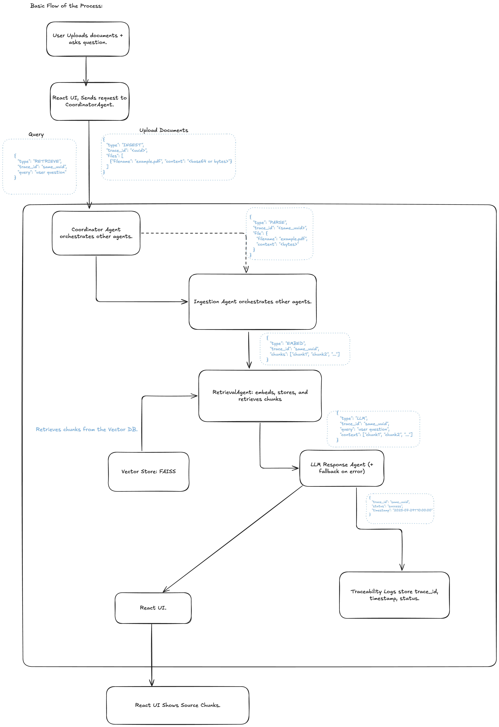

Slide 5
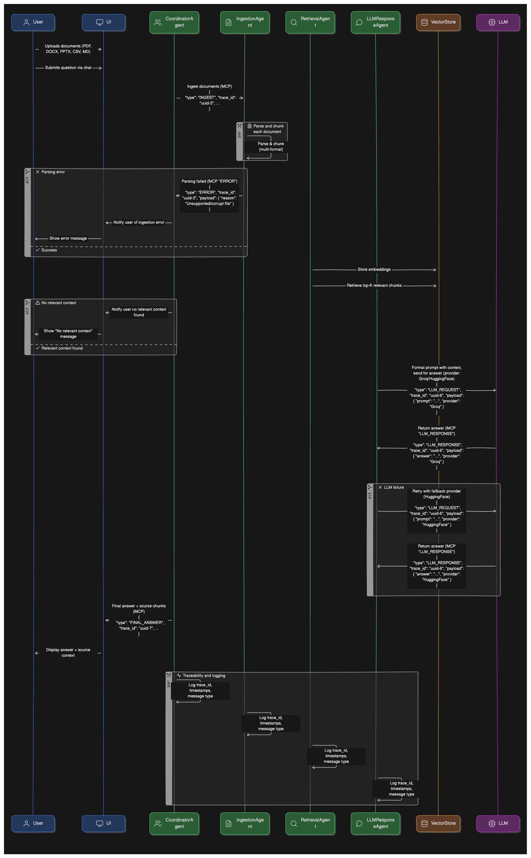
Sequence Diagram

Slide 6
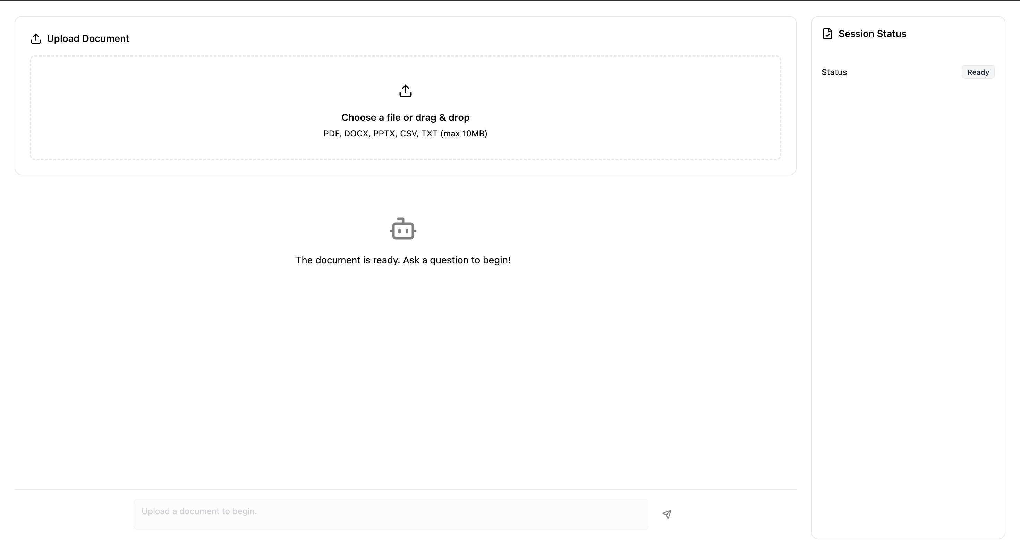
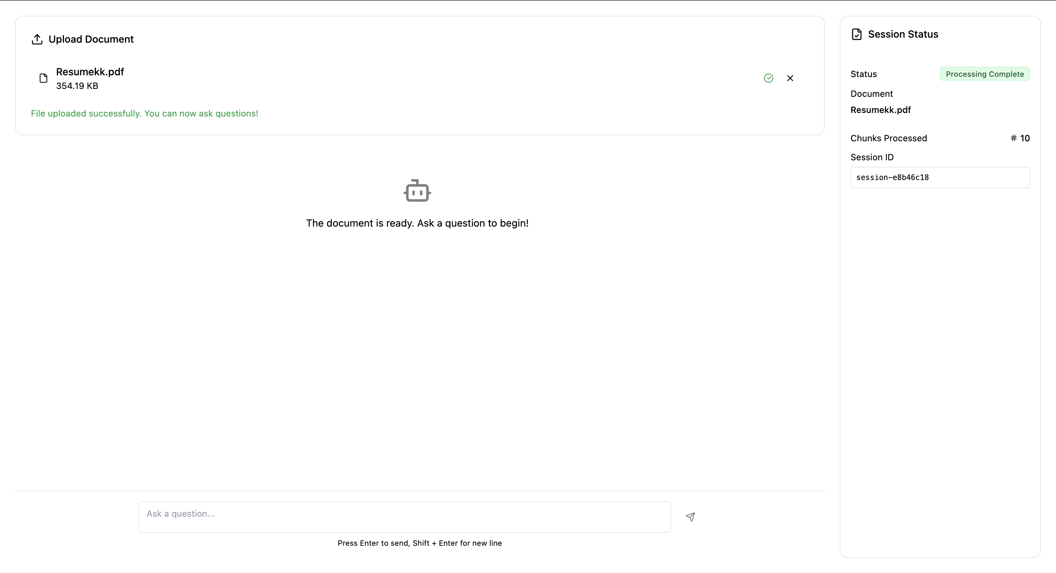
Technology Stack and Application UI
Frontend (UI): A responsive single-page application built with React, Vite, and TypeScript, styled with TailwindCSS.
Backend & Orchestration: An asynchronous API built with FastAPI and Python.
Embeddings & Vector Store:
Embeddings Model: Sentence-Transformers (all-MiniLM-L6-v2) for creating vector representations.
Re-Ranking Model: Cross-Encoder (ms-marco-MiniLM-L-6-v2) for precision.
Vector Database: FAISS (in-memory) for efficient similarity search.
LLM Provider: Groq API (Llama3-70B).
Document Parsing: Support for PDF, DOCX, PPTX, CSV, and TXT is handled by libraries like PyMuPDF and python-docx.

Slide 7
Challenges and Future Directions
Challenges Faced:
Asynchronous Orchestration: Managing the chain of async/await httpx calls in the Coordinator was crucial to ensure the microservice pipeline executed in the correct order without blocking the server.
Stateful Service Design: Implementing the session-based vector store required managing a shared, in-memory Python dictionary. While effective for this project, this presents a scaling challenge in a production environment.
CORS Configuration: Properly configuring CORS middleware in FastAPI was a critical step to allow communication between the separate frontend (:5173) and backend (:8000) development servers.
Future Scope / Improvements:
Persistent & Scalable State: Replace the in-memory session dictionary with an external cache like Redis. This would allow the backend to be scaled across multiple nodes and persist sessions across server restarts.
Streaming Responses: Implement response streaming from the LLM all the way to the frontend for a more immediate "typing" effect and better perceived performance.
Containerization: Dockerize the frontend and backend services and use Docker Compose to simplify setup and deployment, creating a more production-ready environment.

