Slide 1

DEENBANDHU CHHOTU RAM UNIVERSITY OF SCIENCE AND TECHNOLOGY, MURTHAL (SONIPAT)
PROFESSIONAL TRAINING PRESENTATION ON
WEB DEVELOPMENT
SUBMITTED TO : DR. JITENDER BHARDWAJ
SUBMITTED BY : BHUPESH
ROLL NO : 22001001024

Slide 2

ABOUT THE ORGANISATION
Founded: 2010 by Sarvesh Agrawal, IIT Madras alumnus
Headquarters: Gurgaon, Haryana, India
Nature of Platform: India’s largest internships and online training platform
Reach:
21+ million registered students
300,000+ companies posting internships/jobs
Available across 80+ countries
Core Offerings:
Internships (Paid & Unpaid) across 20+ profiles
Online training in fields like Web Dev, React, Data Science etc.
Fresher jobs and placement preparation tools

Slide 3
ACHIEVEMENTS AND IMPACT
Skill Development: Over 7 million+ students trained in technical & professional skills
Recognitions & Awards:
Featured by Forbes 30 Under 30 (Asia List)
Endorsed by multiple government initiatives like AICTE Internship Portal
Industry Tie-ups: Collaborates with leading companies such as Amazon, HCL, Flipkart, & Reliance
Social Impact: Helps first-time job seekers gain industry experience
Learning Experience:
Self-paced, beginner-friendly courses
Certificate of completion provided
Practical projects, assignments, and mentorship support
Promotes work-from-home, remote & inclusive opportunities

Slide 4

ABOUT THE COURSE
Course Duration: 6 Weeks (4 Weeks Learning + 2 Weeks Major Project)
Platform: Internshala Trainings
Course Objective: To master the fundamentals of React JS and build dynamic, responsive web applications
Key Topics Covered:
Introduction to React & Component-Based Architecture
JSX & Virtual DOM
Props, State & Event Handling
React Hooks (useState, useEffect)
Routing with React Router
API Integration & Fetching Data
Styling with CSS & Conditional Rendering

Slide 5

PROJECT – CLOUD STORAGE MANAGEMENT SYSTEM
Developed a web-based platform that allows users to upload, organize, and manage their files online.
Users can create folders, rename files, delete or recover them from bin, and access recently used or shared files.
Designed with a clean and responsive interface for a smooth and user-friendly experience.

Slide 6



TECH STACK
Frontend: React (Component-based UI, React Router)
Backend: Appwrite (Authentication, Database, Storage API)
Styling: Tailwind CSS

Slide 7
WHY REACT + APPWRITE ?
React :
Fast & efficient rendering using Virtual DOM
Reusable components for cleaner, modular code
Better state management with hooks (useState, useEffect)
Large community support & ecosystem for faster development
Appwrite :
Ready-to-use APIs for Authentication, Storage, and Database
Scalable and secure – ideal for production-ready apps
Combined Benefits :
Rapid Development: Reduces time and effort compared to building a backend from scratch
Handles backend logic like user sessions, file uploads, and access control
Reliability: Ensures secure data handling and smooth performance
Focus on Frontend: Allows developers to spend more time on user experience and UI

Slide 8
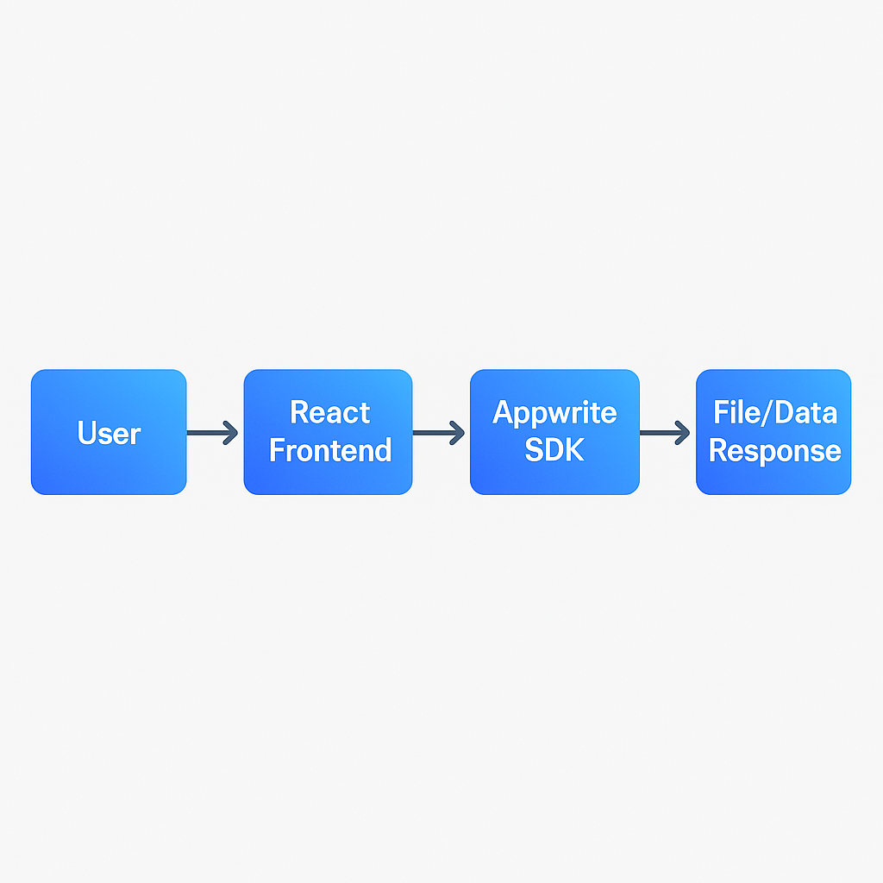
System Architecture
Flow :
Key Components :
Authentication, Storage Service, File/Folders Collection.

Slide 9
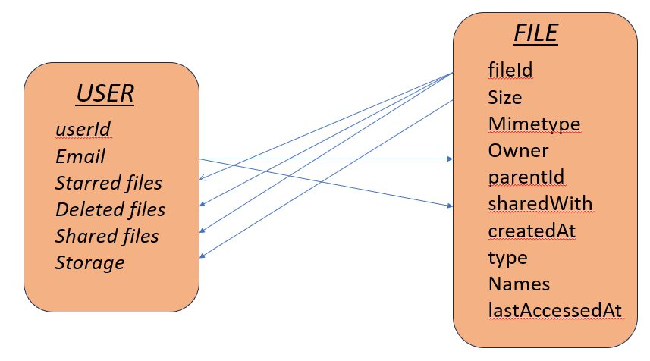
Database & Storage Design
For storage , Appwrite bucket has been used which stores the actual files uploaded by the user

Slide 10
Authentication
Used Email OTP (One-Time Password) method for verifying and logging in users.
On sign-up, users receive a unique OTP link/code on their registered email.
Appwrite automatically handles session creation after successful verification.
Managed user state (login/logout) through Appwrite SDK integrated in React frontend.
Ensures data privacy and restricted access — only authenticated users can view, upload, or manage their files.
Enhanced user experience with instant feedback and error handling (invalid OTP, expired session, etc.).

Slide 11

File and Folder Management
1
Upload any type of file.
2
View and download files.
3
Delete files (moved to Bin).
4
Mark (star) the important files
5
Rename files and folders
6
Real-time update of file list after upload/delete.

Slide 12


Sharing and Recent section
Shared With Me :
In this section, the files shared by other with you are displayed and there is a separate copy of the file for you than the one possessed by its actual owner. One can also share file with others by granting access to the files for specific emails
Recent :
This section lists the files in the order of their usage. If any file is viewed or updated its lastAccessed Time is updated to current time and therefore it appears on the top in the recent section

Slide 13

BIN
Deleted files moved to bin
Option to restore or permanently delete
Prevents accidental data loss.

Slide 14
Inline File Operative Features
On hover, we can get multiple options to operate upon the file within the list row which makes the UX very effective
These operations include :
Mark As Important (Star)
Share with others
Rename the file
Download the file
Move to Bin

Slide 15
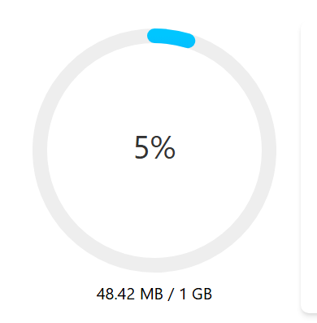
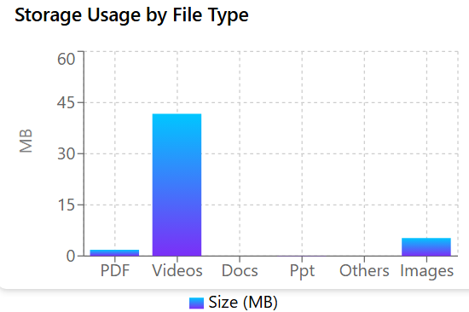
Storage Tracking and Visualization
Integrated Recharts library in the React frontend for interactive data visualization.
Implemented per-user storage tracking using Appwrite’s Databases and Storage APIs.
Displayed:
Total storage used by the user.
Breakdown of files based on their MIME types
Charts update dynamically whenever files are uploaded, deleted, or restored.
This provides a clear and visual insight into storage consumption patterns.

Slide 16
Challenges faced and their solutions
Ensuring smooth navigation between folders.
SOLUTION : Used parentId attribute for each file and folder and save the currentParentId in the localStorage to display the files for which parentId equals currentParentId
1
Managing state updates after file operations.
SOLUTION : Used a Refresh Context and hookes (useEffect) to update the value of refreshToken whenever the list file needs to be updated
2
3
Rendering large file lists slowed down the dashboard
SOLUTION : Applied React.memo() and useCallback() to prevent unnecessary re-renders. Also used conditional rendering directly in the jsx

Slide 17
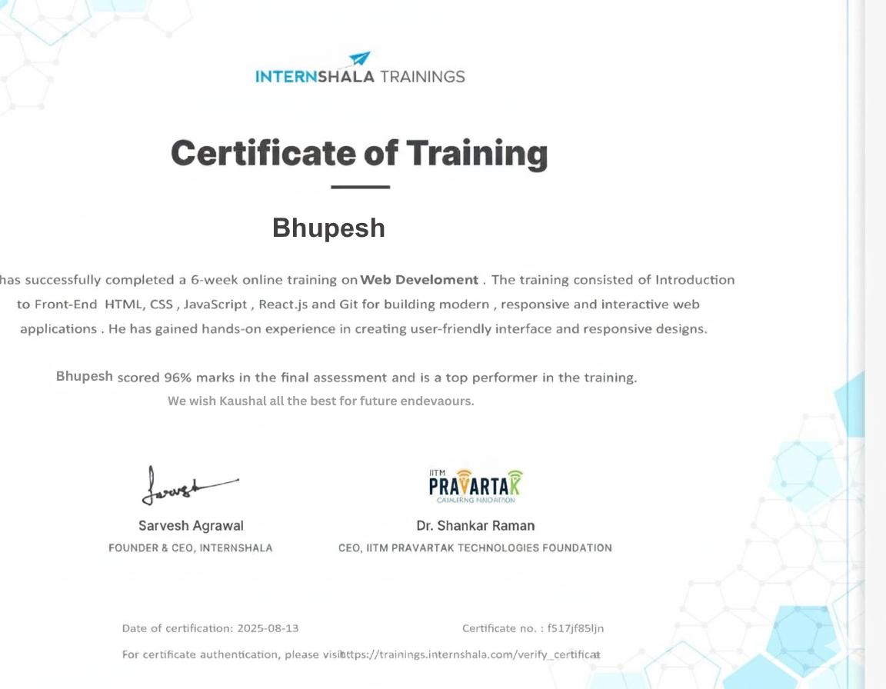

Slide 18
Thank You!

